Slide 1

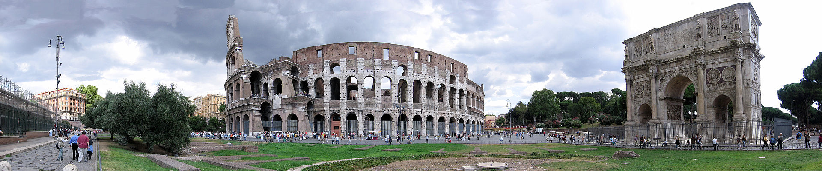
Rome, Italy
The Eternal City

Slide 2
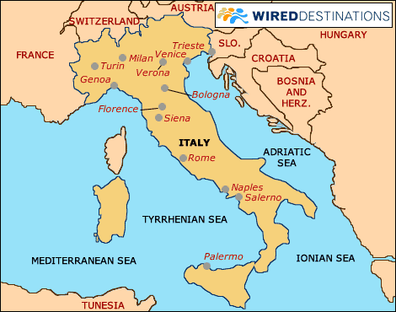
Rome is the capital of Italy and of the Lazio region. With 2,869,461 residents in 1,285 km2 (496.1 sq mi), it is also the country's largest and most populated comune and fourth-most populous city in the European Union by population within city limits. The Metropolitan City of Rome has a population of 4.3 million. The city is located in the central-western portion of the Italian Peninsula along the shores of Tiber river.

Slide 3
Rome has the status of a global city. Rome ranked in 2014 as the 14th-most-visited city in the world, 3rd most visited in the European Union, and the most popular tourist attraction in Italy. Its historic centre is listed by UNESCO as a World Heritage Site. Monuments and museums such as the Vatican Museums and the Colosseum are among the world's most visited tourist destinations with both locations receiving millions of tourists a year. Rome hosted the 1960 Summer Olympics and is the seat of United Nations' Food and Agriculture Organization (FAO).

Slide 4
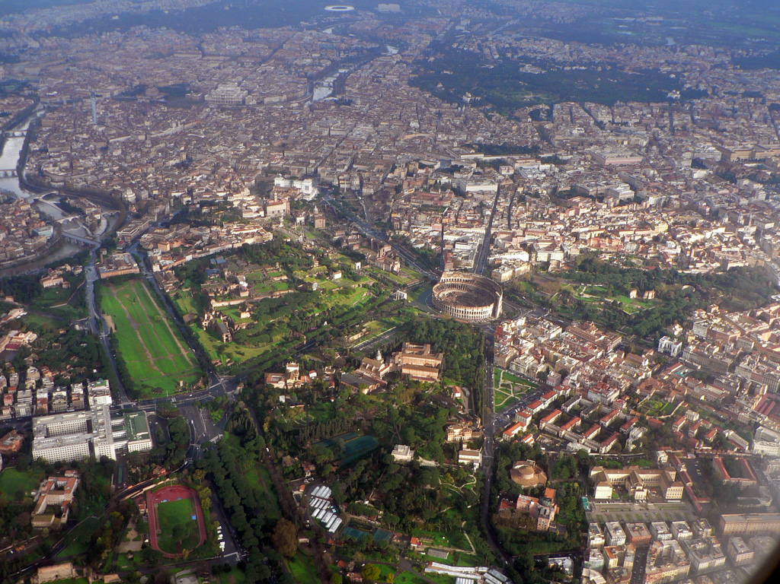
Aerial View

Slide 5
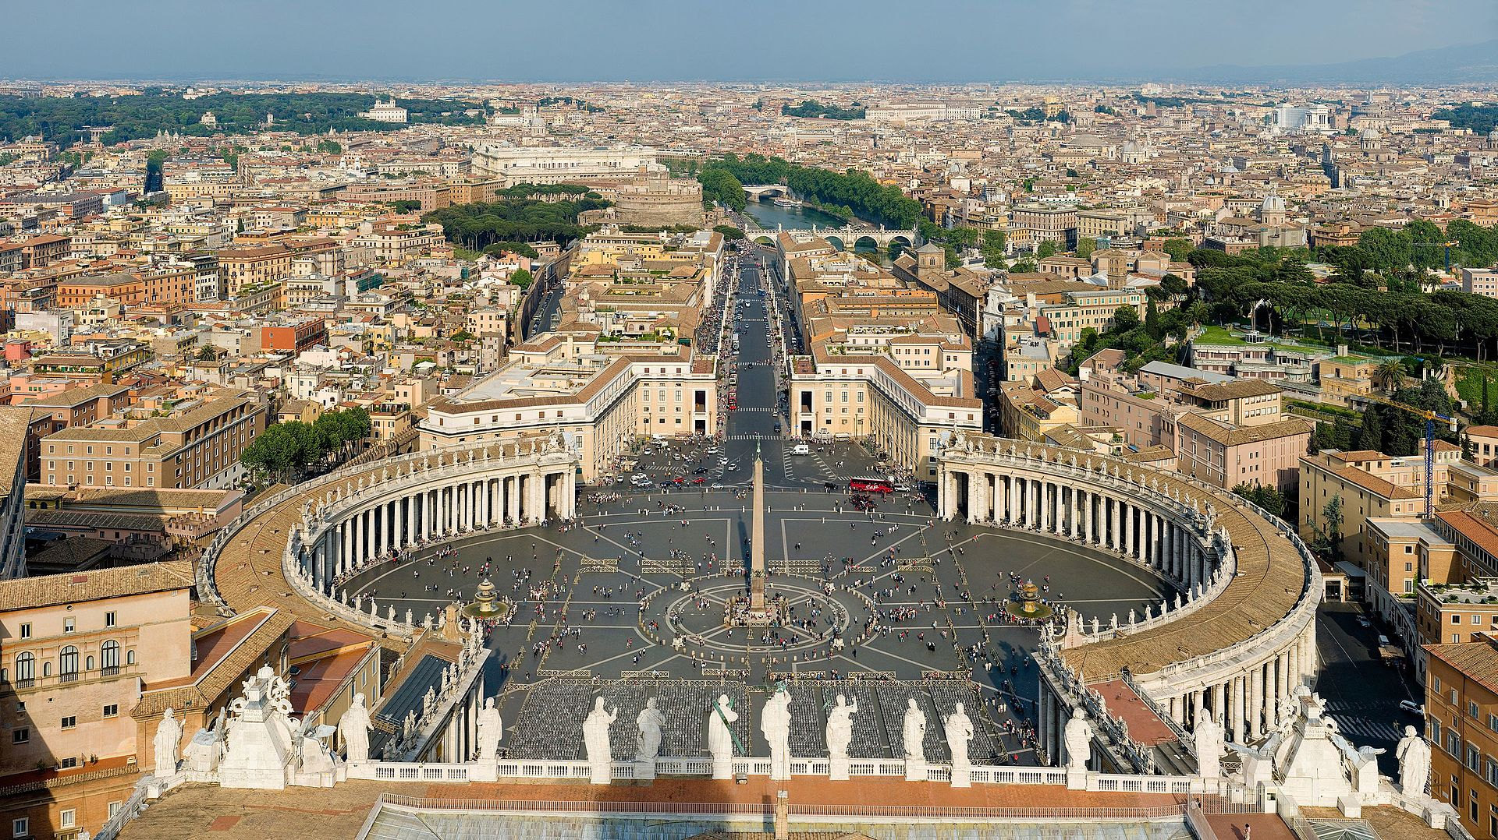
Rome from the roof of St. Peter’s Basillica
Vatican City – the only country within a city

Slide 6
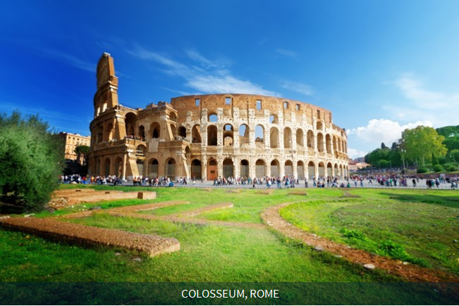

Slide 7
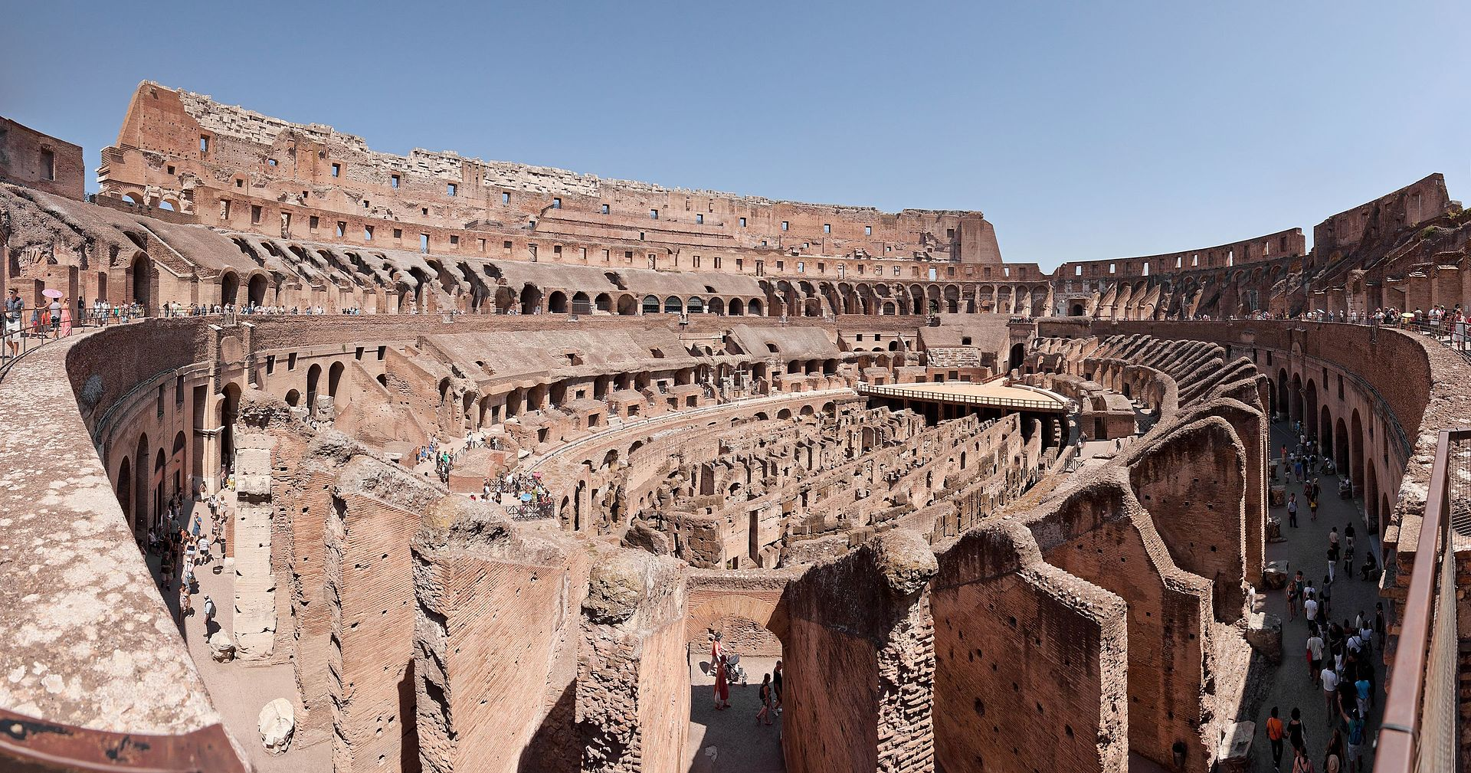
Inside the Colosseum

Slide 8
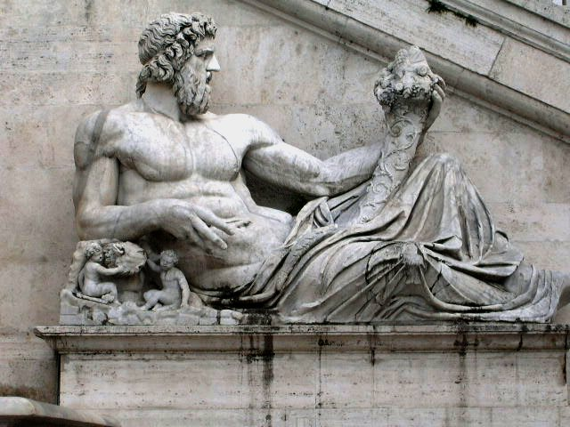
Roman representation of Tiber as a god.

Slide 9
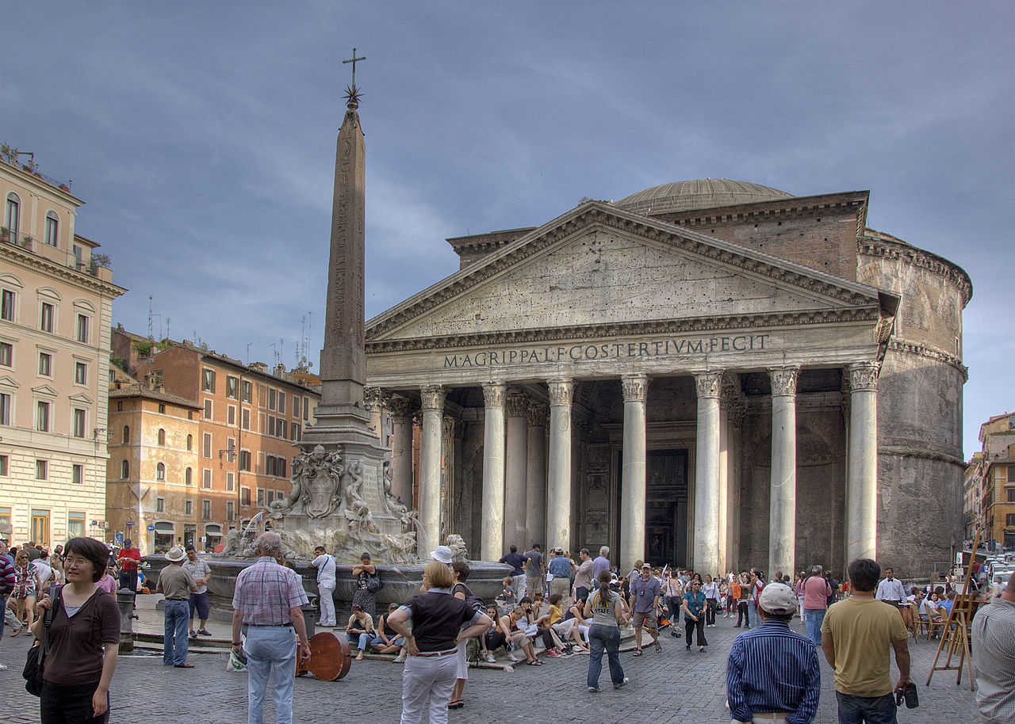
The Pantheon.

Slide 10
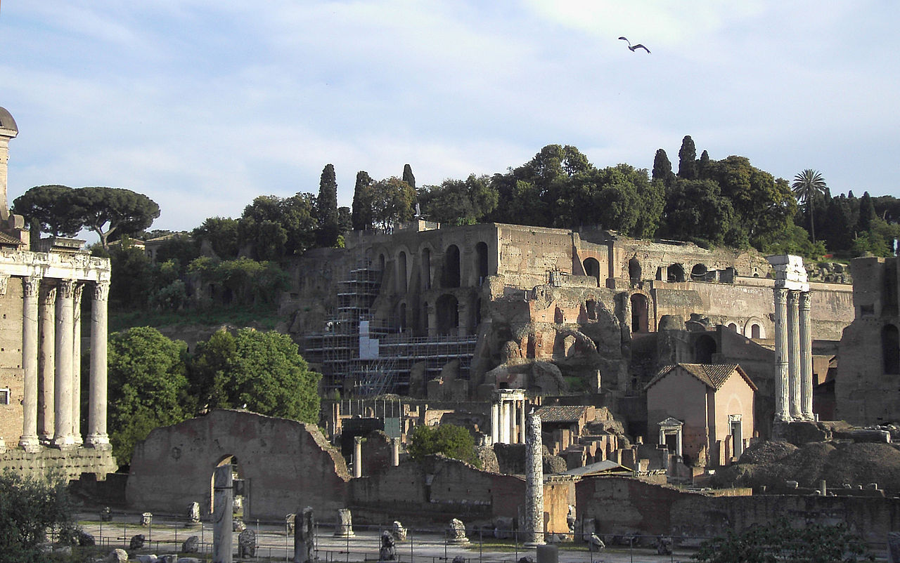
Palatine Hill.

Slide 11
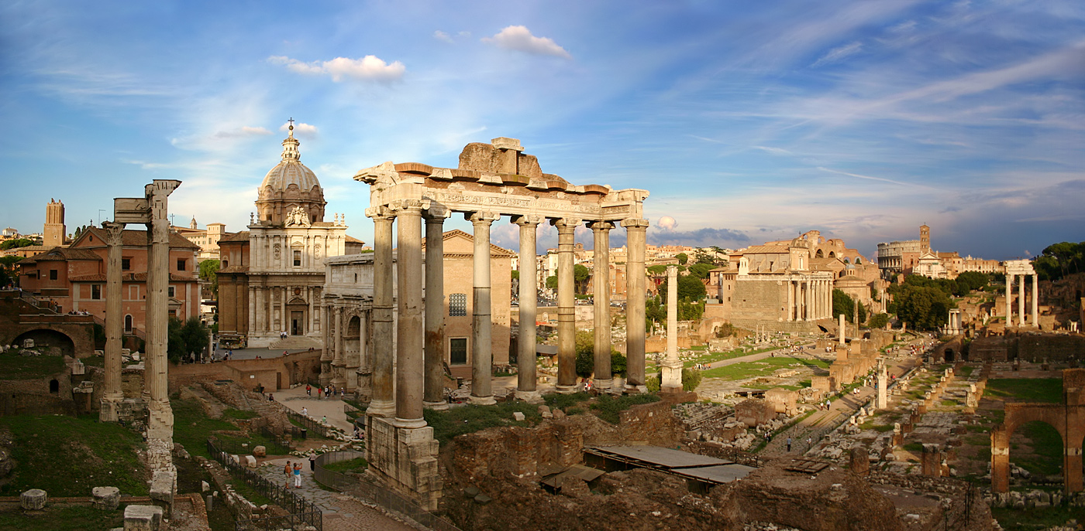
The Forum

Slide 12
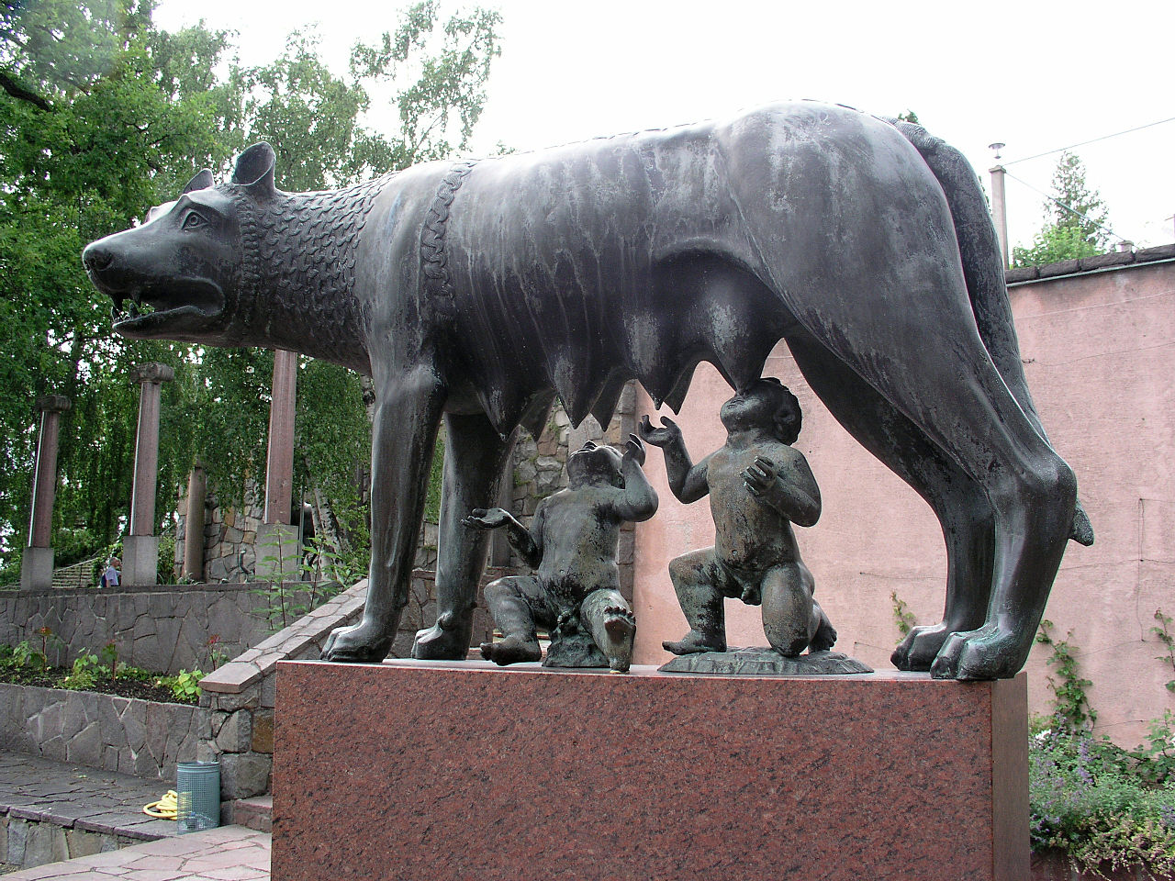
Capitoline Wolf suckles the infant twins Romulus and Remus.

Slide 13
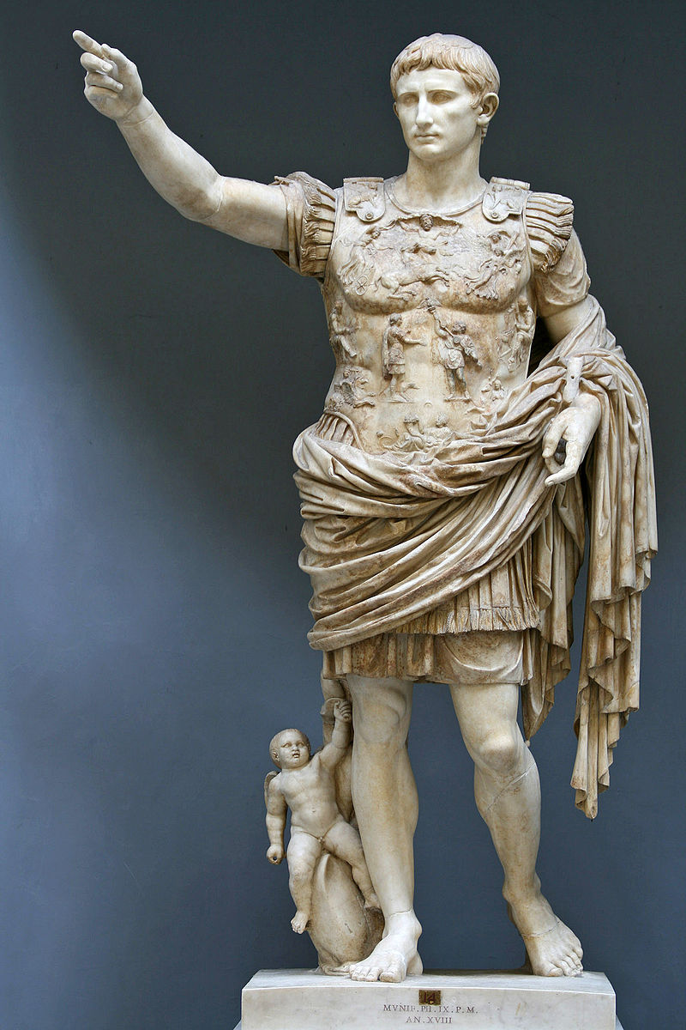
Augustus, the first Emperor.

Slide 14
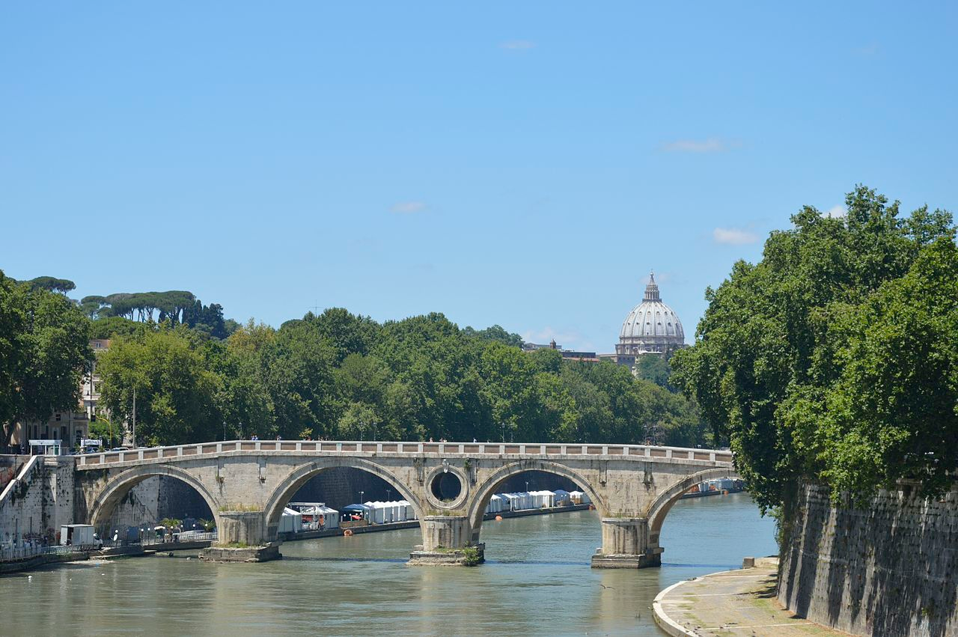
Ponte Sisto on the Tiber River — an excellent example of Italian Renaissance architecture

Slide 15
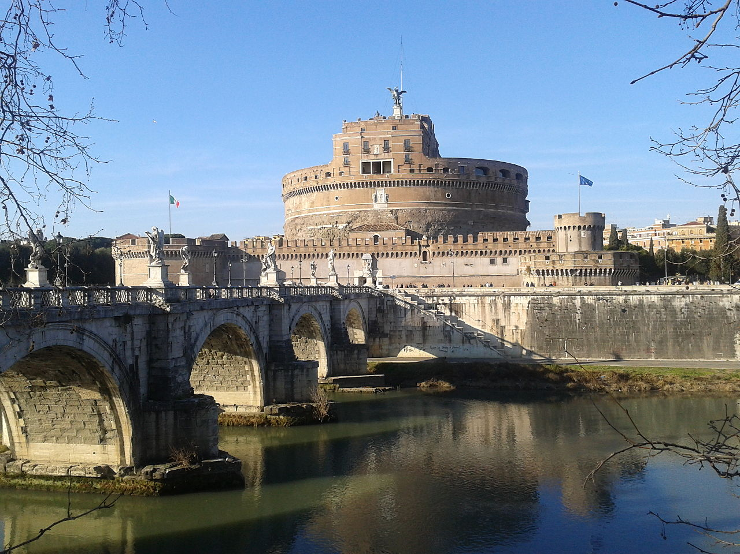
Castel Sant'Angelo, Hadrian’s Tomb

Slide 16
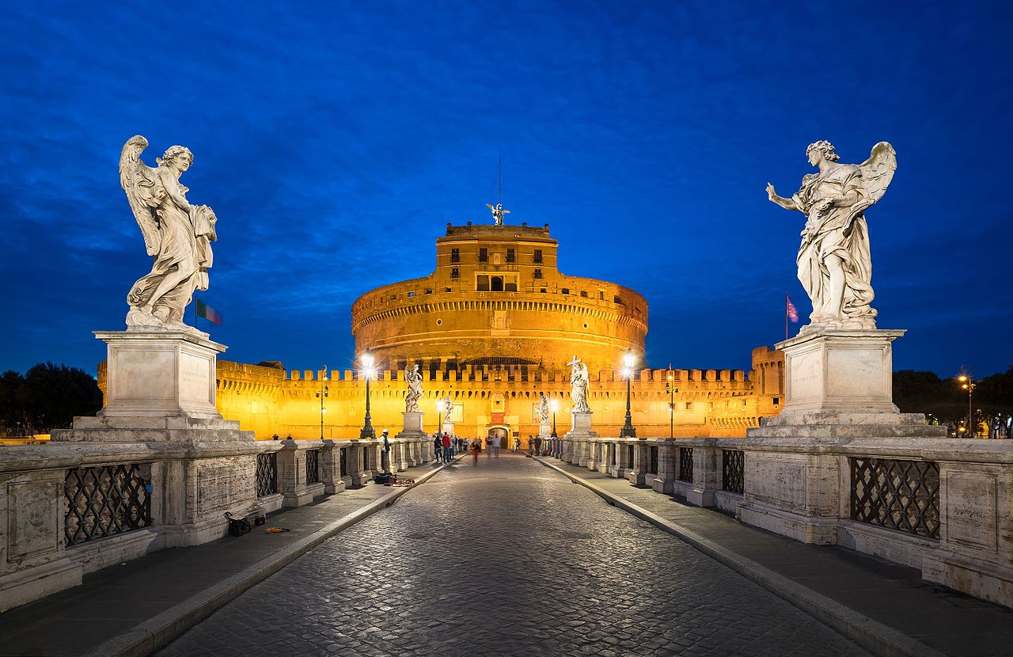
Bridge of Angels & Castel Sant Angelo

Slide 17
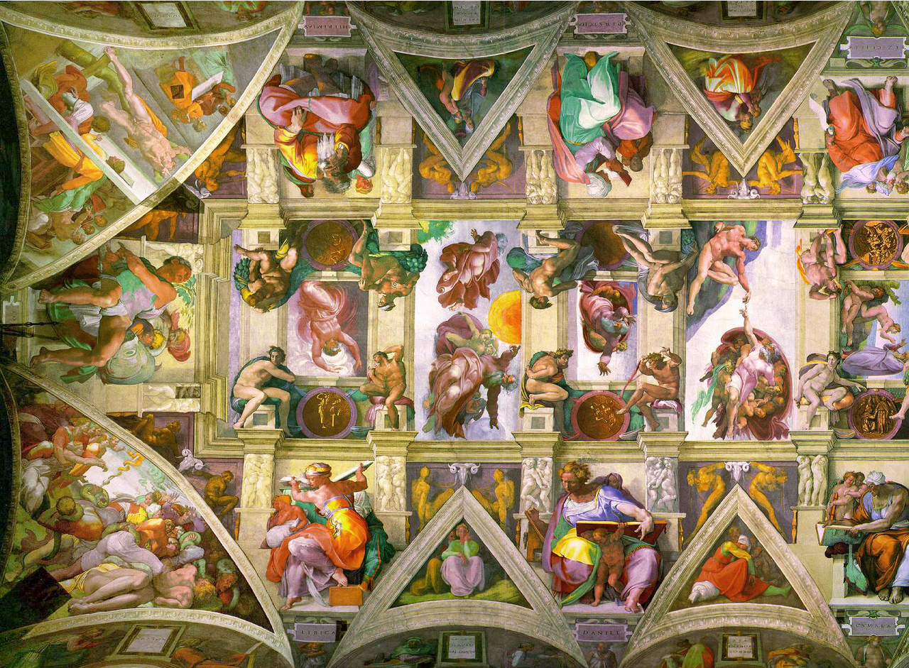
Part of Michelangelo's Sistine Chapel ceiling painted in 1508.

Slide 18
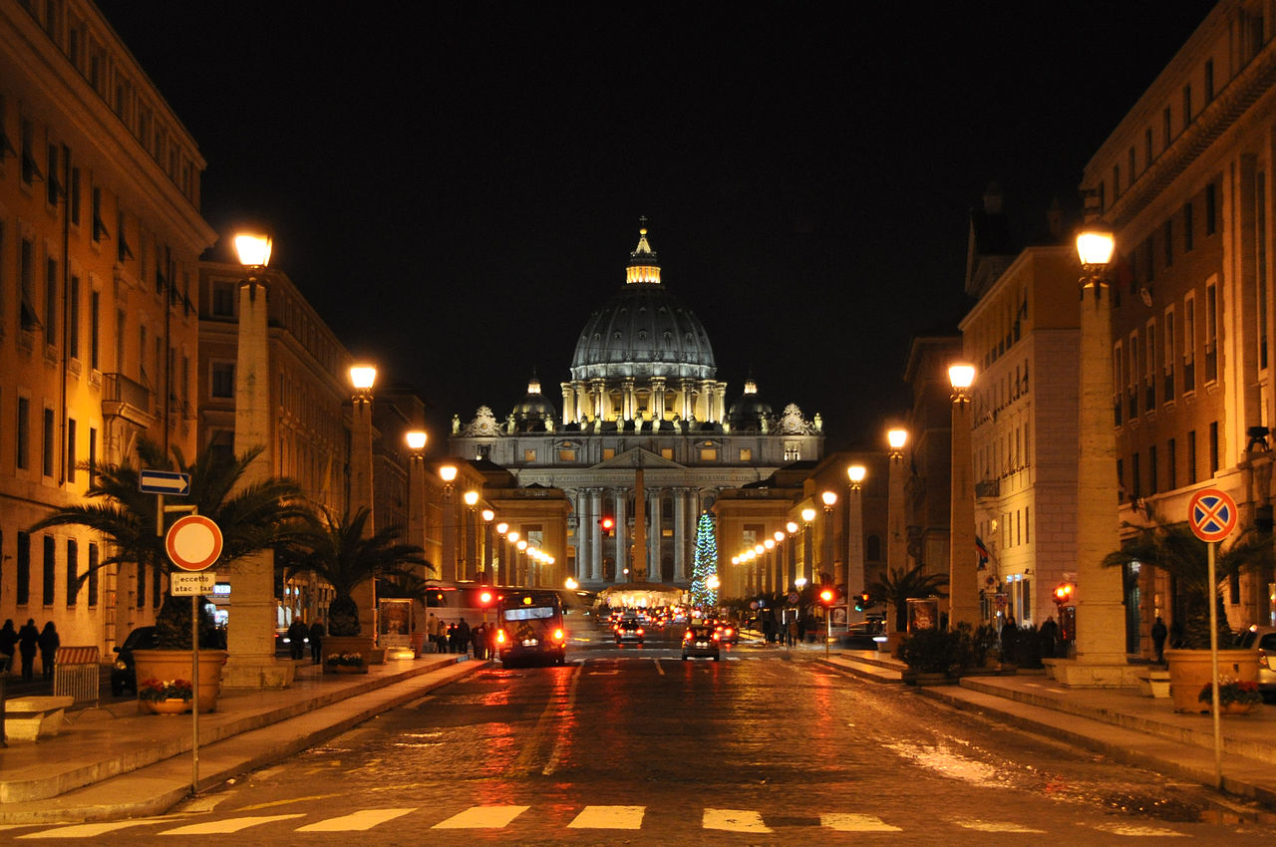
St. Peter's Basilica at night from Via della Conciliazione in Rome.

Slide 19
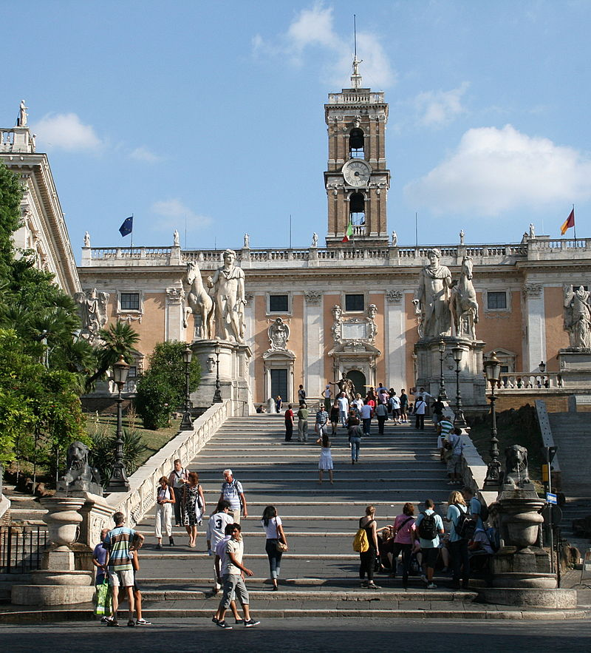
Palazzo Senatorio, Rome City Hall

Slide 20
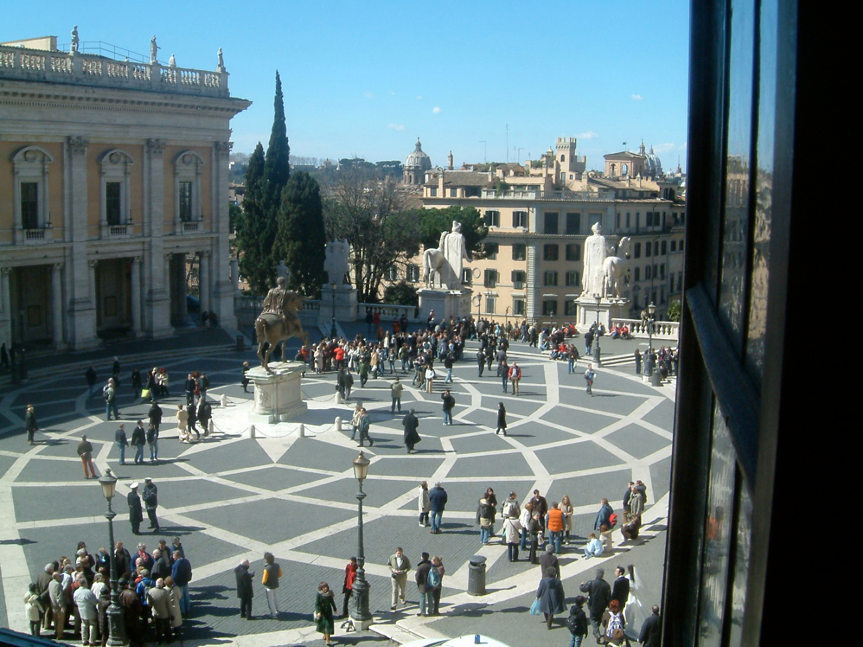
Piazza del Campidoglio designed by Michelangelo

Slide 21
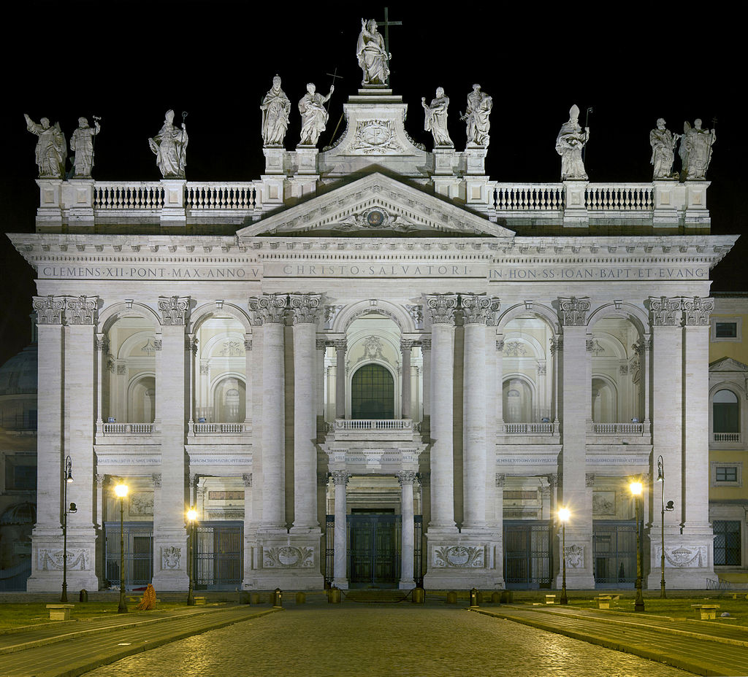
Papal Archbasilica of St. John Lateran, Rome's Cathedral.

Slide 22
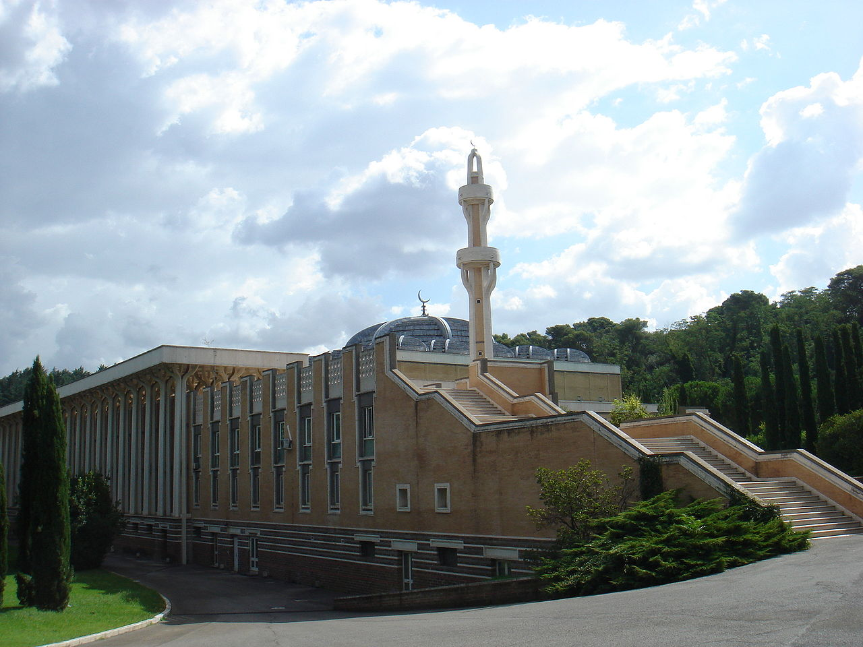
Mosque of Rome, the largest mosque in Europe.

Slide 23
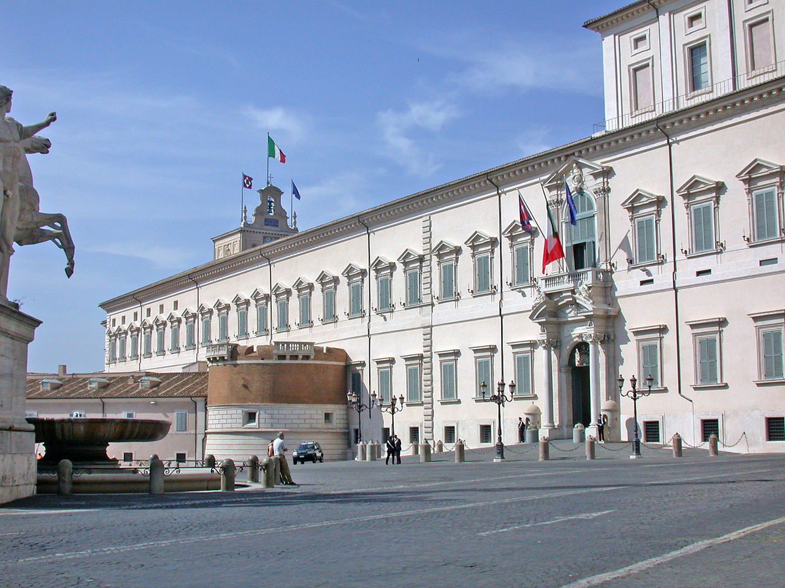
The Palazzo del Quirinale, now seat of the President of the Italian Republic.

Slide 24
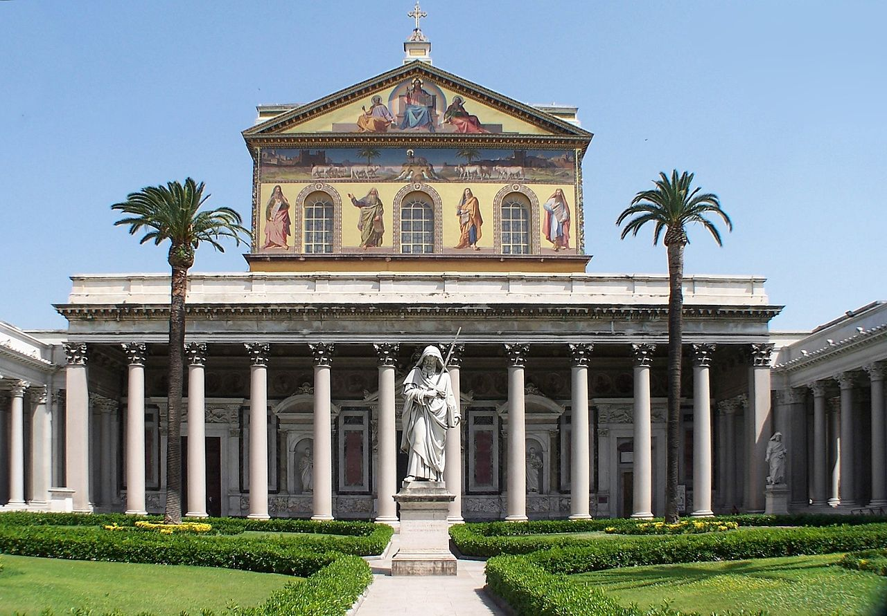
The San Paolo fuori le mura with the statue of Paul the Apostle, the patron.

Slide 25
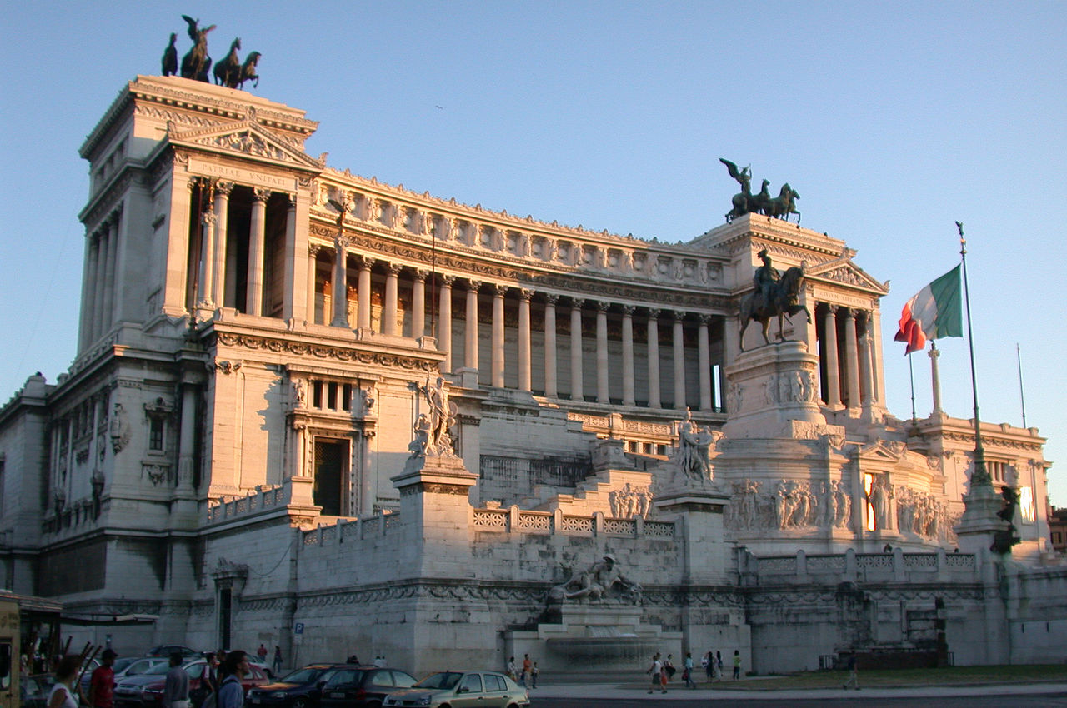
The Monument to Vittorio Emanuele II.

Slide 26
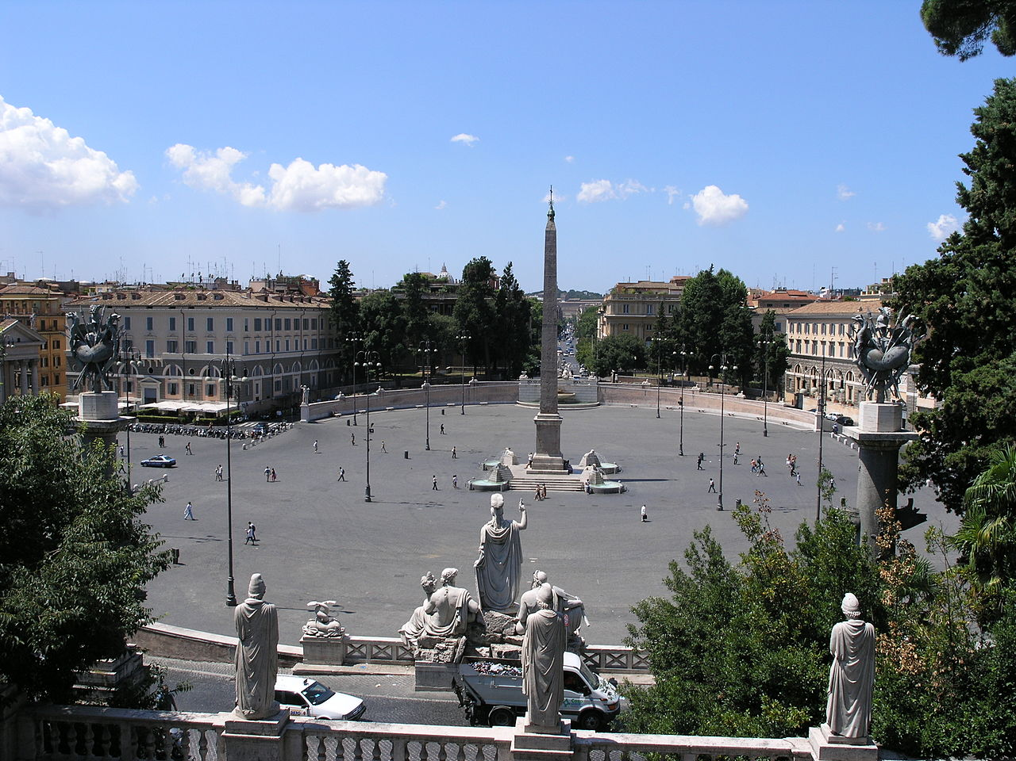
Piazza del Popolo.

Slide 27
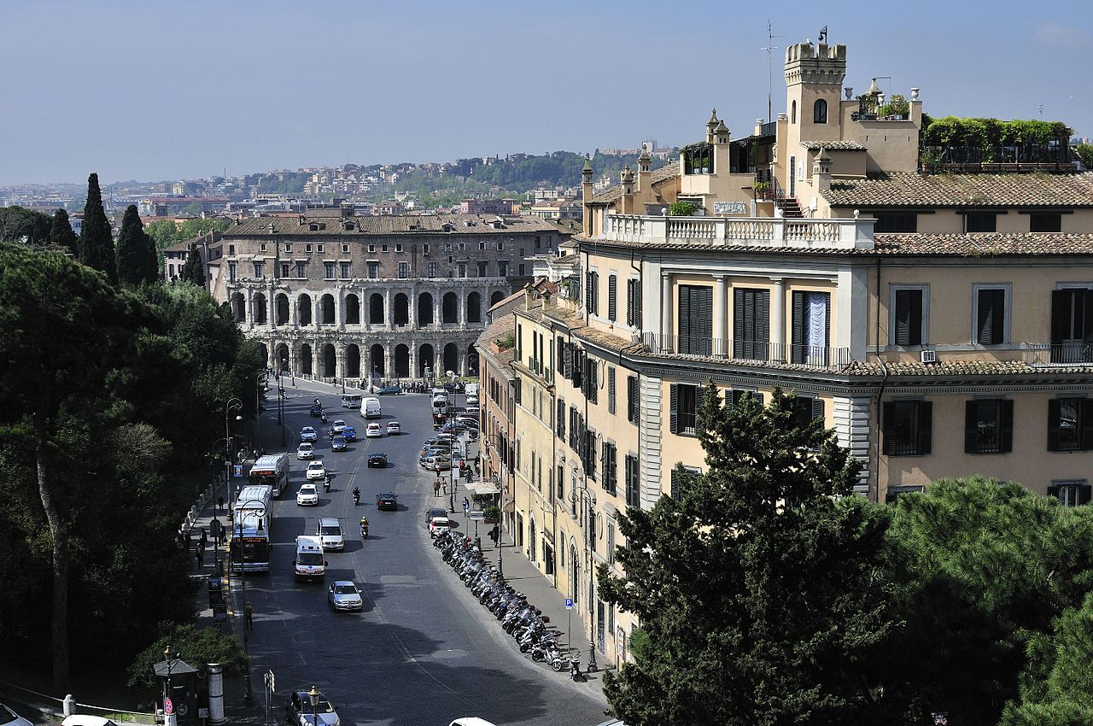
Via del Teatro di Marcello.

Slide 28
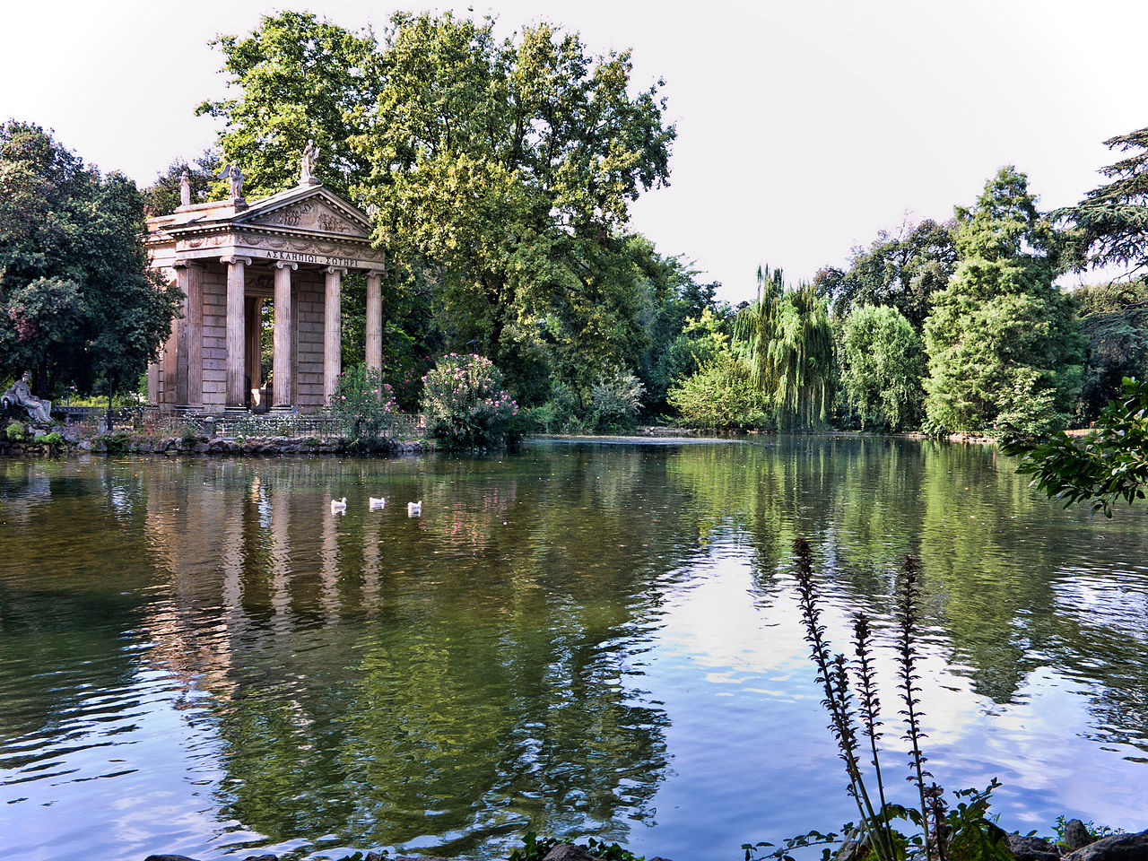
The gardens of Villa Borghese.

Slide 29
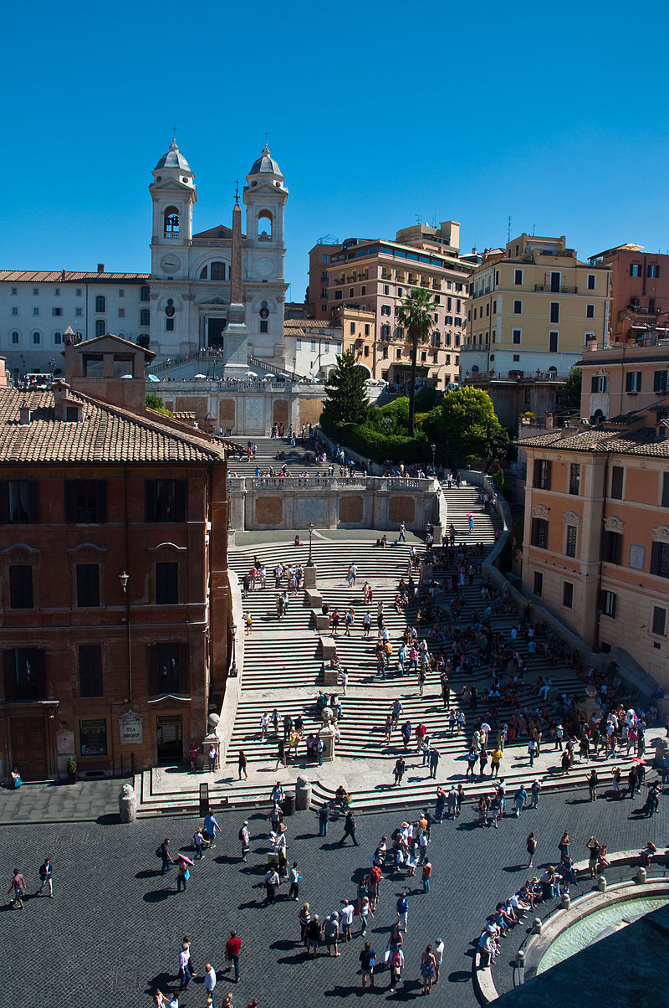
Spanish Steps and Trinita dei Monti

Slide 30
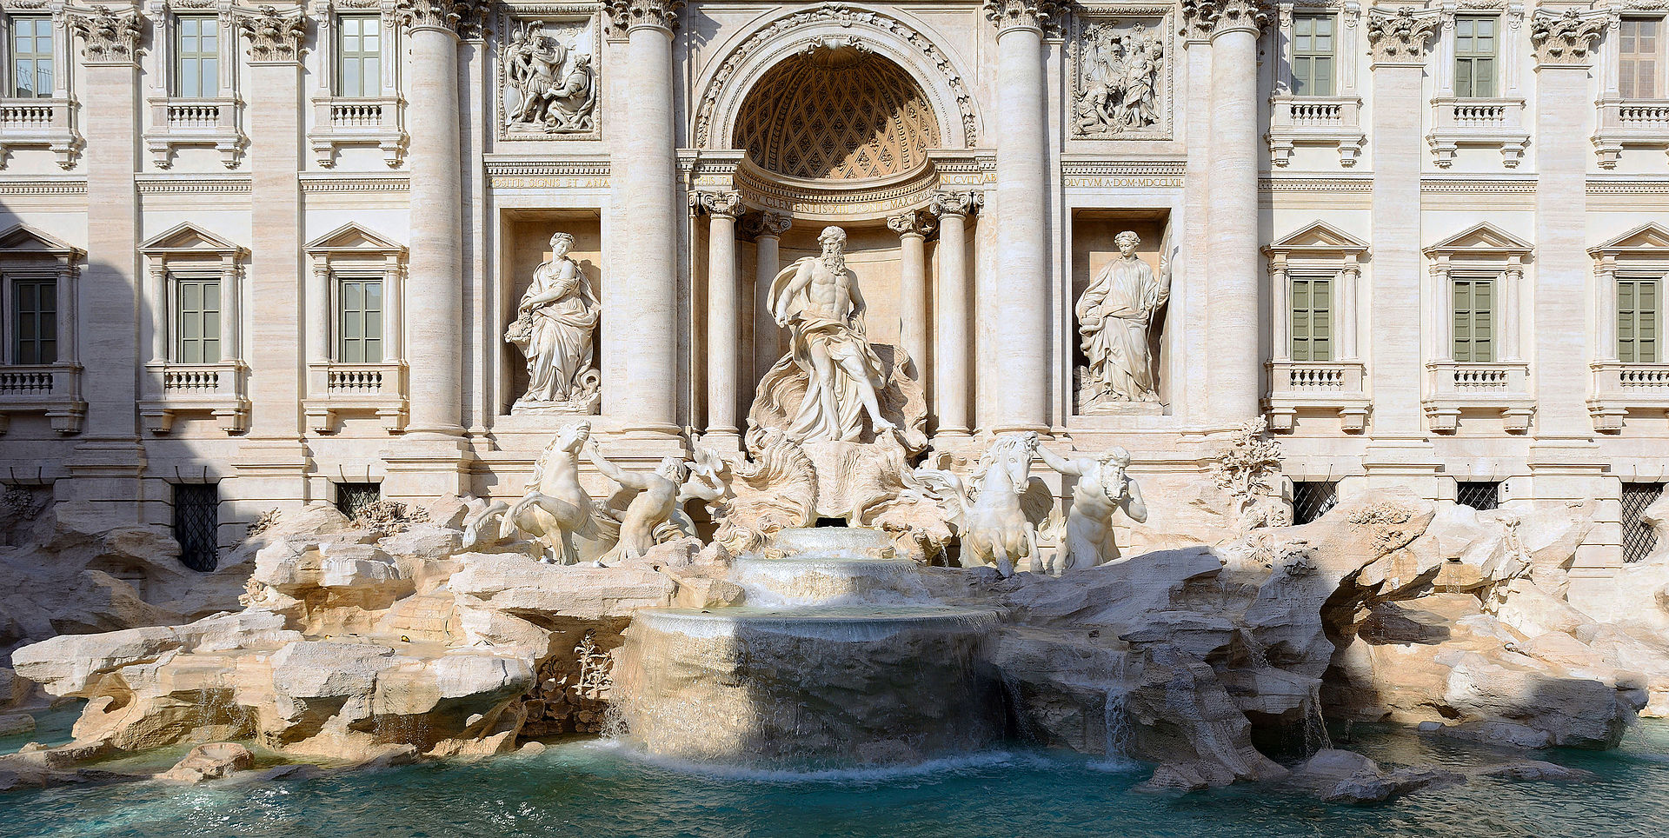
The Trevi Fountain

Slide 31
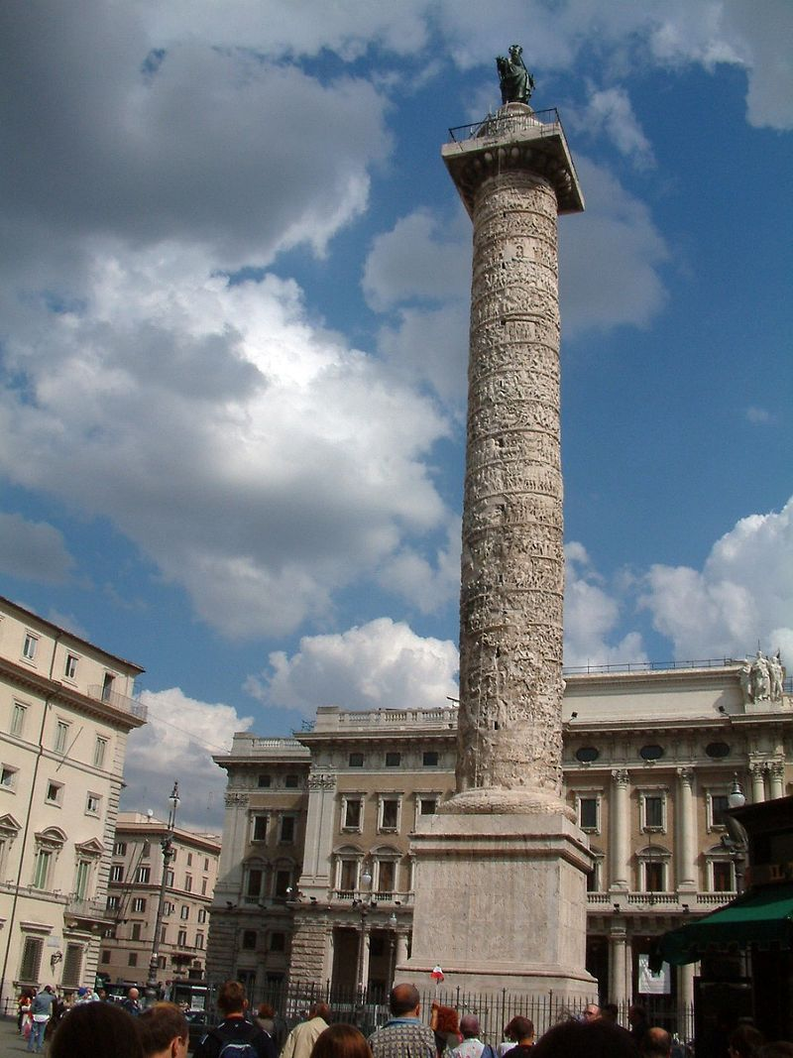
The 39.7 m tall[95 ft.] Column of Marcus Aurelius.

Slide 32
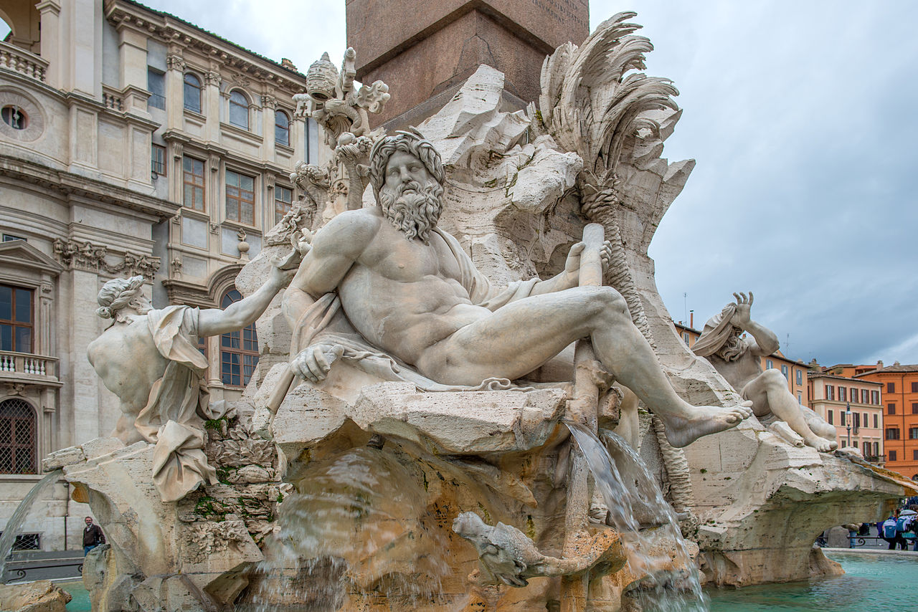
Roman statues by Bernini in Piazza Navona.

Slide 33
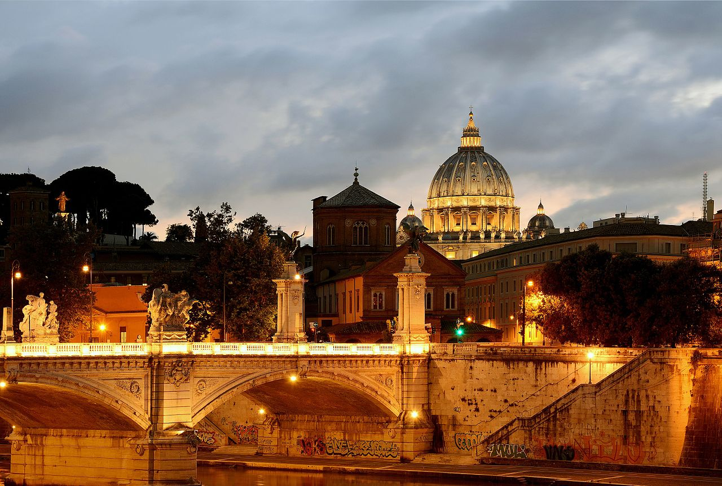
Ponte Vittorio Emanuele II at sunset.

Slide 34
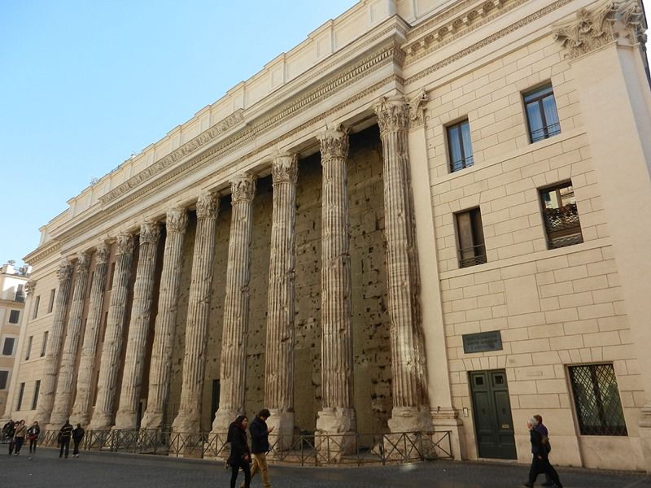
Rome chamber of commerce in ancient Temple of Hadrian

Slide 35
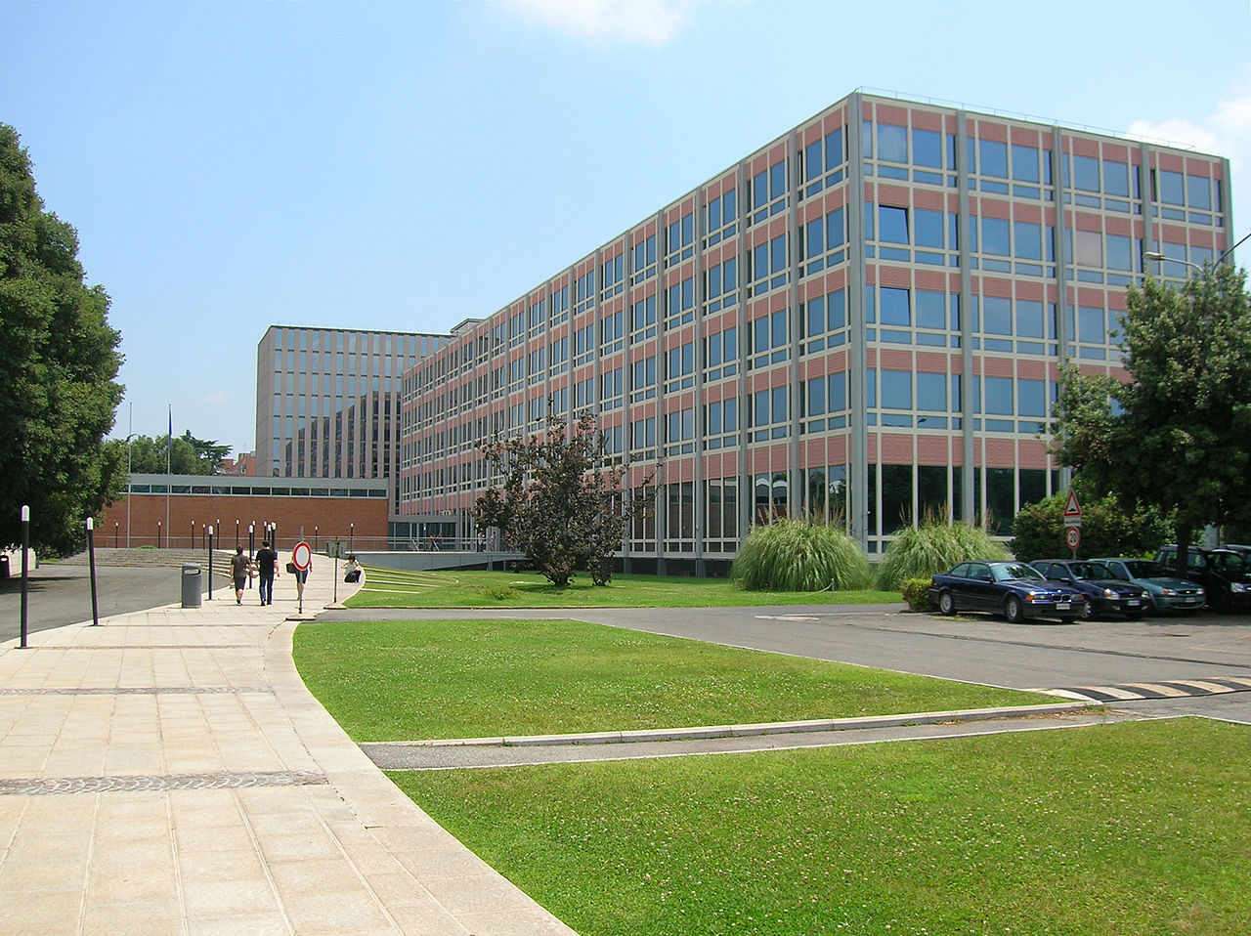
National Central Library

Slide 36
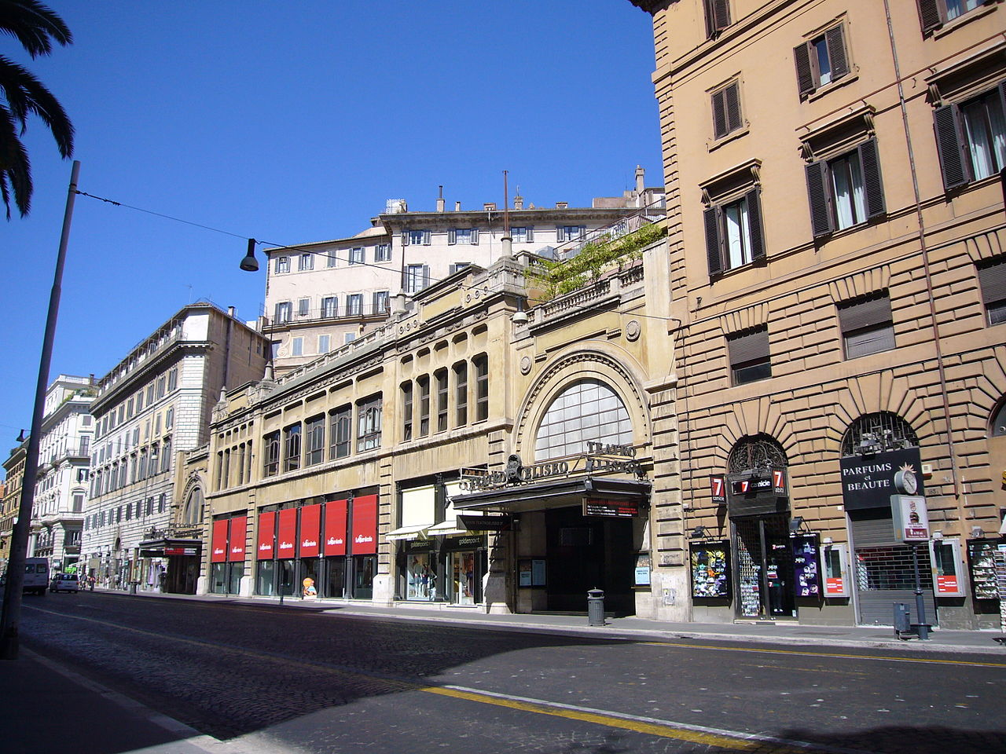
Eliseus Theater in Rome.

Slide 37
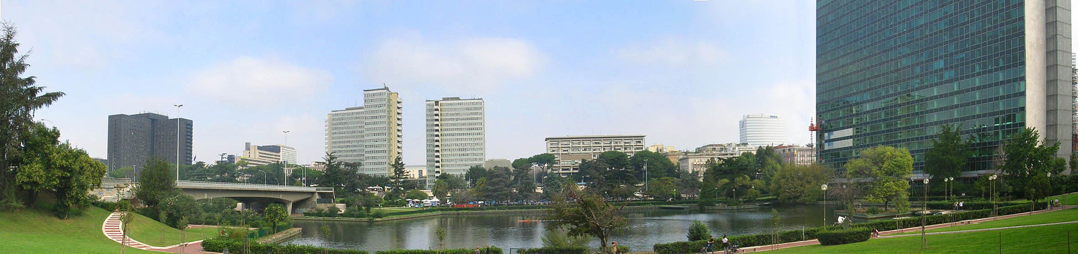
Panoramic view of EUR business district.

Slide 38
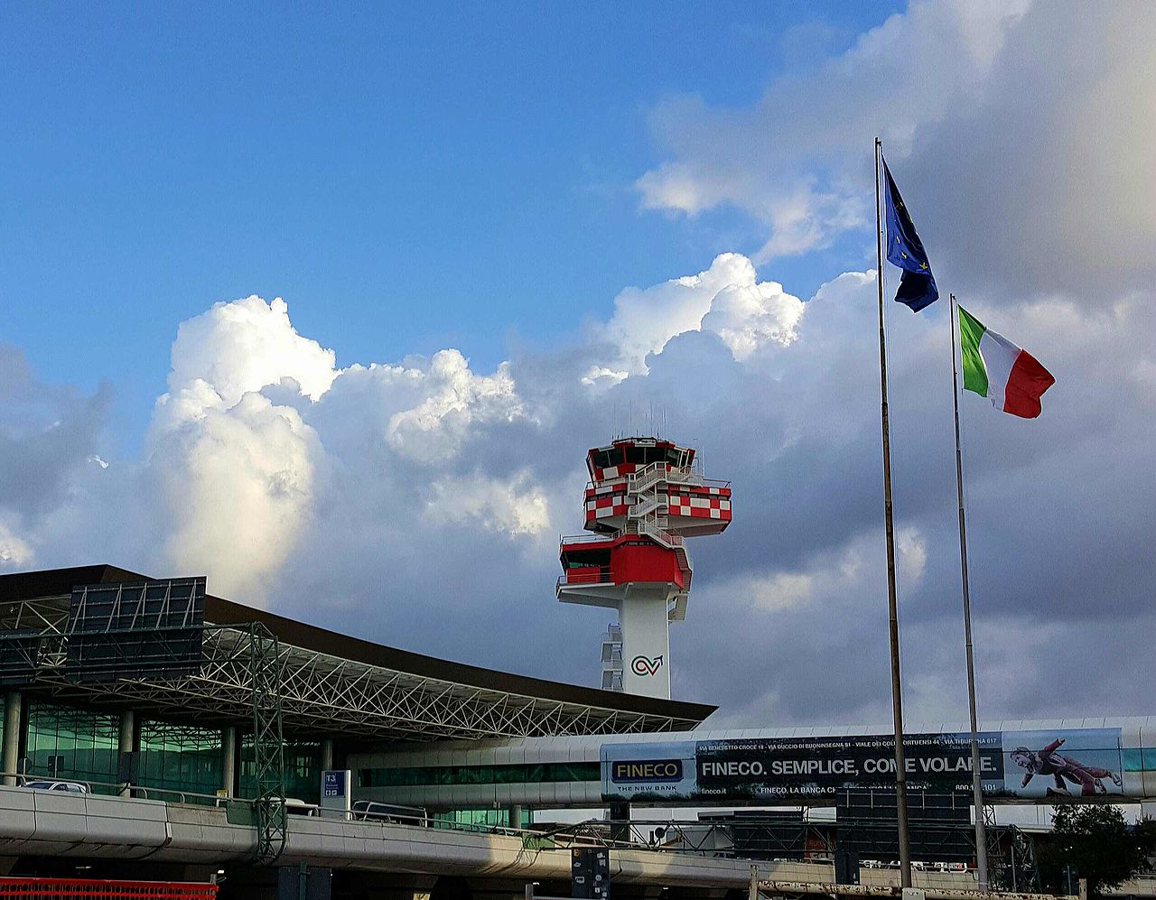
Rome-Fiumicino Airport was the 8th busiest in Europe in 2012.

Slide 39
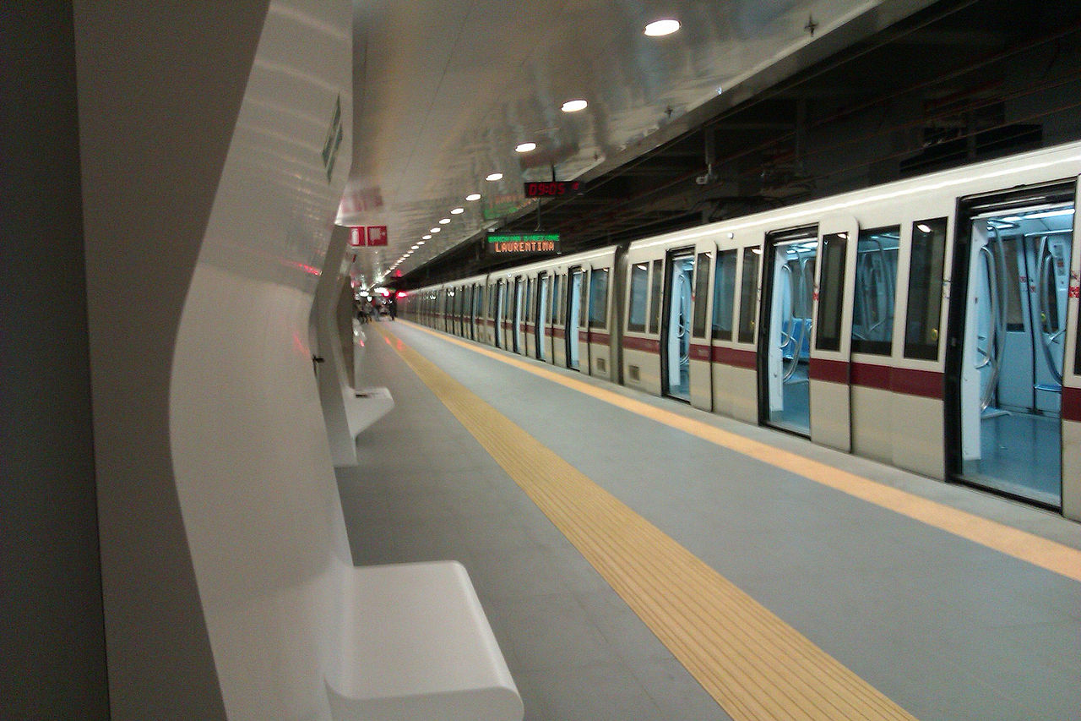
Metro (subway) Station

Slide 40
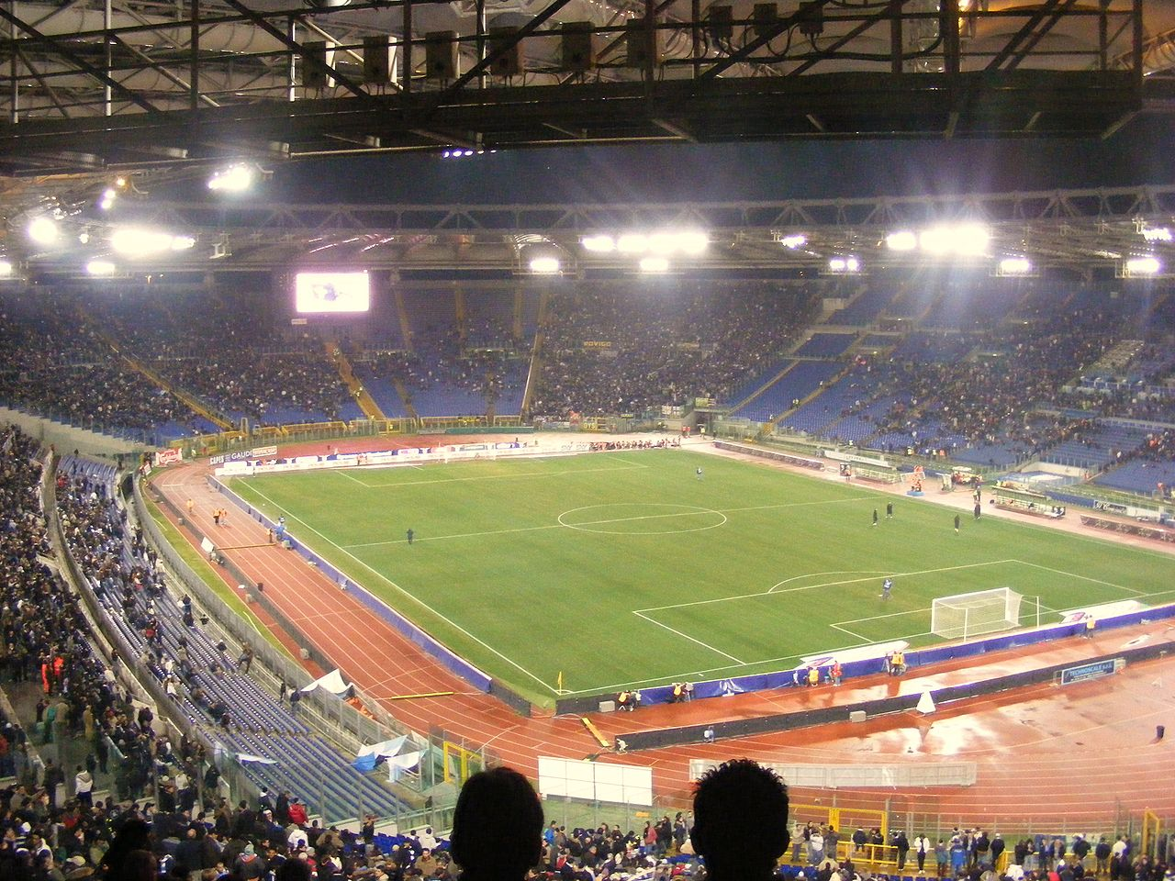
Stadio Olimpico, one of the largest in Europe, with a capacity of over 70,000.

