Slide 1
Manhattan on ice - Stunning aerial photos show the magical effects of the Siberian Express on New York
By Sophie Jane Evans For Dailymail.com

Slide 2
Spectacular pictures, captured by photographer Spencer Platt, show effects of 'Siberian Express' on Manhattan
Feature Central Park blanketed in pristine sheet of snow and tugboats negotiating ice floes on the Hudson River
Temperature was so cold on Friday it fell to just two degrees in NYC - breaking the 1950 record of seven degrees
Comes as new arctic blast - dubbed 'Winter Storm Pandora' - is poised to strike vast parts of the US on Saturday

Slide 3
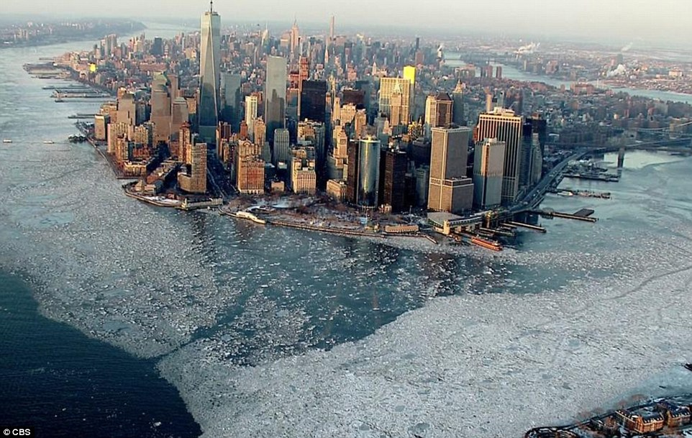
ice floes surrounding skyscrapers in Lower Manhattan

Slide 4
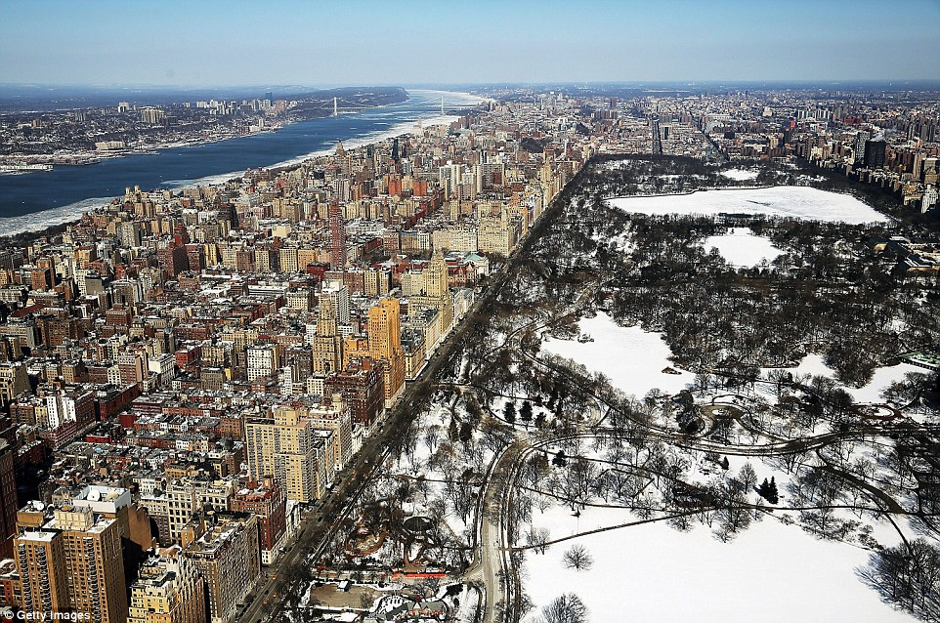
Central Park blanketed in a pristine sheet of snow

Slide 5
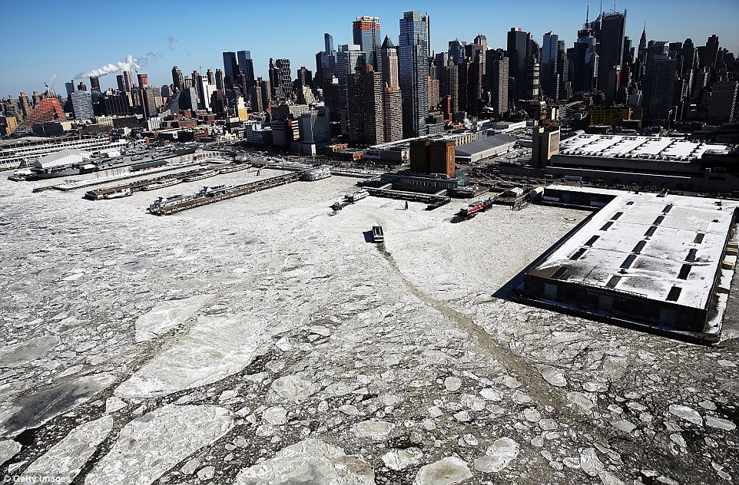
A tugboat tries to negotiate ice floes

Slide 6
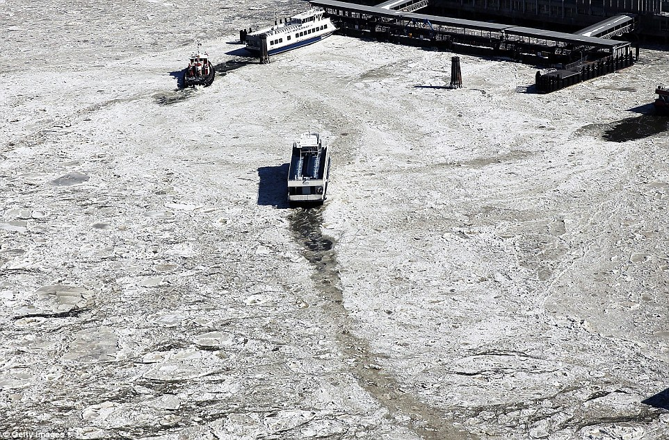
temperature dropped to a record breaking two degrees in NYC on Friday

Slide 7
And New York City wasn't the only region to see record-breaking temperatures. On Friday morning, at least 72 records were recorded, from Marquette, Michigan (-26 degrees) to Miami (42 degrees). Lynchburg, Virginia, even saw a bone-chilling minus 11 degrees - a new all-time record low
The sub-zero temperatures transformed a fountain in Letchworth State Park, New York, into a 50-foot 'ice volcano', caused the Niagara Falls to partially freeze over and led to 40-foot snow piles in the streets of Boston. The latter has inspired some locals to jump from their windows onto the snowbanks.

Slide 8
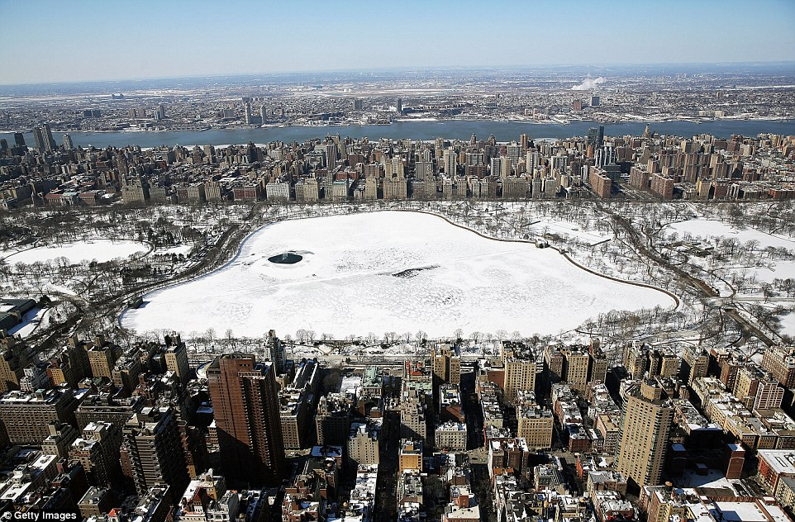
Tourist attractions, such as Central Park were virtually empty

Slide 9
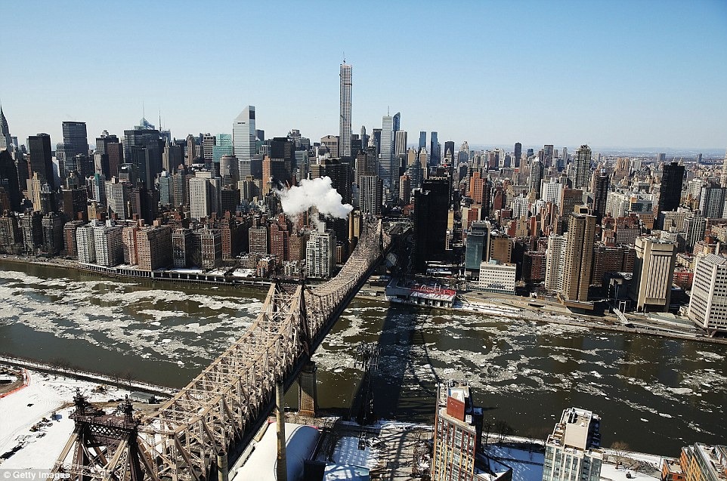
Ice floes on Manhattan's East River

Slide 10
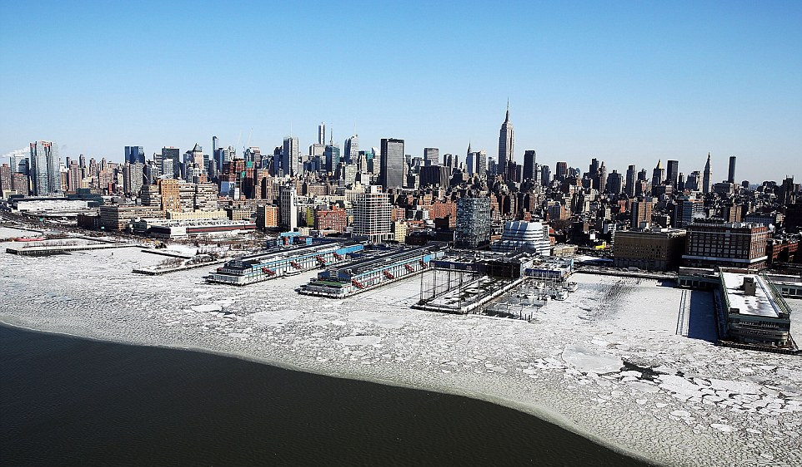
The 'Siberian Express' resulted in striking scenes; it also caused deaths of at least 20 people from hypothermia

Slide 11
'This week ranks among the most intense arctic outbreaks so far in the 21st century for the eastern U.S., and it is certainly one of the most impressively cold air masses we've seen this late in winter,' meteorologist Nick Wiltgen said. The 'Siberian Express' phenomenon was given its name because the winds came in from Russia and traveled over the Arctic Circle, pushing frigid air into Canada and the United States

Slide 12
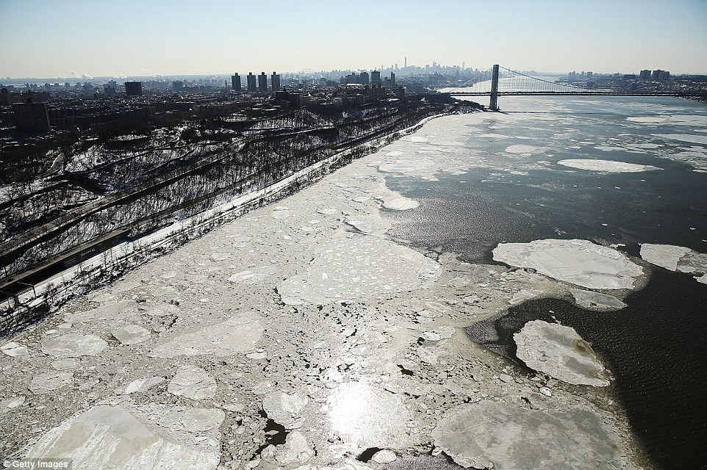

Slide 13
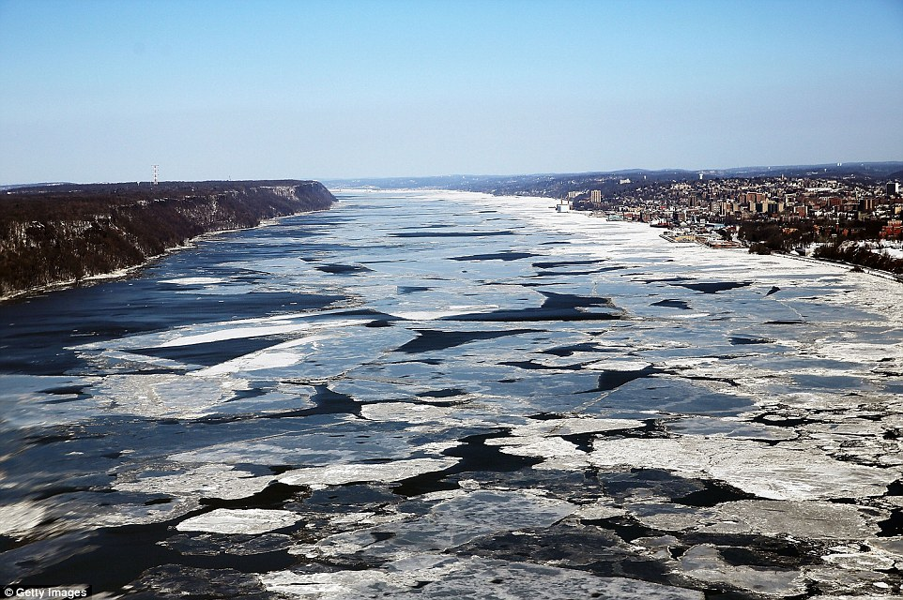
Ice floes on the Hudson River in Manhattan, New York

Slide 14
Week of Feb. 22, 2015
'This week ranks among the most intense arctic outbreaks so far in the 21st century for the eastern U.S., and it is certainly one of the most impressively cold air masses we've seen this late in the winter season, coming only a month before the spring equinox,' senior meteorologist Nick Wiltgen said.
It comes as a new arctic blast - labeled 'Winter Storm Pandora' by meteorologists - is poised to strike vast parts of the country on Saturday, bringing another round of heavy snow, freezing rain and treacherous ice to areas from Missouri to the mid-Atlantic, and as far south as Alabama and Georgia.

Slide 15
Bruce Sullivan, a senior meteorologist with the National Weather Service, said: 'Higher amounts [of snow] over the next two days will probably be across southern Indiana and Illinois and eastward through Ohio into western Pennsylvania. That's where it looks like the jackpot will be.'
The 'Siberian Express' phenomenon was given its name because the winds came in from Russia and traveled over the Arctic Circle, pushing frigid air into Canada and the United States. On Friday, Washington's Reagan National Airport saw a record low temperature of just six degrees.
This beat a 119-year-old record low for the day of eight degrees. In Pennsylvania, temperatures dipped to minus 18 in New Castle and six below zero in Pittsburgh - both records. A record low was also set at New Jersey's Newark Liberty International Airport (one degree), USA Today reported,

Slide 16
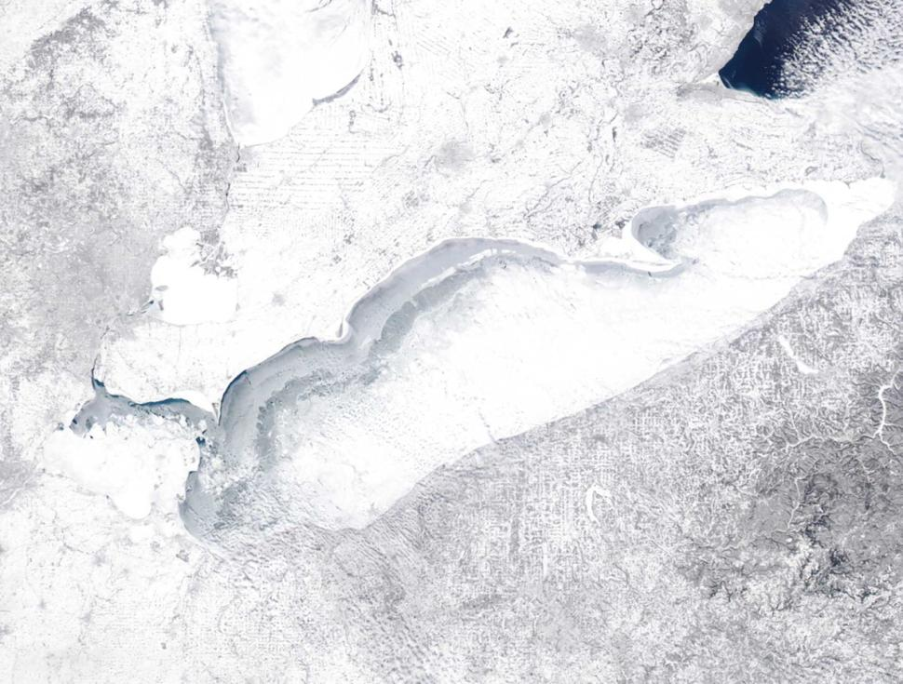
Great Lakes freeze over; Lake Erie nearly 100% covered in ice

Slide 17
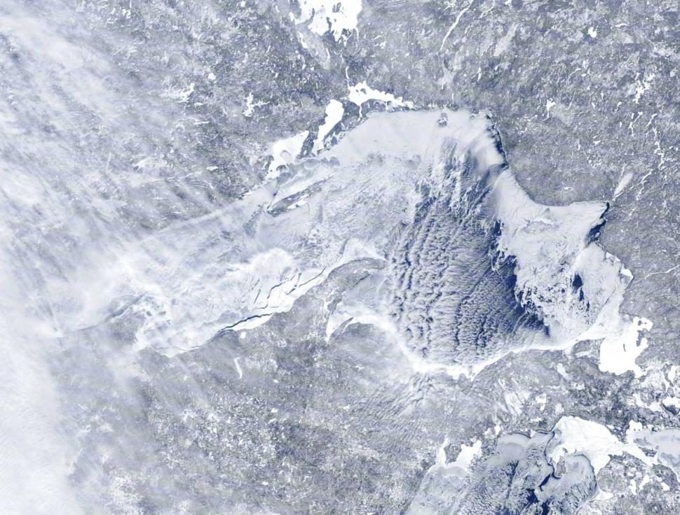
Lake Superior was more than 80% ice on Sunday.

Slide 18
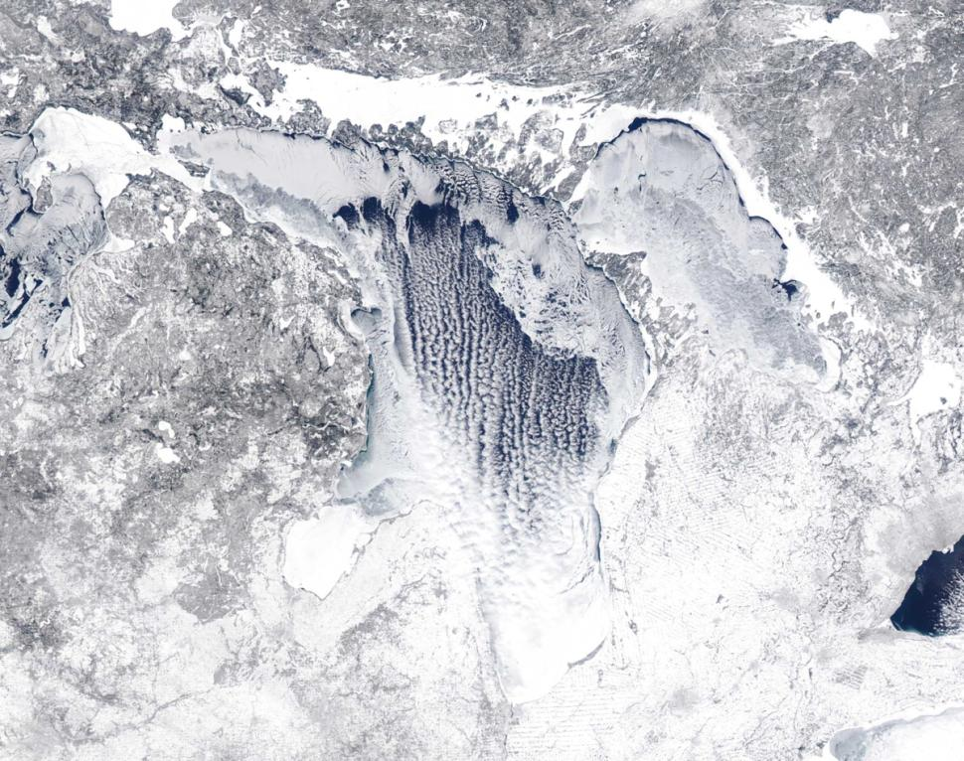
Lake Huron was more ice than water, too.

Slide 19
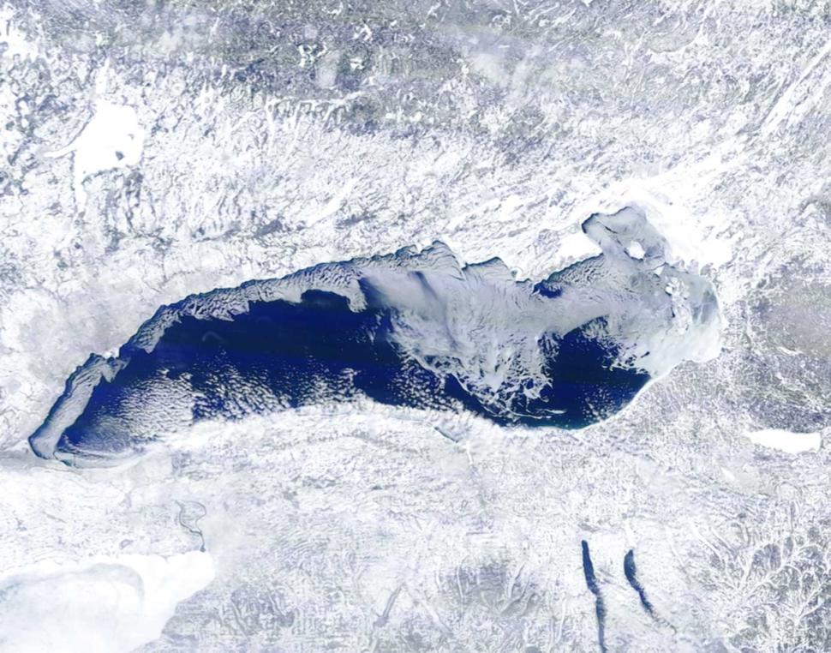
Lake Ontario's surface was between 50% and 60% ice.

Slide 20
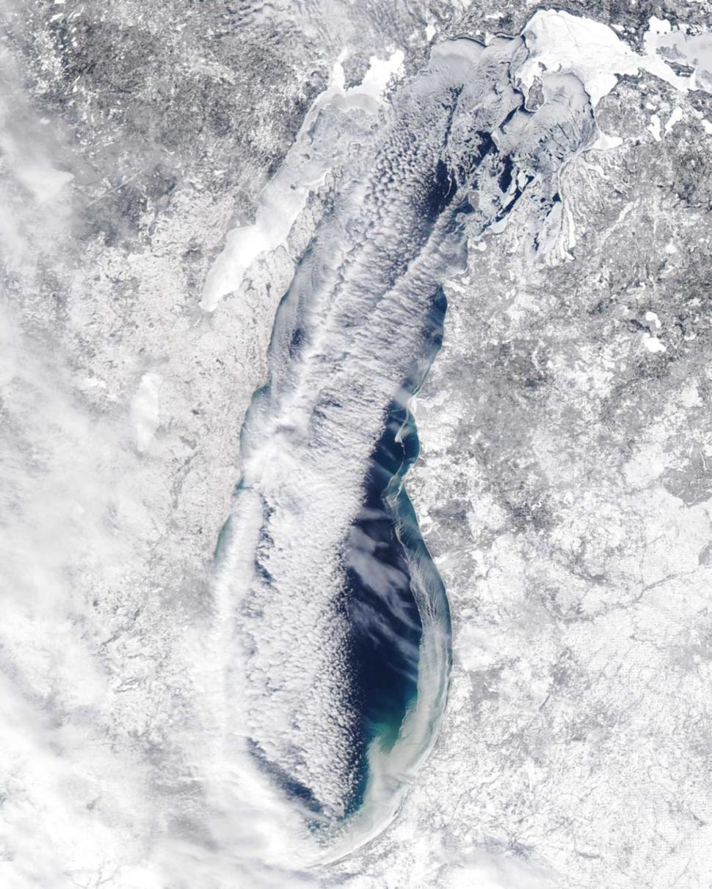
An aerial show shows a freezing Lake Michigan Sunday.

