Slide 1
Lagos, Nigeria
Former Capital City

Slide 2
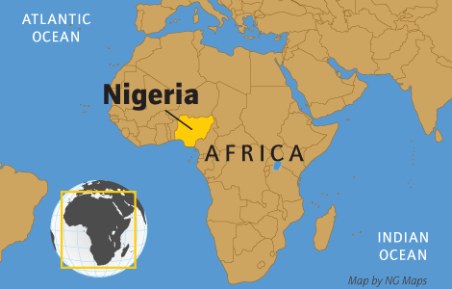

Slide 3
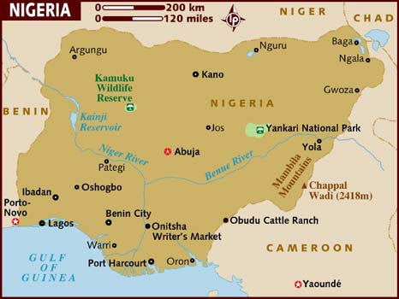
Lagos is a city in the Nigerian state of Lagos. The city, with its adjoining conurbation, is the largest in Nigeria, as well as on the African continent. It is one of the fastest growing cities in the world and also one of the most populous urban agglomerations in the world. Lagos is a major financial centre in Africa; the megacity has the highest GDP,[ and also houses one of the largest and busiest ports on the continent.

Slide 4
Lagos which was the capital of Nigeria since its amalgamation in 1914, went on to become the capital of Lagos State, after its creation. However, the state capital was later moved to Ikeja in 1976, while the federal capital also moved to Abuja in 1991. Even though Lagos is still widely referred to as a city, the present day Lagos, also known as "Metropolitan Lagos", and officially as "Lagos Metropolitan Area" is an urban agglomeration or conurbation, consisting of 16 LGAs, including Ikeja, the state capital of Lagos State. This conurbation makes up 37% of Lagos State's total land area, but houses about 85% of the state's total population.

Slide 5
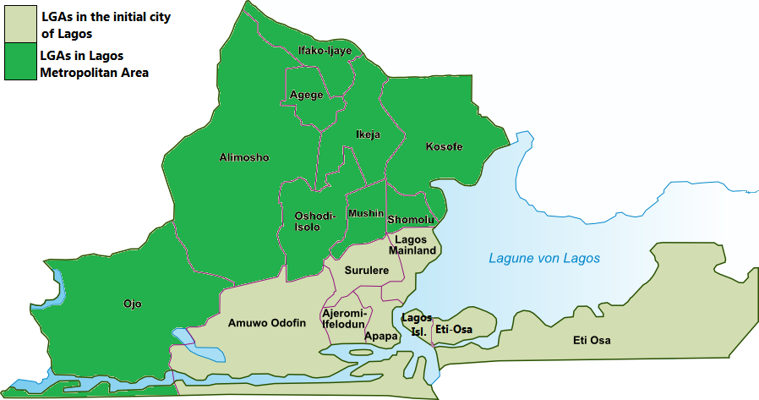

Slide 6
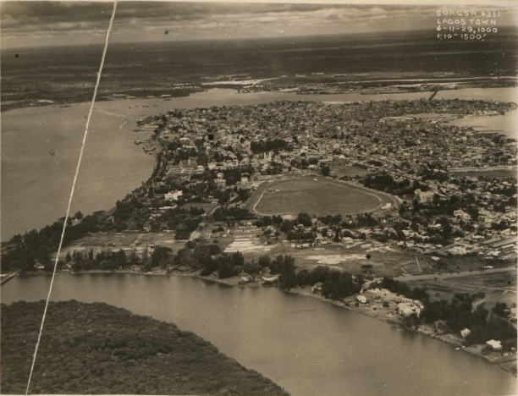
Aerial view of Lagos in 1929

Slide 7
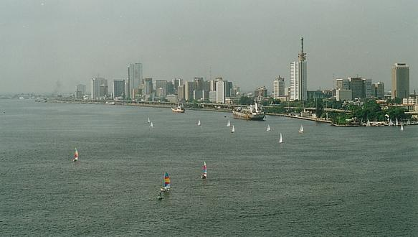
Skyline Today

Slide 8
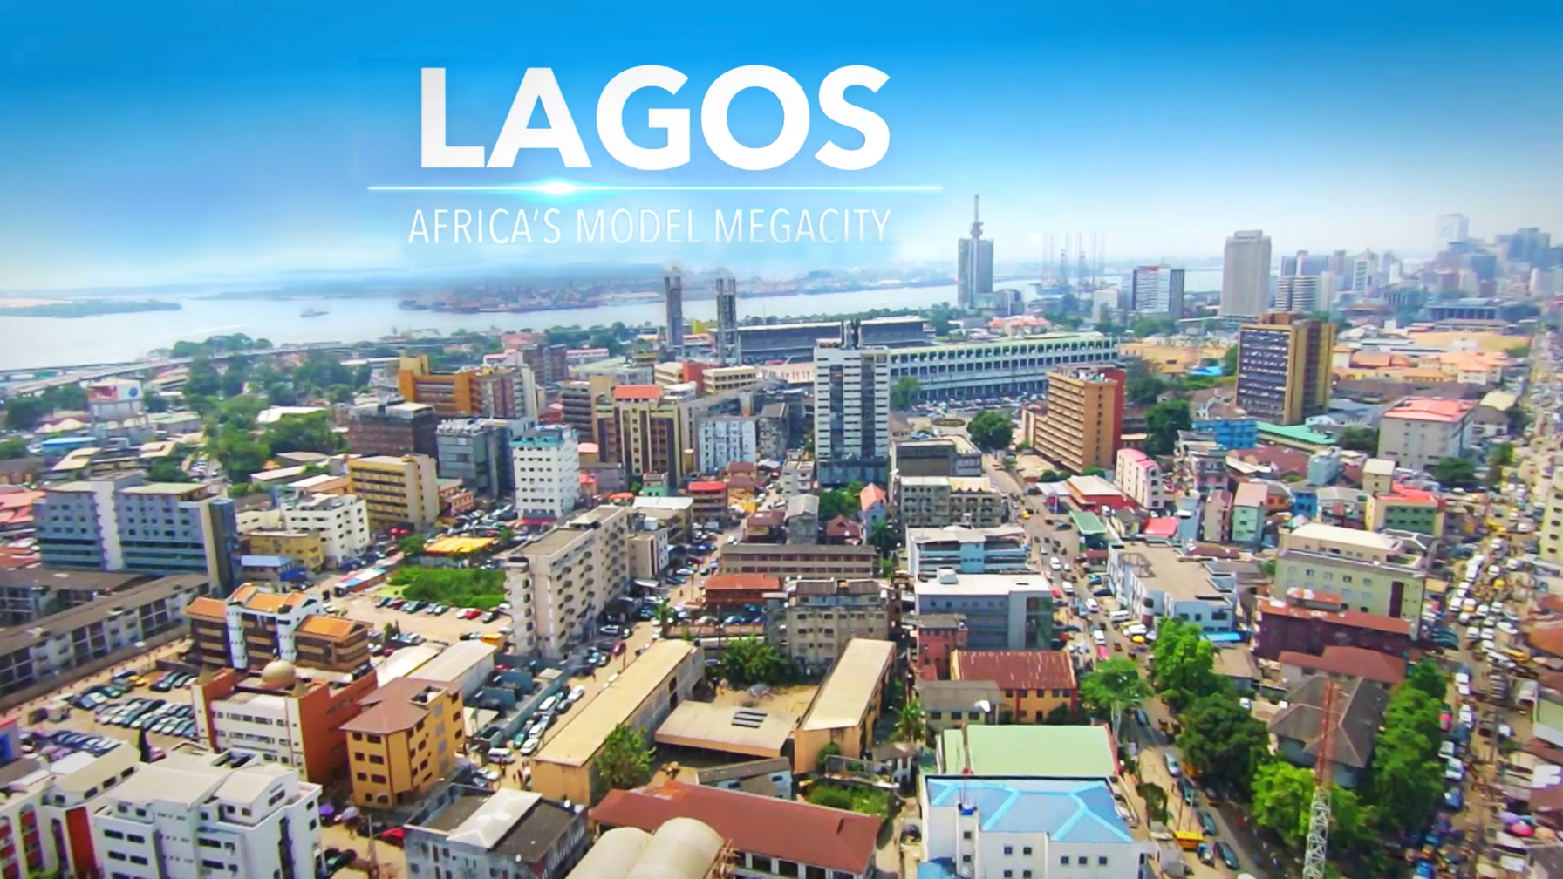

Slide 9
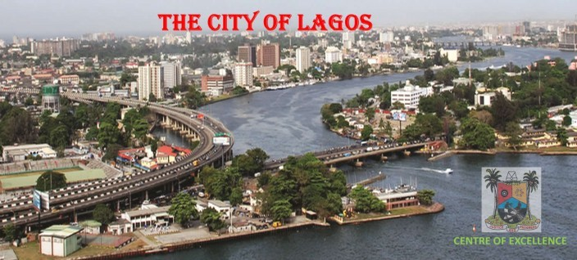

Slide 10
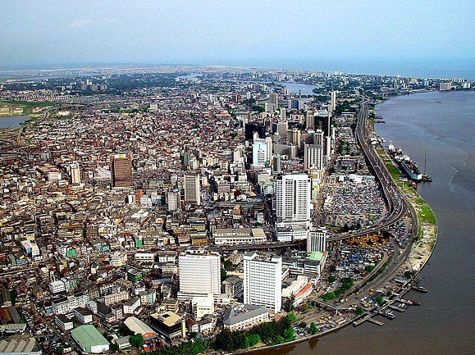

Slide 11
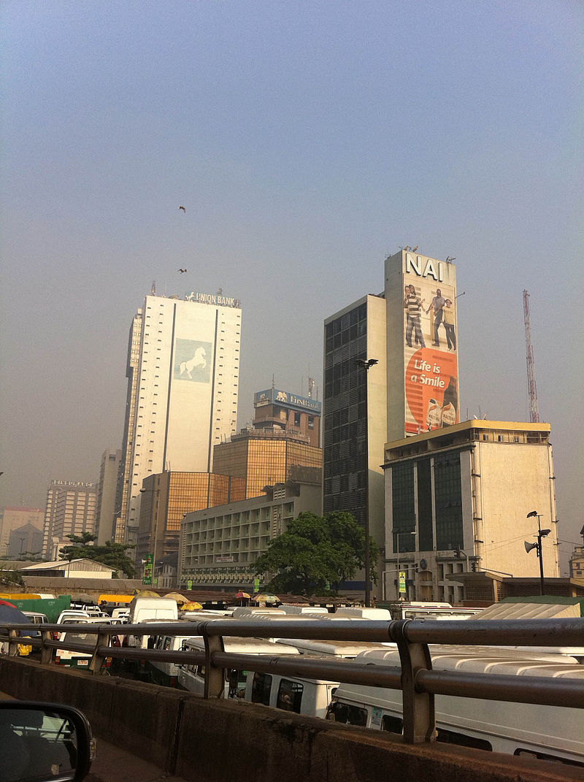
Lagos Marina.

Slide 12
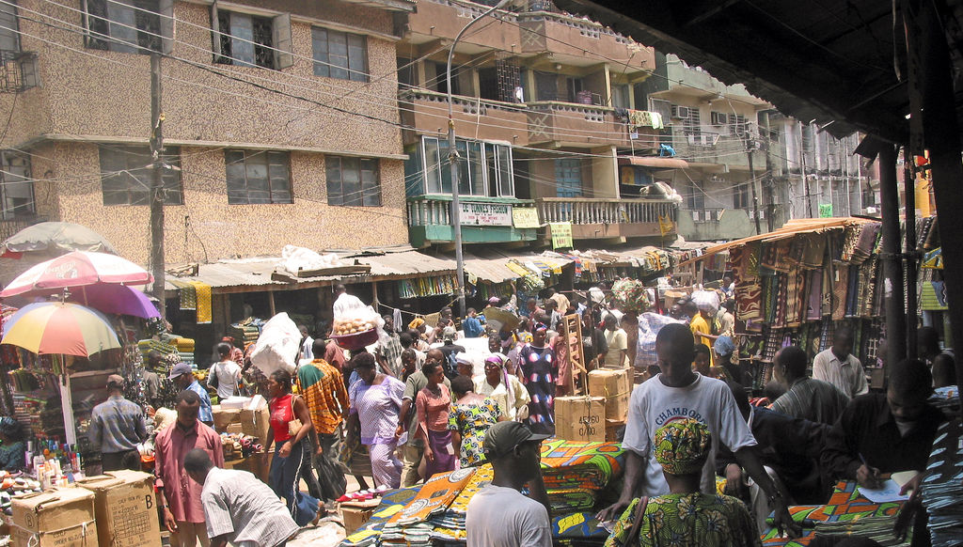
Lagos market scene

Slide 13
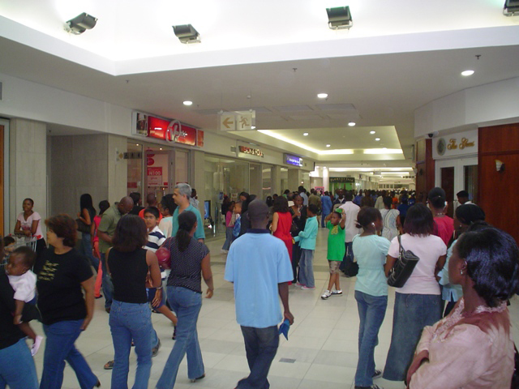
Shopping at the Mall

Slide 14
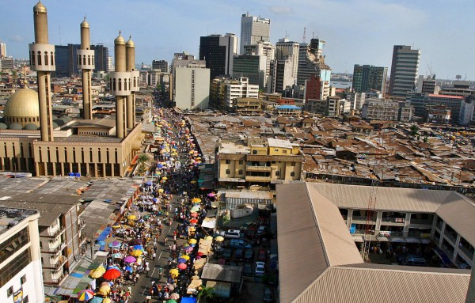
The poor and the not poor

Slide 15
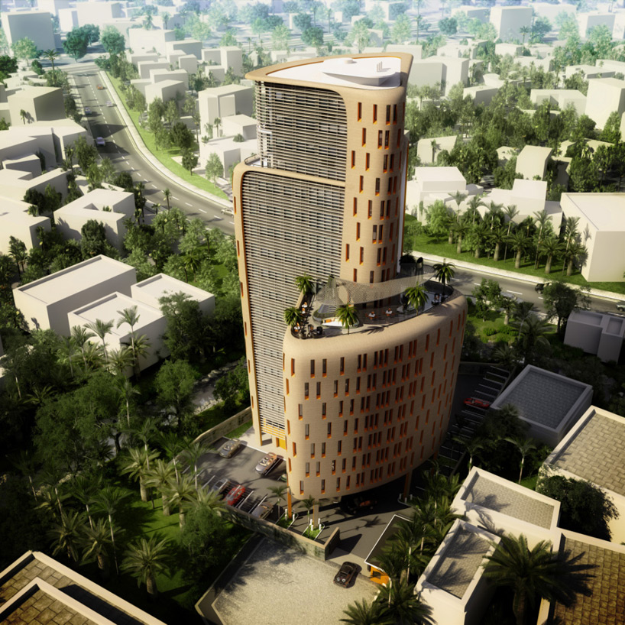
Athena Ramzi Towers

Slide 16
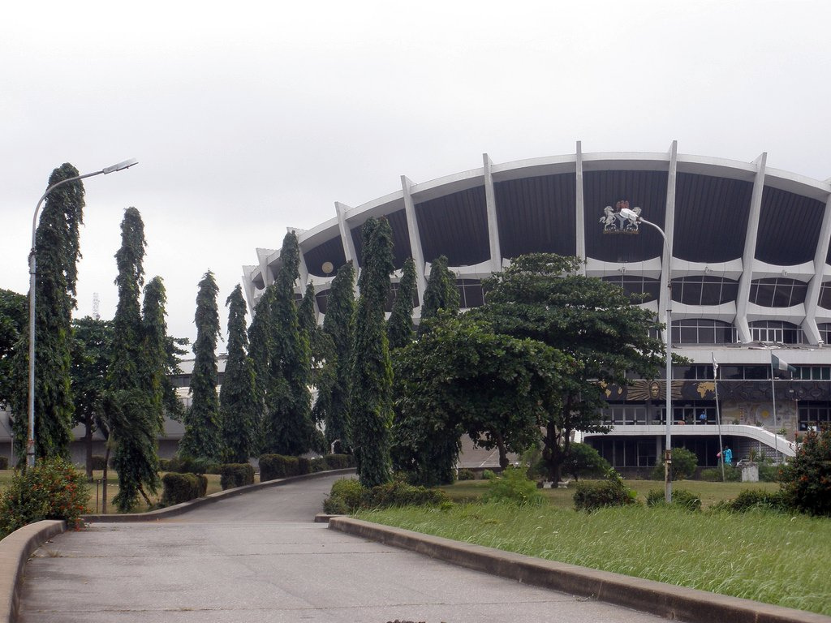
National Arts Theater

Slide 17
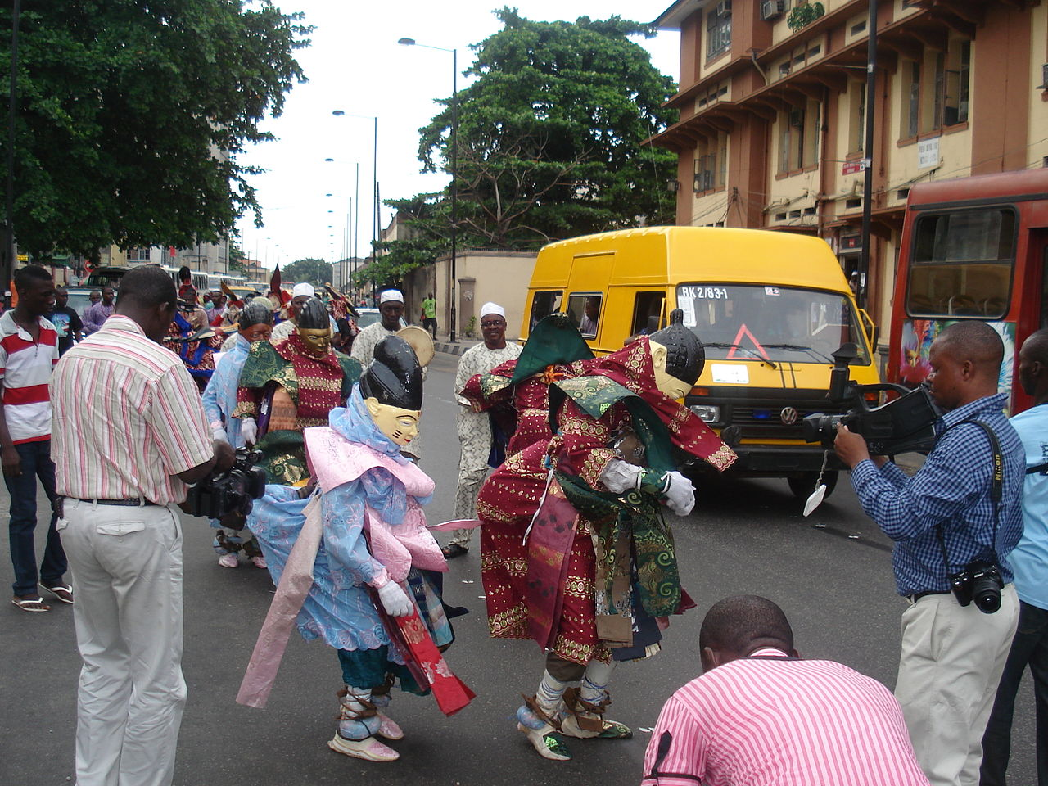
The Lagos Black Heritage Festival Parade (2012).

Slide 18
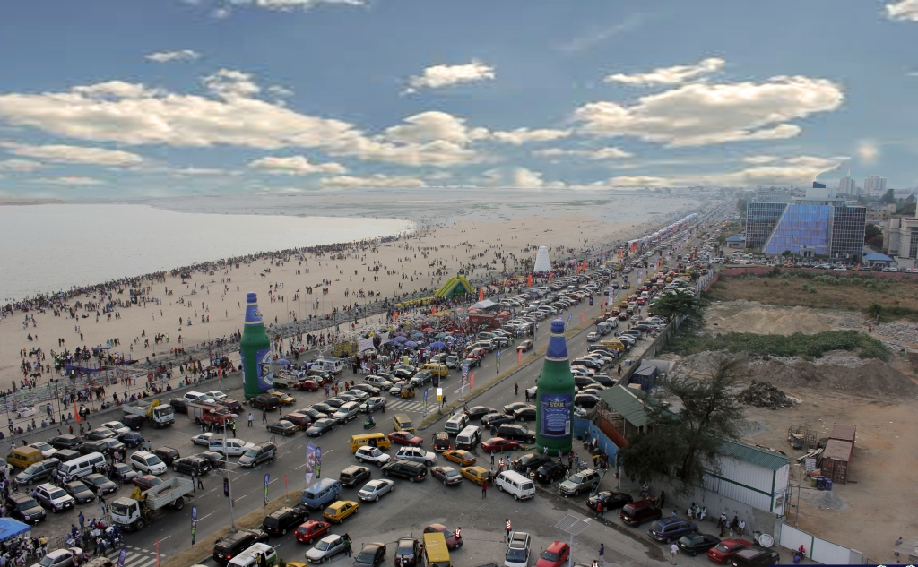
An overview of the Barbeach

Slide 19
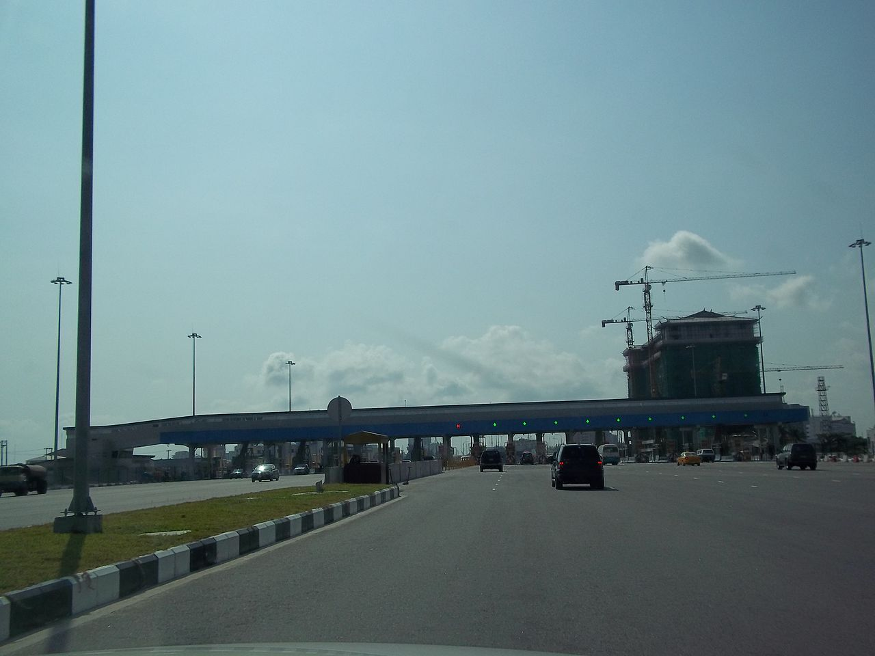
Toll gates and roads at the Lekki-Ẹpẹ Expressway.

Slide 20
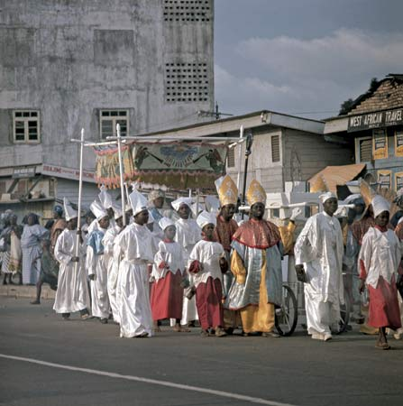
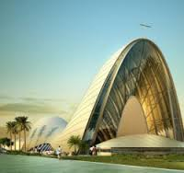
A Catholic procession marching past spectators on the streets of Lagos
New Catholic Church

Slide 21
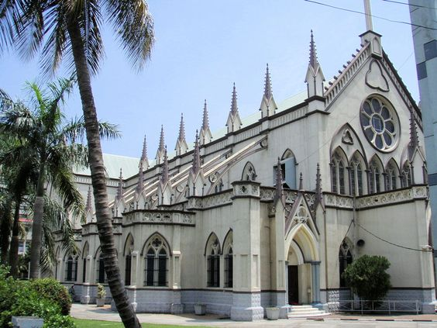
Holy Cross Cathedral

Slide 22



The world’s oldest profession is alive and well?

Slide 23
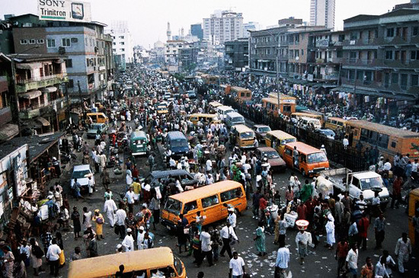
The Poor Part of Lagos

Slide 24
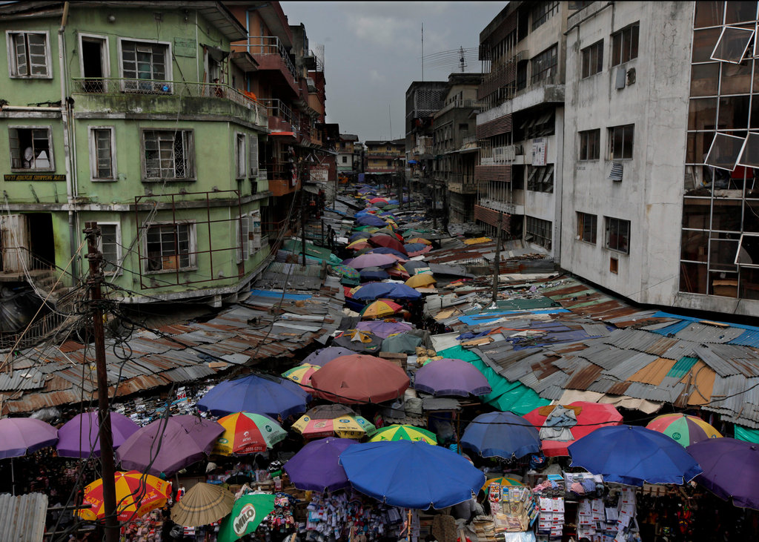
Market in the poor part of town

Slide 25
