Slide 1
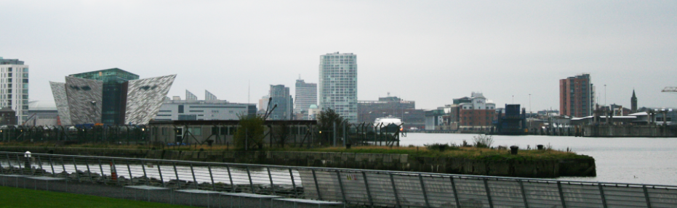
Belfast, Ireland

Slide 2
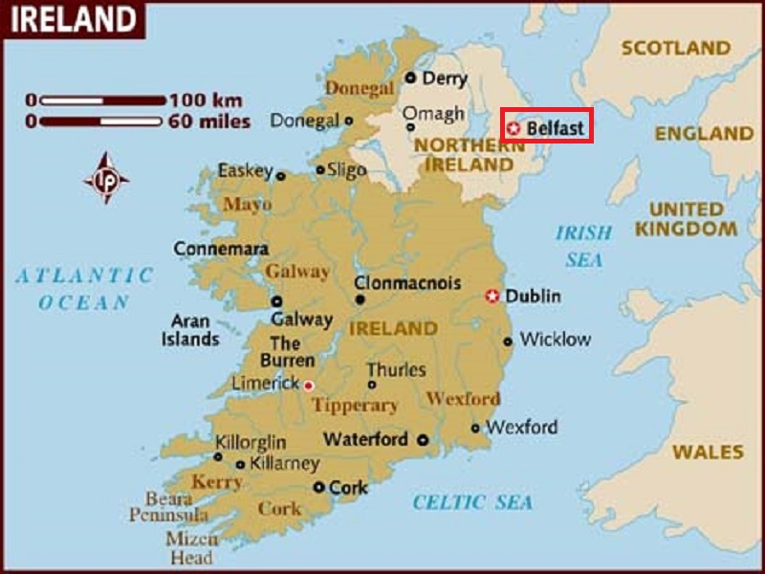
Belfast is the capital and largest city of Northern Ireland, the second largest city on the island of Ireland.

Slide 3
Today, Belfast remains a centre for industry, as well as the arts, higher education, business, and law, and is the economic engine of Northern Ireland. The city suffered greatly during the conflict called "the Troubles", but latterly has undergone a sustained period of calm, free from the intense political violence of former years, and substantial economic and commercial growth. Additionally, Belfast city centre has undergone considerable expansion and regeneration in recent years, notably around Victoria Square.
Belfast is served by two airports: George Best Belfast City Airport in the city, and Belfast International Airport 15 miles (24 km) west of the city. Belfast is a major port, with commercial and industrial docks dominating the Belfast Lough shoreline, including the Harland and Wolff shipyard, and is listed by the Globalization and World Cities Research Network (GaWC) as a global city

Slide 4
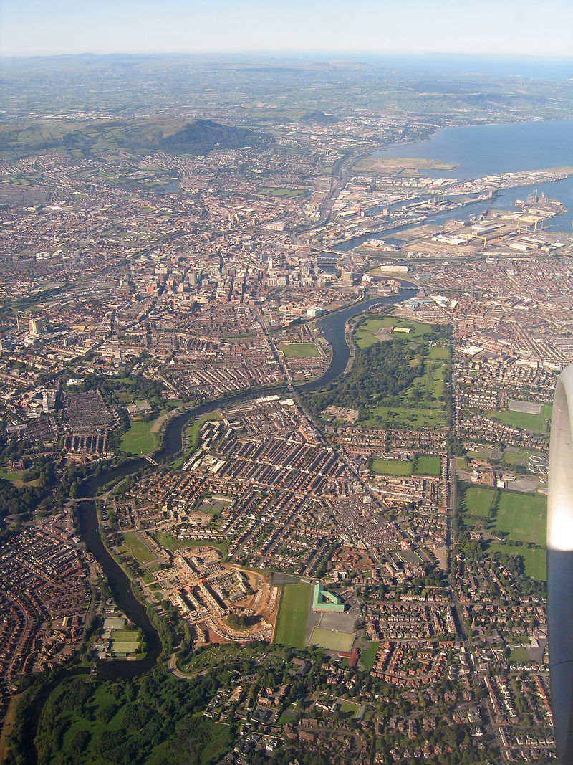
Aerial view of Belfast.

Slide 5
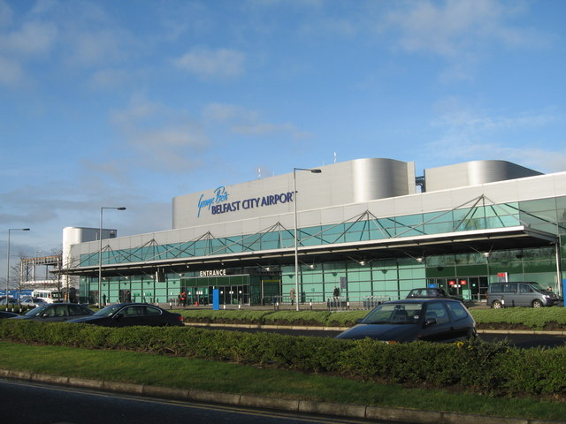

Slide 6
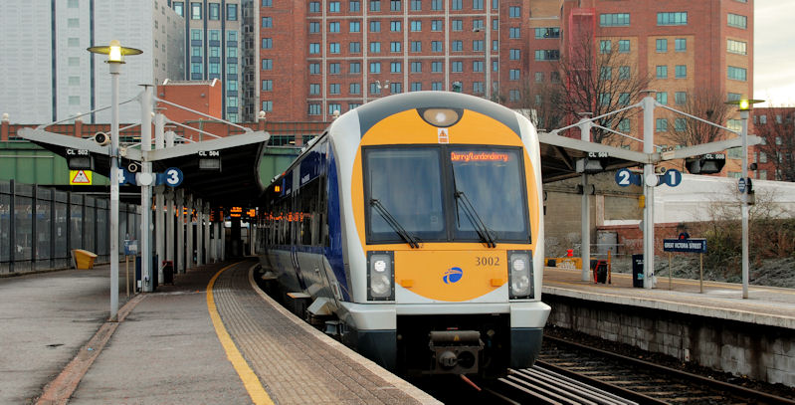
Great Victoria Street station on Northern Ireland Railways
Great Victoria Street station on Northern Ireland Railways
Great Victoria Street station on Northern Ireland Railways

Slide 7
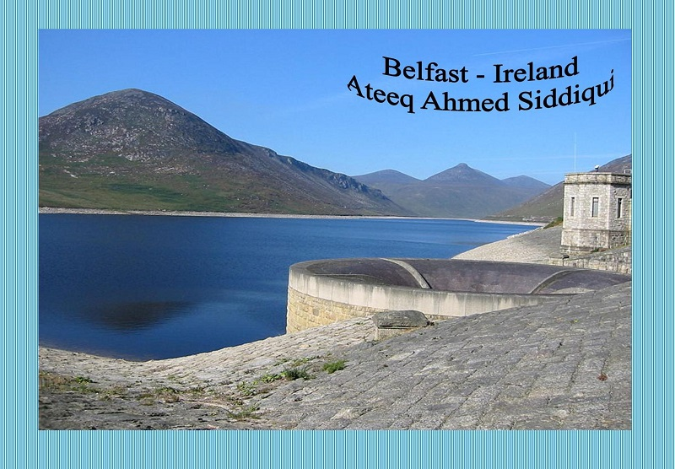

Slide 8
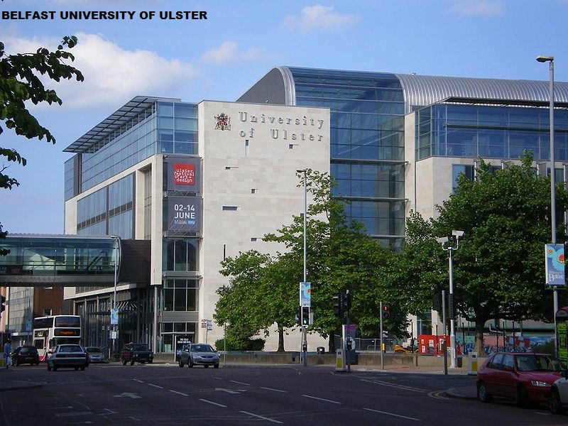

Slide 9
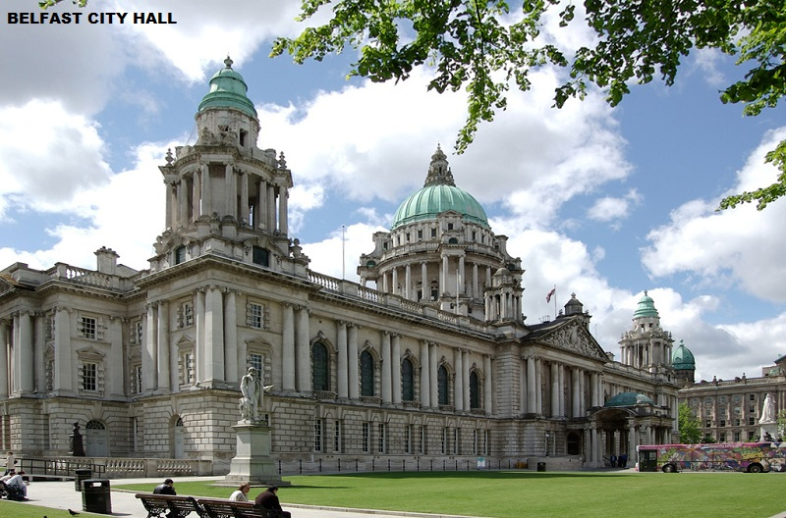

Slide 10
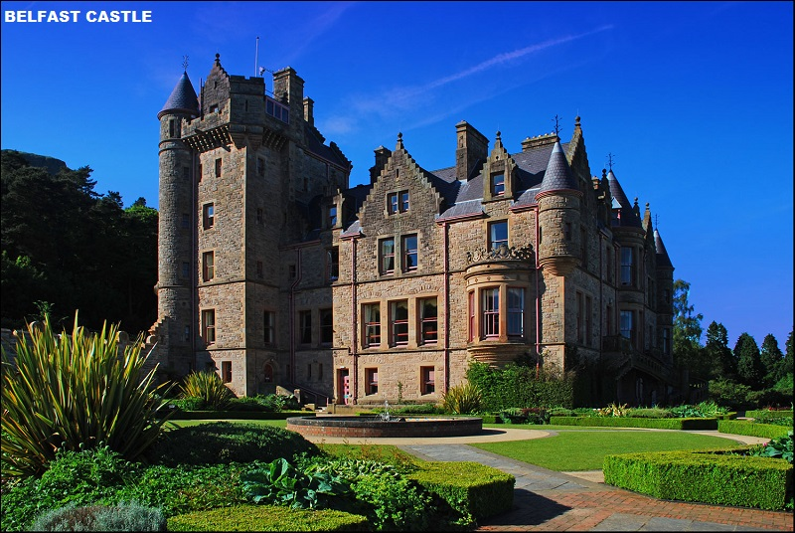

Slide 11
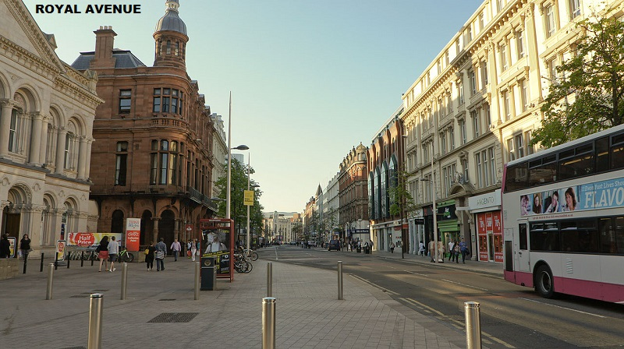

Slide 12
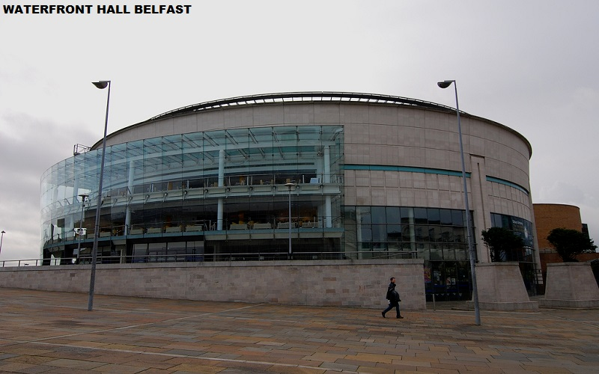

Slide 13
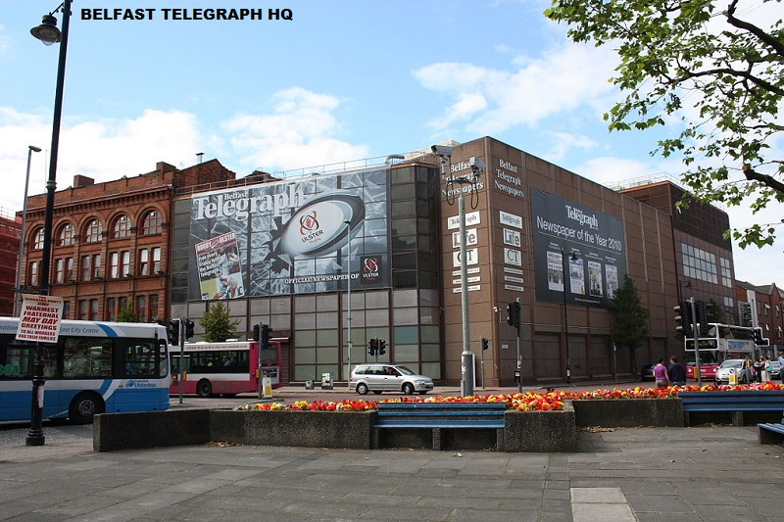

Slide 14
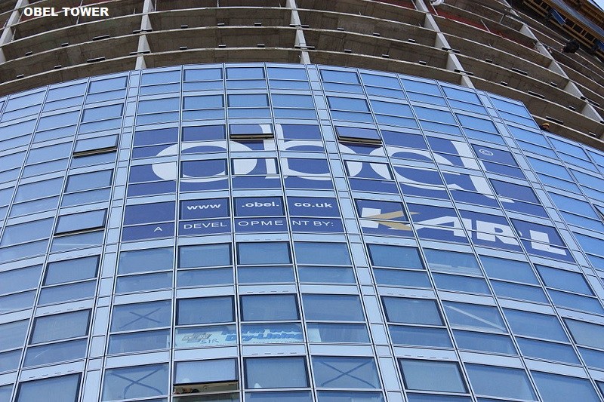

Slide 15
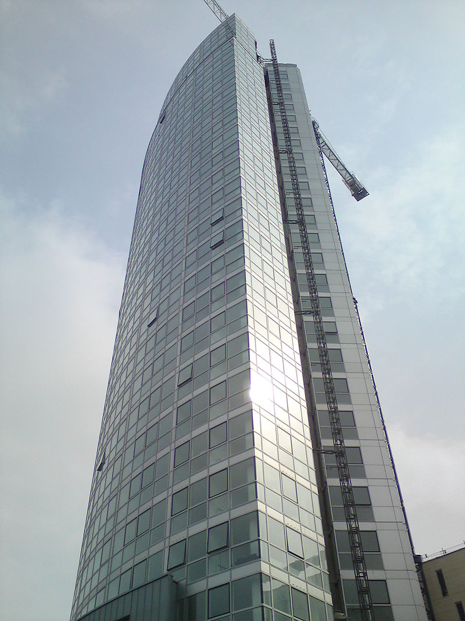
Obel Tower is the tallest building in Belfast and Ireland.

Slide 16
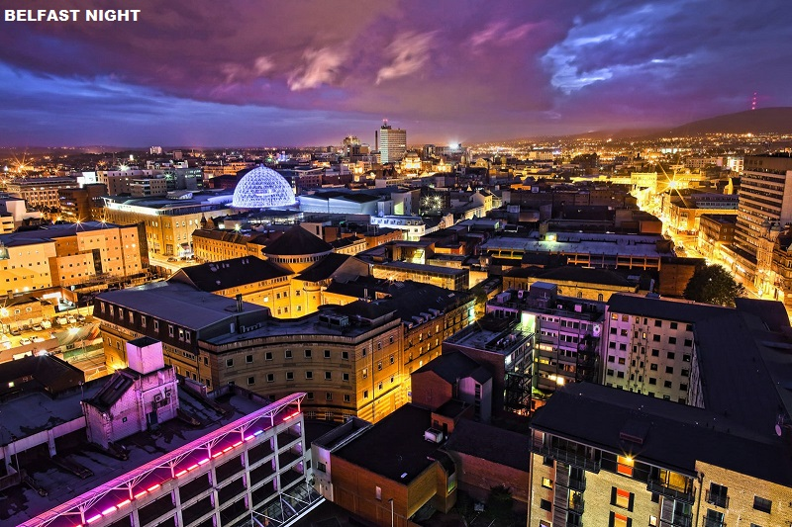

Slide 17
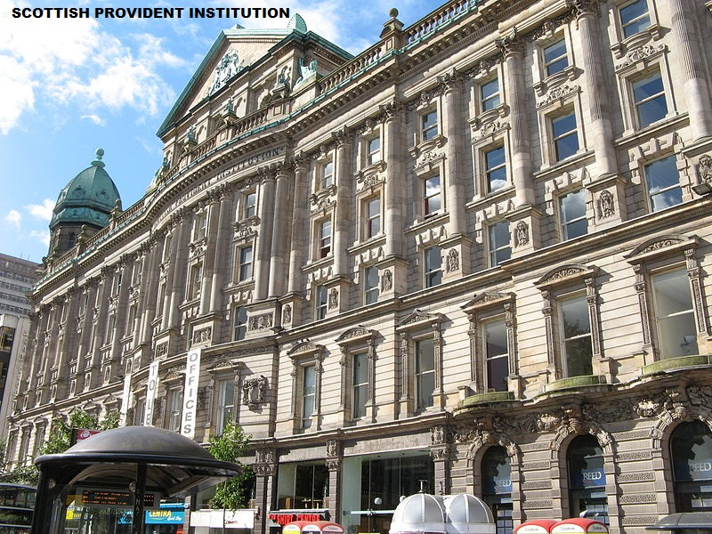

Slide 18
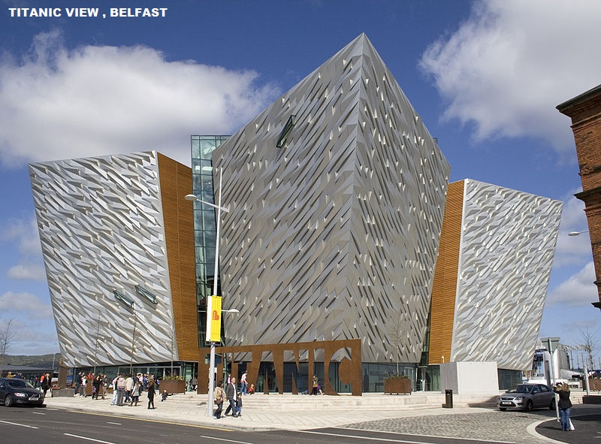

Slide 19
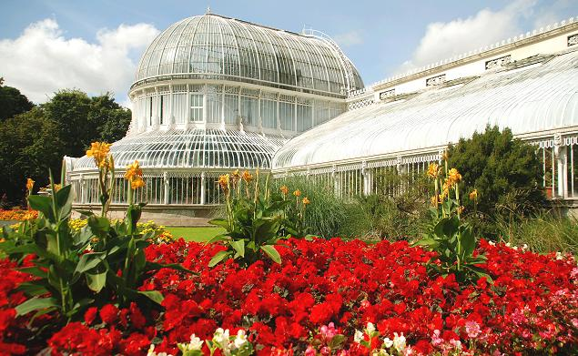
The Palm House at the Botanic Gardens

Slide 20
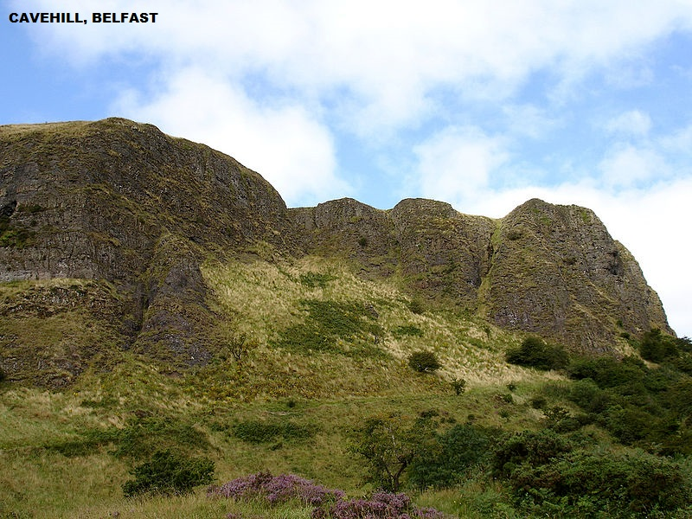

Slide 21
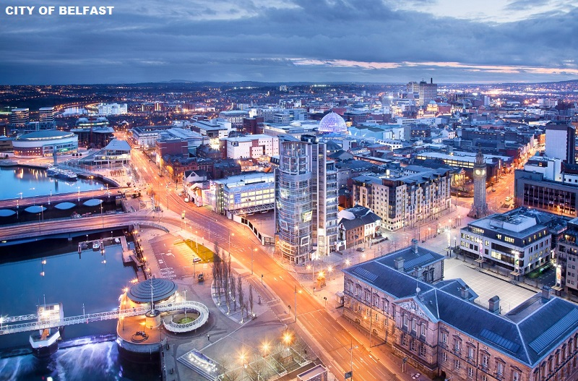

Slide 22
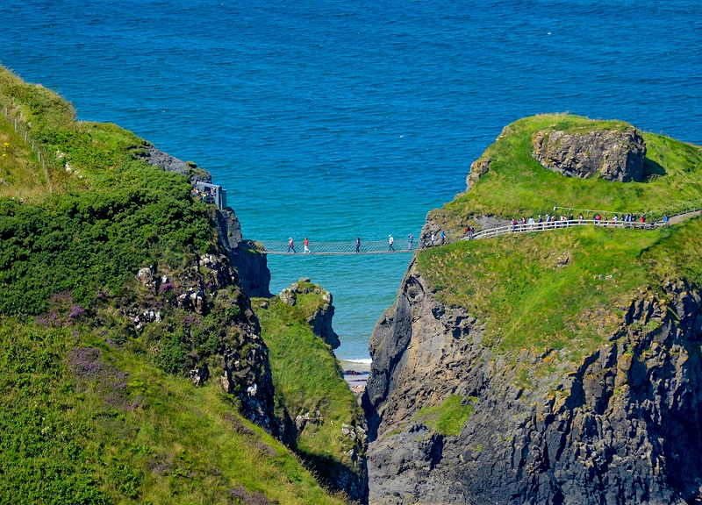

Slide 23
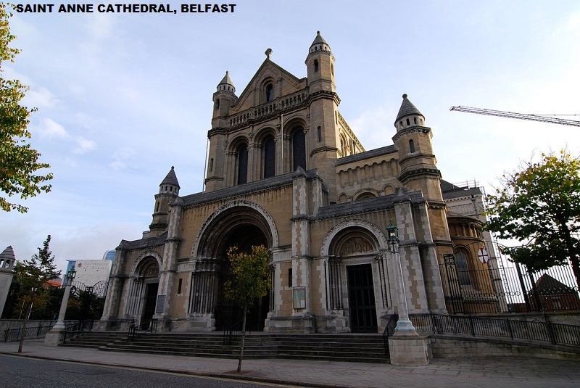

Slide 24
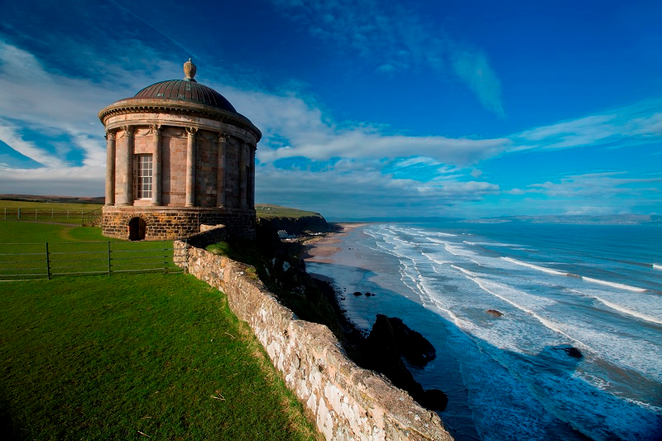

Slide 25
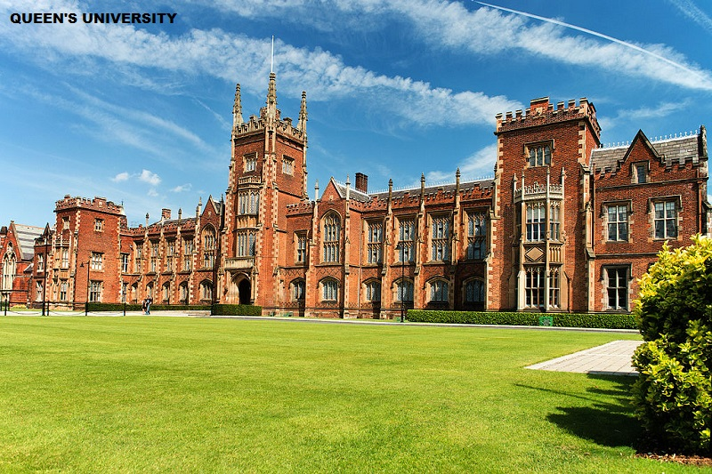

Slide 26
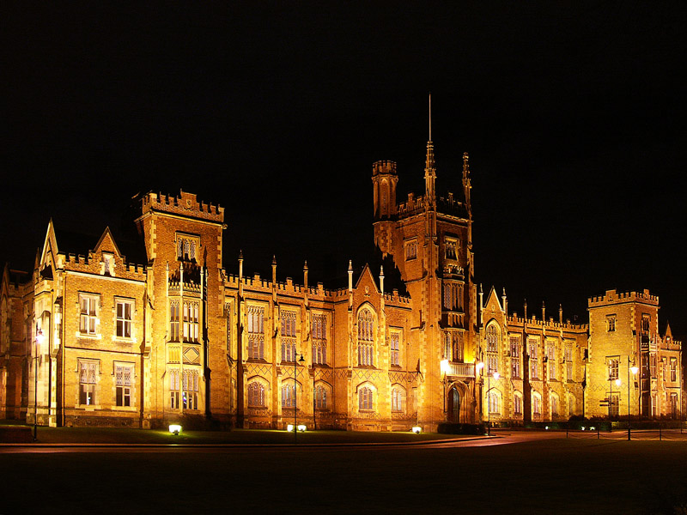

Slide 27
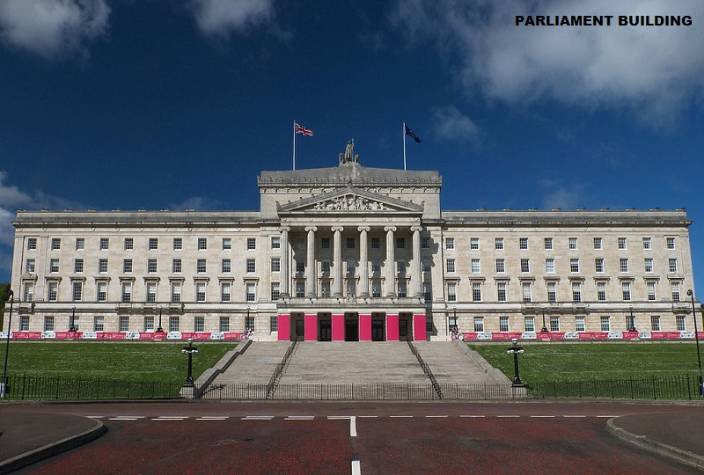

Slide 28
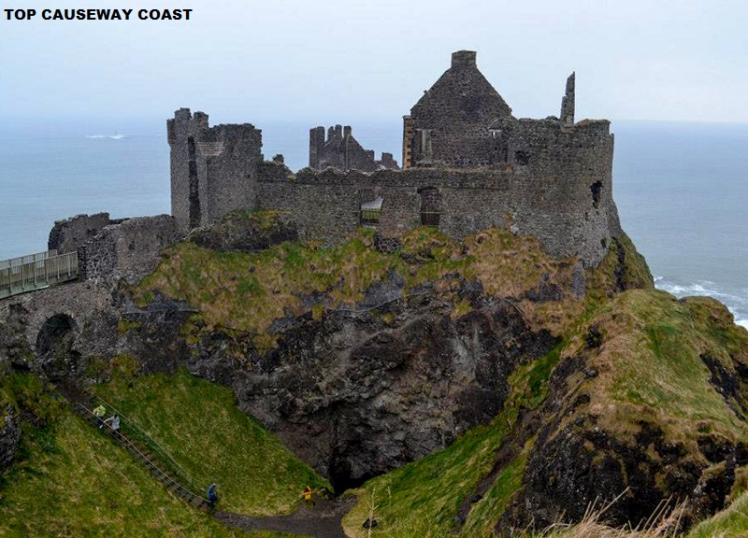

Slide 29
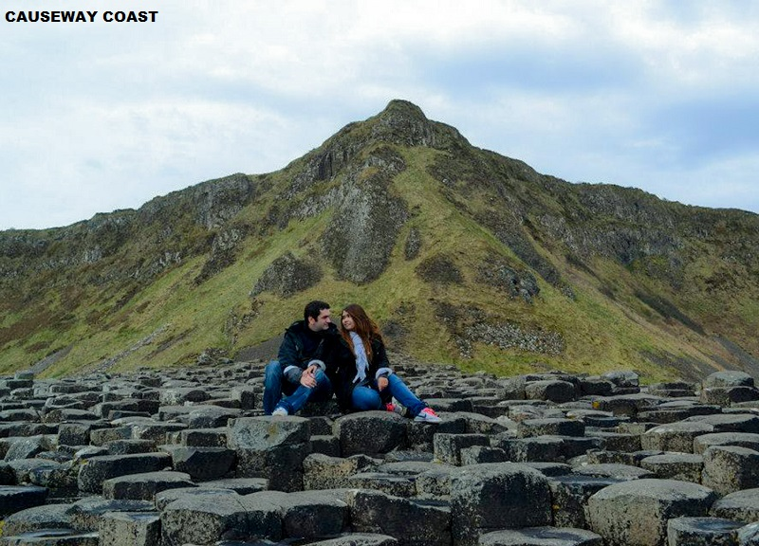

Slide 30
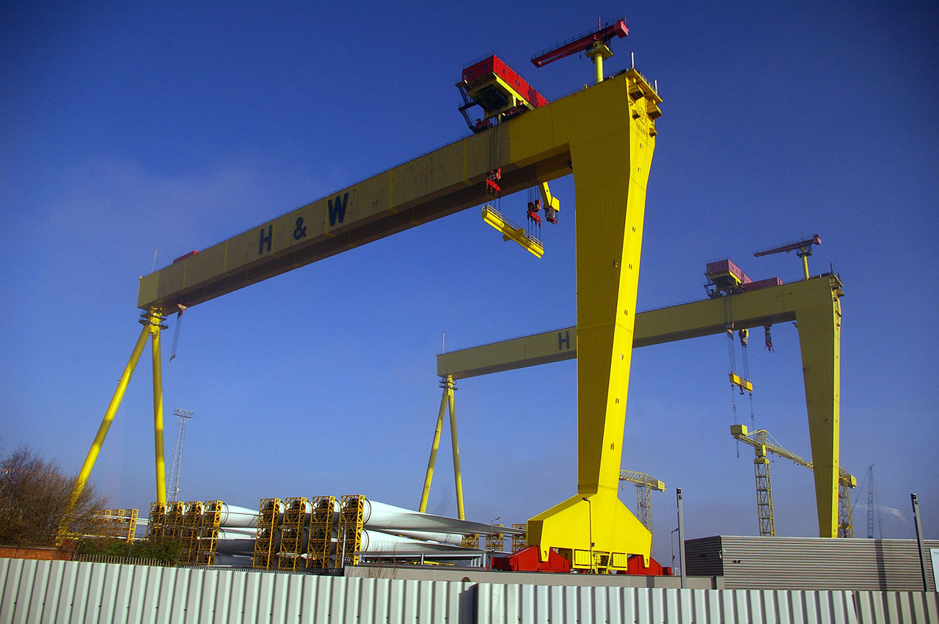
Samson and Goliath, Harland & Wolff's gantry cranes.

Slide 31
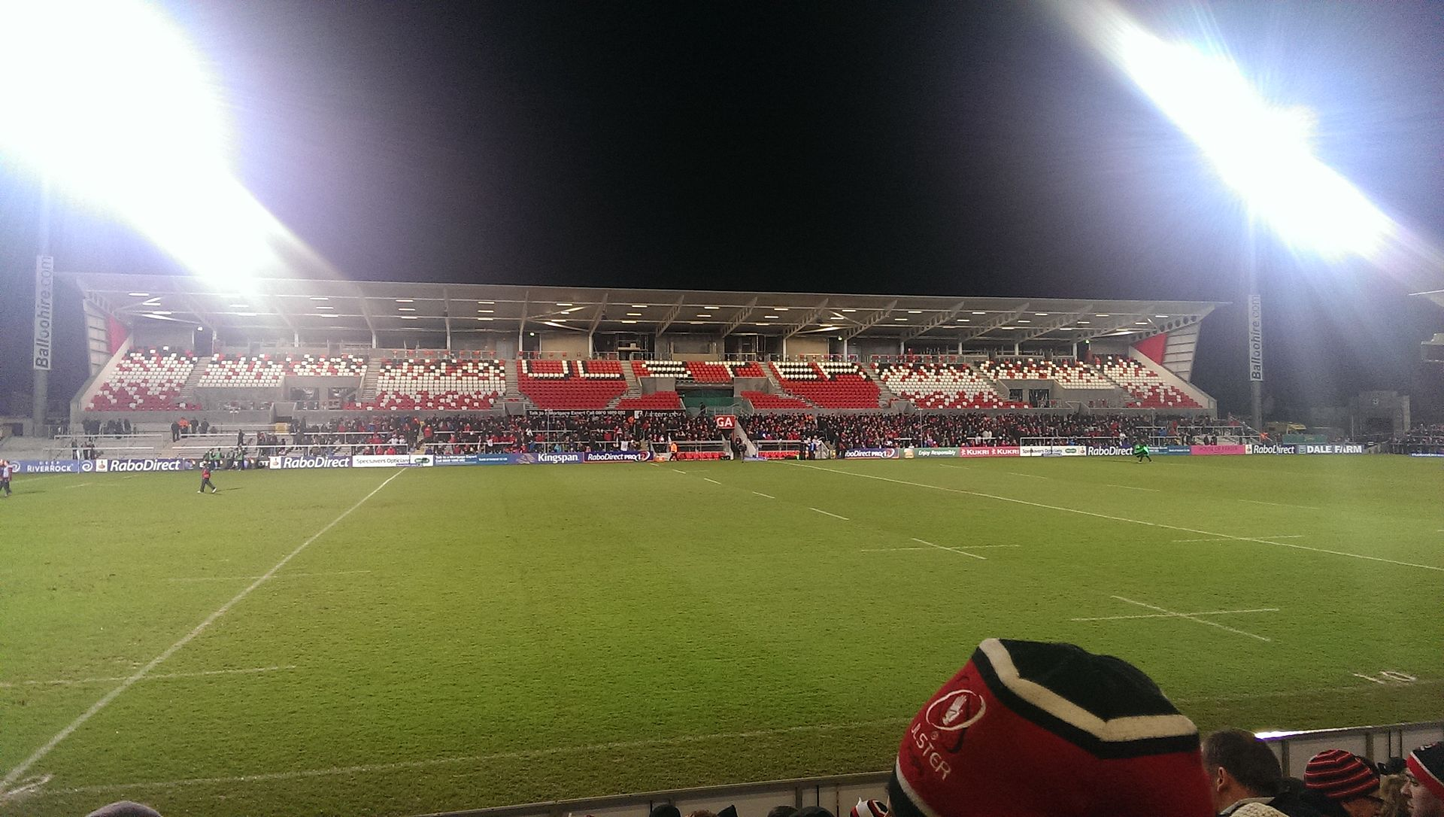
The Kingspan Stadium is the home of Ulster Rugby

