Slide 1
Yokohama, Japan

Slide 2
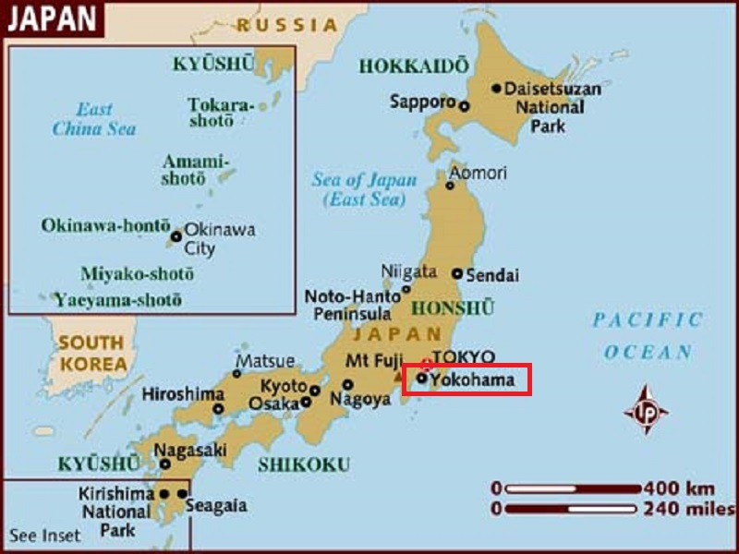
Yokohama is the second largest city in Japan. It is the capital city of Kanagawa Prefecture.

Slide 3
Yokohama, a Japanese city south of Tokyo, was one of the first Japanese ports opened to foreign trade, in 1859. It contains a large Chinatown with hundreds of Chinese restaurants and shops. It’s also known for Sankei-en Garden, a botanical park containing preserved Japanese residences from different eras, and the seaside Minato Mirai district, site of the 296m Landmark Tower. Today it is one of its major ports along with Kobe, Osaka, Nagoya, Hakata, Tokyo, and Chiba.

Slide 4
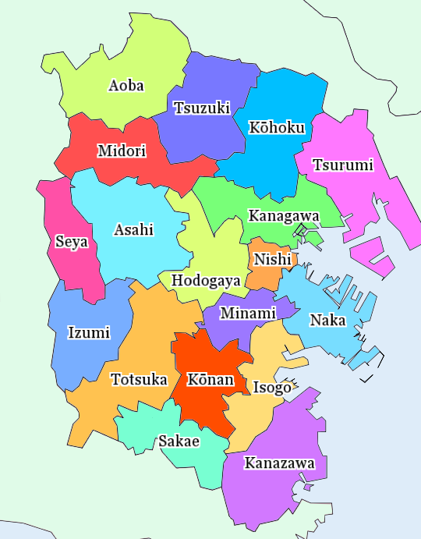
A map of Yokohama's wards

Slide 5
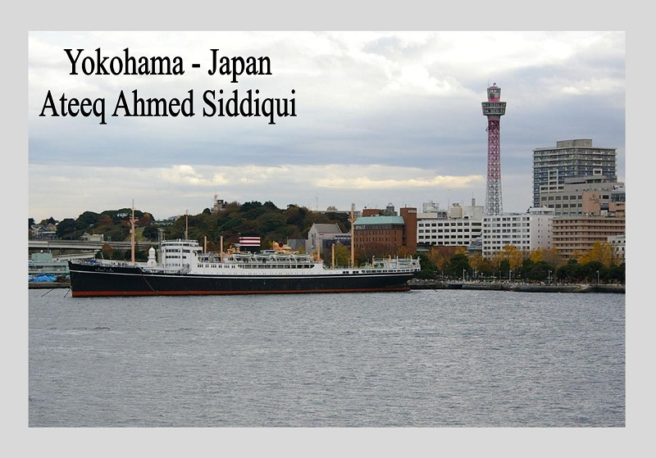

Slide 6
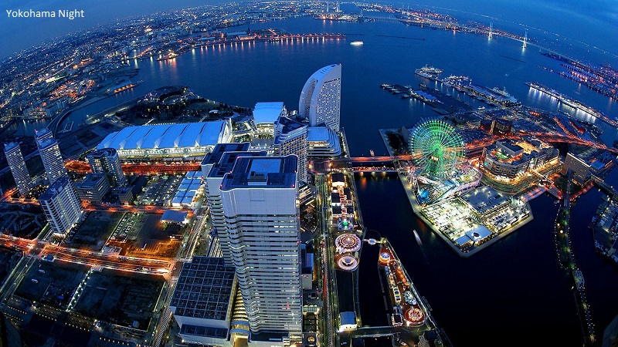

Slide 7
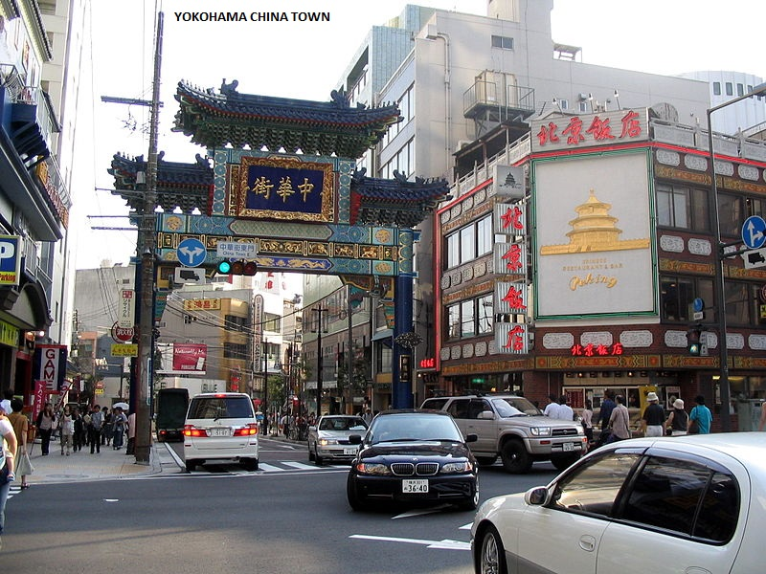

Slide 8
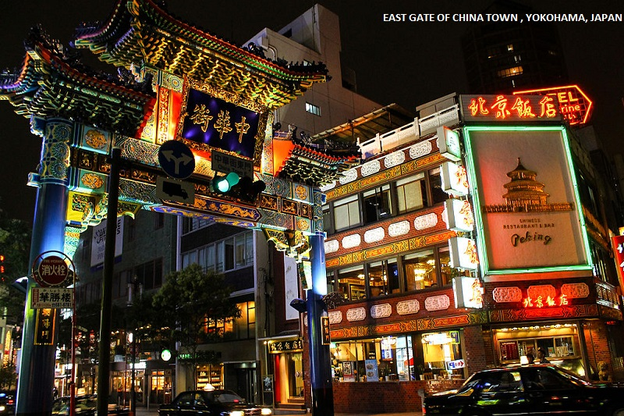

Slide 9
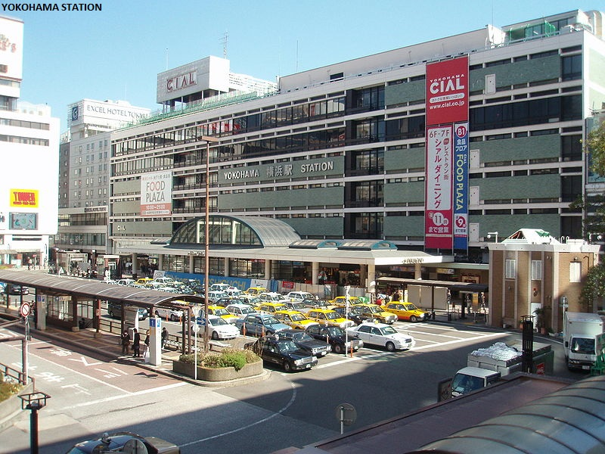

Slide 10
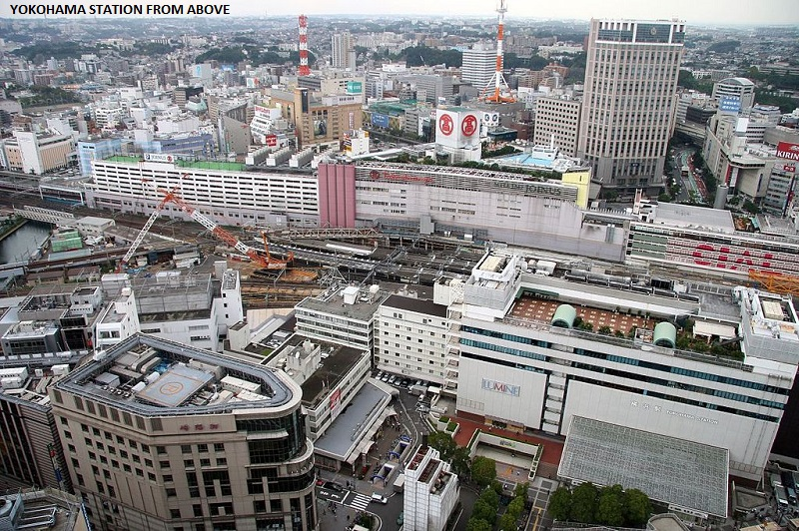

Slide 11
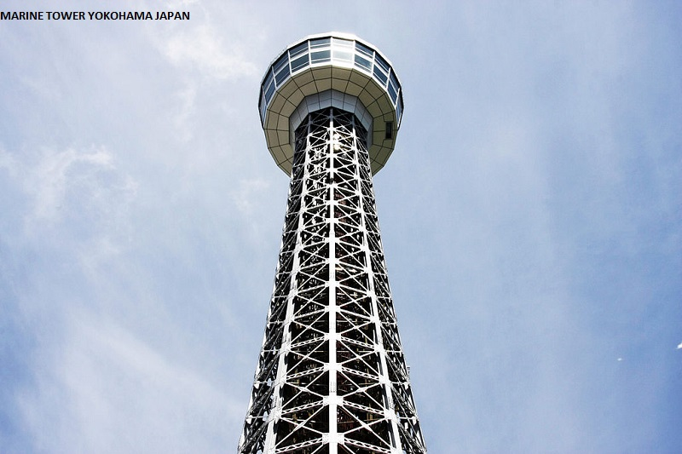
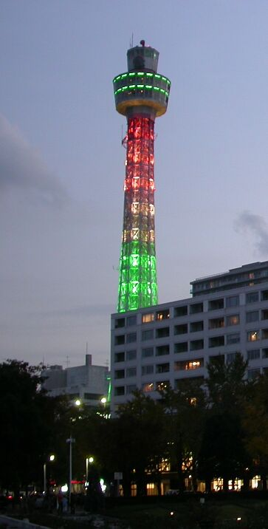

Slide 12
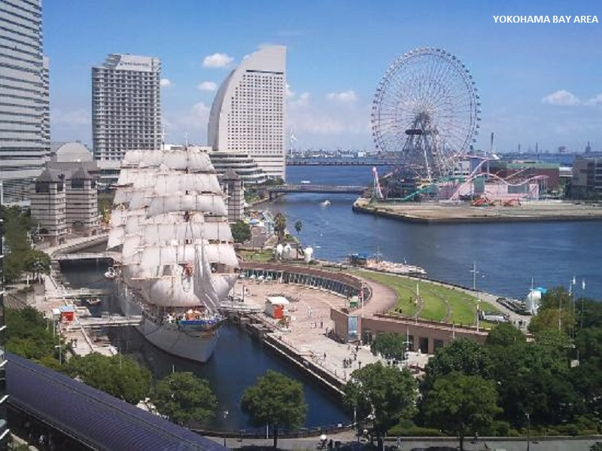

Slide 13
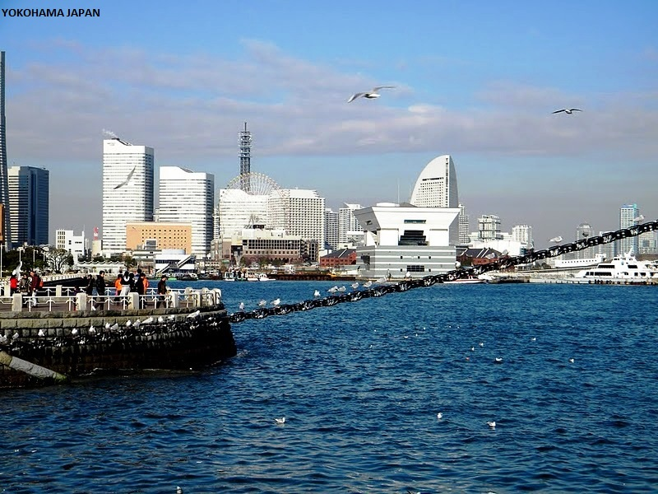

Slide 14
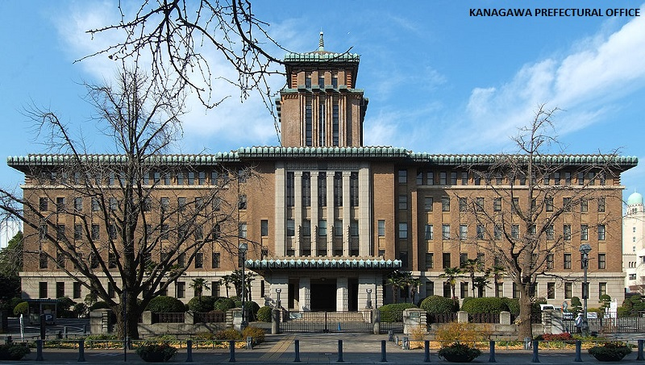

Slide 15
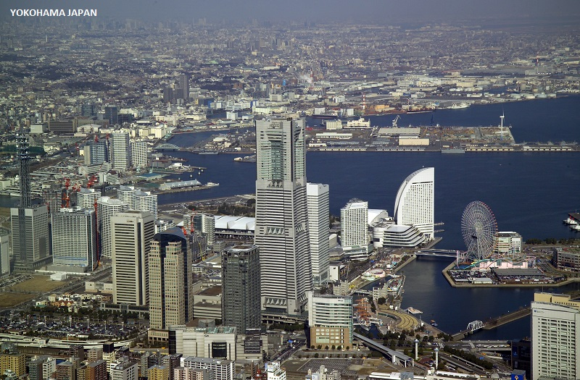

Slide 16
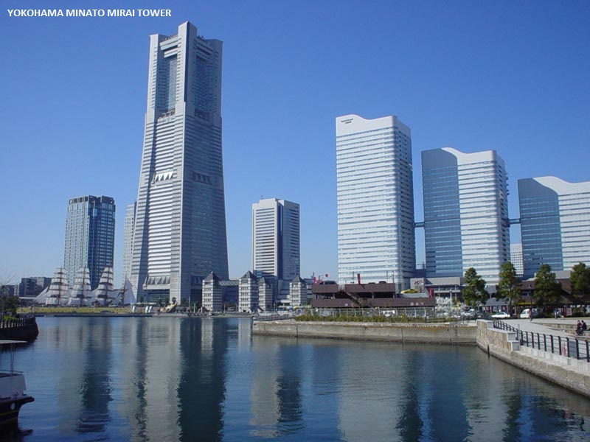

Slide 17
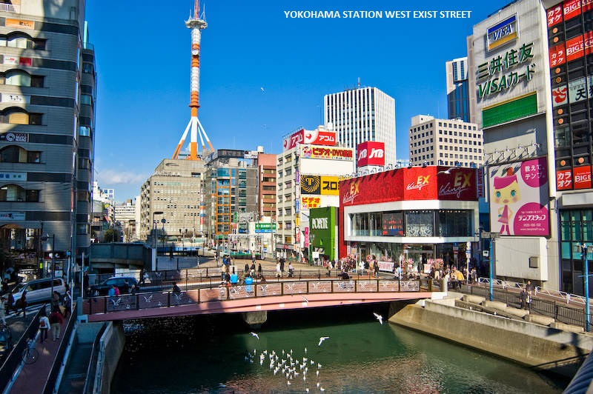

Slide 18
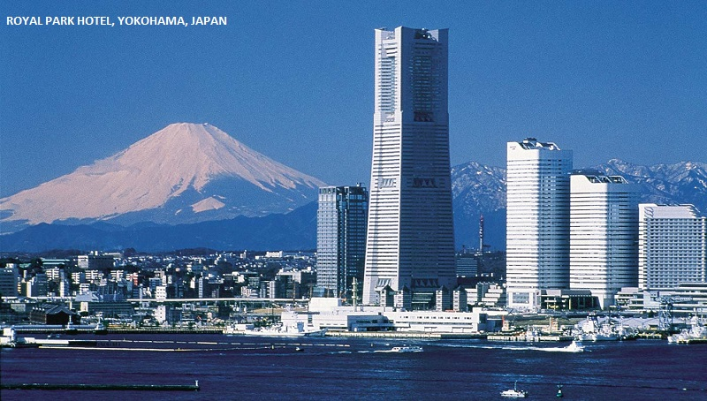

Slide 19
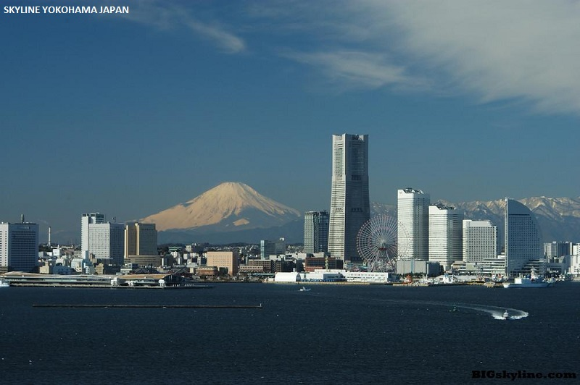

Slide 20
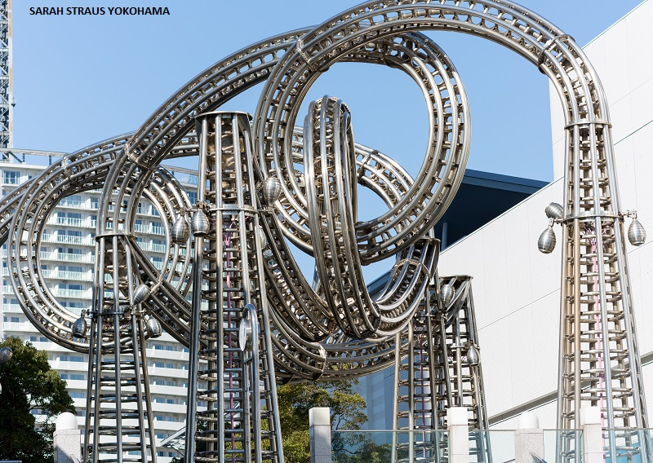

Slide 21
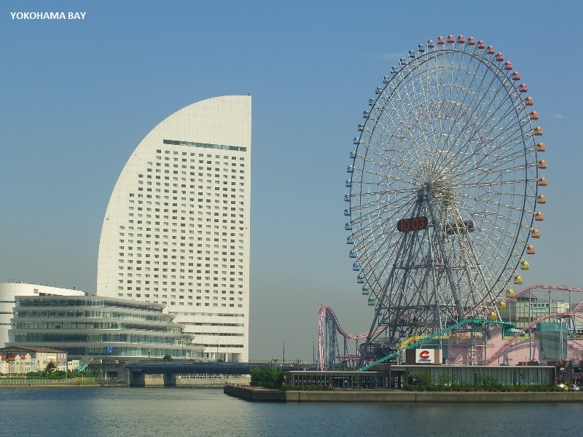

Slide 22
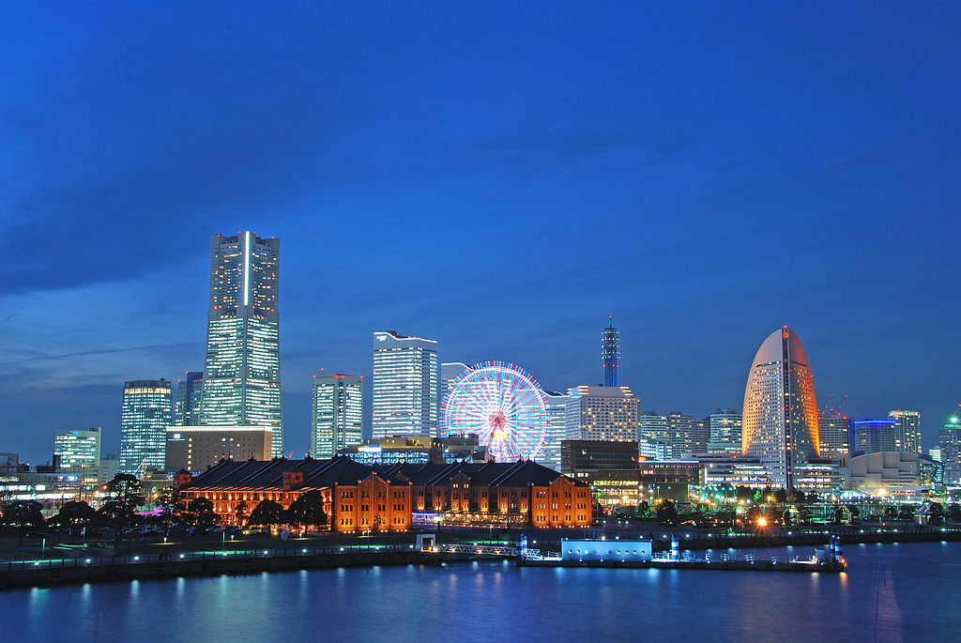

Slide 23
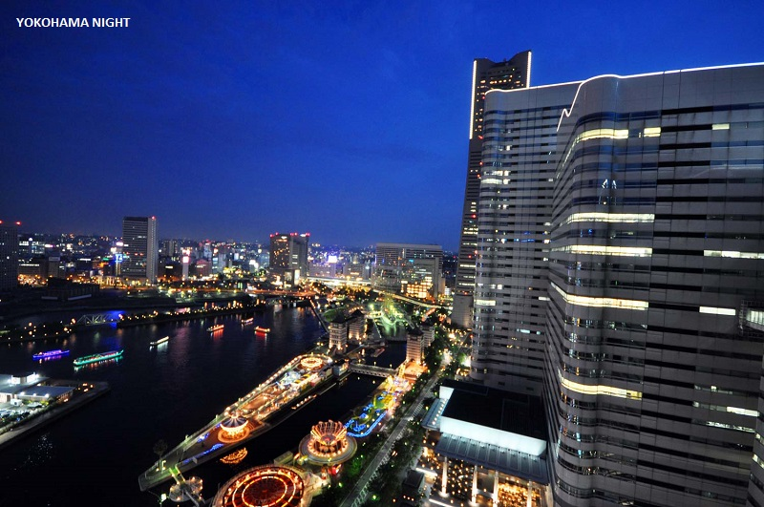

Slide 24
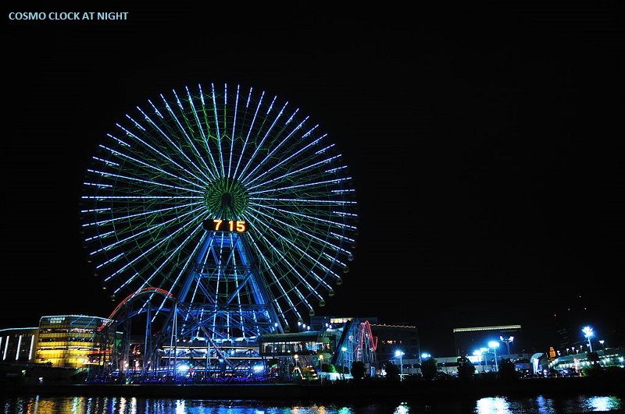

Slide 25
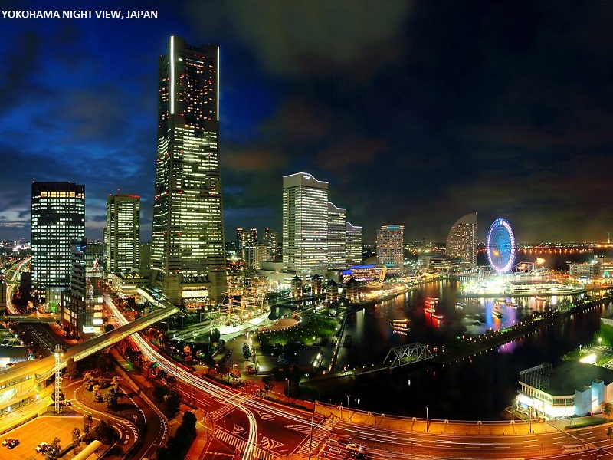

Slide 26
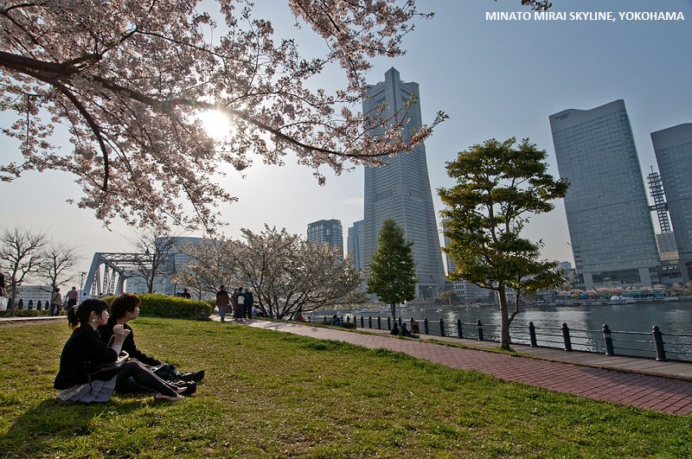

Slide 27
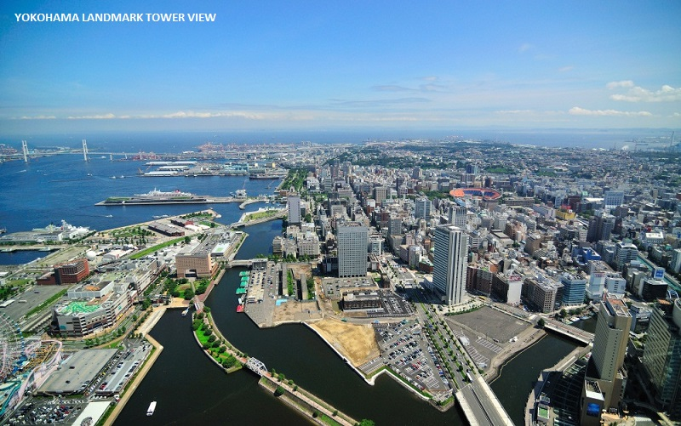

Slide 28
