Slide 1
Villages Around the World
There still are countries where most of the people live in villages.

Slide 2
Definition:
A village is a clustered human settlement or community, larger than a hamlet but smaller than a town, with a population ranging from a few hundred to a few thousand. Though often located in rural areas, the term urban village is also applied to certain urban neighborhoods. Villages are normally permanent, with fixed dwellings; however, transient villages can occur. Further, the dwellings of a village are fairly close to one another, not scattered broadly over the landscape, as a dispersed settlement
Although many patterns of village life have existed, the typical village was small, consisting of perhaps 5 to 30 families. Homes were situated together for sociability and defense, and land surrounding the living quarters was farmed. Traditional fishing villages were based on artisan fishing (Its fishing and processing are respectful of the environment) and located adjacent to fishing grounds

Slide 3
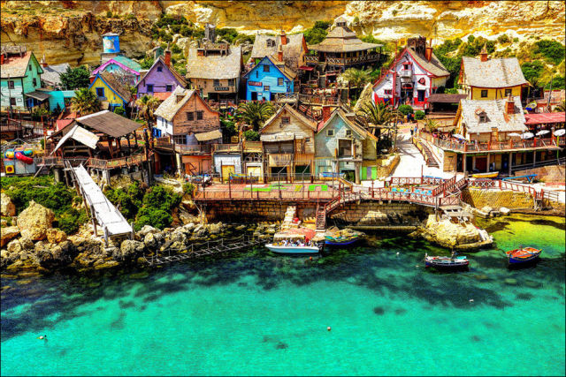
Popeye Village, Malta

Slide 4
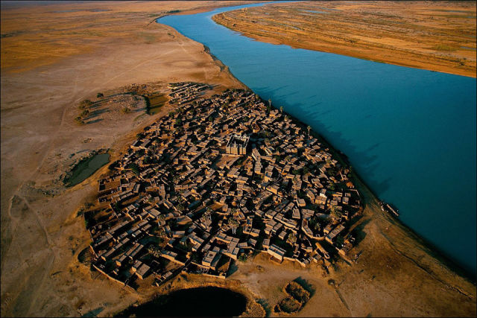
Village on the bank of the Niger River, Mali.

Slide 5
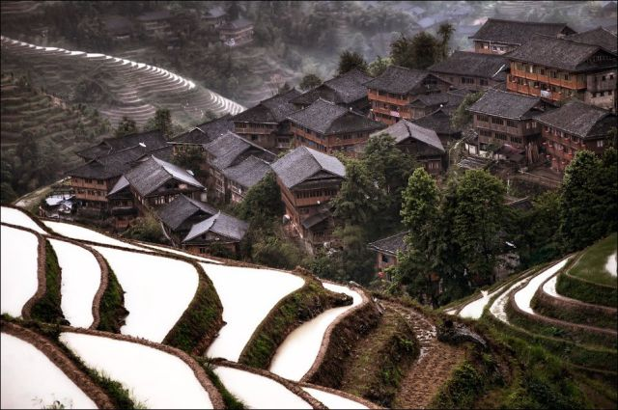
Hidden mountain village in southern China.

Slide 6
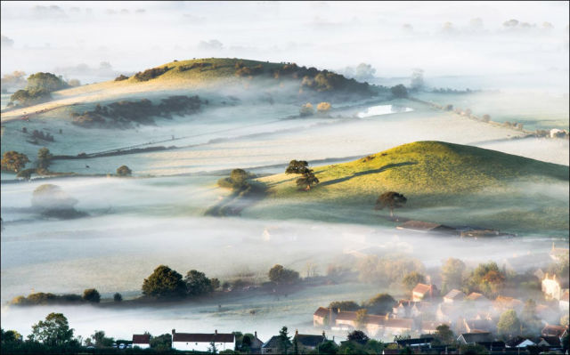
Mist over countryside, England.

Slide 7
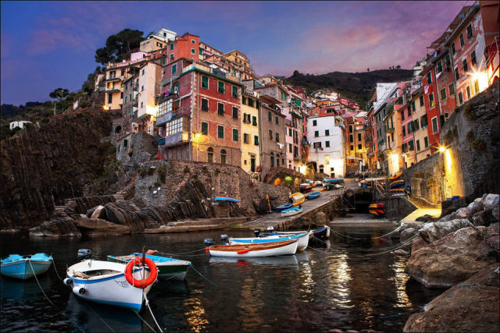
Riomaggiore, Italy.

Slide 8
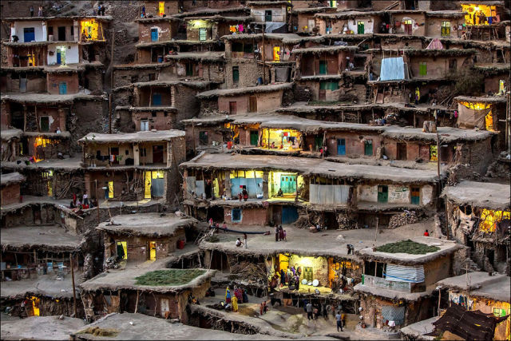
Mountain Village in Iran.

Slide 9
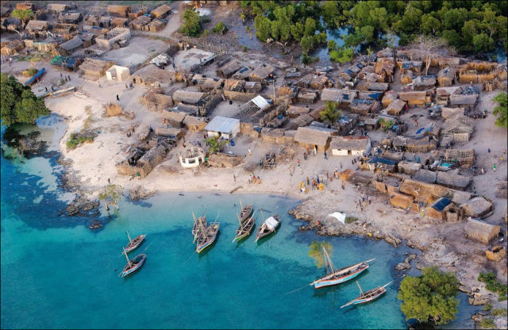
Beautiful African Village.

Slide 10
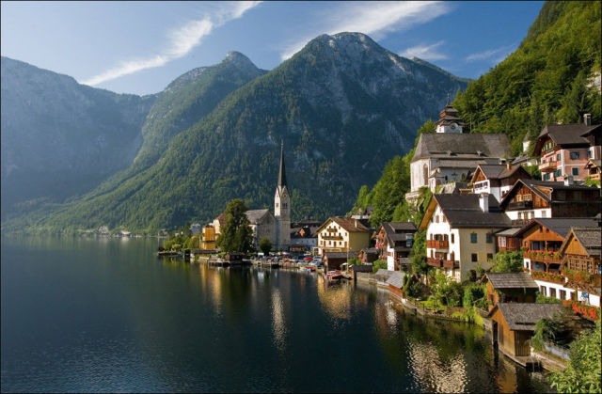
Hallstatt, Austria's Most Beautiful Lake Town.

Slide 11
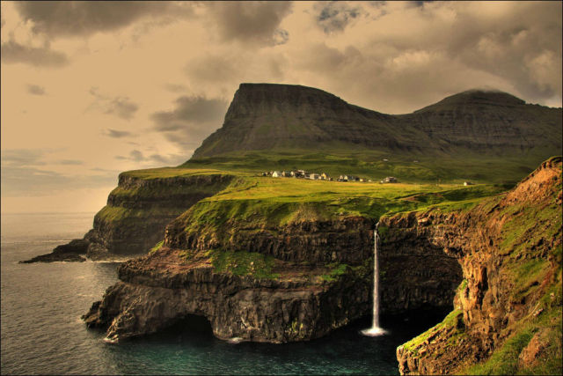
Gásadalur Village, Faroe Islands.

Slide 12
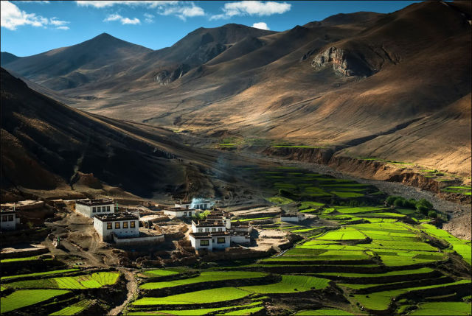
Village in the Himalayas.

Slide 13
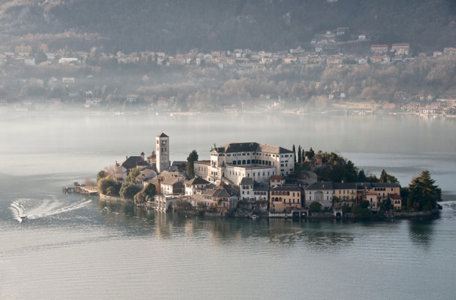
Giulio Island, Italy

Slide 14
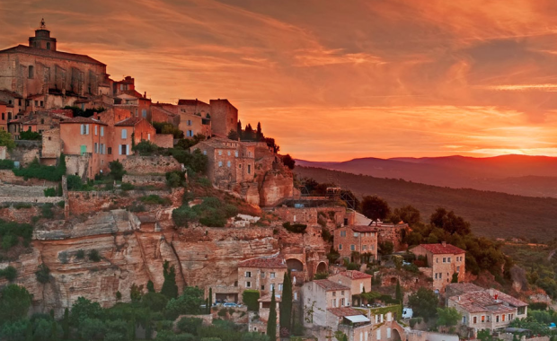
Lovely Gordes Village, Southeastern France

Slide 15
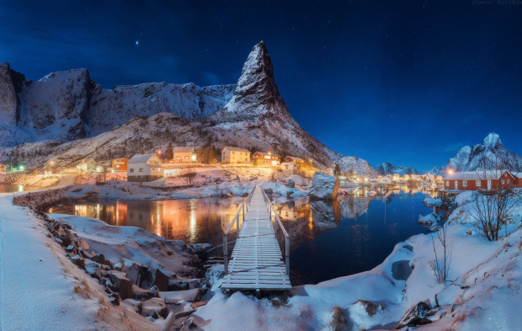
Senja, Norway

Slide 16
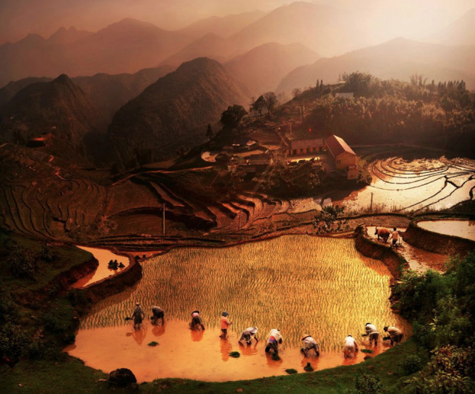
In Vietnam

Slide 17
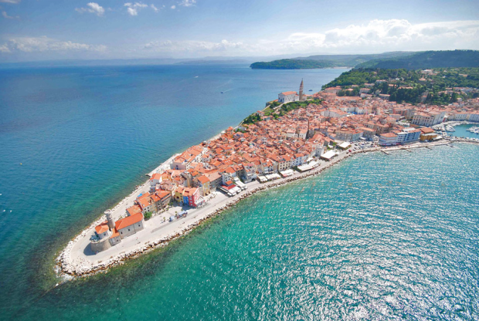
Piran Peninsula, Slovenia.

Slide 18
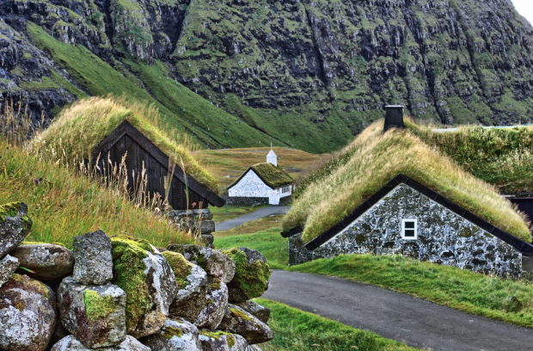
Green roof houses of Faroe Islands

Slide 19
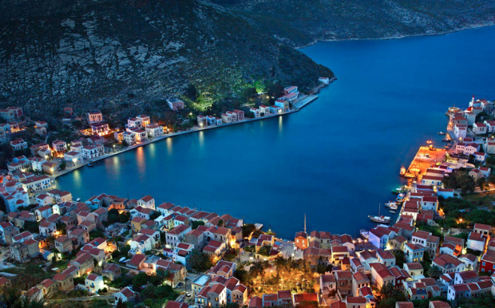
Kastellorizo Island, Greece

Slide 20
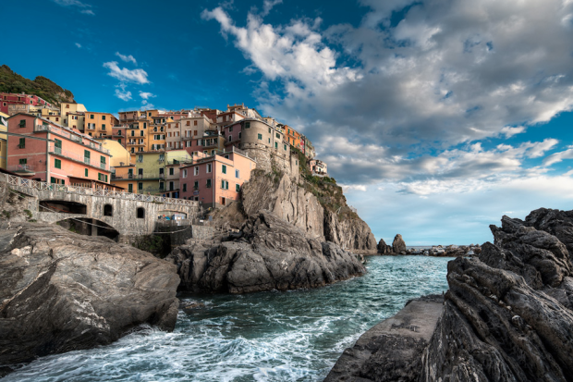
Beautiful Vernazza, Italy

Slide 21
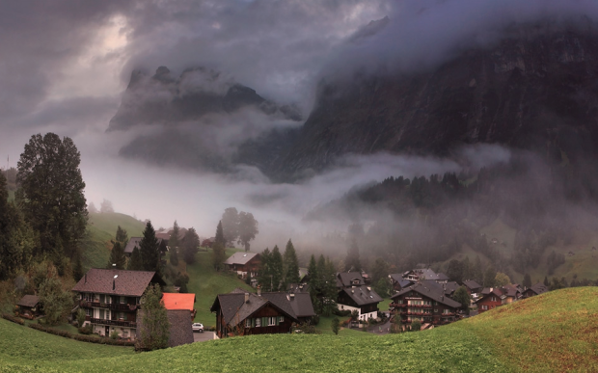
Grindelwald, Switzerland.

Slide 22
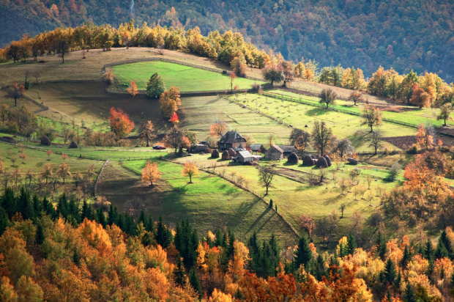
Village Household, Serbia

Slide 23
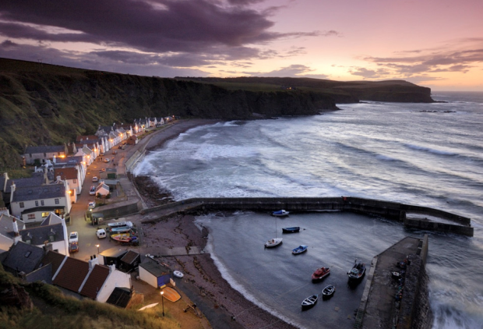
Pennan, Scotland

Slide 24
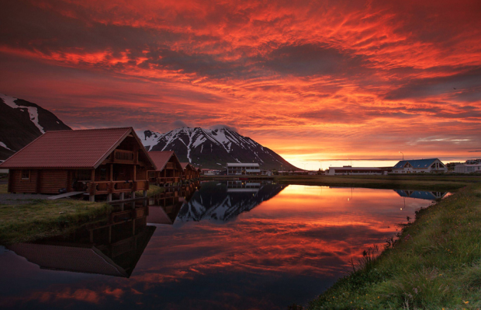
Ólafsfjörður, Iceland

Slide 25
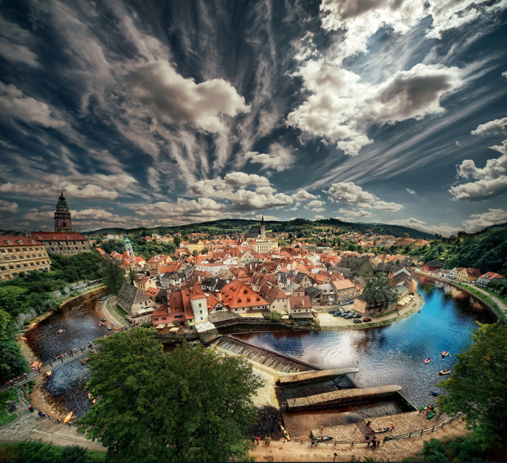
Cesky Krumlov Village, Czech Republic

Slide 26
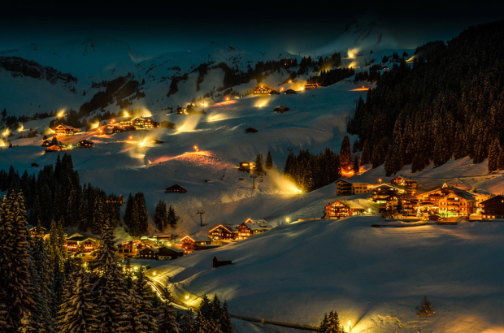
Damüls, Austria

Slide 27
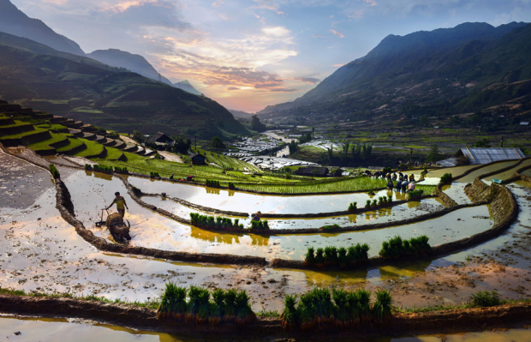
Sapa, Vietnam

Slide 28
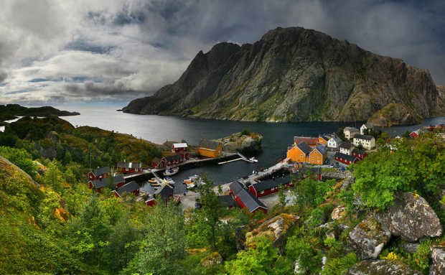
Norway

Slide 29
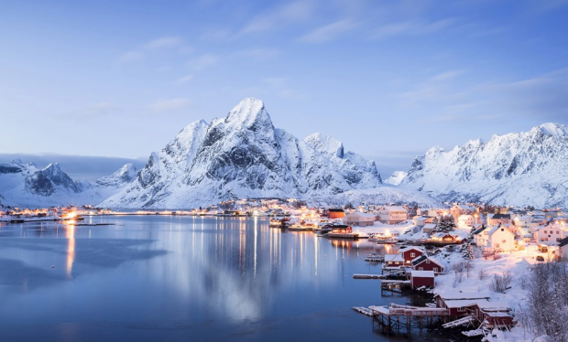
Reine, Norway

Slide 30
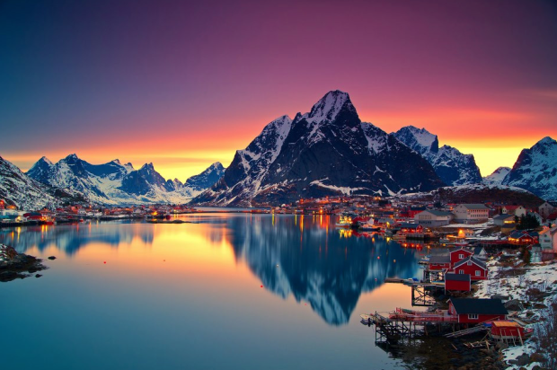
Lofoten, Norway

Slide 31
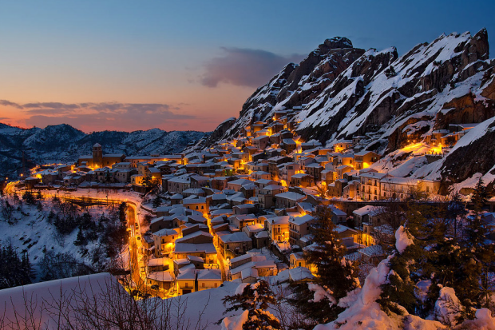
Pietrapertosa Village

Slide 32
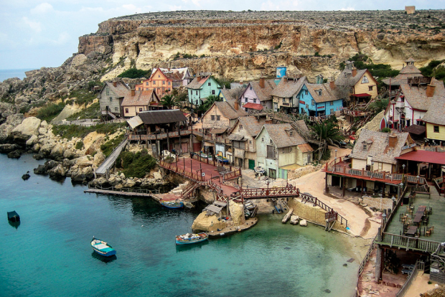
Anchor Bay, Malta

Slide 33
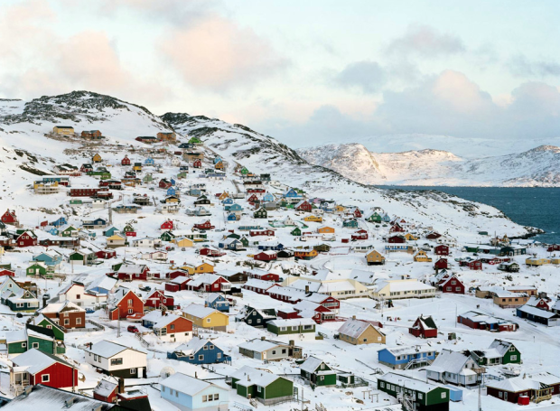
Qaqortoq, Greenland

Slide 34
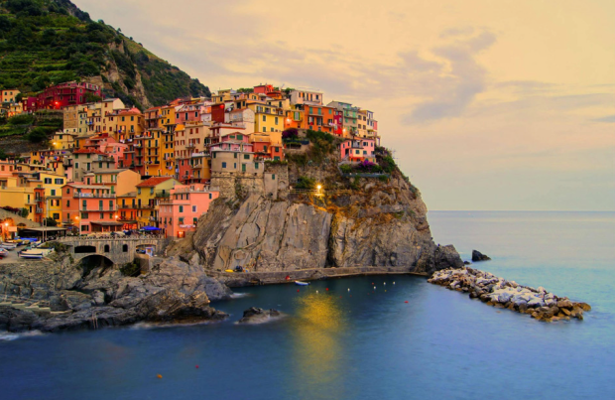
Manarola, Italy

Slide 35
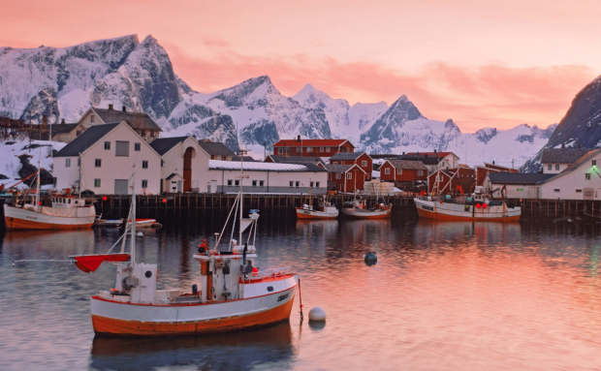
Norway

Slide 36
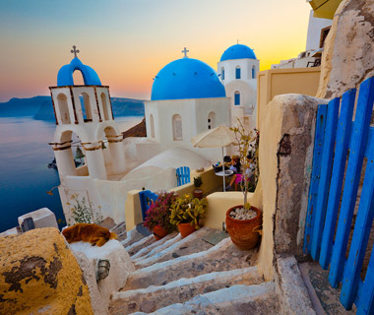
Santorini, Greece

Slide 37
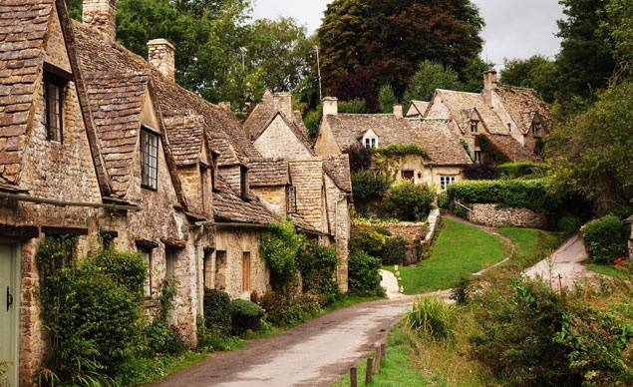
Arlington Road in Bilbury, England

Slide 38
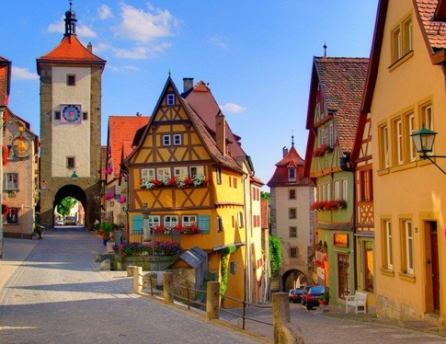
Rotenburg, Germany

Slide 39
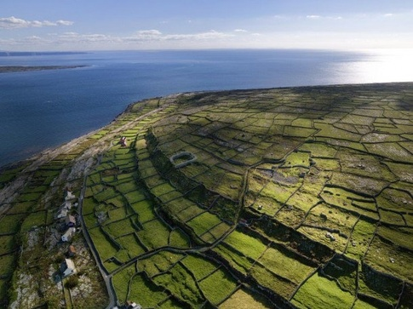
Aran Islands, Ireland

Slide 40
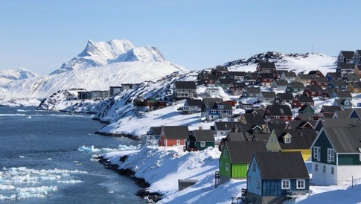
Nuuk, Greenland

Slide 41
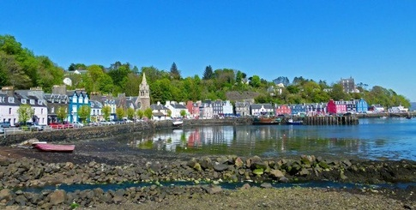
Tobermory, Isle of Mull (Scotland)

Slide 42
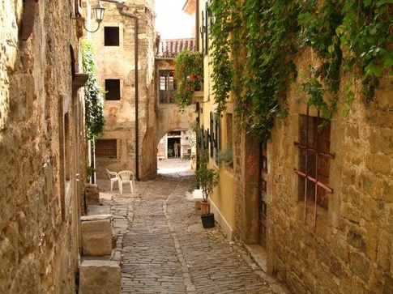
Groznjan, Croatia

Slide 43
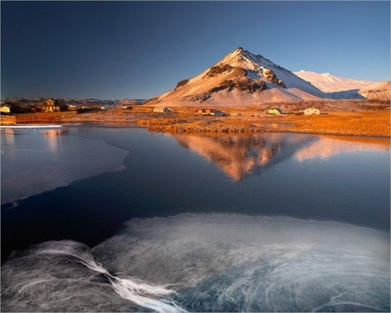
Russian Village

Slide 44
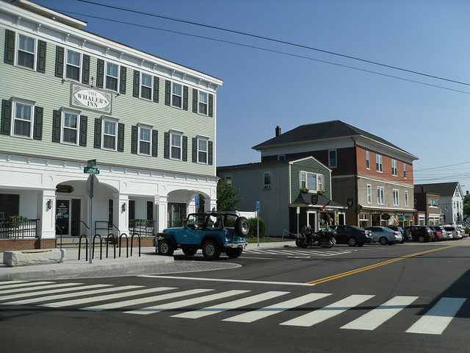
Mystic, Connecticut

Slide 45
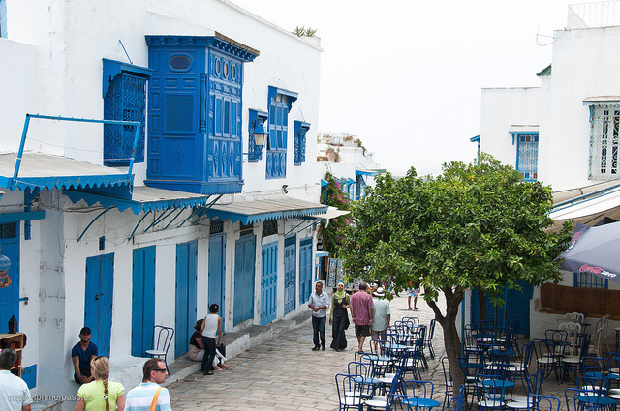
Sidi Bou Said Tunisia

Slide 46
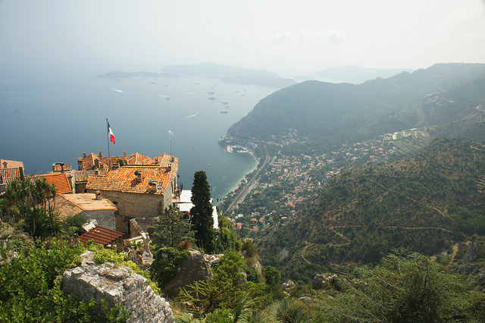
Eze France

Slide 47
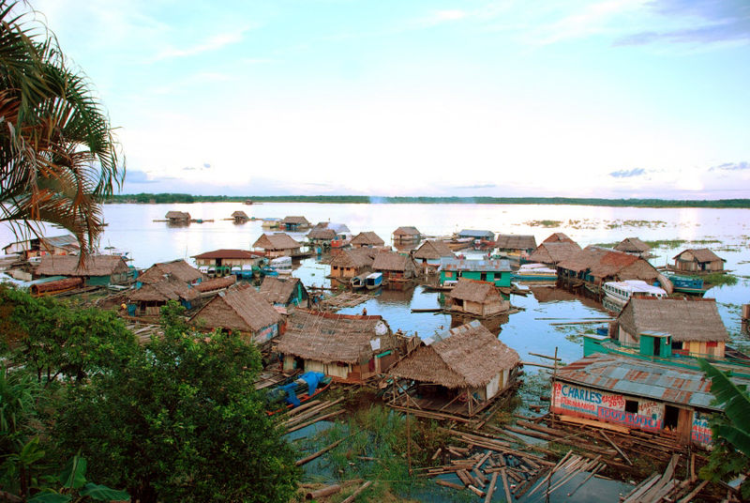
Amazon Floating Village

Slide 48
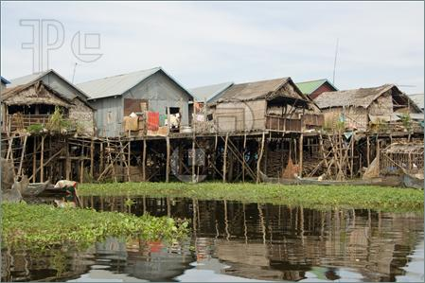
loating village on Tonle Sap, Cambodia

Slide 49
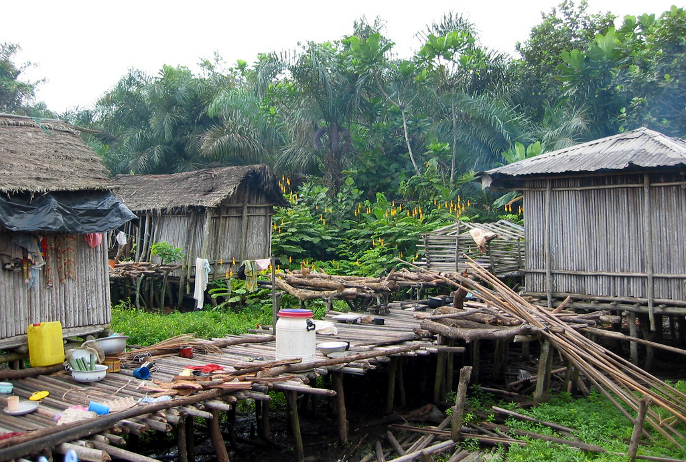
Nzulezo Floating Village, Ghana

Slide 50
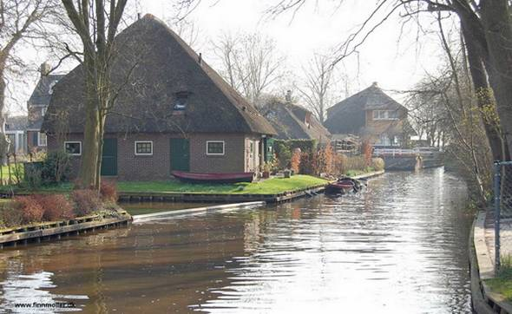
Giethoorn, Netherlands

Slide 51
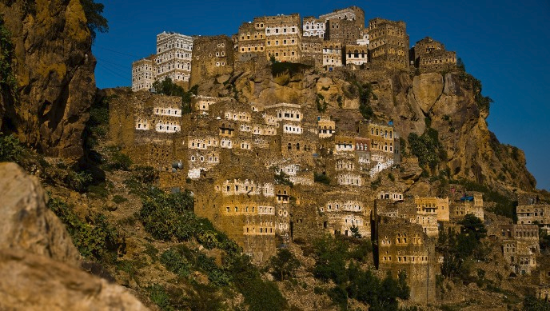
Al Hajjarah, Yemen.

Slide 52
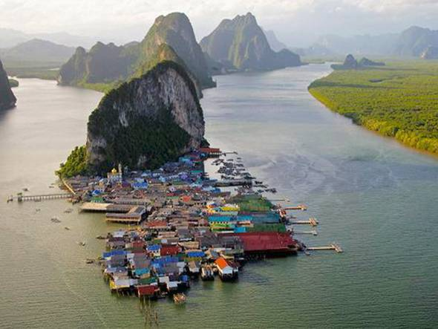
Ko Panyi is a fishing village in Thailand

Slide 53

Anuak Tribe Village

Slide 54

Village of Namche Bazaar in Nepal

Slide 55

Alberobello, Italy

Slide 56

Shirakawa, Japan

Slide 57

Monsanto, Portugal

Slide 58

A Nuba village in the Nuba Mountains.

Slide 59

Gimignano, Italy

Slide 60

Hollókő, Nógrád, Hungary

Slide 61

An alpine village in the Lötschental Valley, Switzerland

Slide 62

Berber village in Ourika valley, High Atlas, Morocco

Slide 63

A North Indian village in Rajasthan, India

Slide 64

A typical rural village in Hainan, China

Slide 65

The nagari of Pariangan, West Sumatra.

Slide 66

Lug, village in northern Serbia

Slide 67

Kovachevitsa, a village in southern Bulgaria

Slide 68

Nook of a village near Lake Baikal, Siberia

Slide 69

Mayaky Village, Donetsk, Ukraine

Slide 70

The village of Rougon in Provence

Slide 71

A village in Kaita, Nigeria

