Slide 1
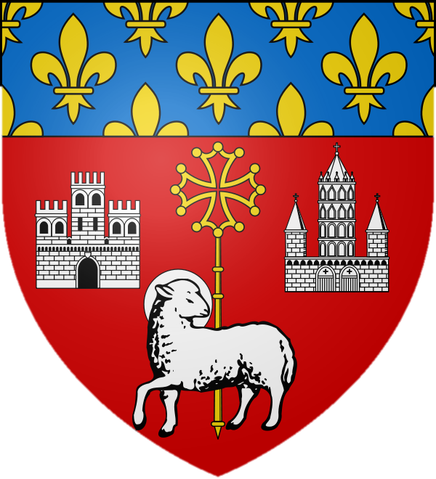
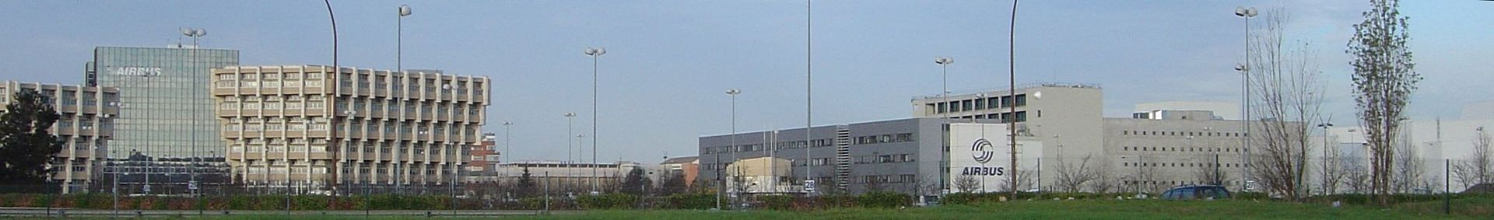
Toulouse, France

Slide 2
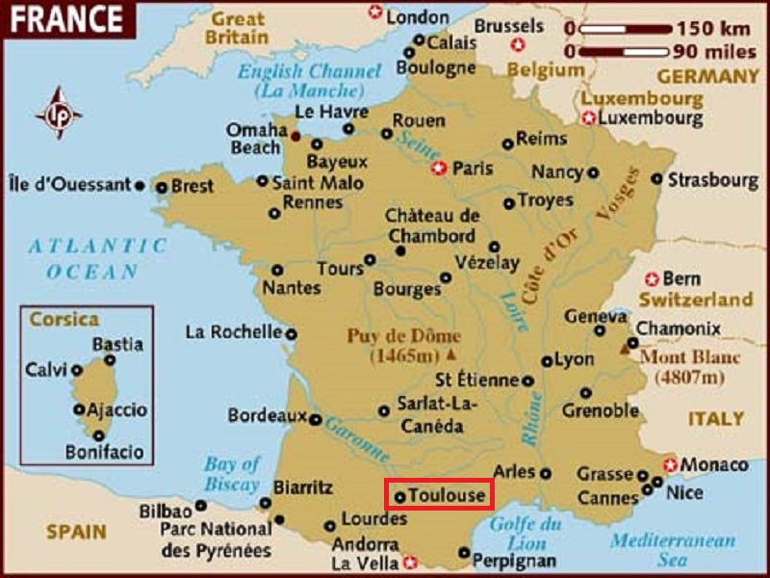
Toulouse is the capital city of the southwestern French department of Haute-Garonne as well as of the Occitanie region.

Slide 3
Toulouse is the centre of the European aerospace industry, with the headquarters of Airbus, the Galileo positioning system, the SPOT satellite system, the Airbus Group (former EADS), ATR and the Aerospace Valley.
The city also hosts the European headquarters of Intel and CNES's Toulouse Space Centre (CST), the largest space centre in Europe.[5] Thales Alenia Space, and Astrium Satellites, Airbus Group's satellite system subsidiary, also have a significant presence in Toulouse. Its world-renowned university is one of the oldest in Europe (founded in 1229) and, with more than 103,000 students, is the fourth-largest university campus of France after Paris, Lyon and Lille.
A city with unique architecture made of pinkish terracotta bricks, which earned it the nickname la Ville Rose ("the Pink City"), Toulouse counts two UNESCO World Heritage Sites, the Canal du Midi (designated in 1996 and shared with other cities), and the Basilica of St. Sernin, the largest remaining Romanesque building in Europe,^{[11]} designated in 1998 because of its significance to the Santiago de Compostela pilgrimage route.

Slide 4
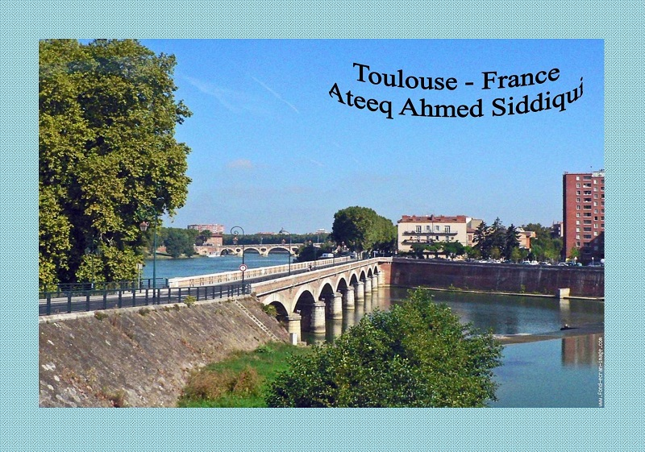

Slide 5
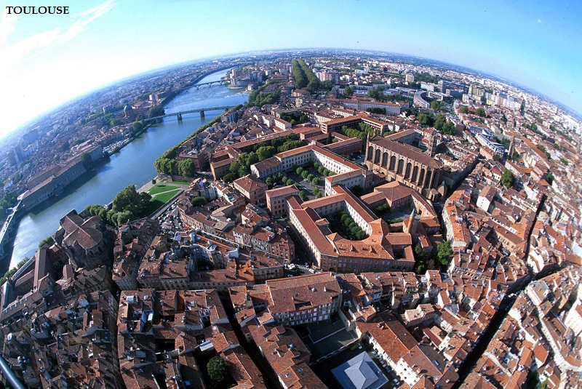

Slide 6
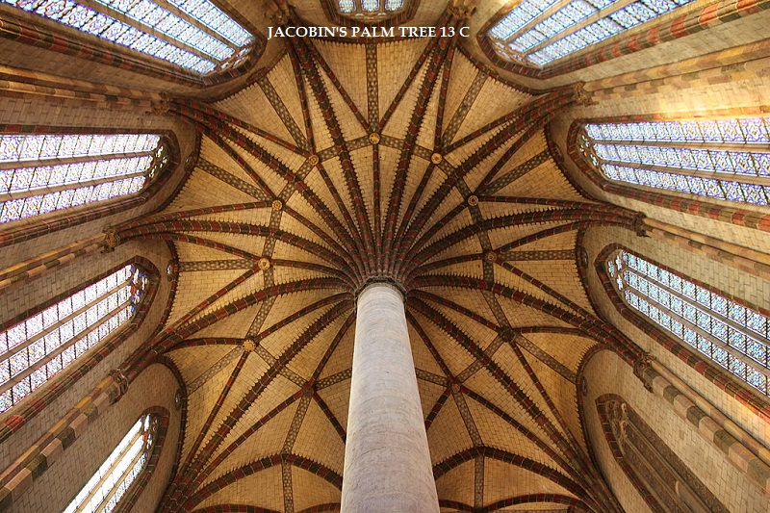

Slide 7
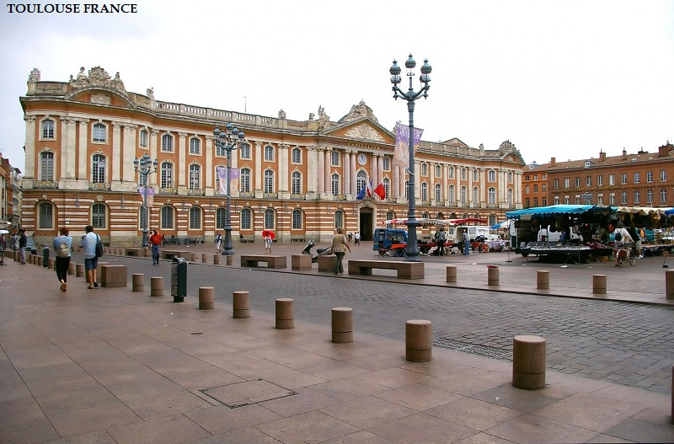

Slide 8
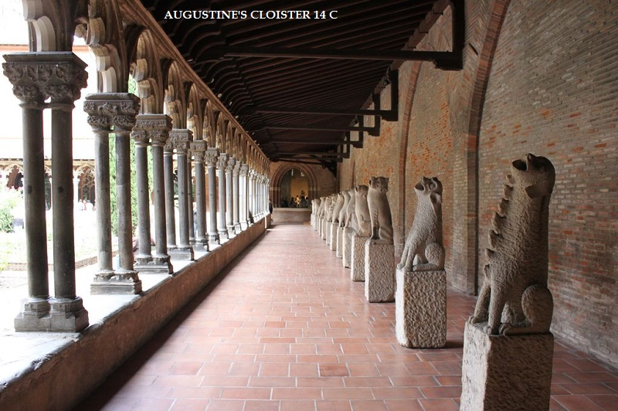

Slide 9
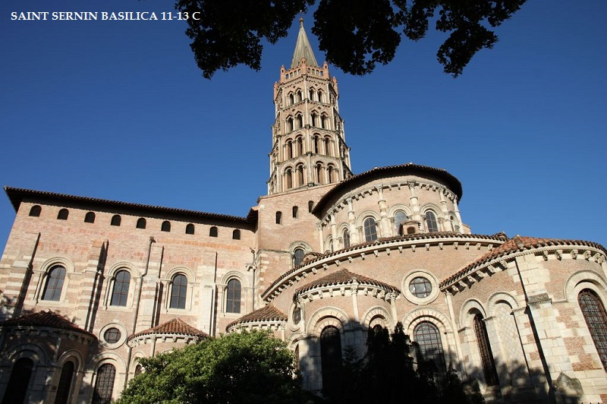

Slide 10
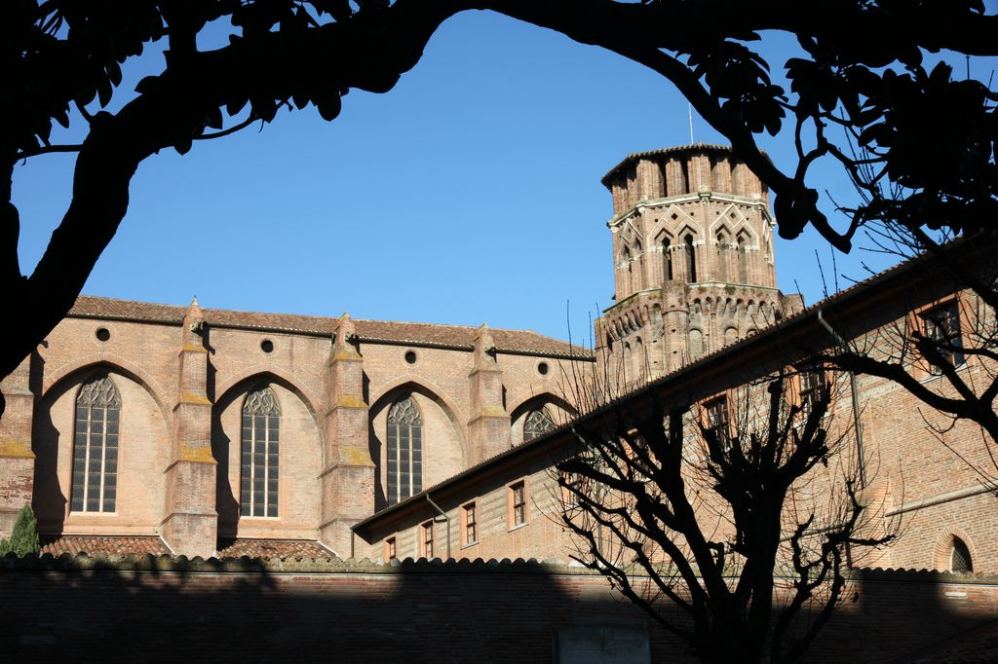
Augustine's convent (14th c.)

Slide 11
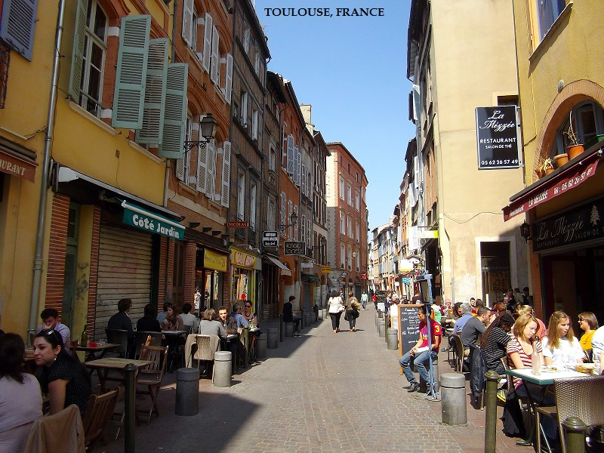

Slide 12
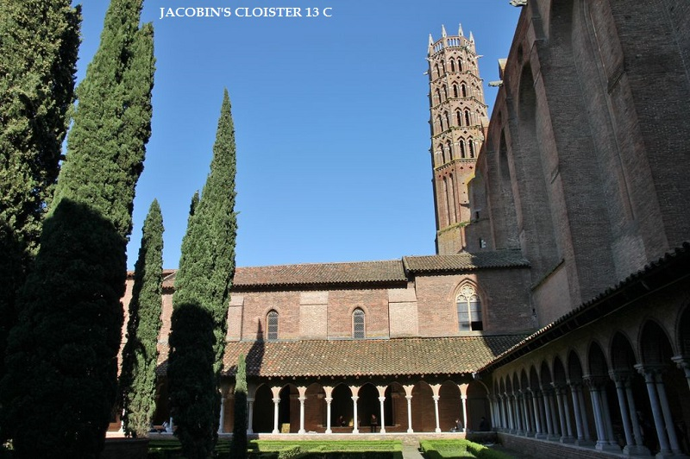

Slide 13
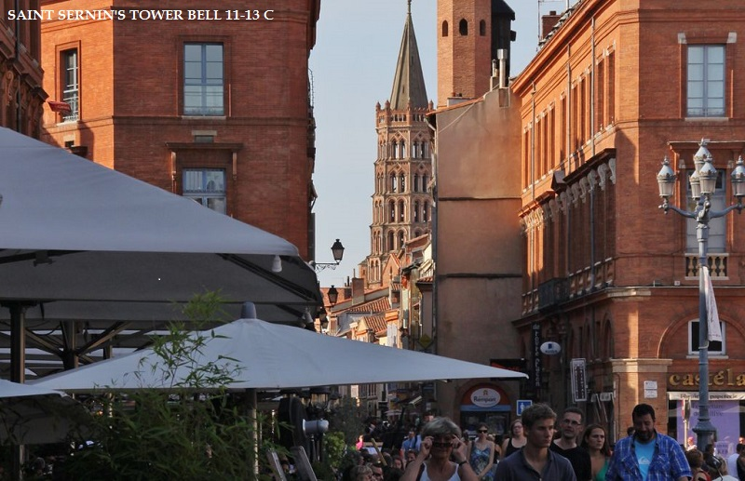

Slide 14
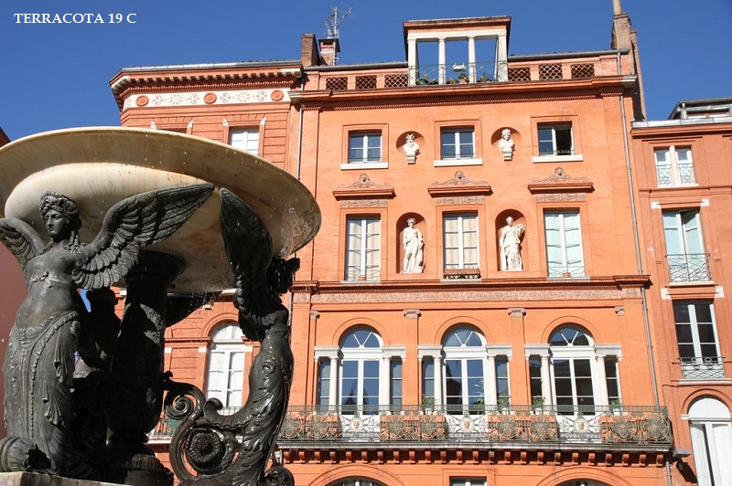

Slide 15
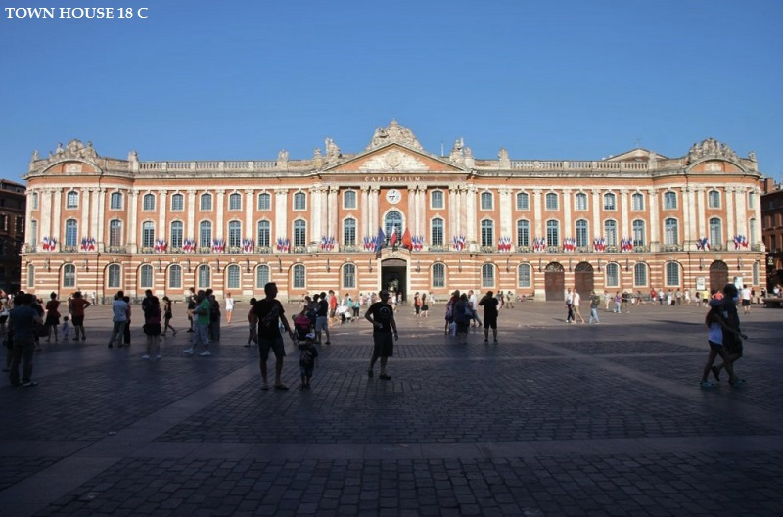

Slide 16
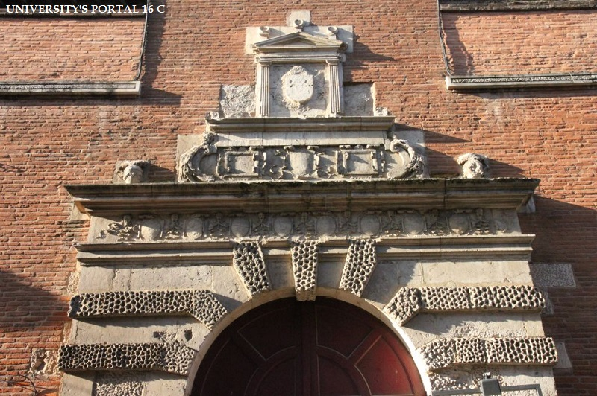

Slide 17
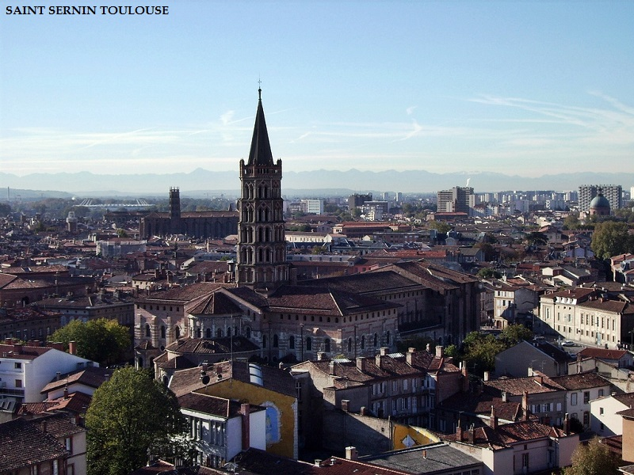

Slide 18
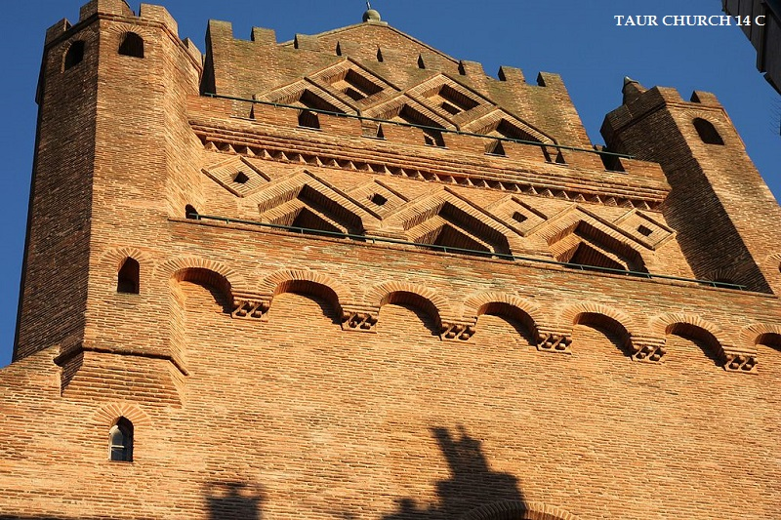

Slide 19
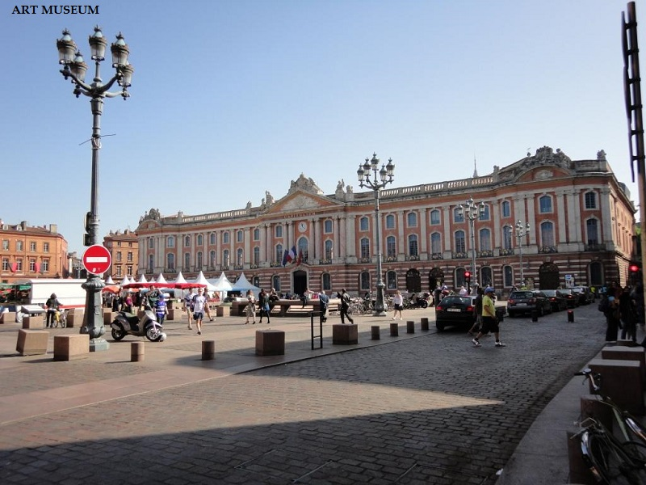

Slide 20
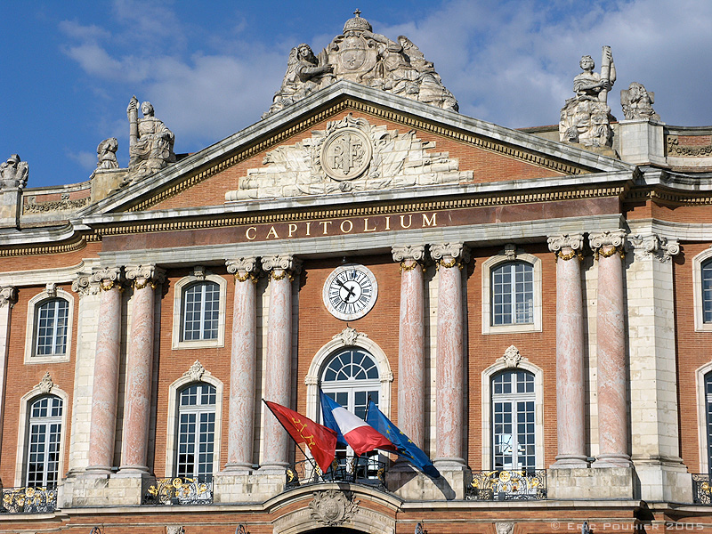
The Capitole de Toulouse is an example of the 18th-century architectural projects in the city.

Slide 21
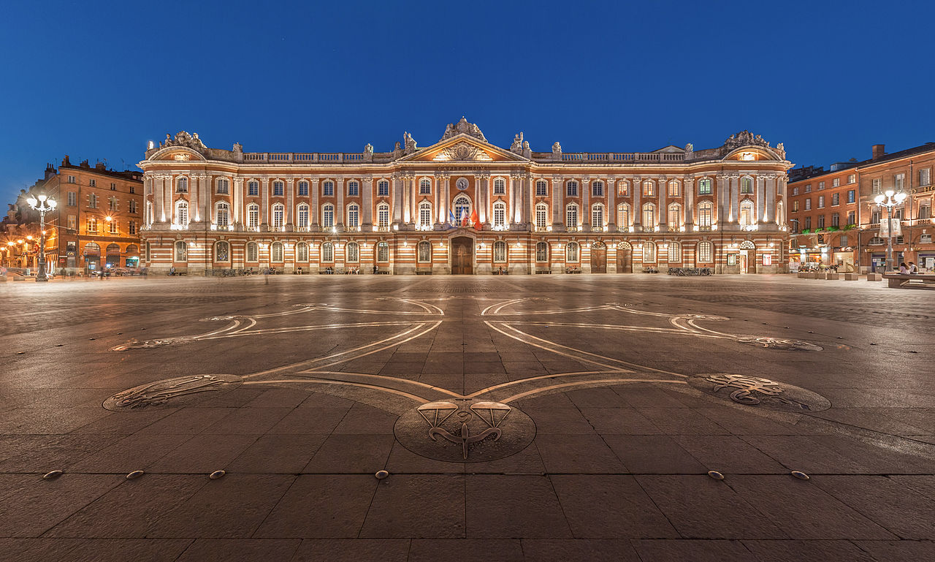
The Capitole of Toulouse, and the square of the same name with the Occitan cross designed by Raymond Moretti on the ground

Slide 22
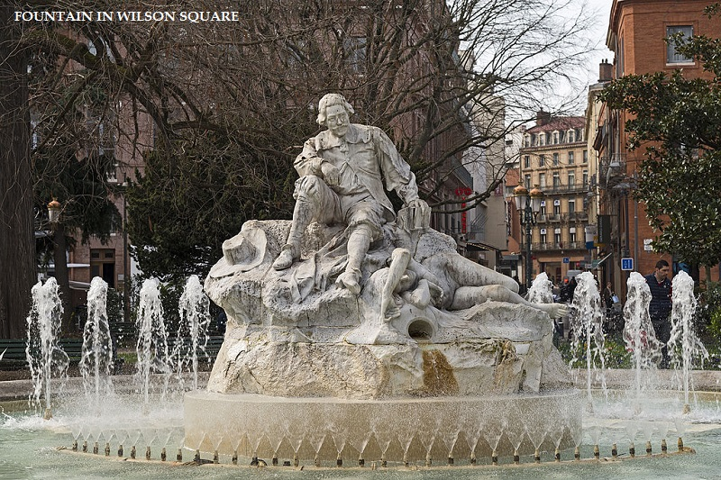

Slide 23
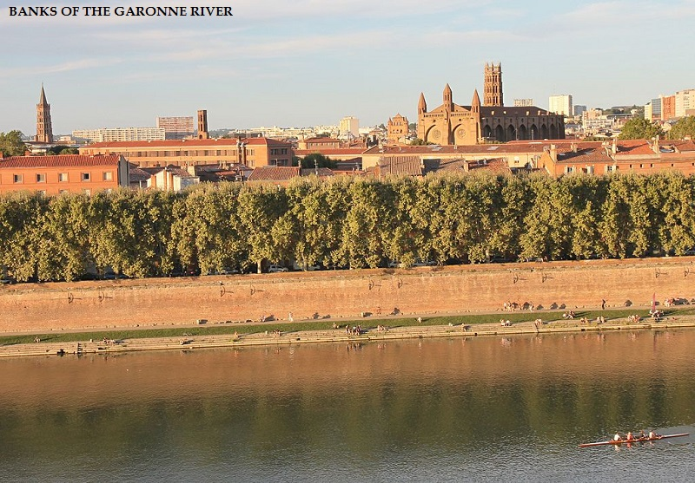

Slide 24
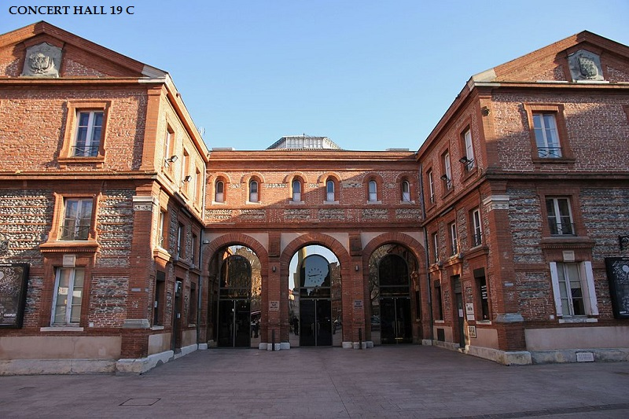

Slide 25
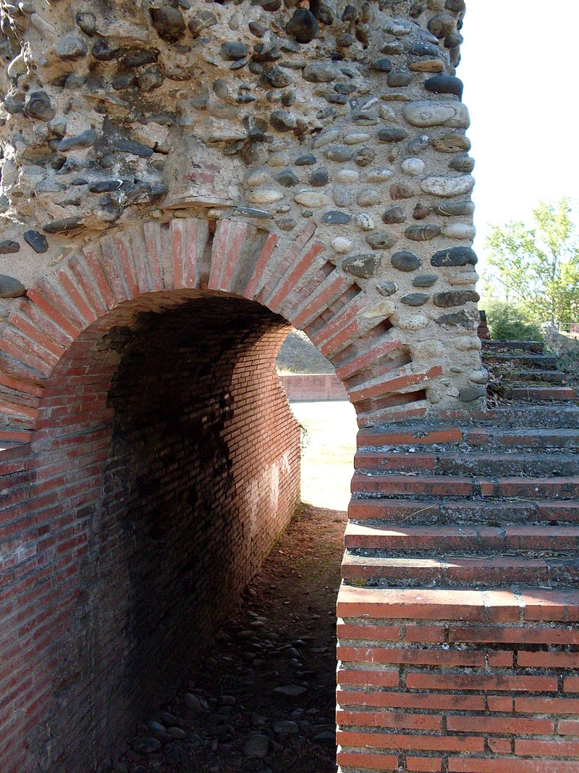
Vomitorium at the Roman amphitheatre in Toulouse

Slide 26
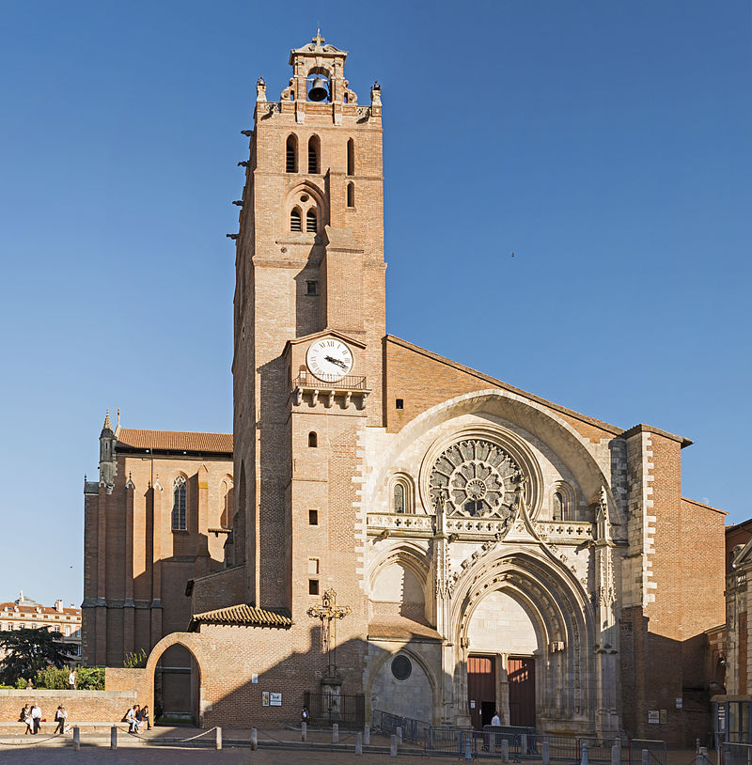
Toulouse Cathedral

Slide 27
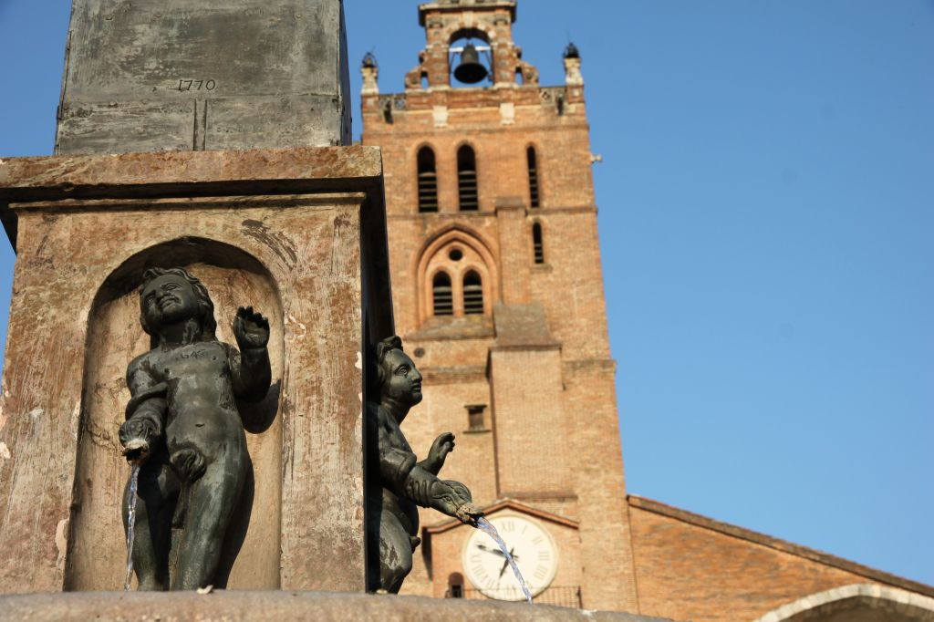
Saint Etienne cathedral

Slide 28
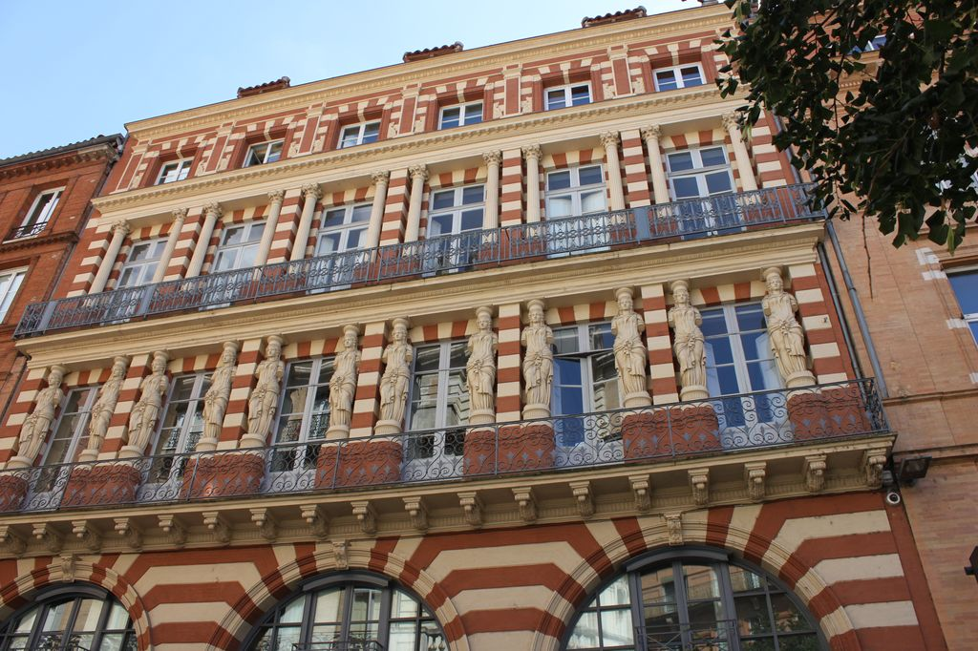
Virebent terracotta façade

Slide 29
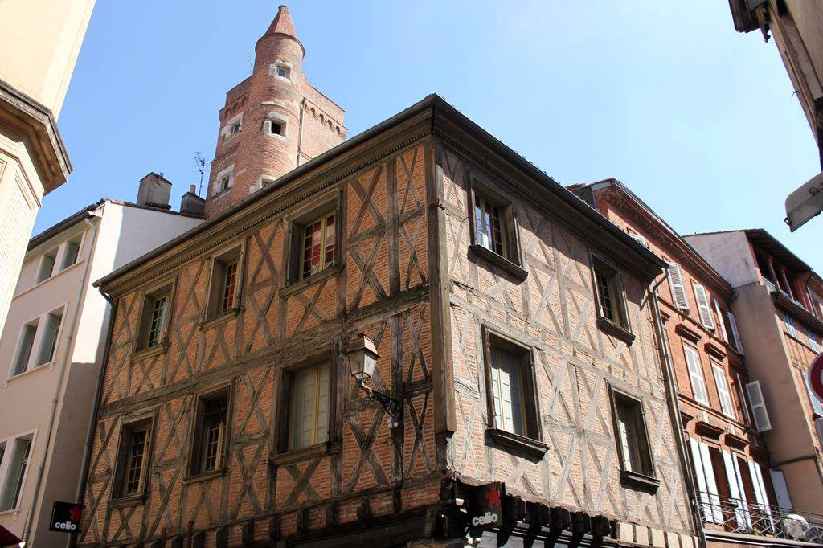
Serta's tower

Slide 30
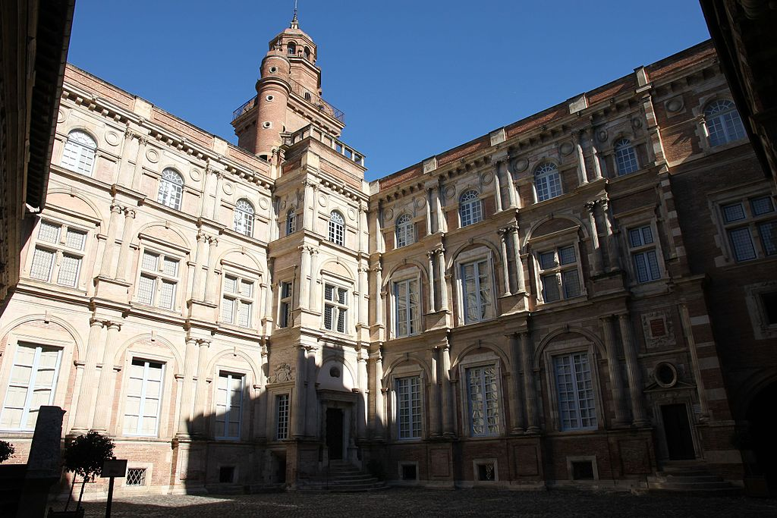
Hôtel d'Assézat

Slide 31
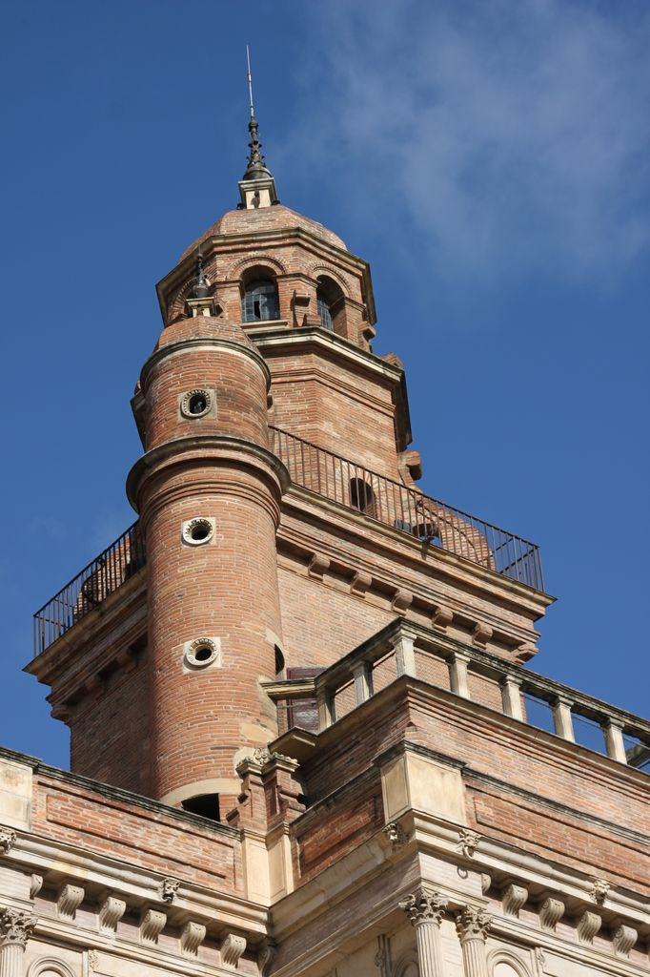
Assézat's tower

Slide 32
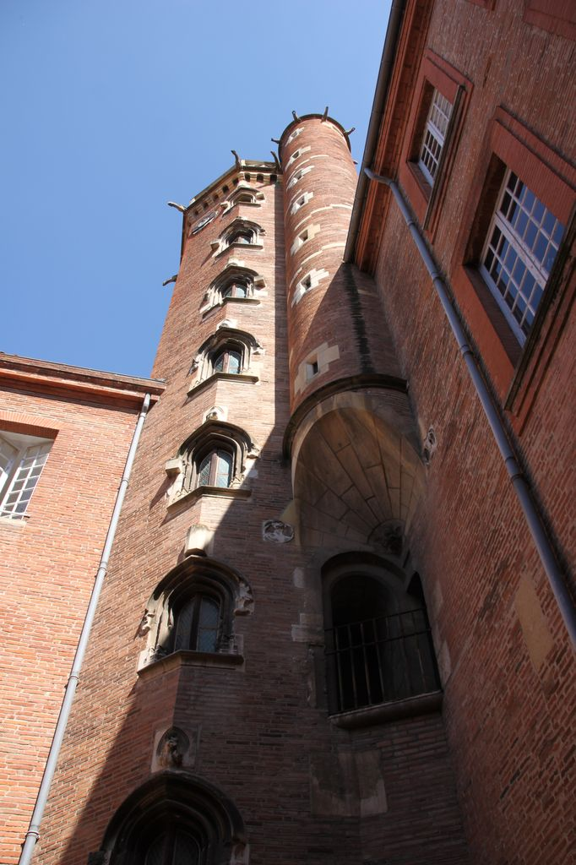
Hôtel de Bernuy (16th c.)

Slide 33
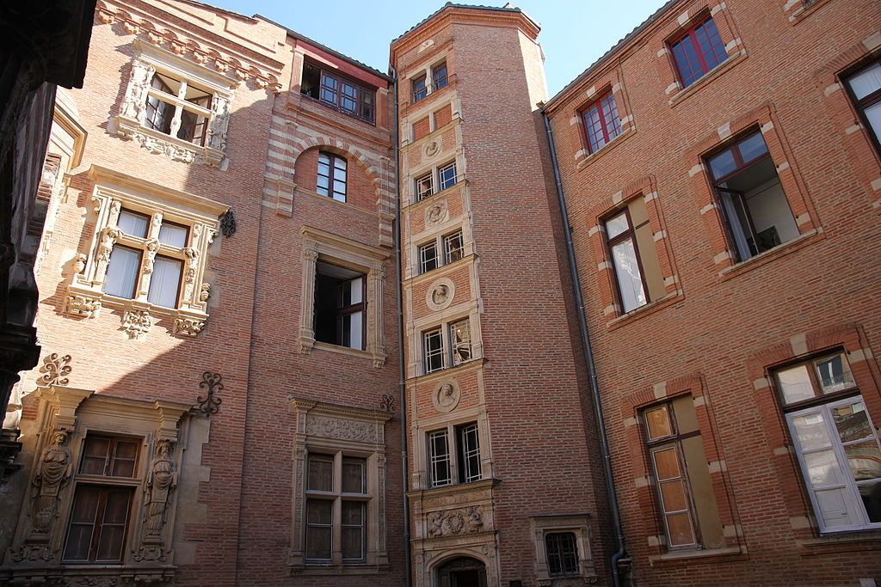
Hôtel du Vieux Raisin

Slide 34
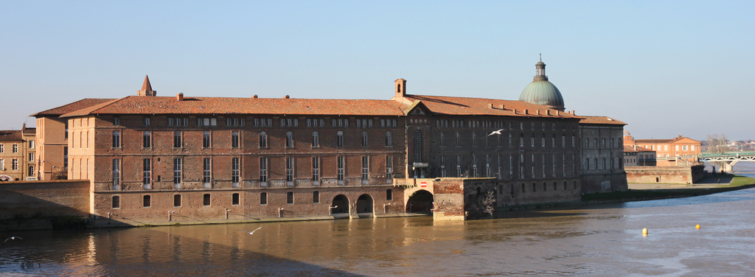
Hôtel-Dieu (12-19th c.)

Slide 35
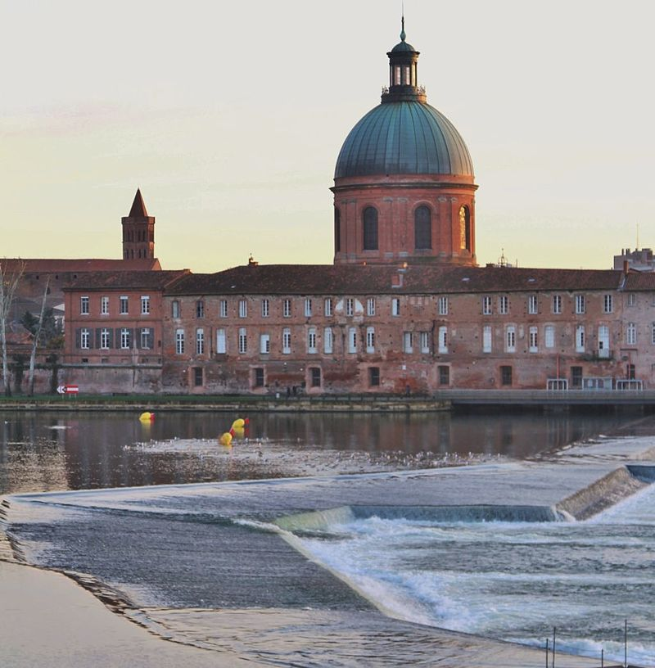
La Grave (12-18th c.)

Slide 36
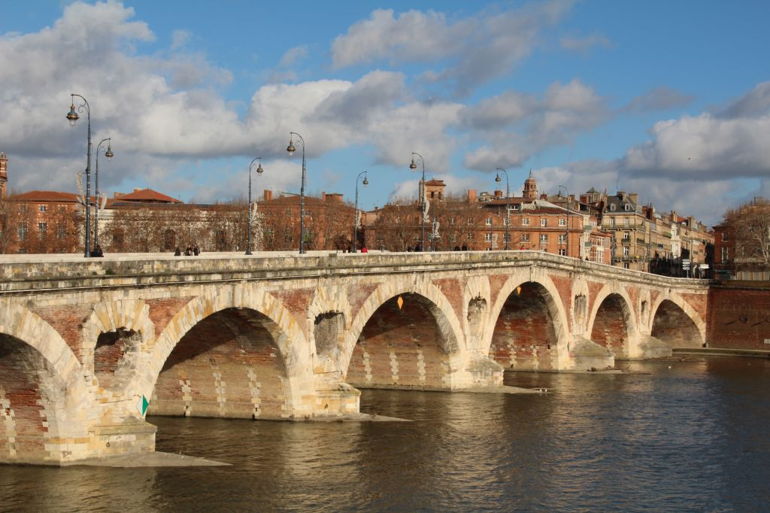
Pont neuf (16-17th c.)

Slide 37
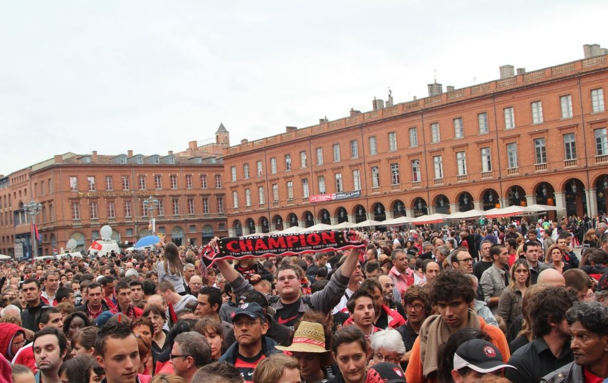
Capitol square (19th c.)

Slide 38
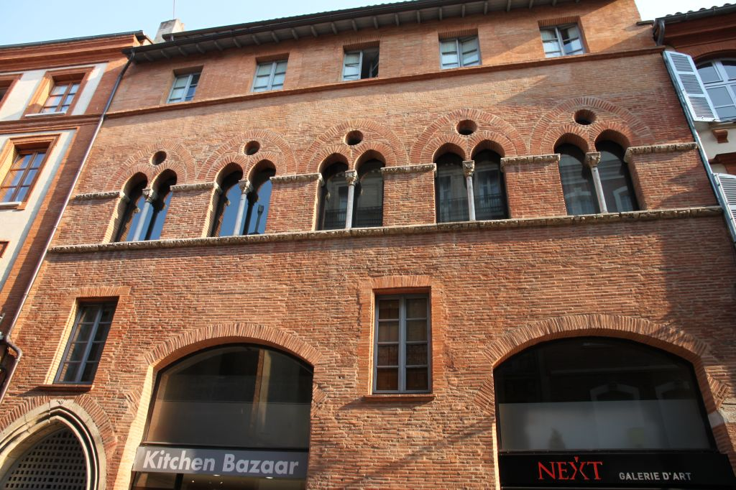
13th century's house

Slide 39
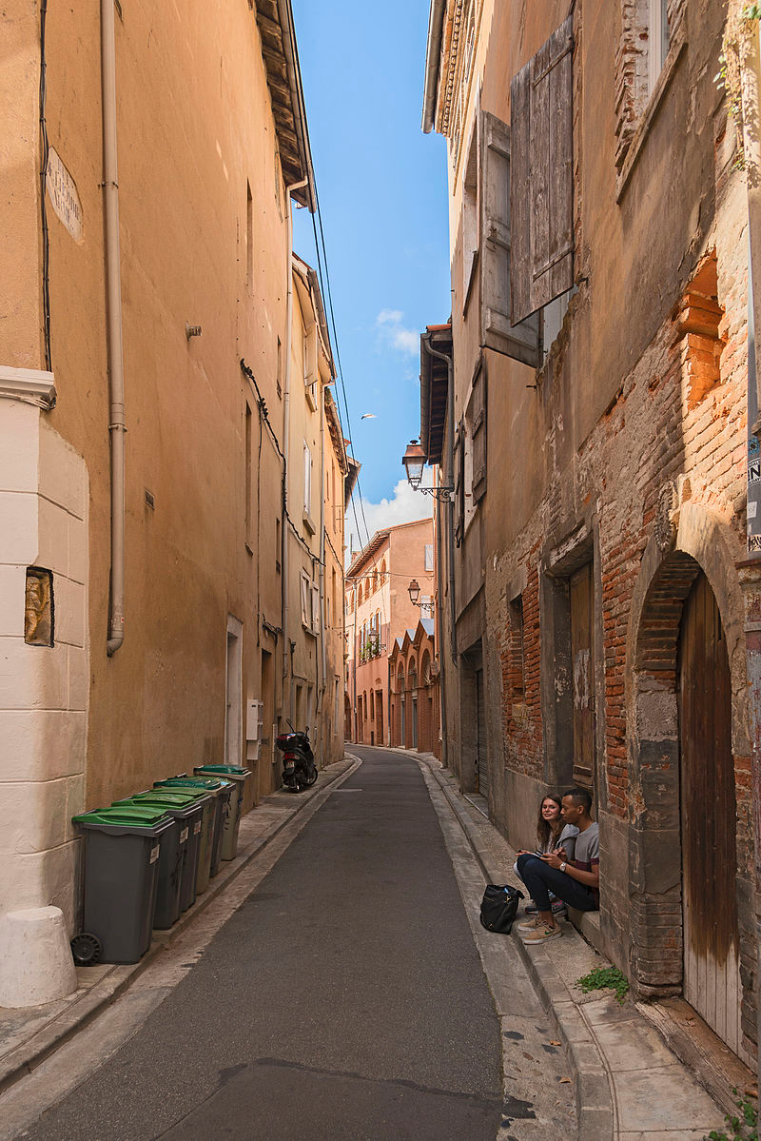
A typical "Pink City" street

Slide 40
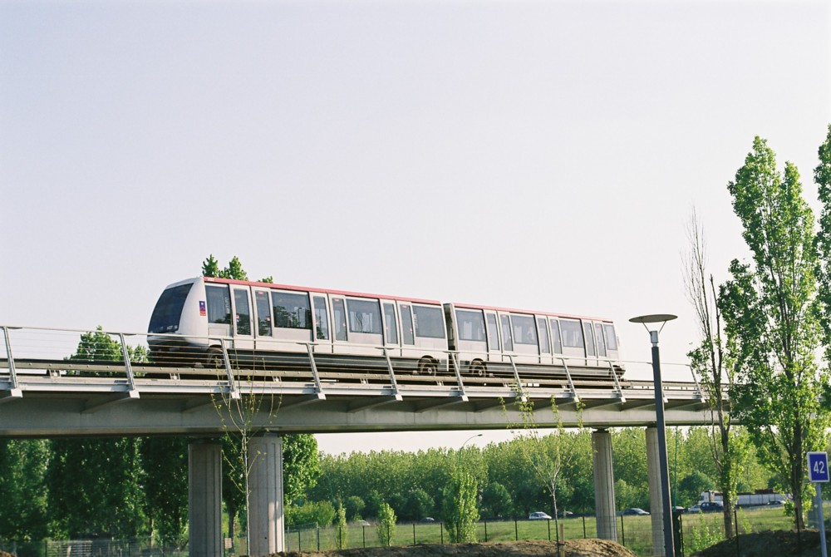
Toulouse Metro.

