Slide 1
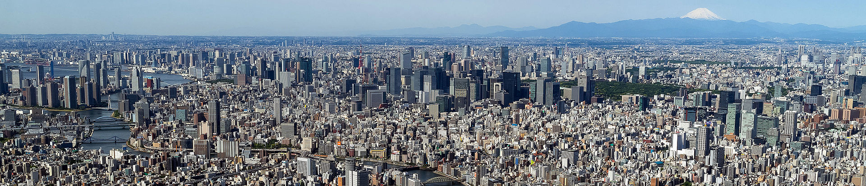
Tokyo, Japan

Slide 2
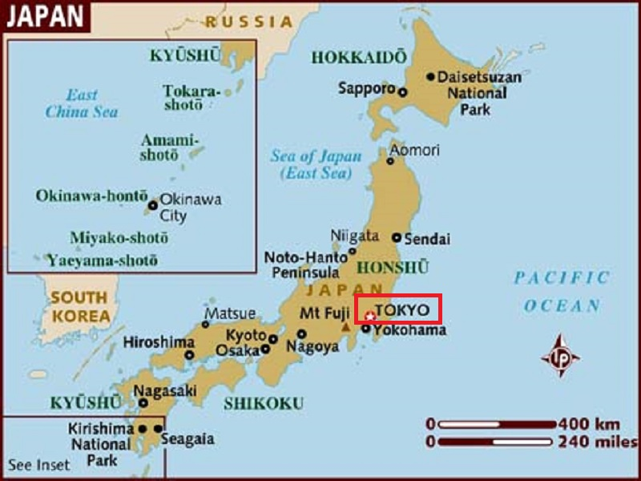
Tokyo, officially Tokyo Metropolis is the capital of Japan. The Greater. Tokyo Area is the most populous metropolitan area in the world.

Slide 3
Tokyo is often referred to as a city, but is officially known and governed as a "metropolitan prefecture", which differs from and combines elements of a city and a prefecture, a characteristic unique to Tokyo. The Tokyo metropolitan government administers the 23 Special Wards of Tokyo (each governed as an individual city), which cover the area that was the City of Tokyo before it merged and became the metropolitan prefecture in 1943. The metropolitan government also administers 39 municipalities in the western part of the prefecture and the two outlying island chains. The population of the special wards is over 9 million people, with the total population of the prefecture exceeding 13 million. The prefecture is part of the world's most populous metropolitan area with upwards of 37.8 million people and the world's largest urban agglomeration economy.

Slide 4
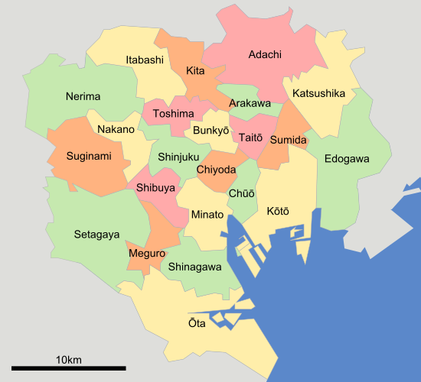
A map of Tokyo's 23 Special wards

Slide 5
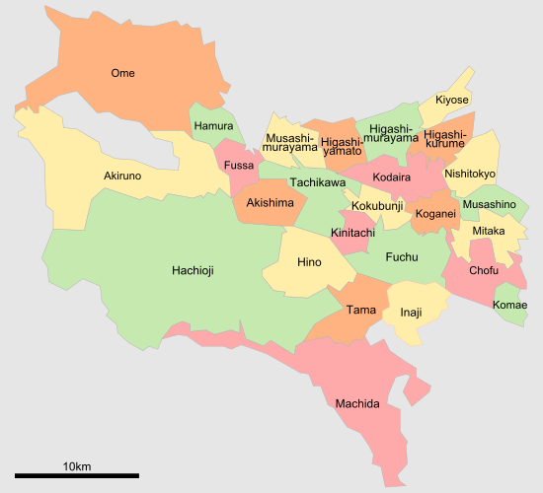
A map of cities in western part of Tokyo. They border on the three westernmost special wards in the previous map.

Slide 6
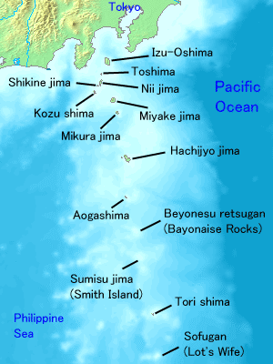
Map of the Izu Islands in black labels

Slide 7
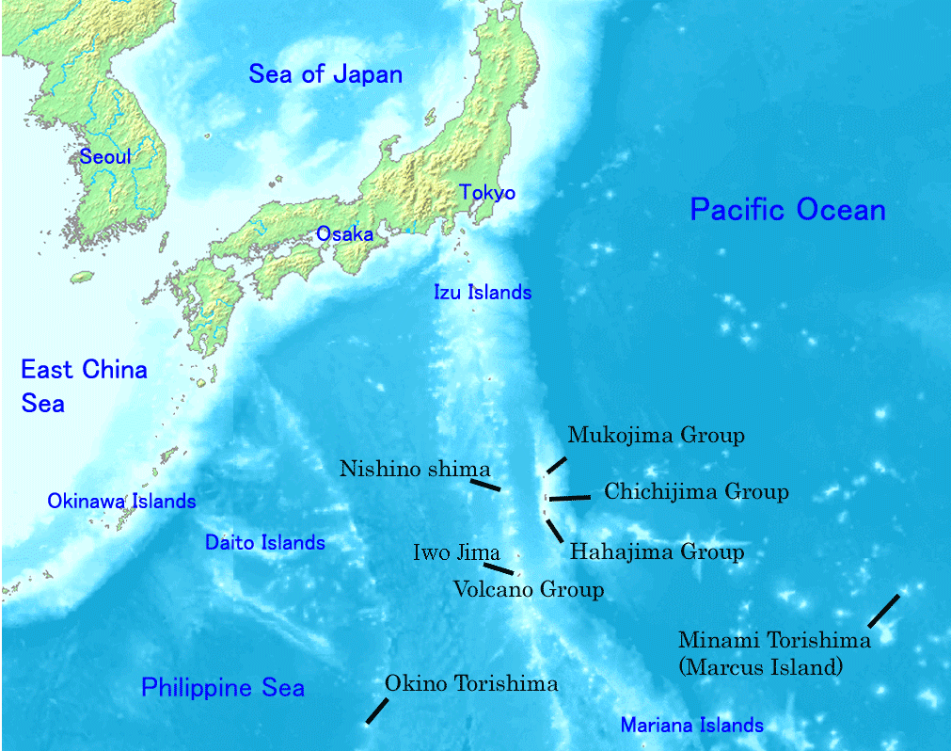
Map of the Ogasawara Islands in black labels

Slide 8
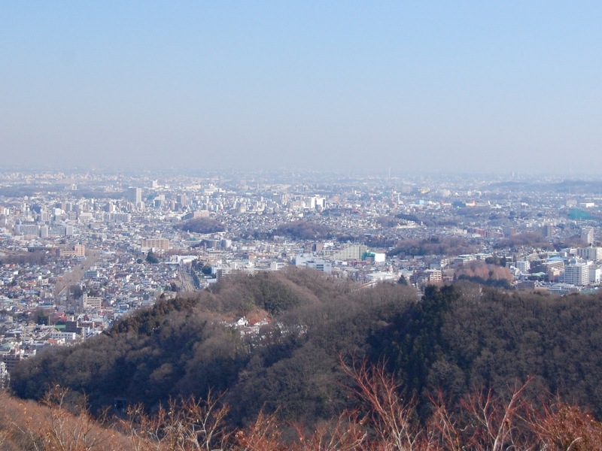
Hachioji

Slide 9
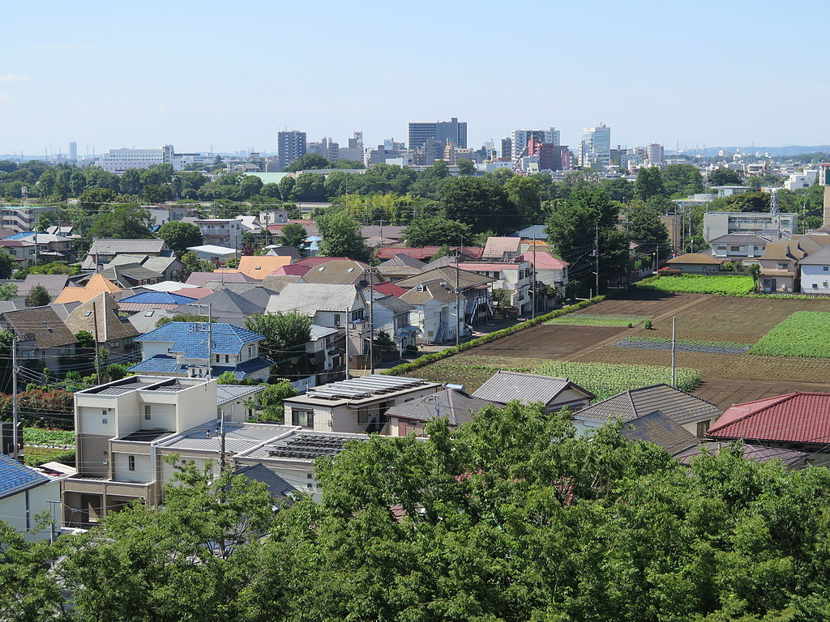
Musashino

Slide 10
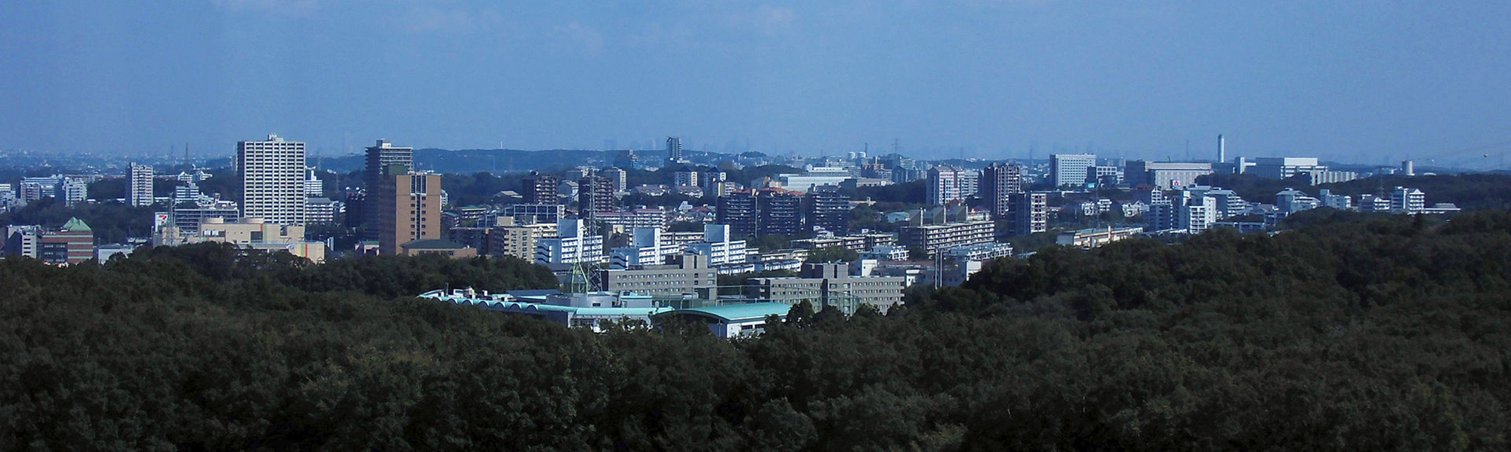
Tama

Slide 11
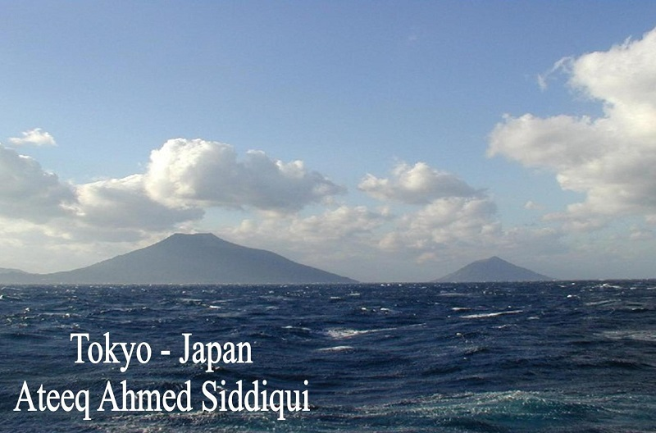

Slide 12
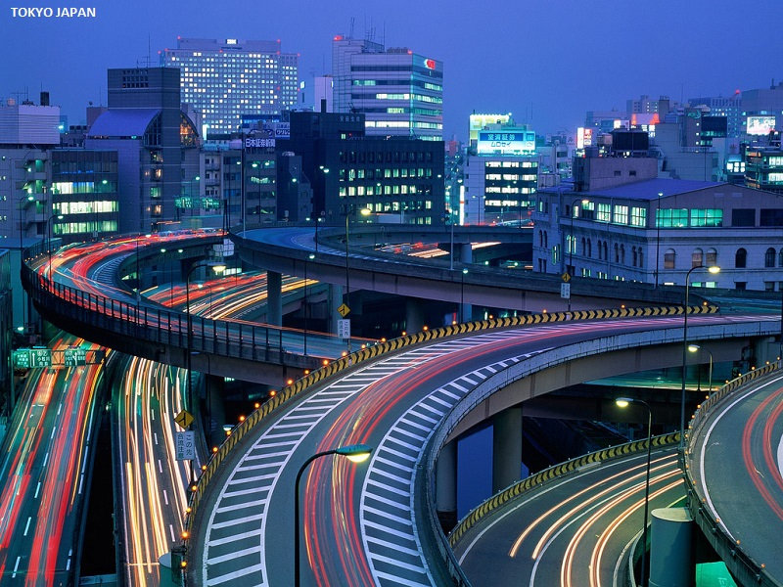

Slide 13
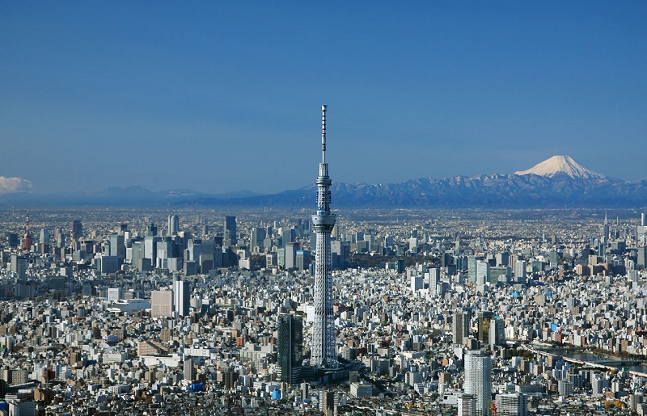

Slide 14
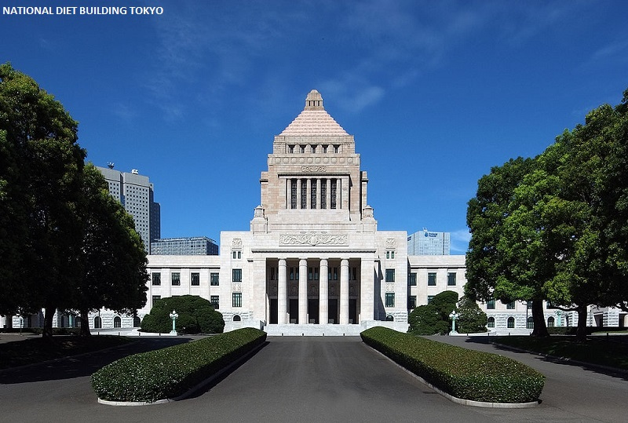

Slide 15
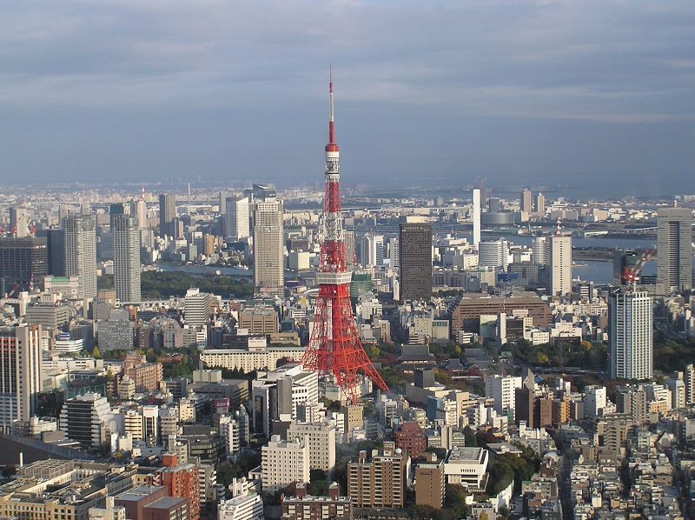

Slide 16
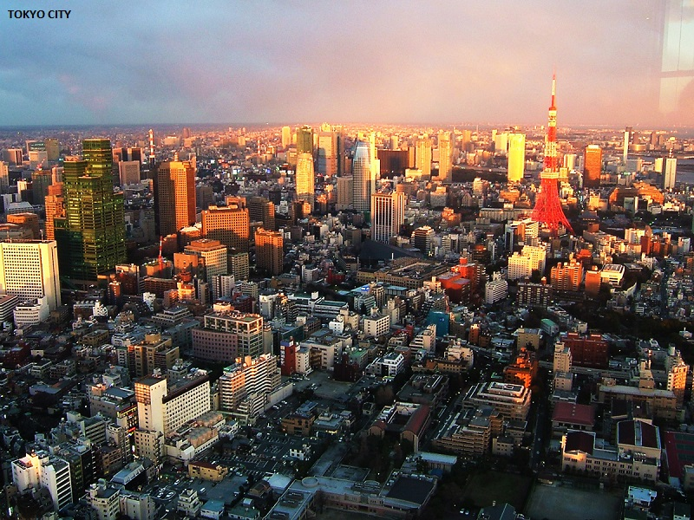

Slide 17
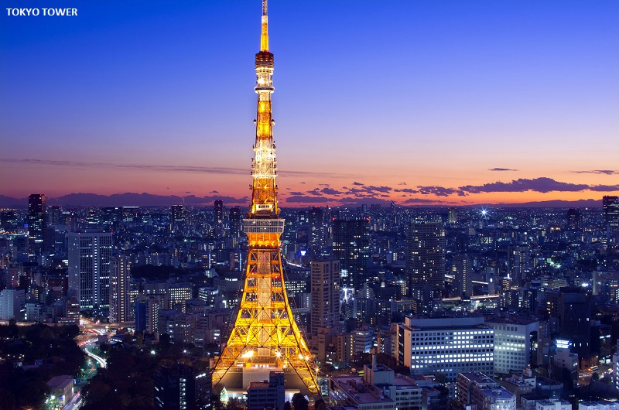

Slide 18
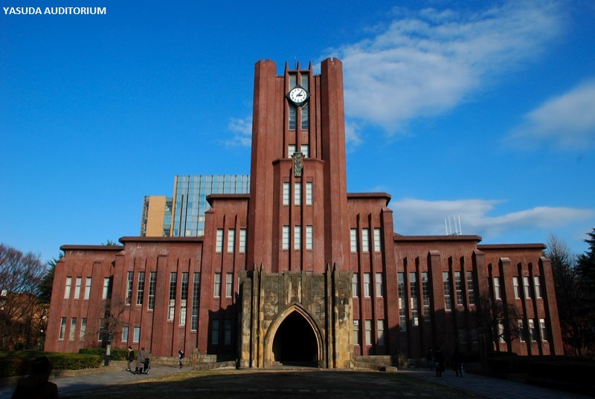

Slide 19
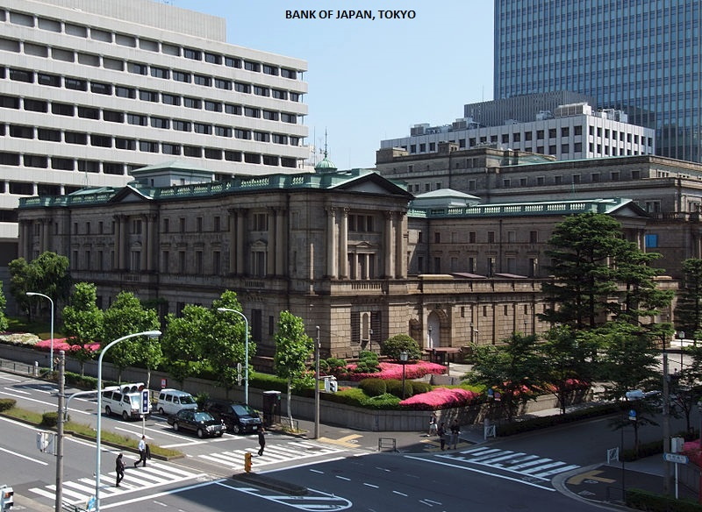

Slide 20
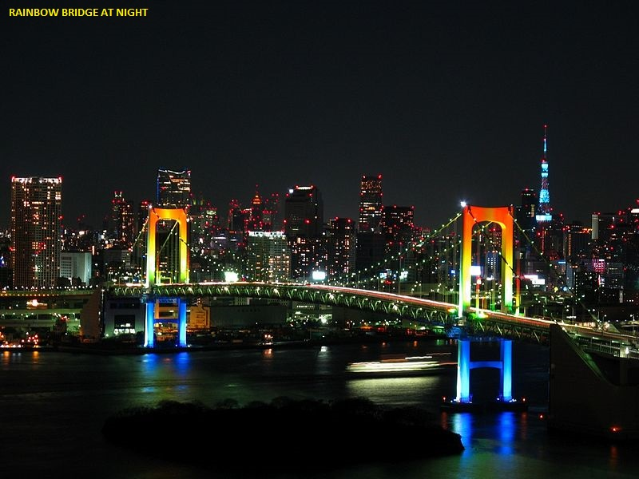

Slide 21
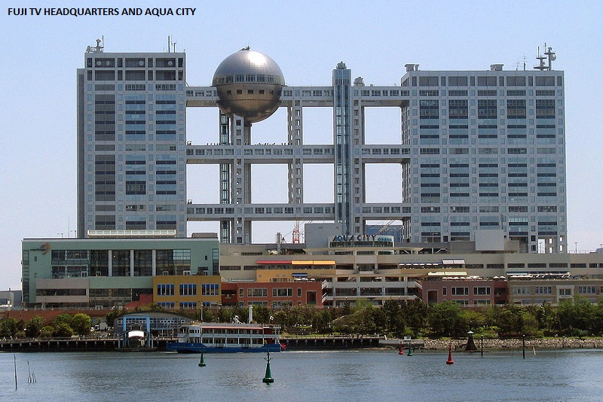

Slide 22
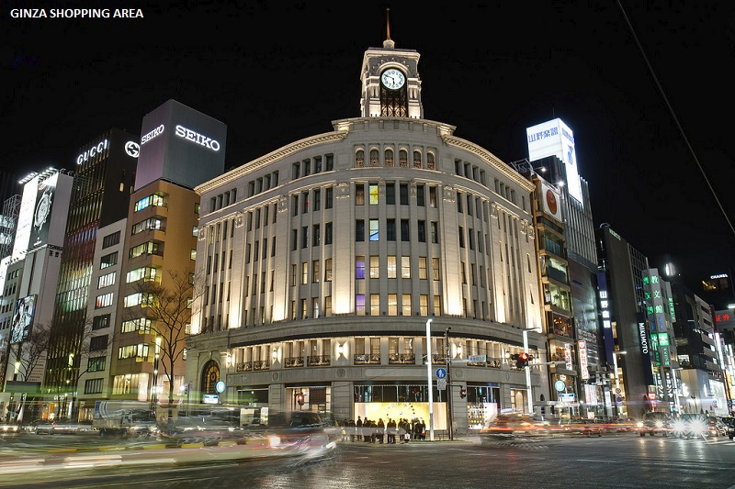

Slide 23
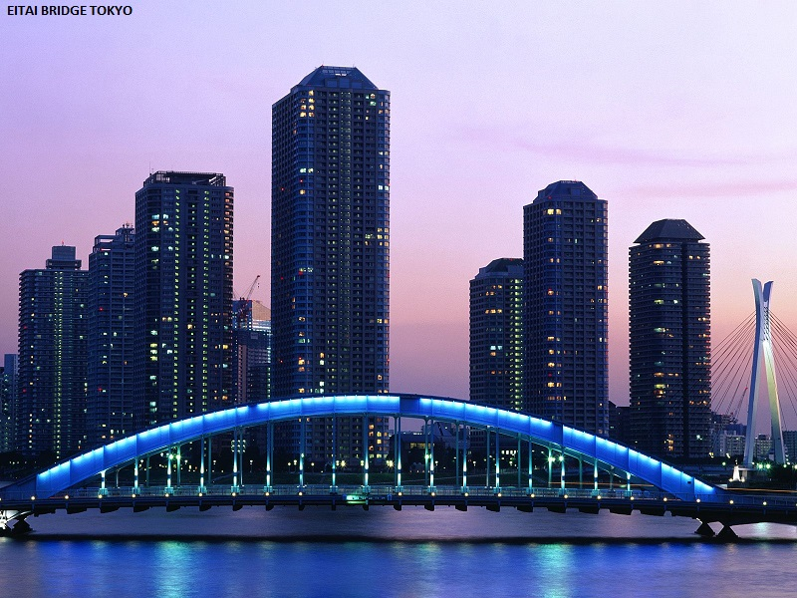

Slide 24
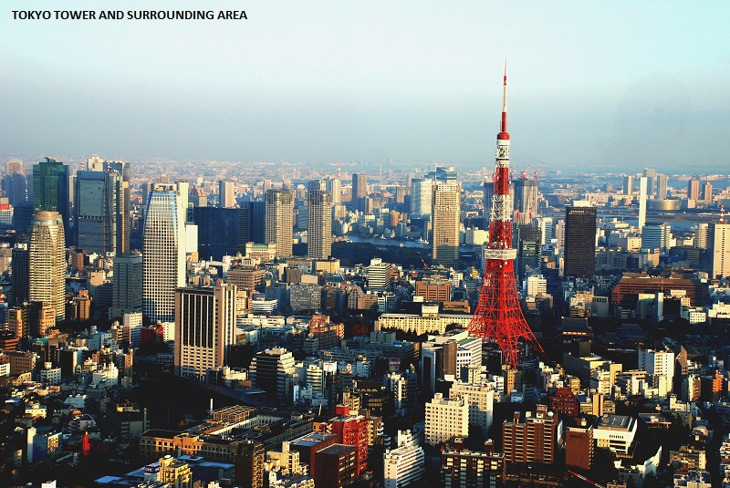

Slide 25
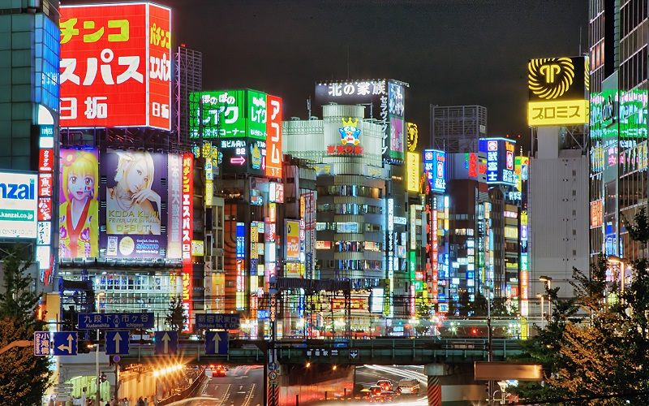

Slide 26
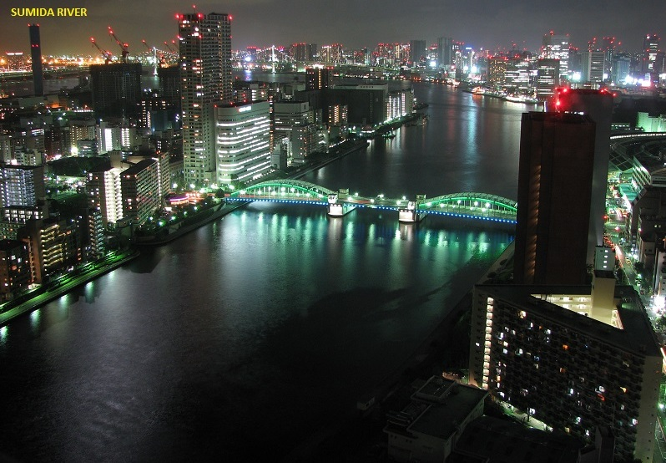

Slide 27
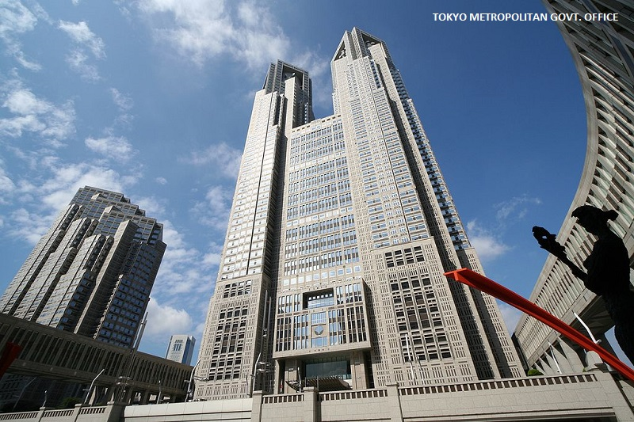

Slide 28
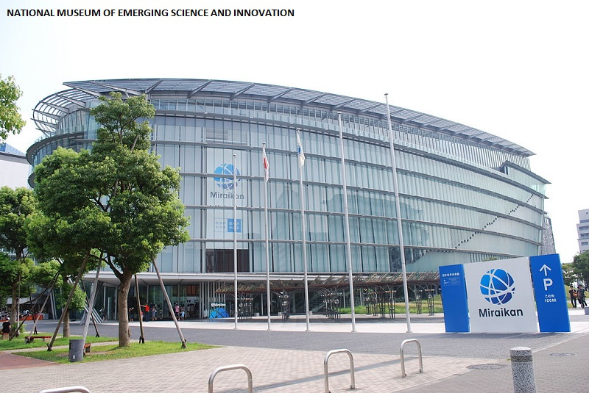

Slide 29
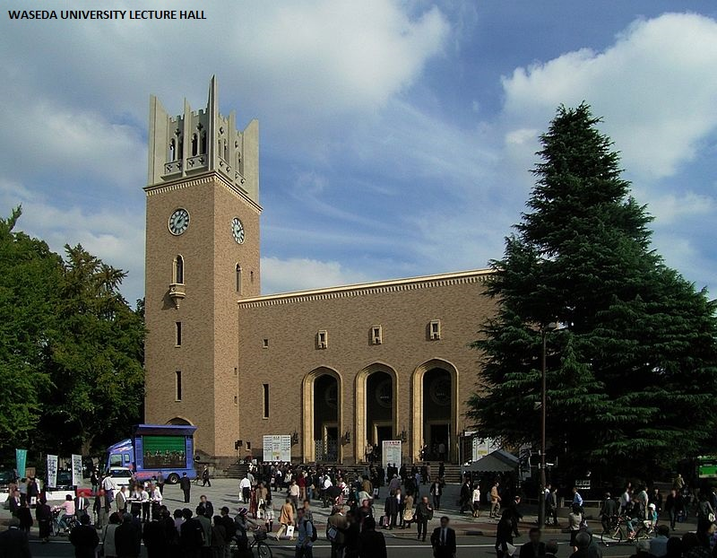

Slide 30
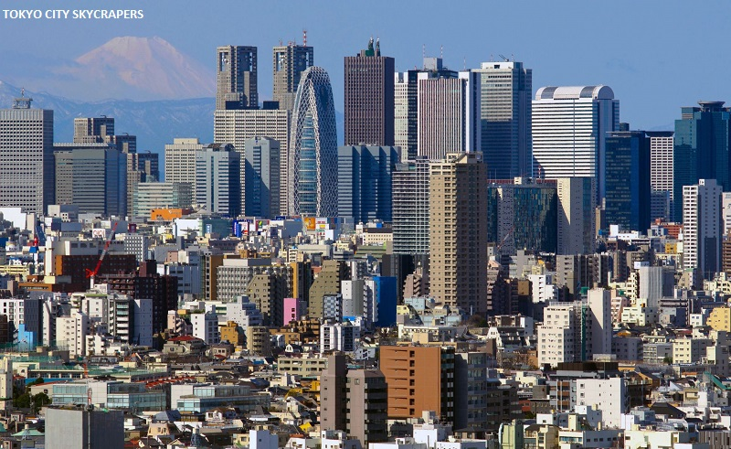

Slide 31
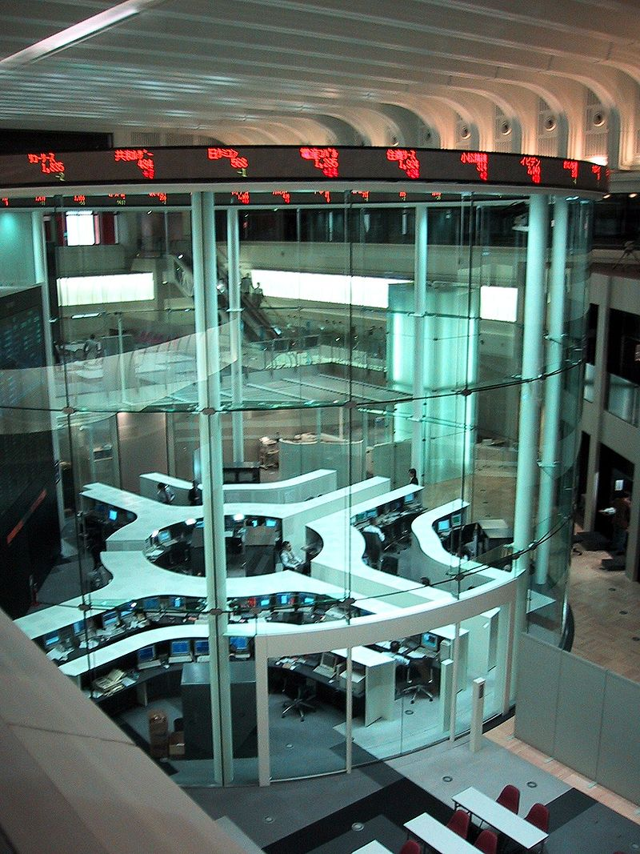
Tokyo Stock Exchange

Slide 32
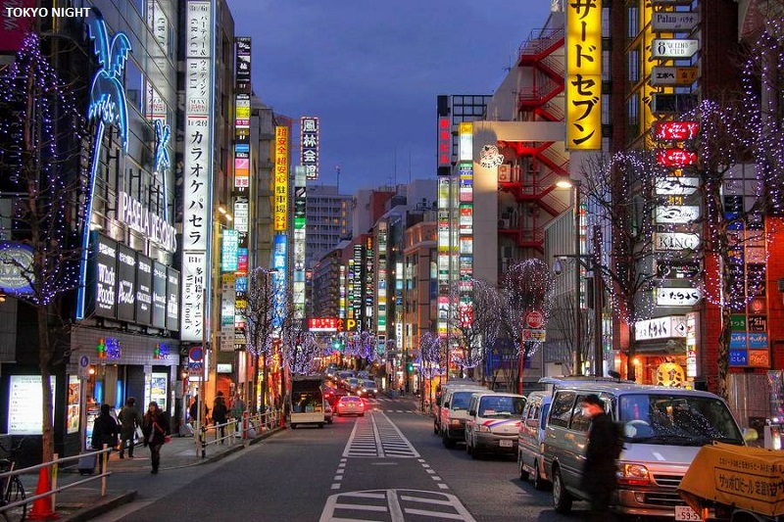

Slide 33
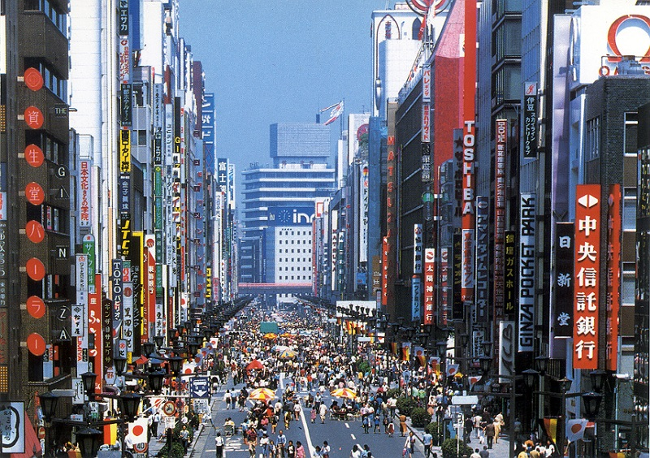

Slide 34
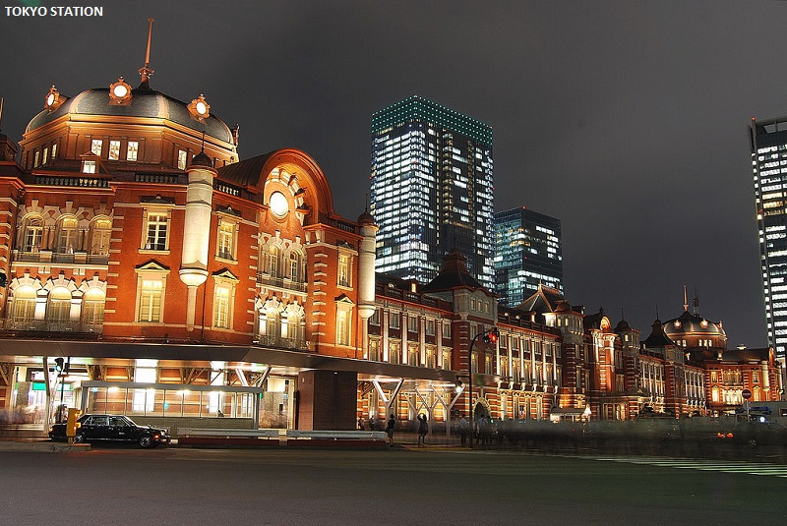

Slide 35
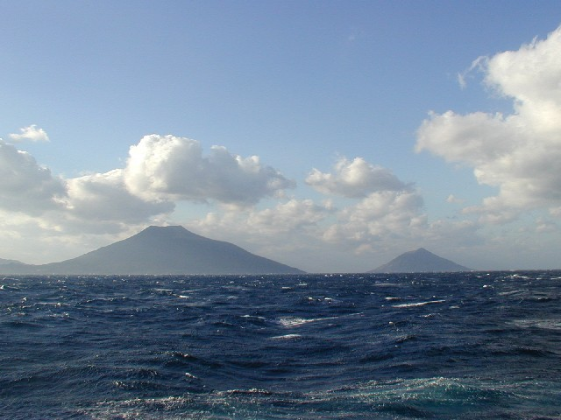
Fuji-Hakone-Izu National Park

Slide 36
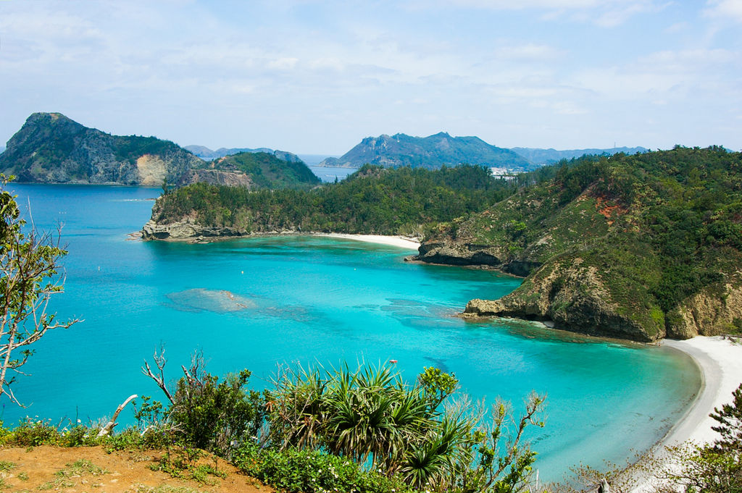
Ogasawara National Park, a UNESCO World Natural Heritage site

Slide 37
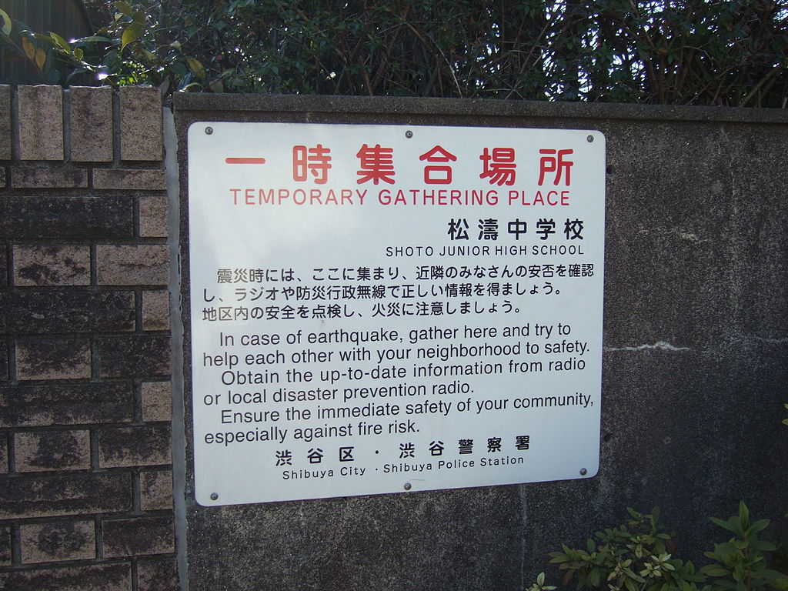
A sign with instructions in case of an earthquake (Shibuya)

Slide 38
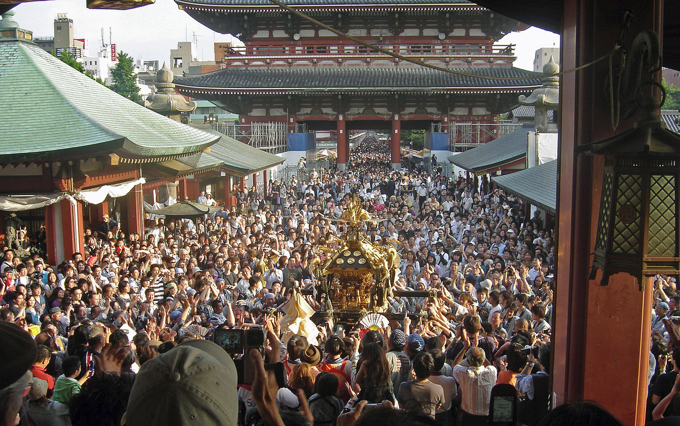
The Sanja Festival in Asakusa

Slide 39
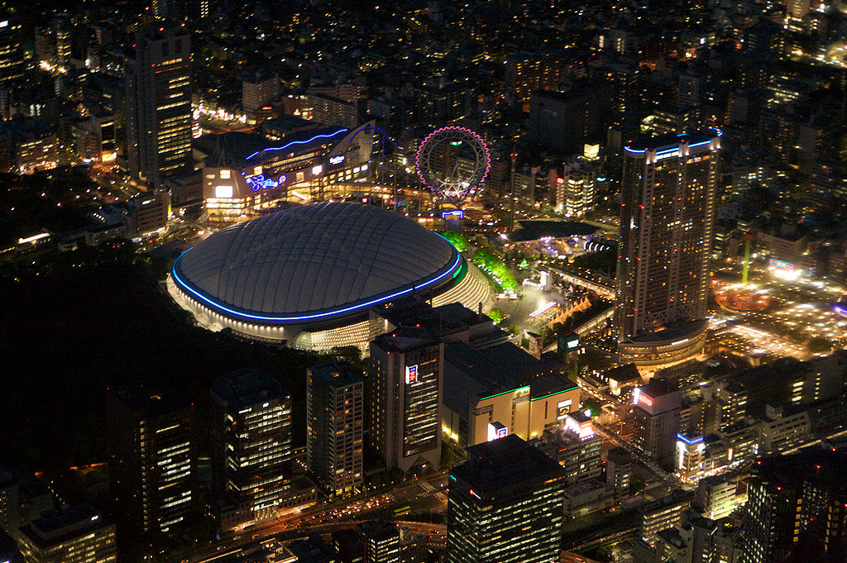
Tokyo Dome, the home stadium for the Yomiuri Giants

Slide 40
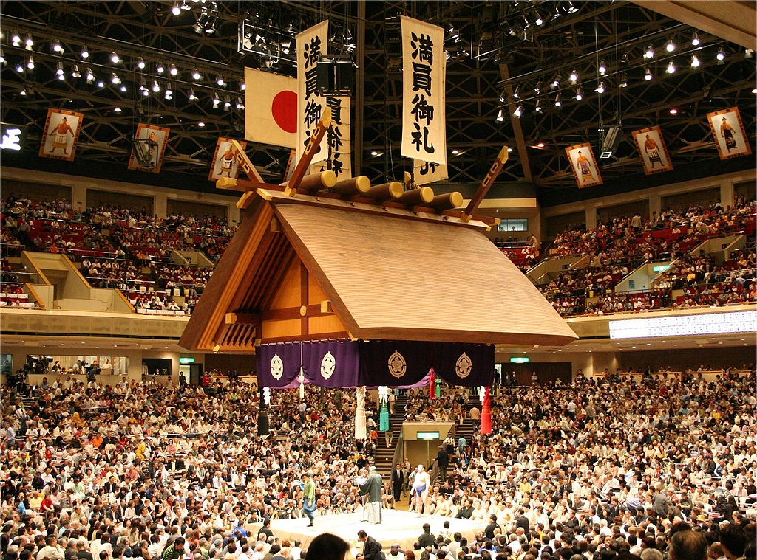
Ryōgoku Kokugikan sumo wrestling arena

