Slide 1
The 10 Worst Neighborhoods In The United States

Slide 2
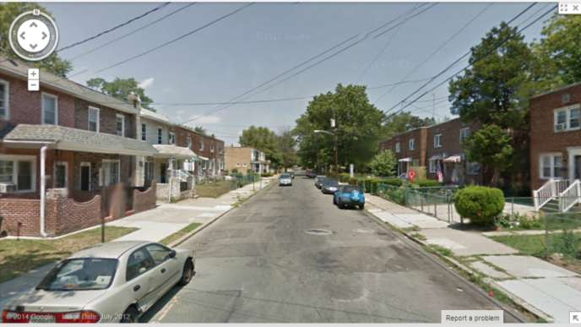
10. Whitman Park in Camden, New Jersey
Eighty-five out of every 1,000 residents are victims of all violent crimes.

Slide 3
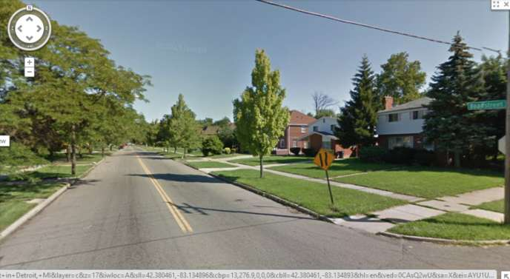
9. Broadstreet Ave. and Cortland St. in Detroit, Michigan
Over 45 percent of residencies are vacant leading to houses being used for harboring fugitives, gambling, and drug dealing, victims of all violent crimes.

Slide 4
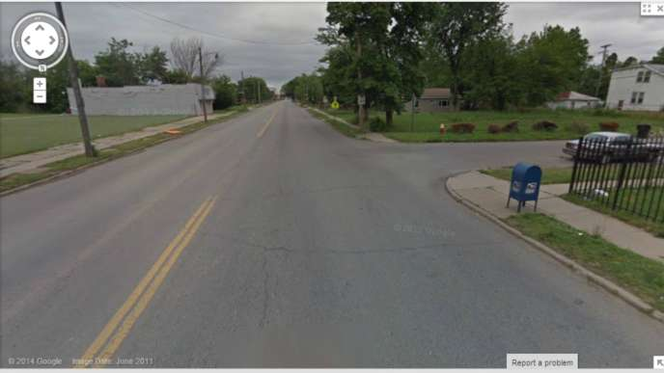
8. Wyoming St. & Orangelawn St. in Detroit, Michigan
Eighty-six out of every 1,000 residents are victims of all violent crimes.

Slide 5
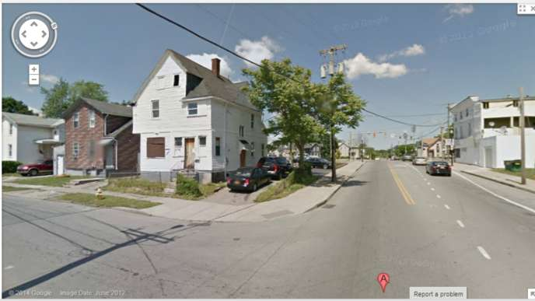
7. Orange St. & W Broad St. in Rochester, New York
One out of every 11 residents has been a victim of a violent crime. Murders, rapes, robberies, and assaults have risen over the past five years as well.

Slide 6
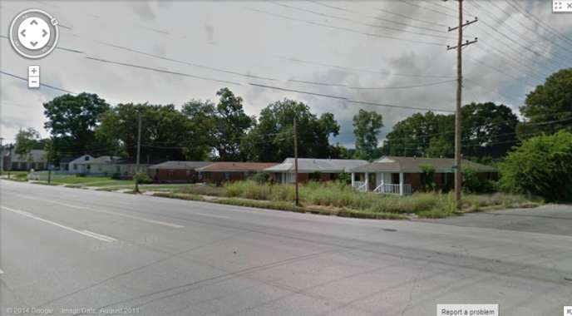
6. Chelsea Ave. & N Claybrook St. in Memphis, Tennessee
The single mother rate here is 90 percent higher than the rest of the U. S. Crimes and poverty are also very high in this area.

Slide 7
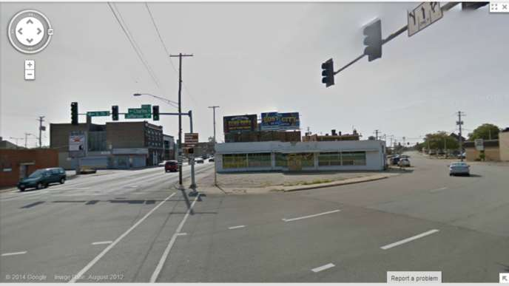
5. 7th St. and E Jefferson St. in Rockford, Illinois
Ninety out of every 1,000 residents are victims of all violent crimes.

Slide 8
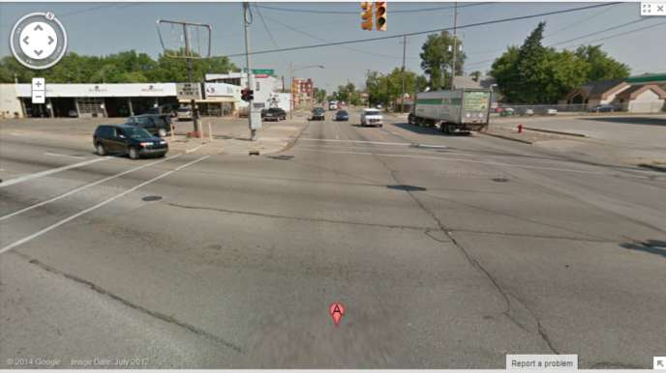
4. E Holland Ave. & E Genesee Ave. in Saginaw, Michigan
Ninety out of every 1,000 residents are victims of all violent crimes. There is high military employment and a high single mothers rate as well.

Slide 9
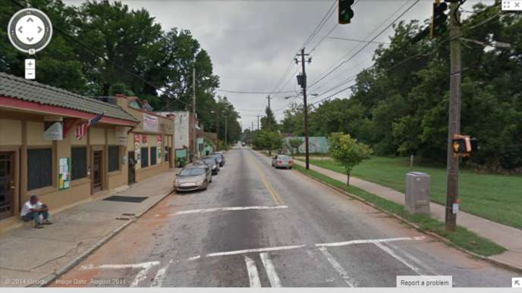
3. Mcdaniel St. SW & Mary St. SW in Atlanta, Georgia
One out of every 10 residents is a victim of all violent crimes.

Slide 10
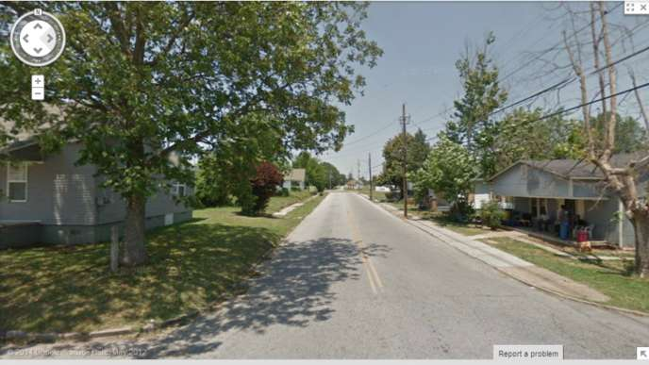
2. James Buchanan Dr. & 1st St. in Jackson, Tennessee
Real estate prices are high, nearly one in 10 people fall victim to crimes, and people mainly rent in this area which makes people come and go quickly.

Slide 11
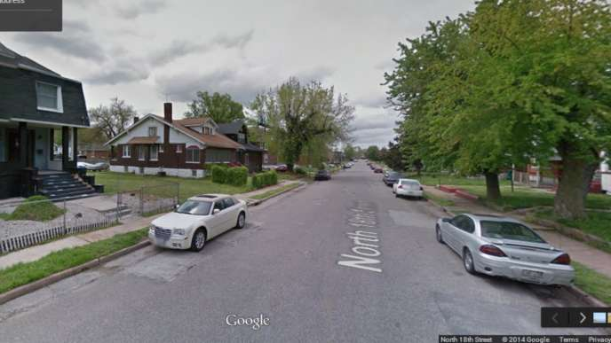
1. City Center in East St. Louis, Illinois
The single mothers rate is 99 percent higher than the rest of the nation. Over 75 percent of children live in poverty. The chance of becoming a victim of a crime is one in 10.

