Slide 1
Sendai, Japan!

Slide 2
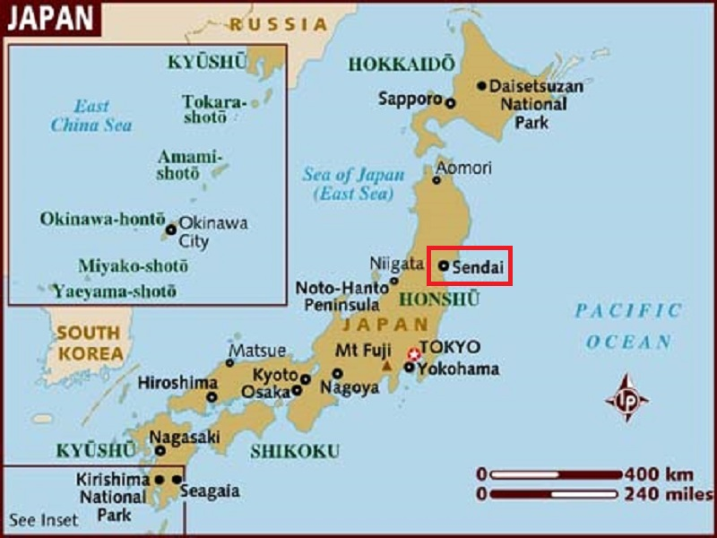
Sendai is the capital city of Miyagi Prefecture, Japan, and the
largest city in the Tohoku region, and the second largest city north of Tokyo.

Slide 3
Sendai is a city in Japan’s Tohoku Region, northeast of Tokyo on Honshu island. The remains of 17th-century Sendai Castle, built for samurai lord Date Masamune on Aoba Hill, overlook the city and include a museum of historic artifacts. The Sendai City Museum focuses on the history and culture of Japan’s Edo period and displays Masamune’s samurai armour.
Sendai is the capital city of Miyagi Prefecture, Japan, and the largest city in the Tōhoku region, and the second largest city north of Tokyo. In 2010, the city had a population of one million, and was one of Japan's 20 designated cities. The city was founded in 1600 by the daimyō Date Masamune, and is nicknamed the City of Trees: there are about 60 zelkova trees on Jōzenji Street
In the summer, the Sendai Tanabata Festival, the largest Tanabata festival in Japan, is held. In winter, the trees are decorated with thousands of lights for the Pageant of Starlight
On March 11, 2011, coastal areas of the city suffered catastrophic damage from a magnitude 9.0 offshore earthquake which triggered a destructive tsunami.

Slide 4
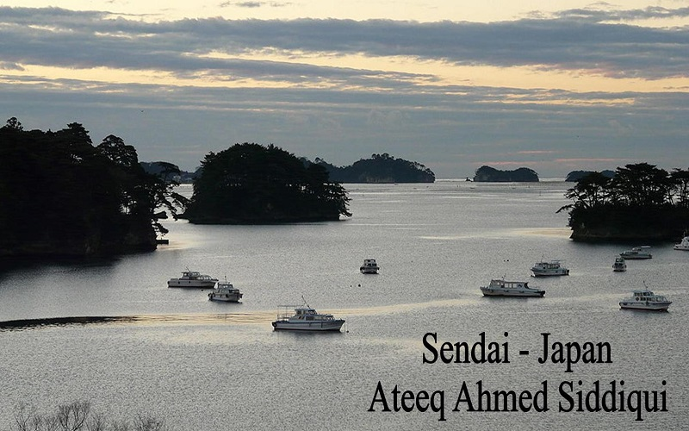

Slide 5
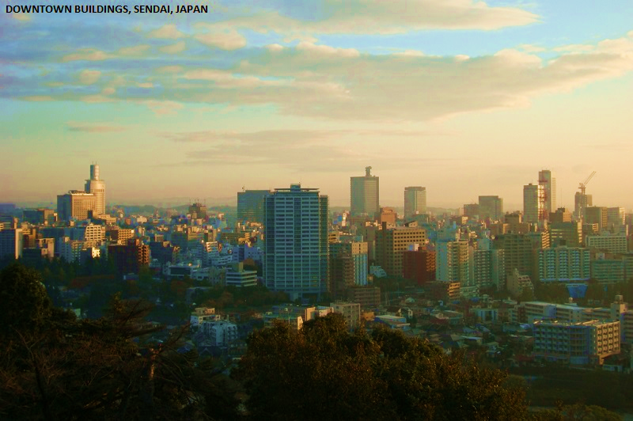

Slide 6
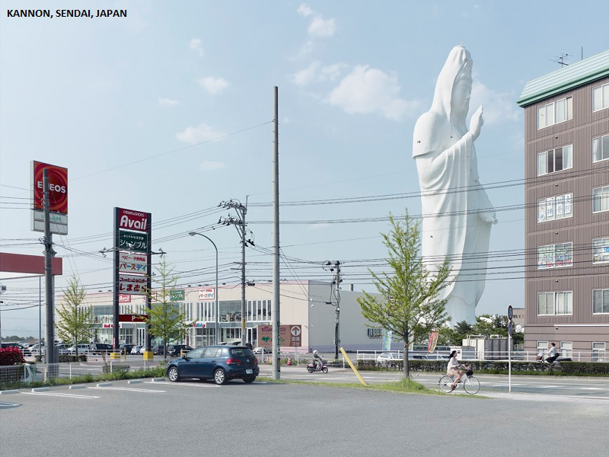

Slide 7
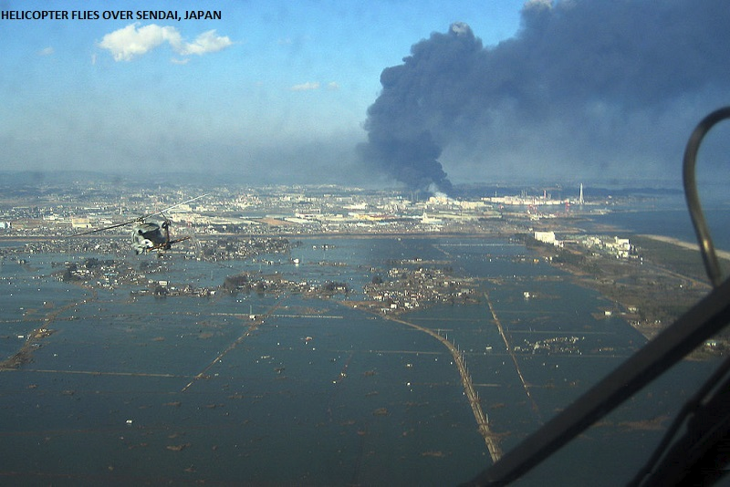
An aerial view of Sendai harbour after the earthquake, 12 March 2011

Slide 8
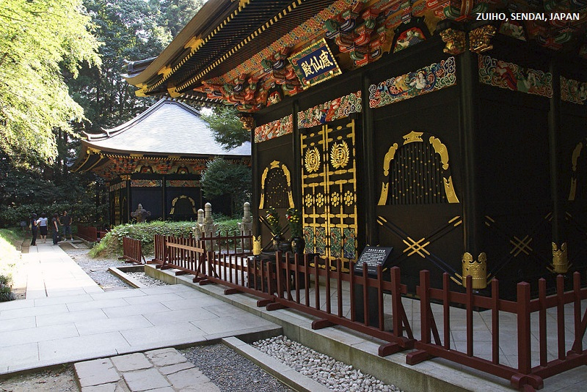

Slide 9
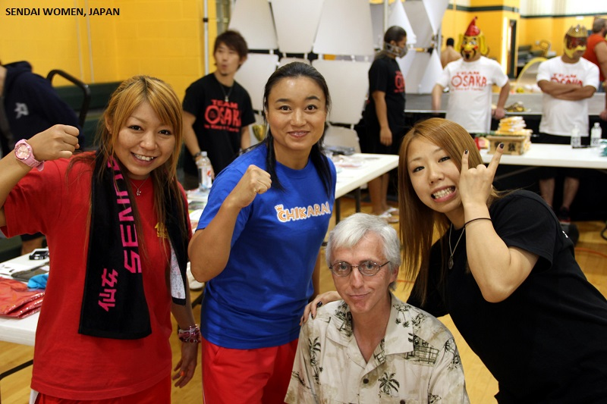

Slide 10
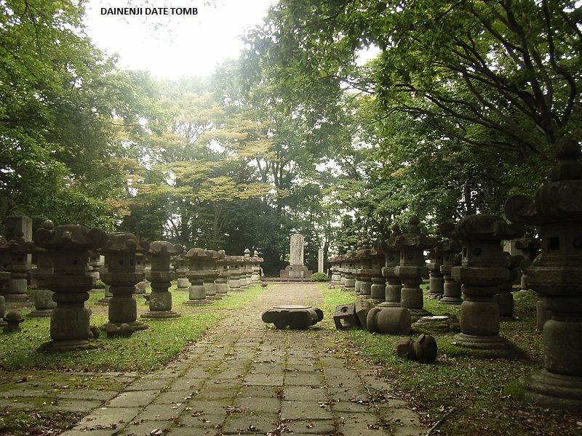

Slide 11
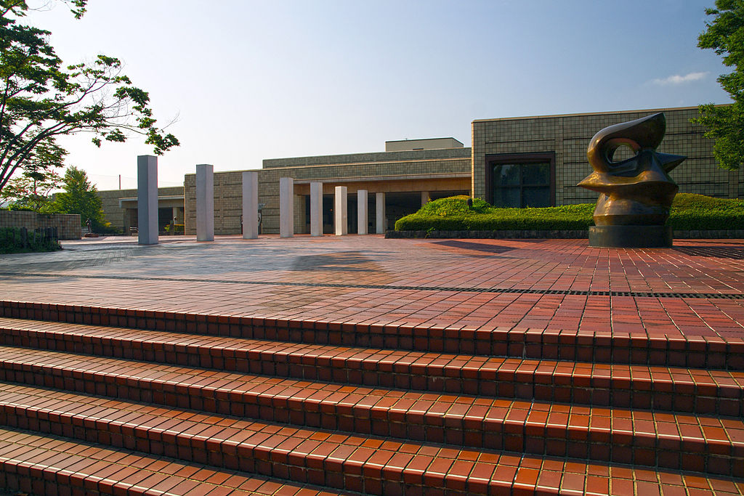
The Miyagi Museum of Art

Slide 12

Zuihōden

Slide 13
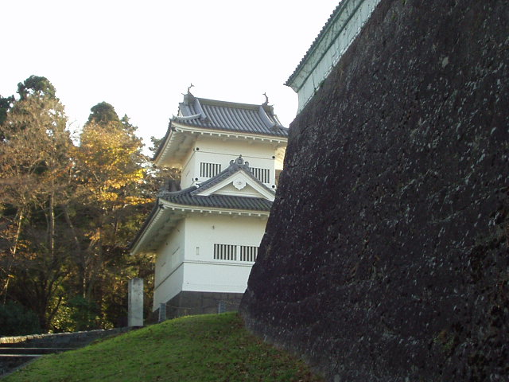
Sendai Castle

Slide 14
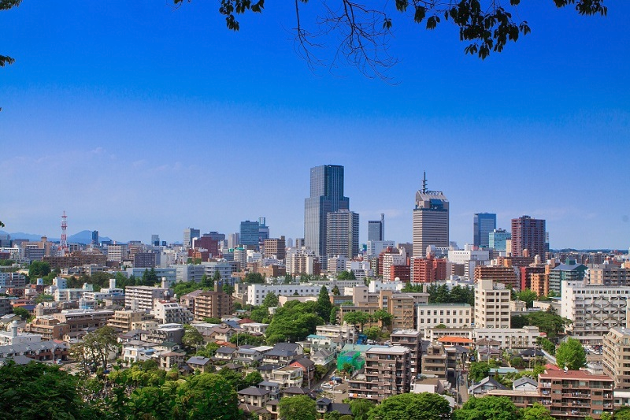

Slide 15
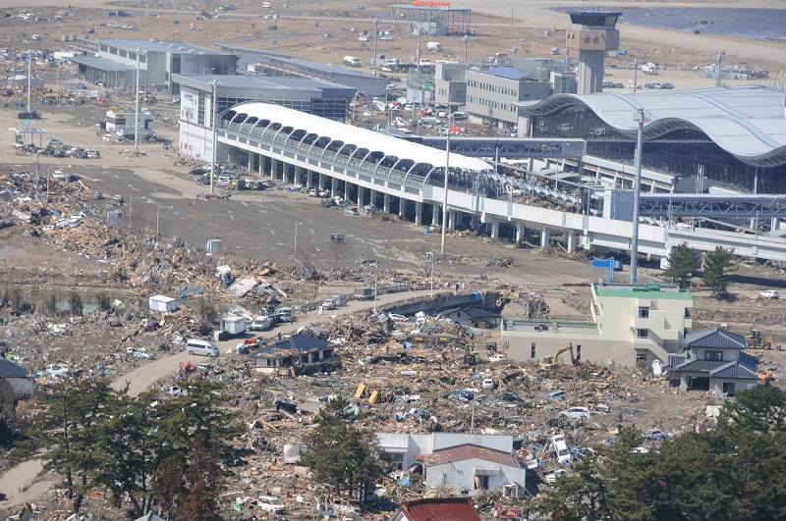

Slide 16
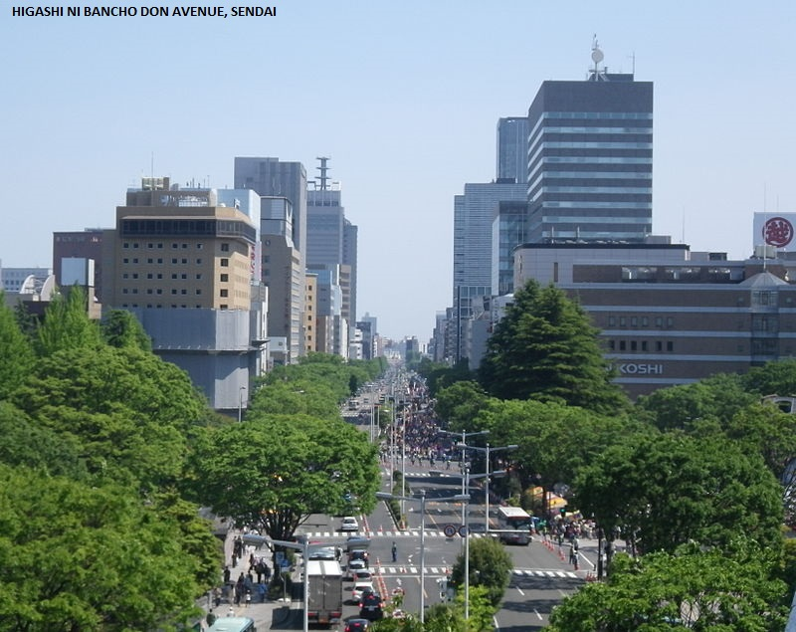

Slide 17
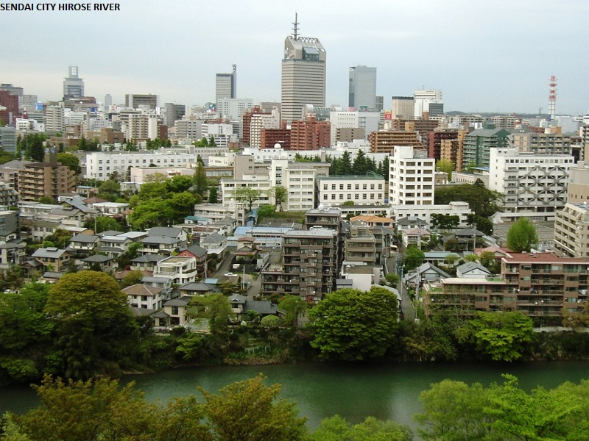

Slide 18
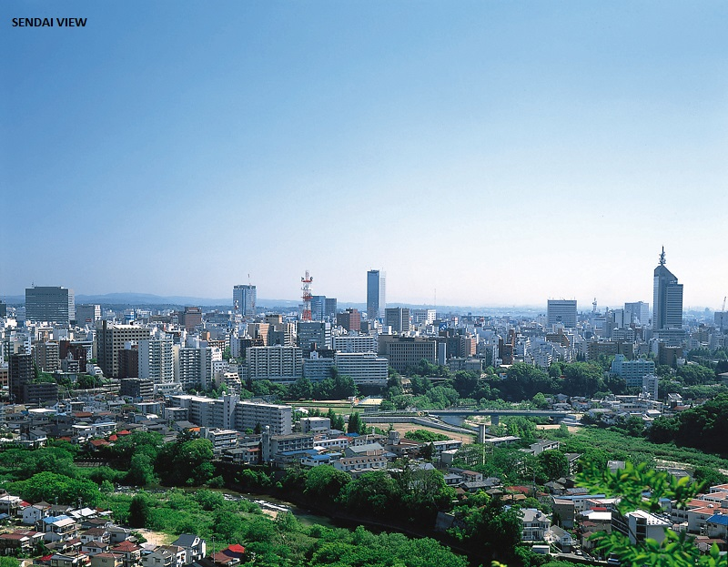

Slide 19
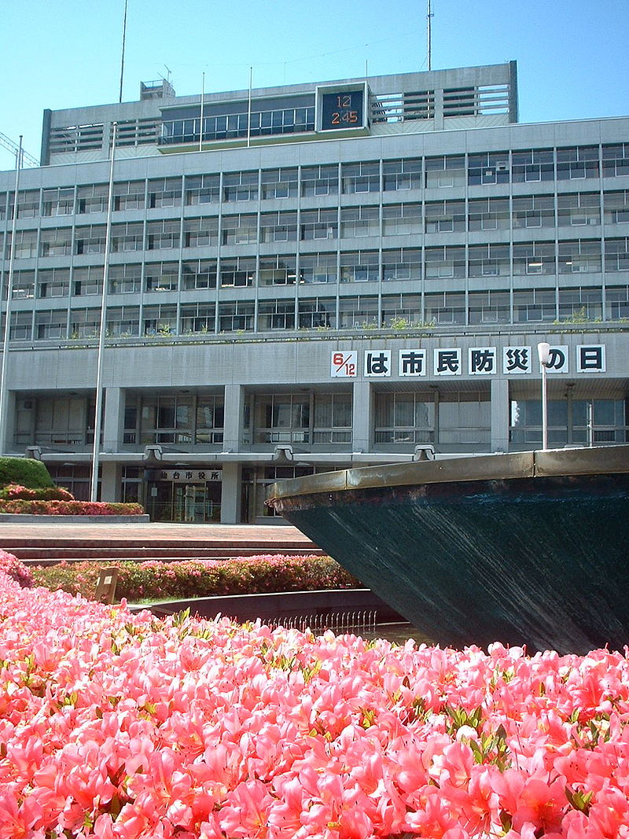
City Hall

Slide 20
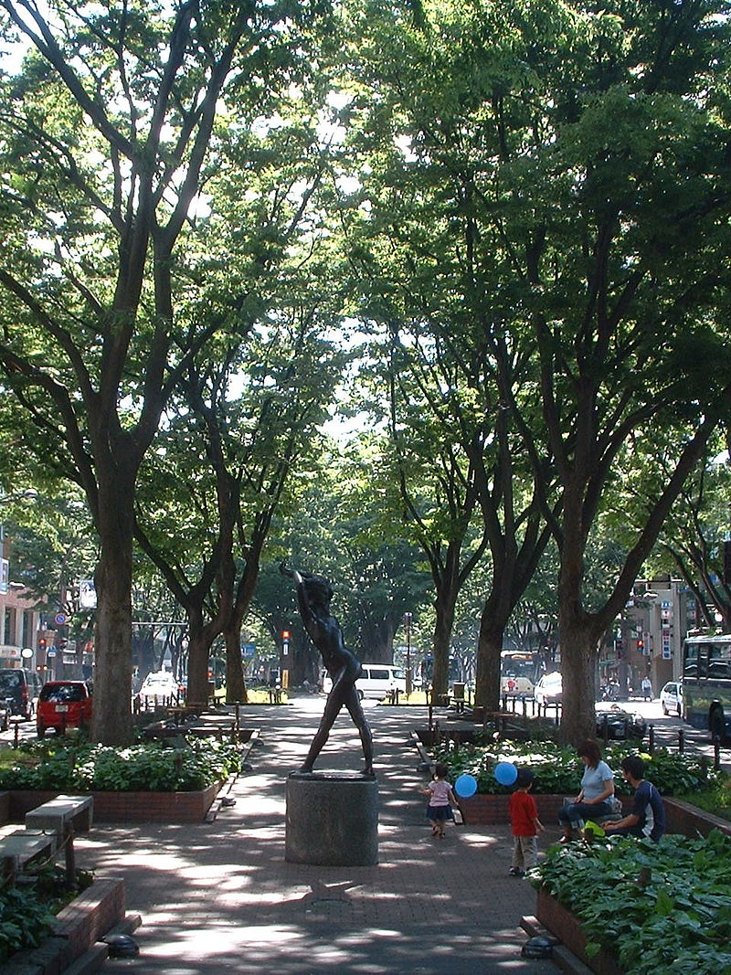
Jozenji-Dori promenade

Slide 21
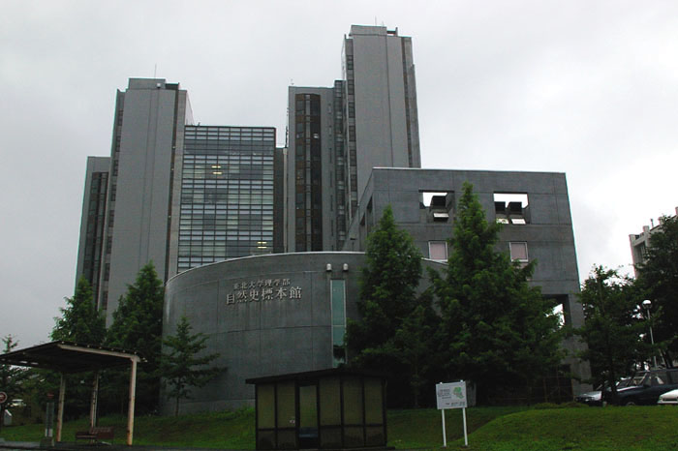
Tohoku University, Aobayama Campus

Slide 22
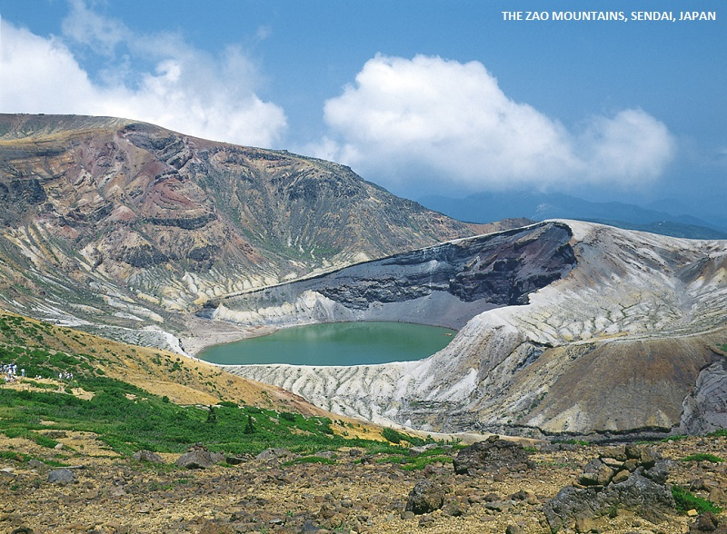

Slide 23
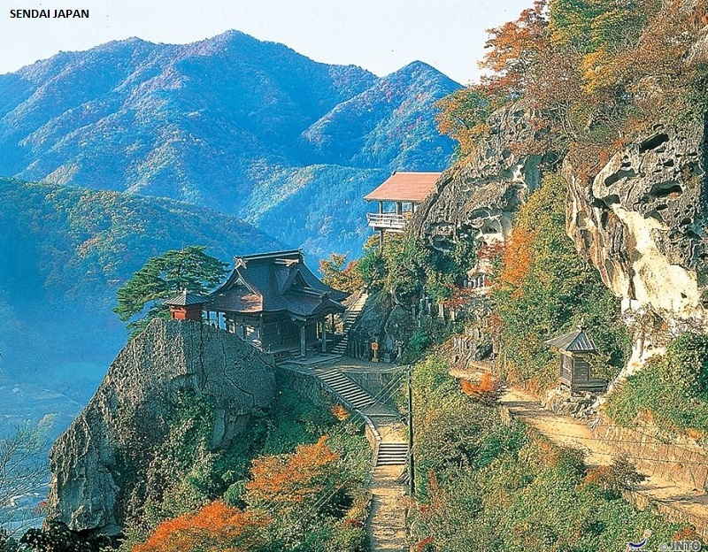

Slide 24
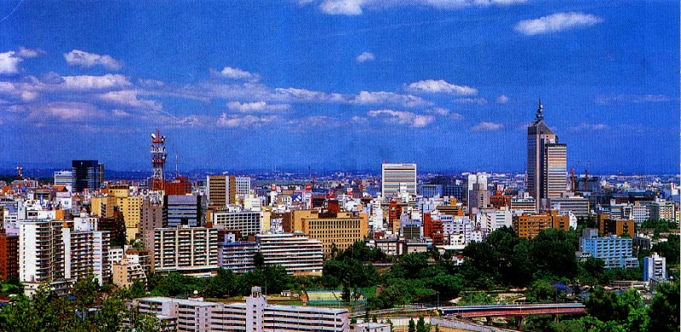

Slide 25
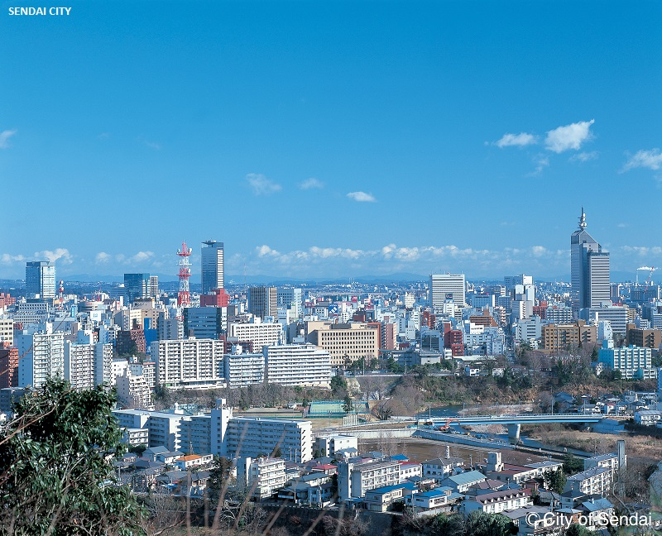

Slide 26
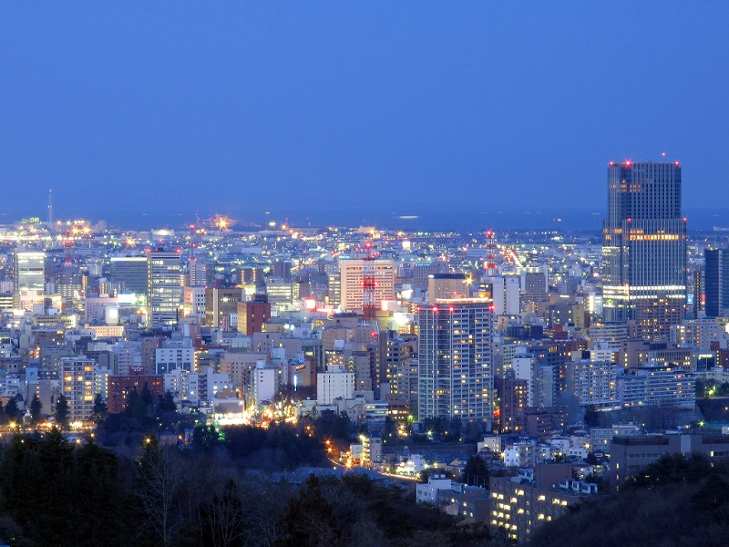

Slide 27
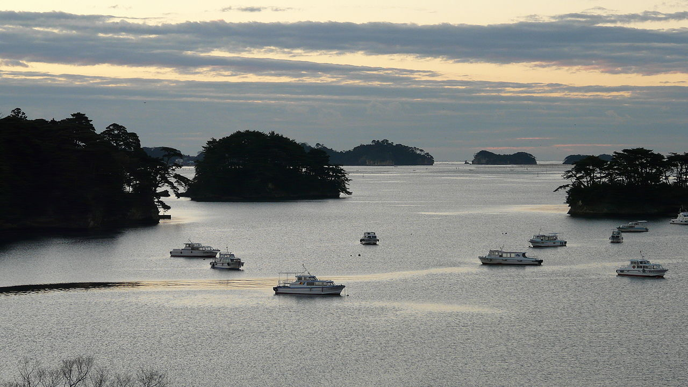
Matsushima

Slide 28
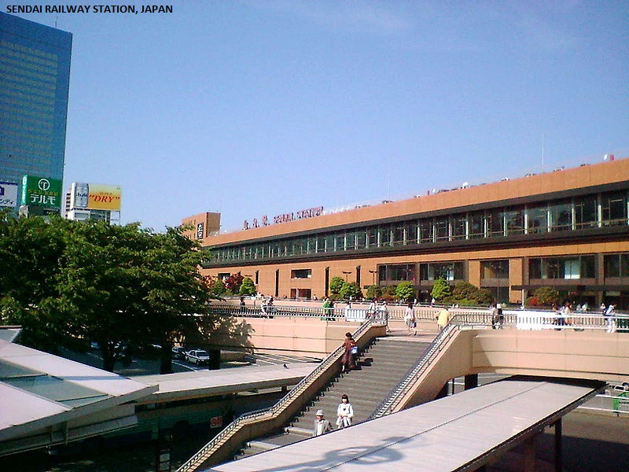

Slide 29
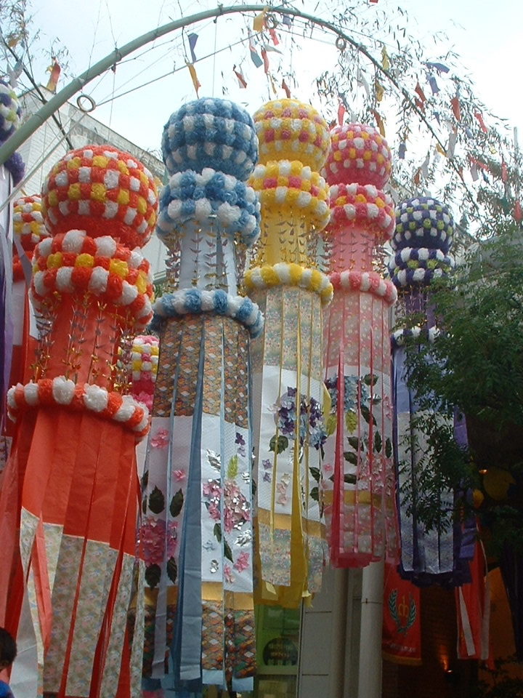
Sendai Tanabata Festival

Slide 30
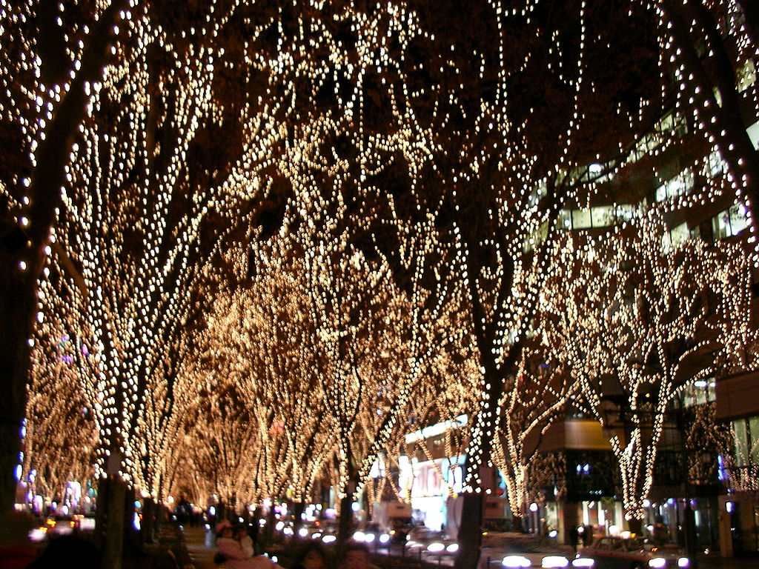
Sendai Pageant of Starlights

