Slide 1
PARADE OF BOATS IN AMSTERDAM

Slide 2
Every five years the parade of ships SAIL Amsterdam takes place. In August thousands of vessels, from small sailboats to large replicas of caravels arrived at the IJ bay north of the city all together and then passed to the capital of the Netherlands in 2015 involving 8,000 vessels are given! Impressive right?

Slide 3
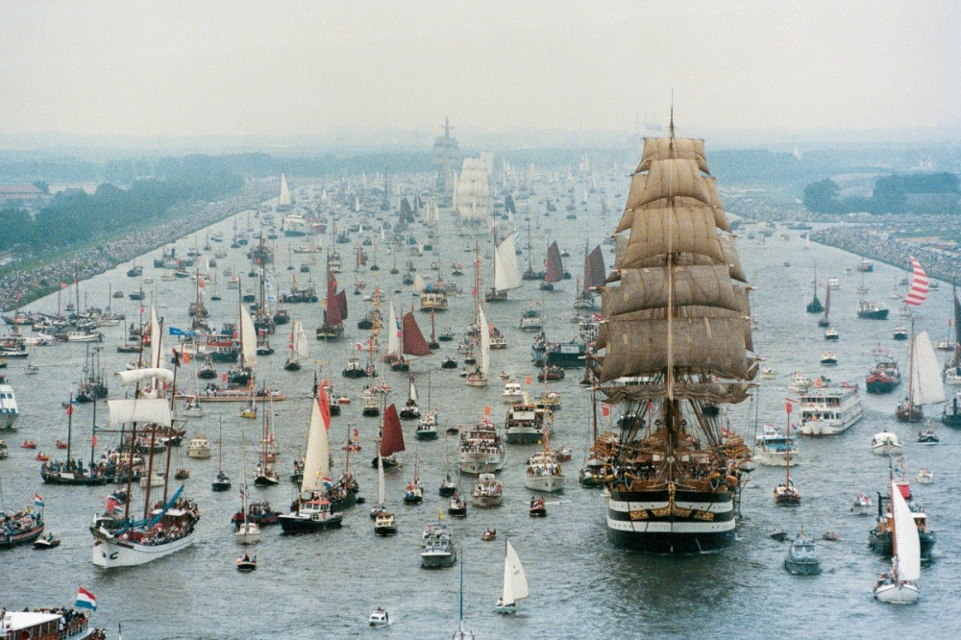

Slide 4
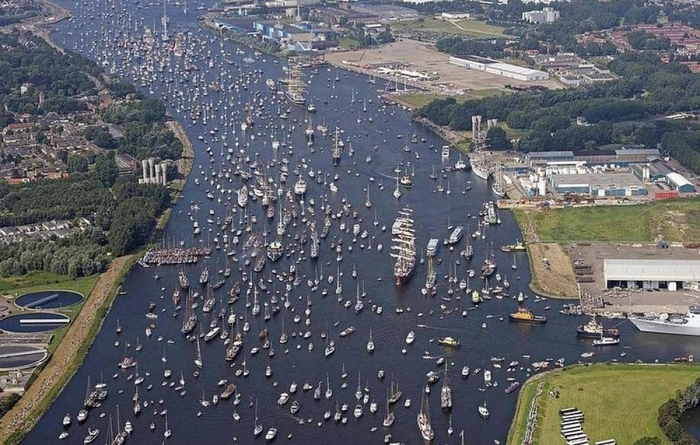

Slide 5
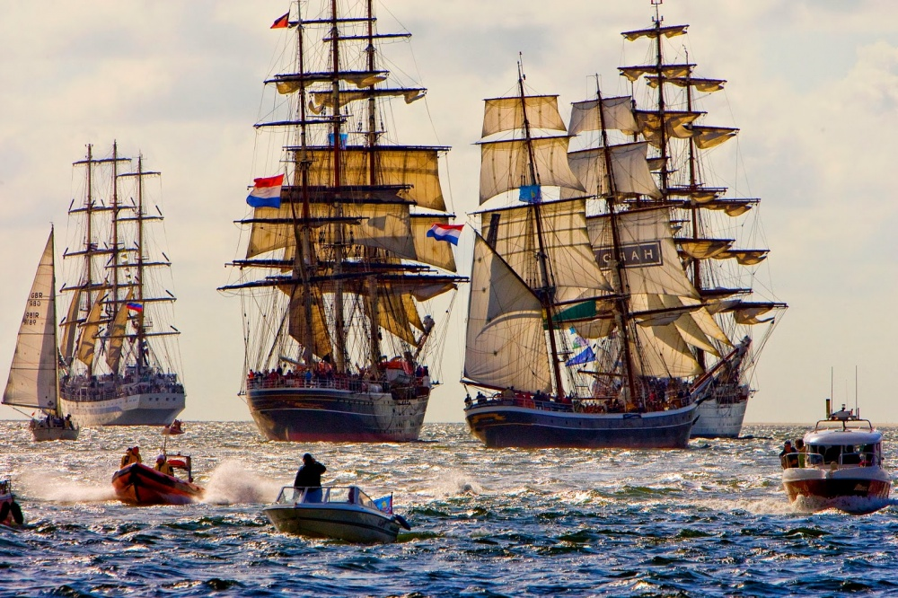

Slide 6
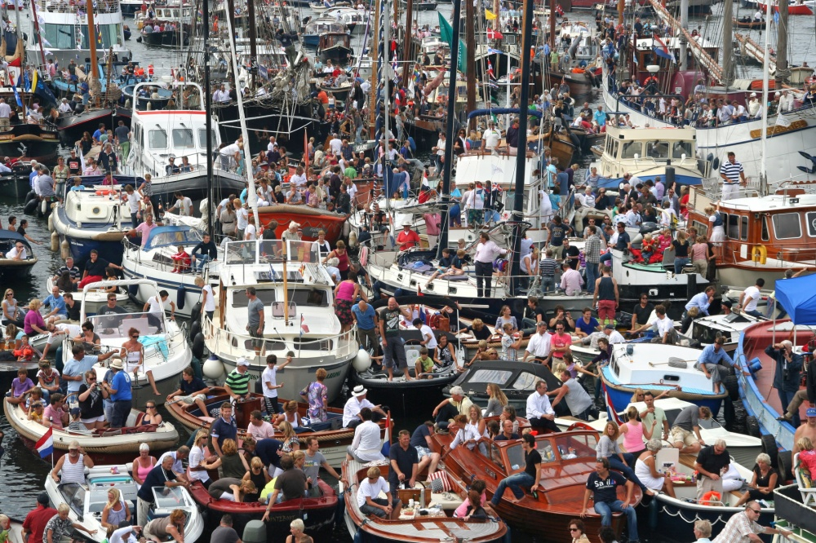

Slide 7
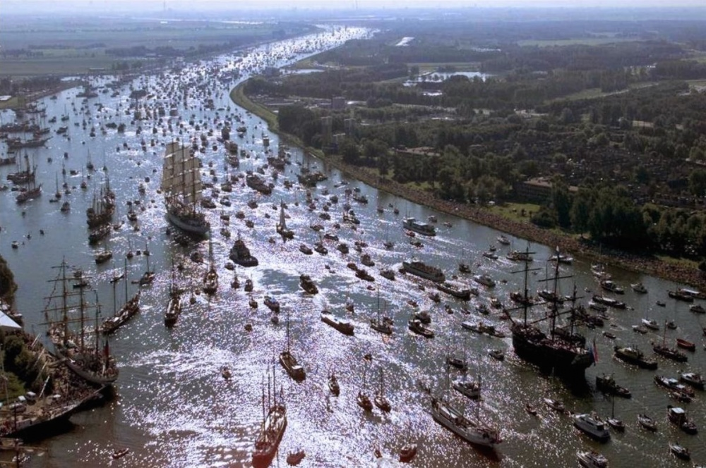

Slide 8
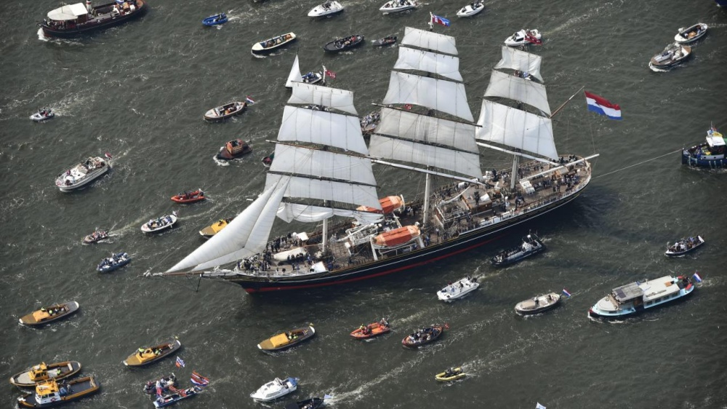

Slide 9
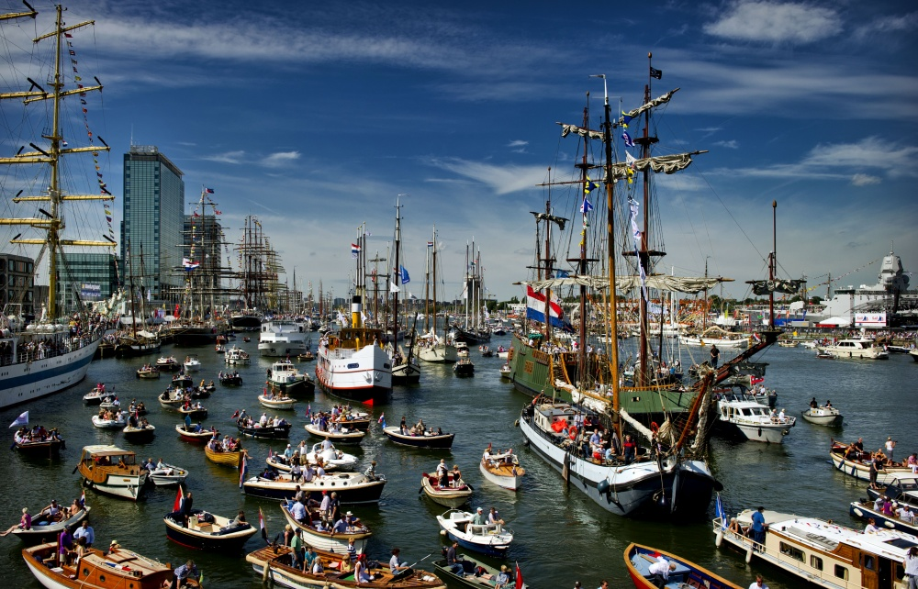

Slide 10
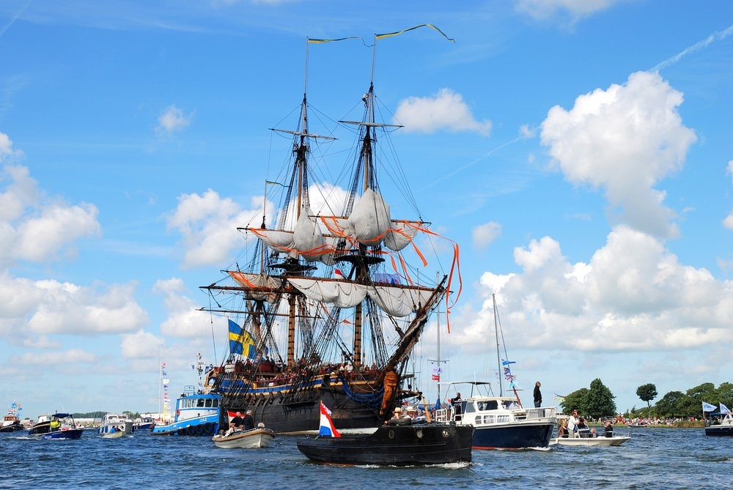

Slide 11
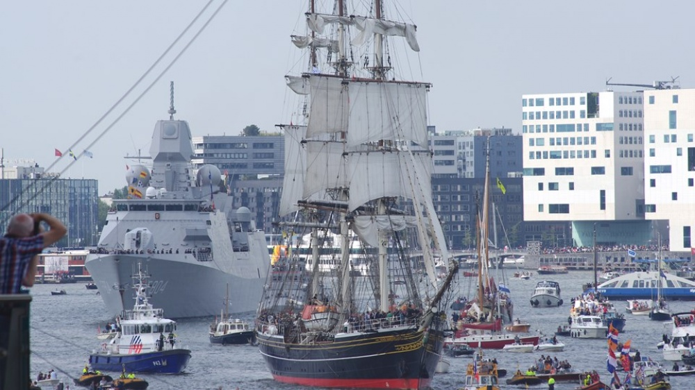

Slide 12
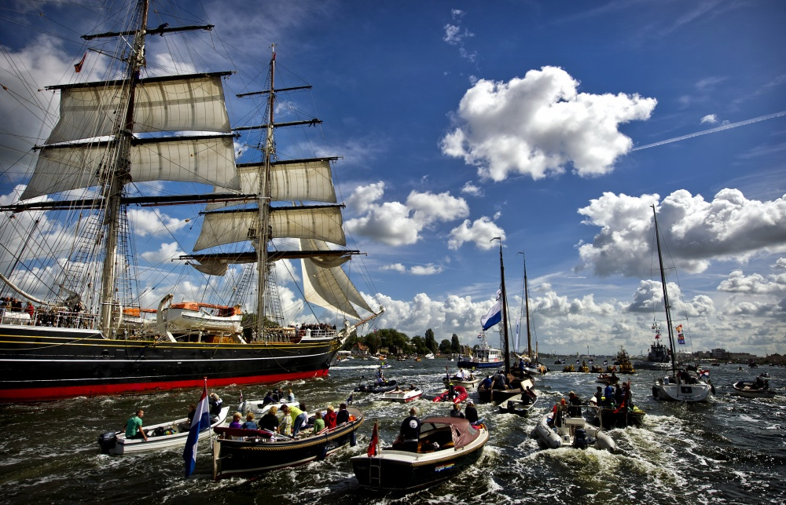

Slide 13
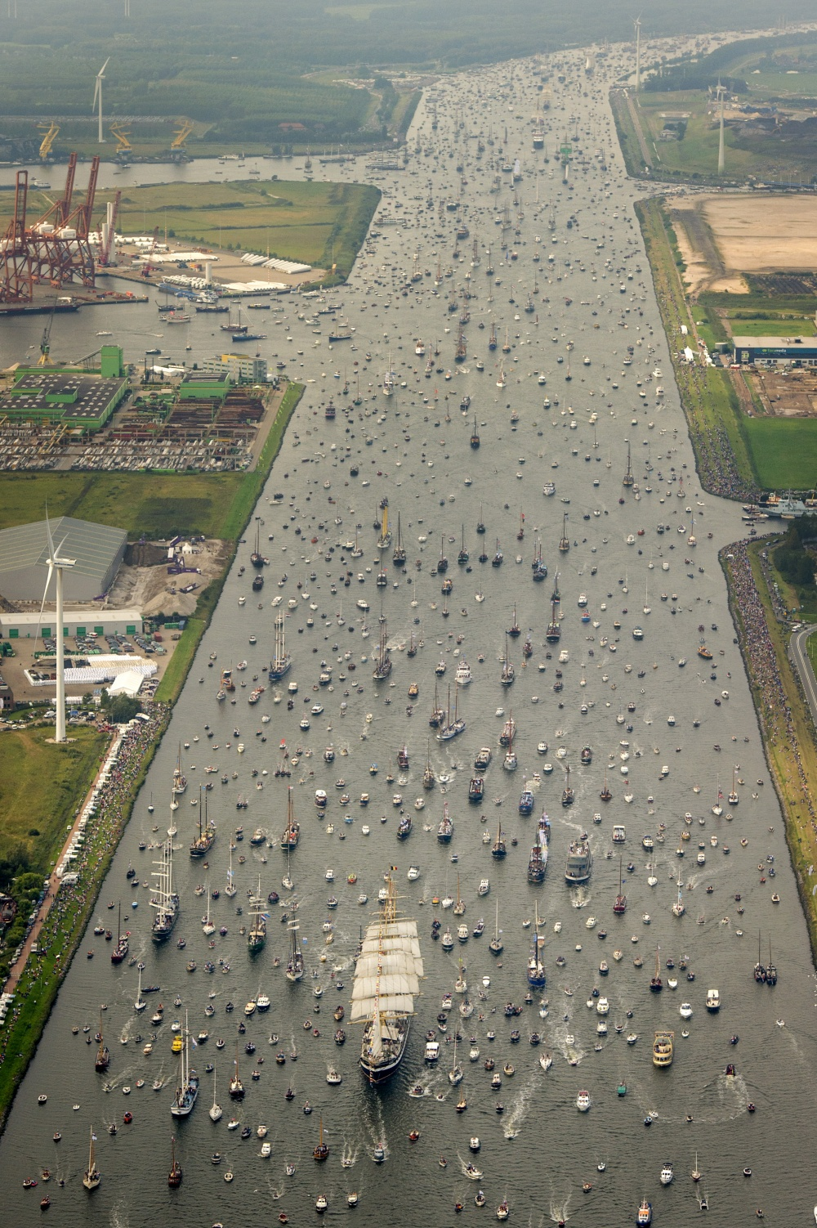
Every five years here gather millions of people to see a show that could not be seen in any other place on earth. It is really an amazing event.

