Slide 1

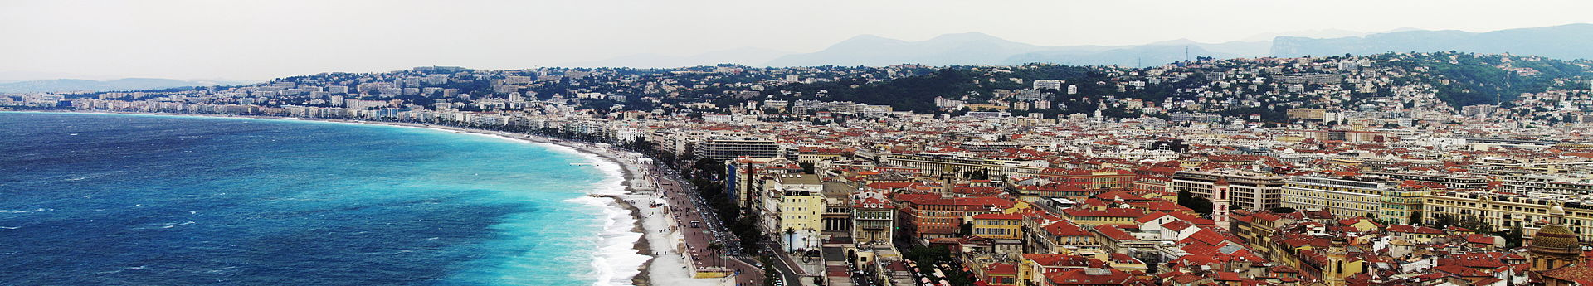
Nice, France
Photos with dates in 2005 were from Prof. Naumann’s trip

Slide 2
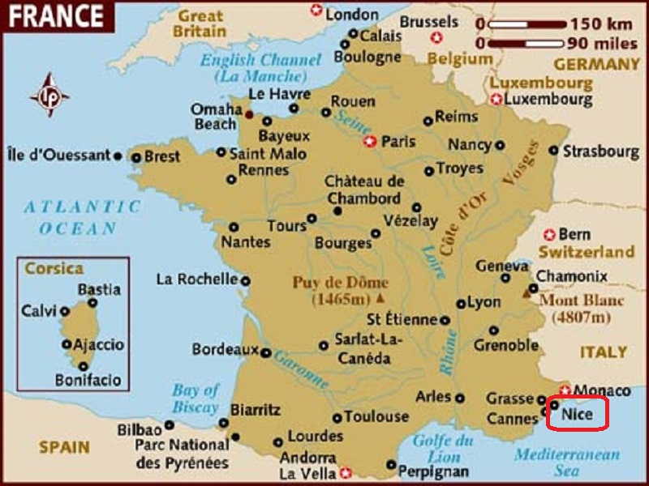
Nice is the fifth most populous city in France and the capital of the Alpes-Maritimes departement. It is located in the French Riviera on the southeast coast of France.

Slide 3
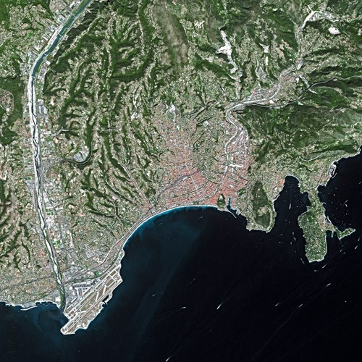
Nice seen from Spot Satellite

Slide 4
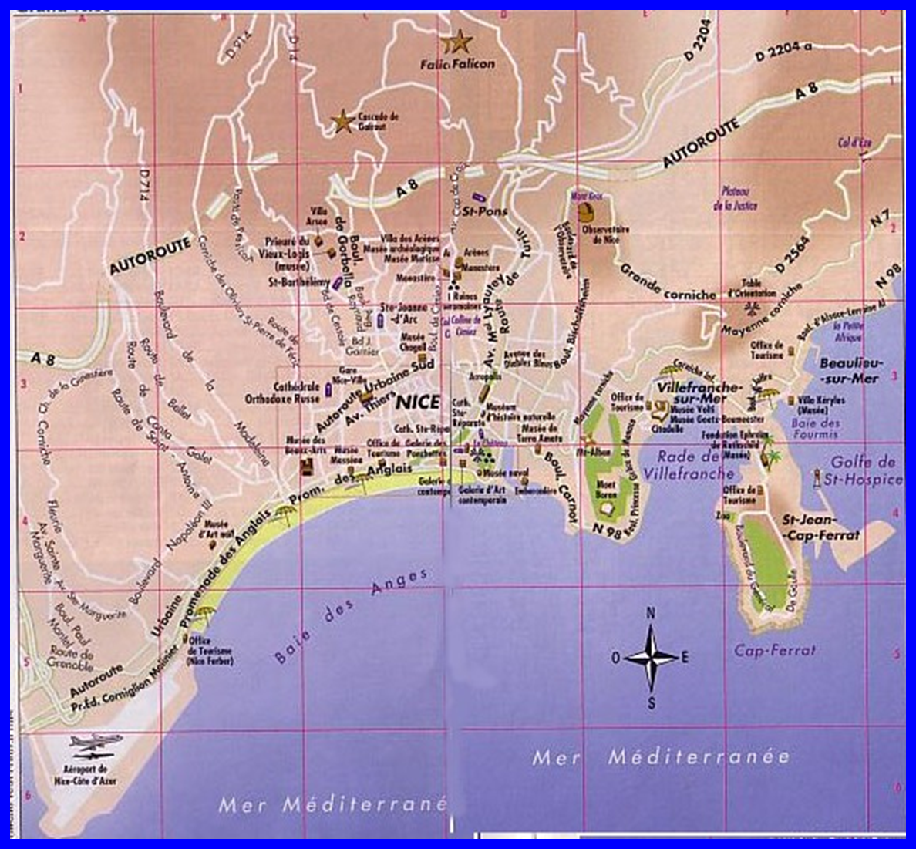
Greater Nice

Slide 5
Nice is the fifth most populous city in France and the capital of the Alpes-Maritimes département. The urban area of Nice extends beyond the administrative city limits, with a population of about 1 million on an area of 721 km2 (278 sq mi). Located in the French Riviera, on the south east coast of France on the Mediterranean Sea, at the foot of the Alps, Nice is the second-largest French city on the Mediterranean coast and the second-largest city in the Provence-Alpes-Côte d'Azur region after Marseille. Nice is about 13 kilometres (8 miles) from the principality of Monaco, and its airport is a gateway to the principality as well.
The city is nicknamed Nice la Belle (Nissa La Bella in Niçard), which means Nice the Beautiful, which is also the title of the unofficial anthem of Nice, written by Menica Rondelly in 1912.

Slide 6
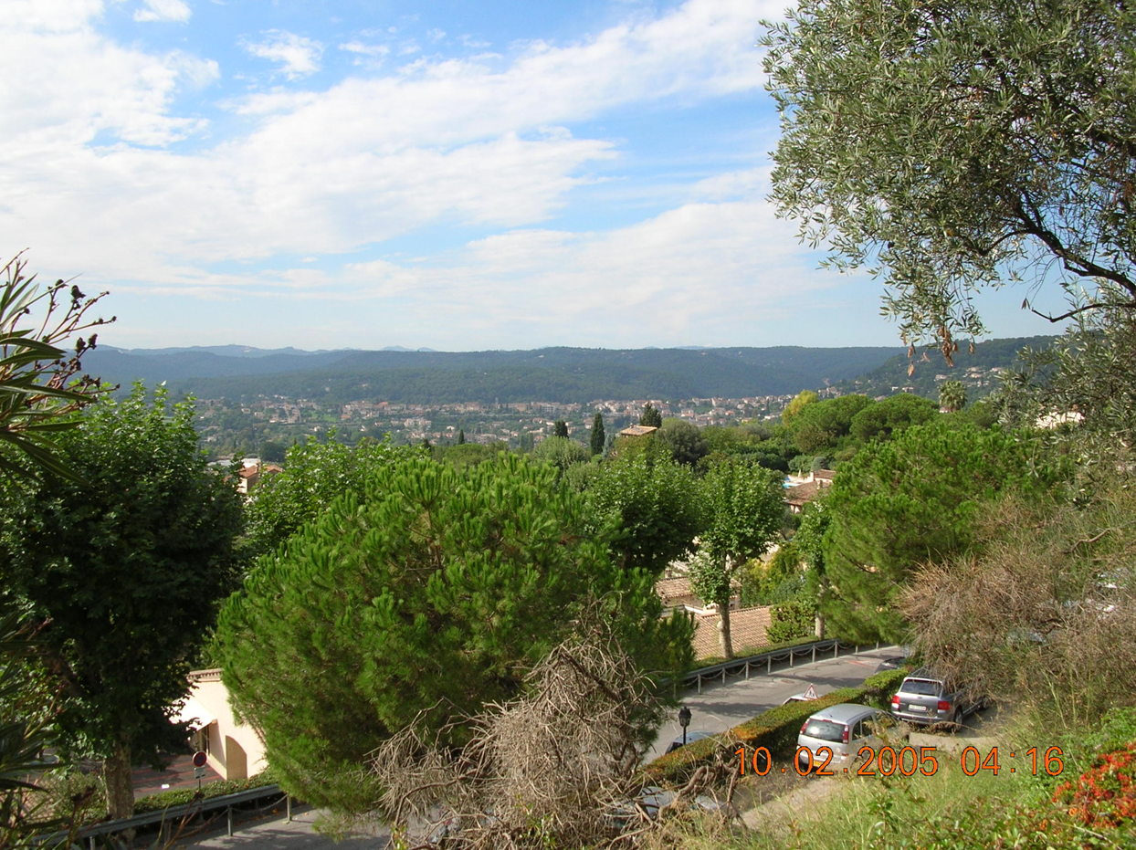
On the road to Nice

Slide 7
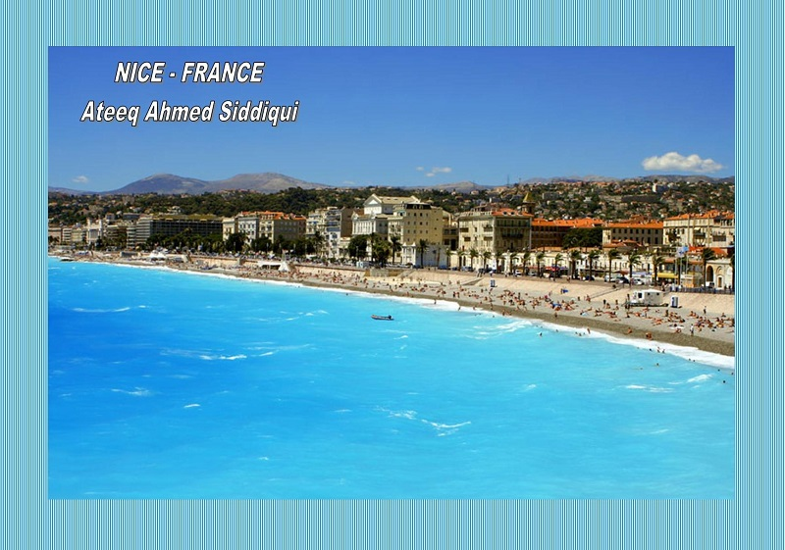

Slide 8
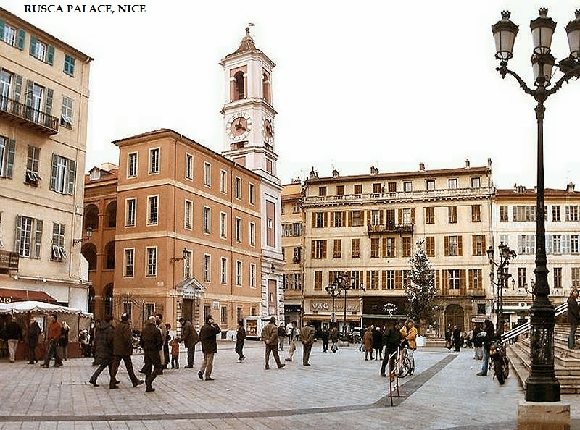

Slide 9
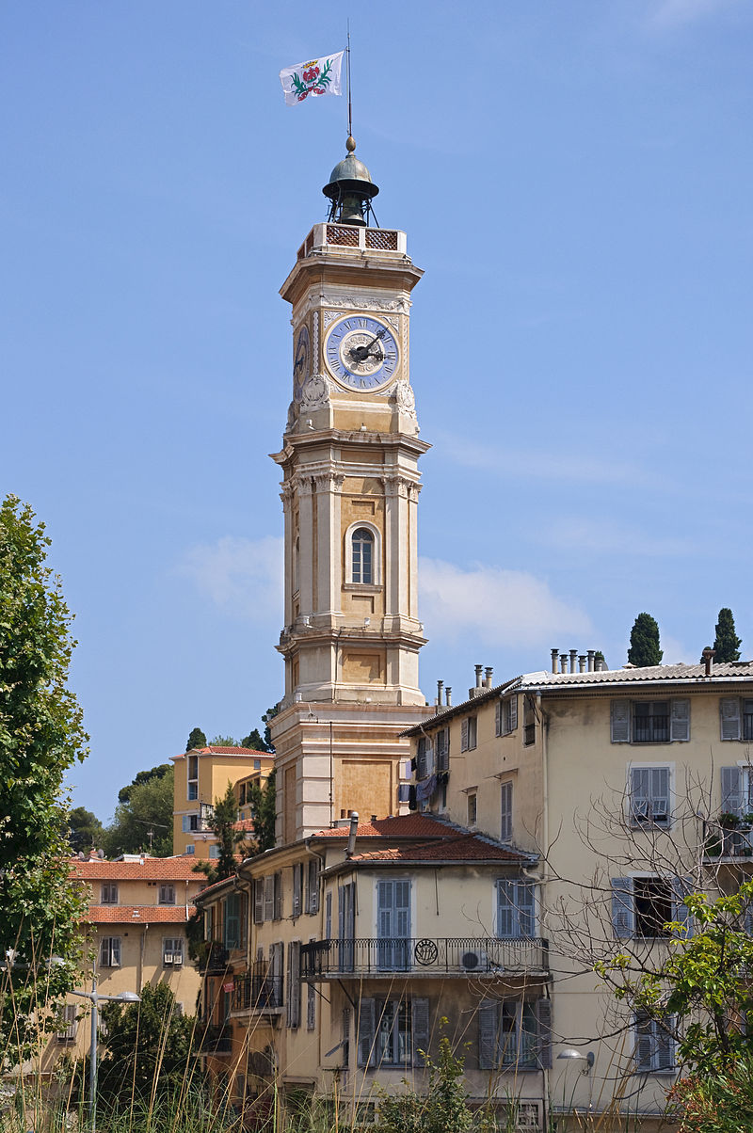
The Tower of St François

Slide 10
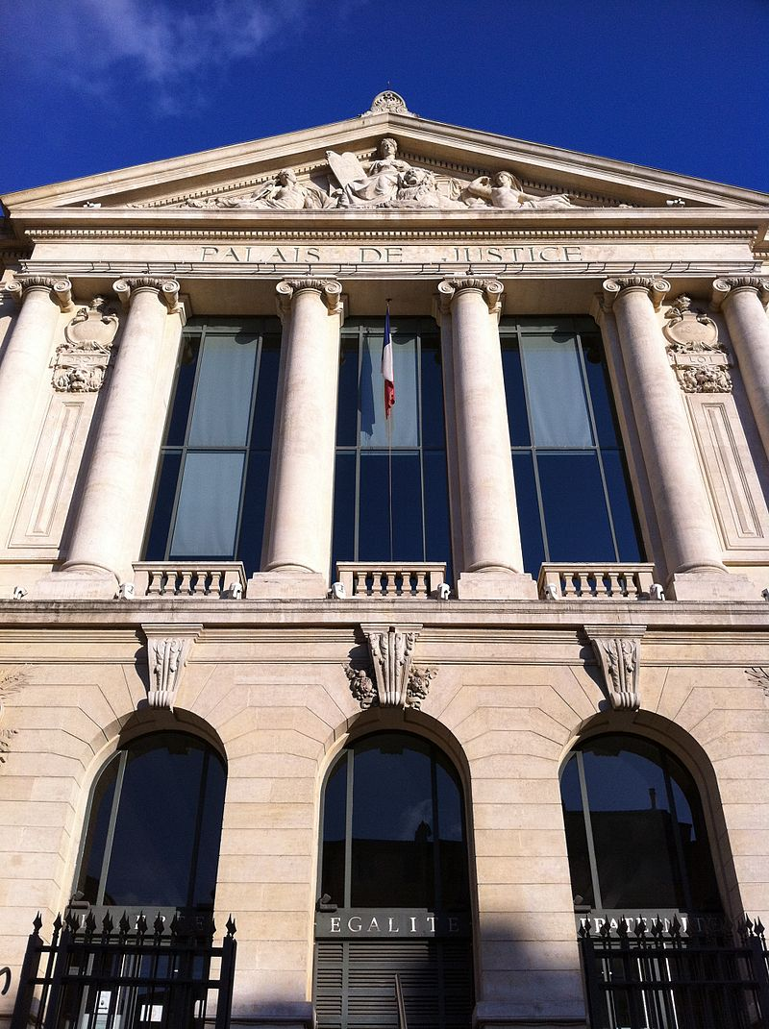
The Palais de Justice

Slide 11
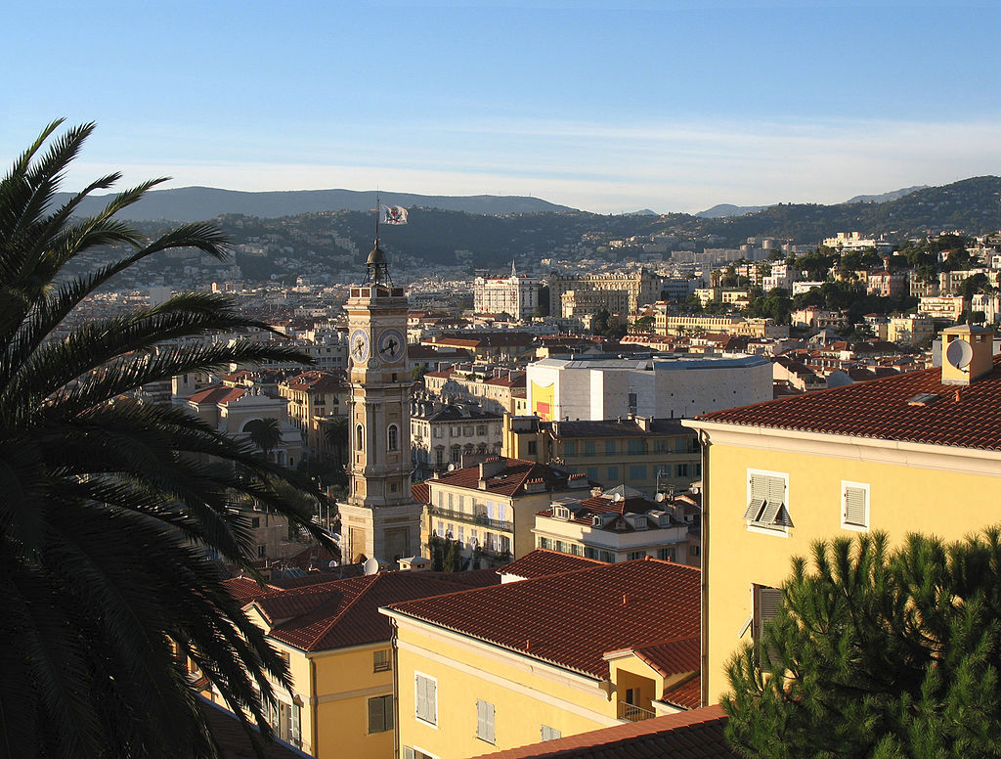
View of the old town

Slide 12
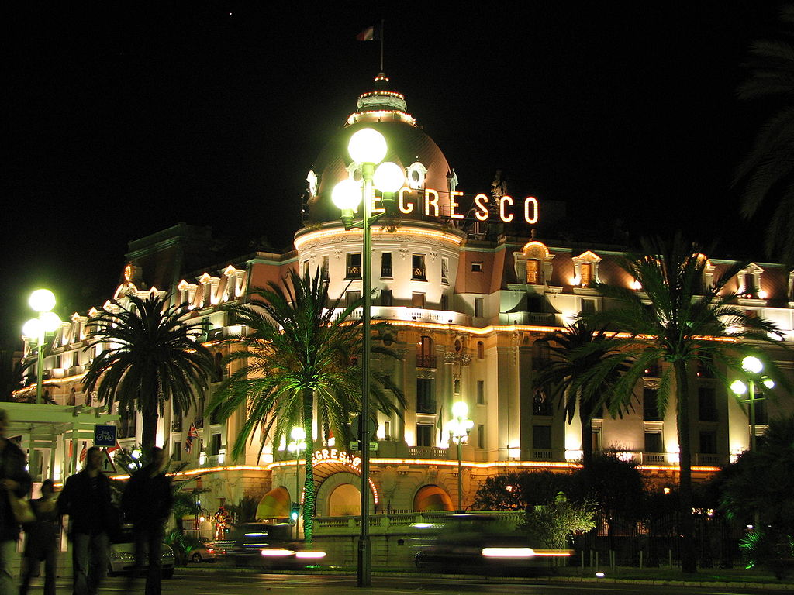
Hotel Negresco

Slide 13
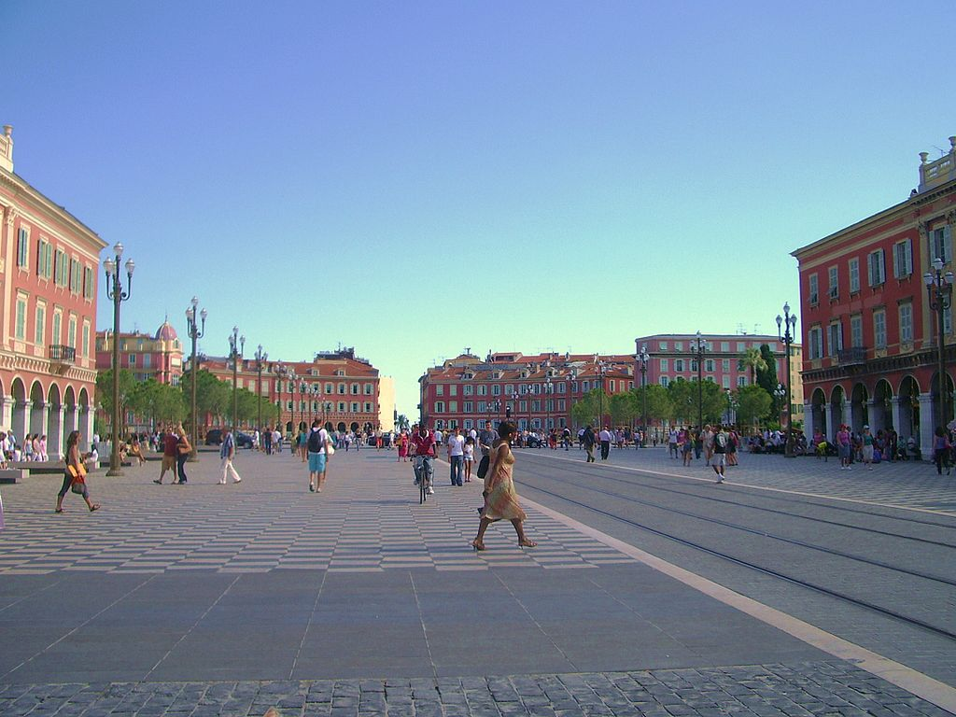
View of the Place Masséna

Slide 14
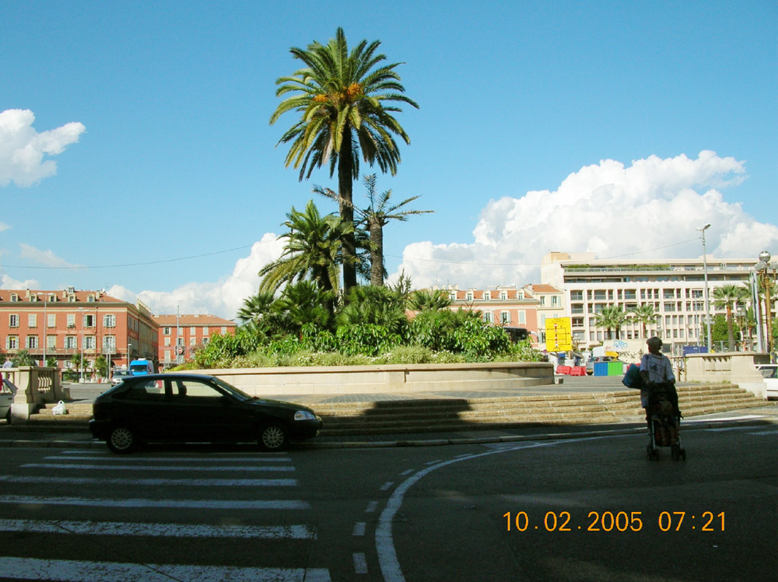
Place Masséna

Slide 15
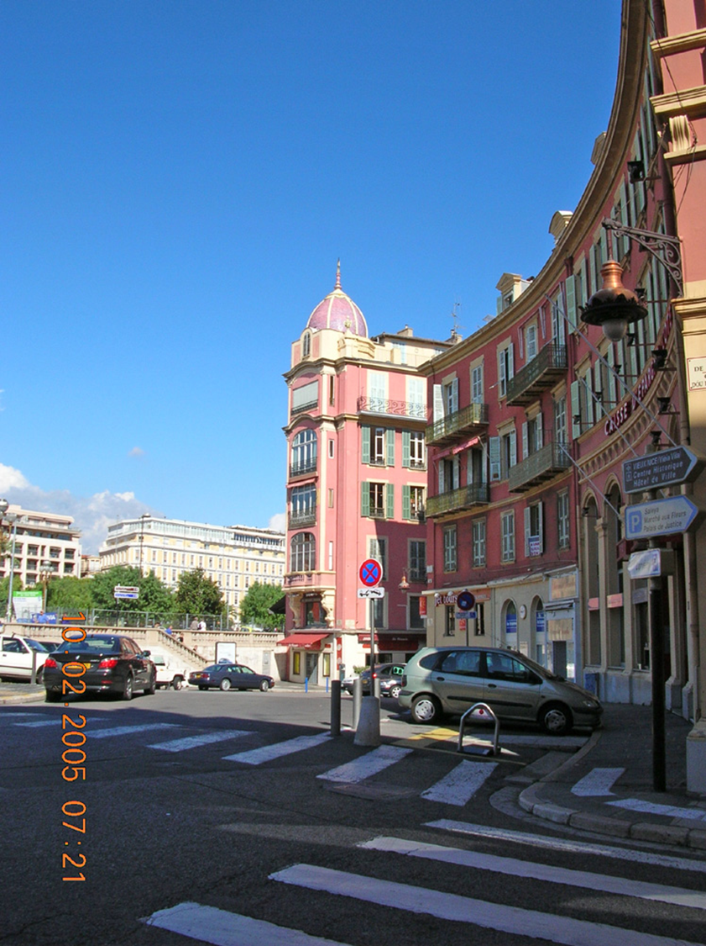
Curved building facades.

Slide 16
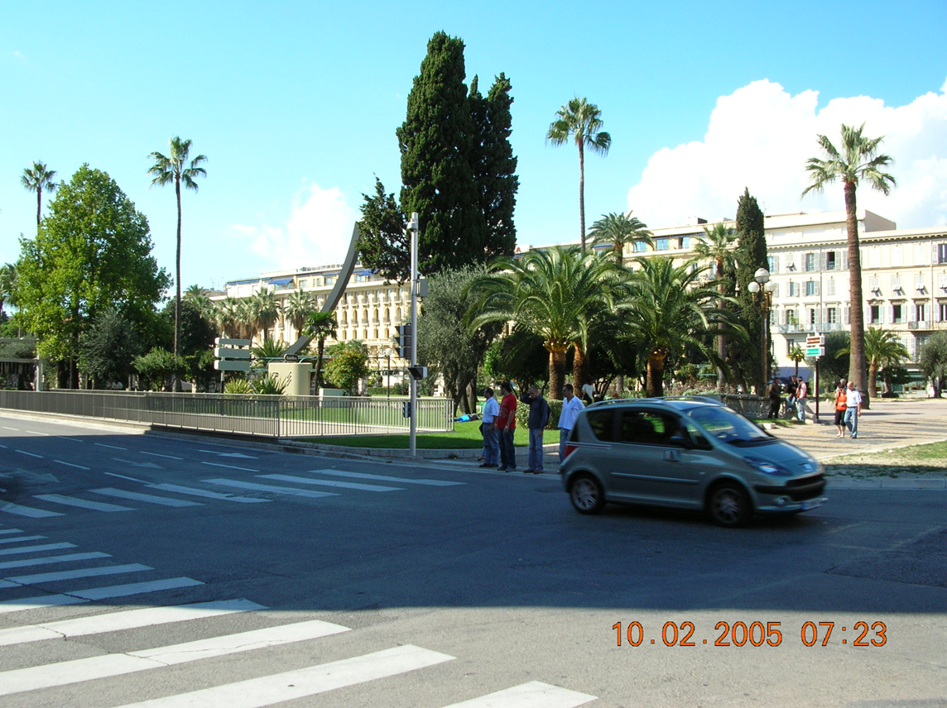
Curved sculpture in traffic island park

Slide 17
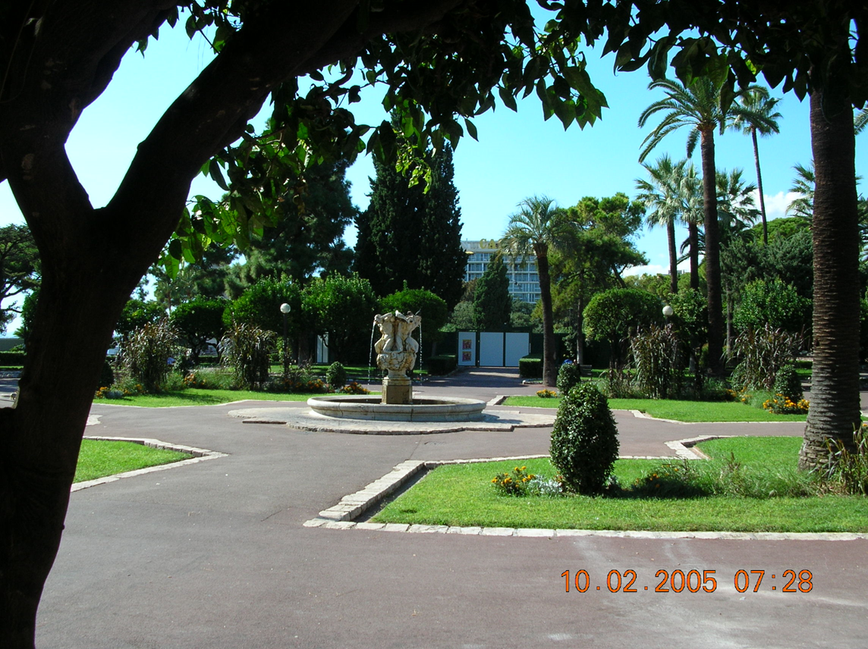
Small park

Slide 18
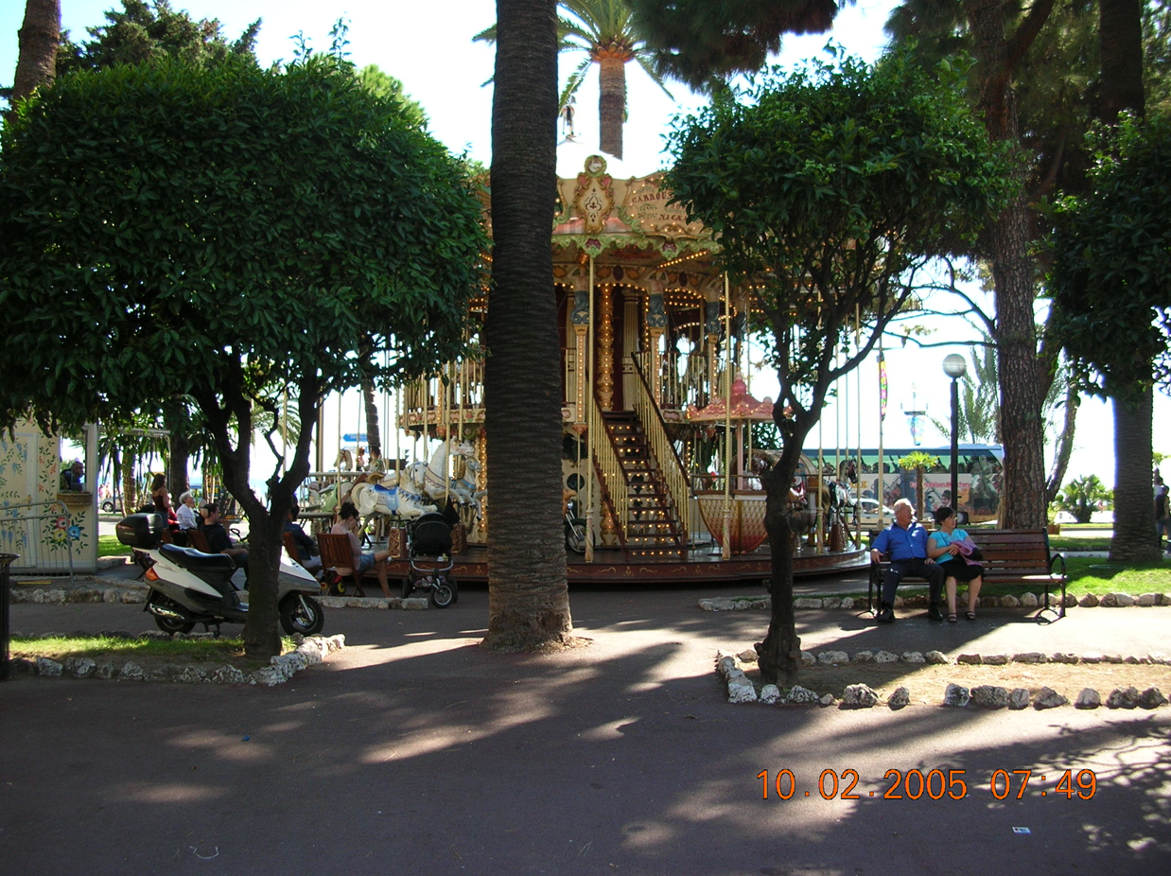
Small carousel in the park

Slide 19
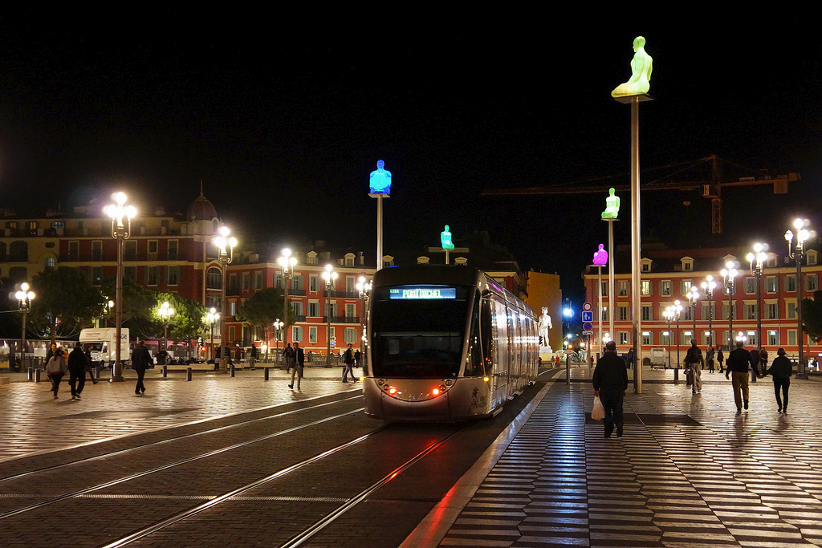
Place Masséna by night

Slide 20
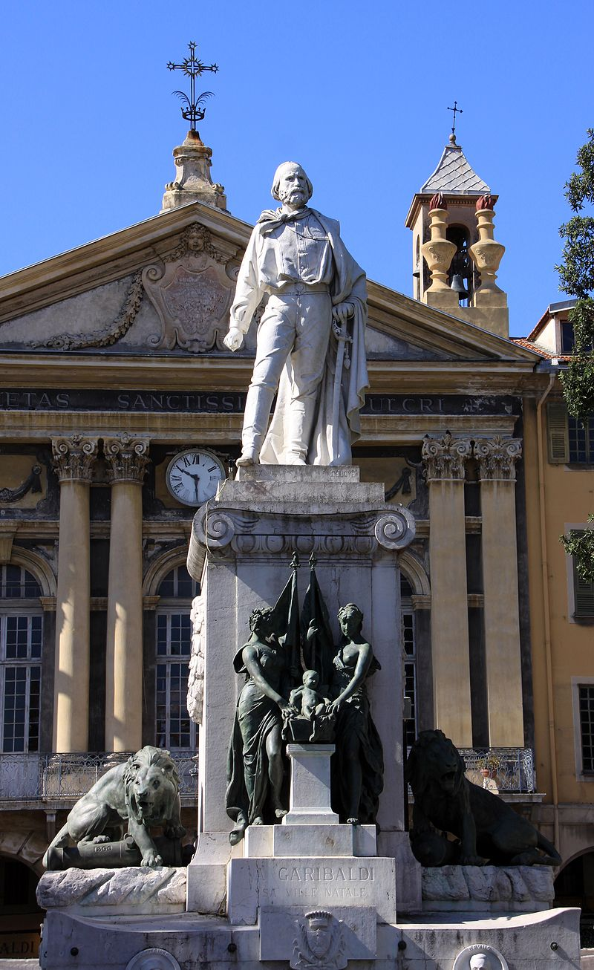
Garibaldi's monument, Place Garibaldi

Slide 21
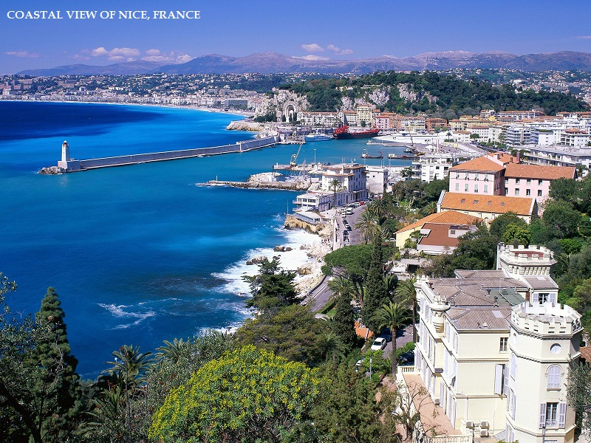

Slide 22
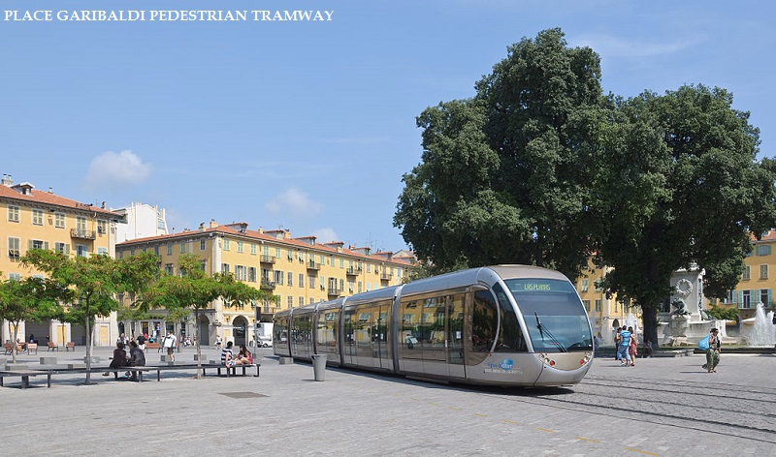

Slide 23
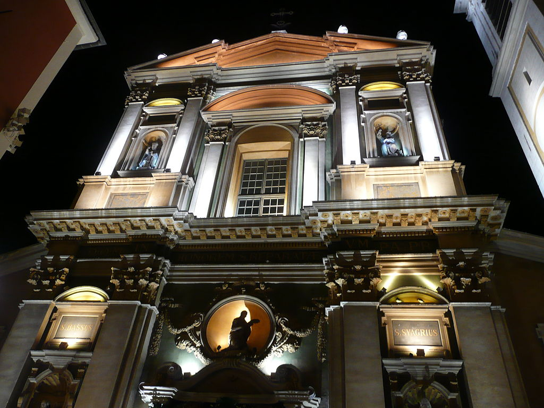
The Cathedral

Slide 24
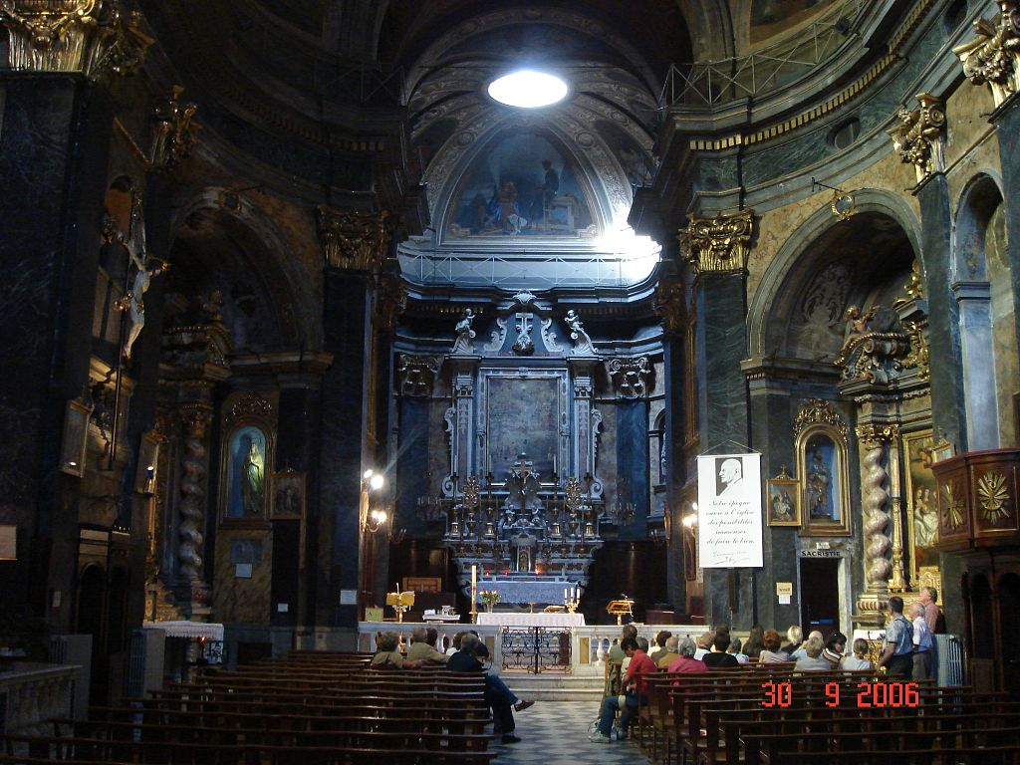
The church of St. Martin in Nice

Slide 25
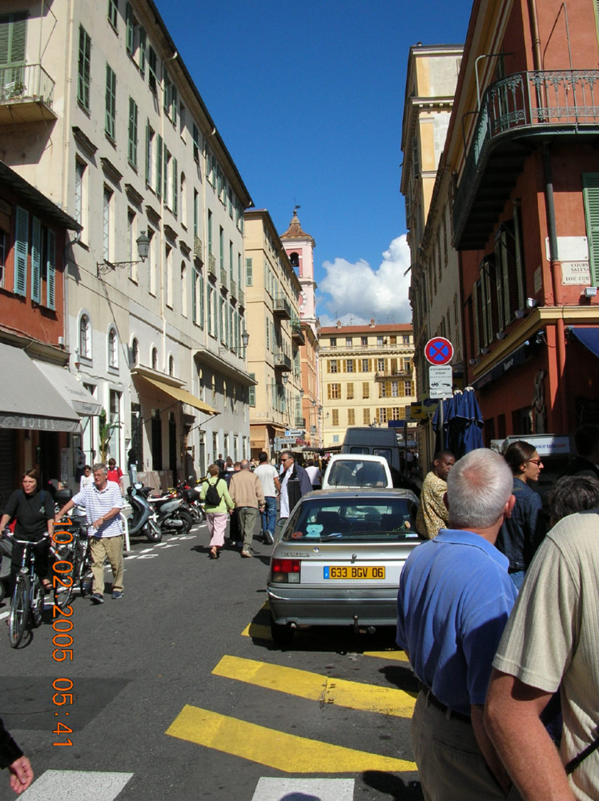
Commercial side street on the way to the flower market.

Slide 26
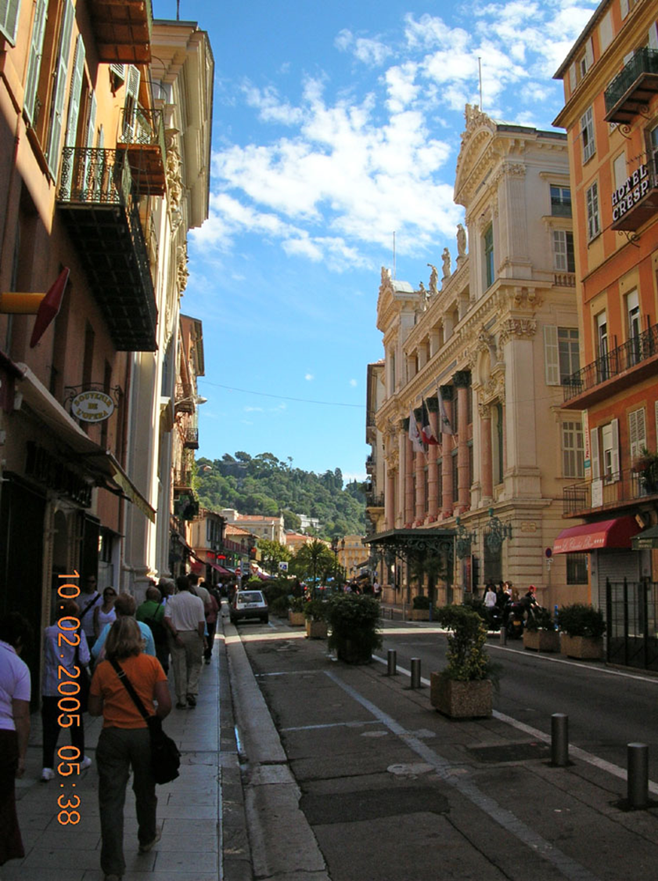

Slide 27
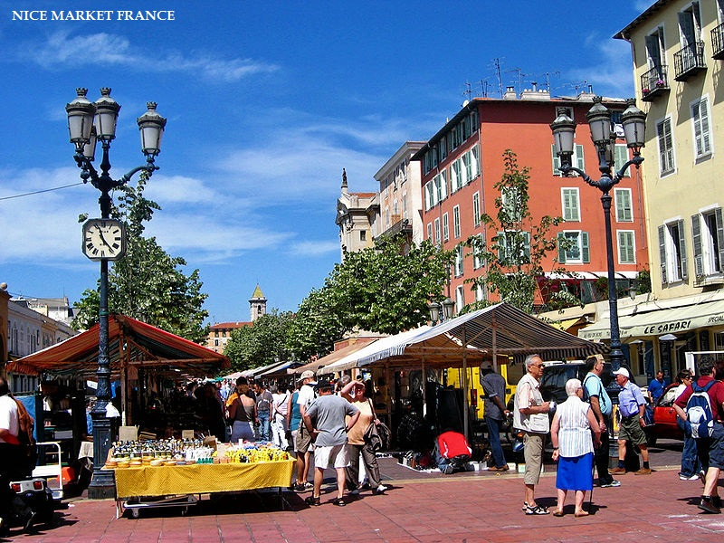
Saleya Course

Slide 28
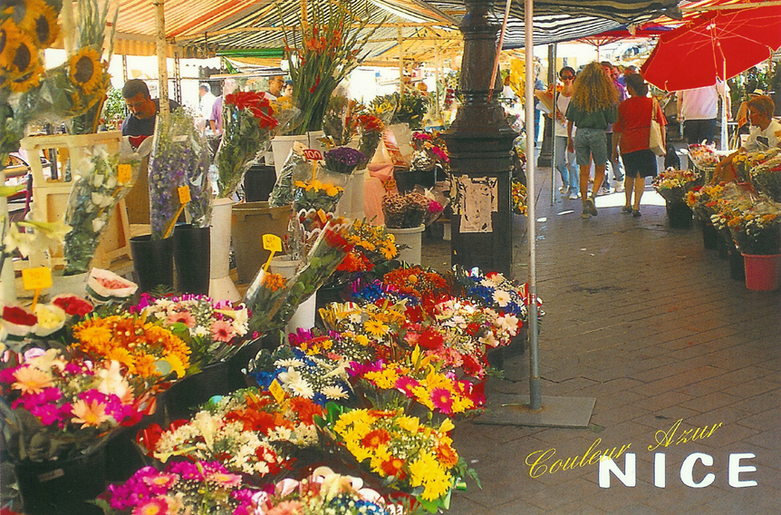

Slide 29
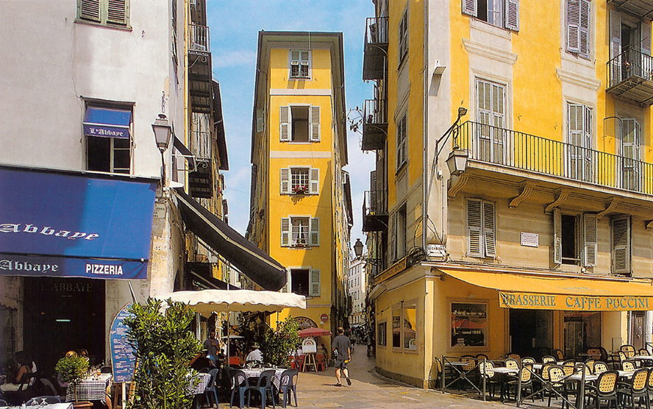

Slide 30
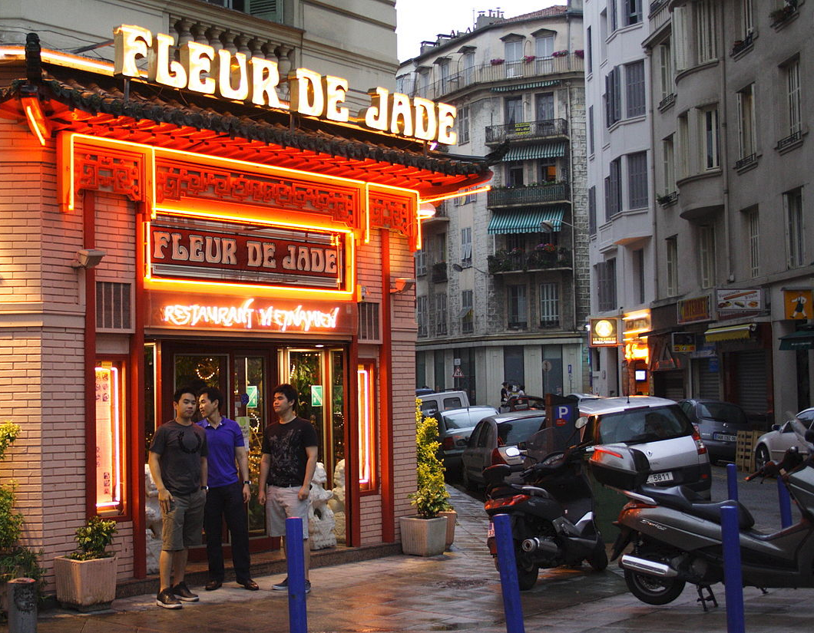
Nice residents of Vietnamese descent stand in front of one of the many Vietnamese restaurants of the city.

Slide 31
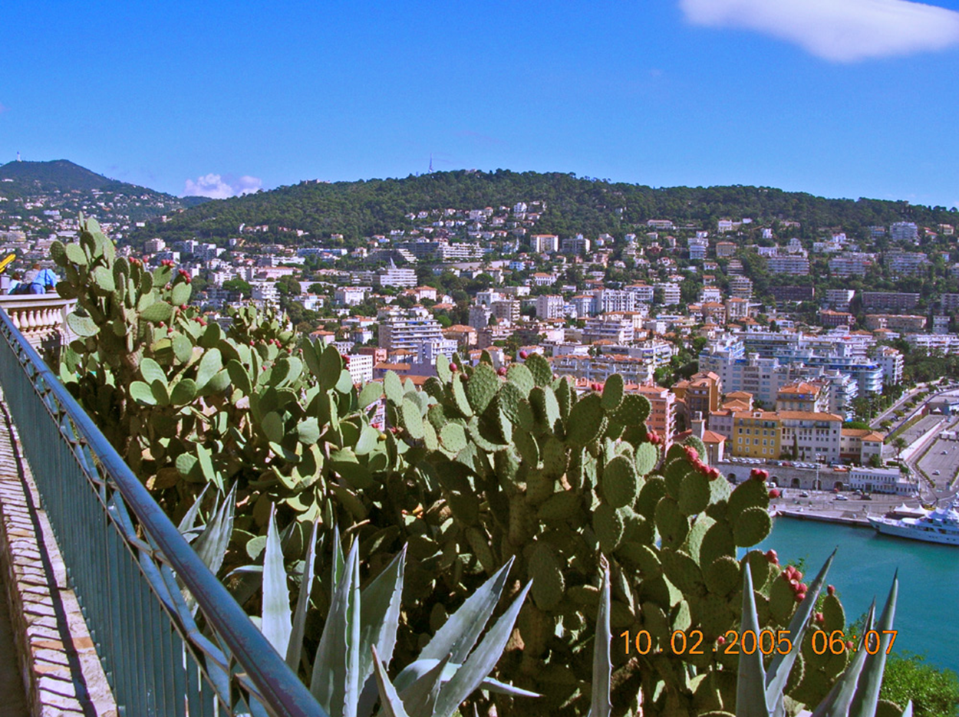
Prickly Pear cacti abound along the Mediterranean.

Slide 32
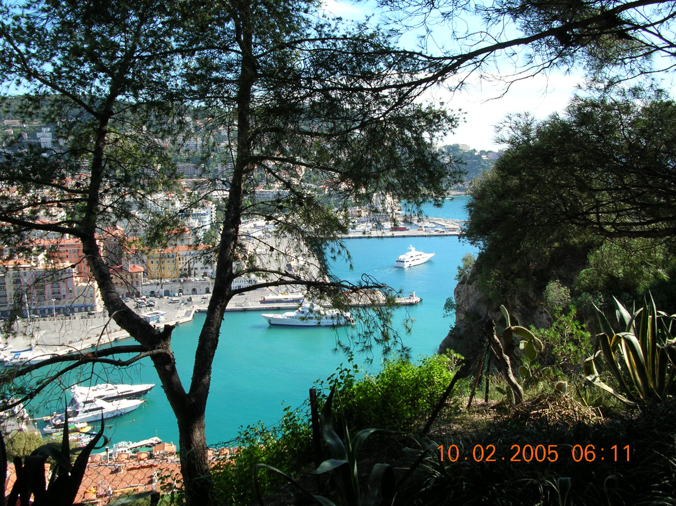

Slide 33
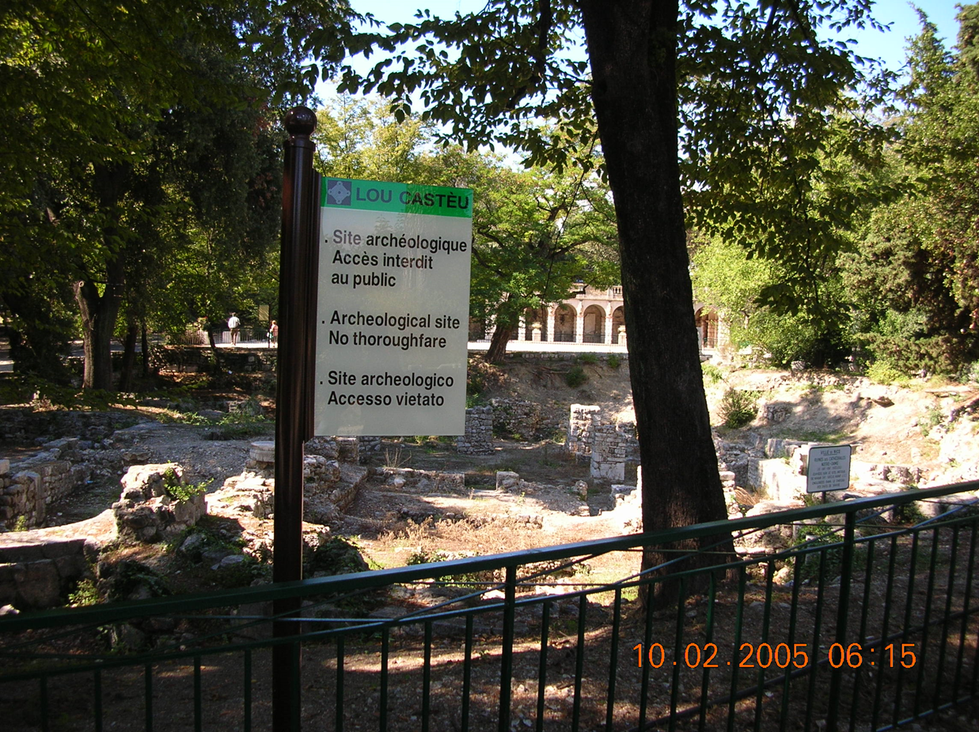

Slide 34
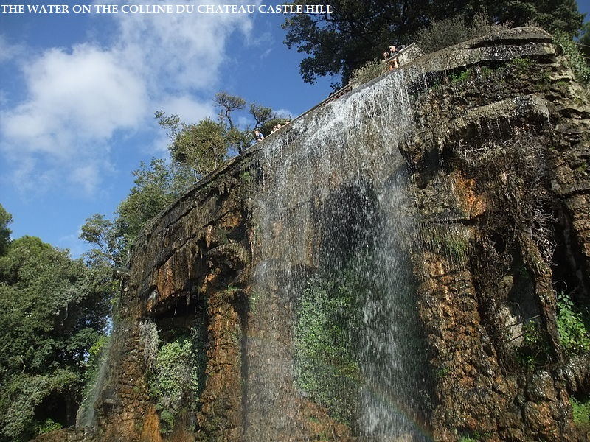

Slide 35
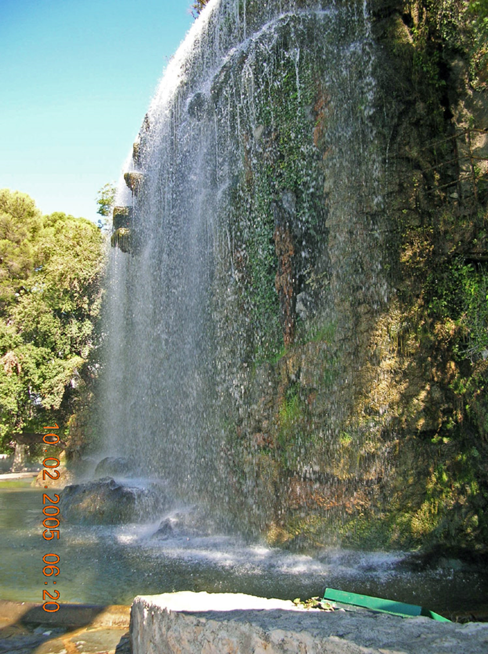
Waterfall fountain at the top of the observation area & park.

Slide 36
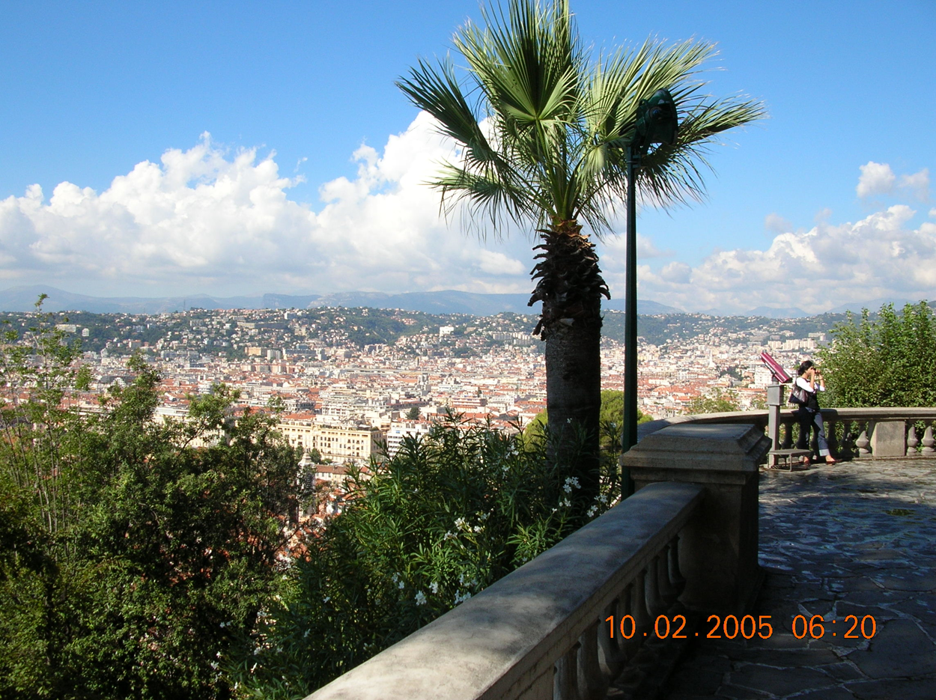
View looking away from the waterfall

Slide 37
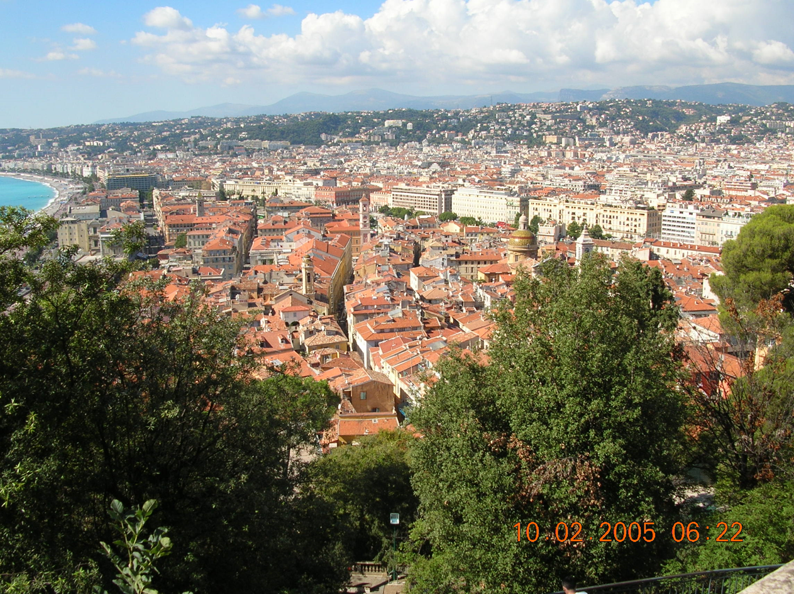
Typical Mediterranean cityscape.

Slide 38
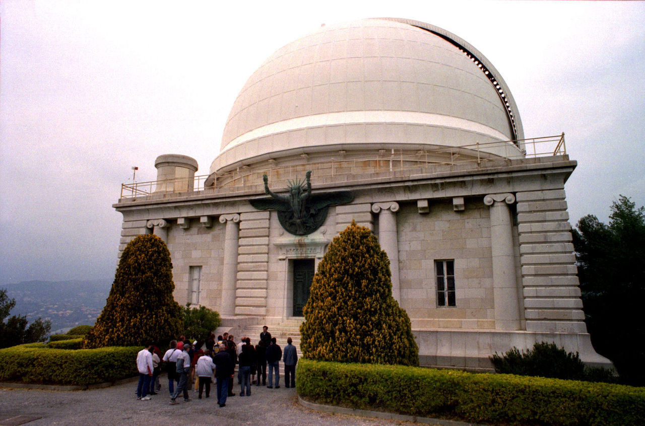
View of the Bischoffsheim cupola, main cupola of Nice Observatory

Slide 39
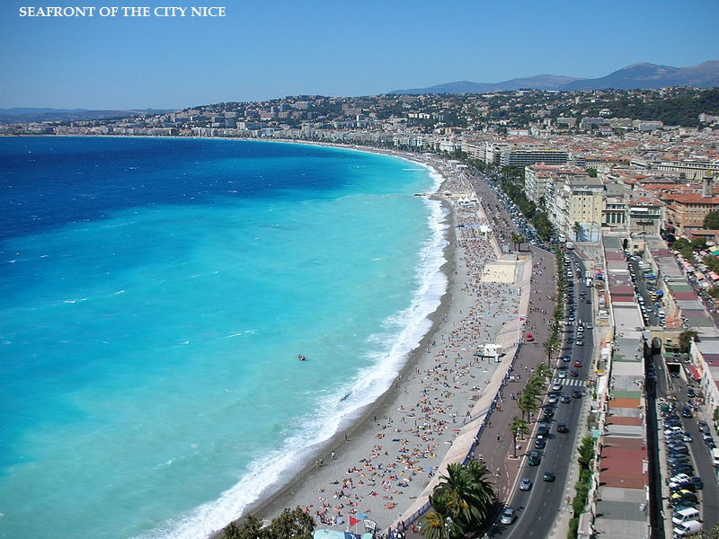

Slide 40
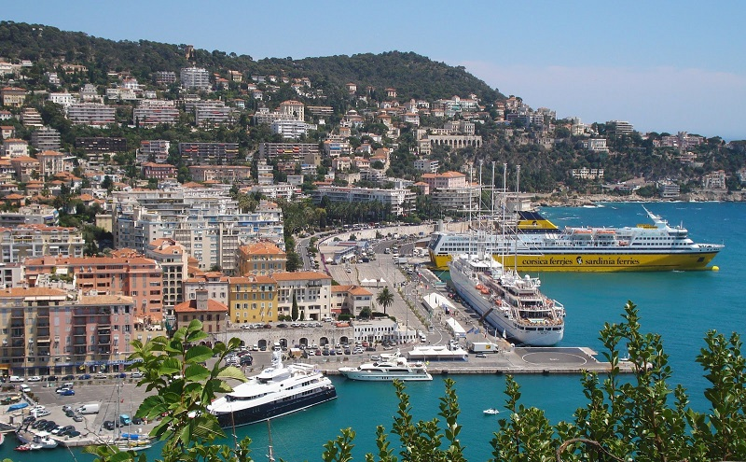

Slide 41
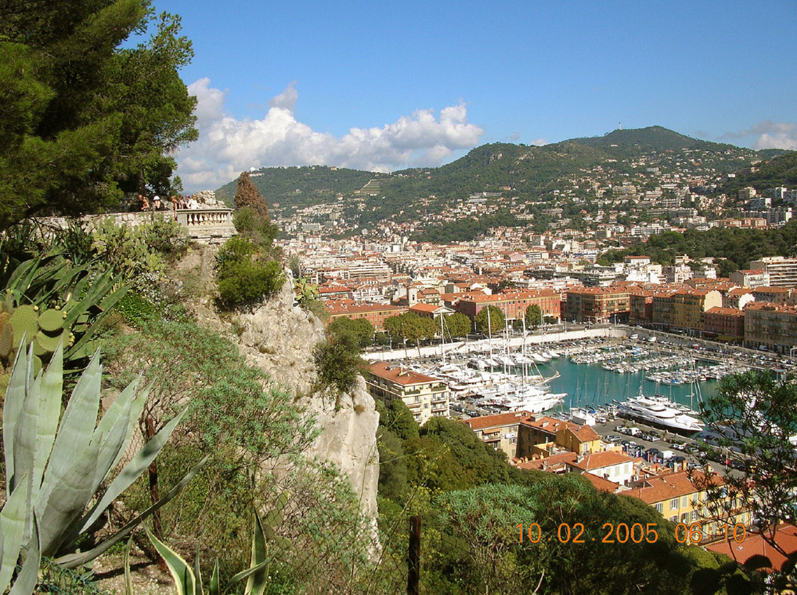
The marina section of the harbor.

Slide 42
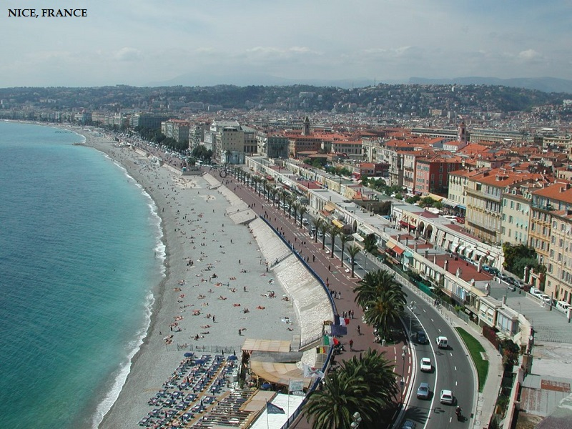

Slide 43
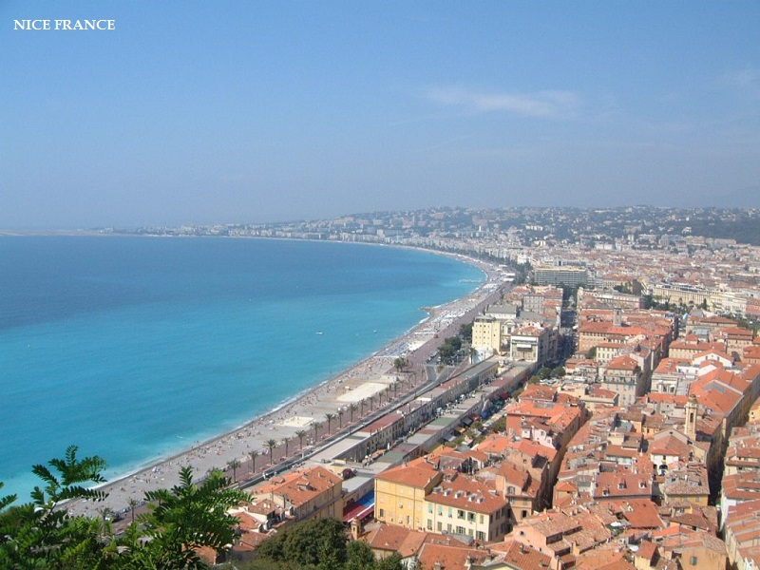

Slide 44
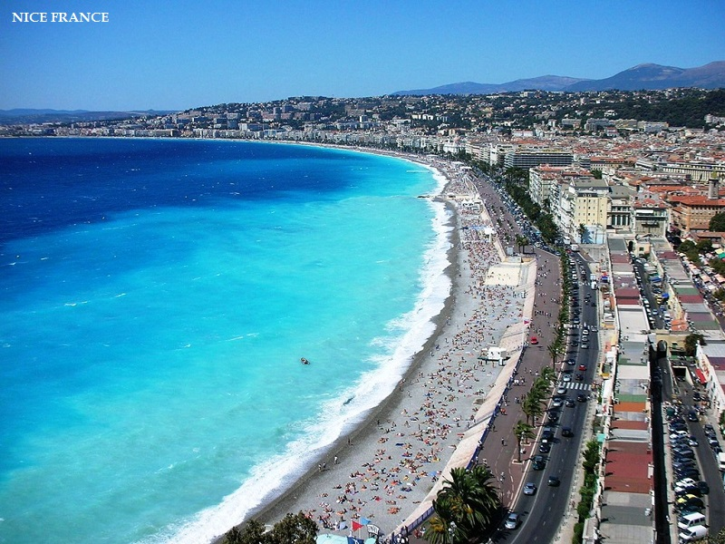

Slide 45
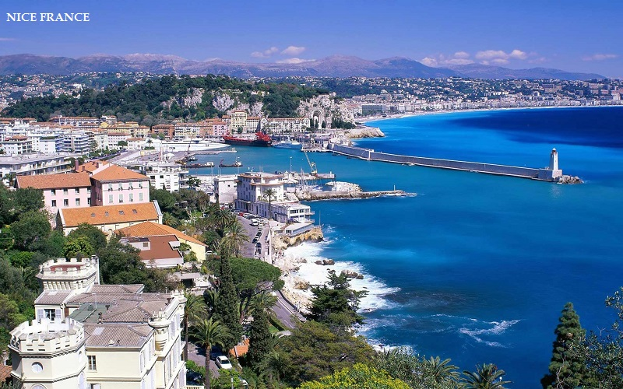

Slide 46
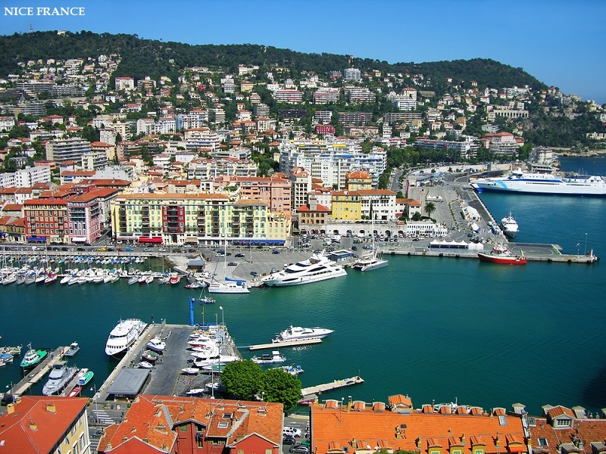

Slide 47
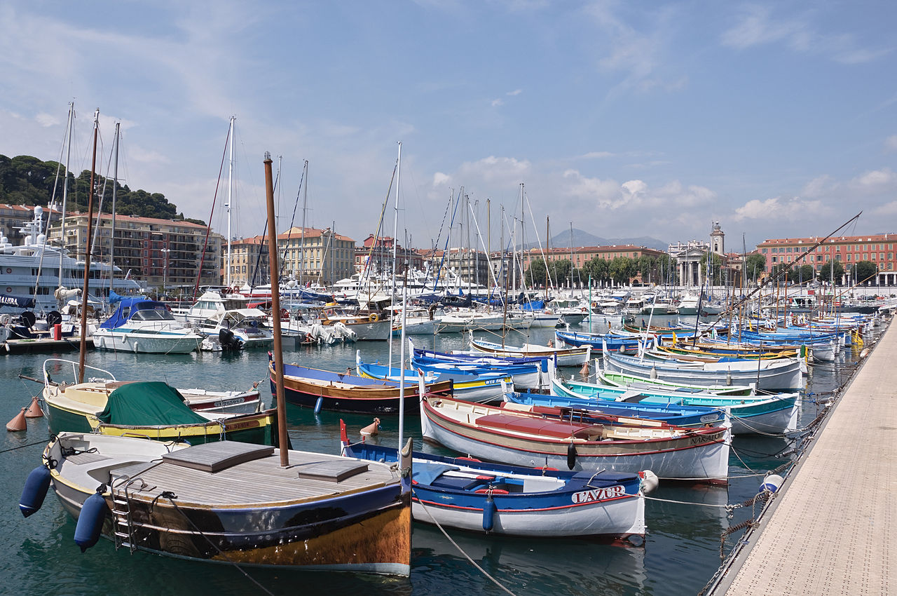
The port of Nice

Slide 48
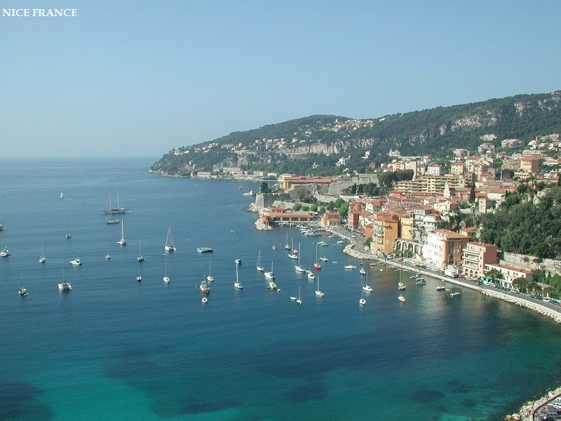

Slide 49
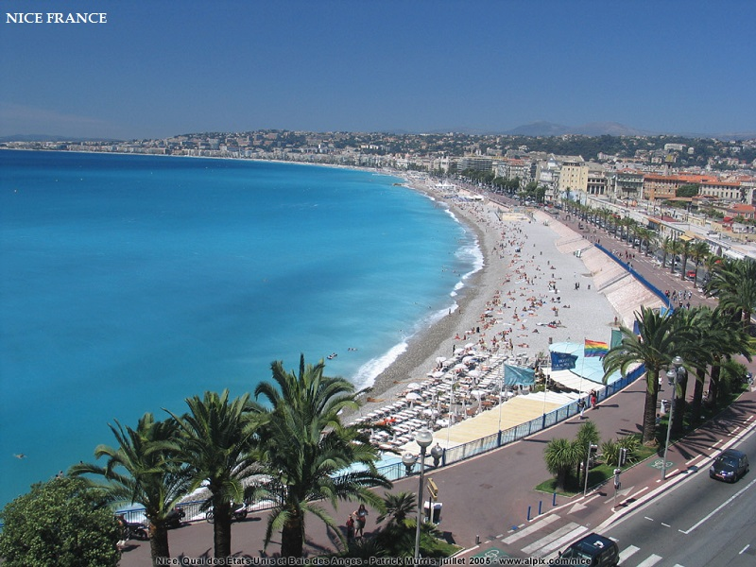

Slide 50
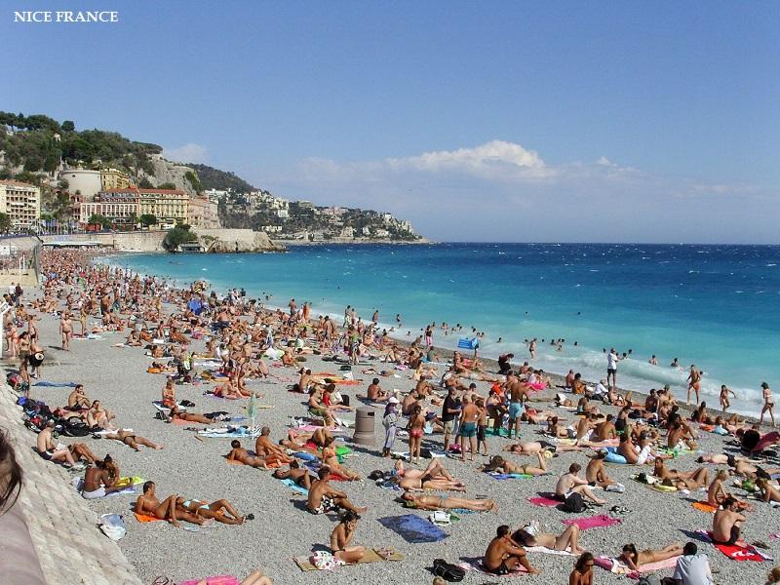

Slide 51
