Slide 1
Moscow City Looked Like A Fairytale During Orthodox Christmas
by Sofia

Slide 2
Moscow city is the capital and the largest city in Russia; not only known as the capital of the land of the birch, Moscow stands at the crossroads between the ancient the modern, between peaceful existence and the bustle of city life.
The winter in Moscow might be bitterly cold but it’s also be magical – especially if you see it through the eyes of photographer Kristina Makeeva. She was able to capture the city as if it were a winter wonderland. Her photo show locations such as the Red Square and the Kremlin, both blanketed in snow and bathed in colourful lights, with people milling about. It’s as if you were looking at images straight out of a fairytale! Each image captures a bold personal style, finding a beautiful balance between the sharp lines, the constant motion of people and precipitation, and overexposed scenes. Below you will find the most beautiful images of Moscow during Christmas. Let’s enjoy and discover the magical beauty.

Slide 3
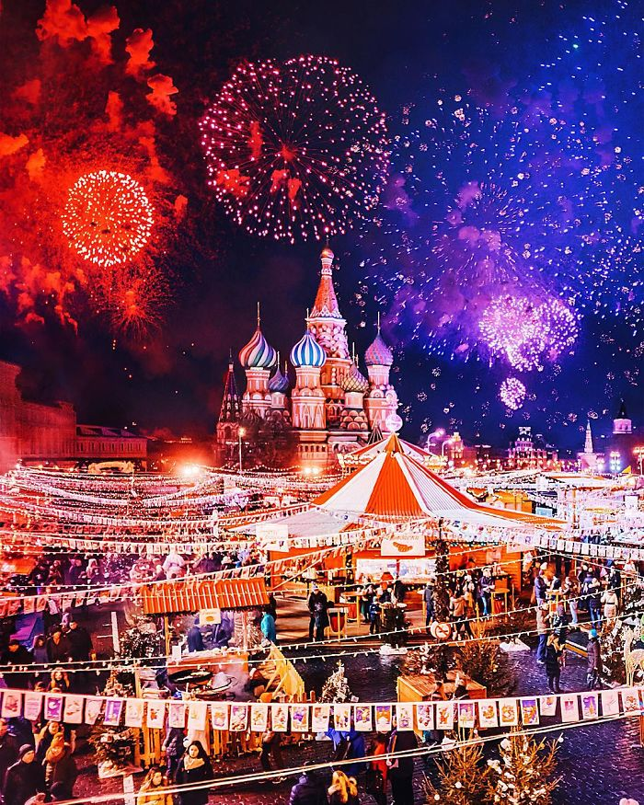

Slide 4
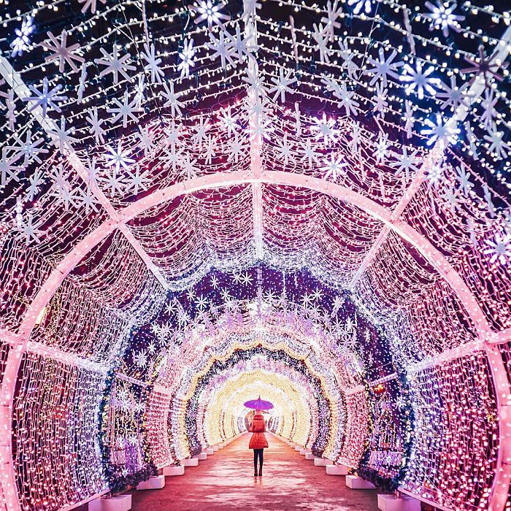

Slide 5
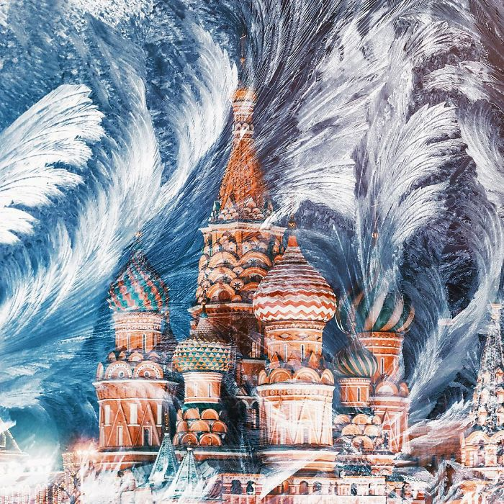

Slide 6
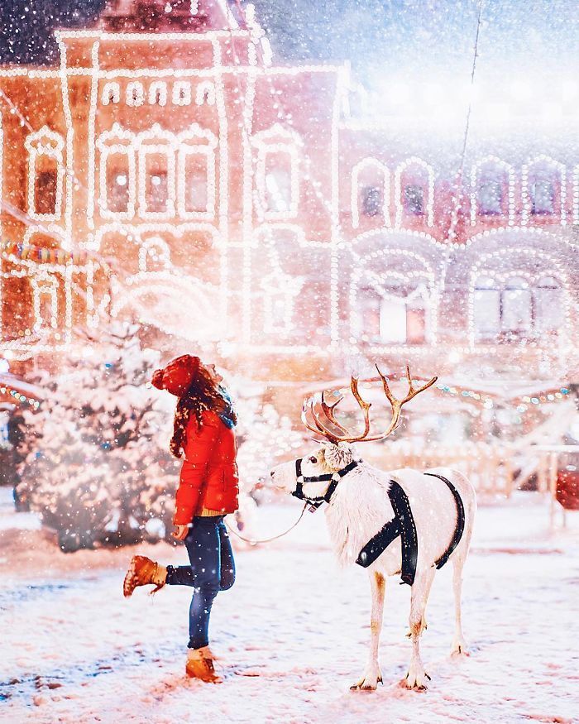

Slide 7
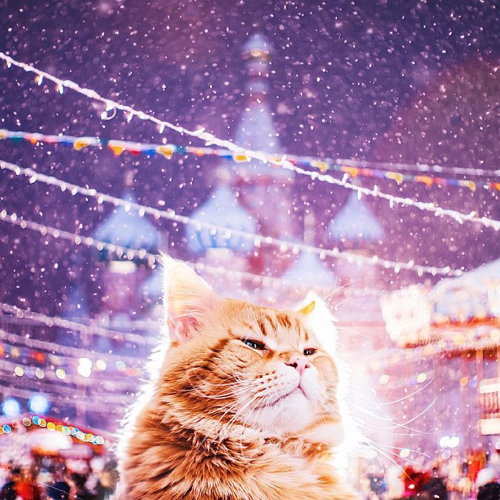

Slide 8
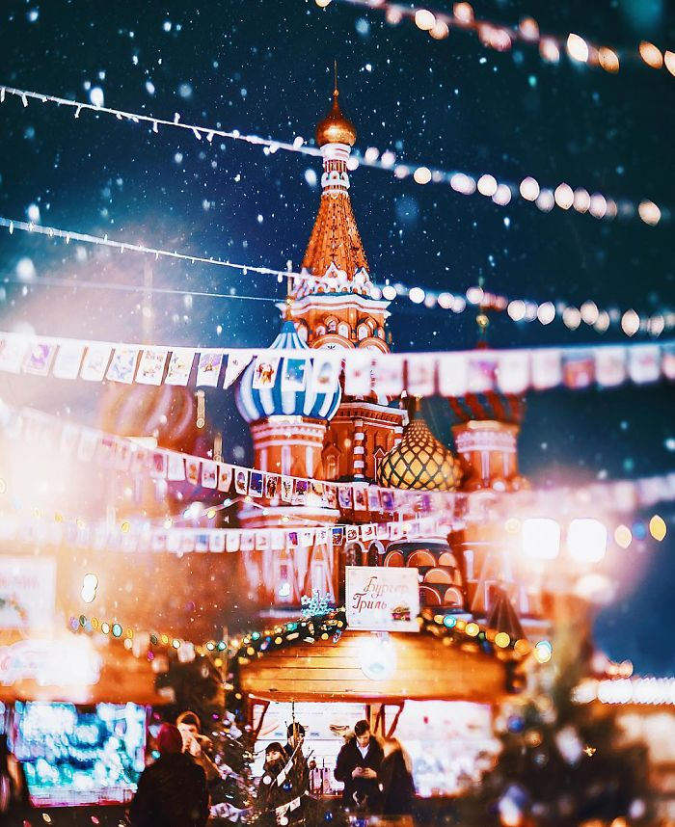

Slide 9
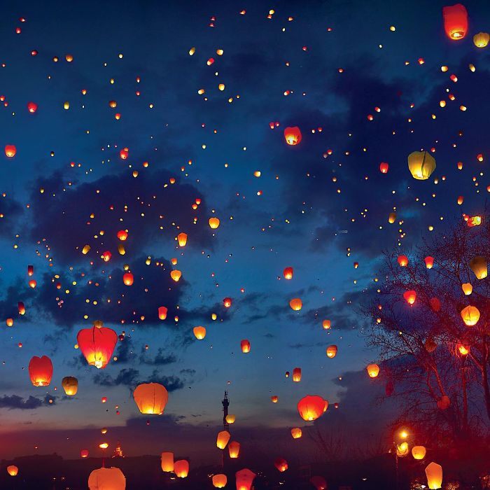

Slide 10
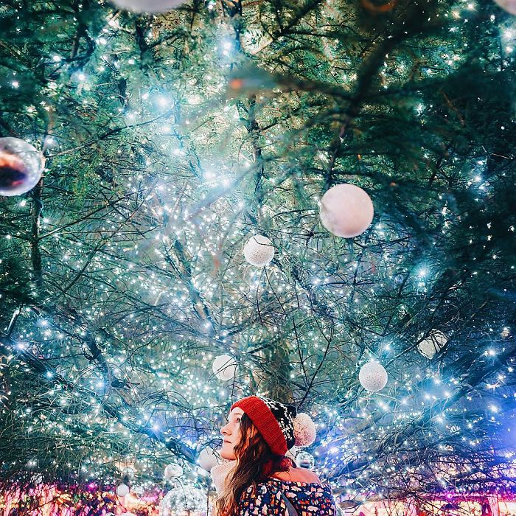

Slide 11
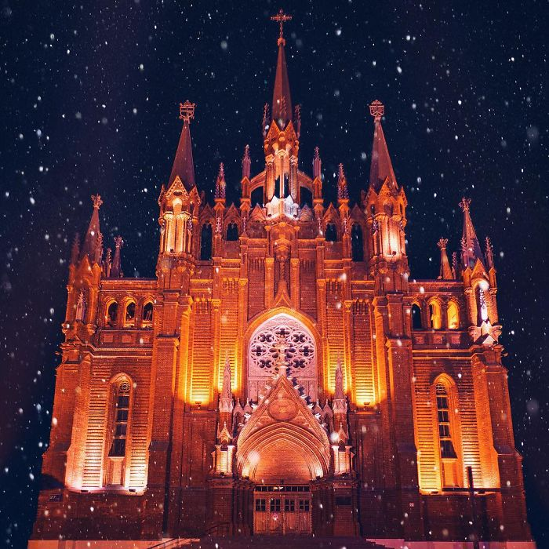

Slide 12
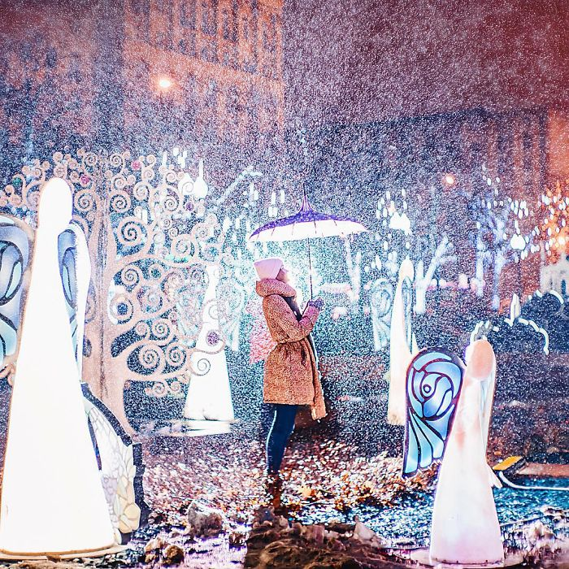

Slide 13
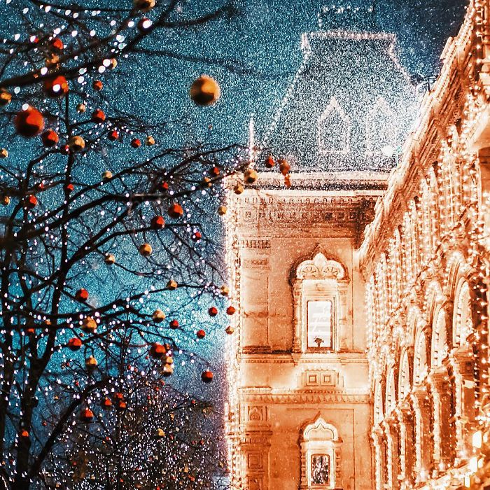

Slide 14
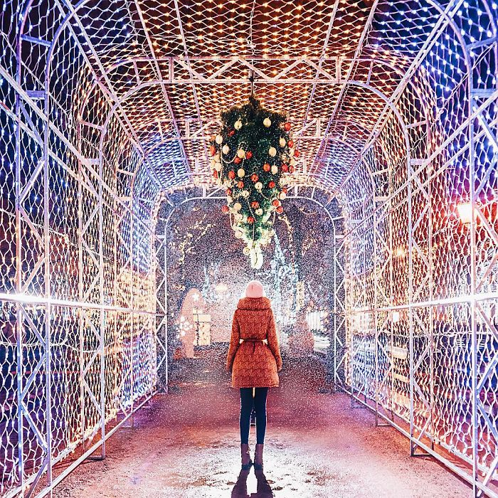

Slide 15
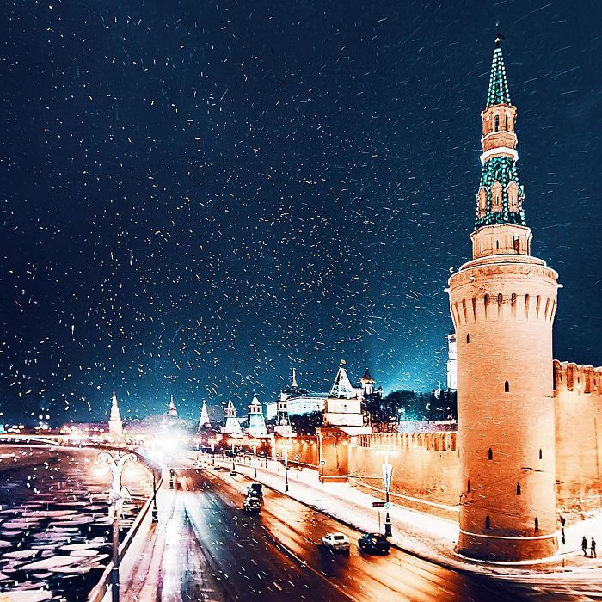

Slide 16
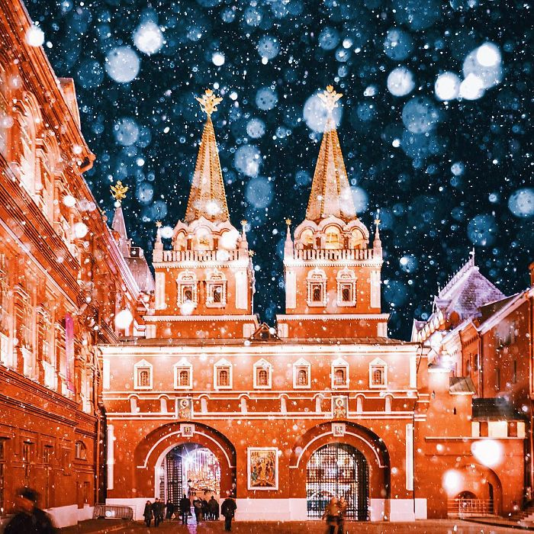

Slide 17
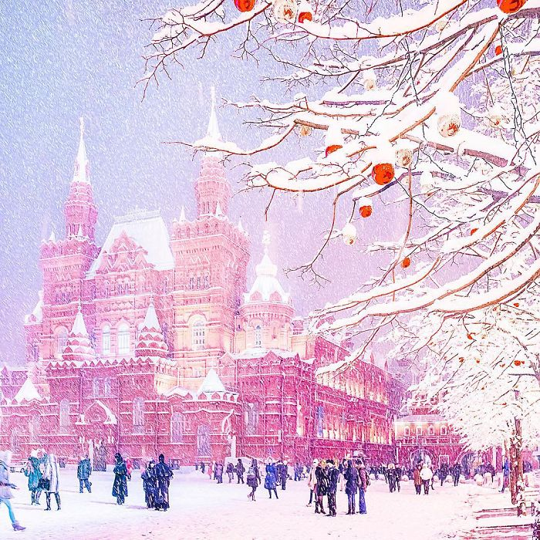

Slide 18
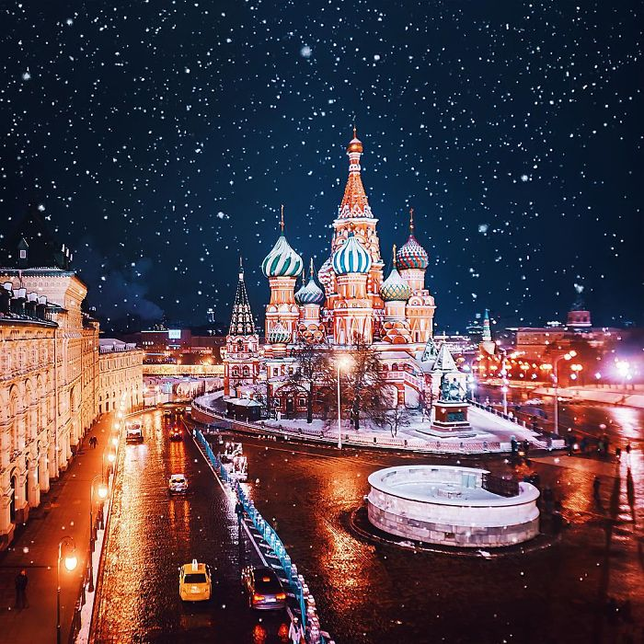

Slide 19
