Slide 1

Milan, Italy
Economic Capital of Italy

Slide 2
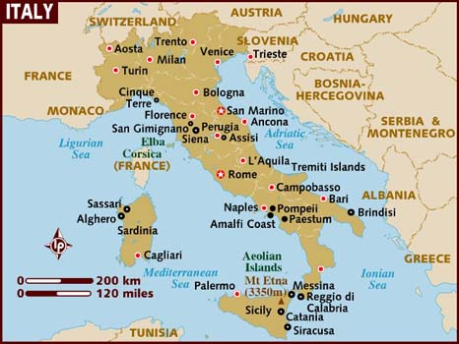
SLIDE TITLE
Milan is an Alpha leading global city, with strengths in the arts, commerce, design, education, entertainment, fashion, finance, healthcare, media, services, research, and tourism. Its business district hosts Italy's Stock Exchange and the headquarters of the largest national and international banks and companies. The city is a major world fashion and design capital,

Slide 3
Milan is a city in Italy, capital of the Lombardy region, and the most populous metropolitan area and the second most populous comune in Italy. The population of the city proper is 1,346,000, and that of the Metropolitan City of Milan is 3,209,000. According to Eurostat, the commuting area has 4,252,000 inhabitants but its built-up-urban area (that stretches beyond the boundaries of the Metropolitan City of Milan), has a population estimated to be about 5,270,000 in 1,891 square kilometres (730 square miles), ranking 4th in the European Union. The wider Milan metropolitan area, known as Greater Milan, is a polycentric metropolitan region that comprehends almost all the provinces of Lombardy and the Piedmont province of Novara and has a population of about 8,500,000 people. Milan is the main industrial and financial centre of Italy and one of global significance. In terms of GDP, it has the largest economy among European non-capital cities. Milan is considered part of the Blue Banana and lies at the heart of one of the Four Motors for Europe.

Slide 4
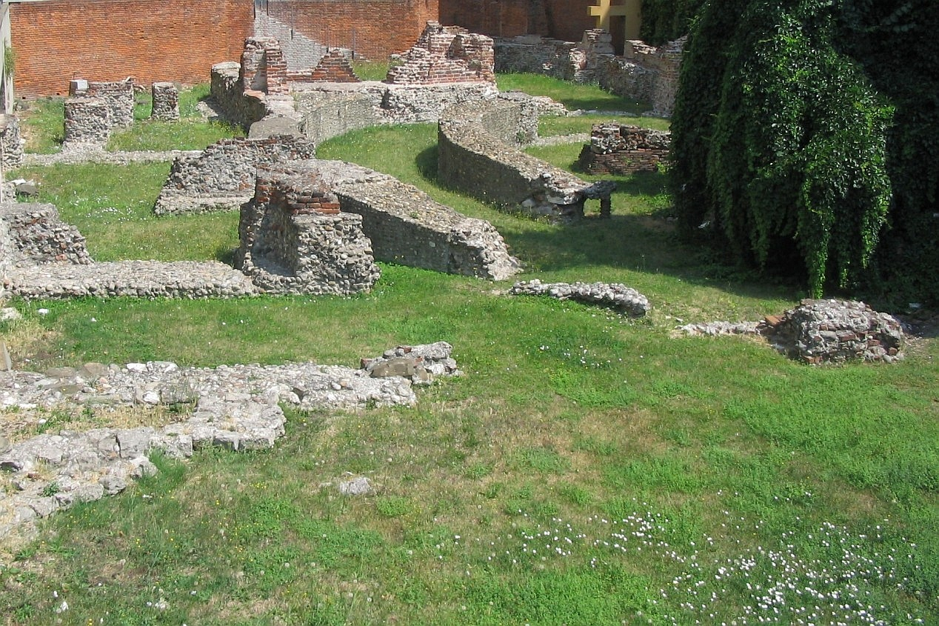
Ruins of the Emperor's palace in Milan
Here Constantine I and Licinius issued the Edict of Milan.

Slide 5
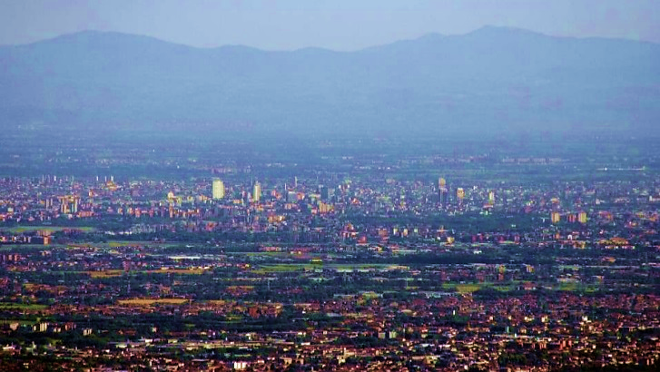
Milan with the Alps in the background

Slide 6
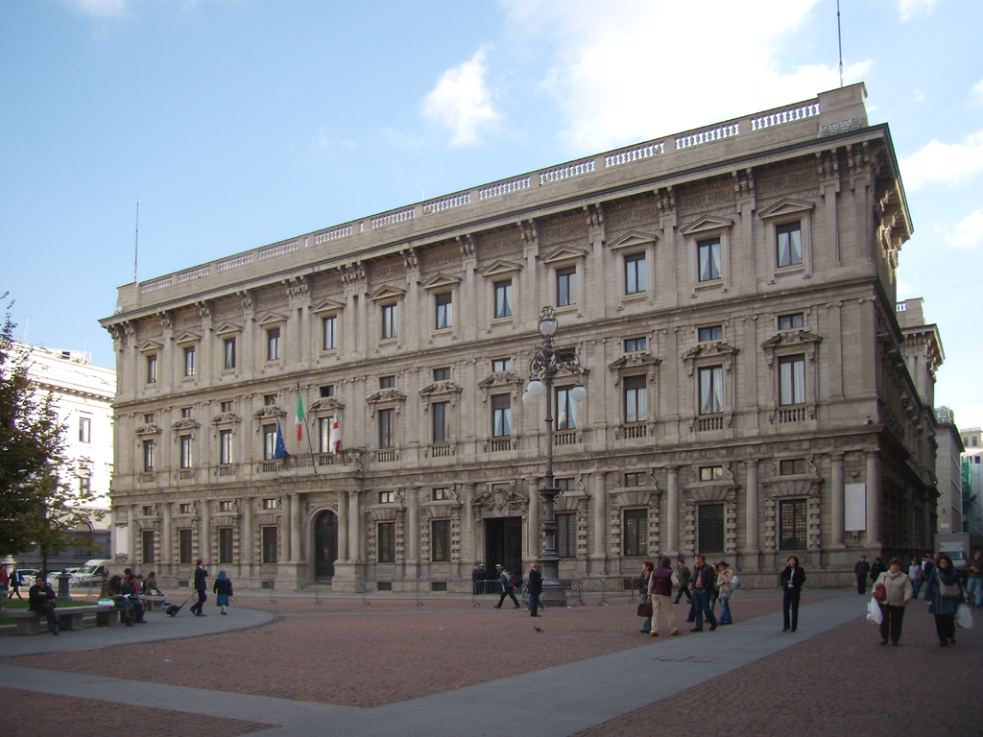
Palazzo Marino, Milan City Hall

Slide 7
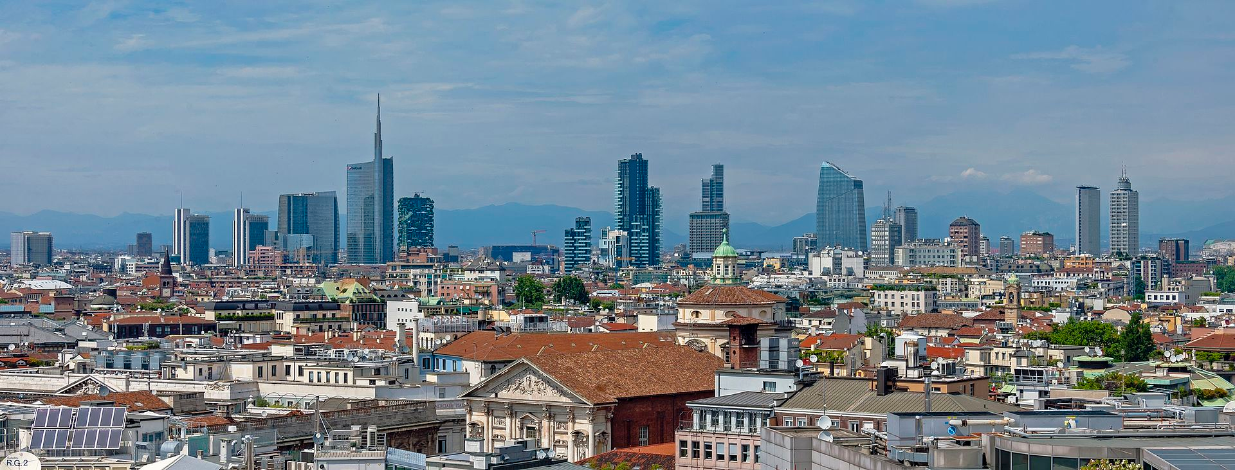
Milan skyline from the roof of the Duomo

Slide 8
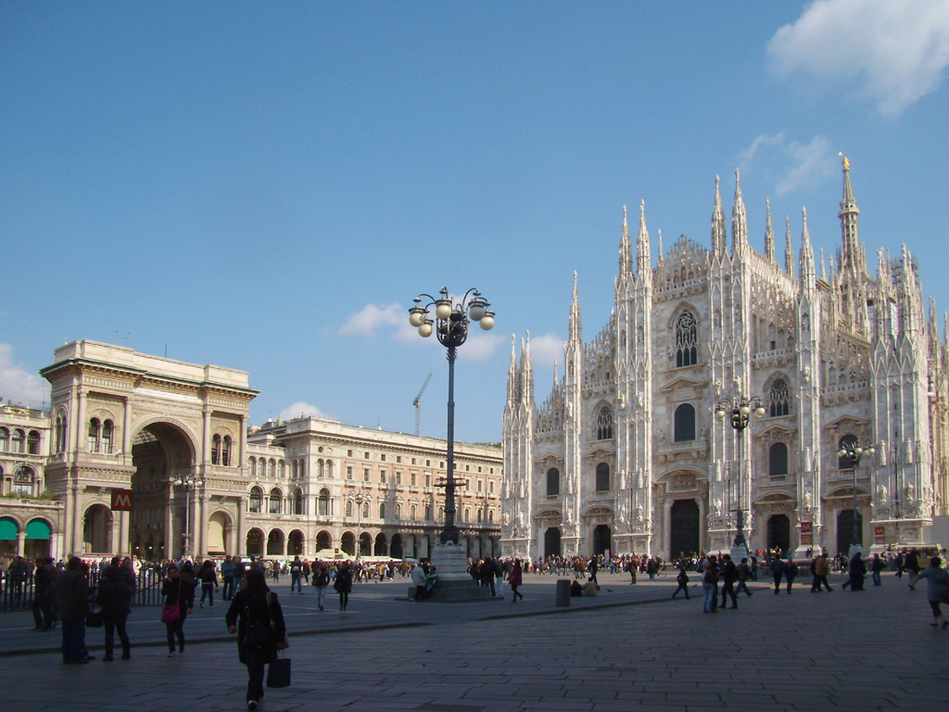
Piazza Duomo with Milan Cathedral and Galleria Vittorio Emanuele II

Slide 9
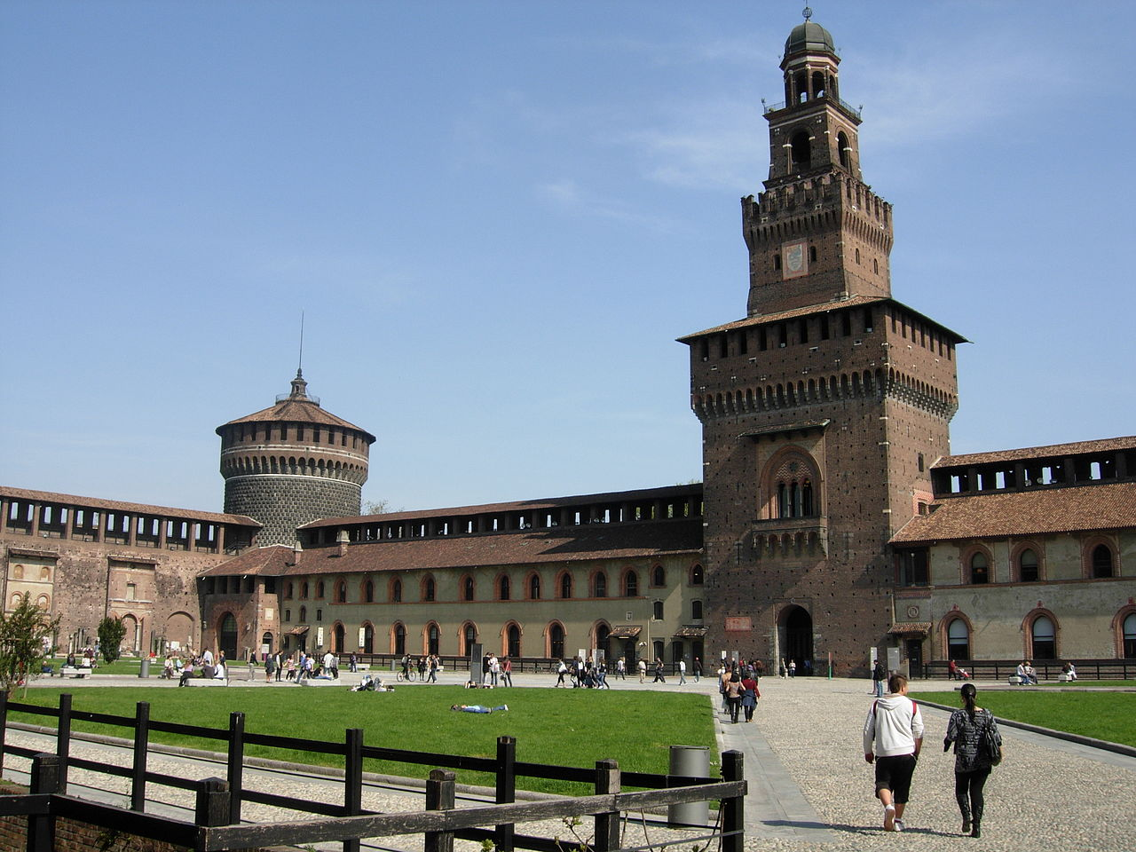
Internal court of Sforza Castle

Slide 10
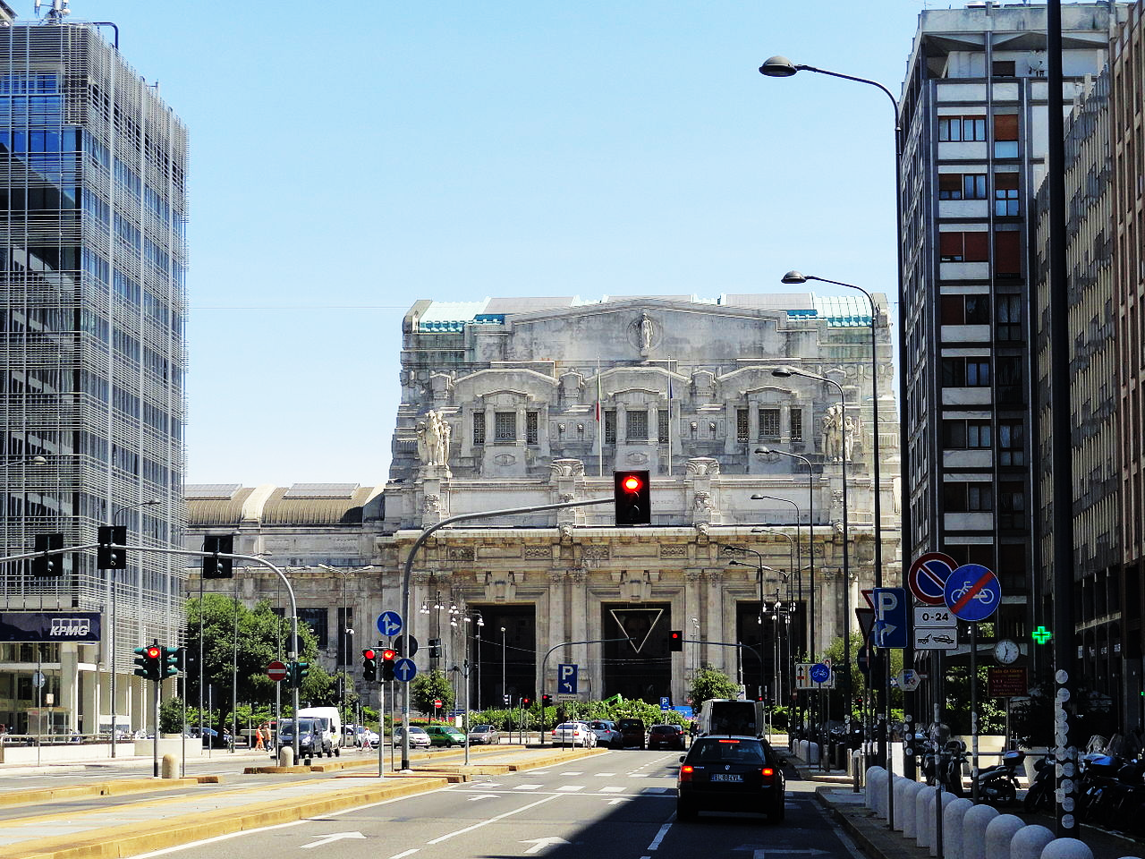
The Art Deco Centrale railway station, built in 1925–31

Slide 11
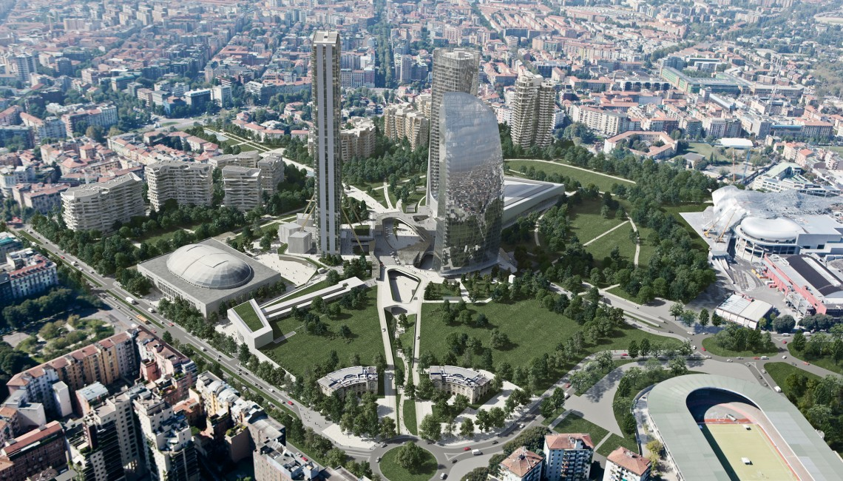
The new CityLife district, artist's impression

Slide 12
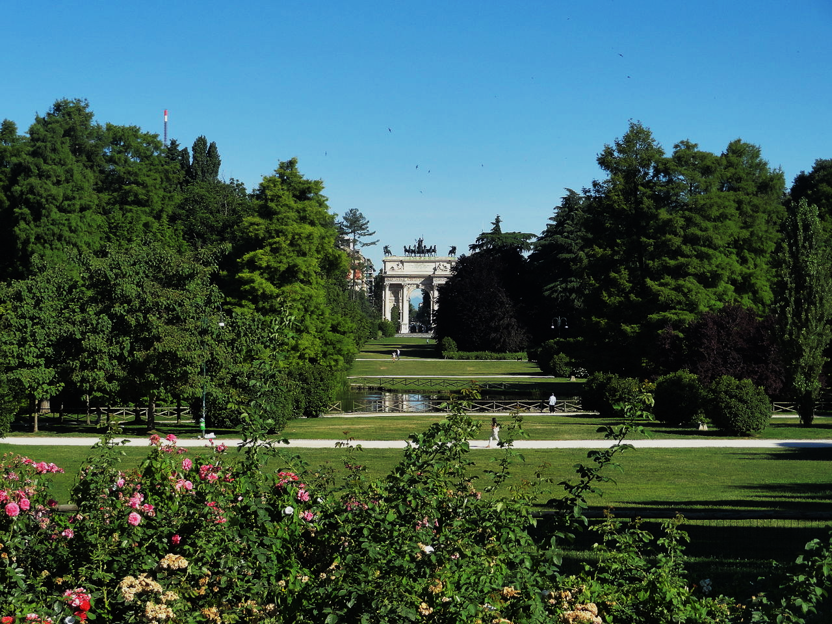
Sempione Park, with the Arch of Peace in the background

Slide 13
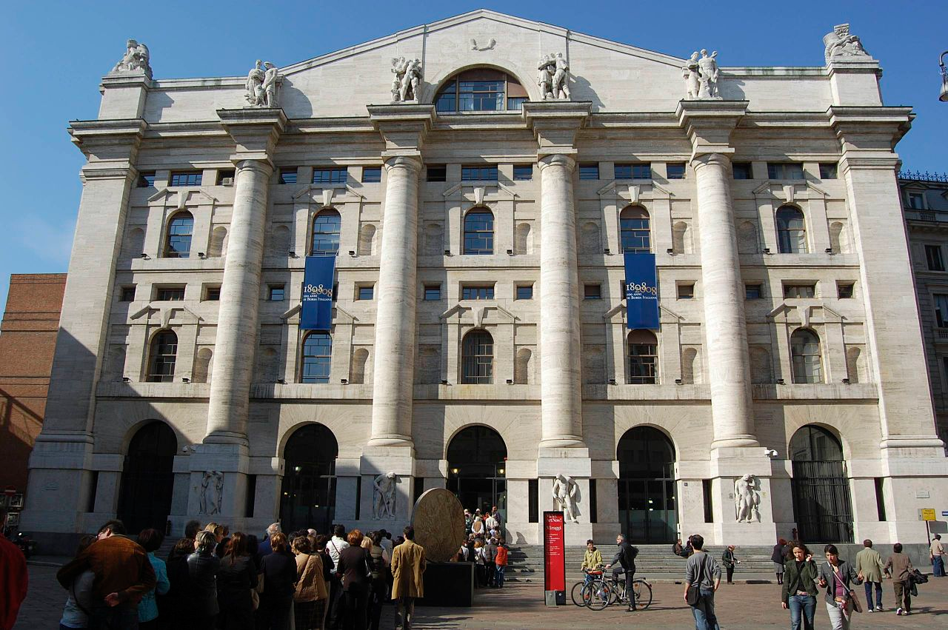
Milan Stock Exchange, Italy's main

Slide 14
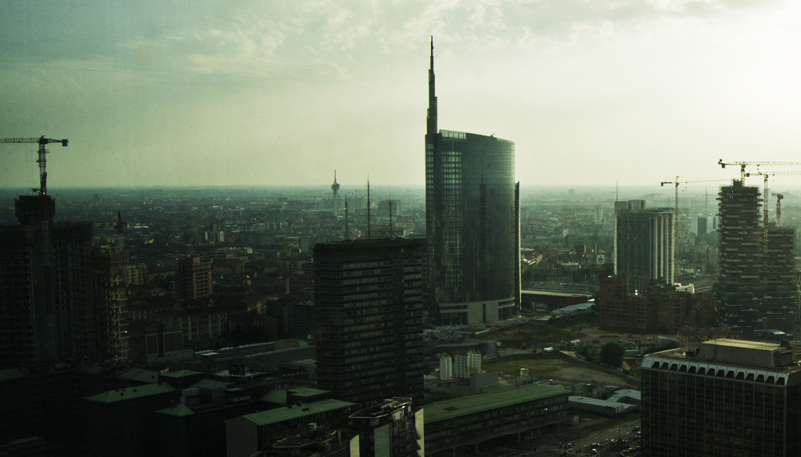
View over Porta Nuova business district at dusk

Slide 15
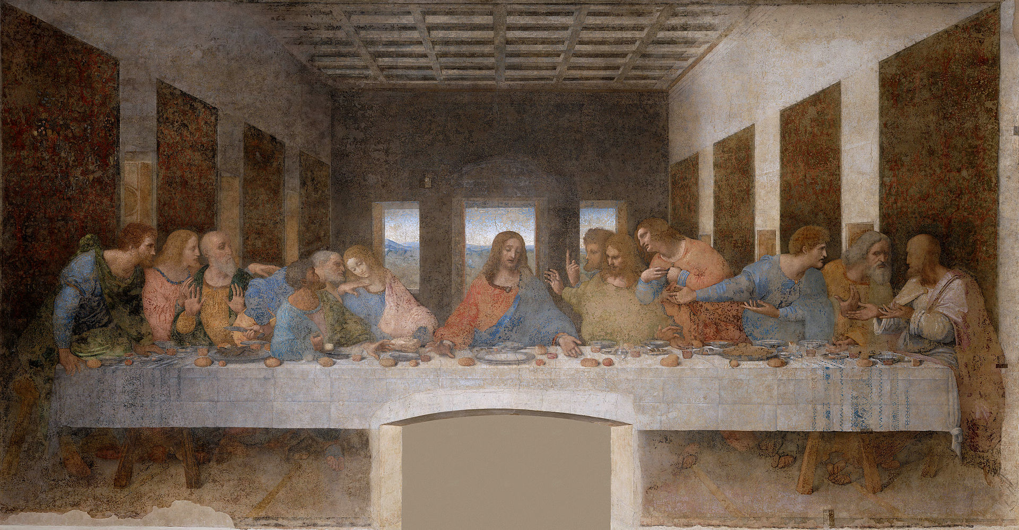
Leonardo da Vinci's The Last Supper, together at the church of Santa Maria delle Grazie

Slide 16
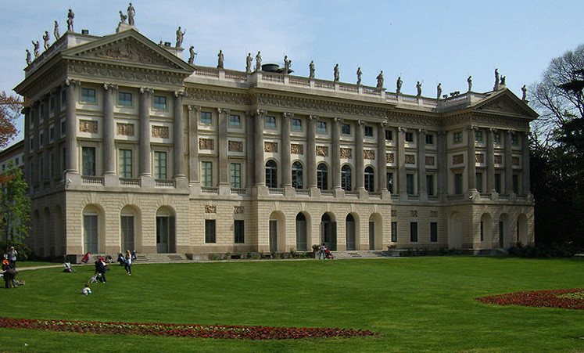
The Royal Villa of Milan

Slide 17
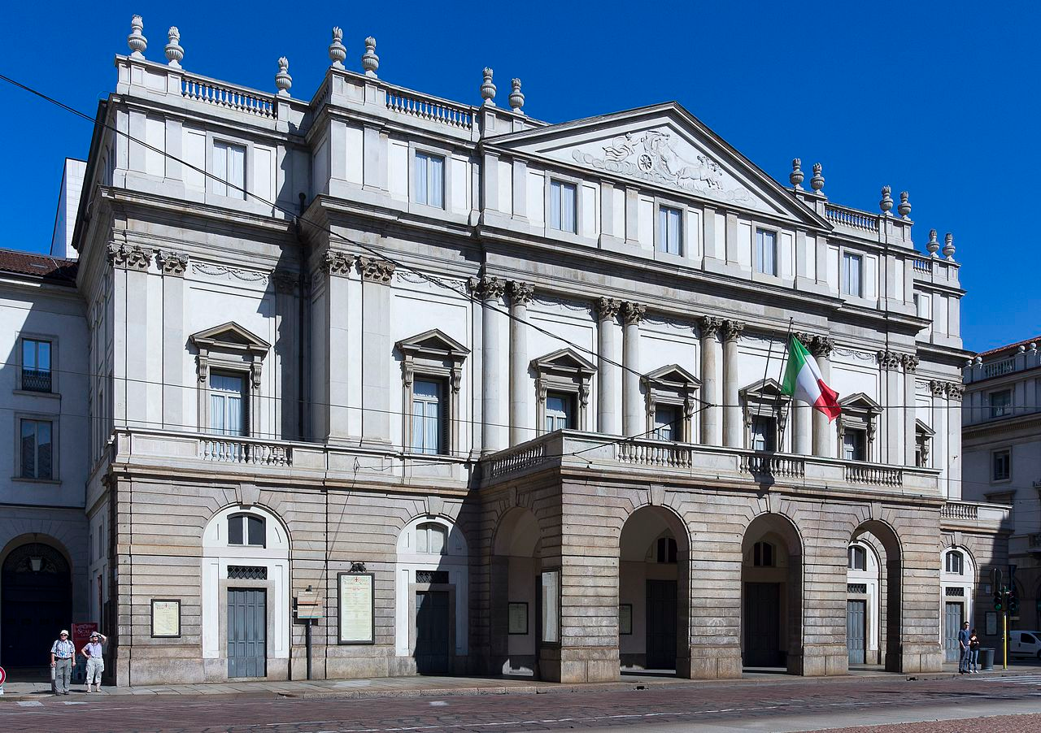
World Famous La Scala Operahouse

Slide 18
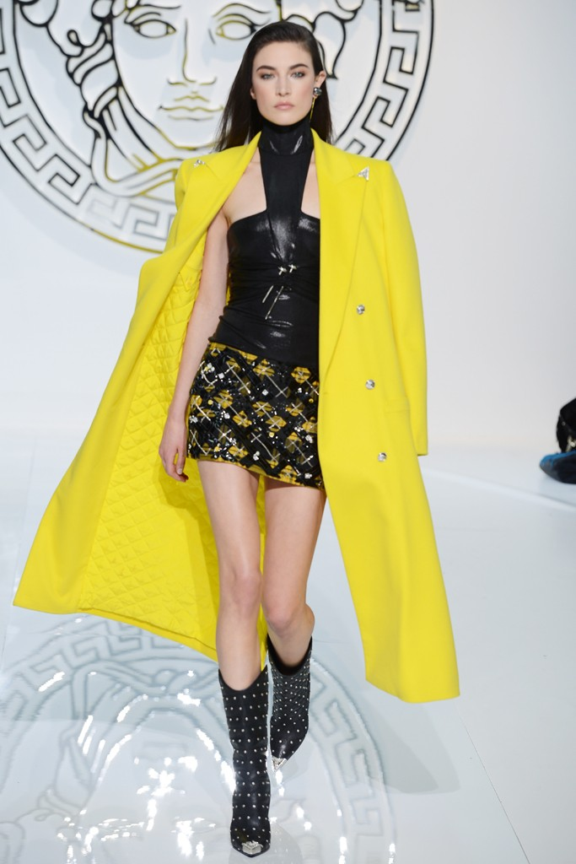
Fashion Center

Slide 19
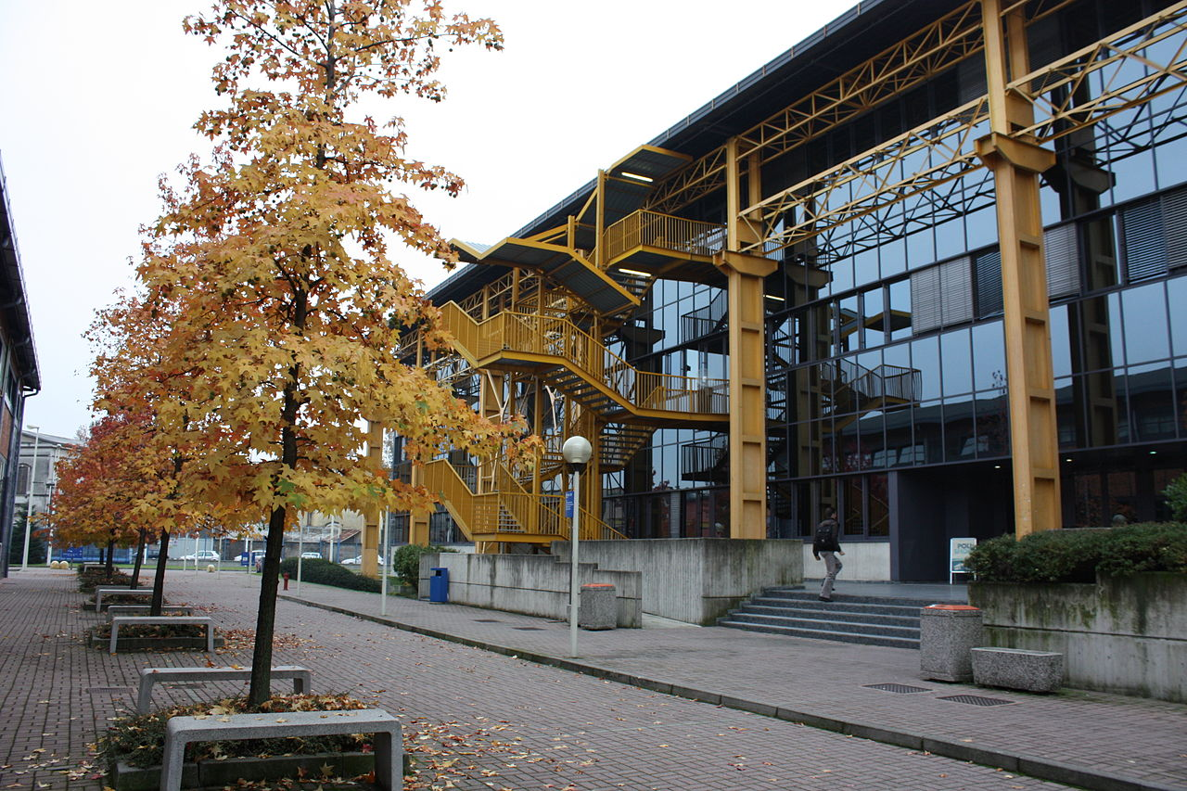
Politecnico di Milano, building in Bovisa district.

Slide 20
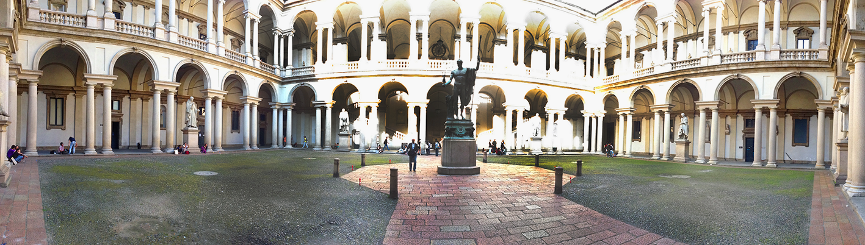
Brera Academy main court

Slide 21
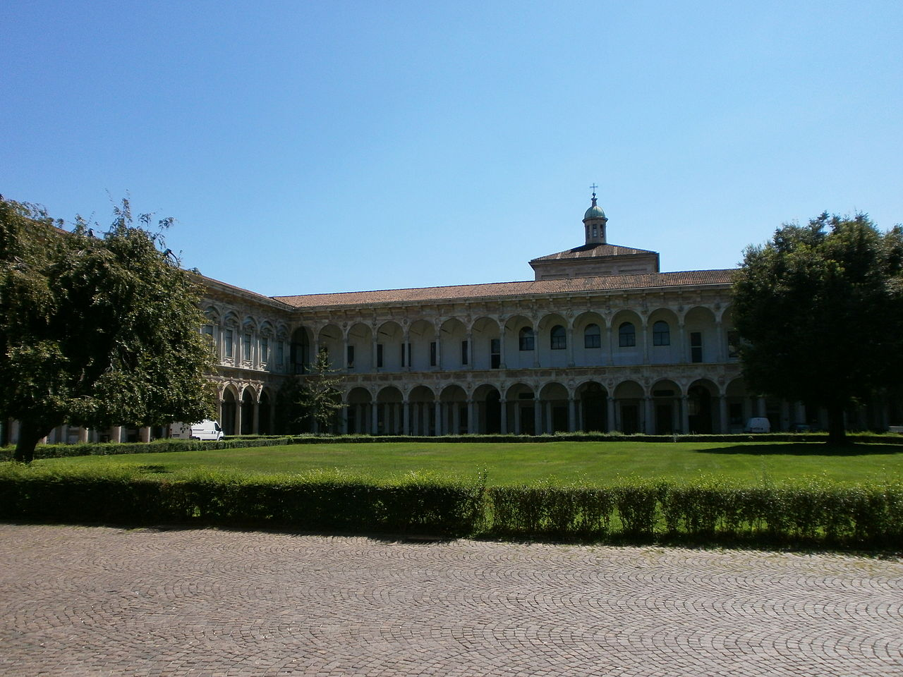
University of Milan cloister

Slide 22
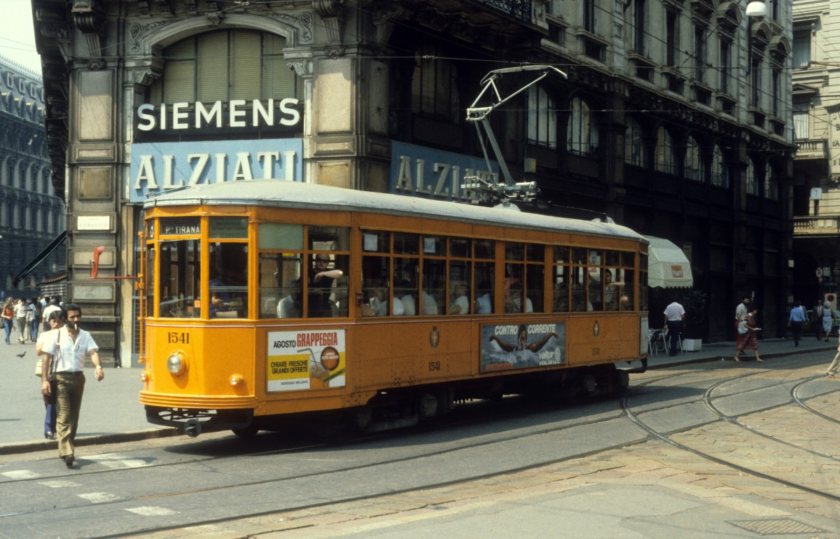
The orange ATM 1500 tram is an iconic symbol of Milan.

Slide 23
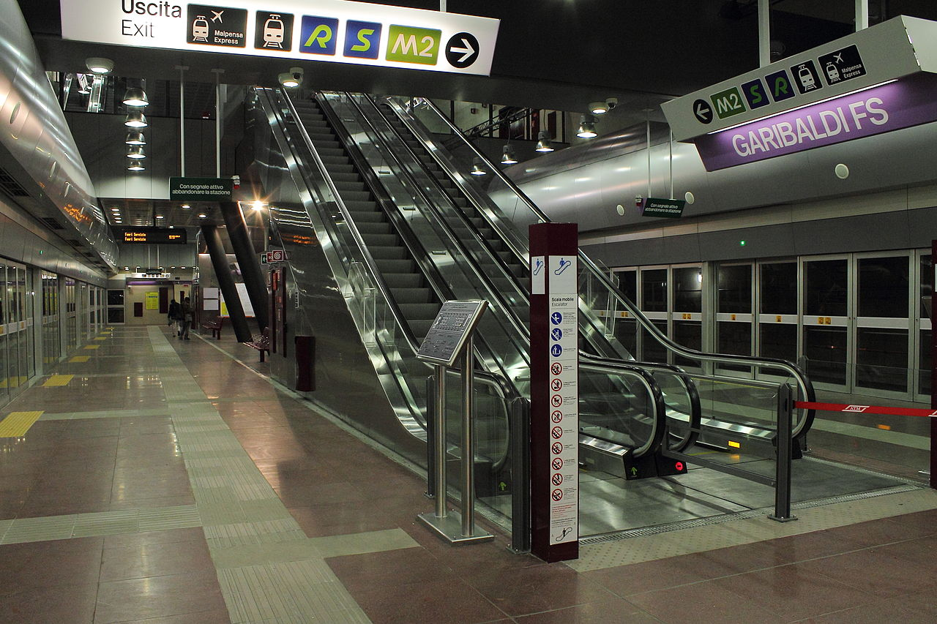
A station of the new M5 line

Slide 24
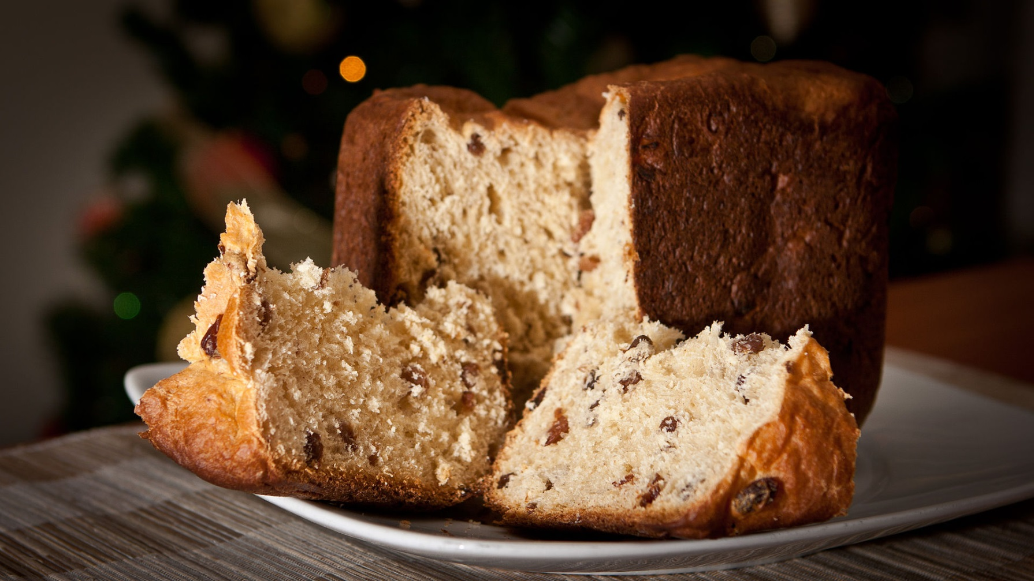
Panettone is a traditional Christmas cake

