Slide 1

Limerick, Ireland

Slide 2
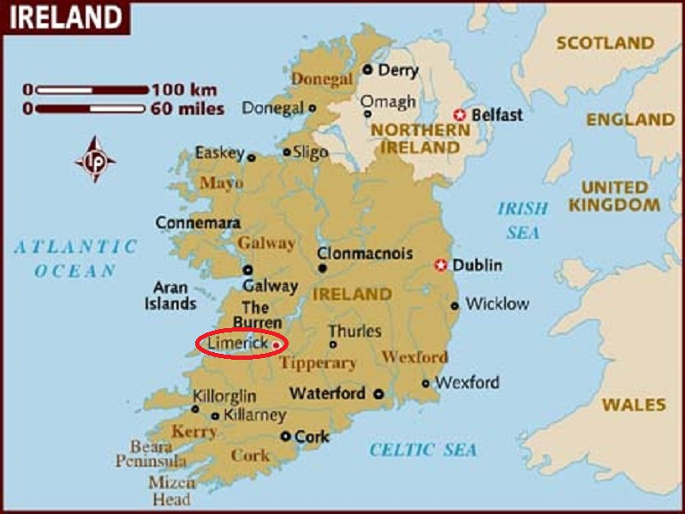
Limerick is a city in the county Limerick, Ireland. It is located in the Mid-West Region and is also part of the province of Munster. The city lies on the River Shannon with the historic core of the city located on King's island.

Slide 3
Limerick is a city in county Limerick, Ireland. It is located in the Mid-West Region and is also part of the province of Munster. Limerick City and County Council is the local authority for the city. The city lies on the River Shannon, with the historic core of the city located on King's Island, which is bounded by the Shannon and the Abbey River. Limerick is also located at the head of the Shannon Estuary where the river widens before it flows into the Atlantic Ocean. With a population of 95,854 (2011 census), Limerick is the third most populous urban area in the state, and the fourth most populous city on the island of Ireland.

Slide 4
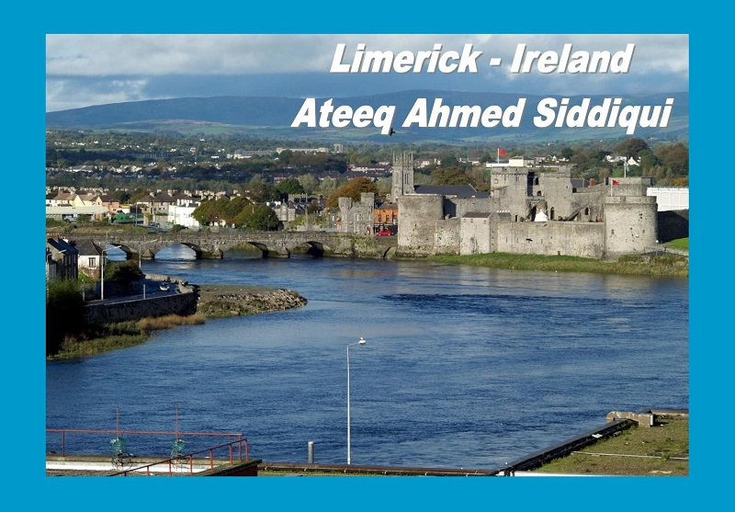

Slide 5
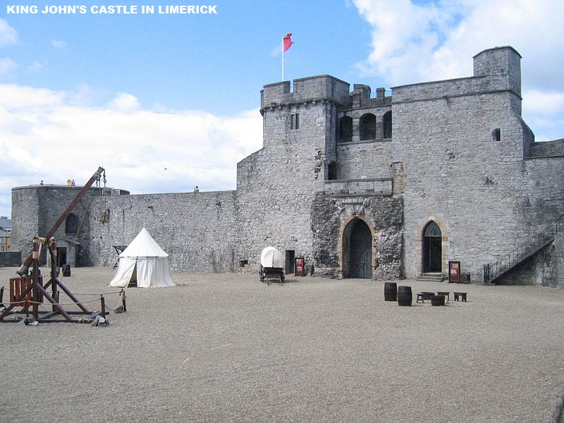

Slide 6
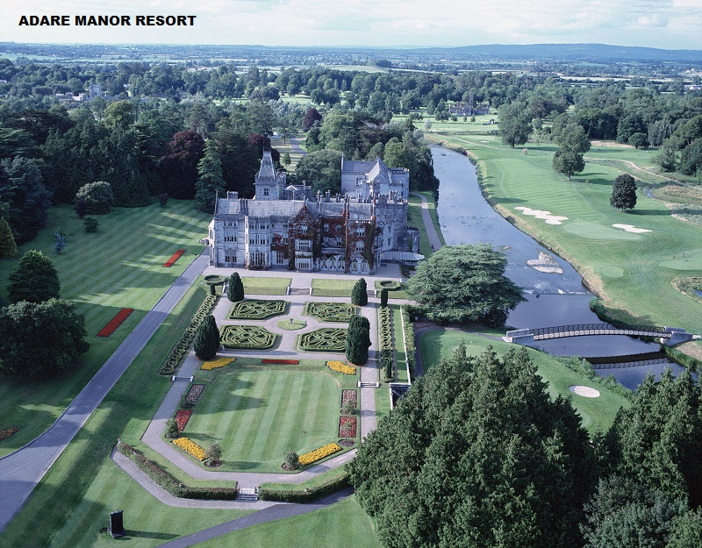

Slide 7
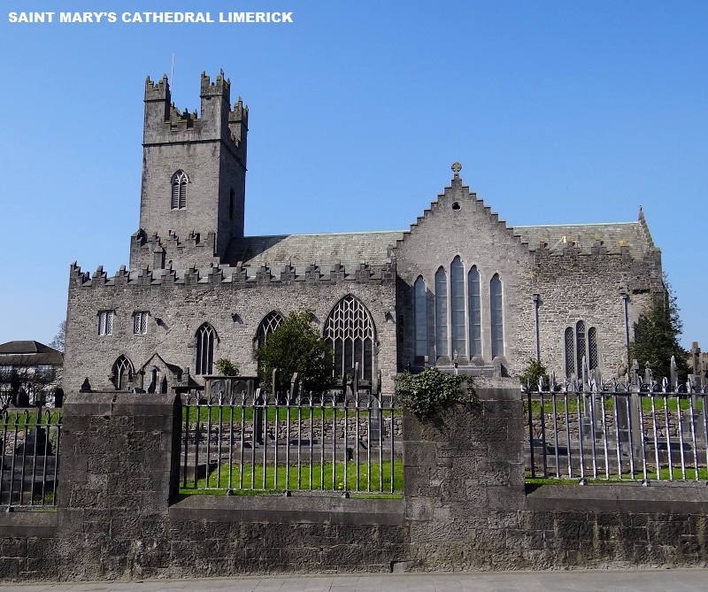

Slide 8
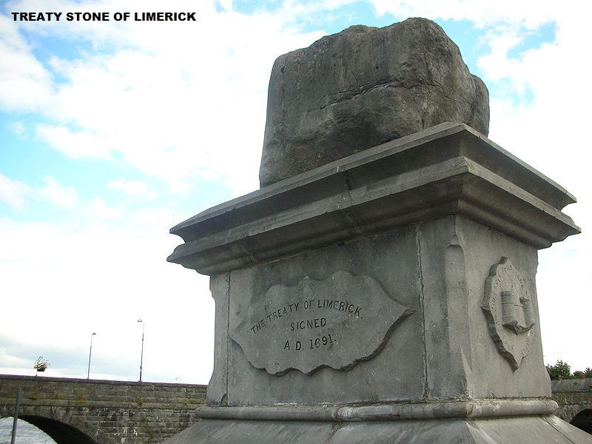

Slide 9
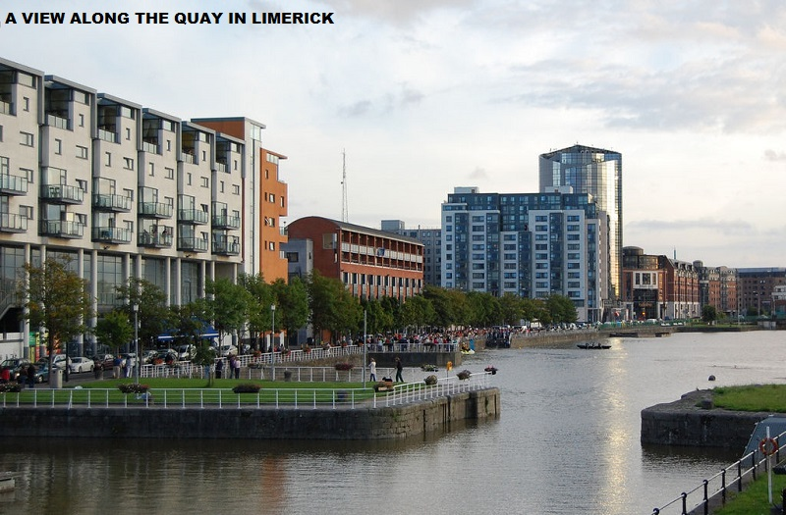

Slide 10
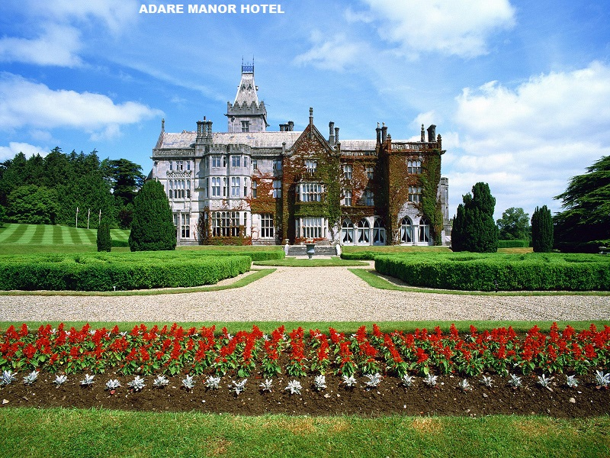

Slide 11
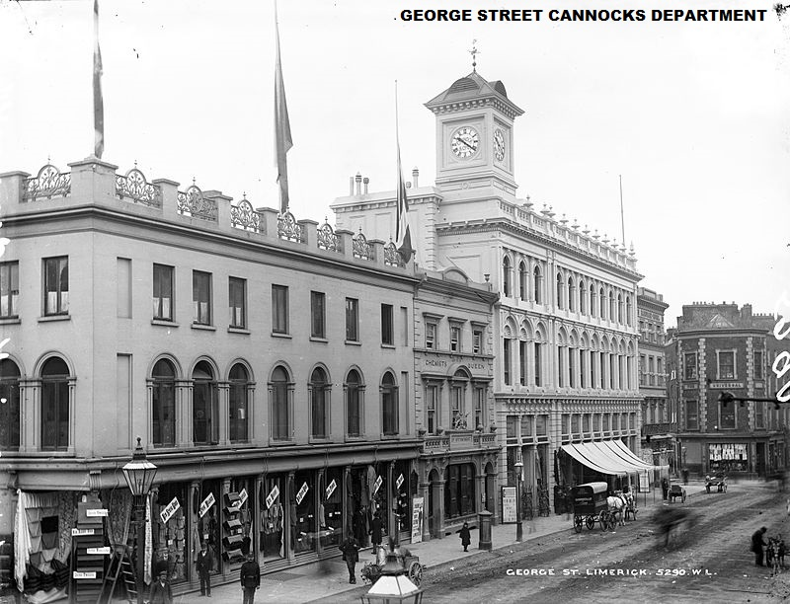
A vintage photo

Slide 12
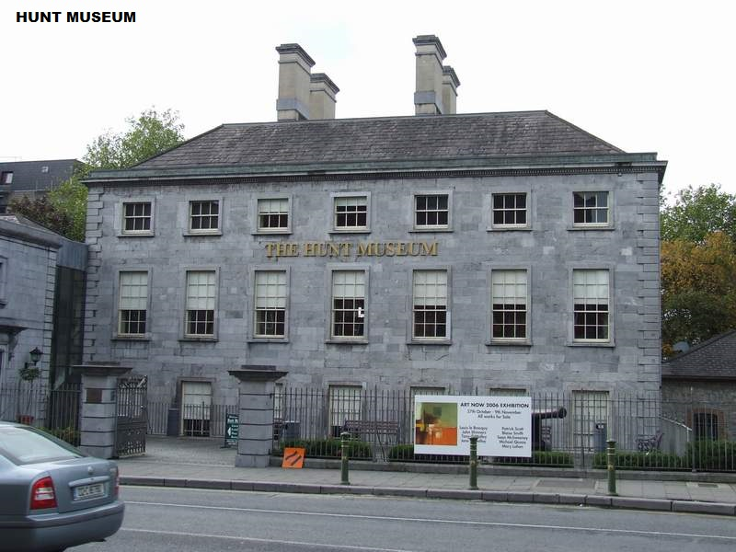

Slide 13
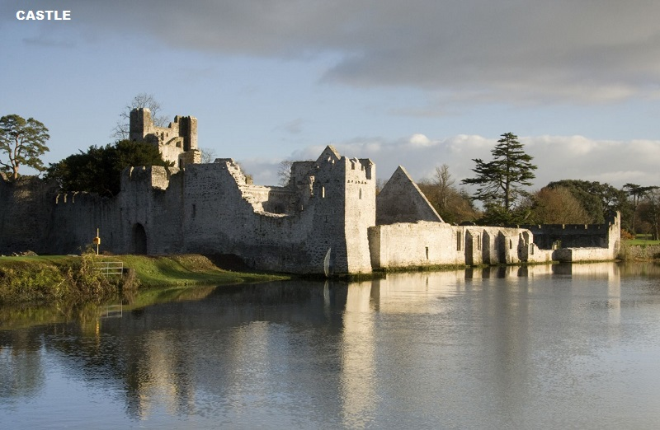

Slide 14


Slide 15
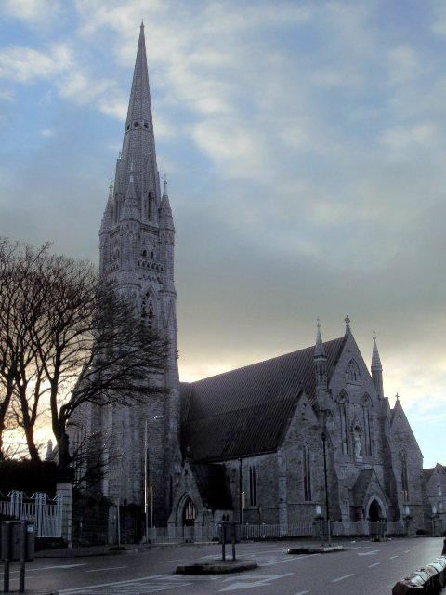
St John's Cathedral has Ireland's tallest church spire.

Slide 16
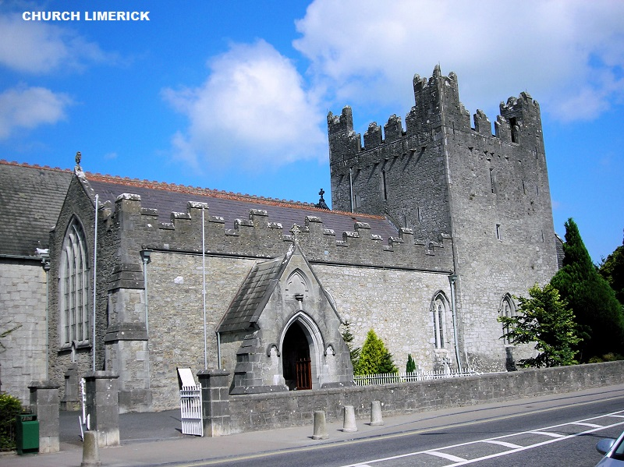

Slide 17
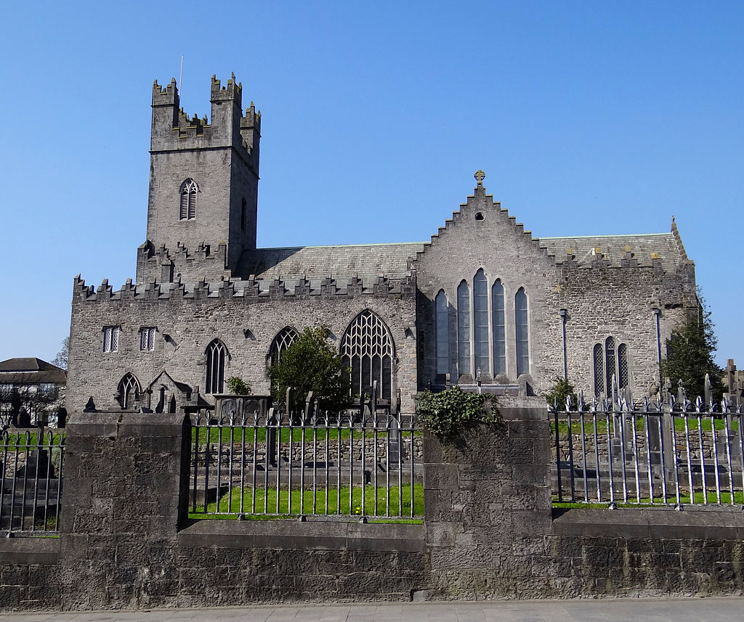
St Mary's Cathedral

Slide 18
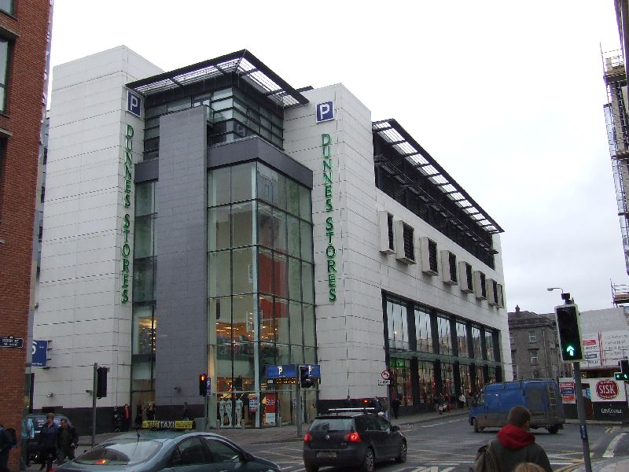
Dunnes Stores in Limerick City

Slide 19
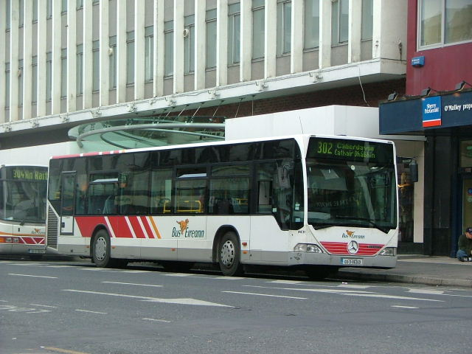
City Centre bus service

Slide 20
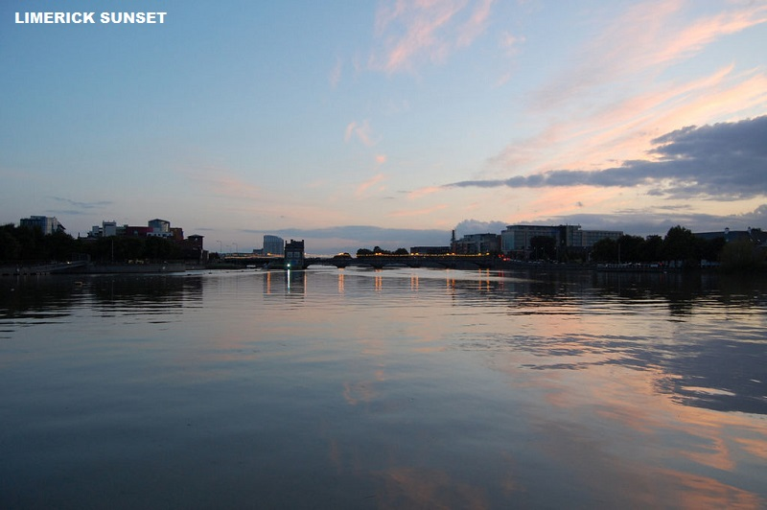

Slide 21
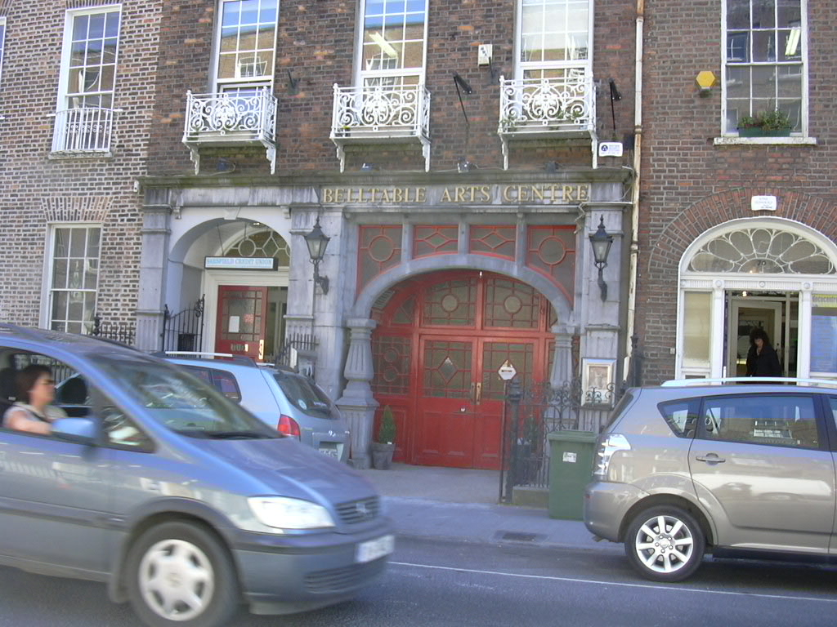
Belltable Arts Centre

Slide 22
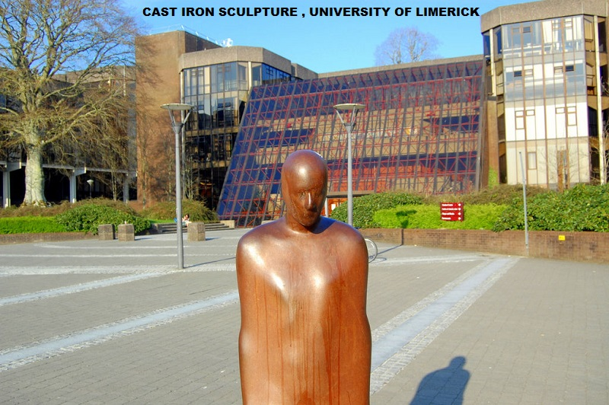

Slide 23
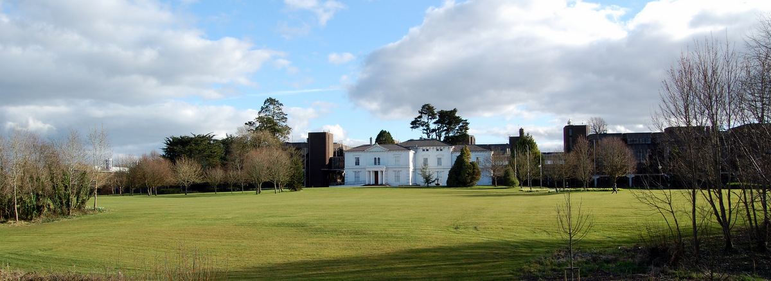
Plassey House at the University of Limerick.

Slide 24
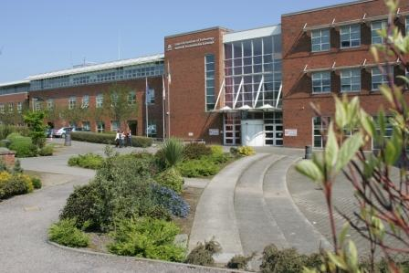
Limerick Institute of Technology

Slide 25
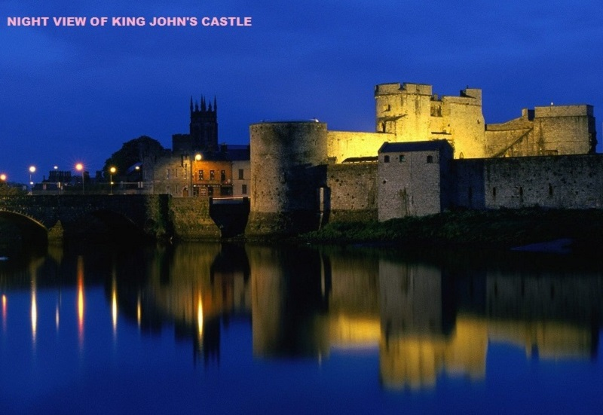

Slide 26
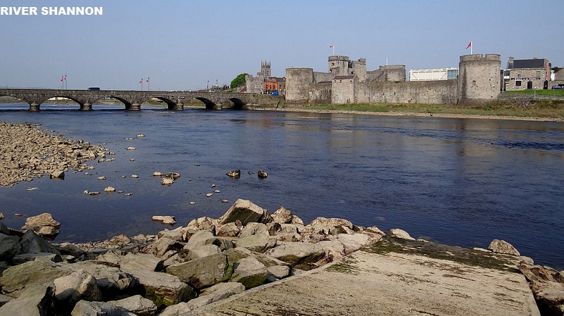
King John’s Castle

Slide 27
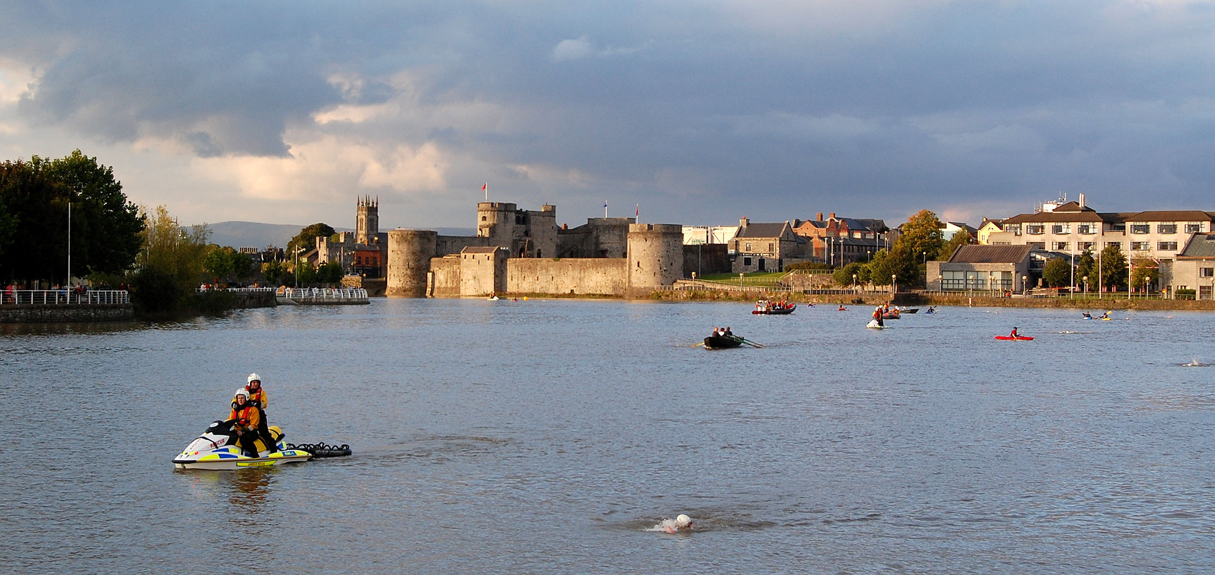
King John's Castle on the River Shannon.

Slide 28
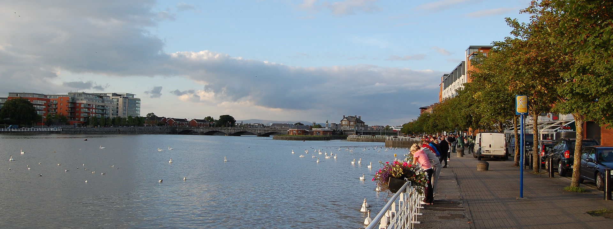
Limerick on the River Shannon as viewed from Bishop's Quay.

Slide 29
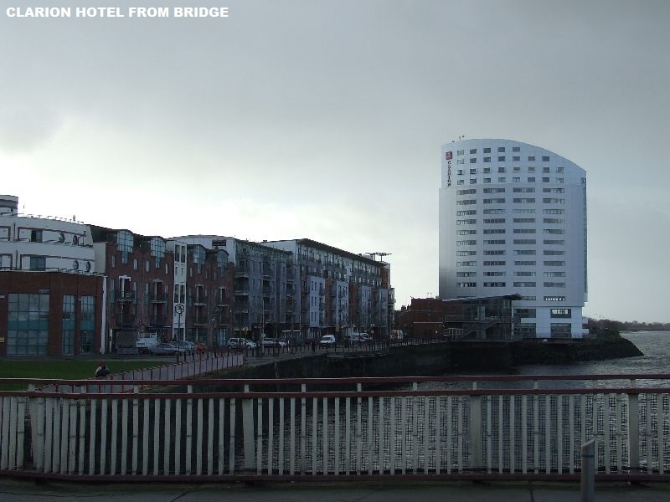

Slide 30
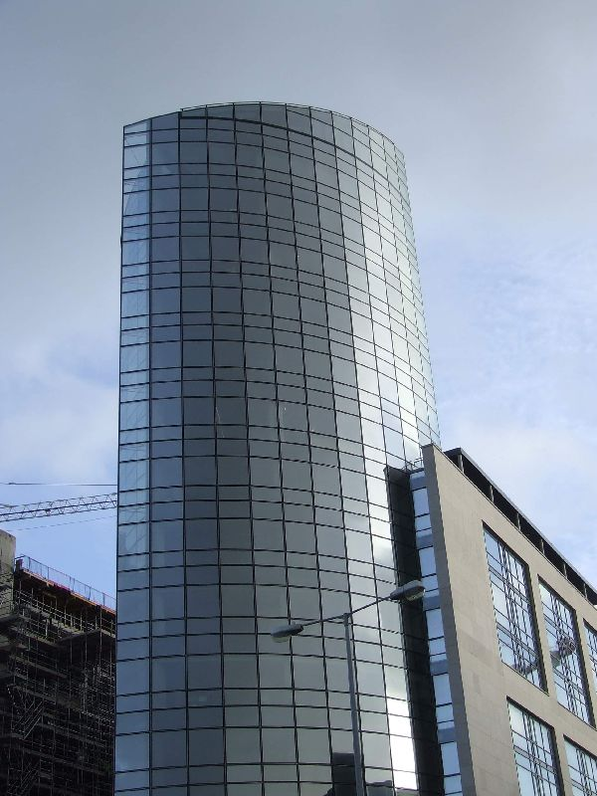
Riverpoint, Limerick's tallest building.

Slide 31
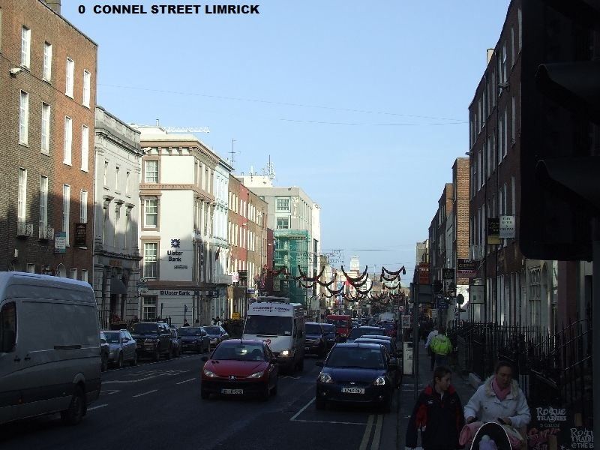

Slide 32
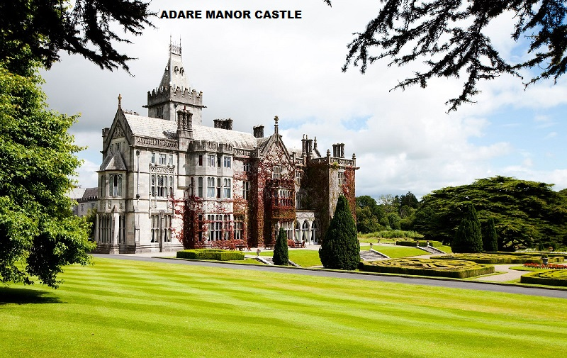

Slide 33
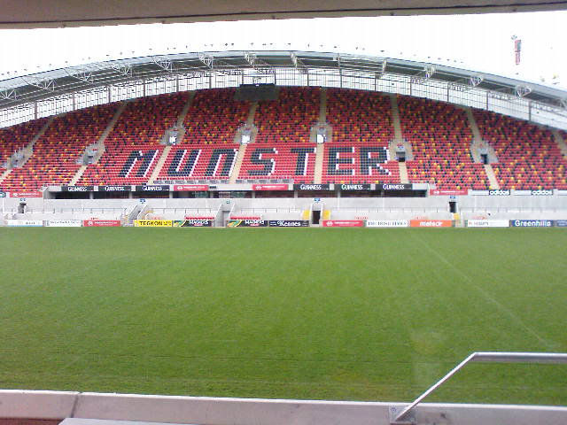
Thomond Park is the home grounds of Munster Rugby

Slide 34
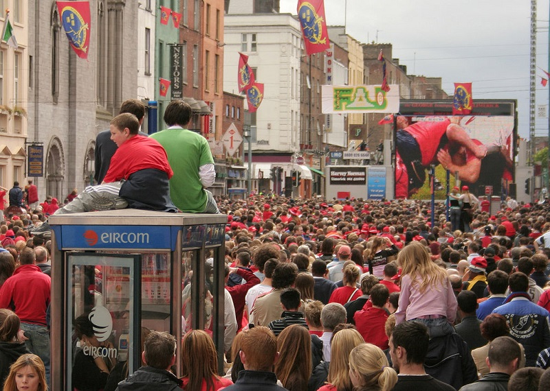
Munster fans in Limerick during the 2006 Heineken Cup.

