Slide 1
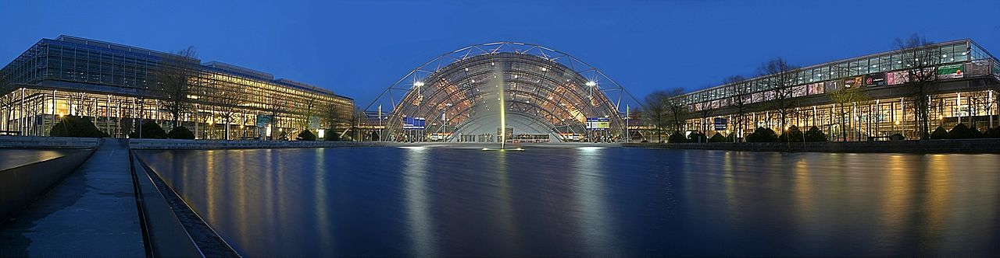
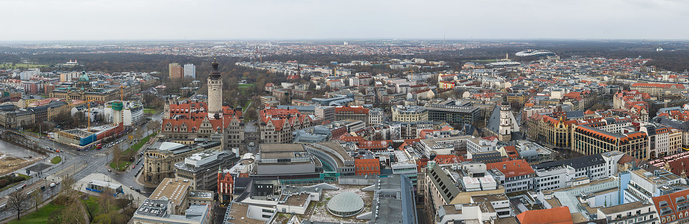
Leipzig, Germany

Slide 2
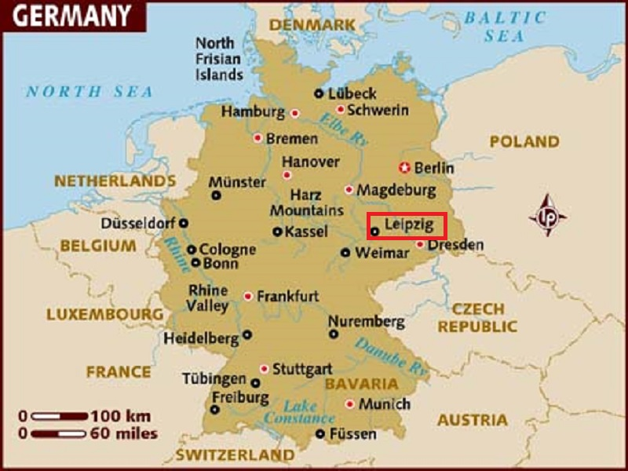
Leipzig is the largest city in the federal state of Saxony, Germany.
Leipzig is located southwest of Berlin at the confluence of the White Elster, Pleisse and Parthe rivers.

Slide 3
Leipzig (/ˈlaɪpsɪɡ/; German: [ˈlaɪptsɪç] ( listen)) is the largest city in the federal state of Saxony, Germany. With a population of 570,087 inhabitants (1,001,220 residents in the larger urban zone) it is Germany's tenth most populous city. Leipzig is located about 160 kilometres (99 mi) southwest of Berlin at the confluence of the White Elster, Pleisse and Parthe rivers at the southern end of the North German Plain.
Leipzig has been a trade city since at least the time of the Holy Roman Empire. The city sits at the intersection of the Via Regia and Via Imperii, two important Medieval trade routes. Leipzig was once one of the major European centers of learning and culture in fields such as music and publishing. Leipzig became a major urban center within the German Democratic Republic (East Germany) after the Second World War, but its cultural and economic importance declined.

Slide 4
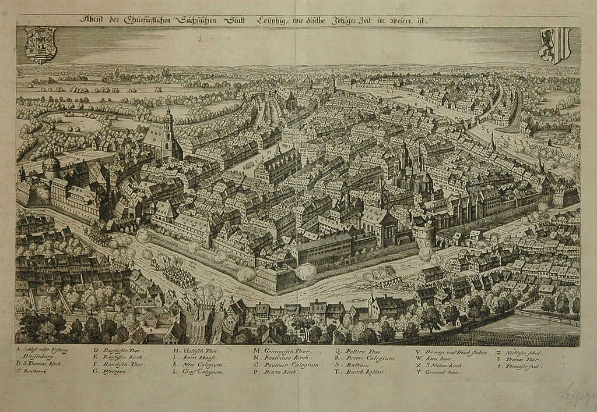
17th Century

Slide 5
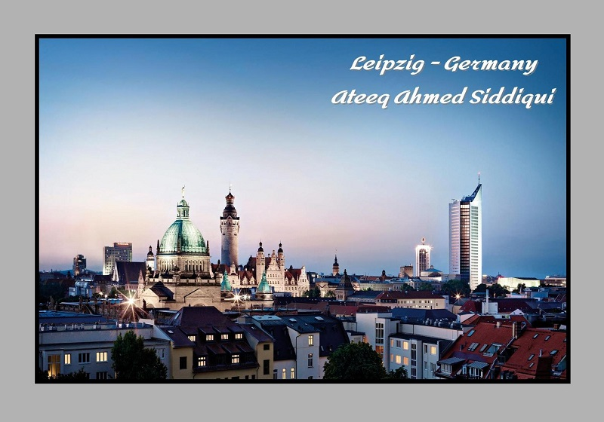

Slide 6
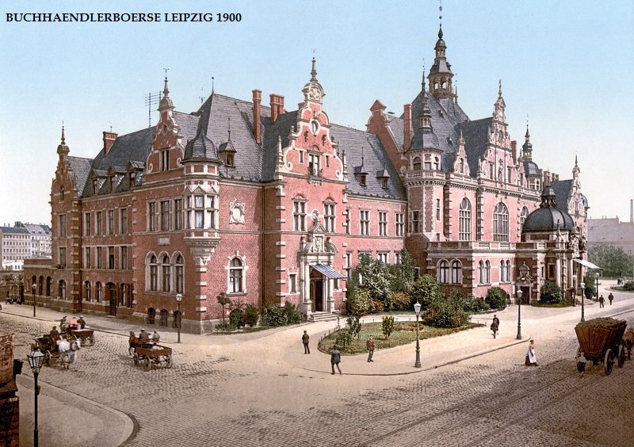

Slide 7
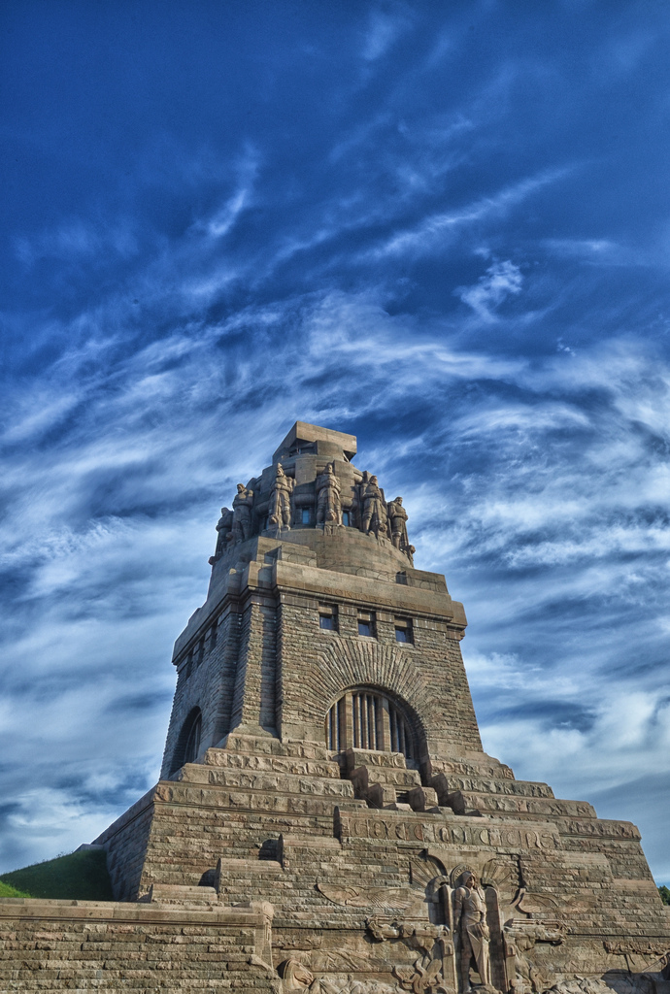
Monument to the Battle of the Nations

Slide 8
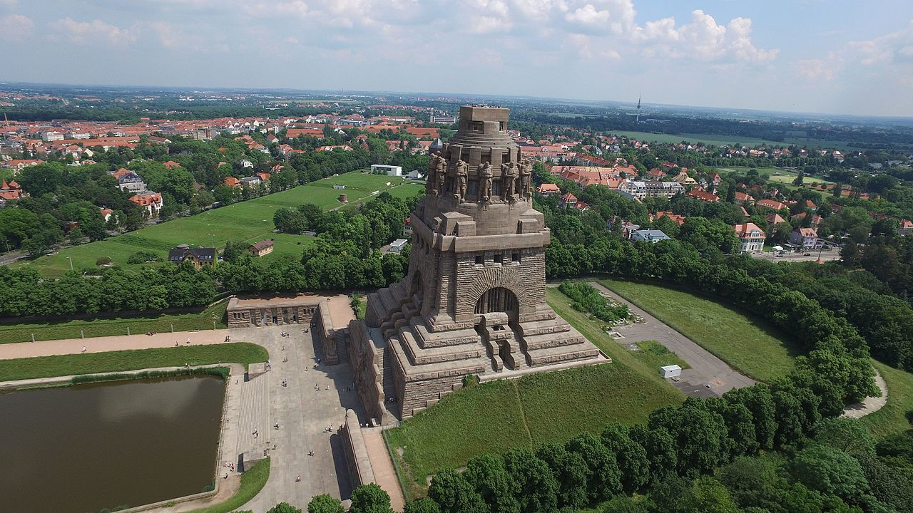

Slide 9
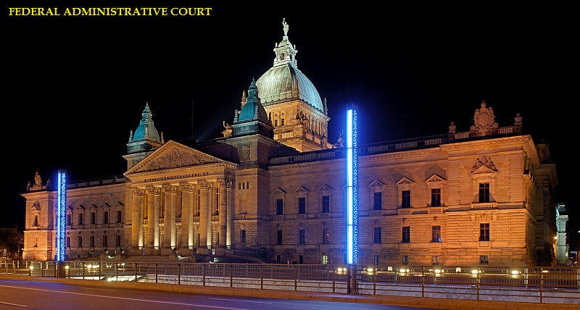

Slide 10
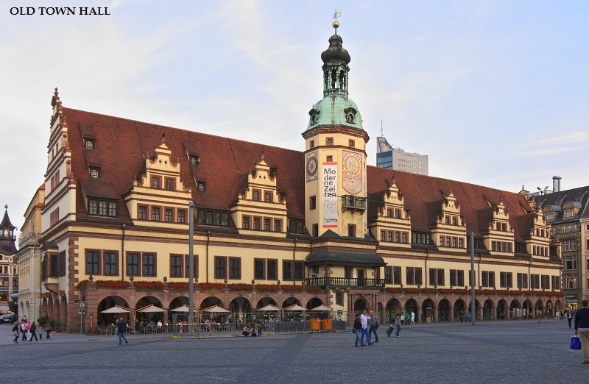

Slide 11
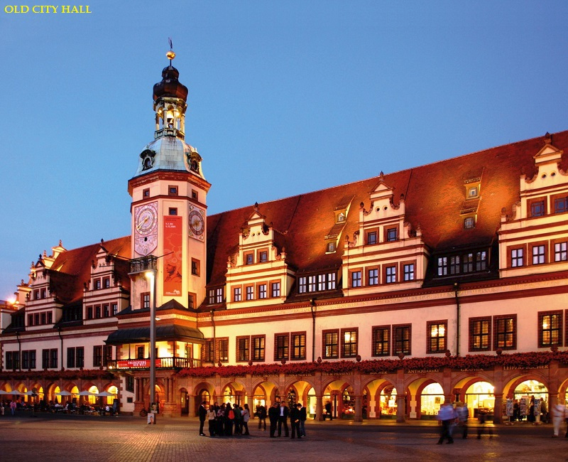

Slide 12
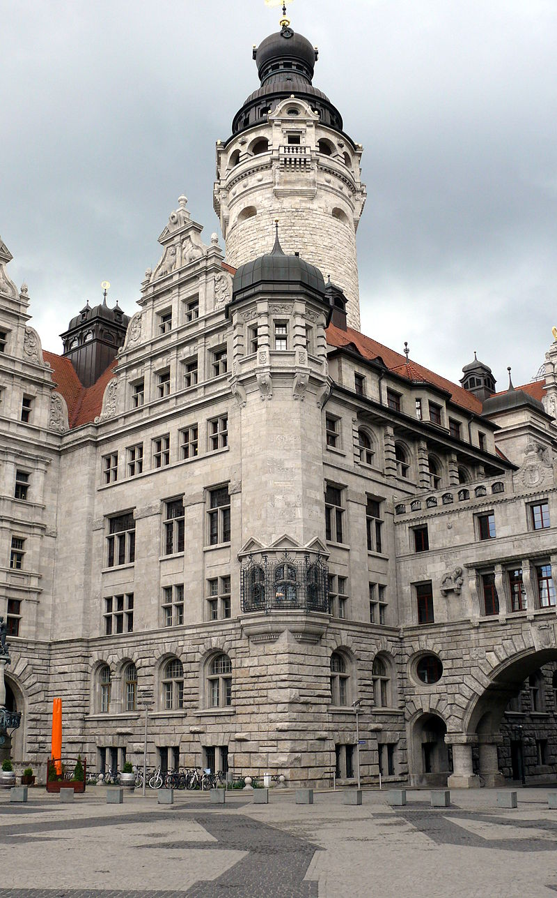
New Town Hall

Slide 13
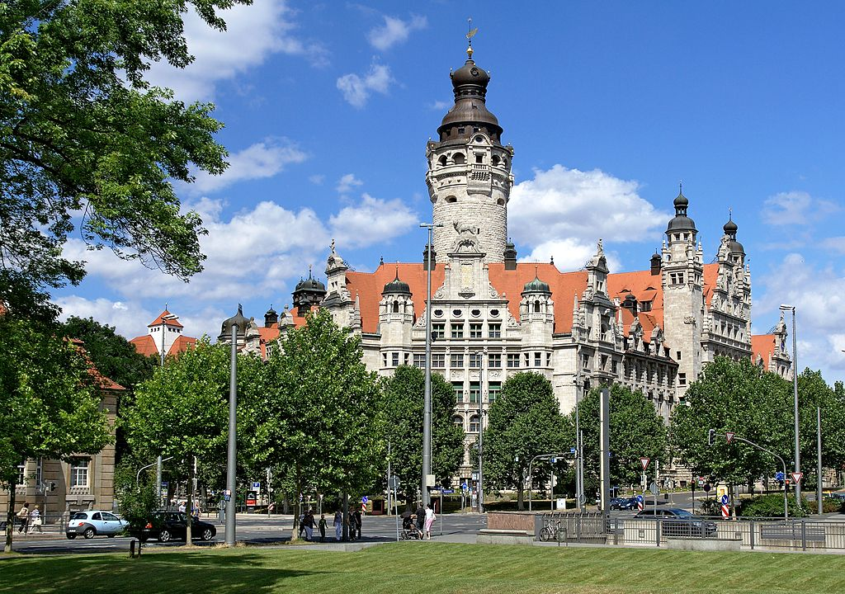
New City Hall

Slide 14
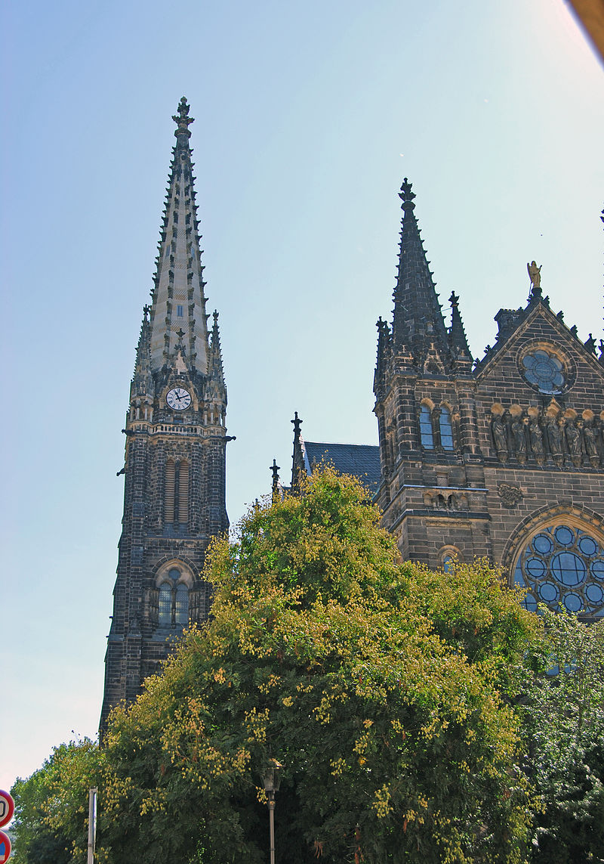
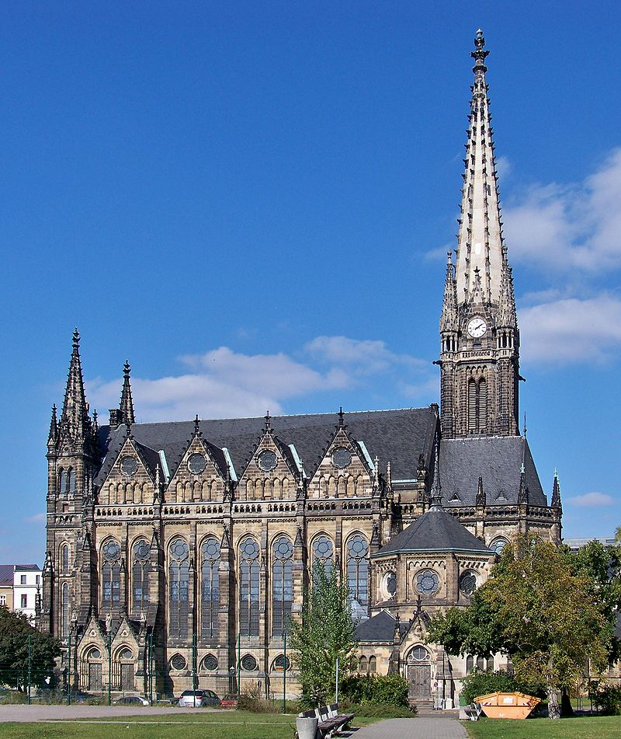

Slide 15
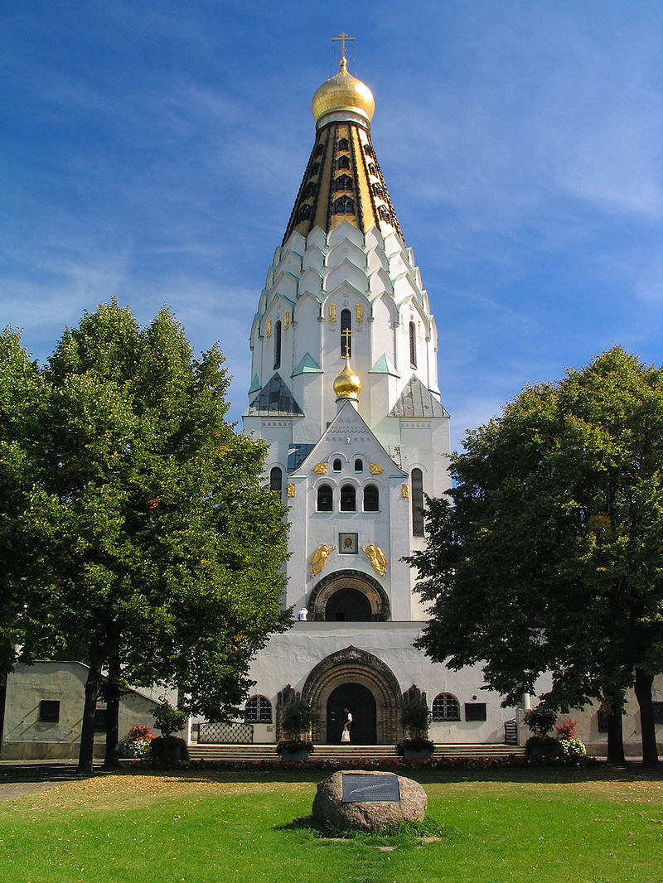
Russian Orthodox

Slide 16
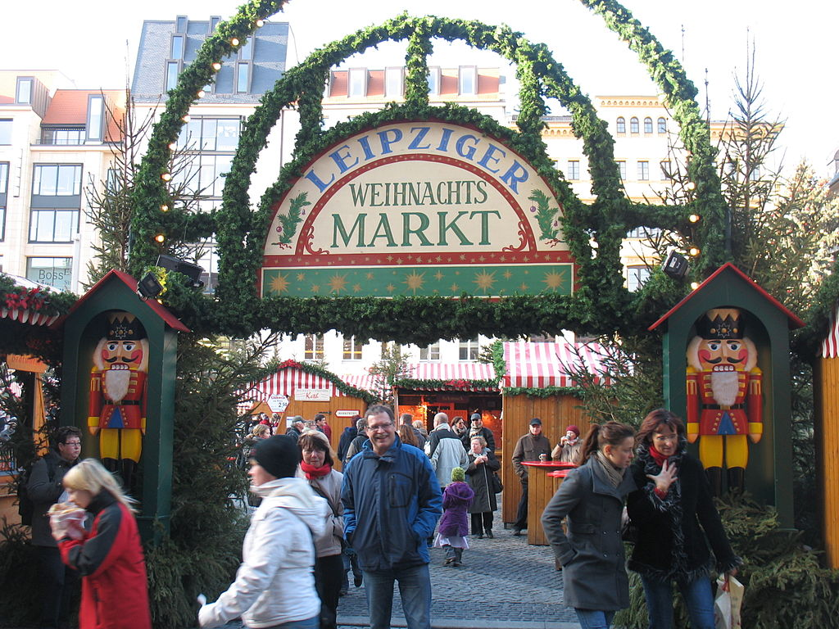
Leipzig Christmas market entrance

Slide 17
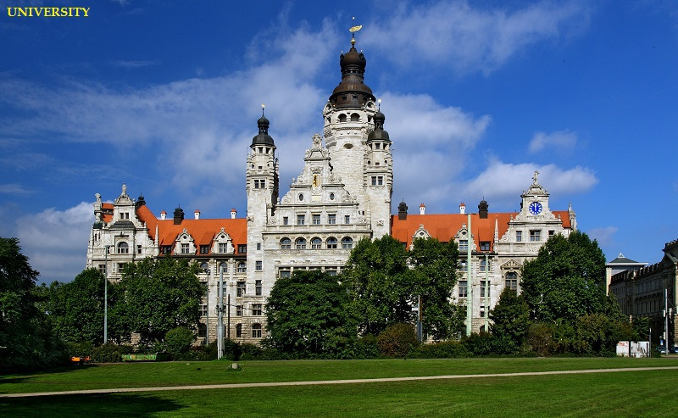

Slide 18
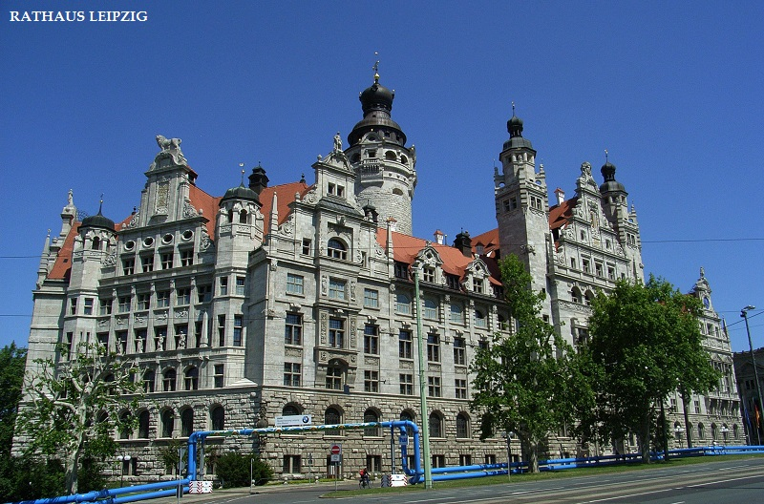

Slide 19
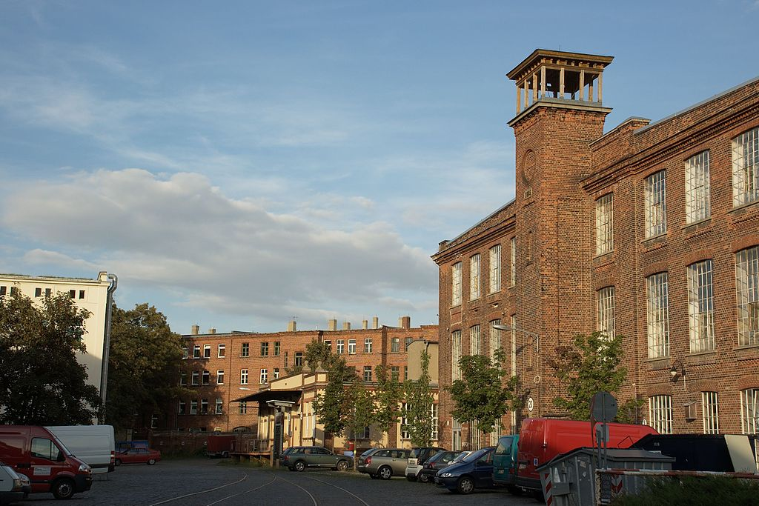

Slide 20
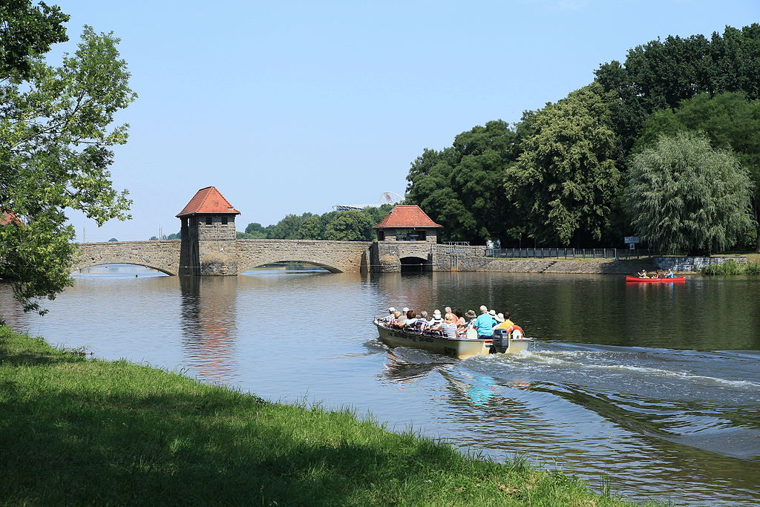

Slide 21
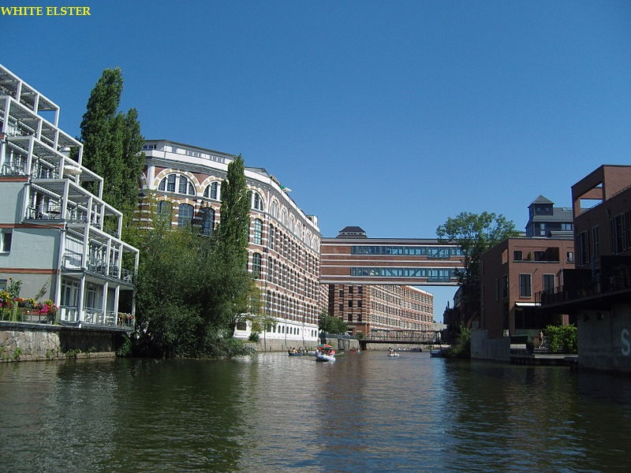

Slide 22
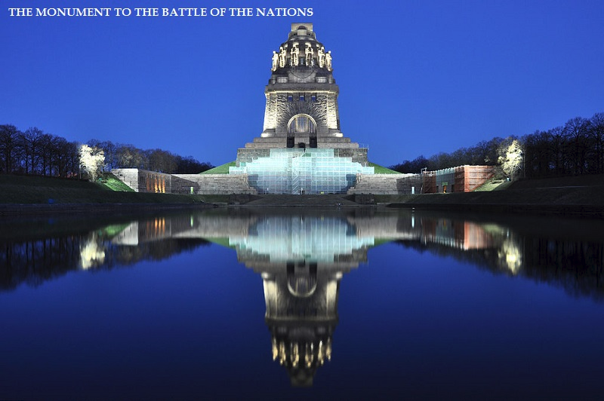

Slide 23
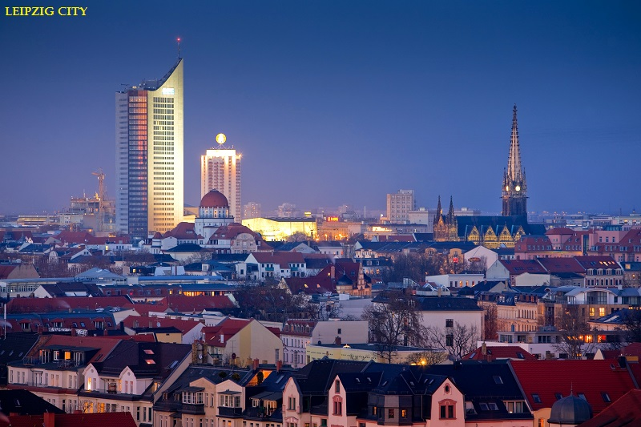

Slide 24
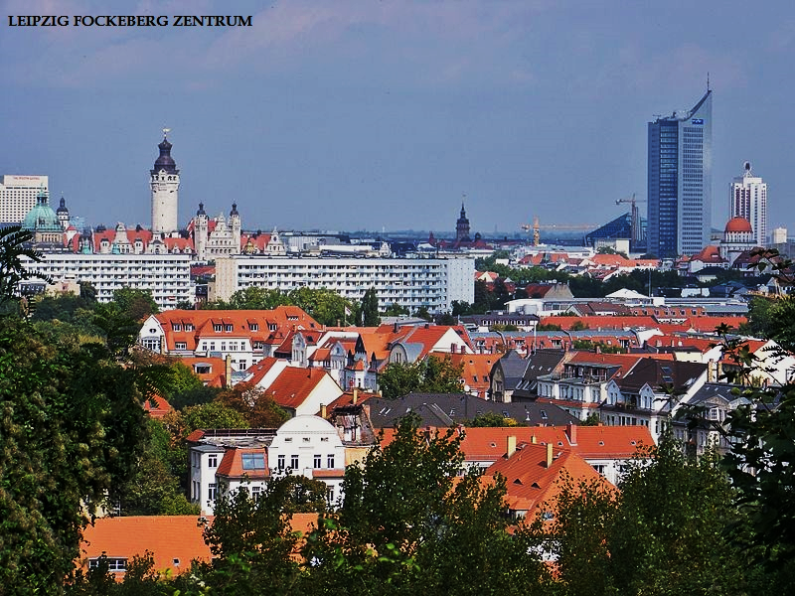

Slide 25
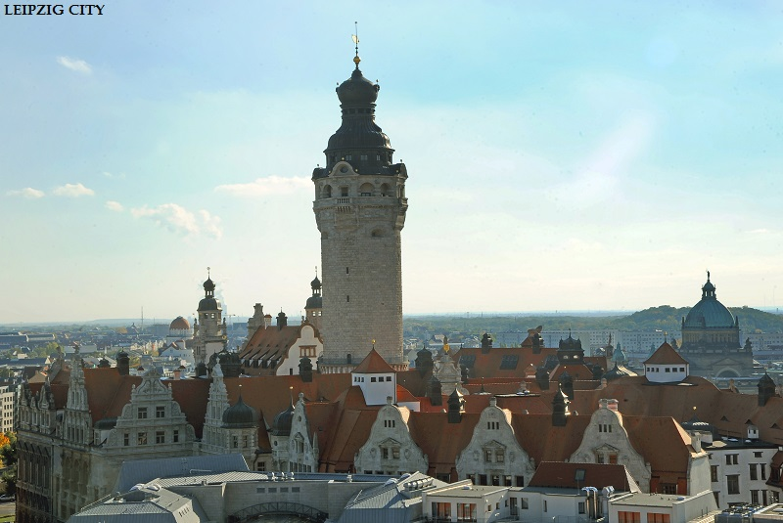

Slide 26
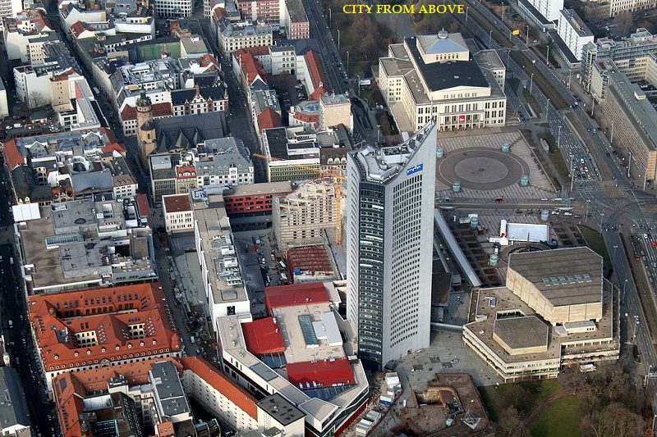

Slide 27
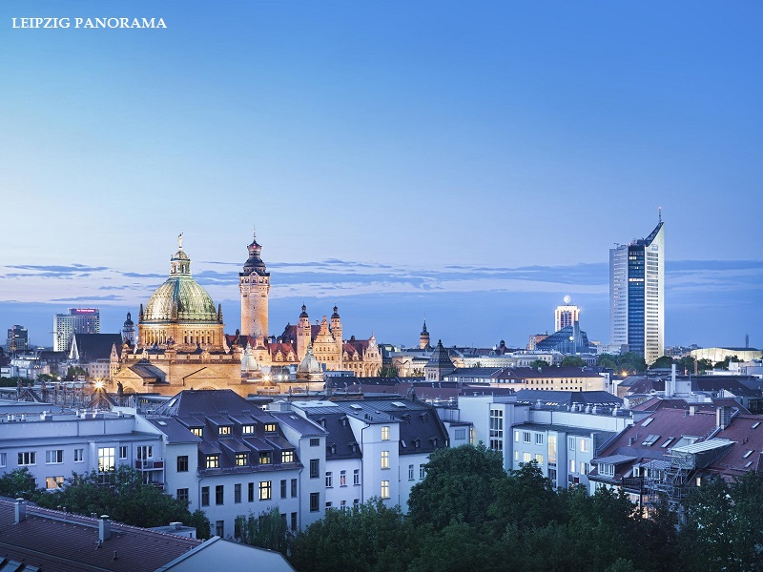

Slide 28
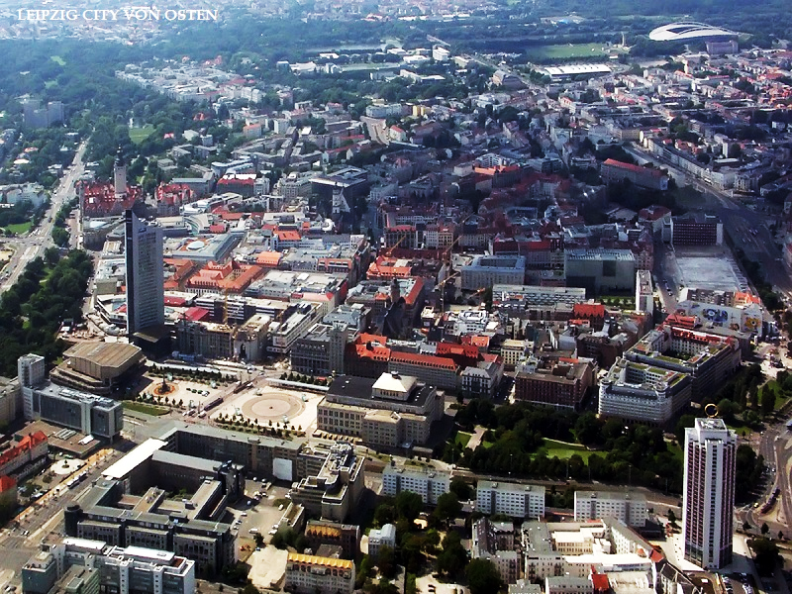

Slide 29
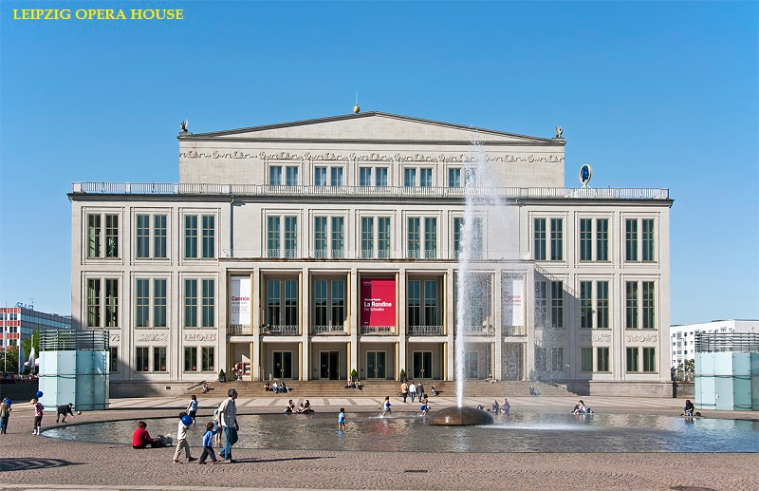

Slide 30
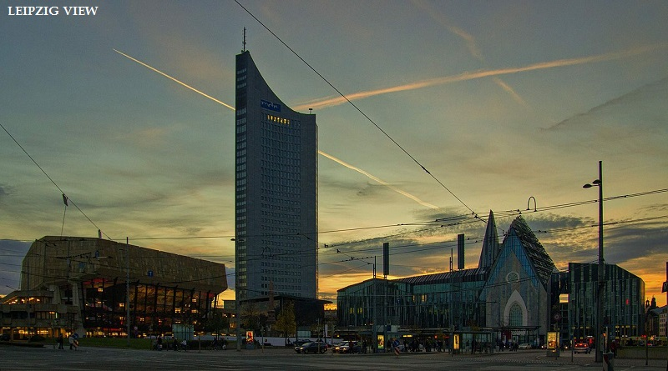

Slide 31
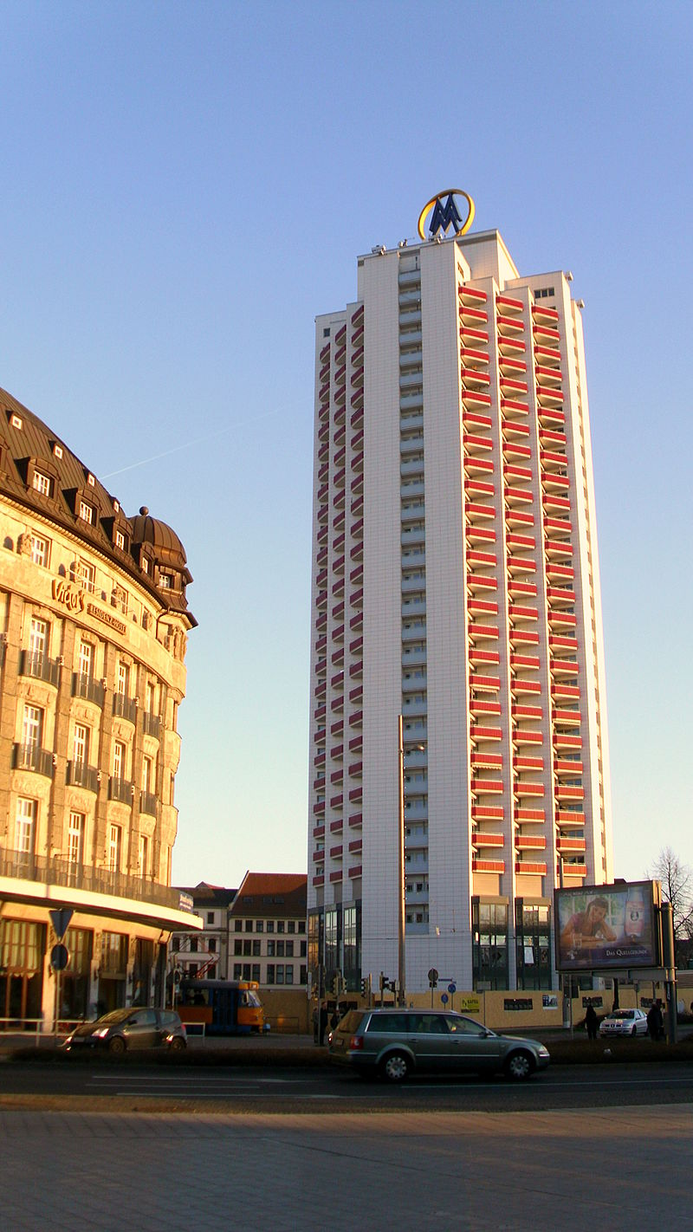
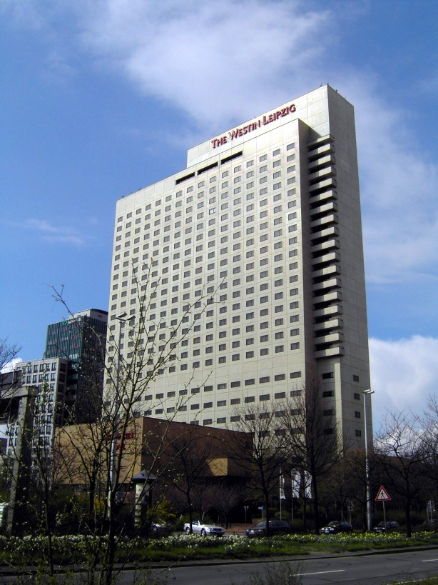

Slide 32
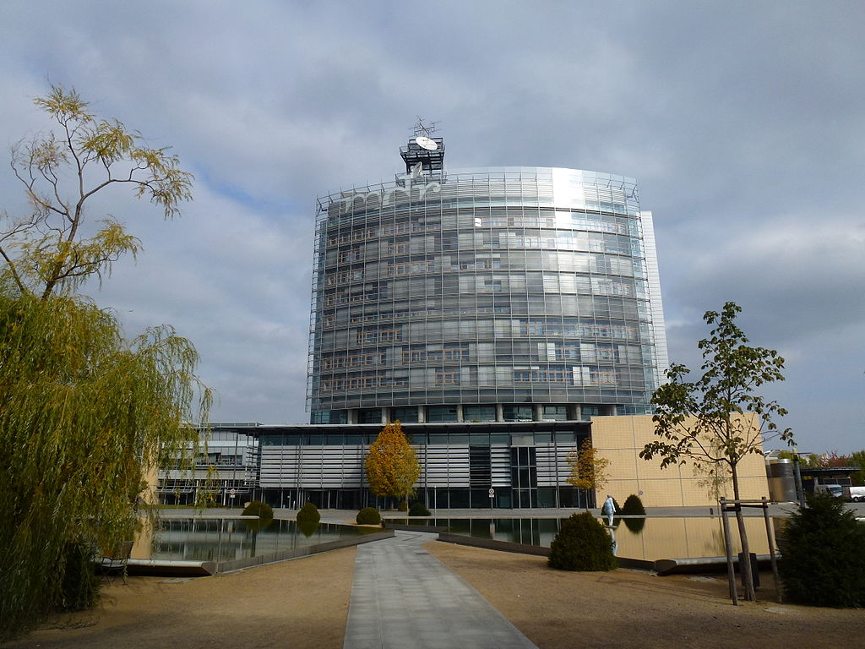

Slide 33
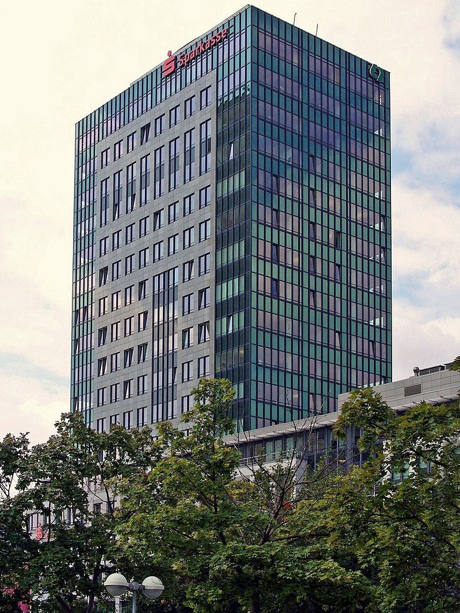

Slide 34
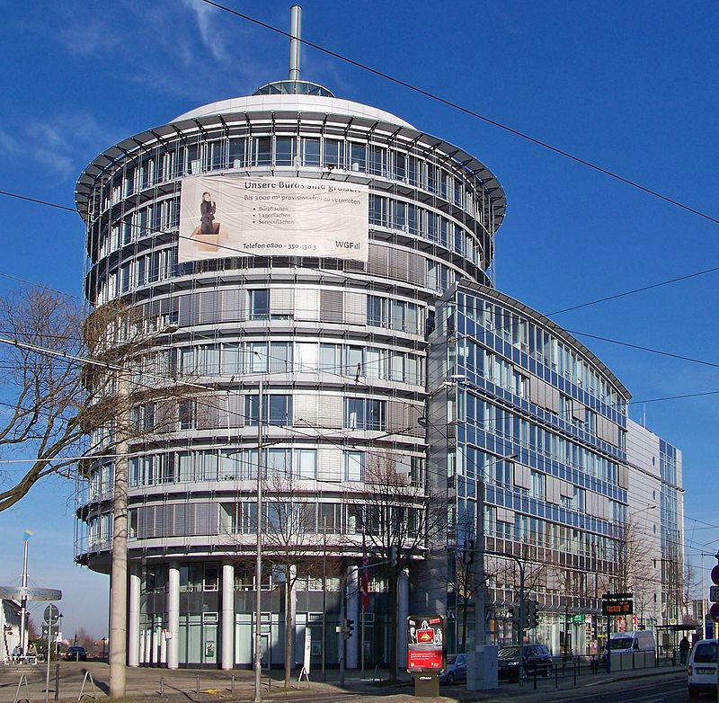

Slide 35
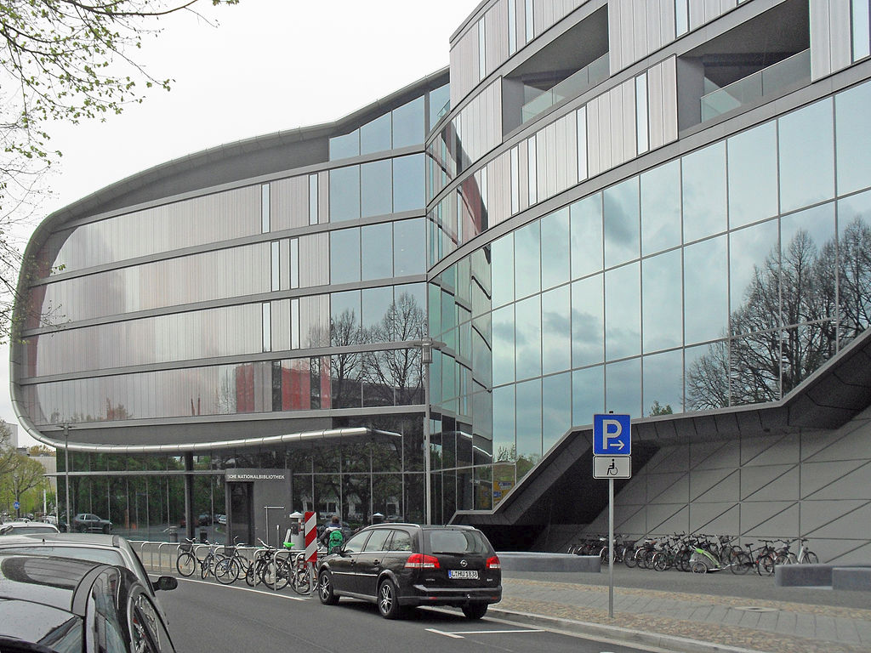
German Museum of Books and Writing

Slide 36
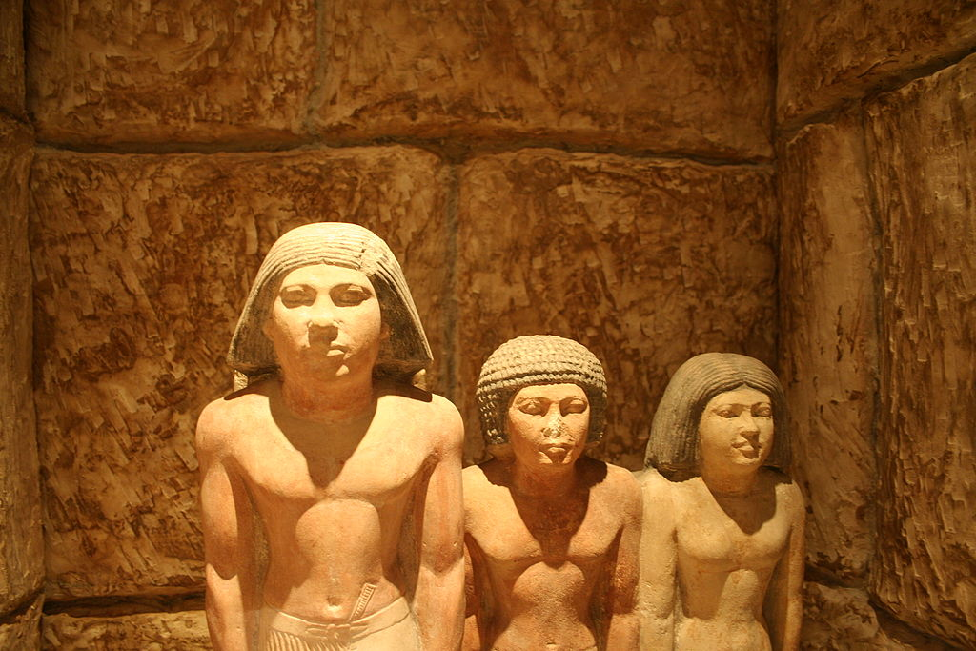
Exhibits of the Egyptian Museum

Slide 37
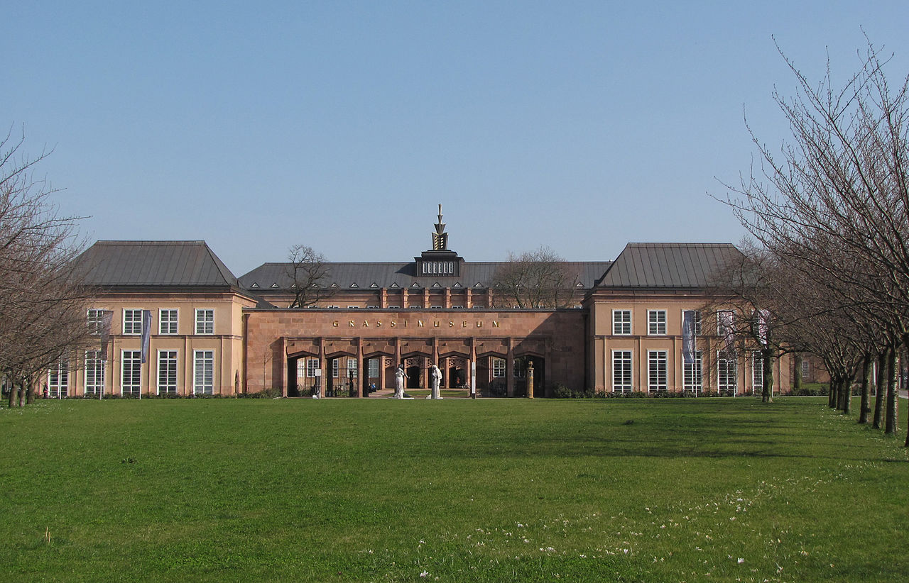
Grassi Museum

Slide 38
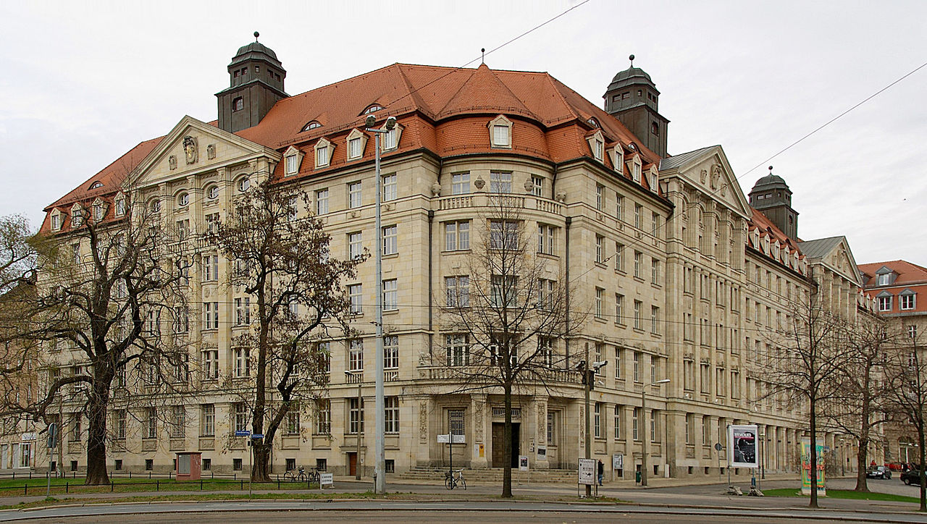
Museum in der Runden Ecke

Slide 39
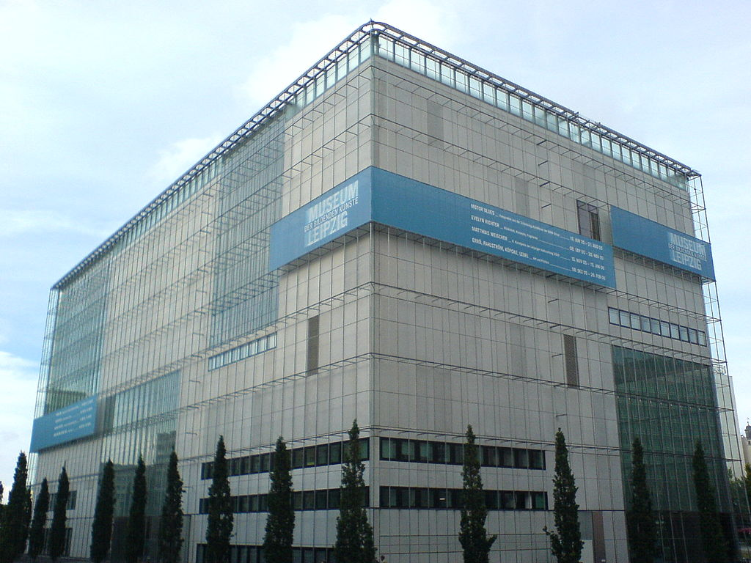
Museum of Fine Art

Slide 40
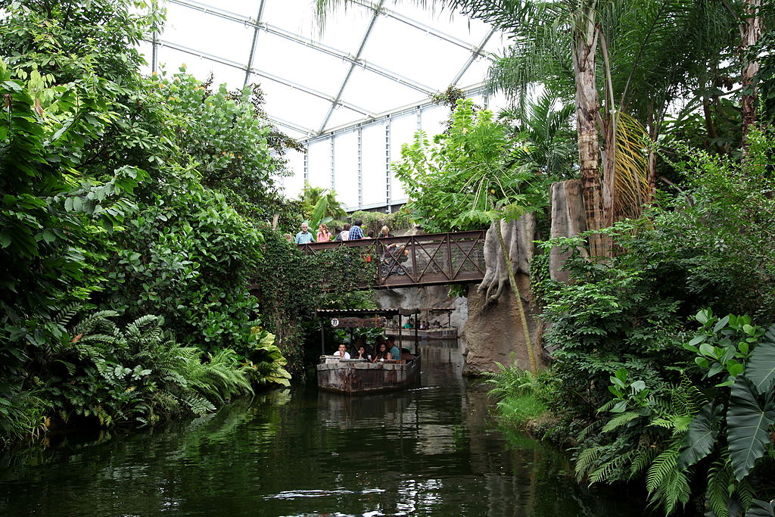
Inside Gondwanaland at Leipzig Zoological Garden

Slide 41
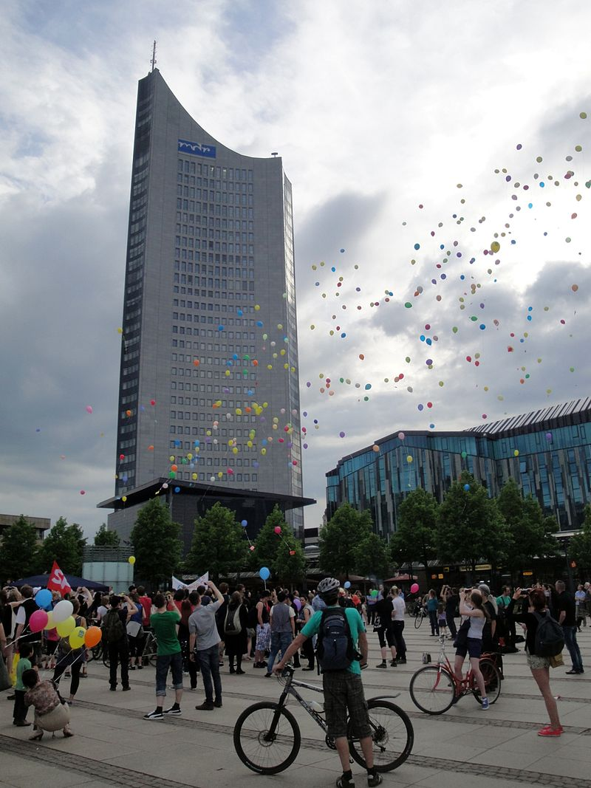

Slide 42
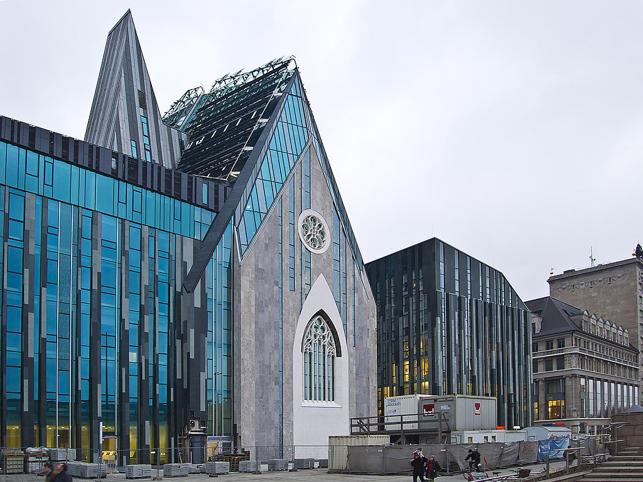
New Augusteum of the University of Leipzig

Slide 43
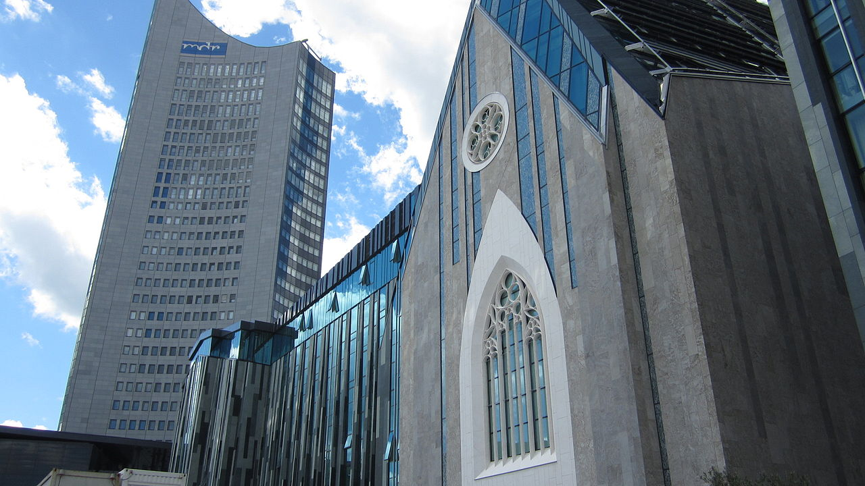

Slide 44
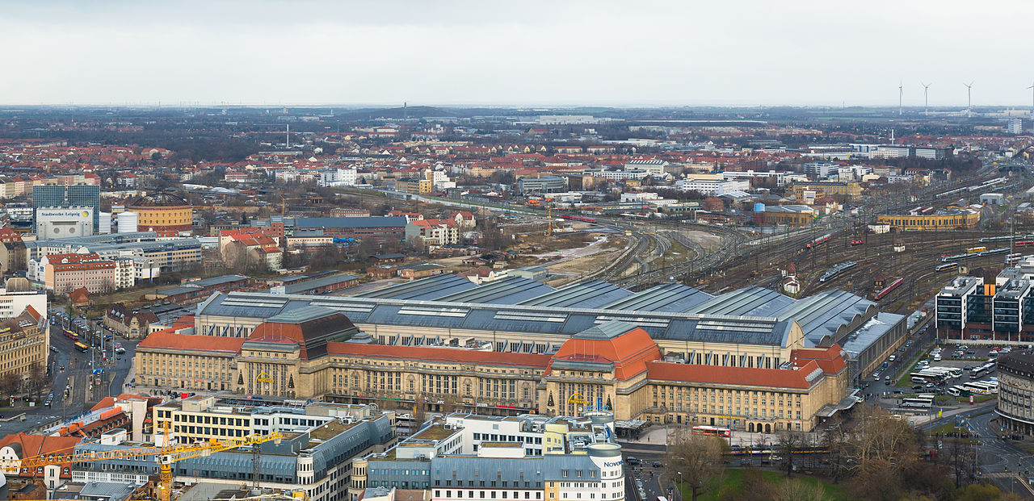

Slide 45
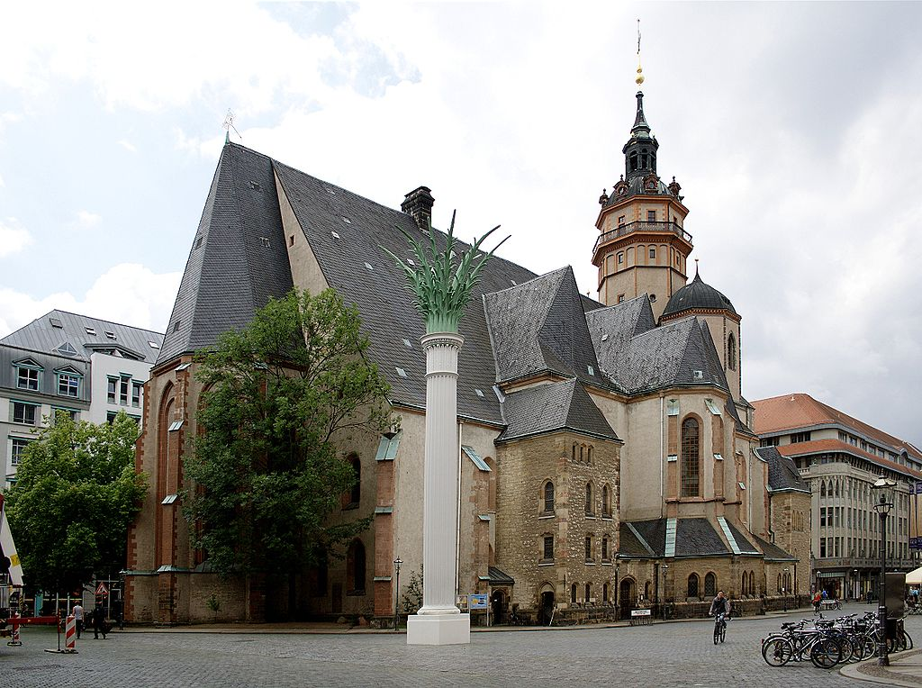

Slide 46
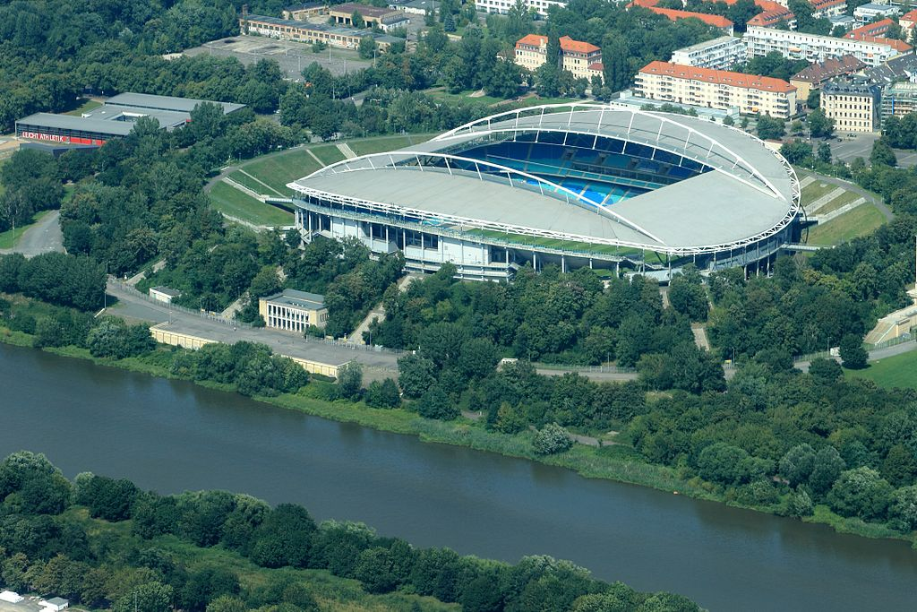

Slide 47
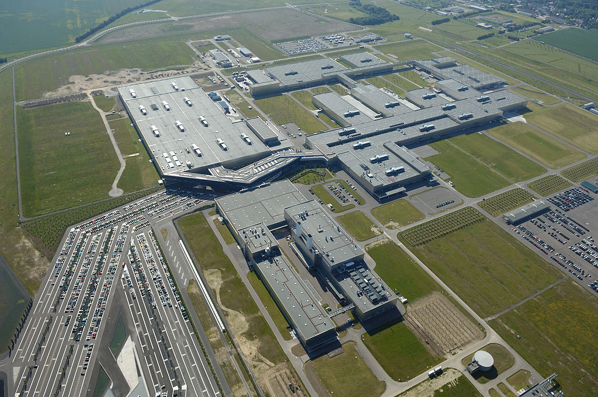
BMW Plant

Slide 48
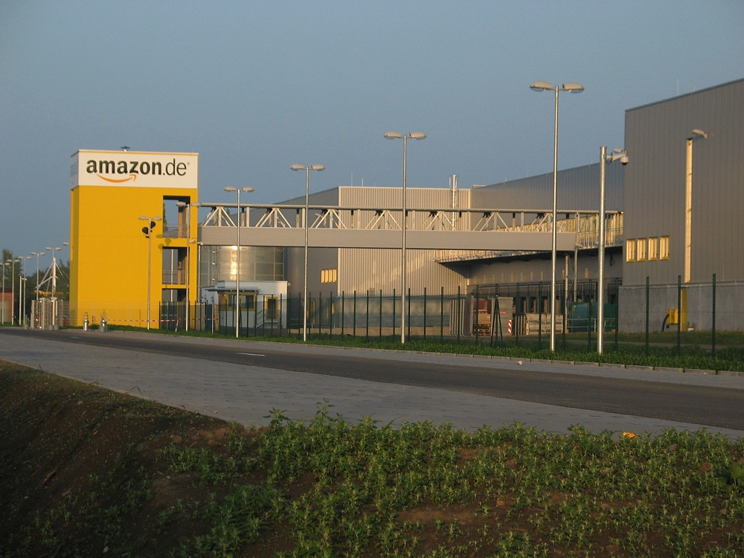

Slide 49


Slide 50


