Slide 1
Lapland, Finland

Slide 2
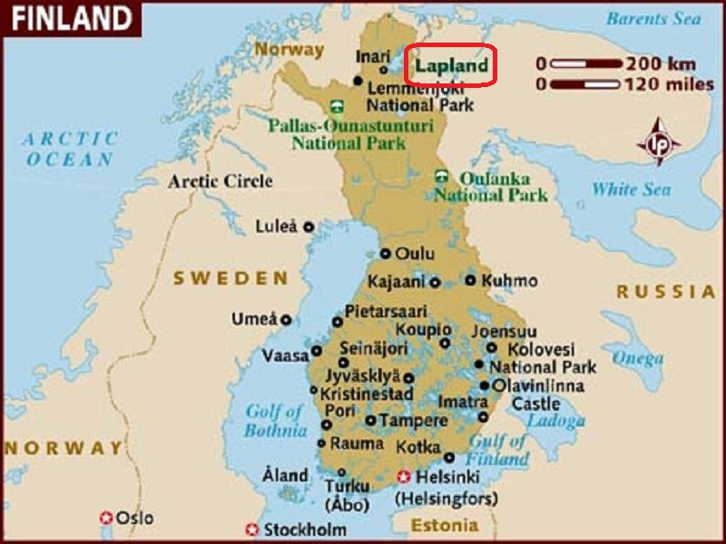
Lapland is the largest and northernmost region of Finland. The municipalities in the region cooperate in a Regional Council.

Slide 3
Lapland is the largest and northernmost region of Finland. The municipalities in the region cooperate in a Regional Council. Lapland borders the region of Northern Ostrobothnia in the south. It also borders the Gulf of Bothnia, Norrbotten County in Sweden, Finnmark County and Troms County in Norway, and Murmansk Oblast and the Republic of Karelia in Russia. The very first snowflakes fall to the ground in late August or early September over the higher peaks. The first ground-covering snow arrives in average in October or late September. Permanent snow cover comes between mid-October and end of November, significantly earlier than in southern Finland. The winter is long, approximately seven months. The snow cover is usually thickest in early April. Soon after that the snow cover starts to melt fast. The thickest snow cover ever was measured in Kilpisjärvi in 19 April 1997 and it was 190 cm.
Due to the warming effect of the Arctic Sea, the coldest spot is not located in northernmost Lapland but in the north-western corner. The annual mean temperature varies from a couple of degrees below zero in Northwest to a couple of degrees above zero in the southwest (Kemi-Tornio area).

Slide 4
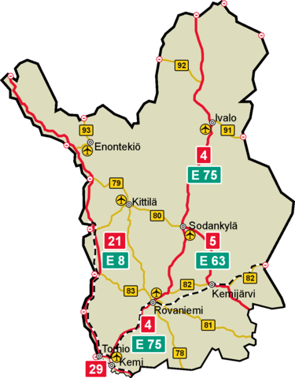
Lapland, Finland

Slide 5
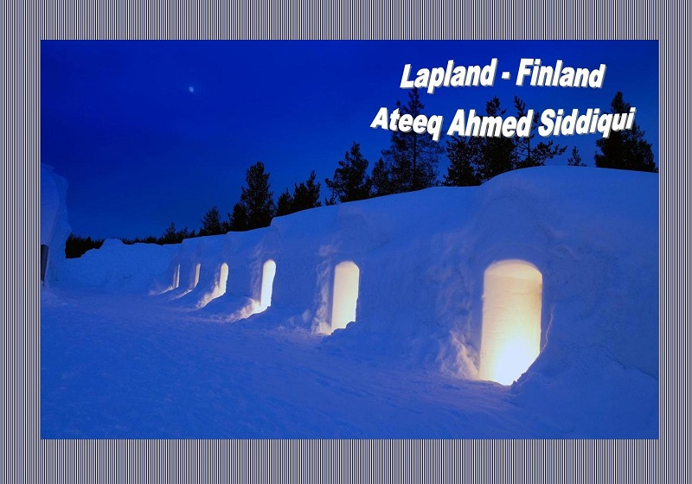

Slide 6
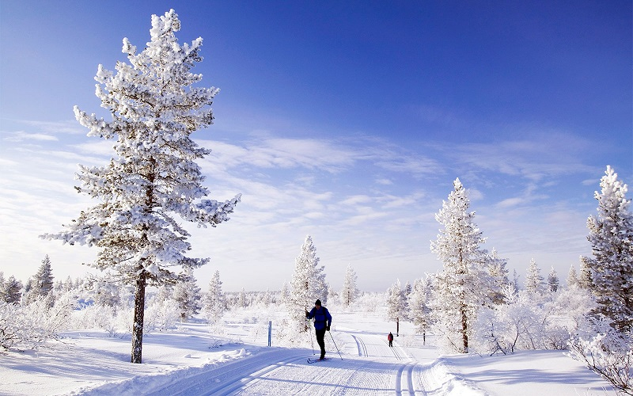

Slide 7
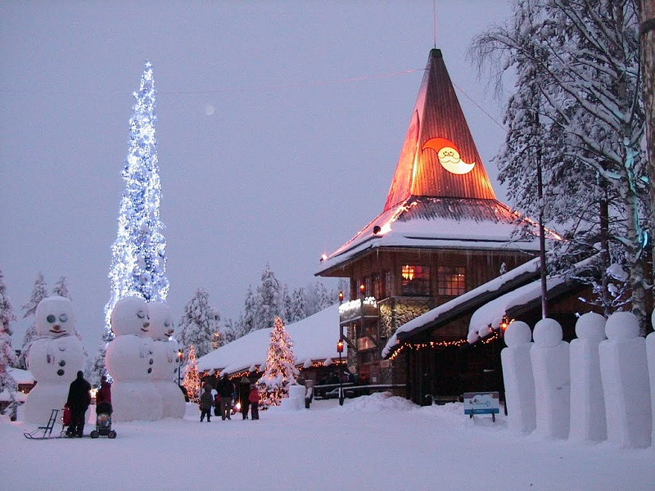

Slide 8
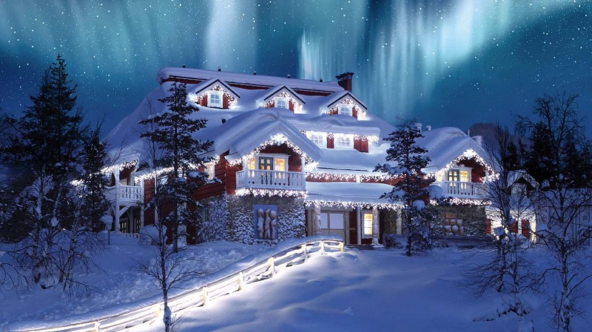

Slide 9
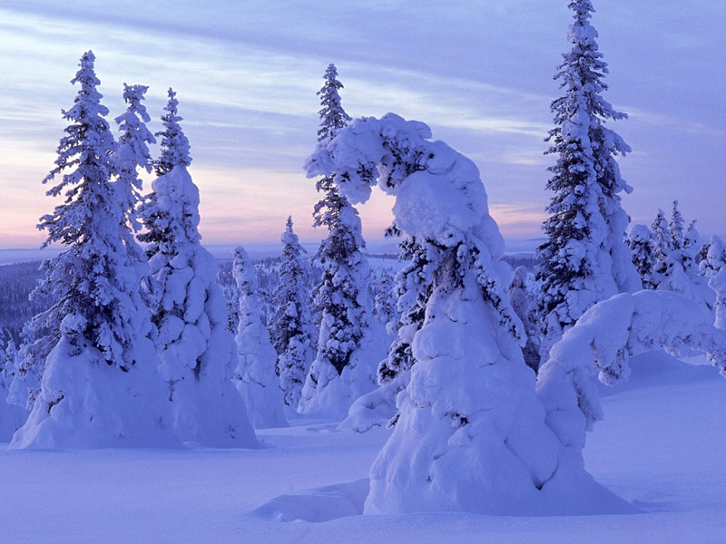

Slide 10
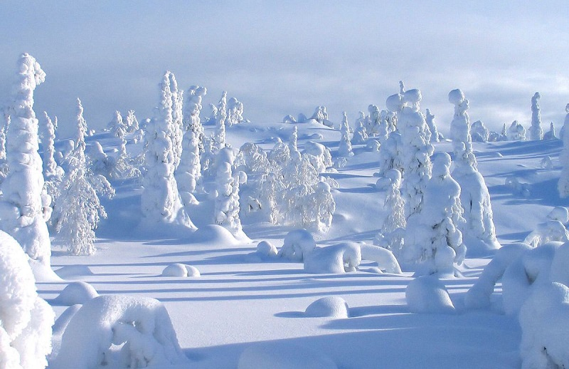

Slide 11
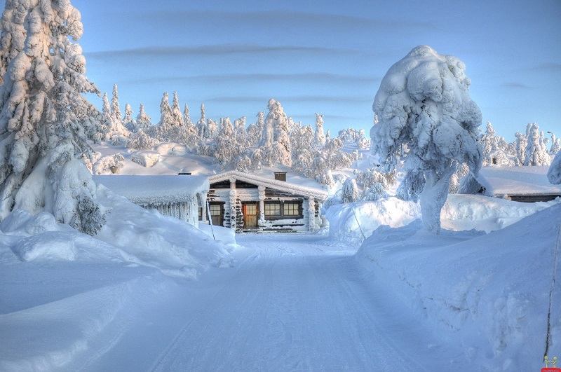

Slide 12
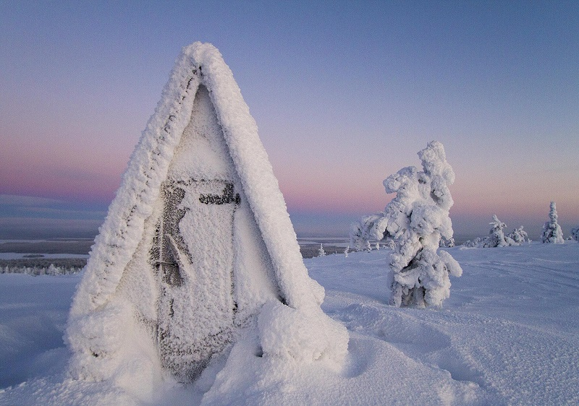

Slide 13
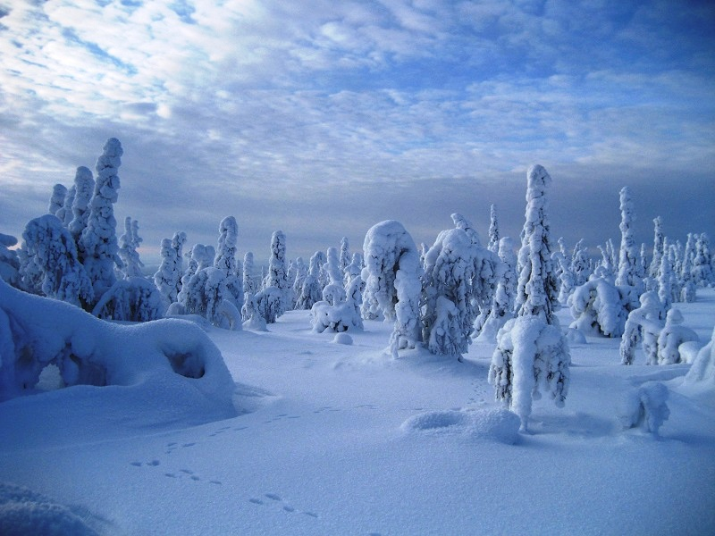

Slide 14
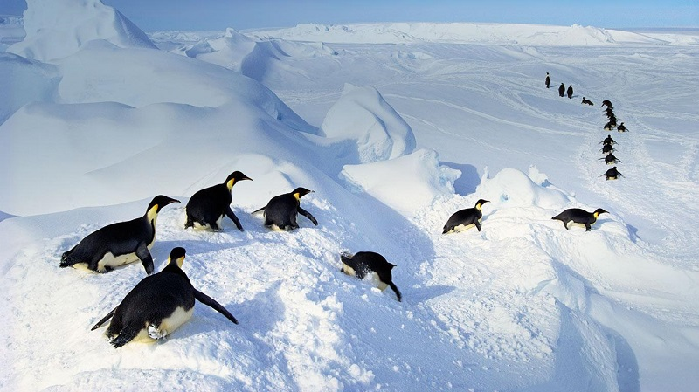
Yes, in Finland!

Slide 15
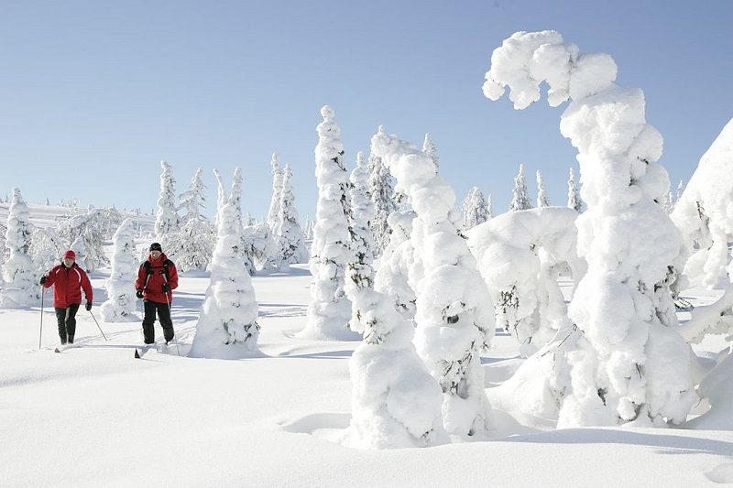

Slide 16
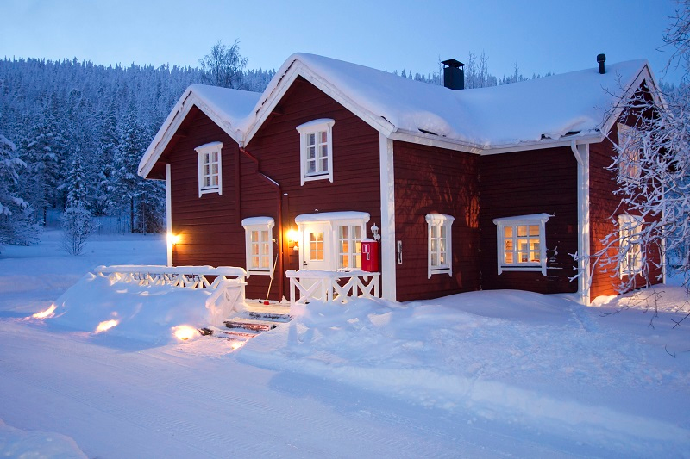

Slide 17
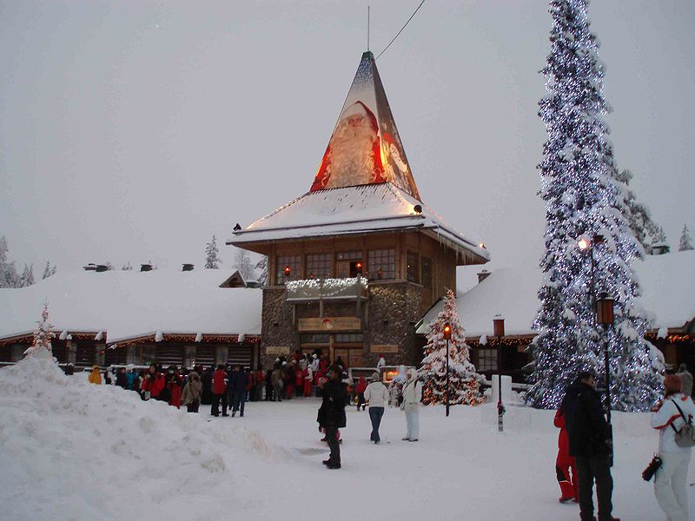

Slide 18
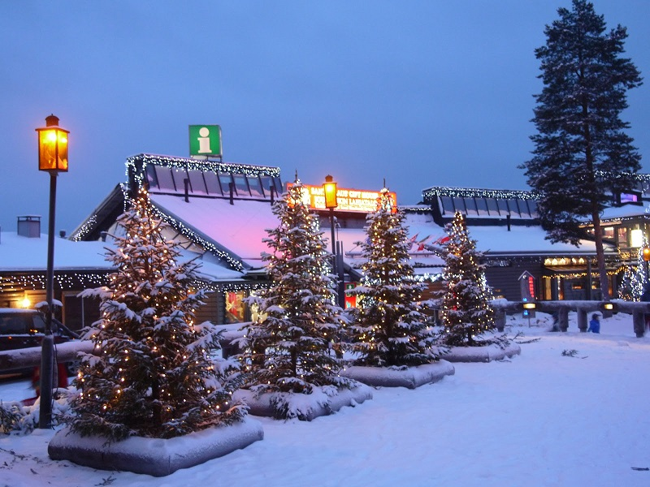

Slide 19
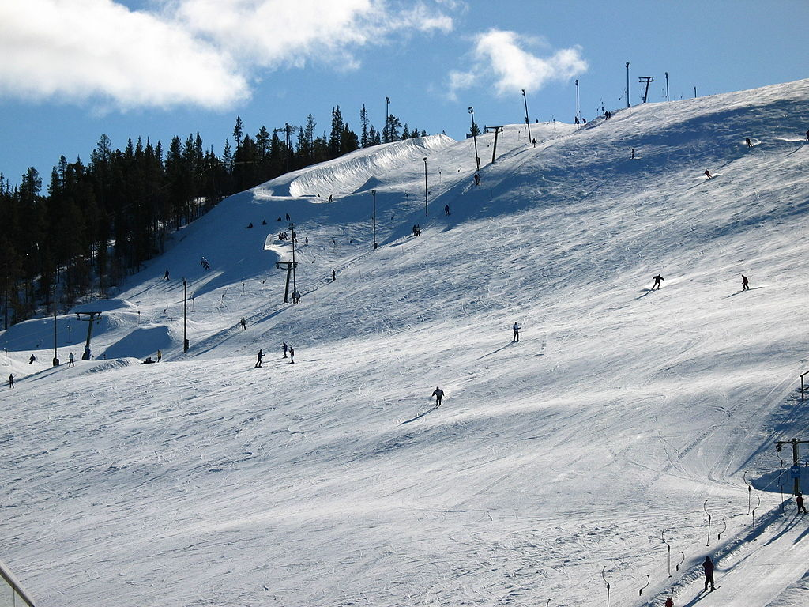

Slide 20
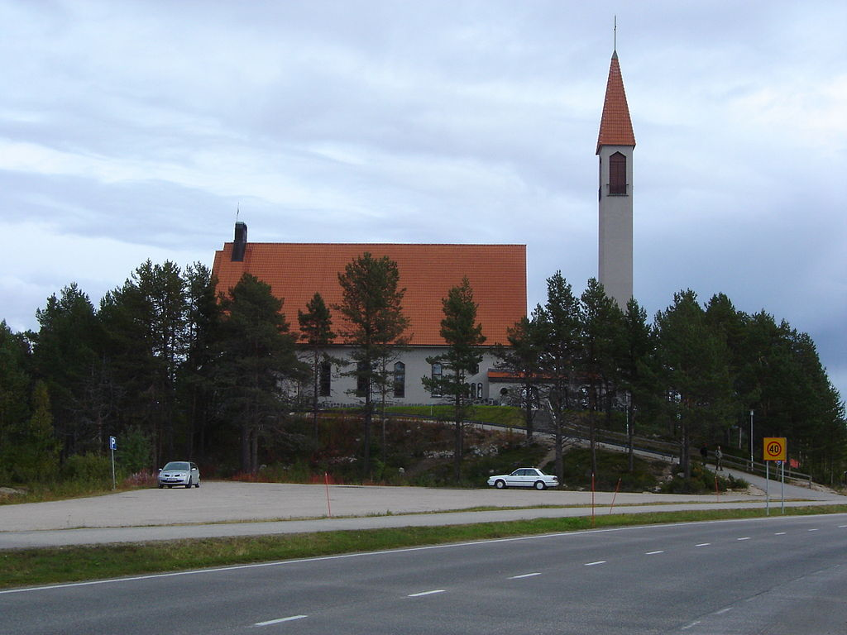
Enontekiö Church, a typical after-World War II-erected church

Slide 21
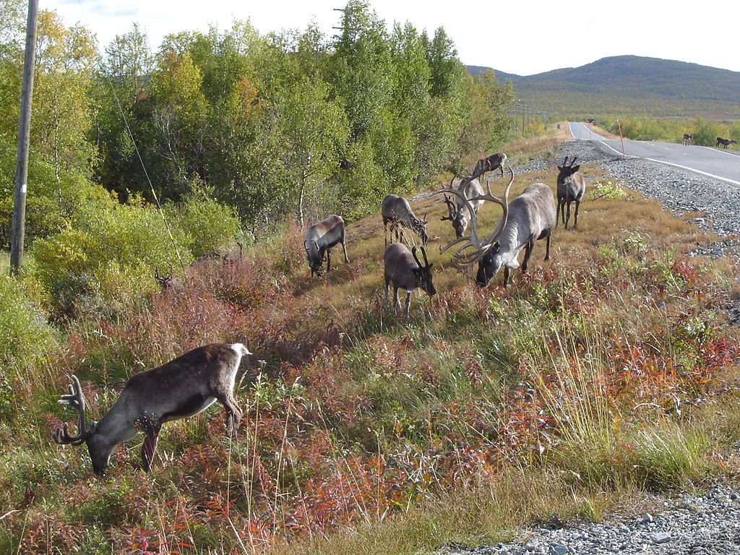
Reindeer in Enontekiö

Slide 22
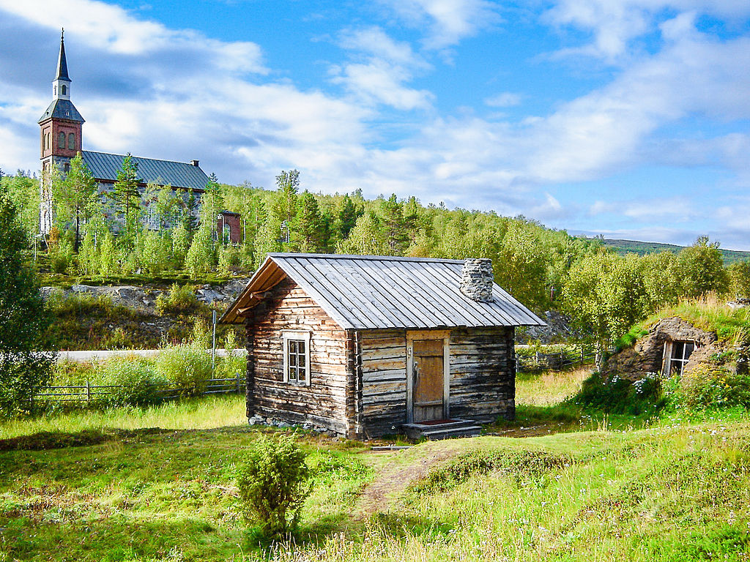
Utsjoki Church and church cabins; the northernmost church in Finland

Slide 23
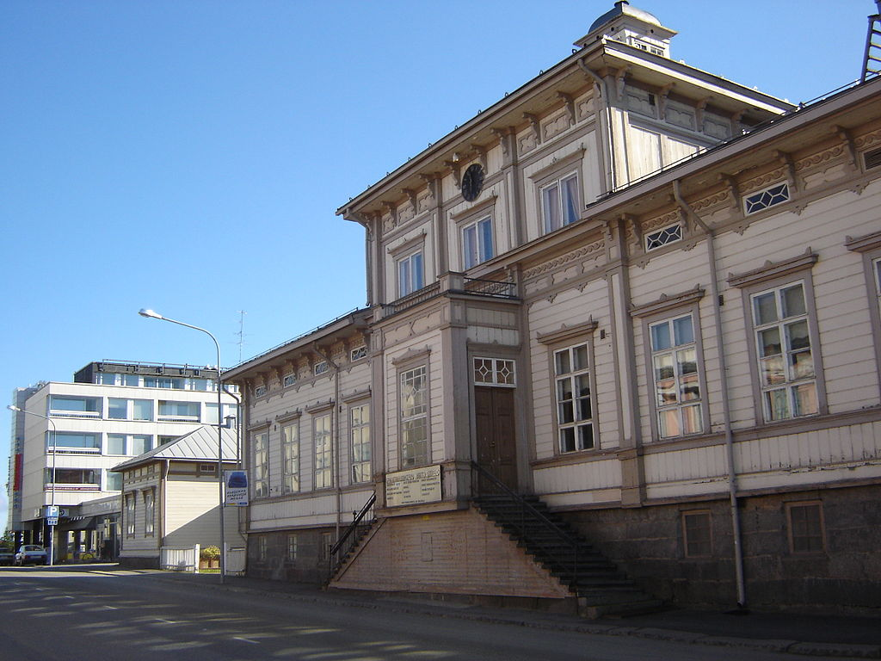
Tornio Town Hall

Slide 24
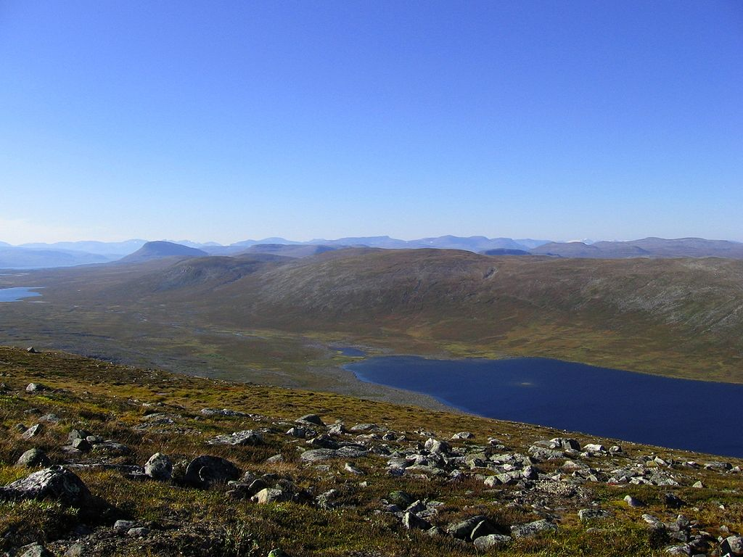
Wilderness in Enontekiö

Slide 25
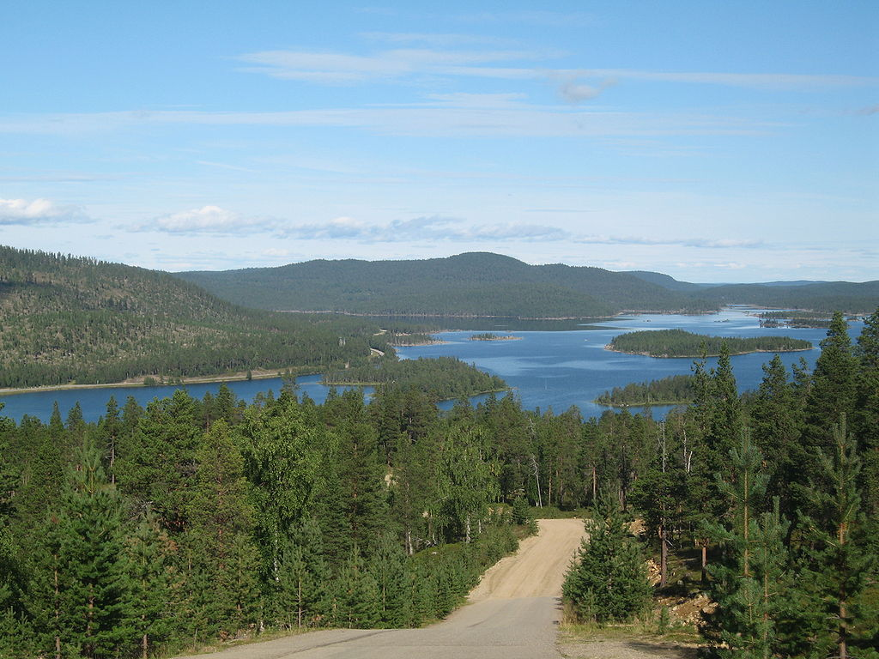
A view towards Lake Inari

Slide 26
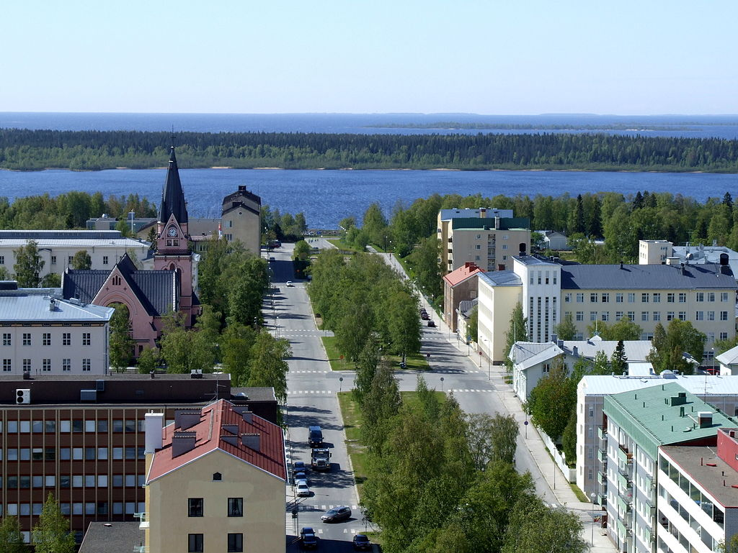
A general view of Kemi town centre with Gulf of Bothnia in the background

Slide 27
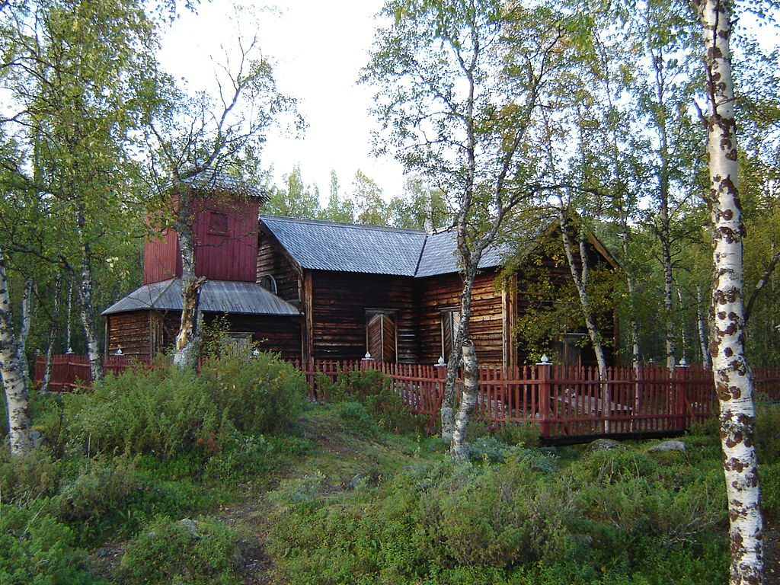
Pielpajärvi Wilderness Church from 1760 managed to avoid getting burnt in World War II

Slide 28
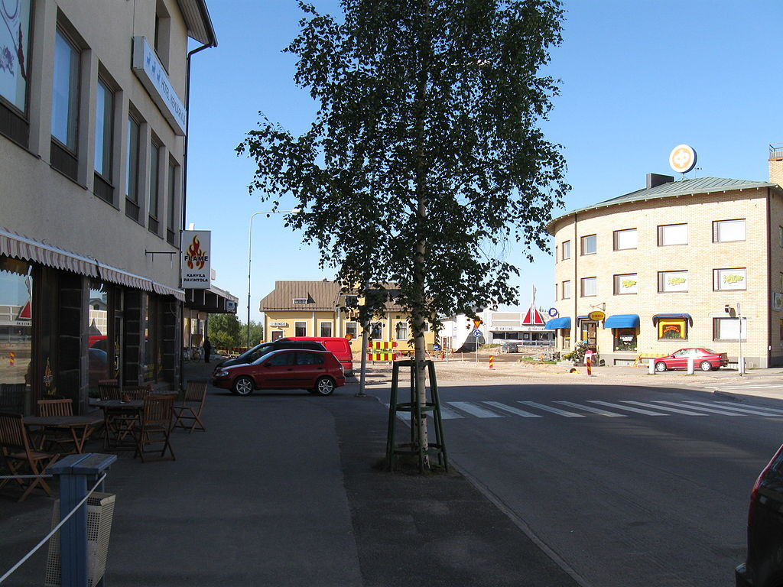
Kemijärvi town centre

Slide 29
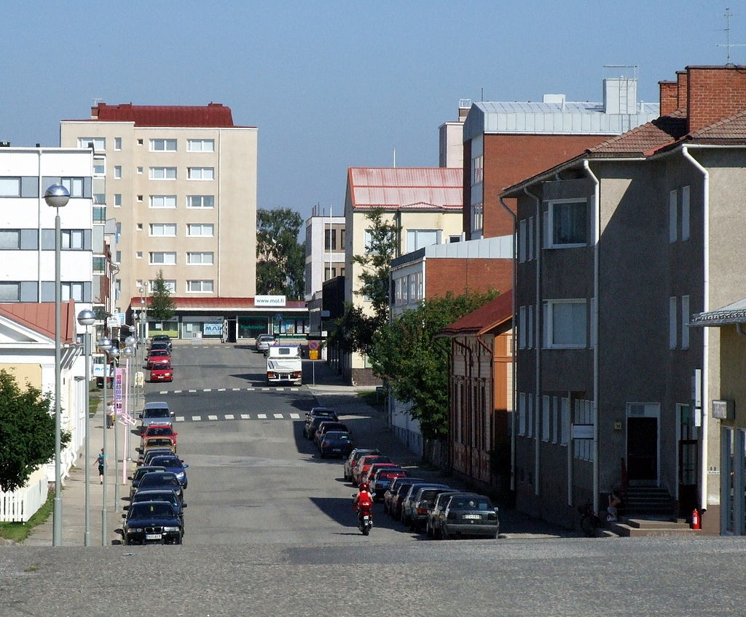
Architecture in Kemi

Slide 30
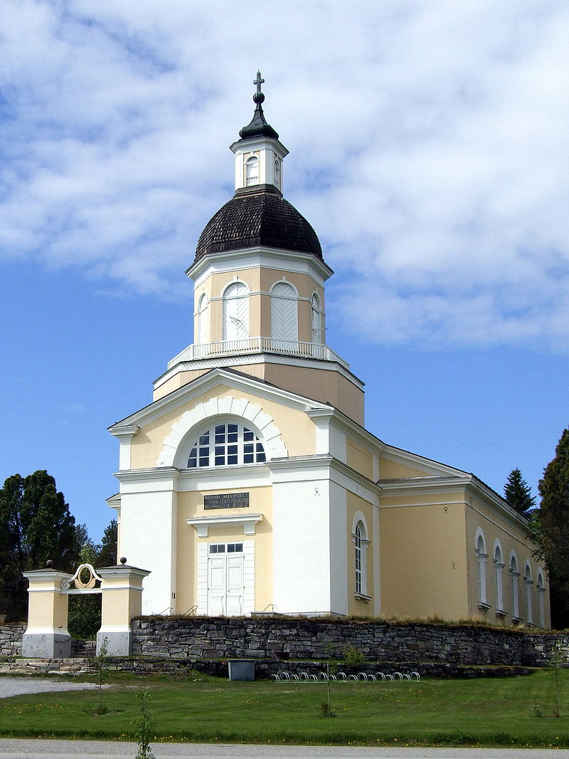
Keminmaa Church

Slide 31
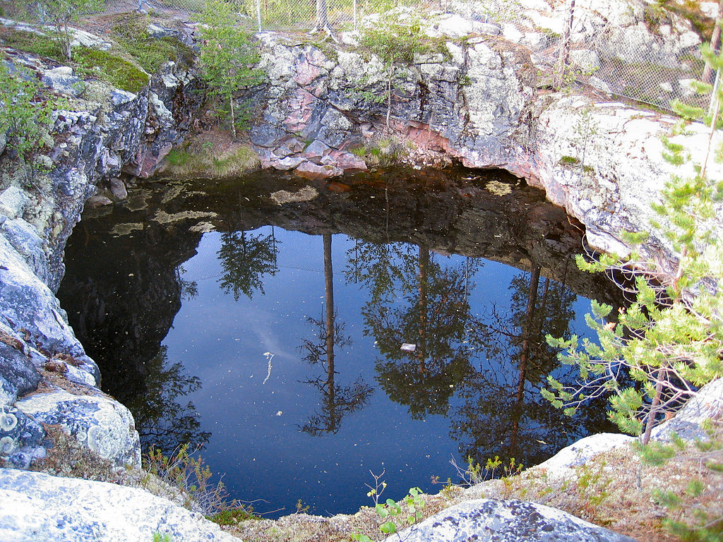
A giant's kettle in Salla, one of the largest in the world.

Slide 32
Kettle
A kettle (kettle hole, pothole) is a shallow, sediment-filled body of water formed by retreating glaciers or draining floodwaters. The kettles are formed as a result of blocks of ice calving from glaciers and becoming submerged in the sediment on the outwash plain. Another source is the sudden drainage of an ice-dammed lake. When the block melts, the hole it leaves behind is a kettle. As the ice melts, ramparts can form around the edge of the kettle hole. The lakes that fill these holes are seldom more than 10 m (33 ft) deep and eventually become filled with sediment. In acid conditions, a kettle bog may form but in alkaline conditions, it will be kettle peatland.

Slide 33
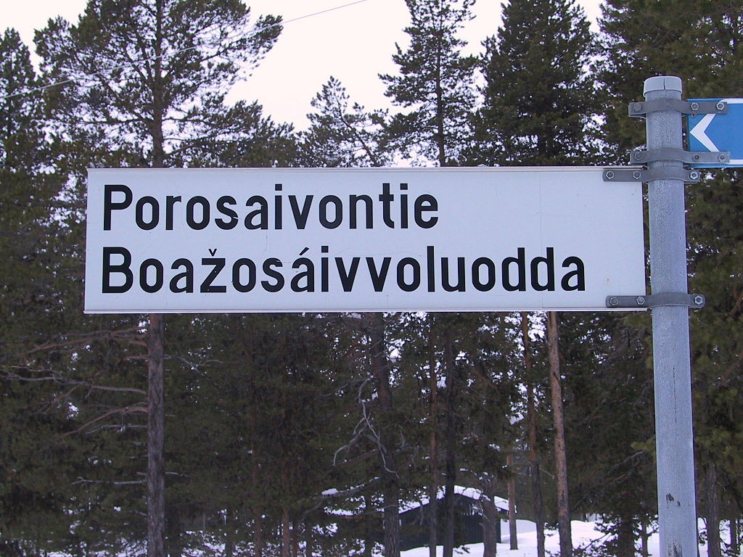
A bilingual (Finnish and Sámi) street sign

Slide 34
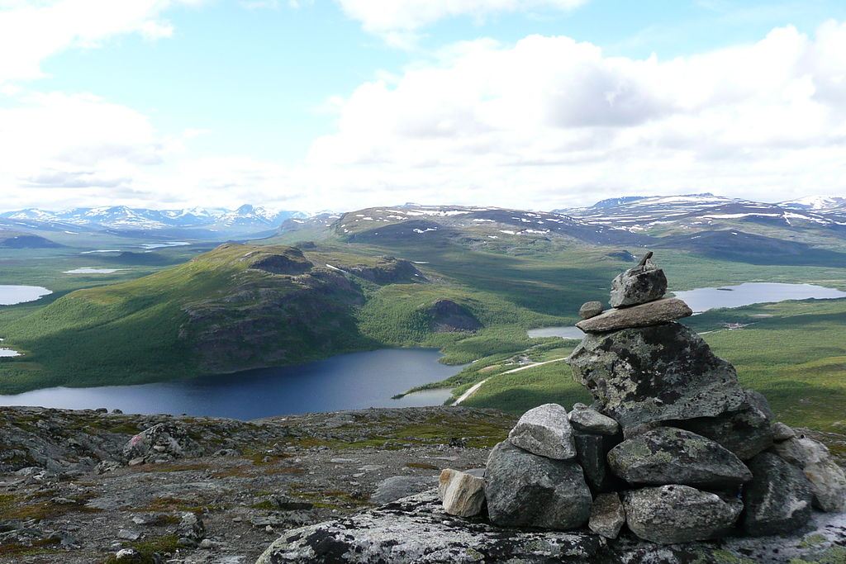
A view from Saana fell

Slide 35
Fell
A fell (from Old Norse fell, fjall, "mountain") is a high and barren landscape feature, such as a mountain range or moor-covered hills. The term is most often employed in Fennoscandia, the Isle of Man, parts of Northern England, and Scotland

Slide 36
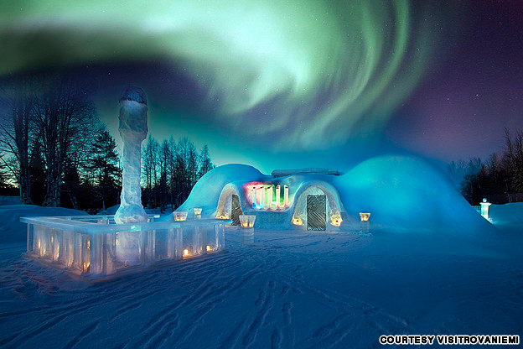

Slide 37
