Slide 1
Ipoh, Malaysia!

Slide 2
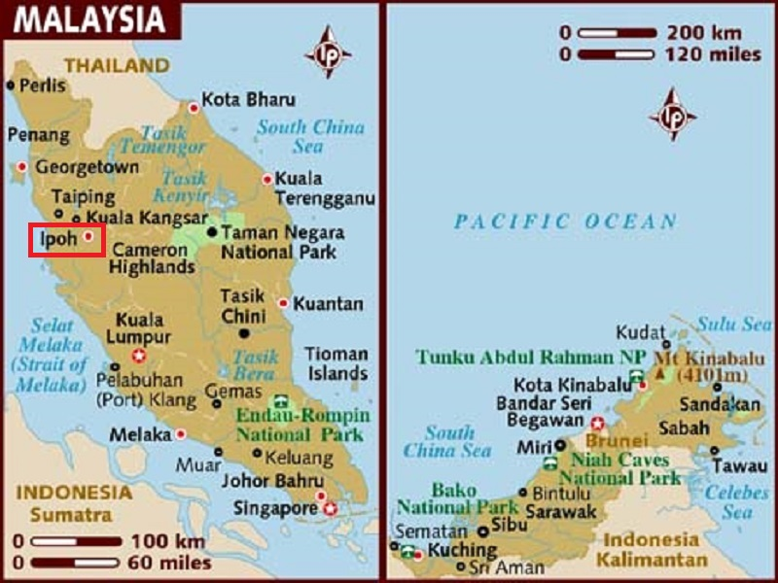
Ipoh is the capital city of the state of Perak, Malaysia and also the third largest city in the country.

Slide 3
Ipoh is the capital city of the state of Perak, Malaysia and also the third largest city in the country. It is approximately 200 km (120 mi) north of Kuala Lumpur and 130 km (81 mi) south of Penang on the North-South Expressway.
It is bordered by Batu Gajah in the west, Cameron Highlands in the east and Simpang Pulai in the south.
Ipoh's old world charm and booming hipster cafes has impressed the largest travel guide book publisher in the world, Lonely Planet, after the city was listed as one of the best Asian destinations to visit in 2016. Ipoh is the only city in Malaysia to be listed, at sixth place.

Slide 4
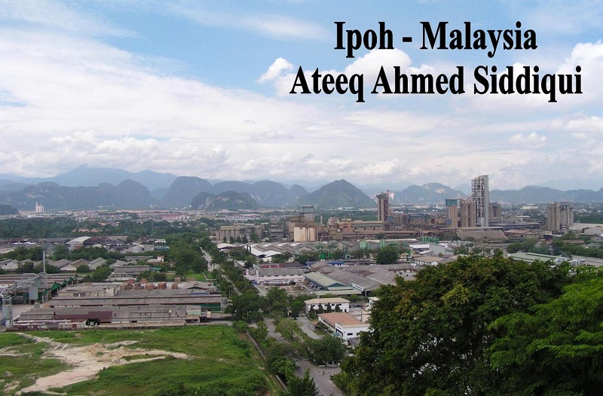

Slide 5
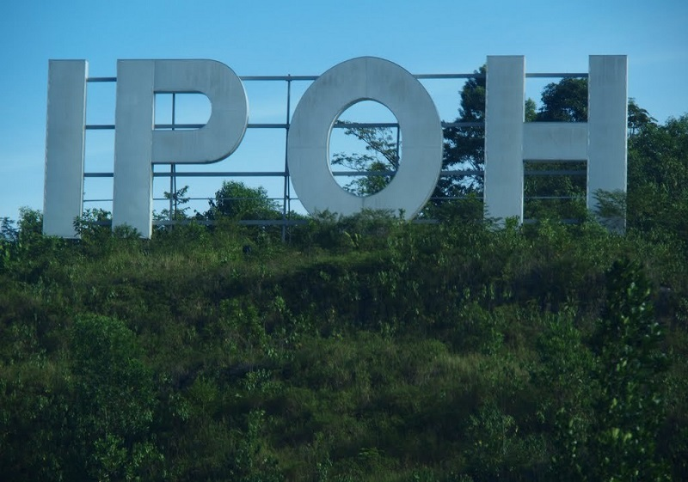

Slide 6
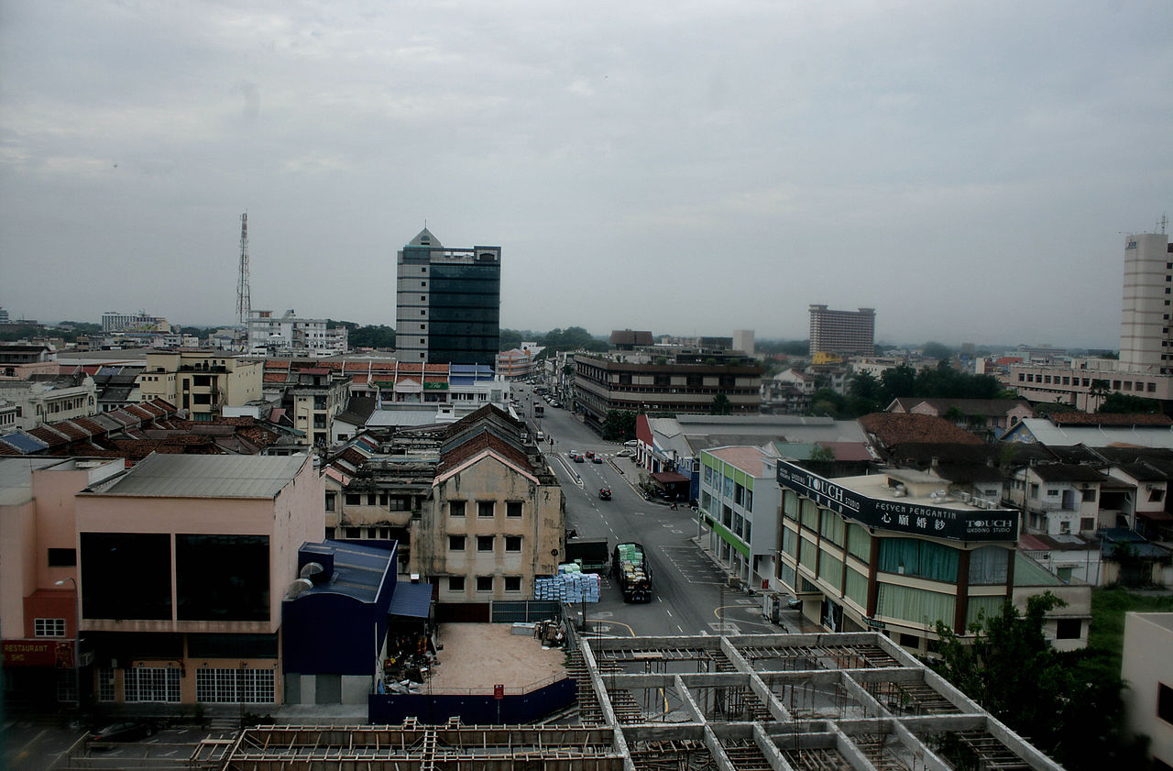
Skyline

Slide 7
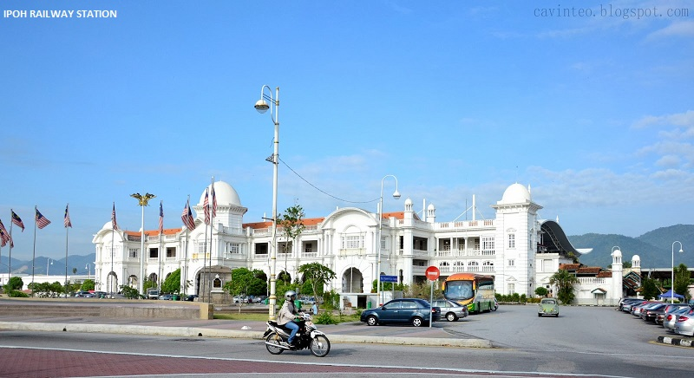

Slide 8
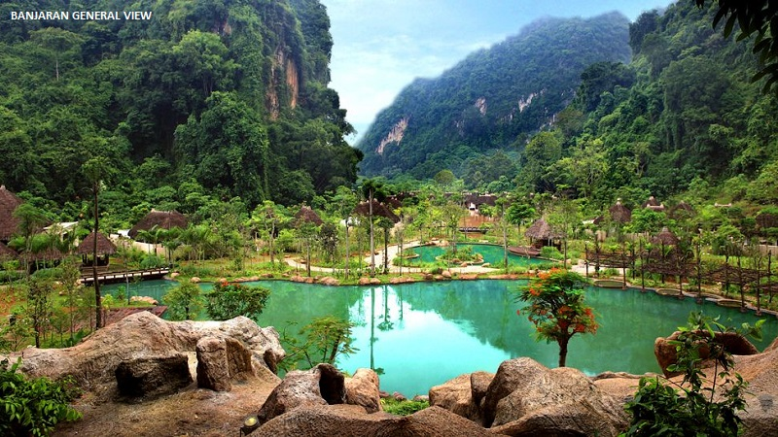

Slide 9
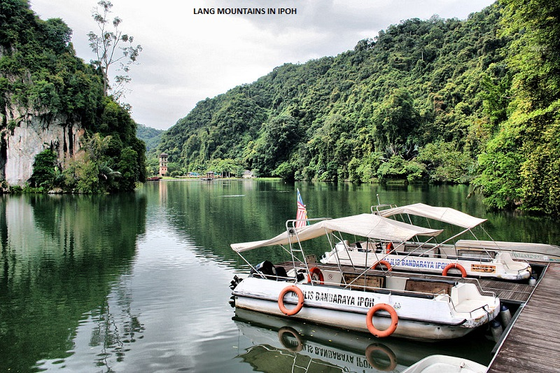

Slide 10
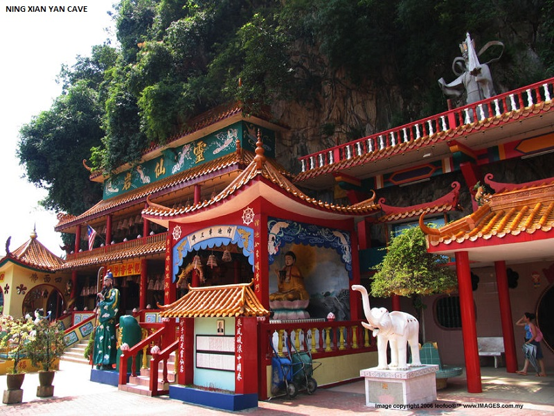

Slide 11


Slide 12
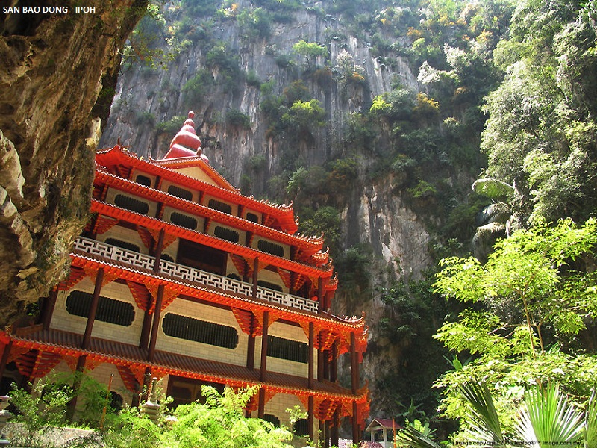

Slide 13
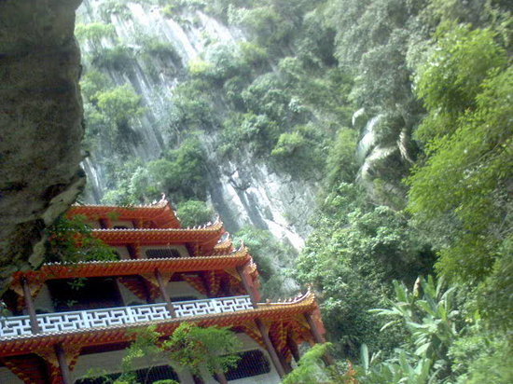

Slide 14
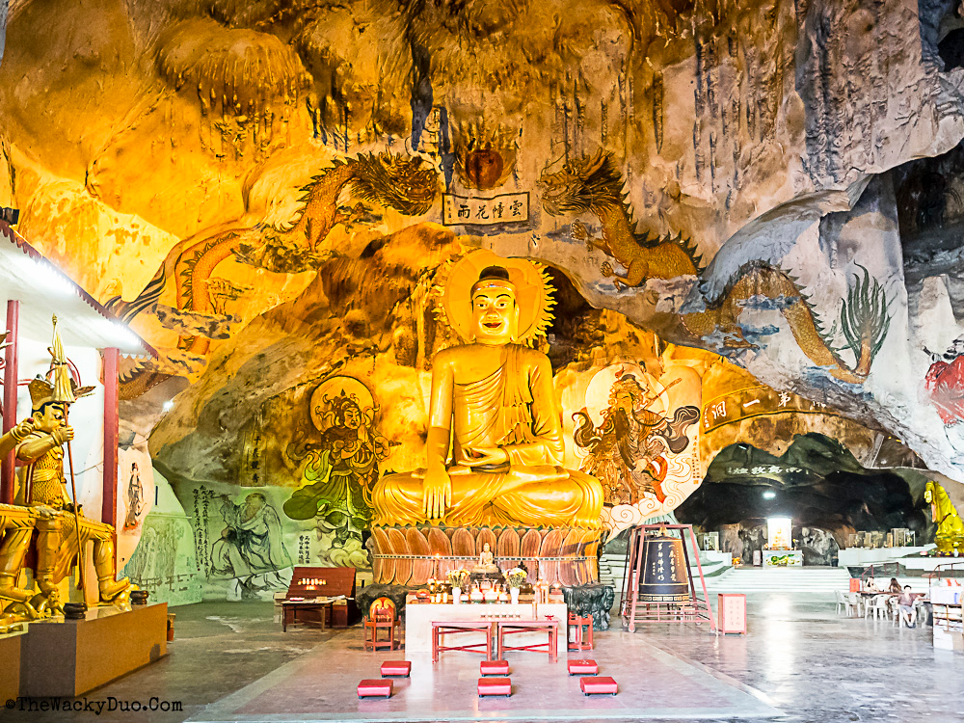
Perak Cave Temple

Slide 15
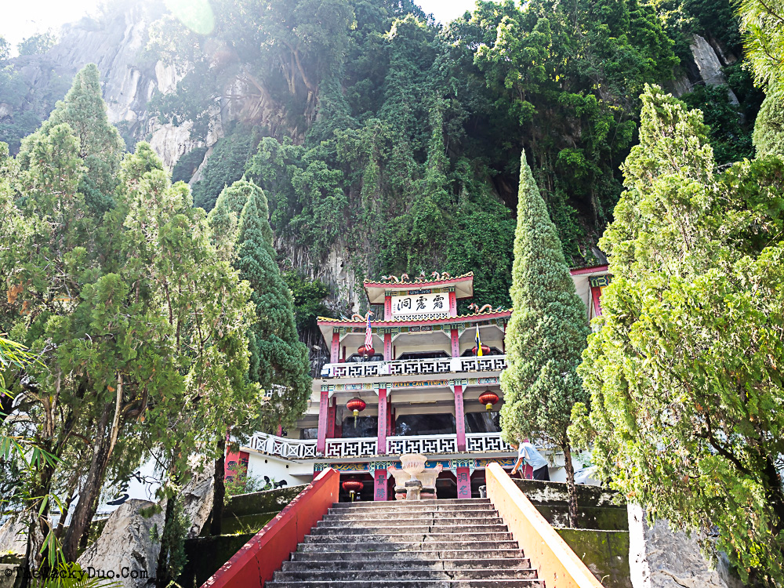
Cave temple

Slide 16
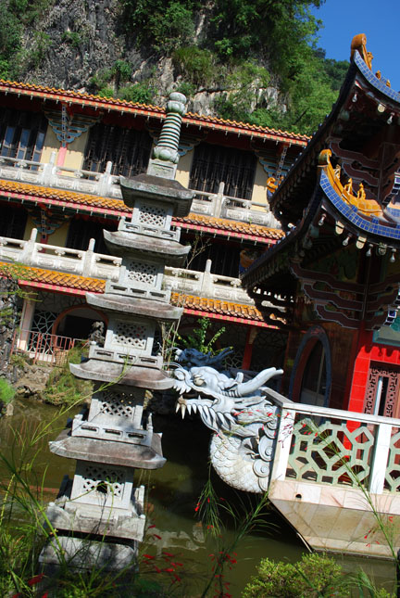
Sam Poh Tong, one of the many beautiful temples in Ipoh

Slide 17
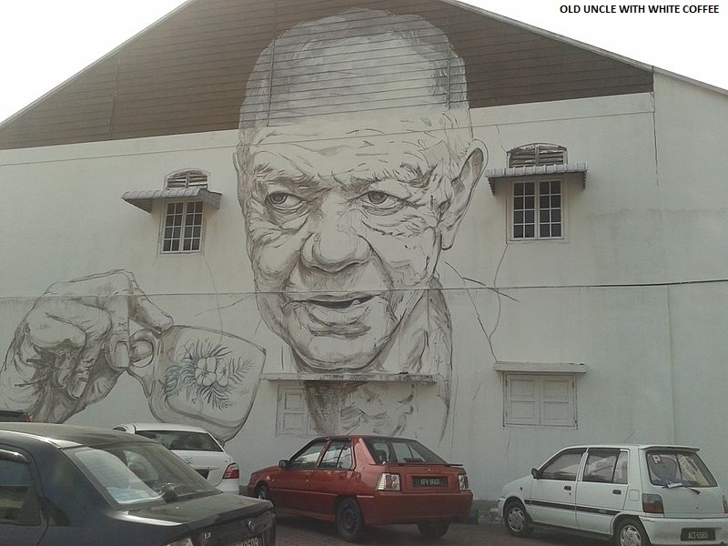
One of the 7 wall art murals drawn by Ernest Zacharevic in Ipoh old town.

Slide 18
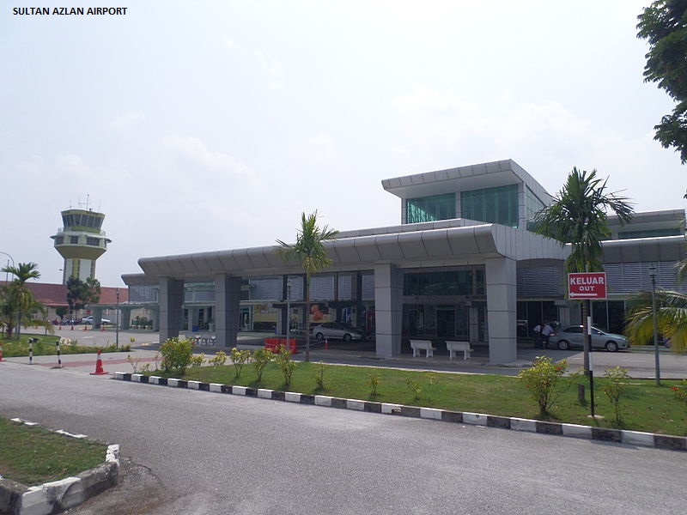

Slide 19
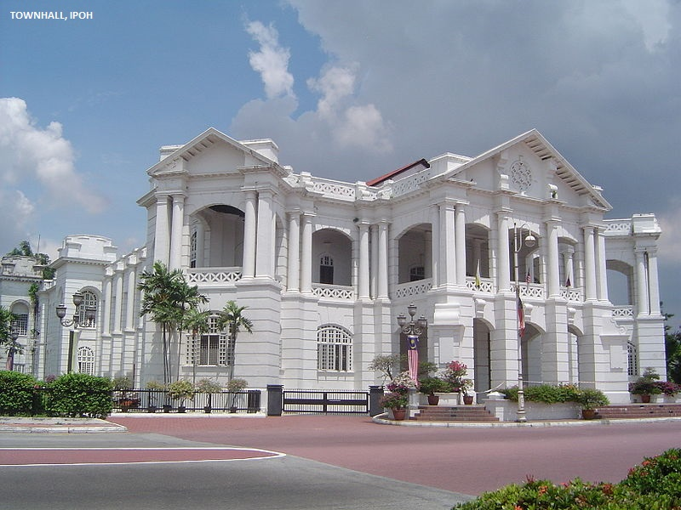

Slide 20
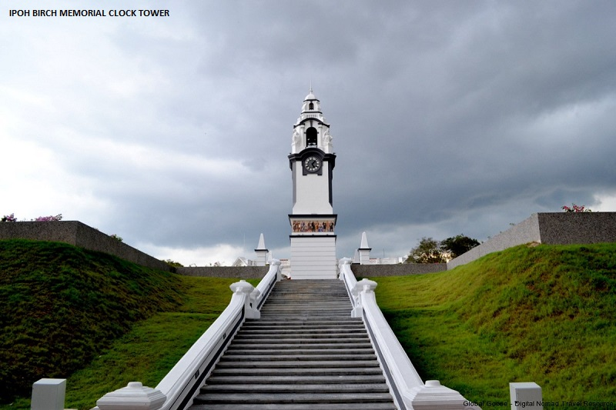

Slide 21
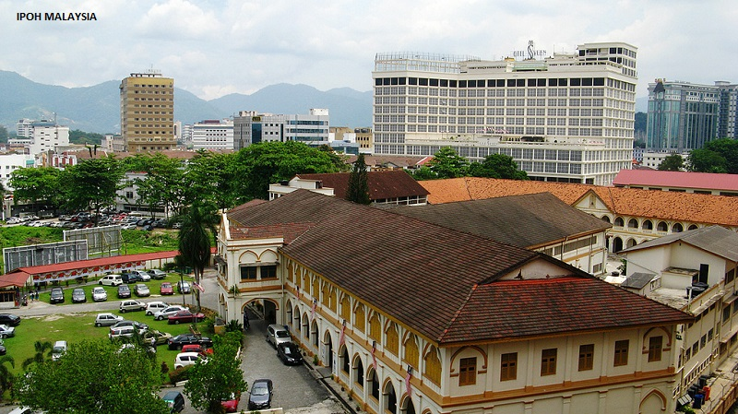

Slide 22
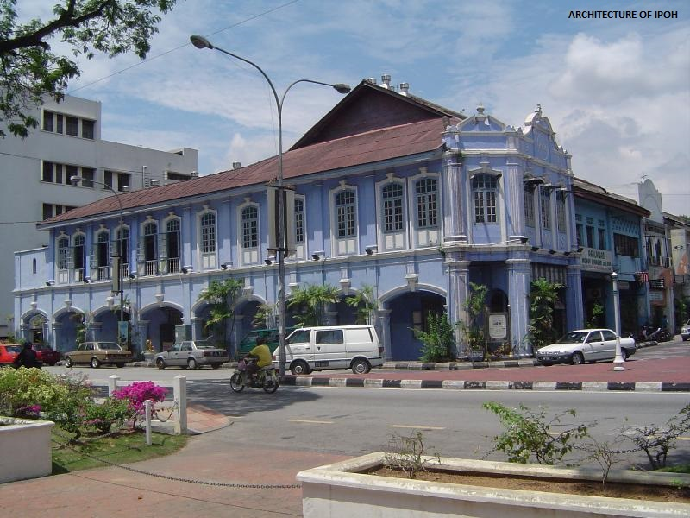

Slide 23
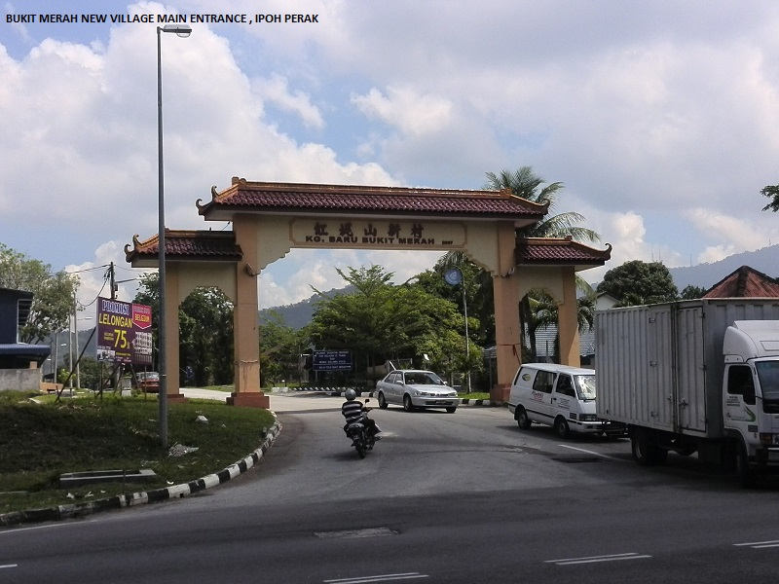

Slide 24
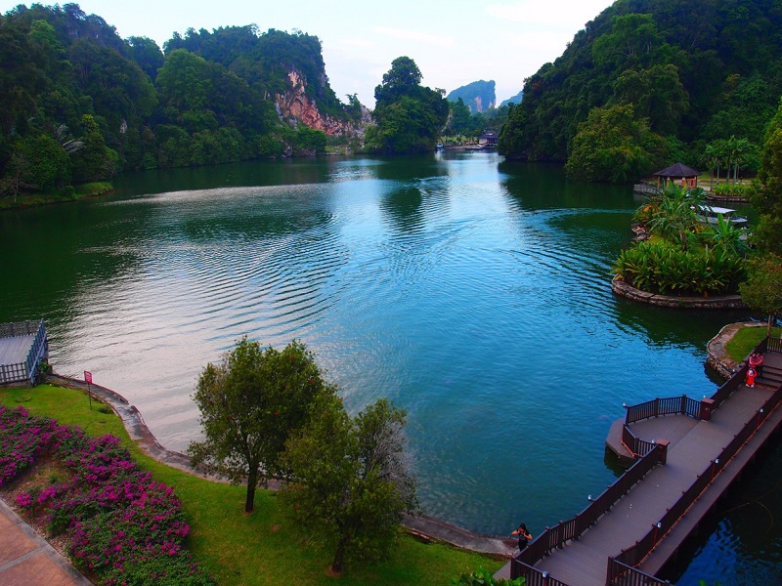

Slide 25
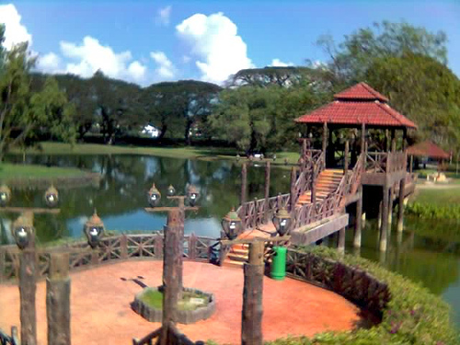
D.R. Seenivasagam Park, formerly Coronation Park

Slide 26
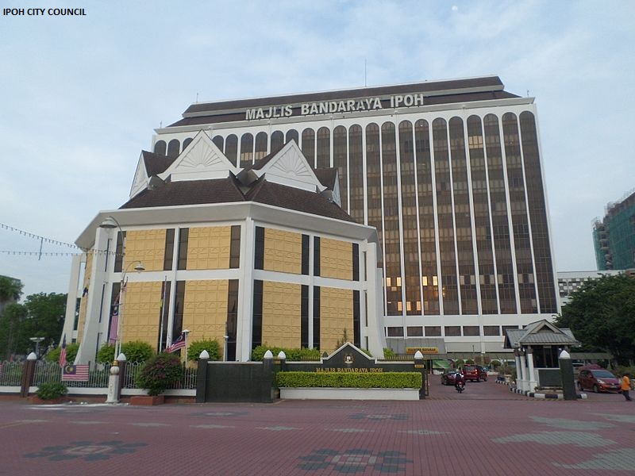

Slide 27
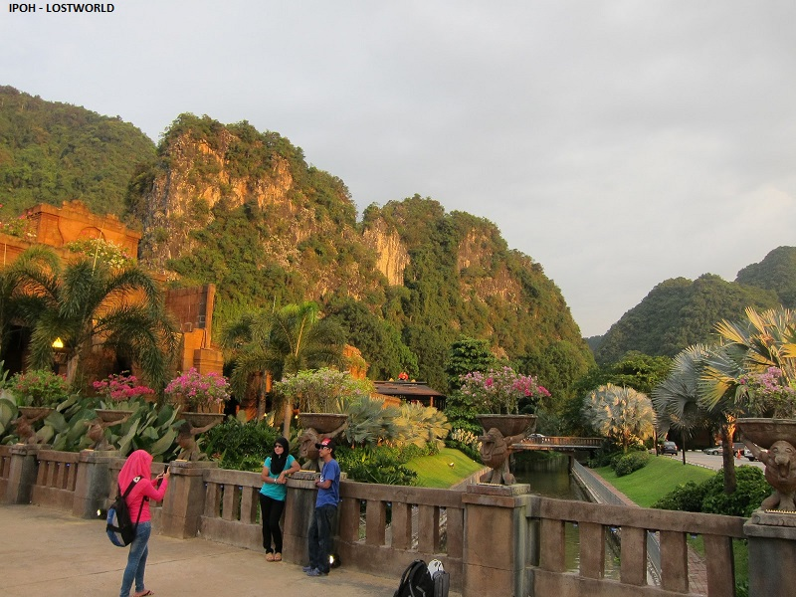

Slide 28
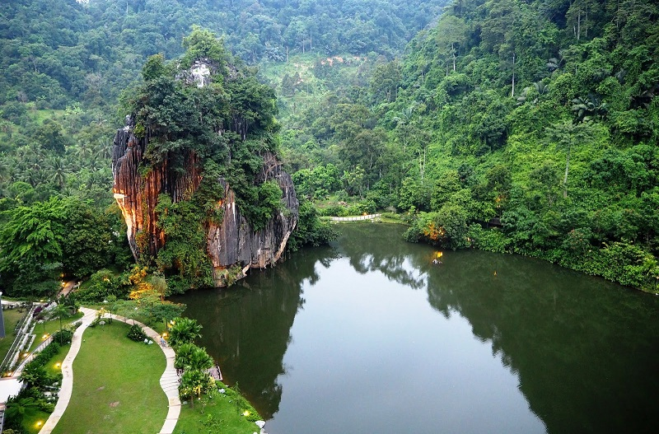

Slide 29
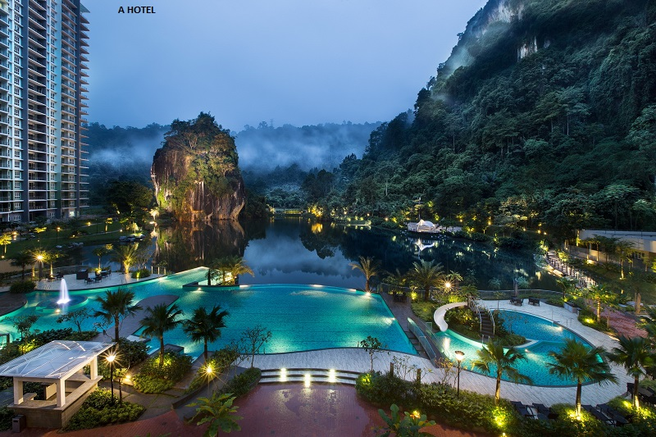

Slide 30
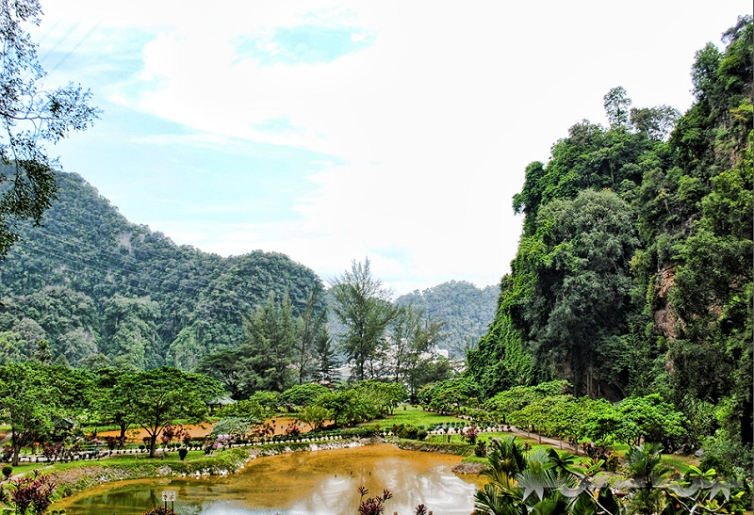

Slide 31

Lang Mountains

Slide 32
