Slide 1

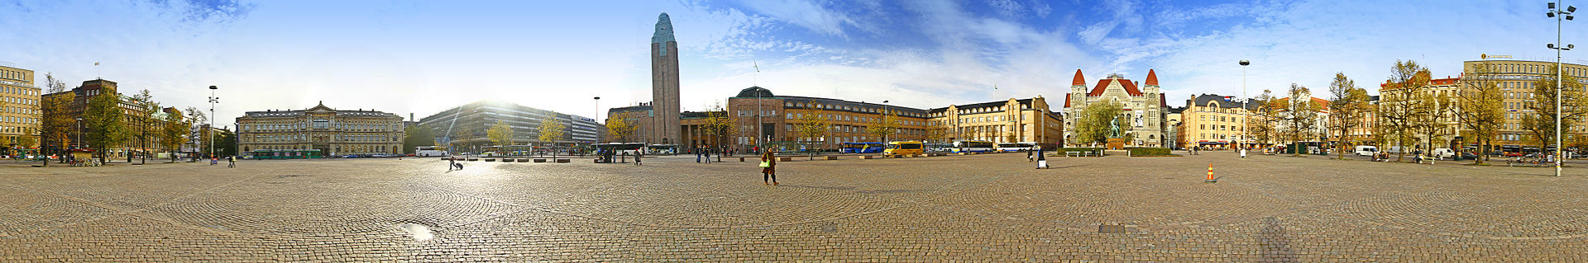
Helsinki, Finland

Slide 2
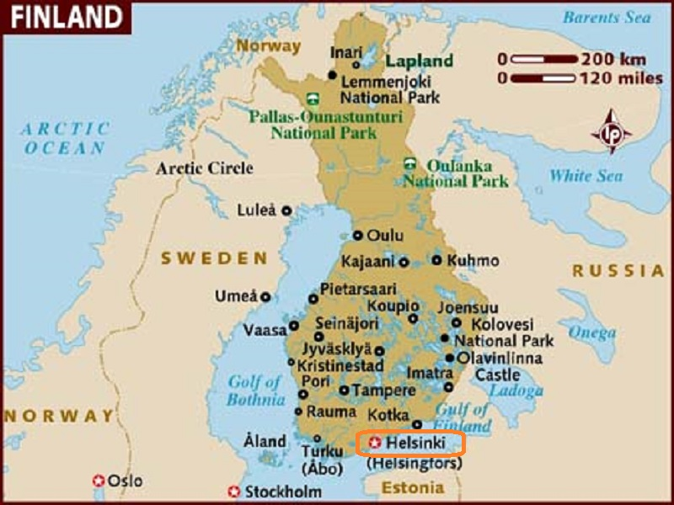
Helsinki is the capital and largest city of Finland.
It is the region of Uusimaa, in southern Finland on the shore of the Gulf of Finland.

Slide 3
The Helsinki metropolitan area includes the urban core of Helsinki, Espoo, Vantaa, Kauniainen, and surrounding commuter towns. It is the world's northernmost metro area of over one million people, and the city is the northernmost capital of an EU member state. The Helsinki metropolitan area is the fourth largest metropolitan area in the Nordic countries, the City of Helsinki being the third largest after Stockholm and Oslo. Helsinki is Finland's major political, educational, financial, cultural, and research center as well as one of northern Europe's major cities. Approximately 75% of foreign companies operating in Finland have settled in the Helsinki region. The nearby municipality of Vantaa is the location of Helsinki Airport, with frequent service to various destinations in Europe and Asia.

Slide 4
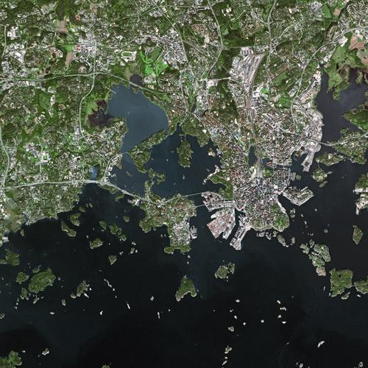
Parts of Helsinki and Espoo seen from SPOT

Slide 5
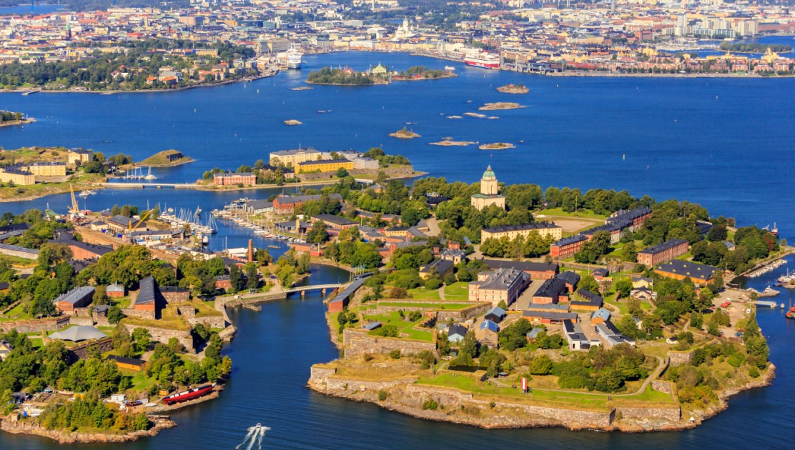

Slide 6
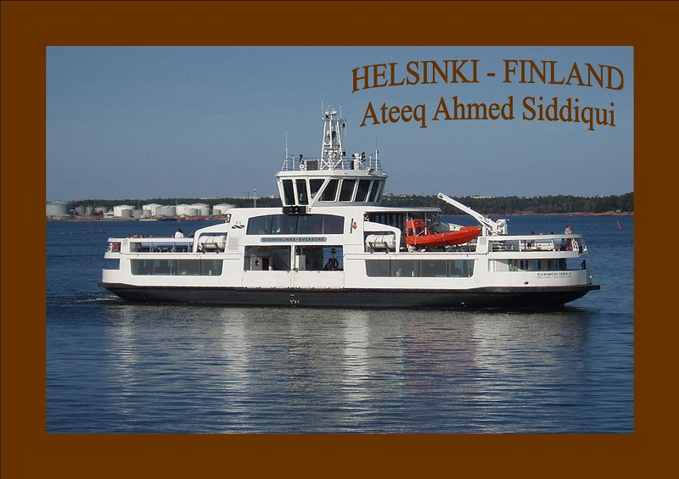

Slide 7
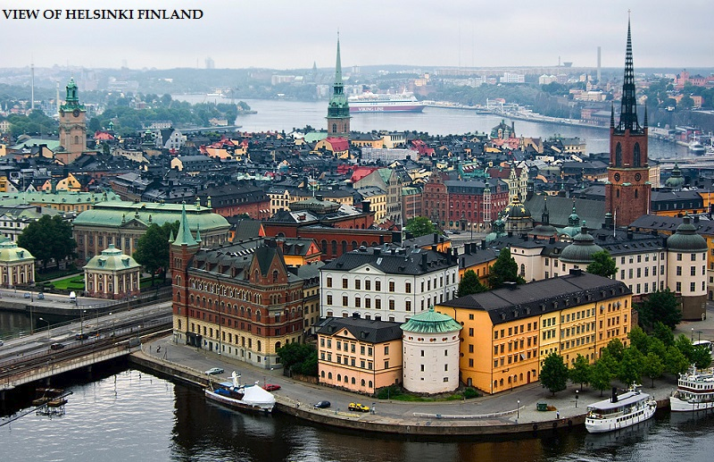

Slide 8
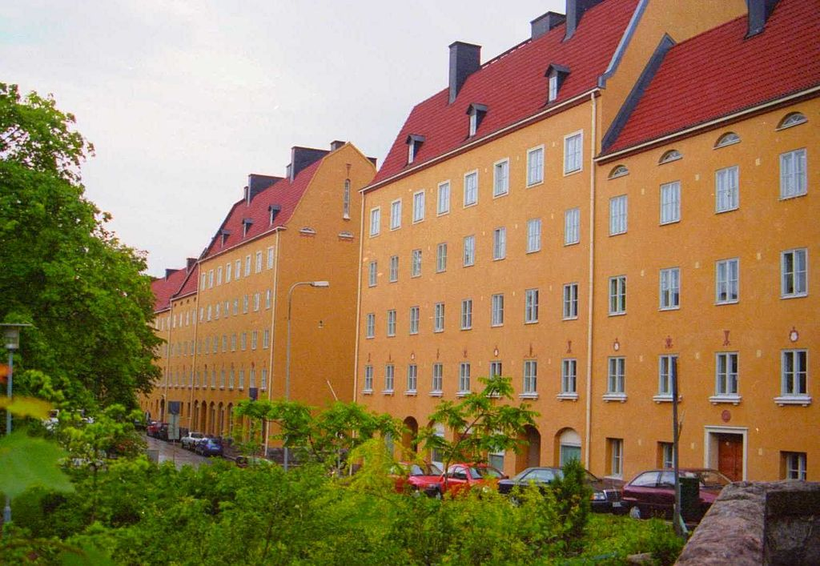
Helsinki in summer

Slide 9
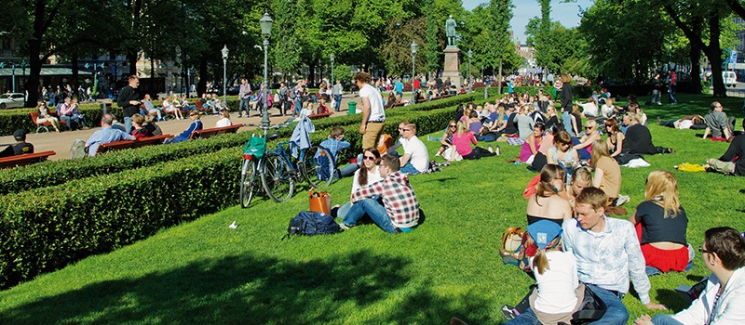
Enjoying the summer sun

Slide 10
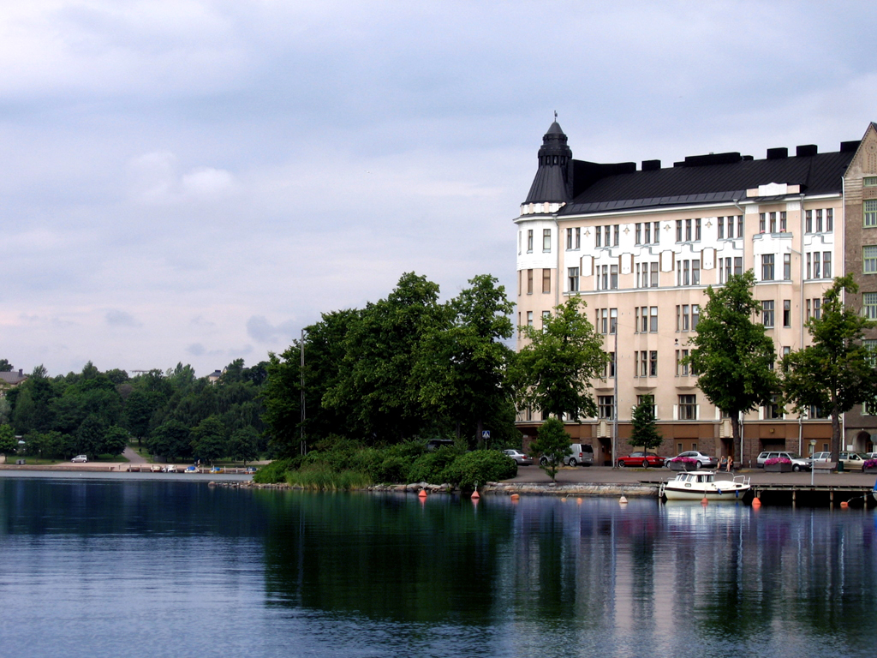
The view across summertime Eläintarhanlahti.

Slide 11
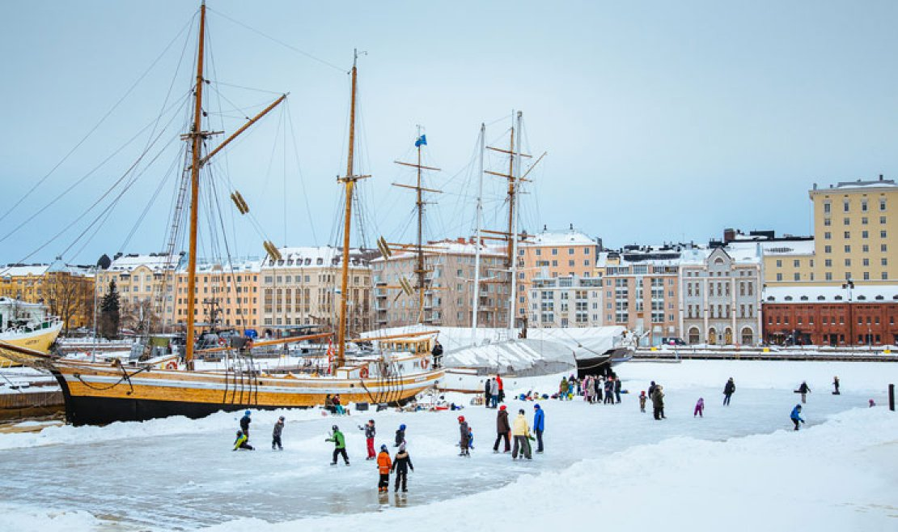
Winter

Slide 12
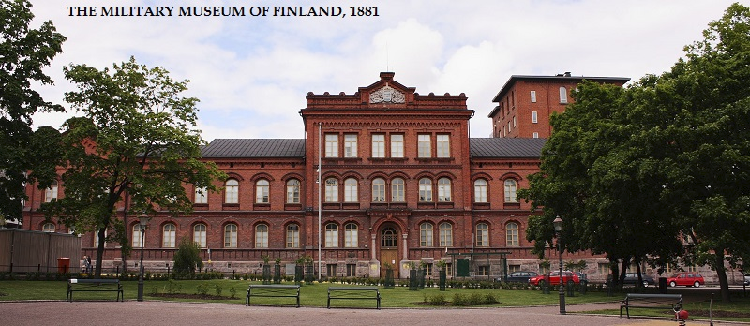

Slide 13
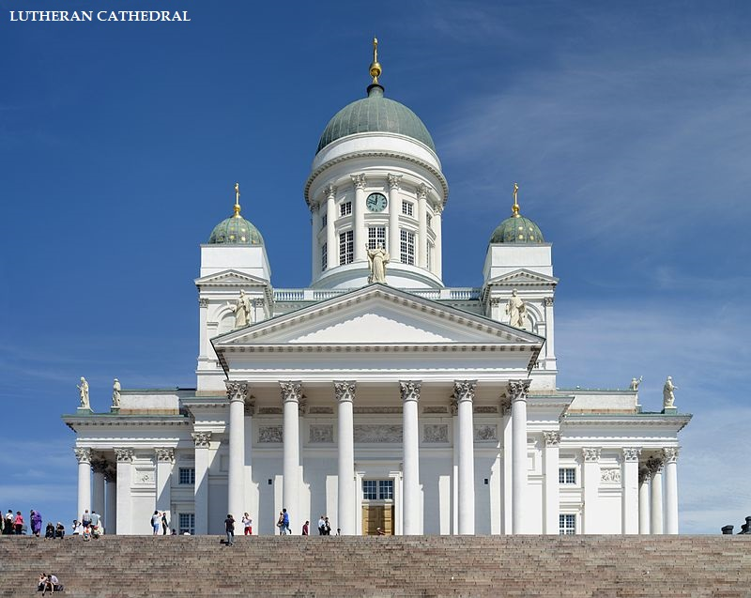

Slide 14
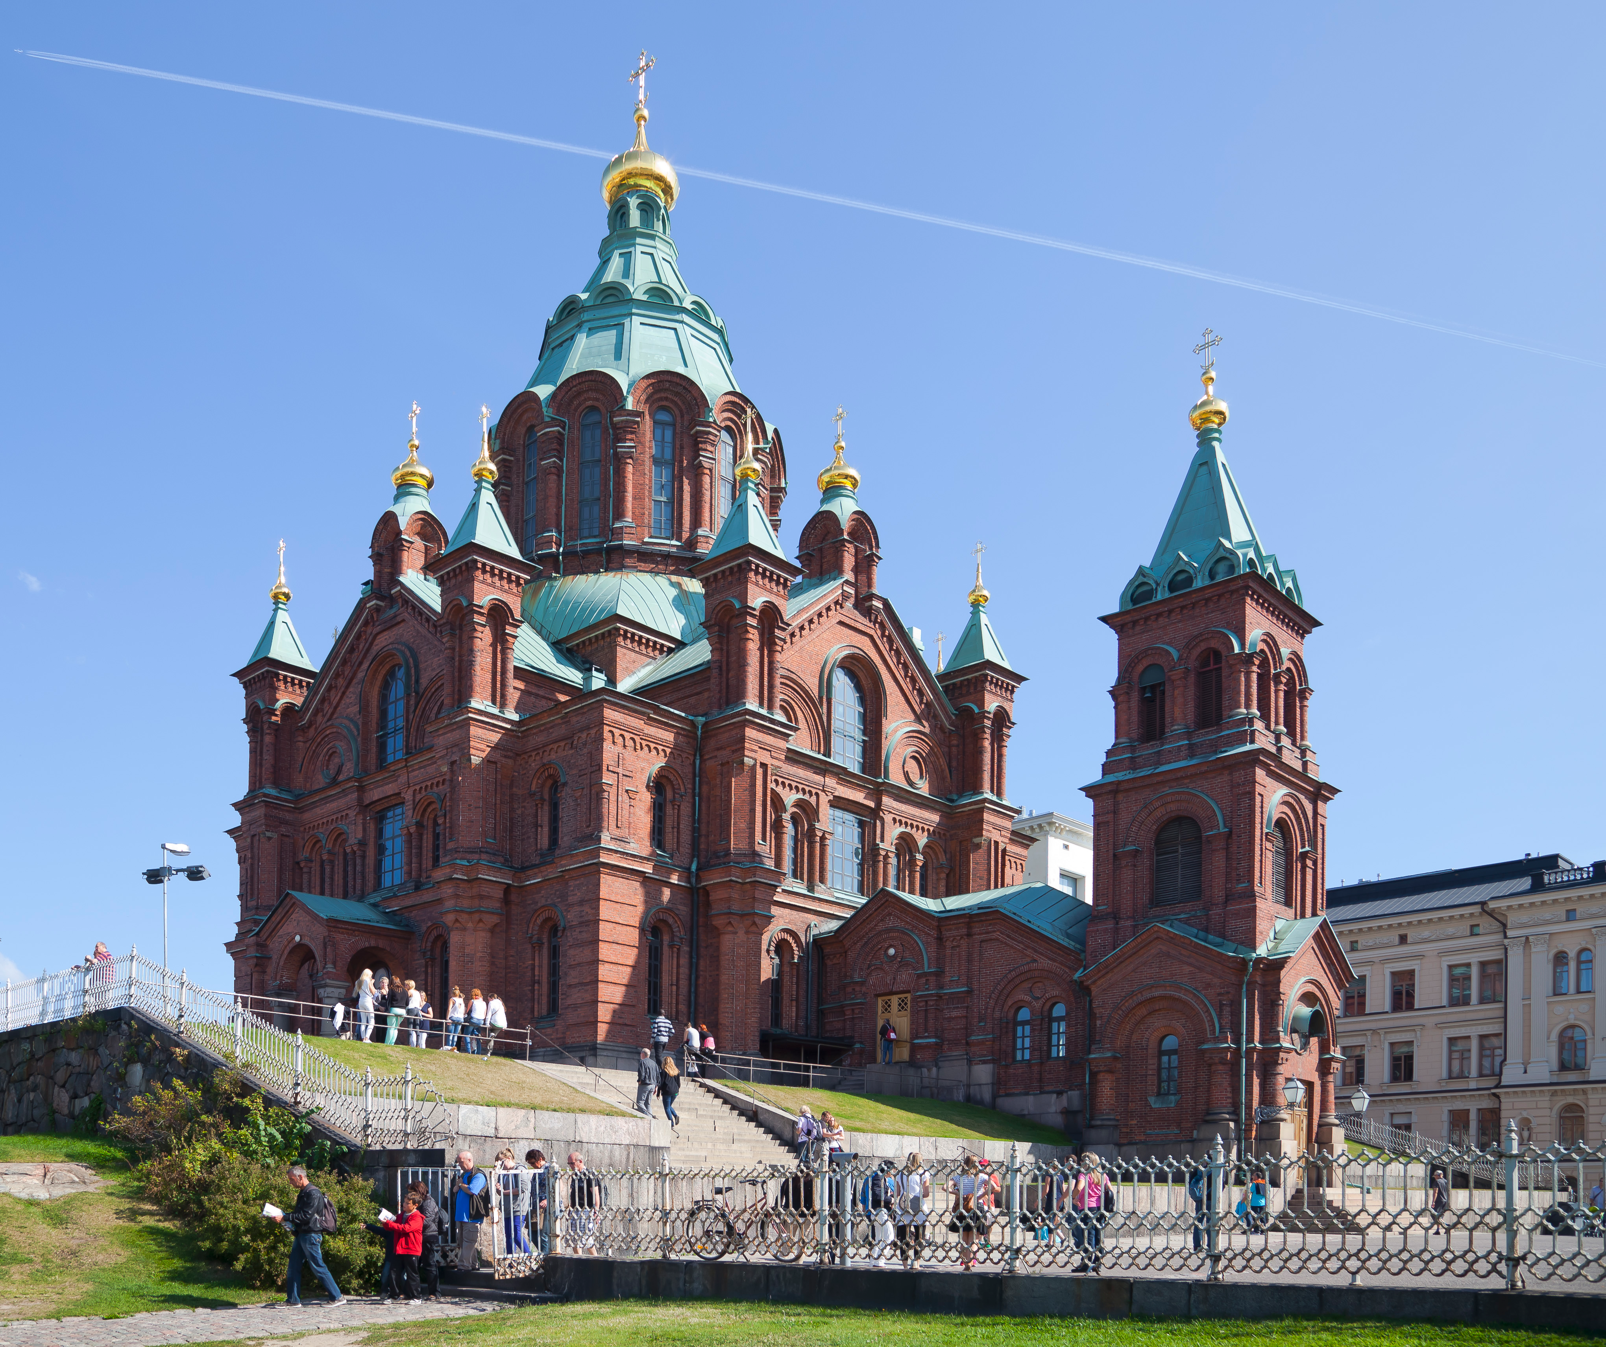
Uspenski Cathedral

Slide 15
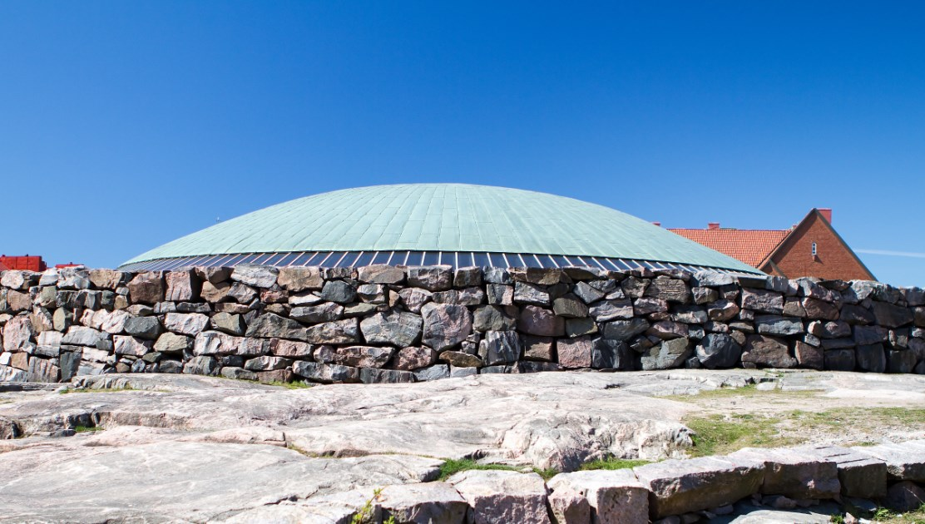
Temppeliaukio Church

Slide 16
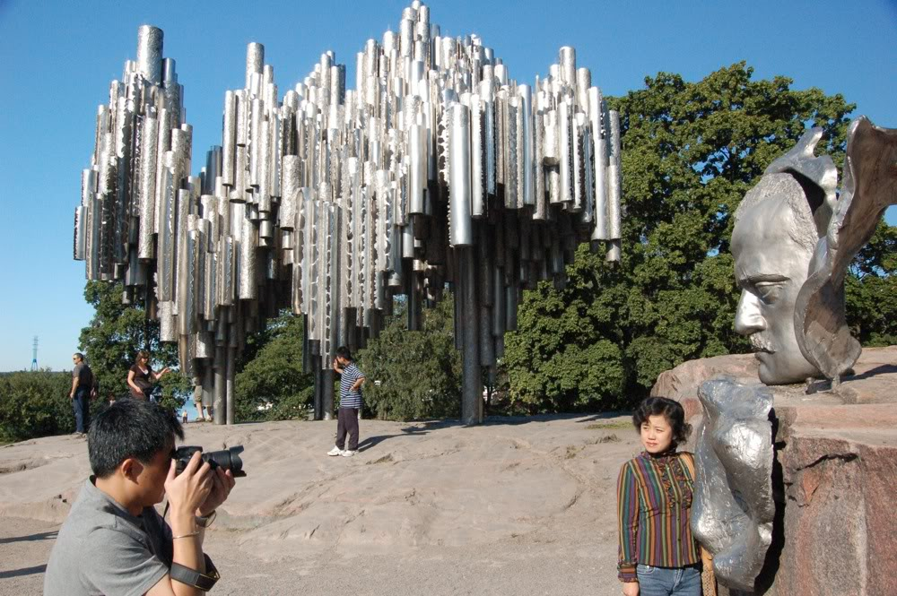
Sibelius Monument

Slide 17
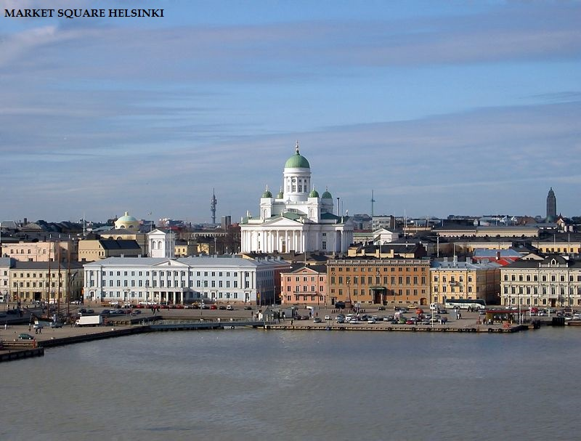

Slide 18
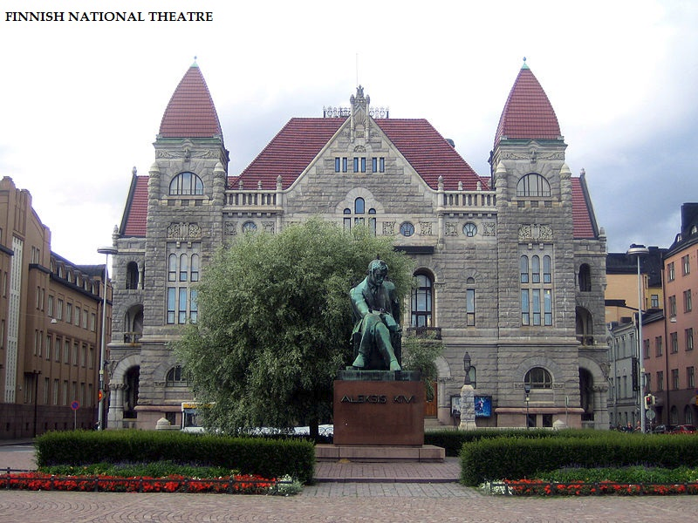

Slide 19
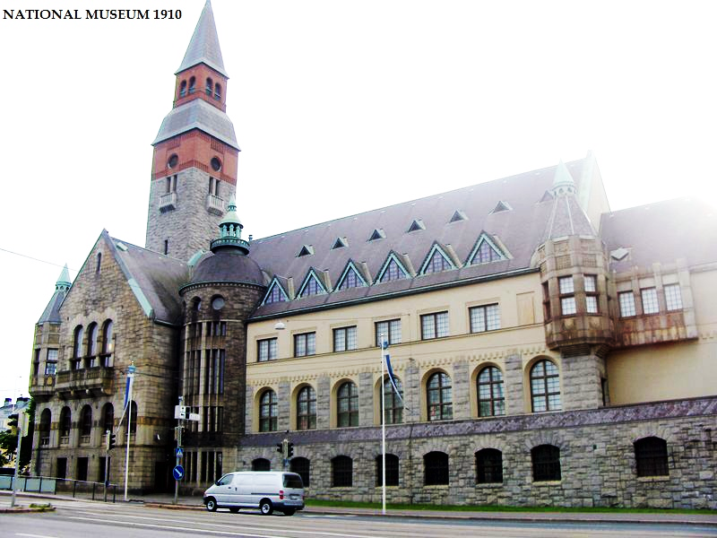

Slide 20
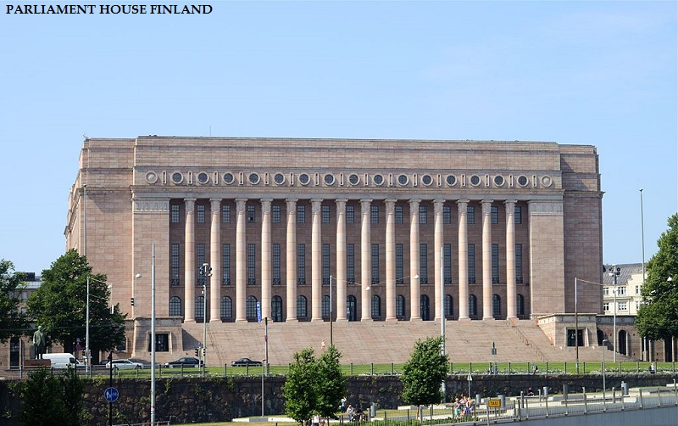

Slide 21
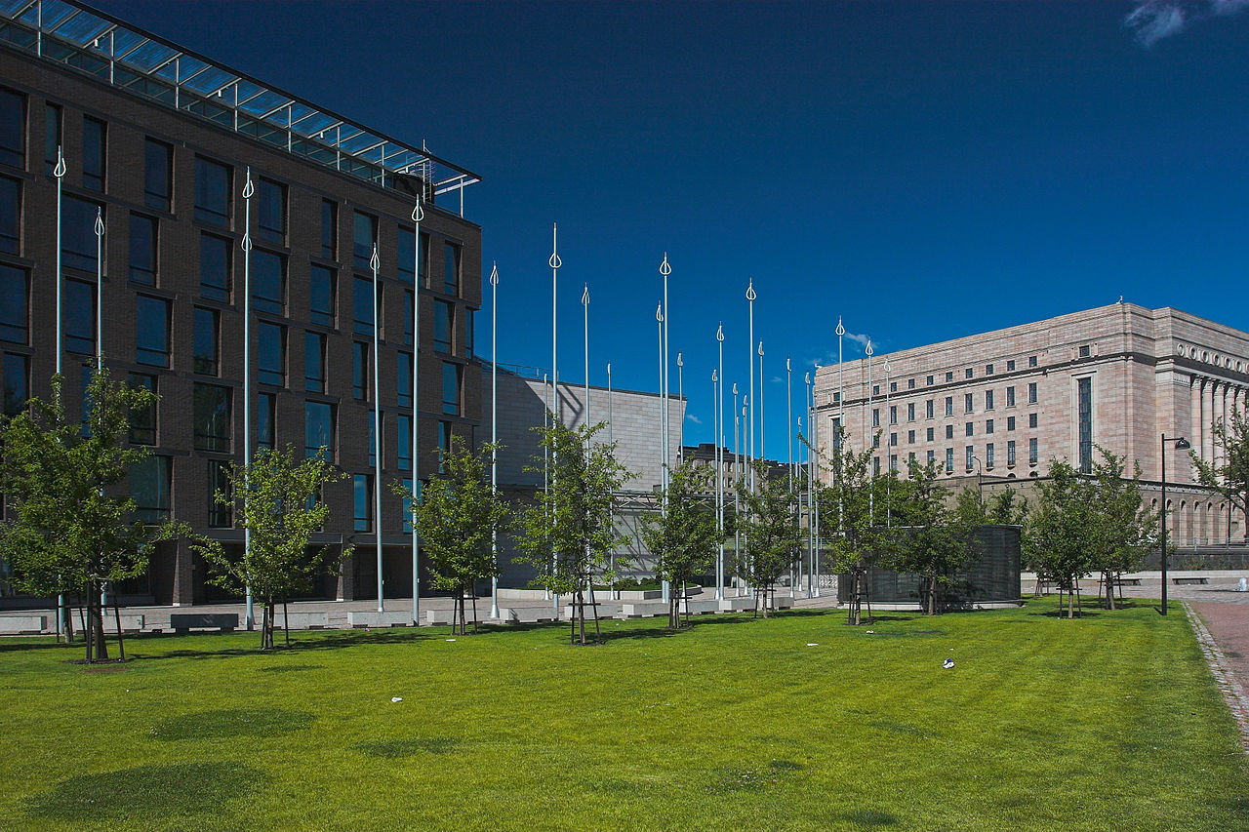
The Parliament of Finland on the right, and new supplemental offices on the left.

Slide 22
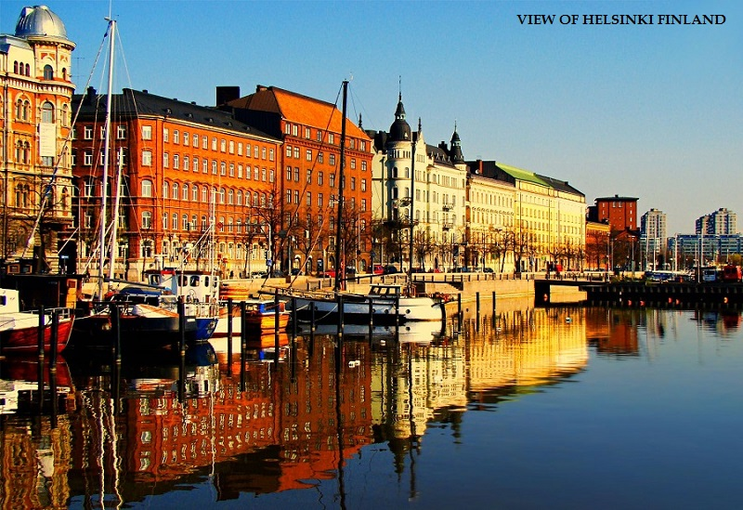

Slide 23
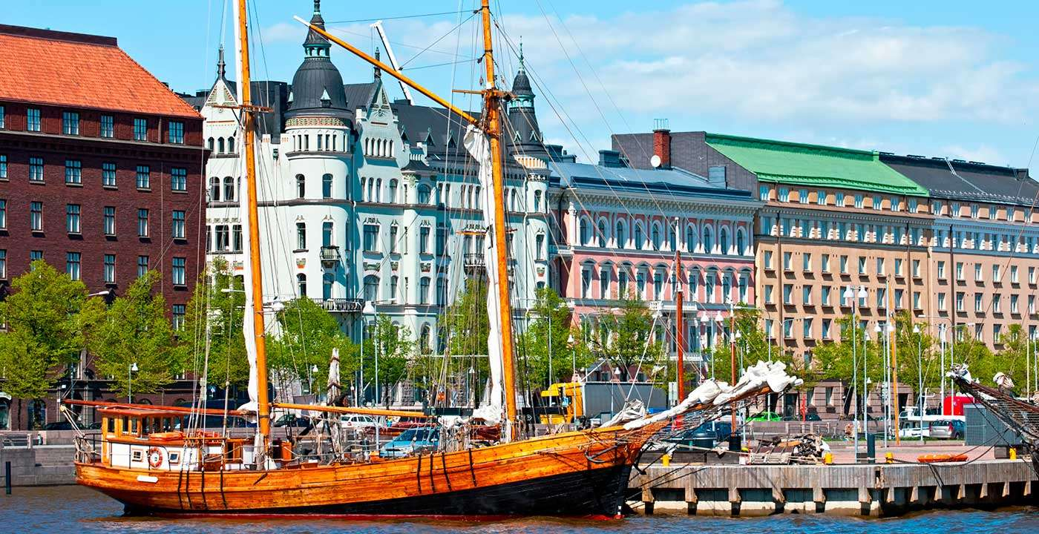

Slide 24
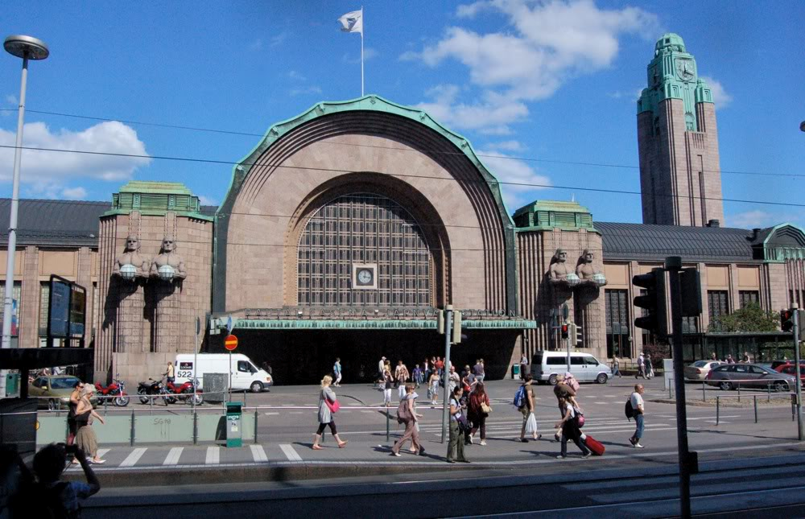
Helsinki central railway station

Slide 25
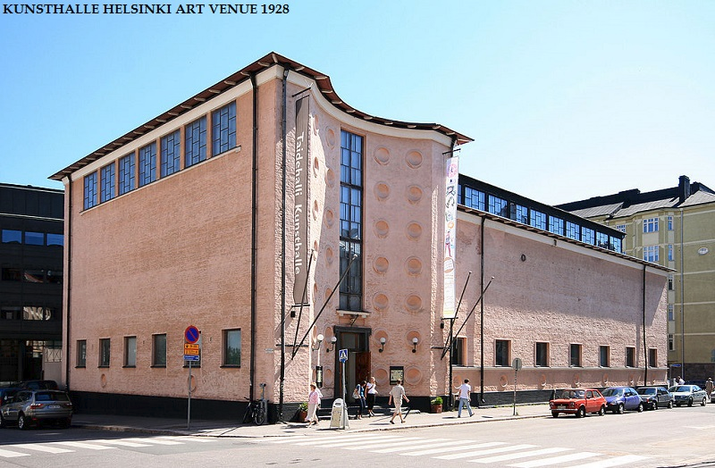

Slide 26
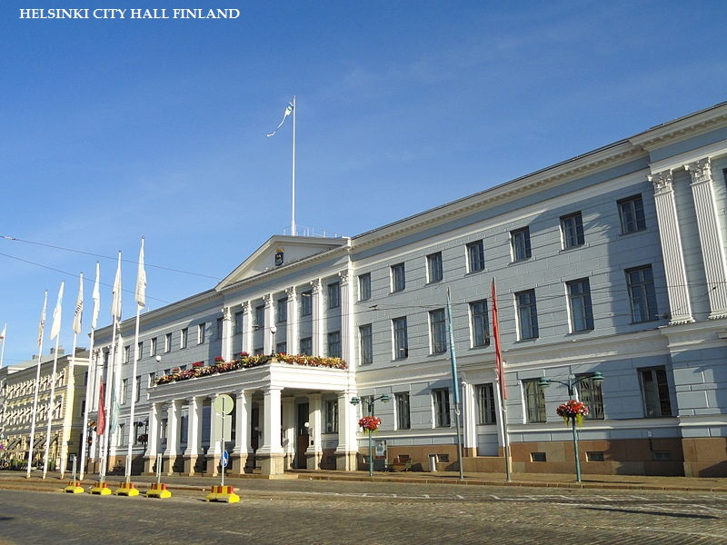

Slide 27
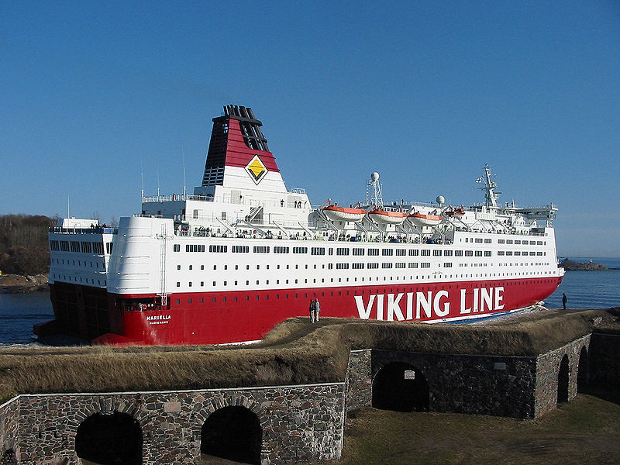

Slide 28
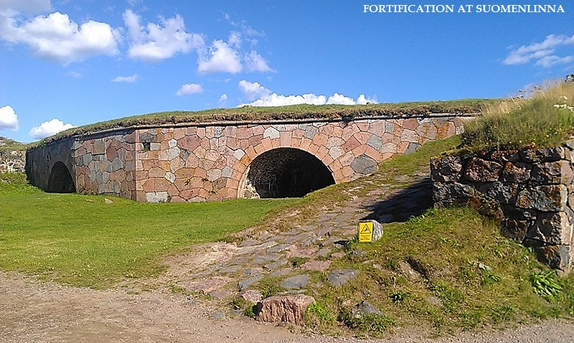

Slide 29
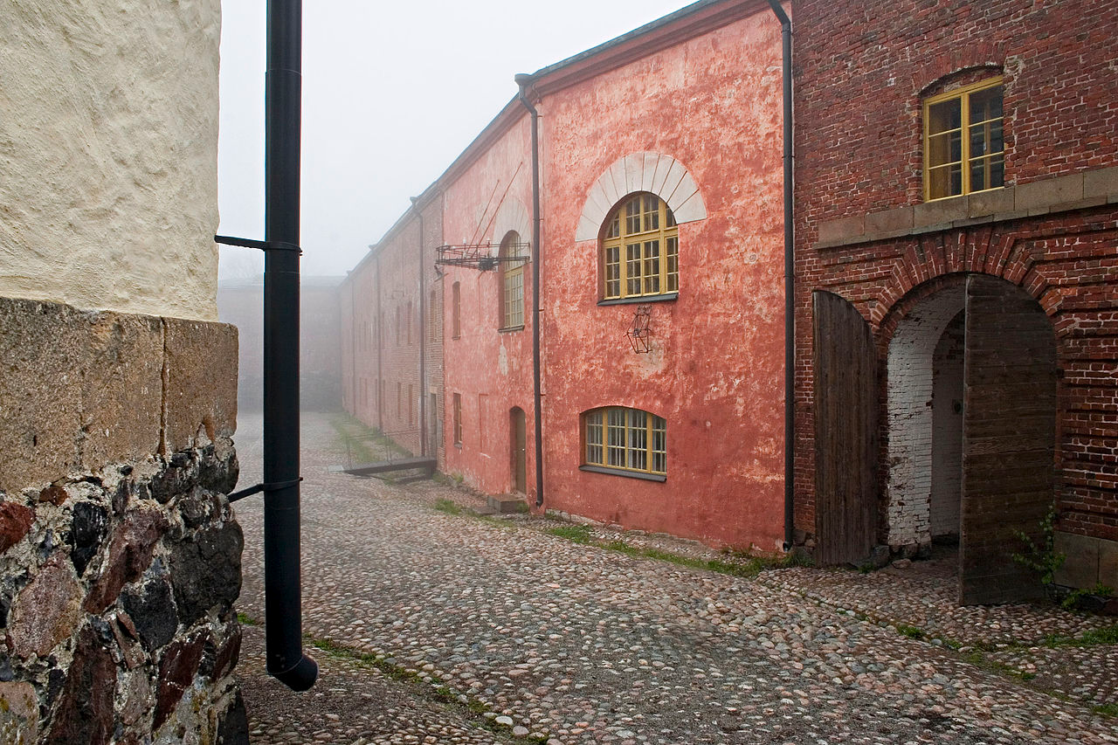
Construction of Suomenlinna began in the 18th century.

Slide 30
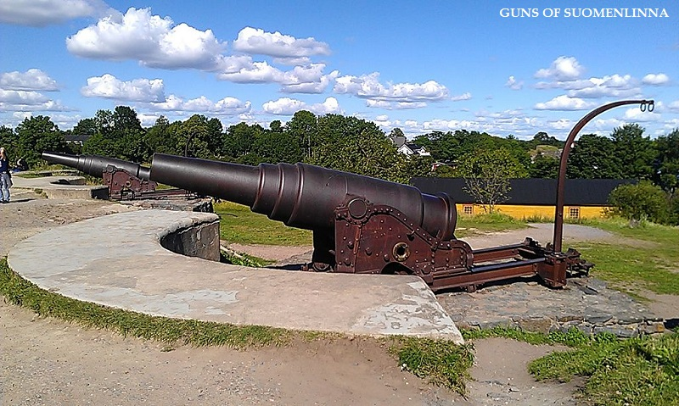

Slide 31
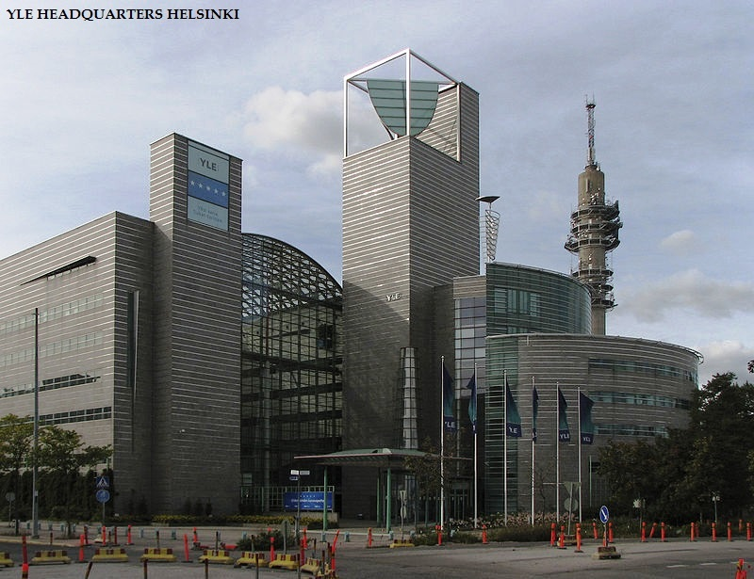

Slide 32
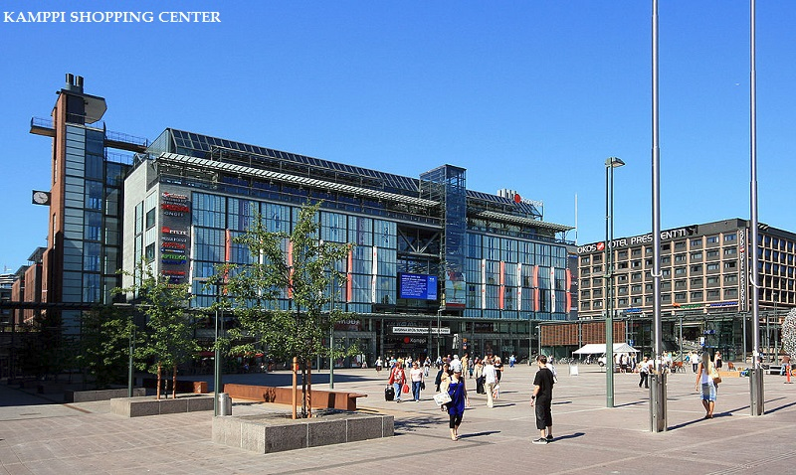

Slide 33
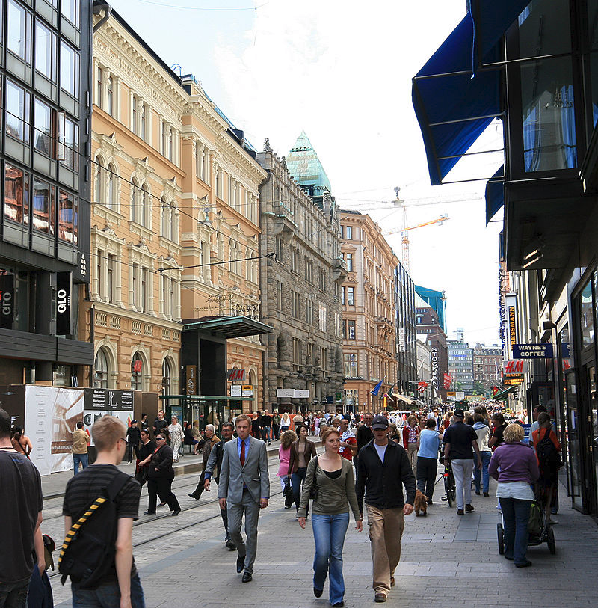
Aleksanterinkatu in Central Helsinki.

Slide 34
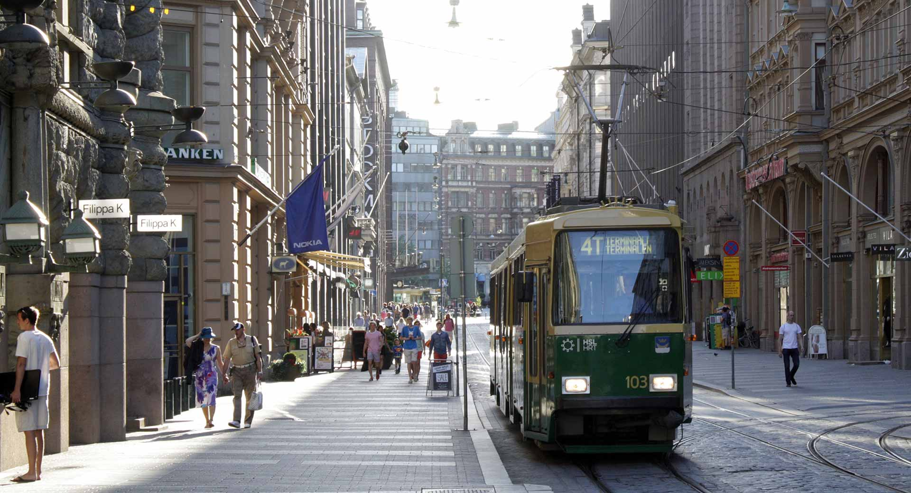

Slide 35
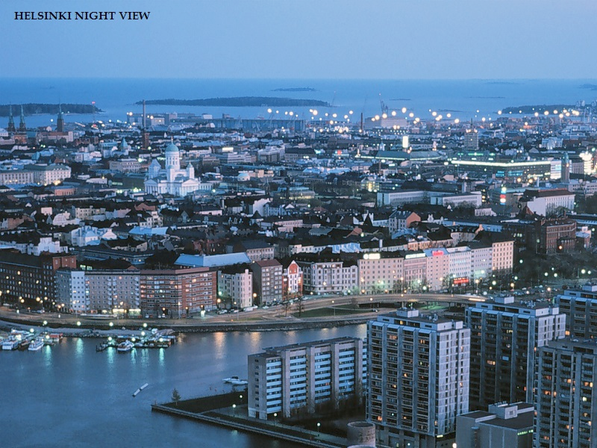

Slide 36
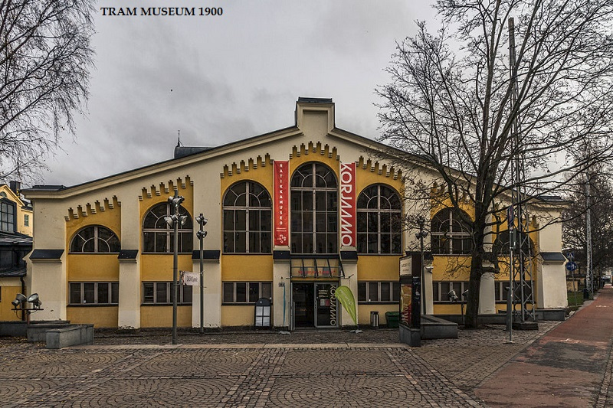

Slide 37
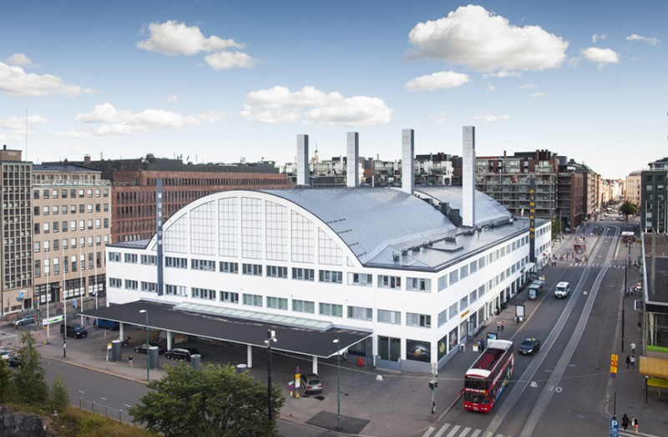
HAM Helsinki Art Museum

Slide 38
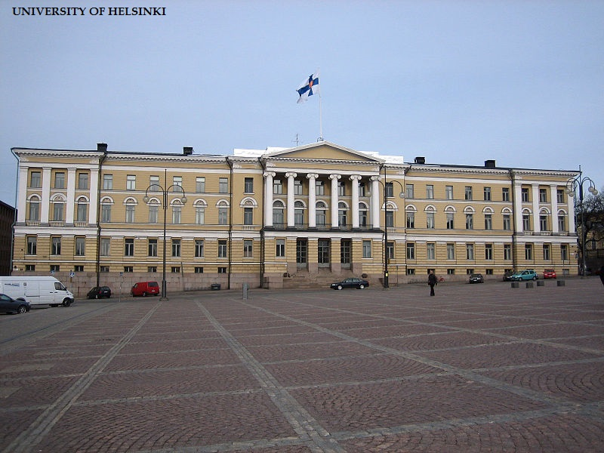

Slide 39
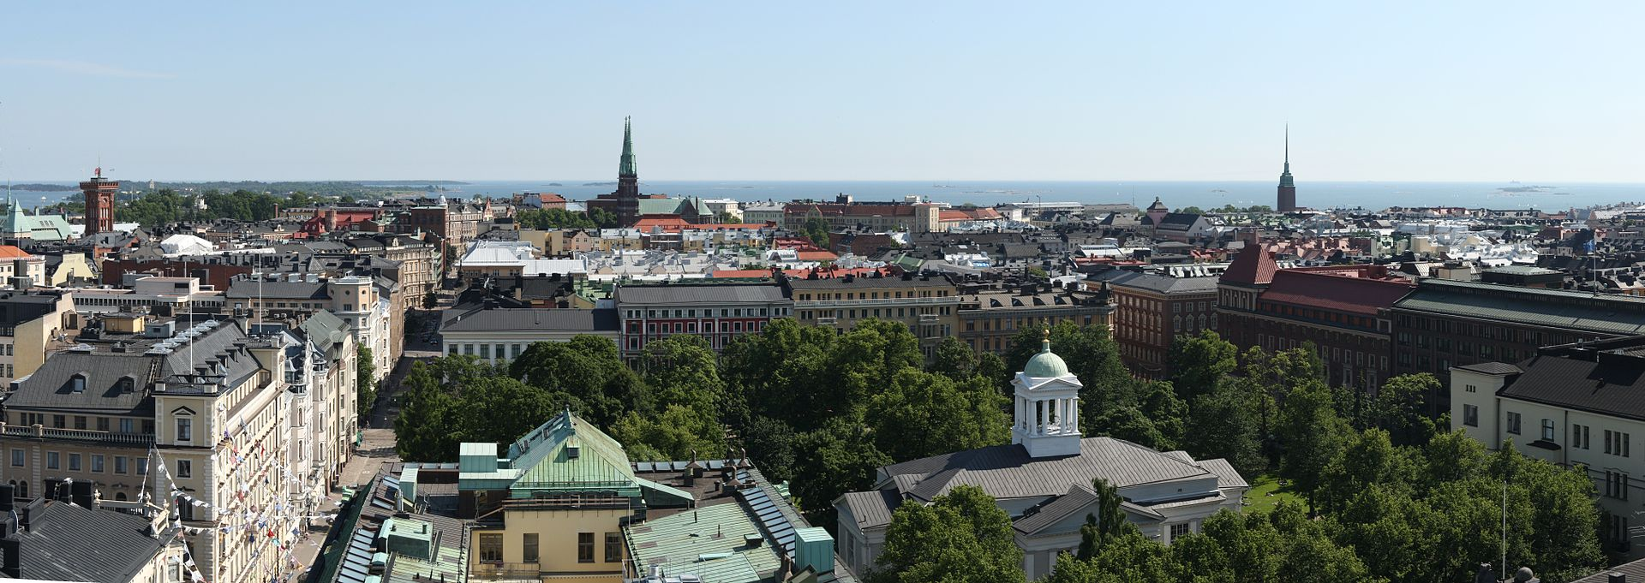
A panoramic view over the southernmost districts of Helsinki from Hotel Torni. The Helsinki Old Church and its surrounding park are seen in the foreground, while the towers of St. John's Church (near center) and Mikael Agricola Church (right) can be seen in the middle distance, backdropped by the Gulf of Finland.

Slide 40
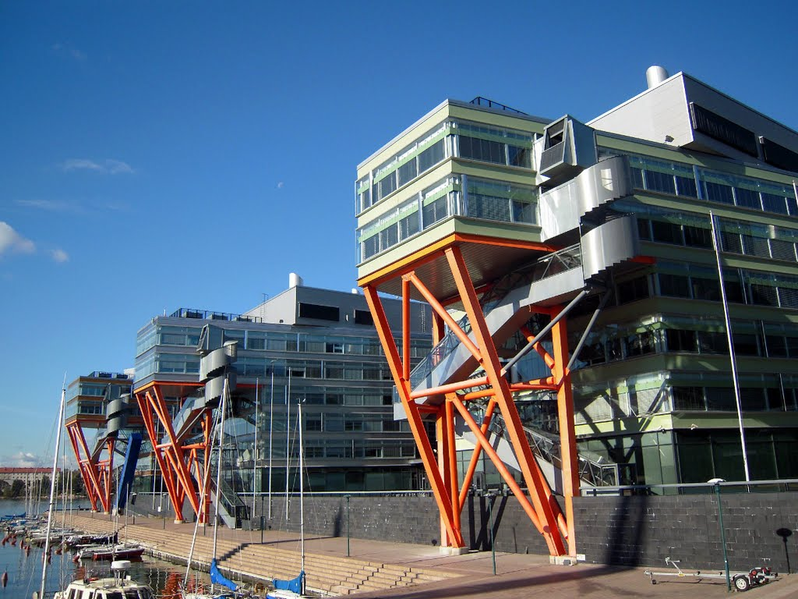

Slide 41
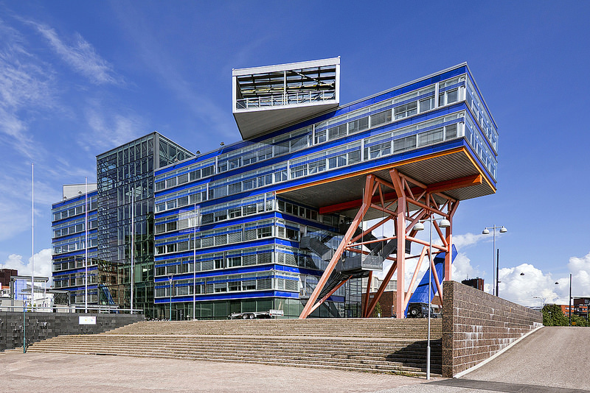

Slide 42
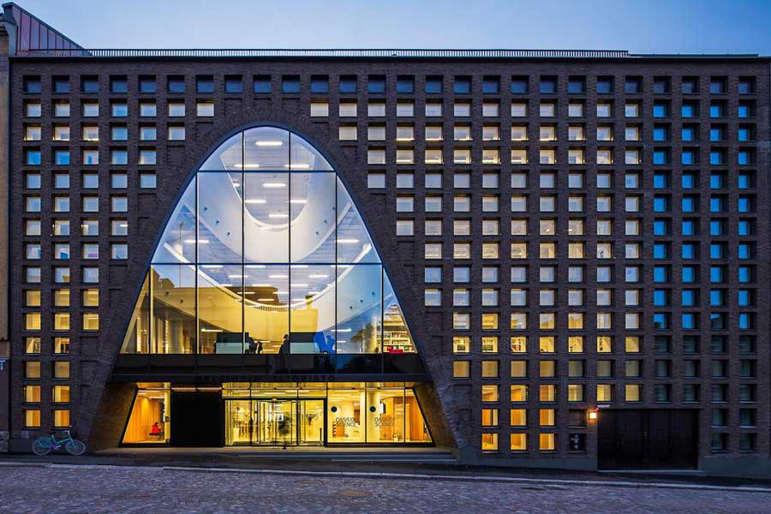
University of Helsinki City Campus Library

Slide 43
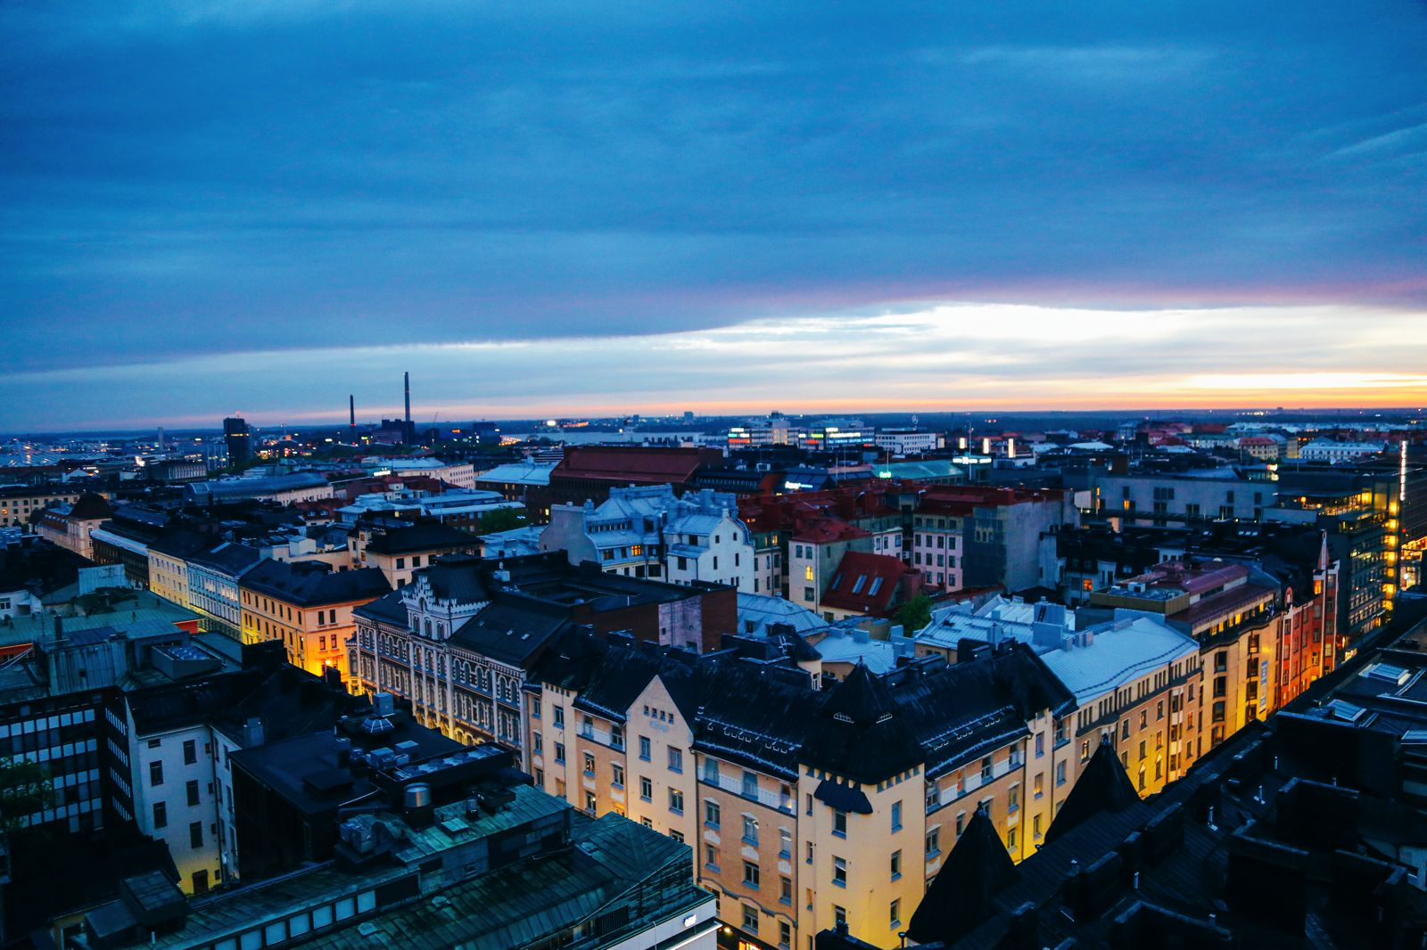

Slide 44
