Slide 1
Hanover, Germany

Slide 2
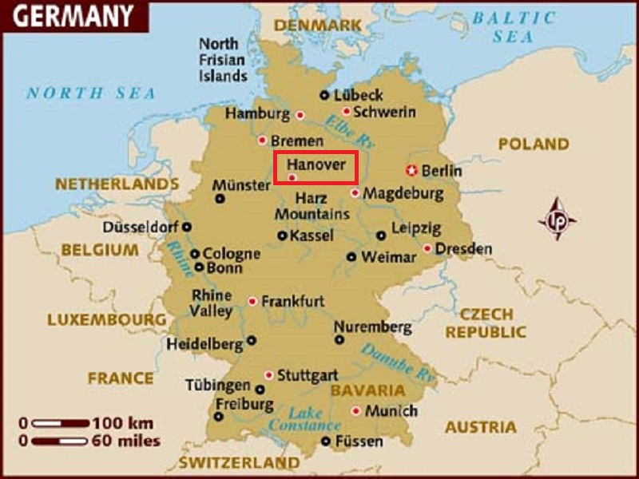
Hanover or Hannover on the River Leine is the capital and largest city of the German state of Lower Saxony.

Slide 3
With a population of 518,000, Hanover is a major centre of Northern Germany and the country's thirteenth largest city. Hanover also hosts annual commercial trade fairs such as the Hanover Fair and the CeBIT. Every year Hanover hosts the Schützenfest Hannover, the world's largest marksmen's festival, and the Oktoberfest Hannover, the second largest such festival in Germany. In 2000, Hanover hosted the world fair Expo 2000. The Hanover fairground, due to numerous extensions, especially for the Expo 2000, is the largest in the world. Hanover is of national importance because of its universities and medical school, its international airport and its large zoo. The city is also a major crossing point of railway lines and highways (Autobahnen), connecting European main lines in both the east-west (Berlin–Ruhr area) and north-south (Hamburg–Munich, etc.) directions.

Slide 4
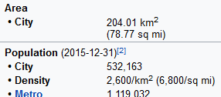

Slide 5
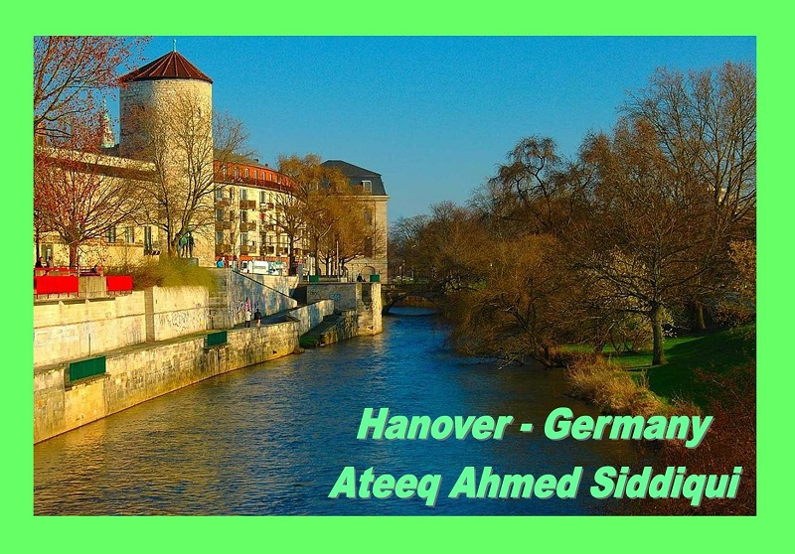

Slide 6
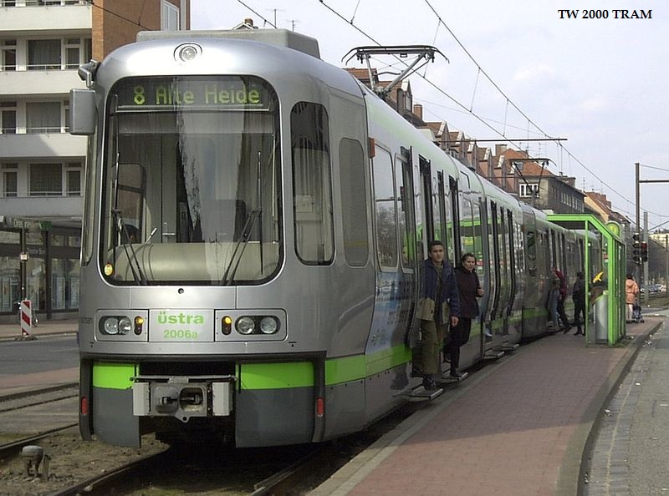

Slide 7
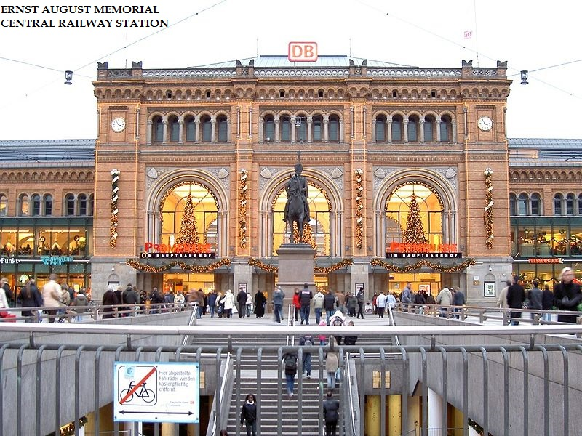

Slide 8
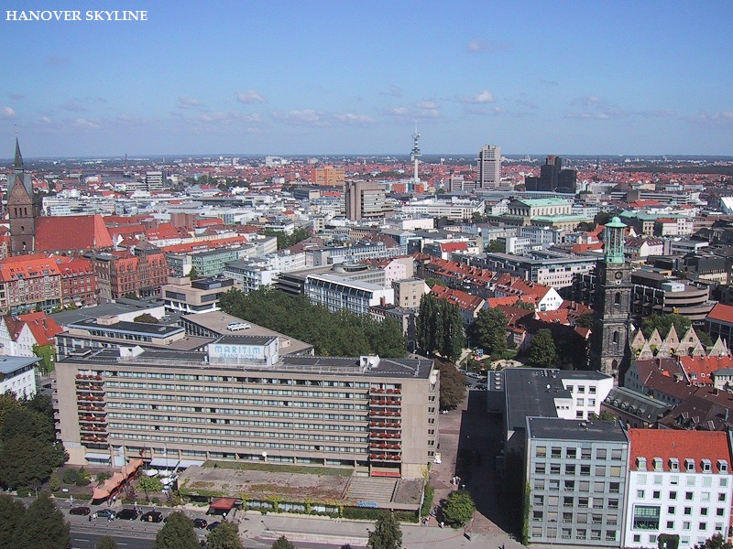

Slide 9
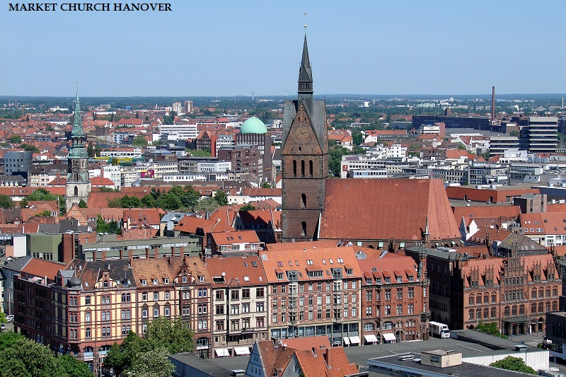

Slide 10
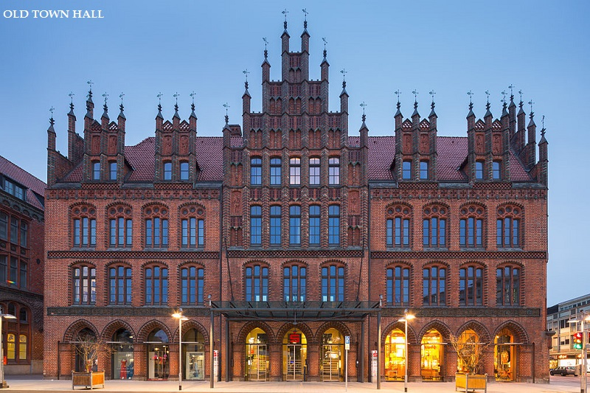

Slide 11
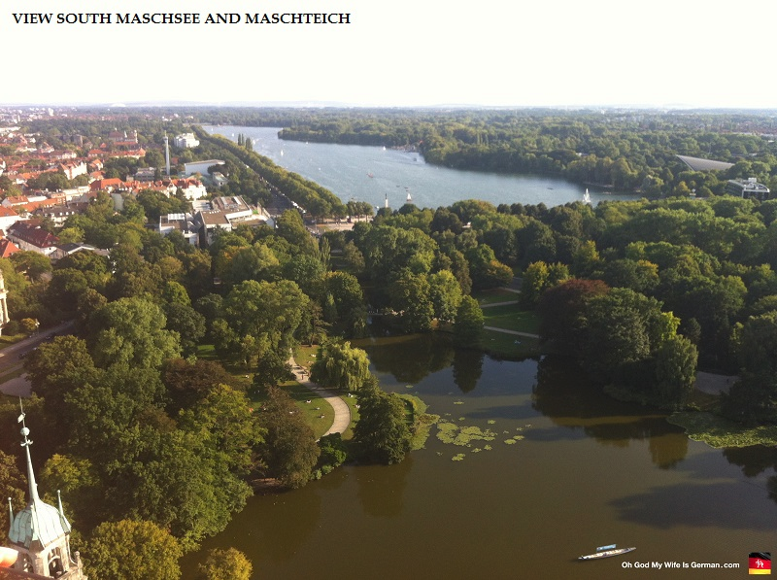

Slide 12
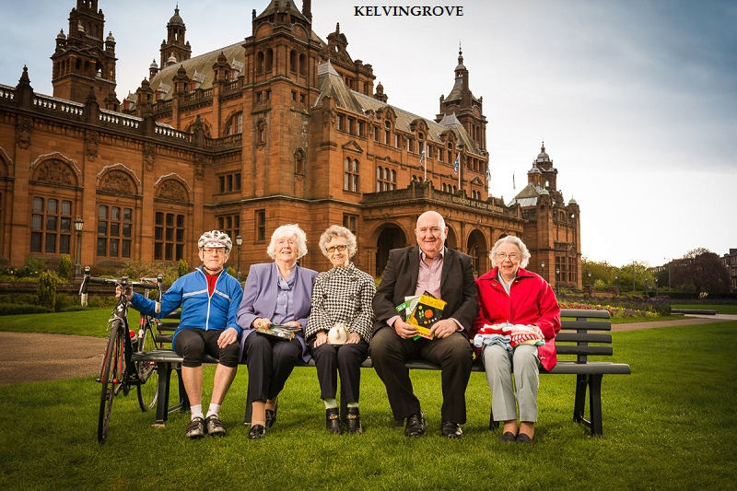

Slide 13
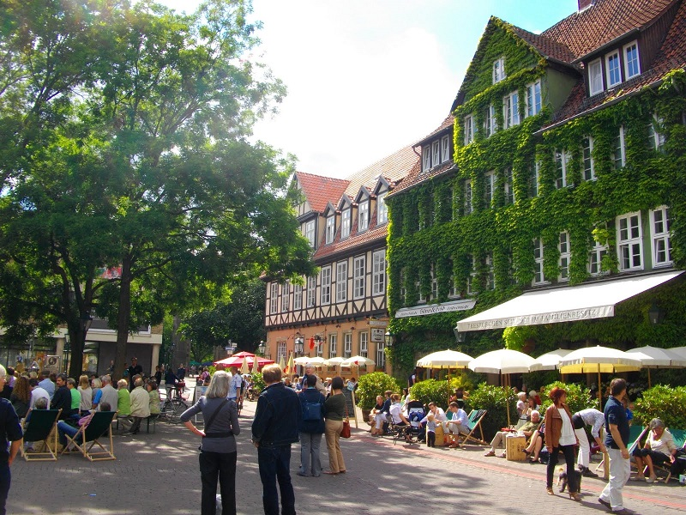

Slide 14
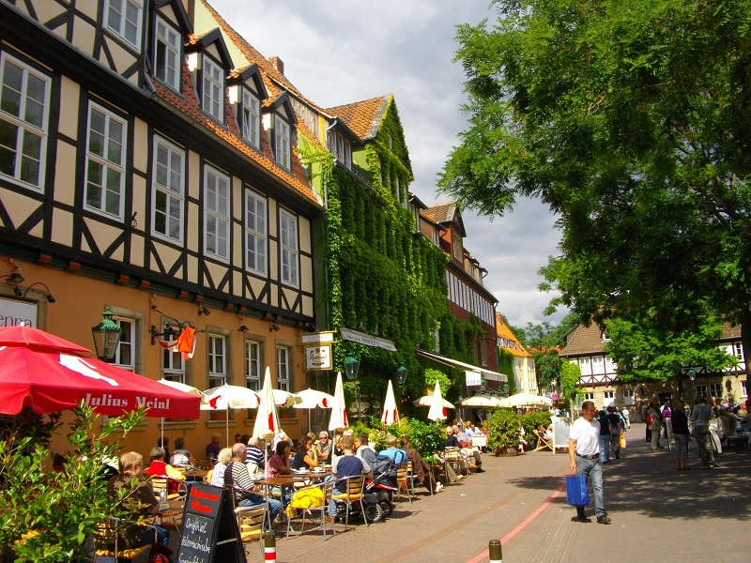

Slide 15
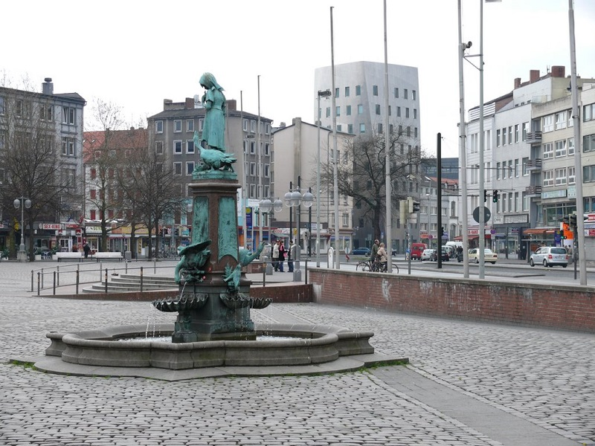

Slide 16
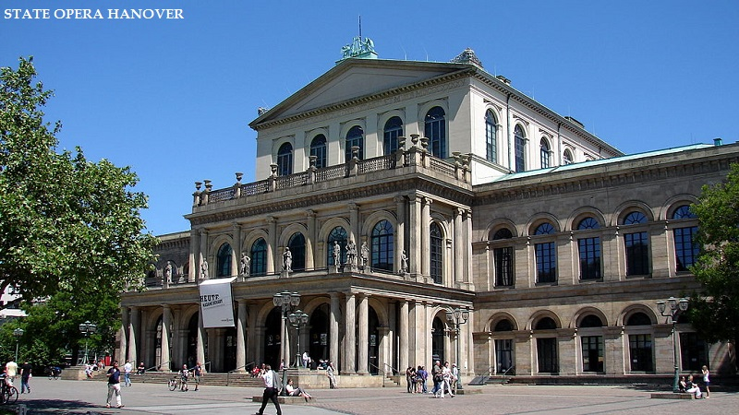

Slide 17
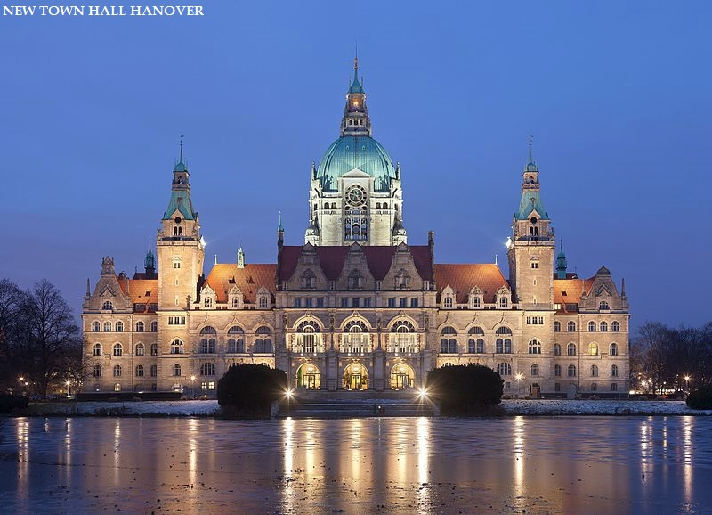

Slide 18
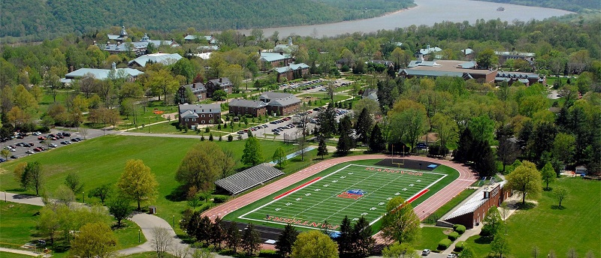

Slide 19
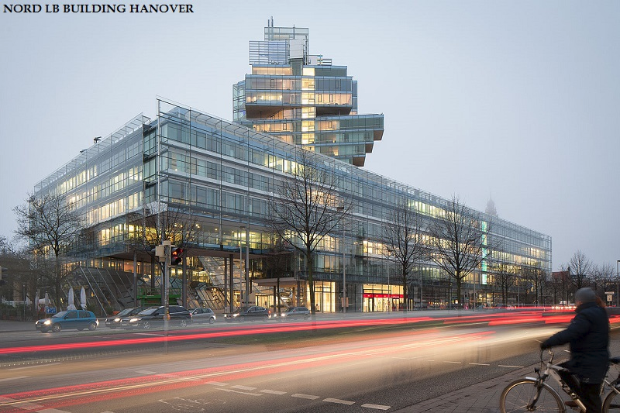

Slide 20
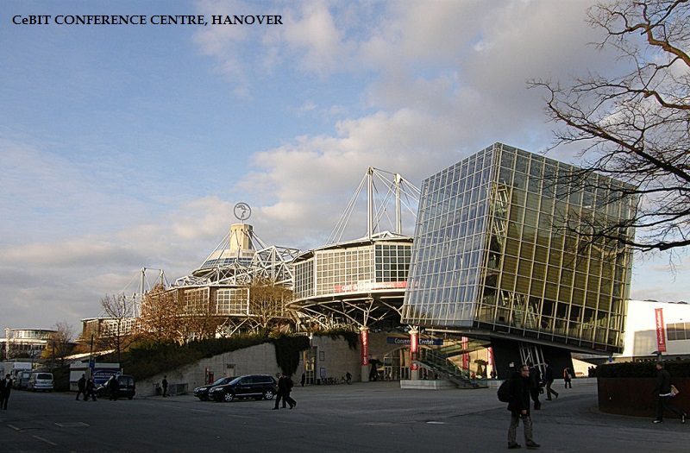

Slide 21
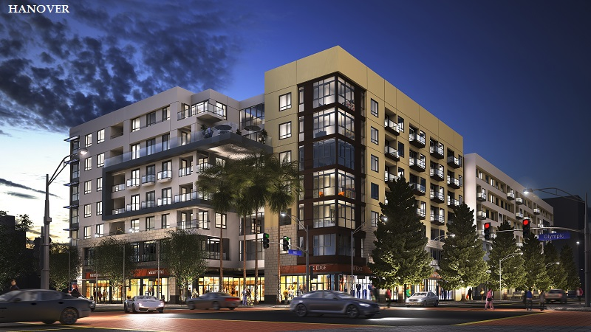

Slide 22
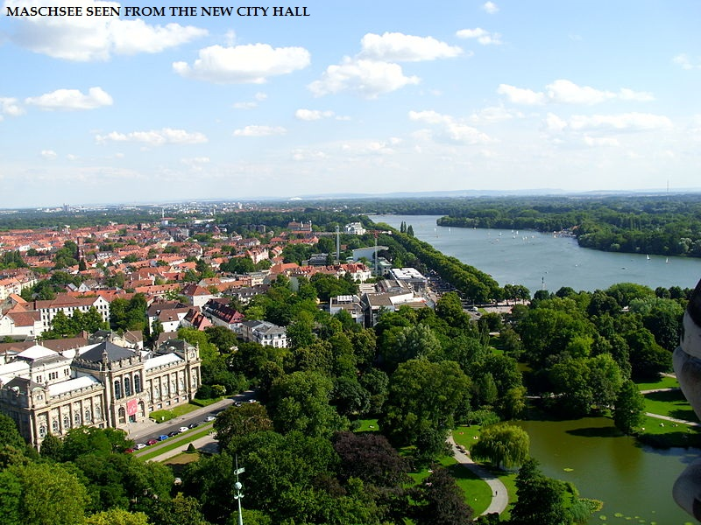

Slide 23
