Slide 1
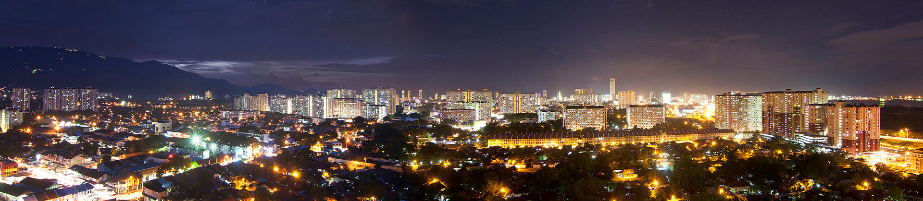
George Town, Malaysia!

Slide 2
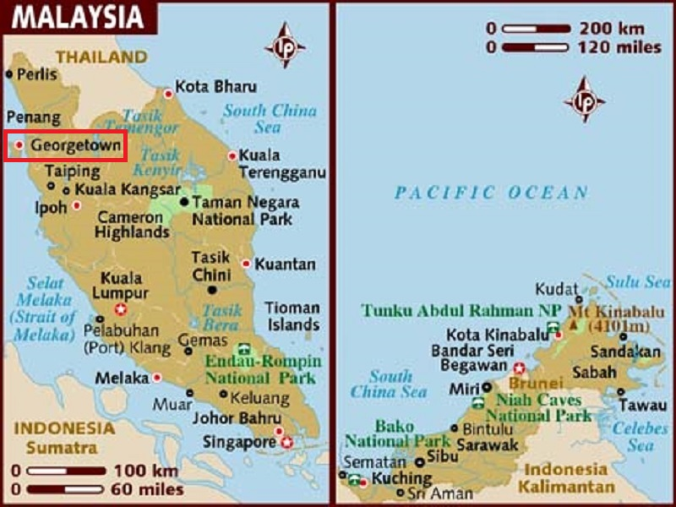
George Town, the capital city of the Malaysian state of Penang,is located at the northeastern tip of Penang Island.
It is the second largest city in Malaysia.

Slide 3
Established by Captain Francis Light of the British East India Company in 1786, George Town was one of the first British settlements in South-East Asia. Together with Singapore and Malacca, George Town was governed under the Straits Settlements, which later became a British crown colony in 1867. It was subjugated by the Empire of Japan during World War II, before being recaptured by the British at war's end. Shortly before Malaya attained independence from the British Empire in 1957, George Town was declared a city by Queen Elizabeth II, the first city in the country's modern history. In 2015, the entire Penang Island was also granted city status.
Due to the intermingling of the various ethnicities and religions that arrived on its shores during its heyday as a British entrepôt, George Town acquired a large assortment of colonial and Asian eclectic architectural styles. It also gained a reputation as Malaysia's gastronomic capital, due to its unique and ubiquitous street food. Moreover, the city hosts intangible cultural heritage, such as that of the Peranakan (formerly known as the Straits Chinese), a hybrid ethnicity which has left its mark on Penang's architecture and cuisine.

Slide 4
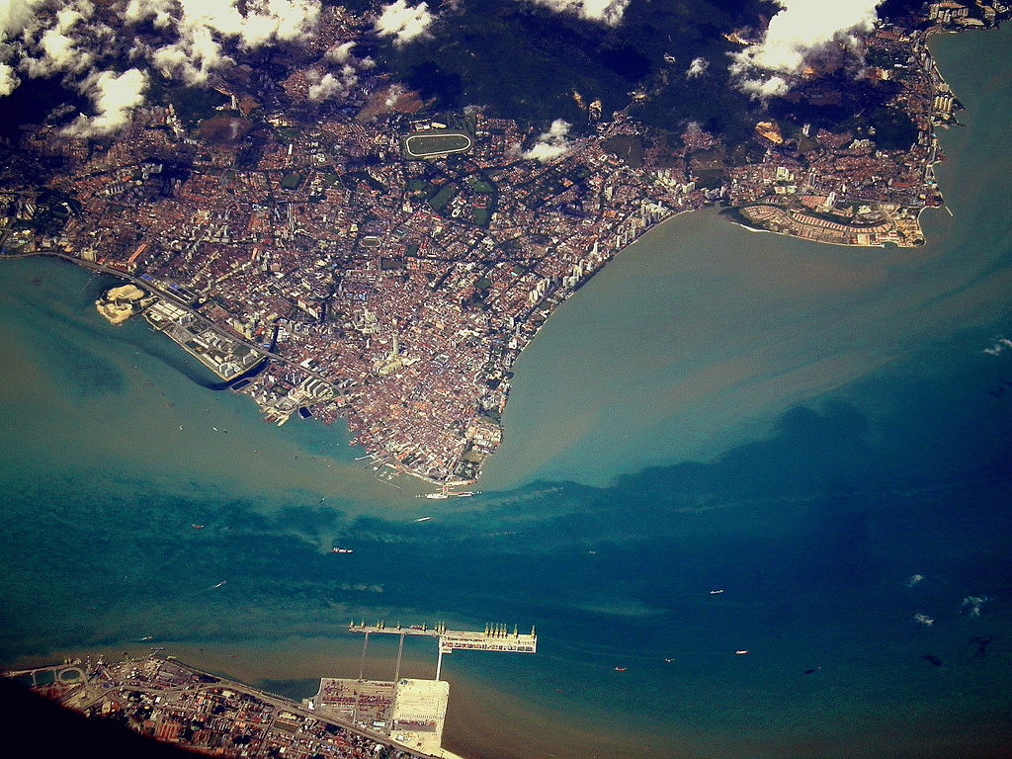
Satellite view of George Town.

Slide 5
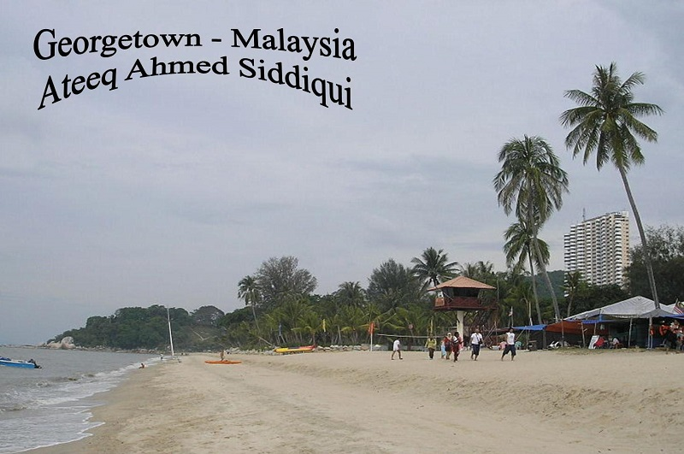

Slide 6
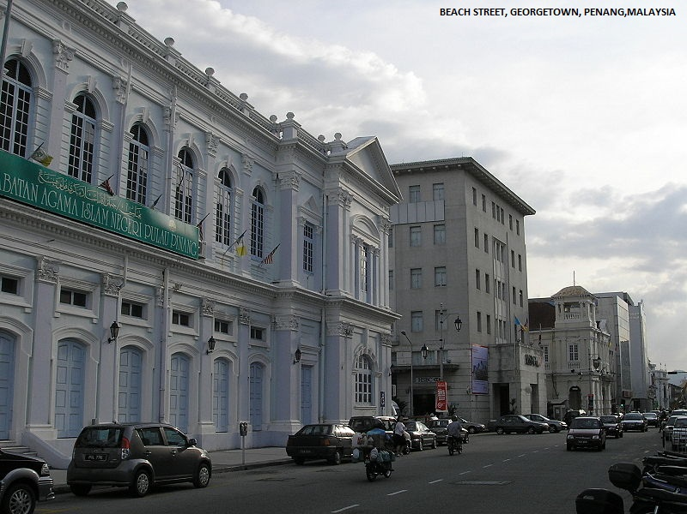
Beach Street still serves as the commercial heart of George Town. The bank buildings along the street were built in the same colonial architecture as in Shanghai.

Slide 7
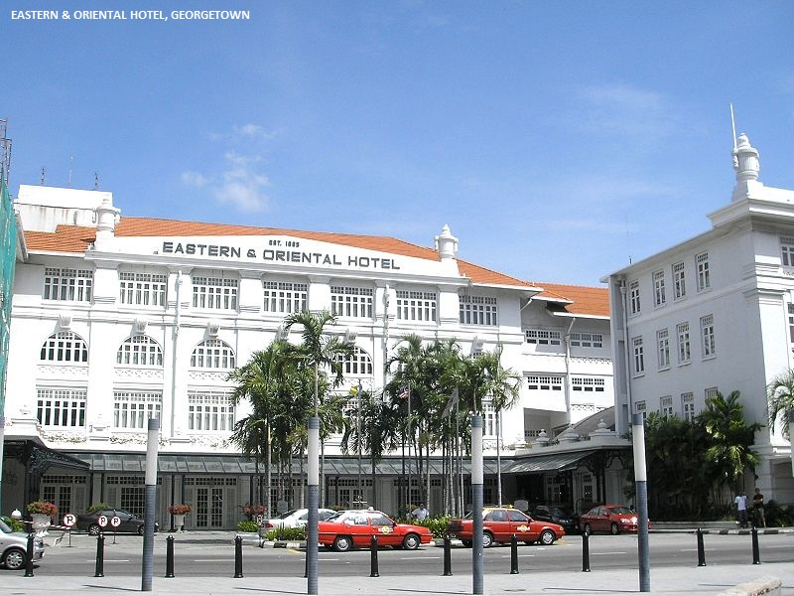

Slide 8
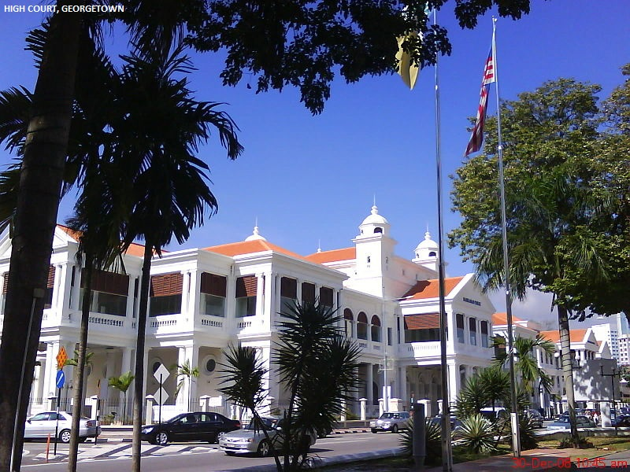

Slide 9
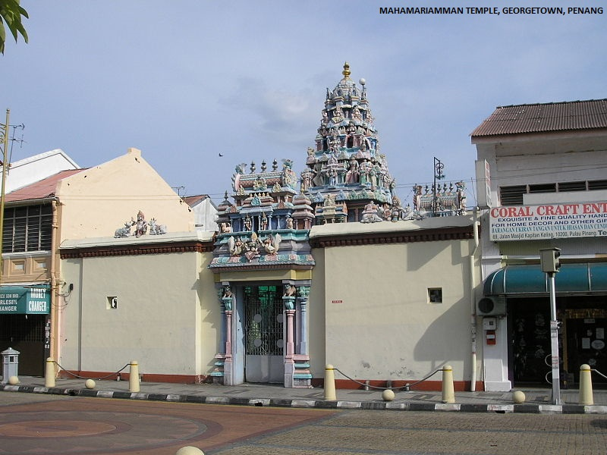

Slide 10
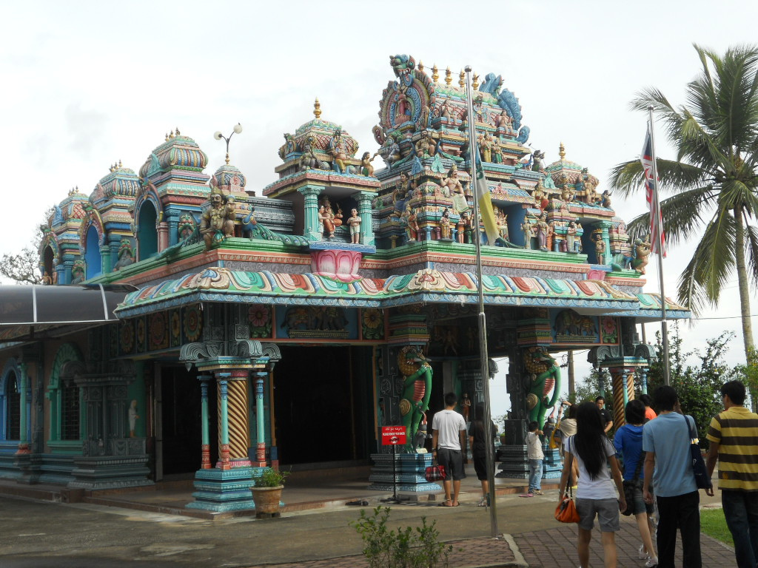
Sri Aruloli Thirumurugan Temple at Penang Hill is one of the oldest Hindu temples in Penang.

Slide 11
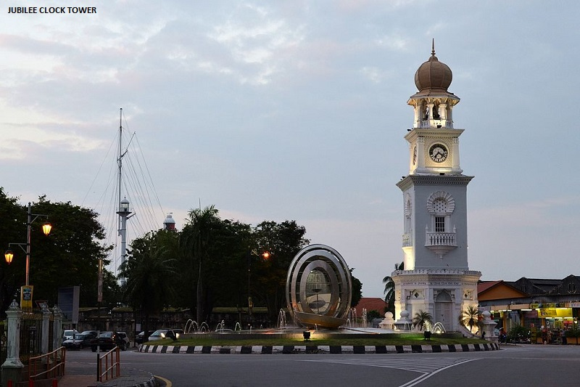

Slide 12
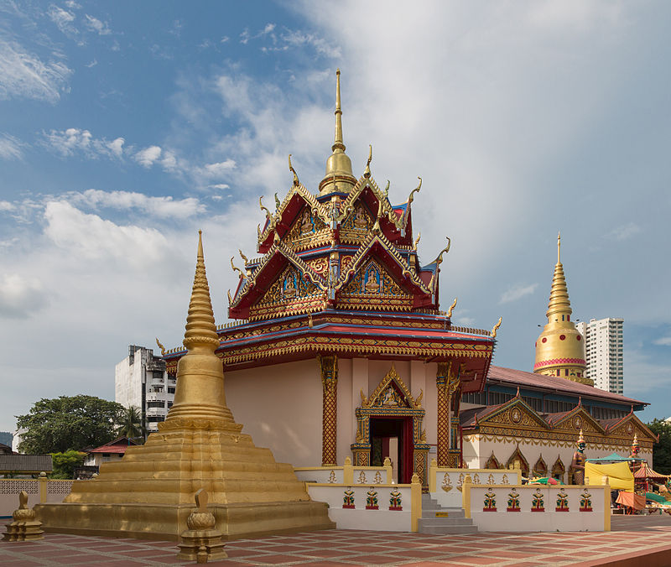
Wat Chayamangkalaram at Pulau Tikus was constructed in 1845 by the Thai community in George Town.

Slide 13
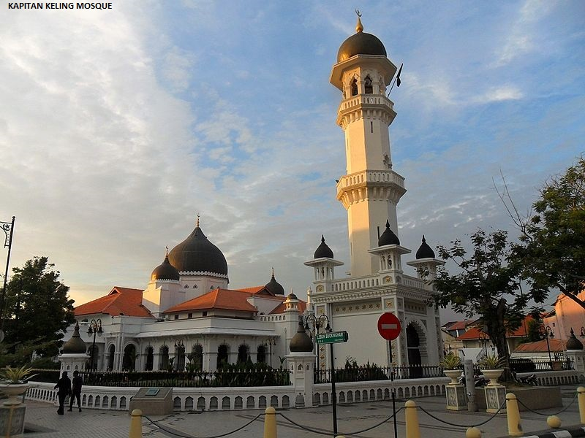

Slide 14
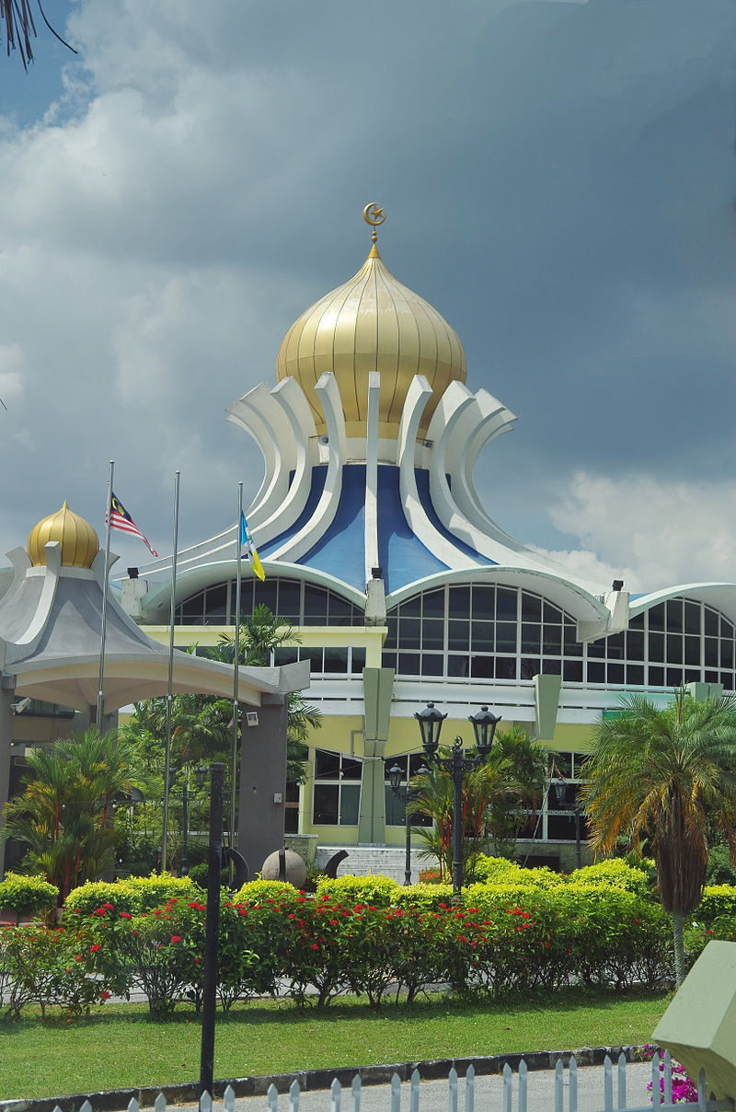
Penang State Mosque at Air Itam Road serves as the main mosque in Penang.

Slide 15
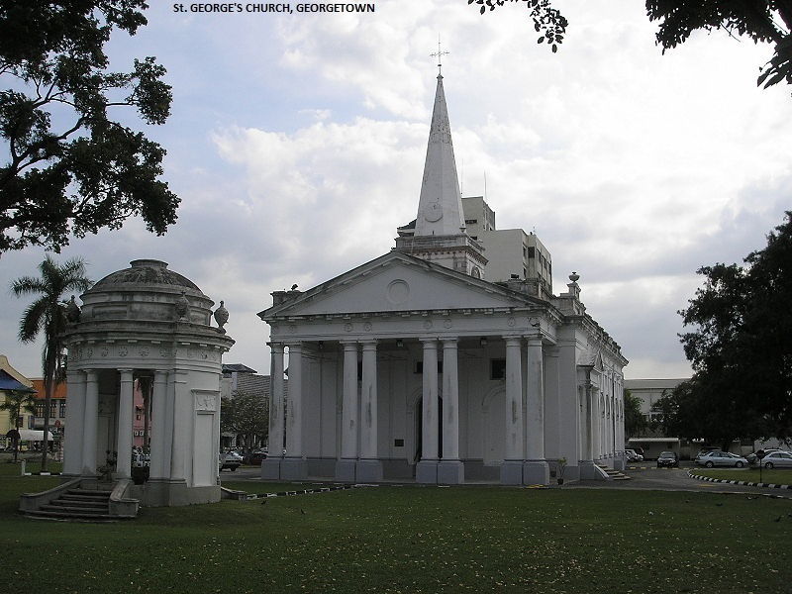

Slide 16
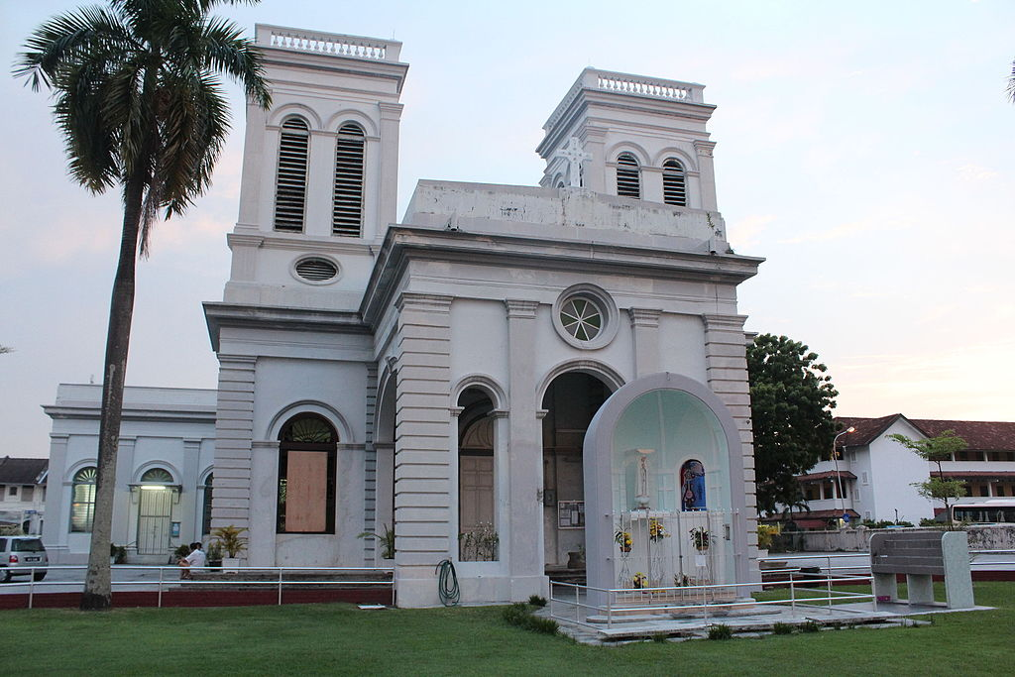
The Church of the Assumption at Farquhar Street is the oldest Catholic church in George Town.

Slide 17
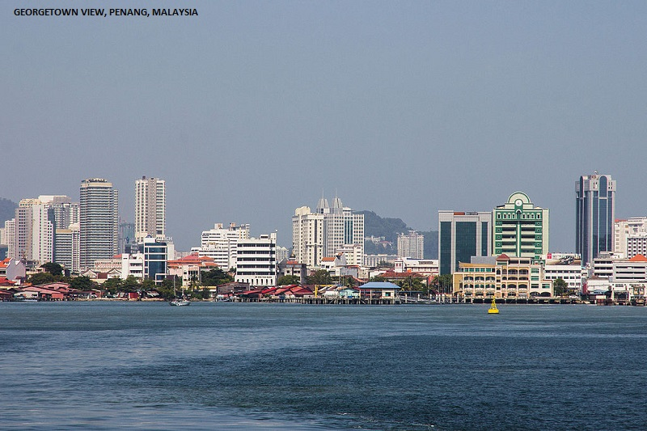

Slide 18
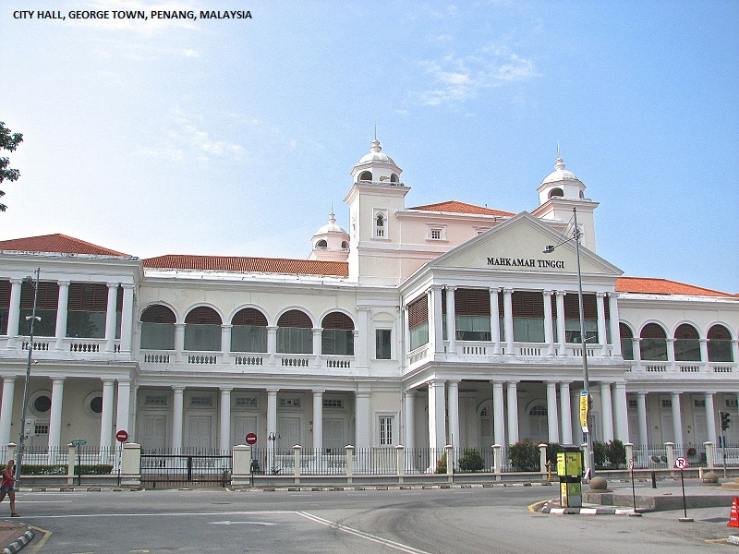

Slide 19
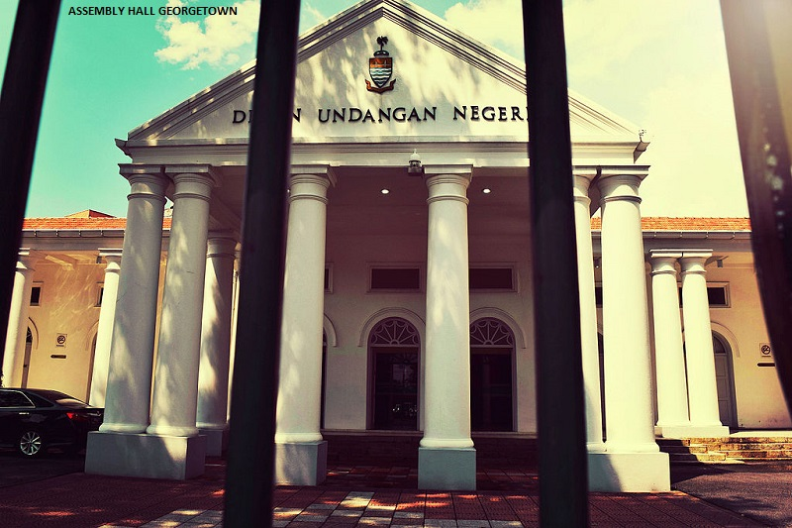

Slide 20
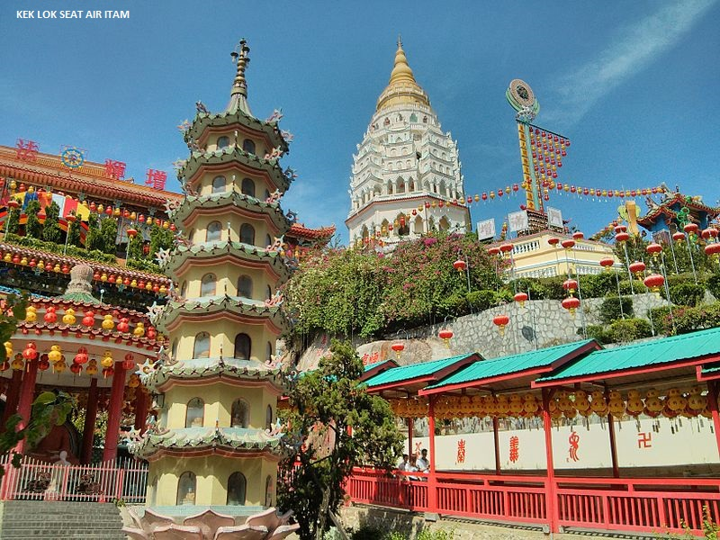

Slide 21
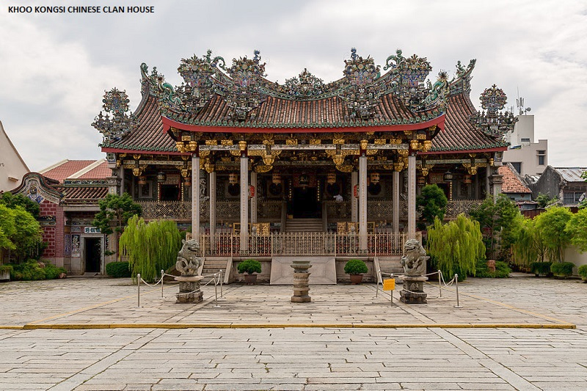

Slide 22
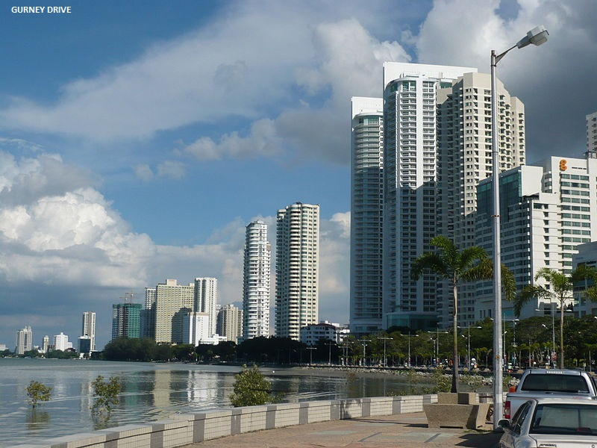

Slide 23
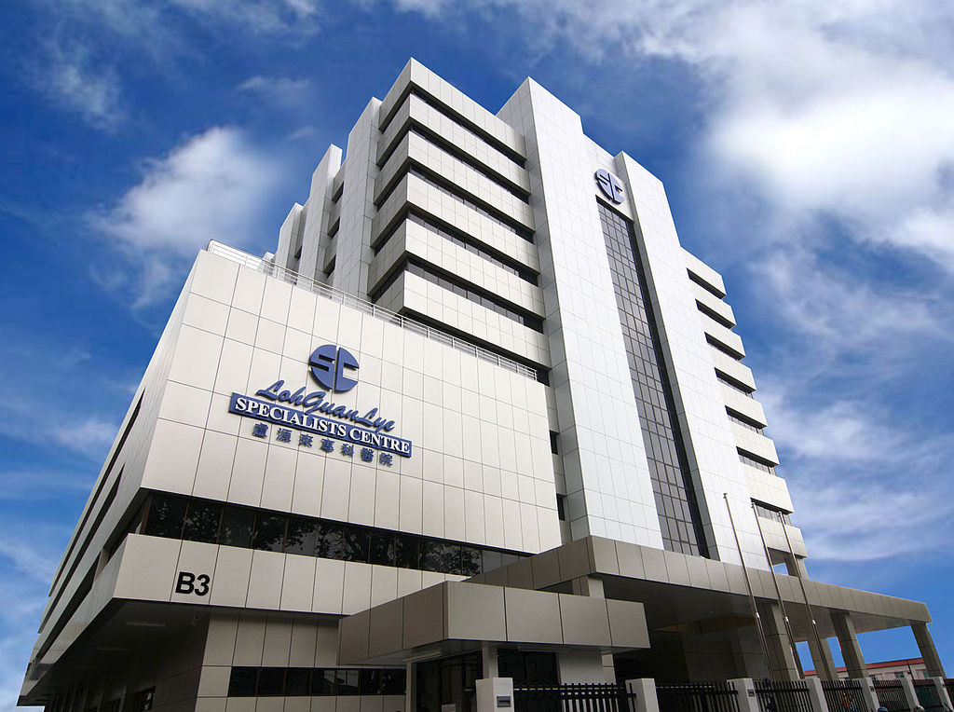
Loh Guan Lye Specialist Centre, at Macalister Road, is one of the many private hospitals located within the city.

Slide 24
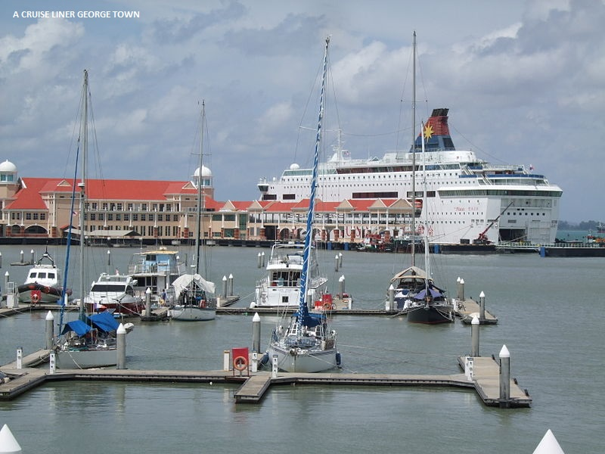

Slide 25
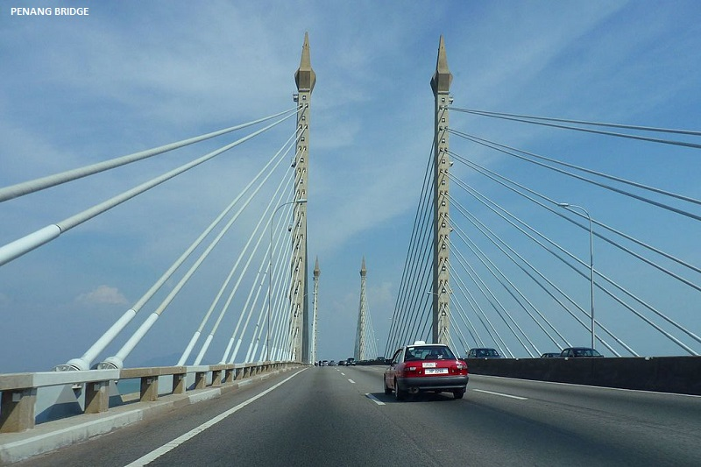

Slide 26
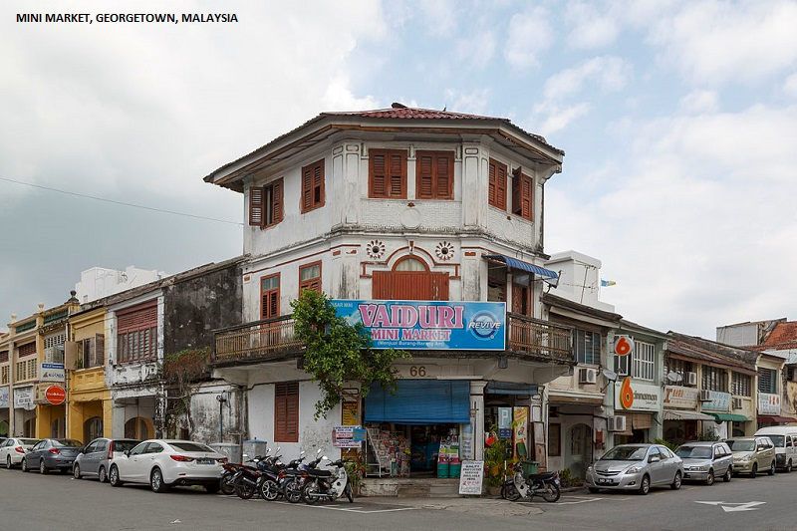

Slide 27
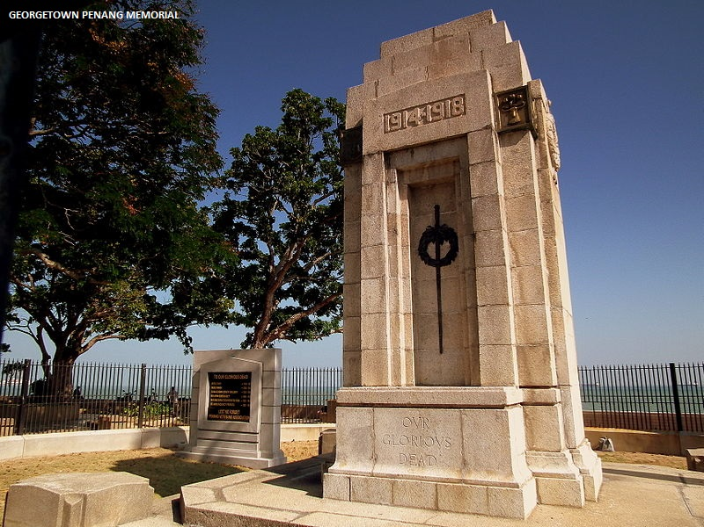

Slide 28
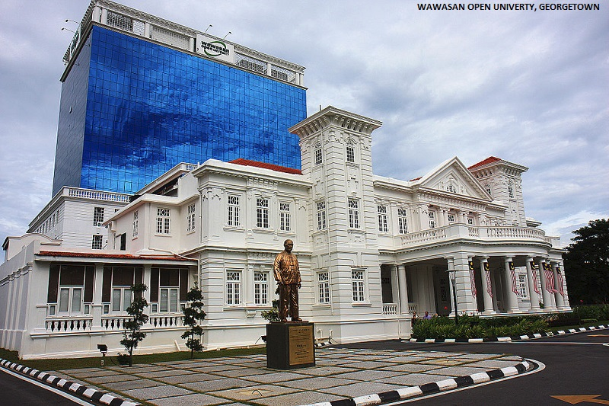

Slide 29
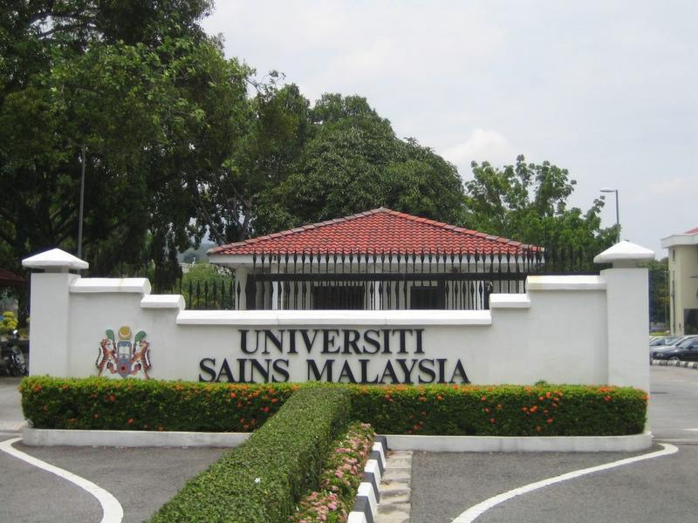
Universiti Sains Malaysia, at Gelugor, is the only public university in George Town.

Slide 30
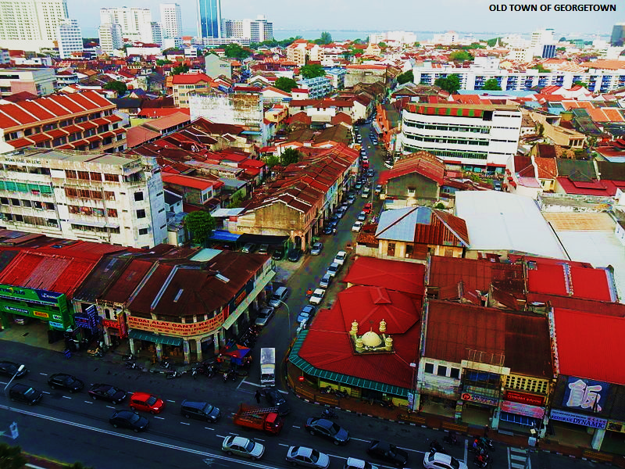

Slide 31
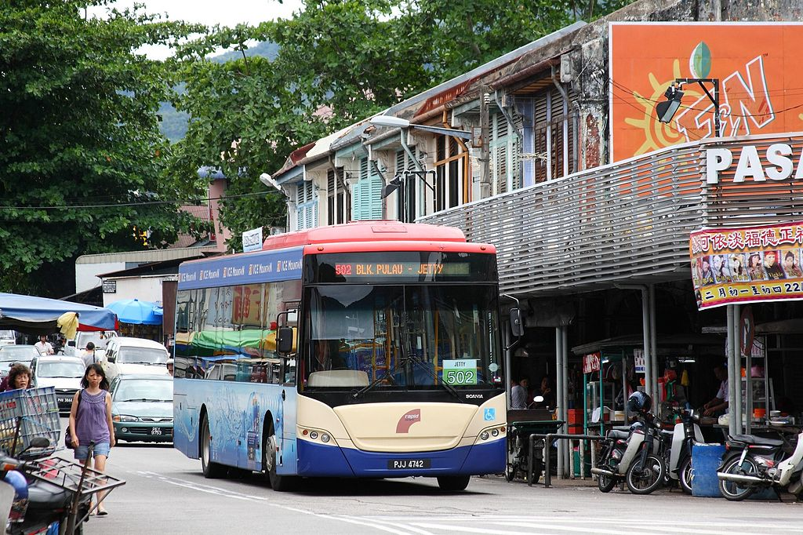
A Rapid Penang bus navigating the narrow streets of Air Itam, west of George Town proper.

Slide 32
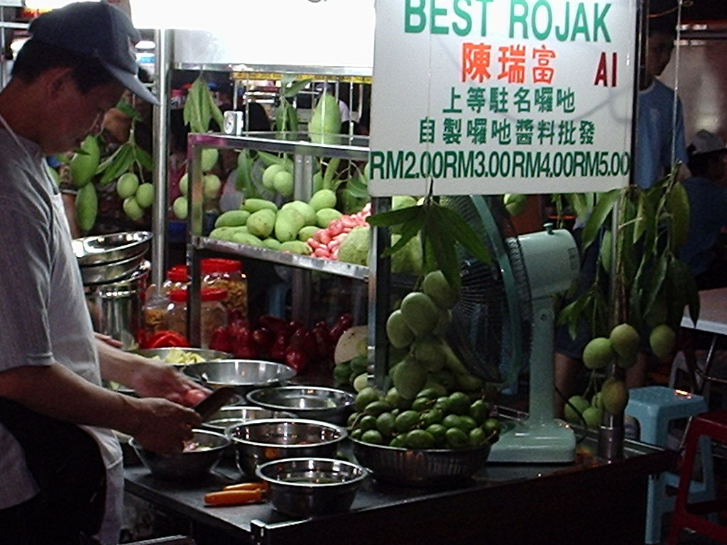
A roadside rojak stall in George Town. Roadside hawker stalls are ubiquitous throughout the city.

Slide 33
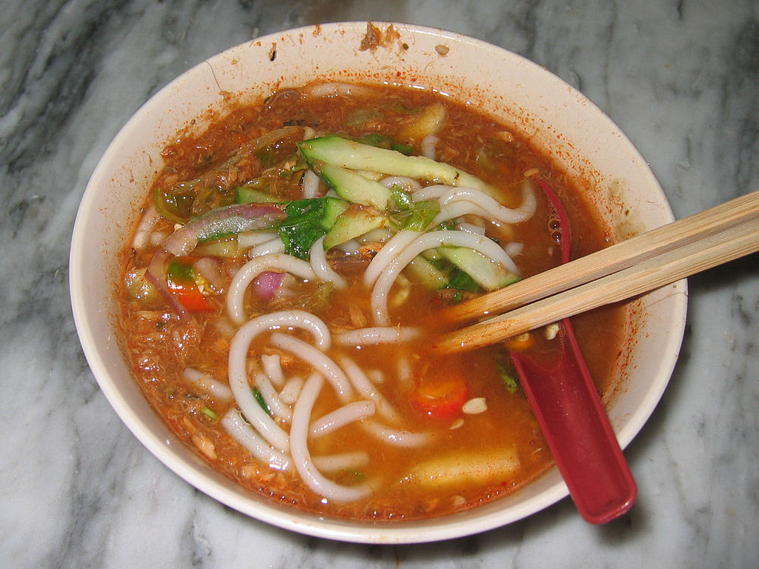
A bowl of asam laksa, Penang's most famous hawker dish. It was ranked 7th. in CNN's list of the world's 50 best foods.

Slide 34
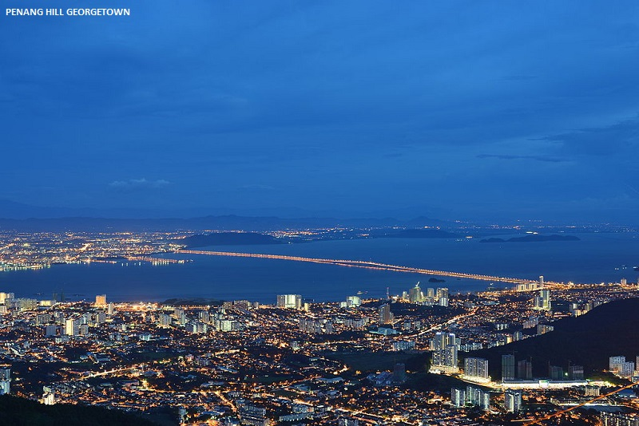

Slide 35
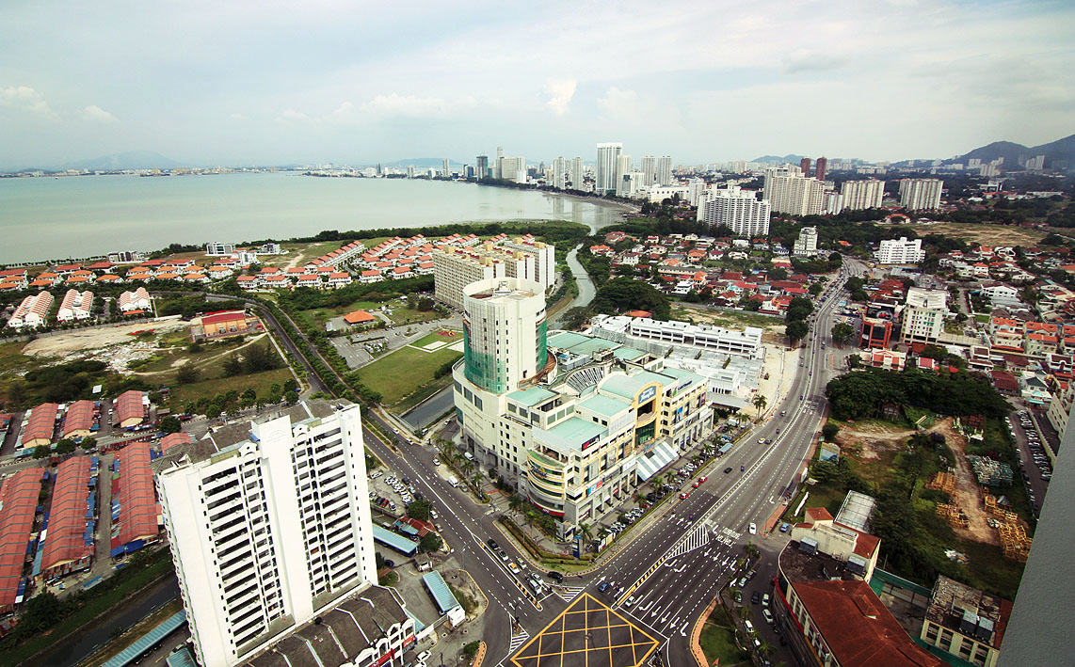
Aerial view of Tanjung Tokong looking towards Gurney Drive, George Town.

Slide 36
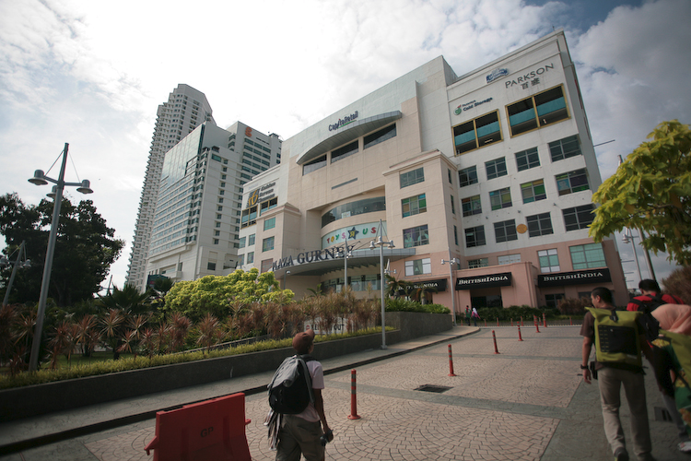
Gurney Plaza, one of the more popular shopping malls in George Town.

Slide 37
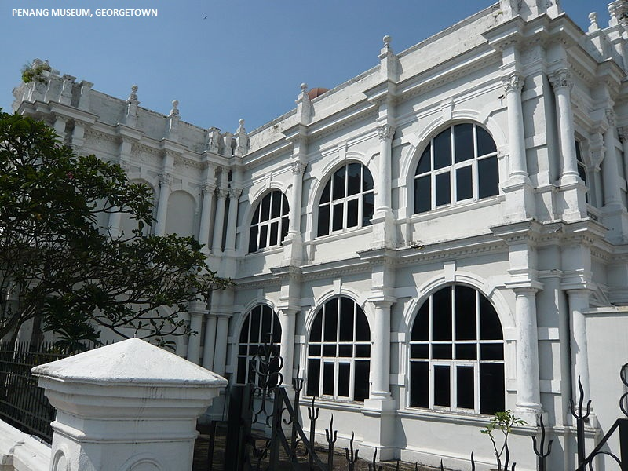

Slide 38
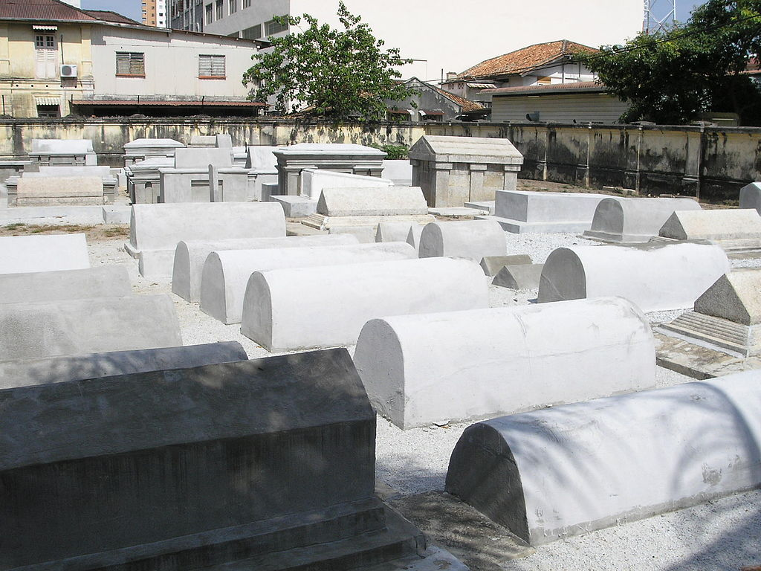
The Jewish Cemetery at Jalan Zainal Abidin is believed to be the oldest in South-east Asia.

Slide 39
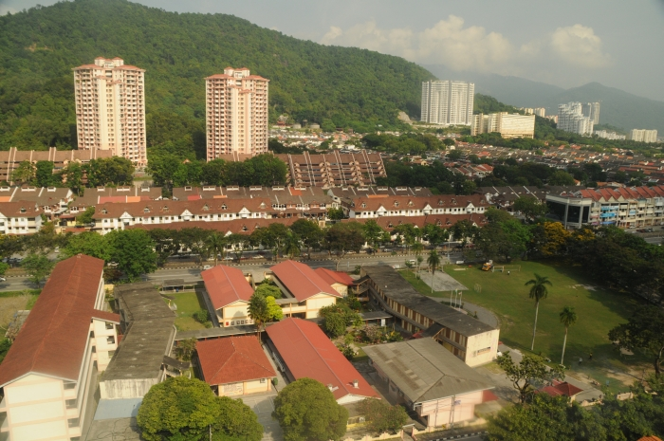
Residential properties in Gelugor, the southern-most suburb of George Town.

Slide 40
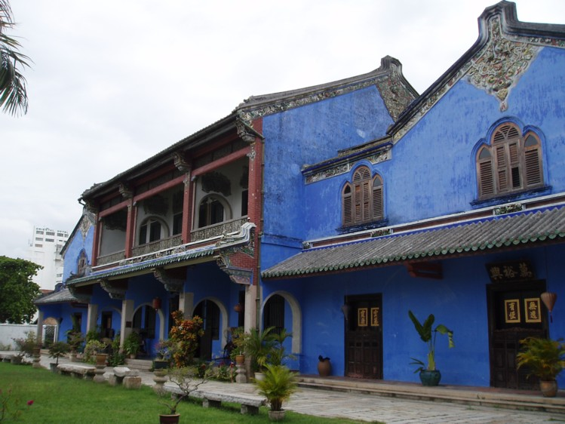
Cheong Fatt Tze Mansion is also known as the 'Blue Mansion' due to its distinctive blue hue.

Slide 41
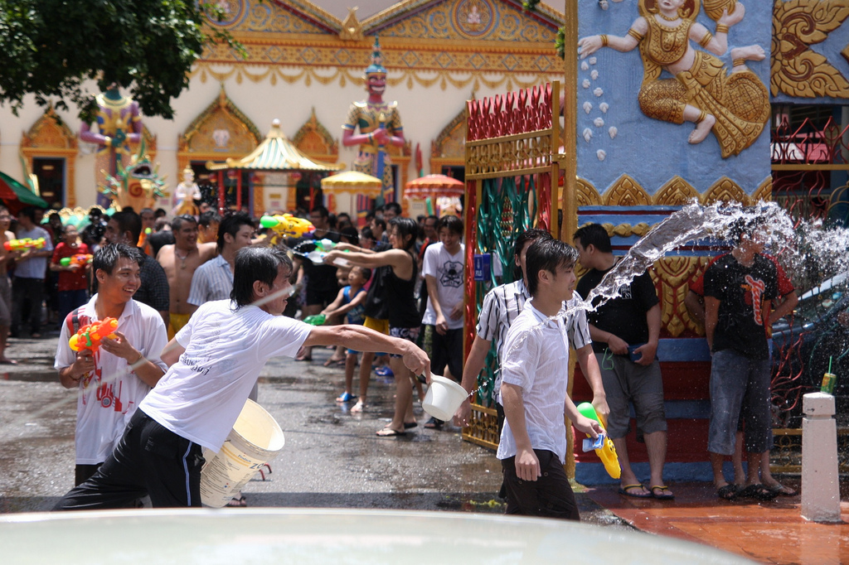
Penangites celebrating Songkran in George Town.

Slide 42
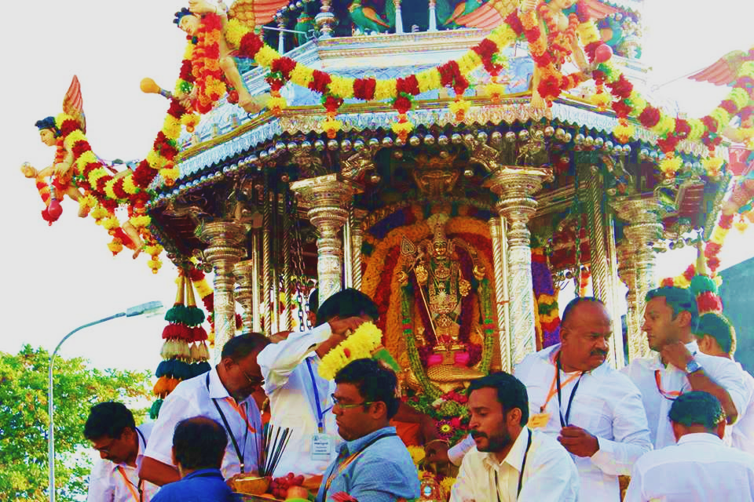
Ethnic Indians celebrating Thaipusam in George Town.

Slide 43
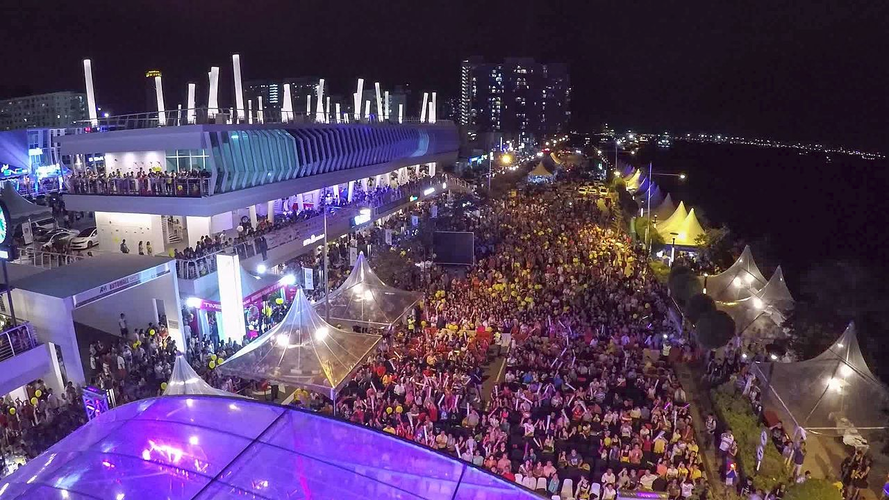
New Year celebrations at Karpal Singh Drive.

Slide 44
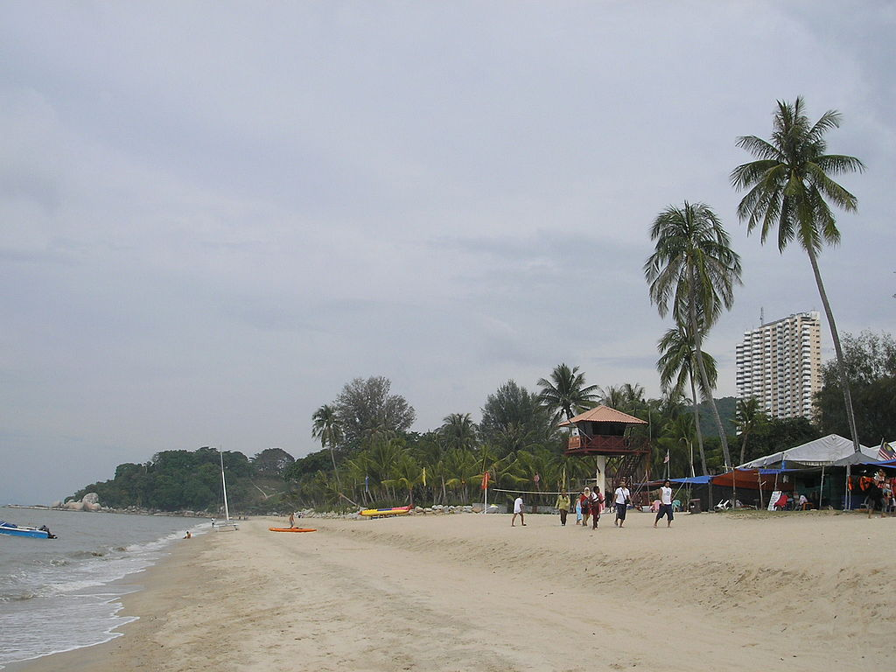
Batu Ferringhi, the most famous beach destination on Penang Island.

Slide 45
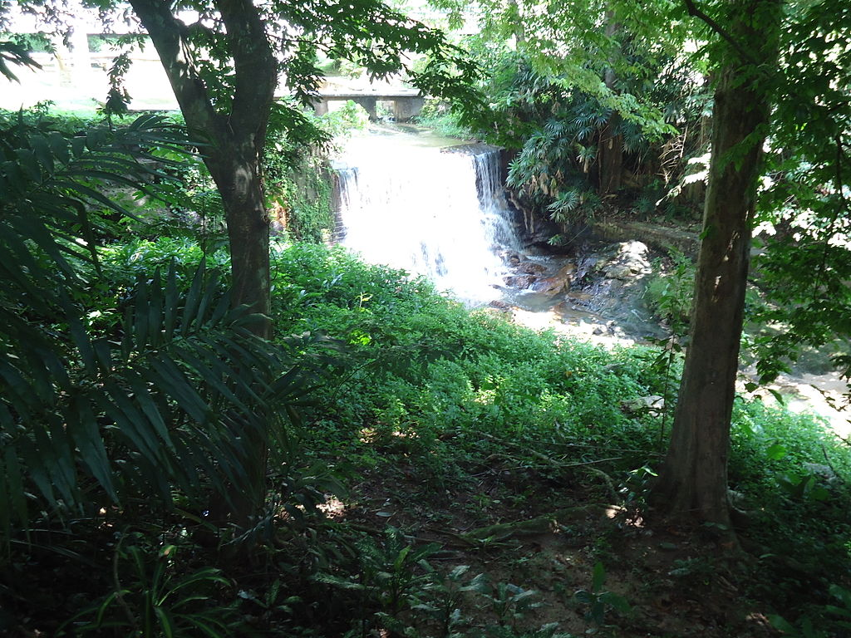
The Penang Botanic Gardens Waterfall. It should be noted that public access to the waterfall is restricted and permission has to be obtained in advance from the Penang Water Authority.

Slide 46
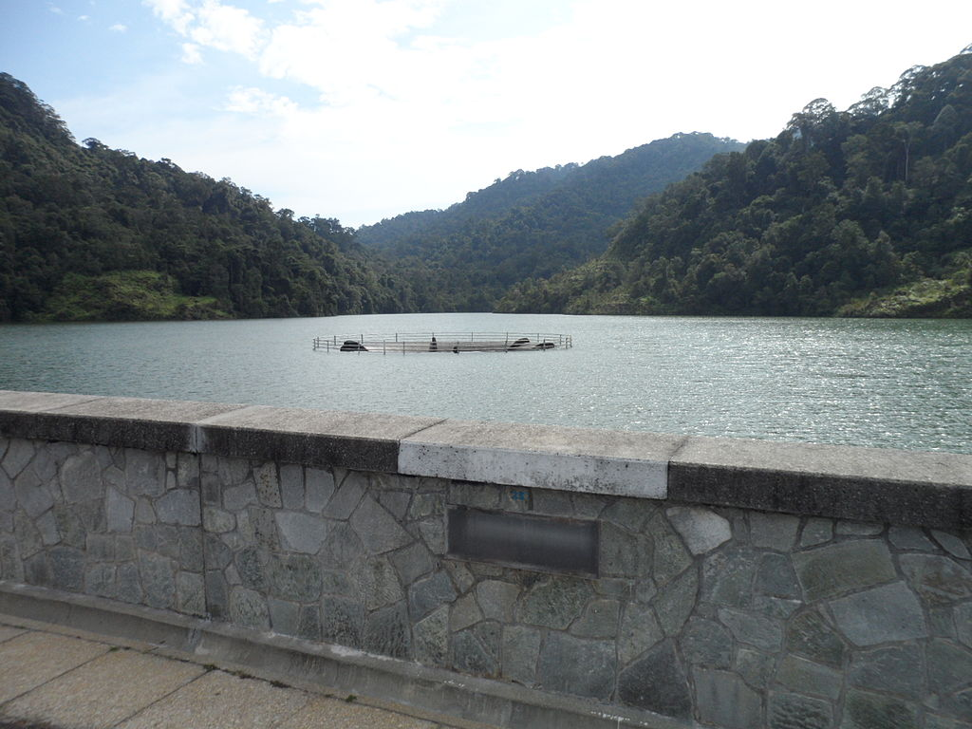
Air Itam Dam

Slide 47
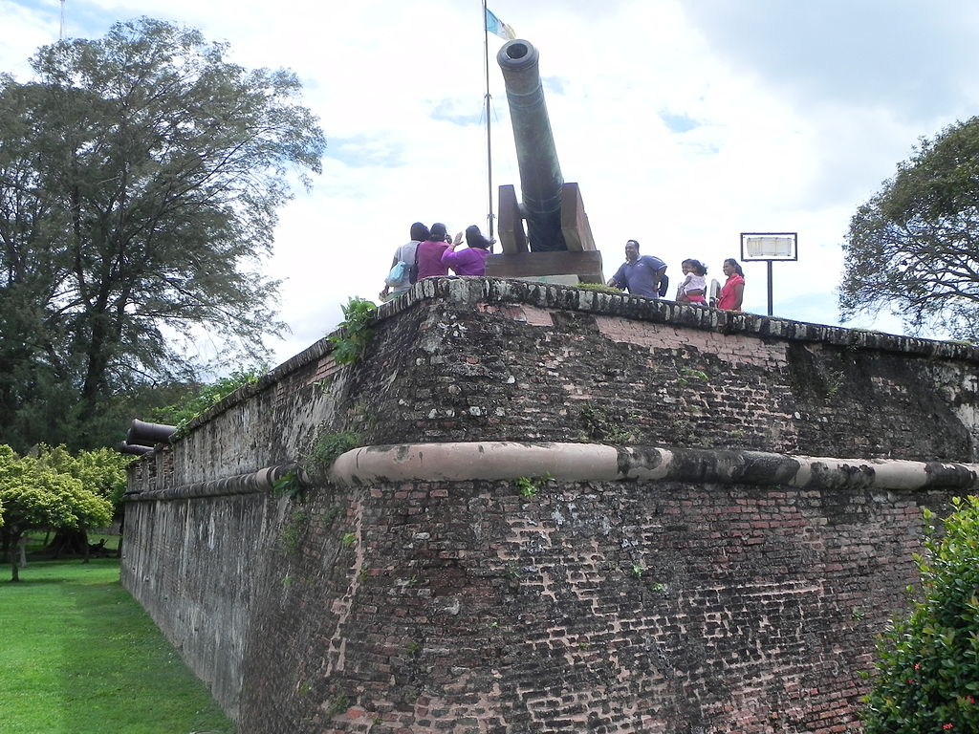
Fort Cornwallis was built in 1786 to protect Penang Island from sea-borne invasion. However, the fort has never been tested in combat.

Slide 48
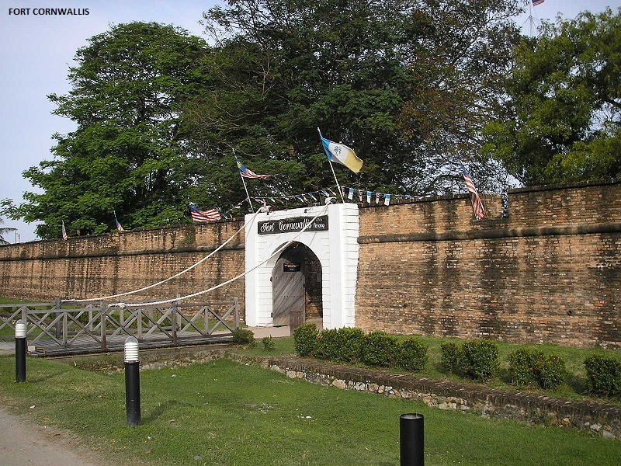

Slide 49
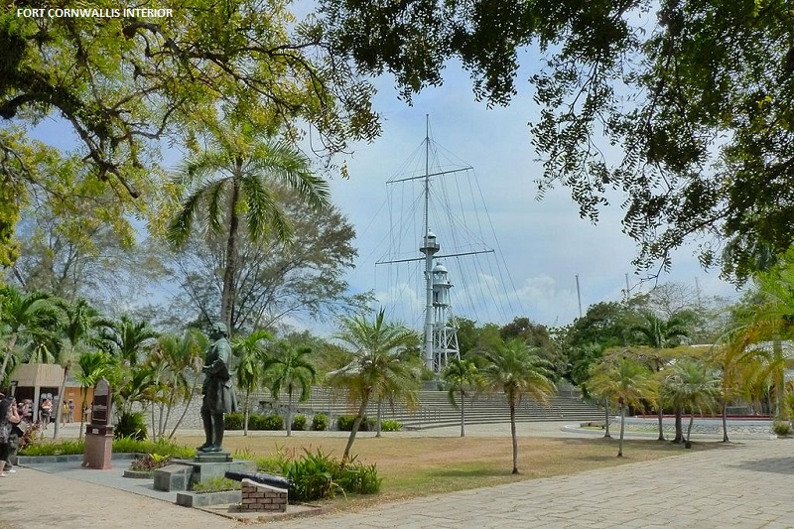

Slide 50
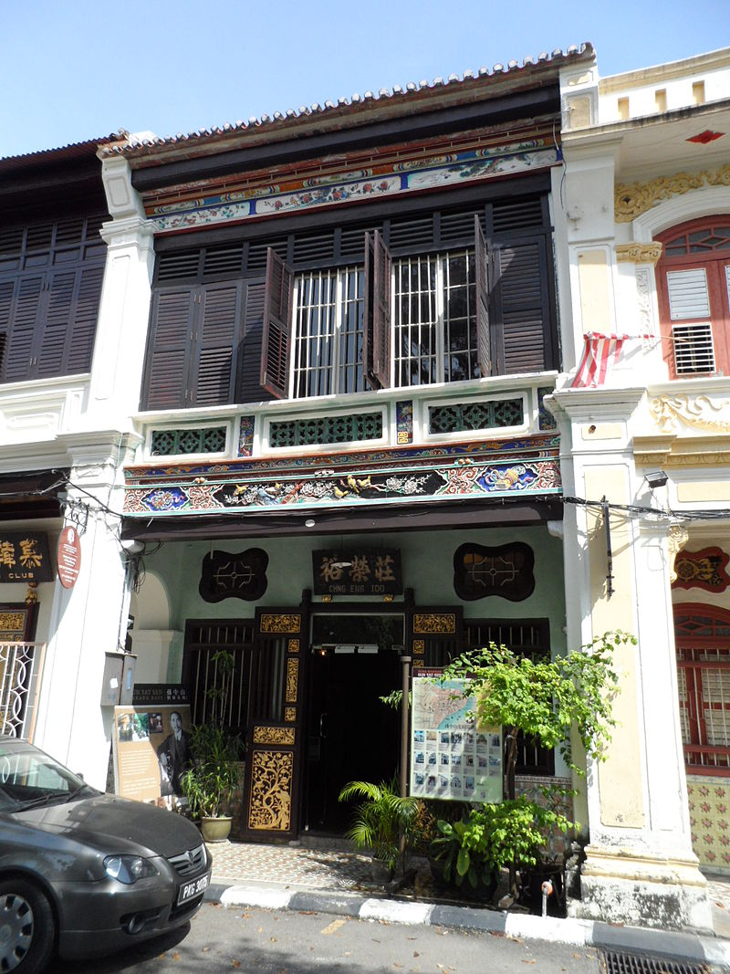
Sun Yat-sen Museum, at Armenian Street, was where Dr. Sun plotted his plans against the Qing dynasty. The museum is also an example of the typical Peranakan townhouse.

Slide 51
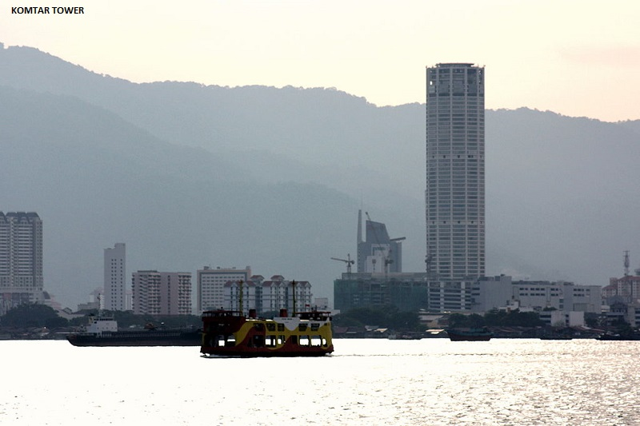
Komtar Tower, Penang's tallest skyscraper, was built in the 1970s. However, it has failed in its original purpose of revitalising George Town.

Slide 52

The new Penang Hill Railway funicular train, which has been in use since 2011.

Slide 53

Passenger terminal of the Penang International Airport.

Slide 54

A Penang Ferry crossing the Penang Strait towards George Town.

