Slide 1
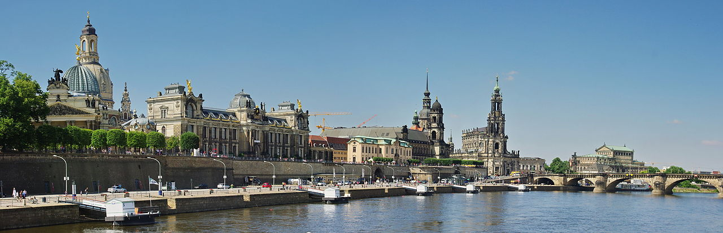
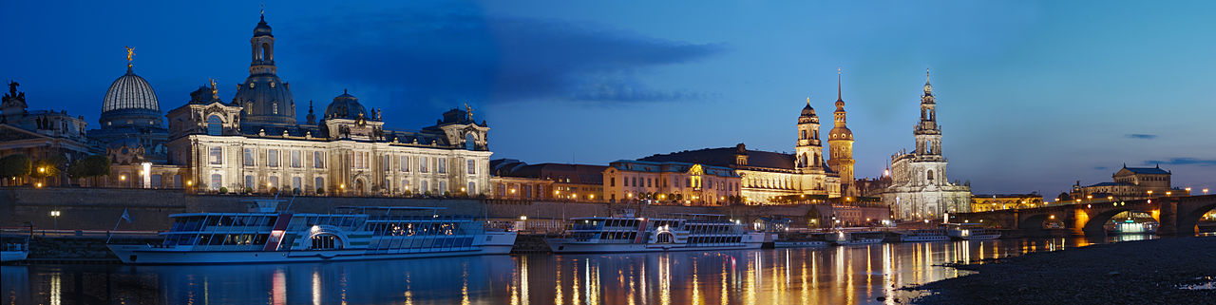
Dresden, Germany

Slide 2
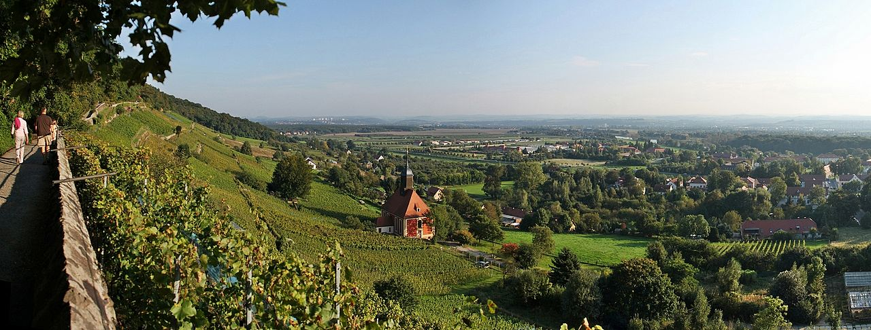
View over Dresden Basin

Slide 3
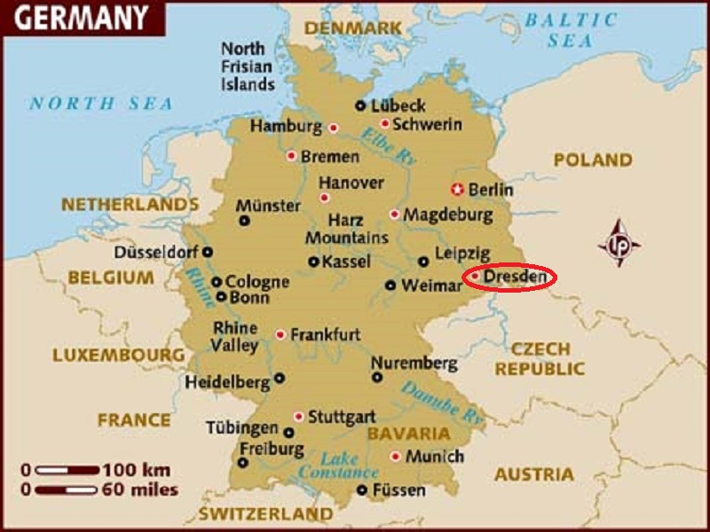
Dresden is the capital city and after Leipzig the second largest city of the Free State of Saxony in Germany. It is situated in a valley on the River Elbe.

Slide 4
Since German reunification in 1990 Dresden is again a cultural, educational and political centre of Germany and Europe. The Dresden University of Technology is one of the 10 largest universities in Germany and part of the German Universities Excellence Initiative. The economy of Dresden and its agglomeration is one of the most dynamic in Germany and ranks first in Saxony. It is dominated by high-tech branches, often called as “Silicon Saxony”. The city is also one of the most visited in Germany with 4,3 million overnight stays per year. The royal buildings are among the most impressive buildings in Europe. Main sights are also the nearby National Park of Saxon Switzerland, the Ore Mountains and the countryside around Elbe Valley and Moritzburg Castle. The most prominent building in the city of Dresden is the Frauenkirche. Built in the 18th century, the church was destroyed during World War II. The remaining ruins were left for 50 years as a war memorial. The church was rebuilt from 1994 to 2005.

Slide 5
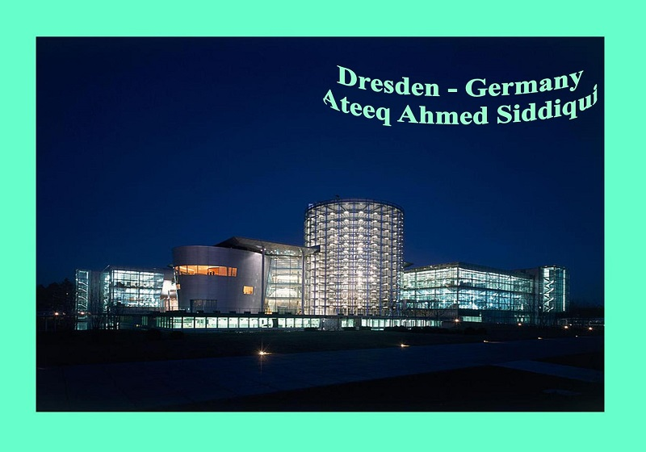

Slide 6
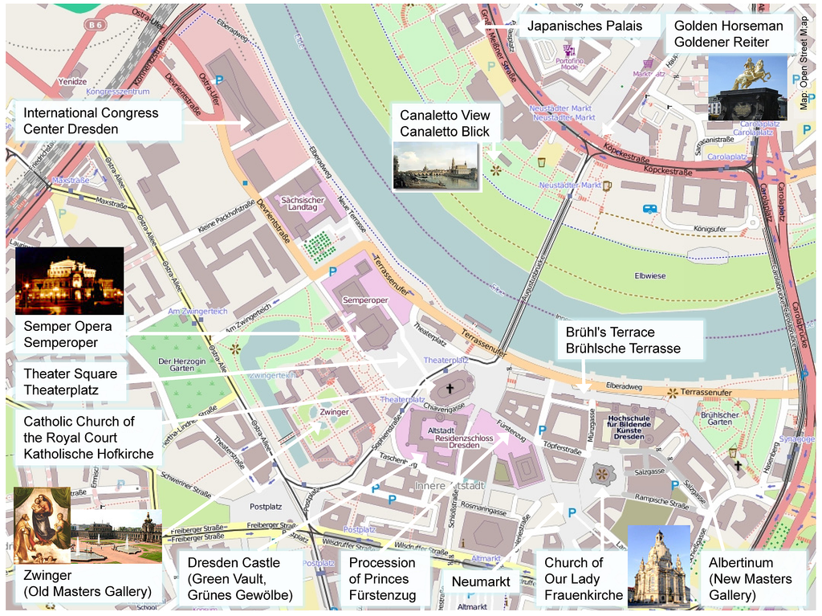

Slide 7
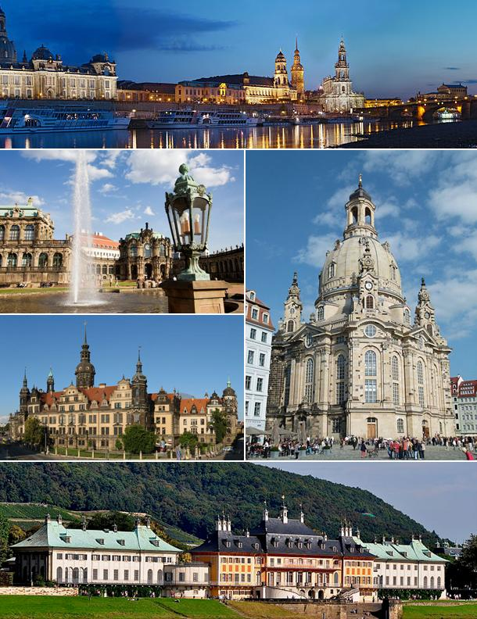

Slide 8
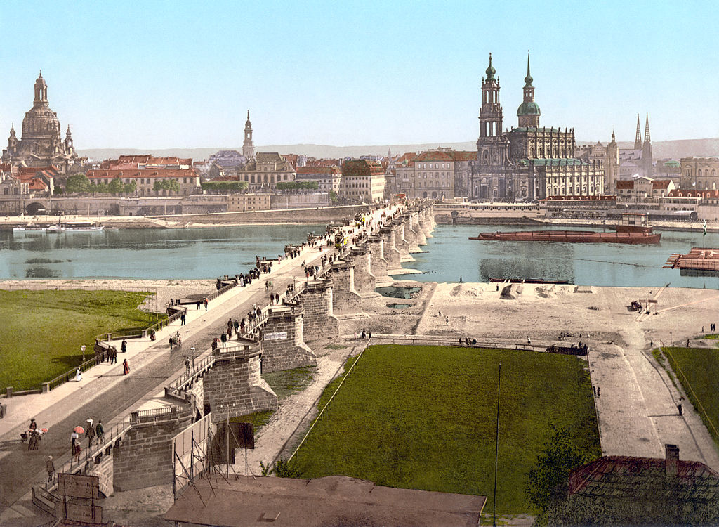

Slide 9
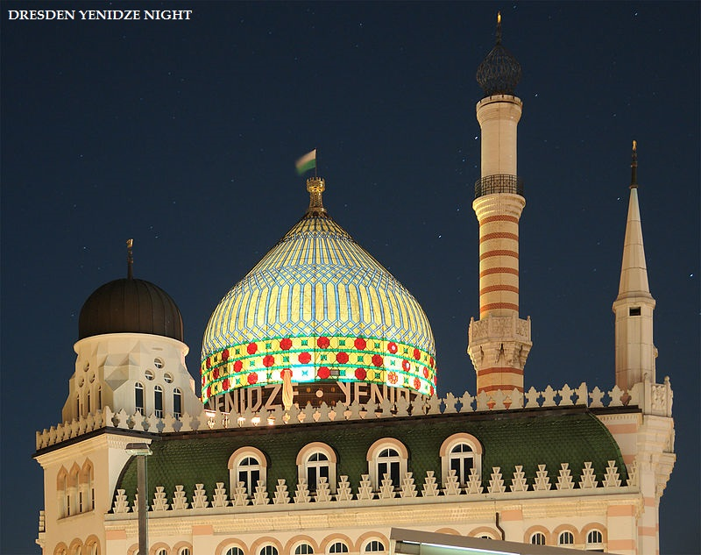

Slide 10
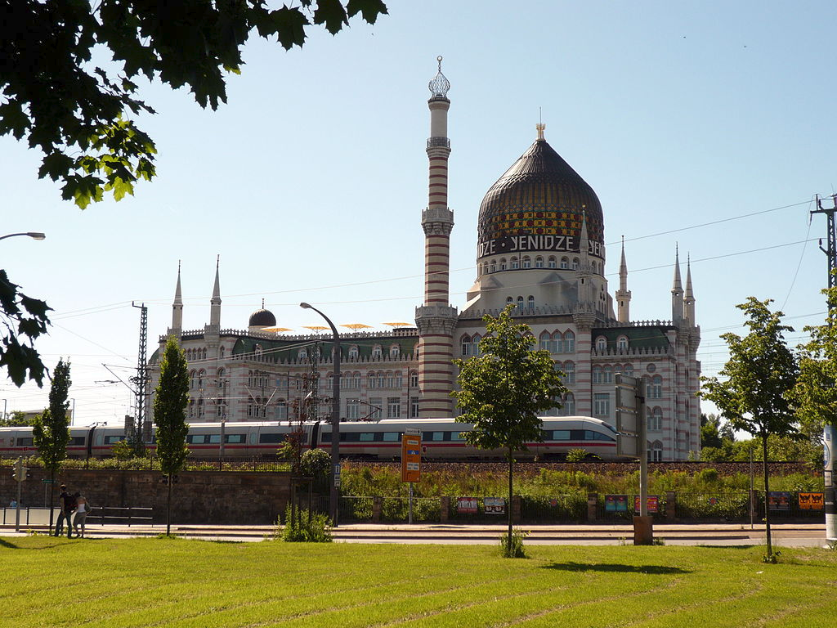

Slide 11
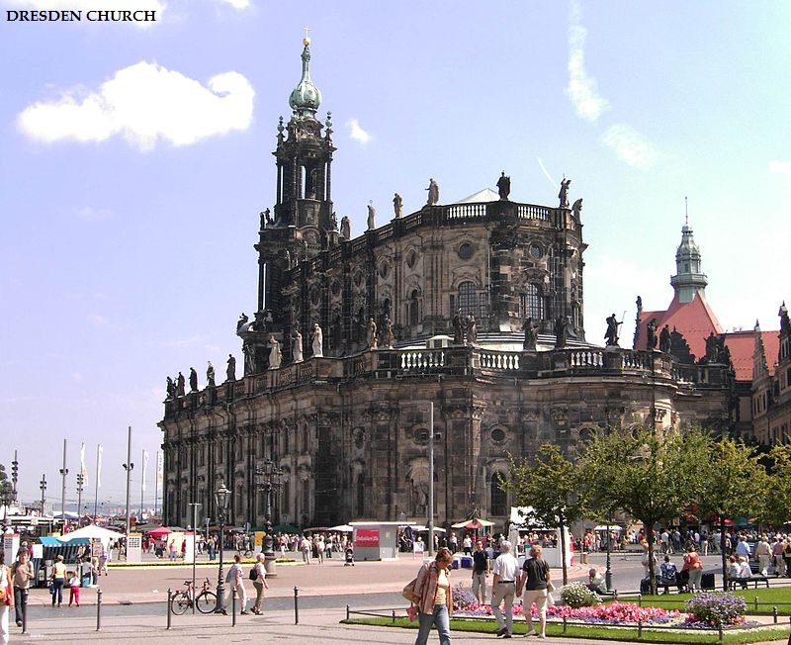

Slide 12
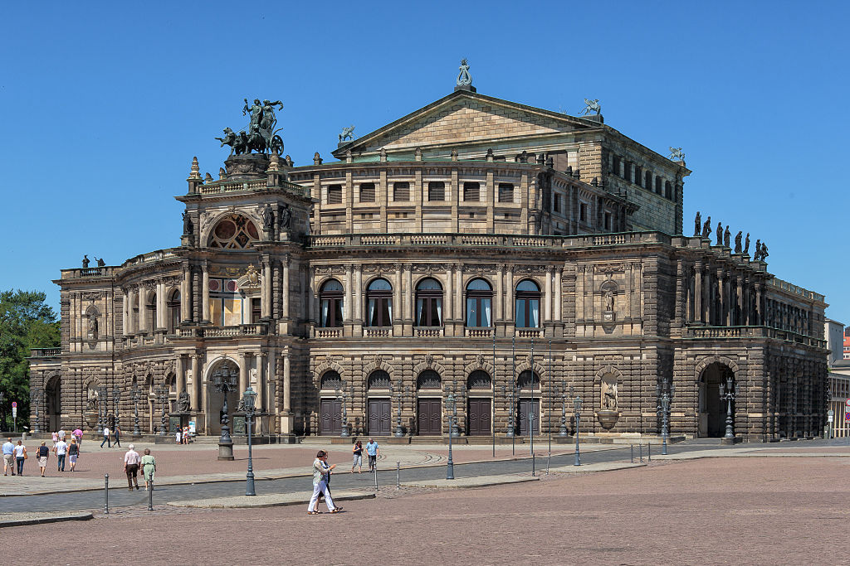
The Semperoper

Slide 13
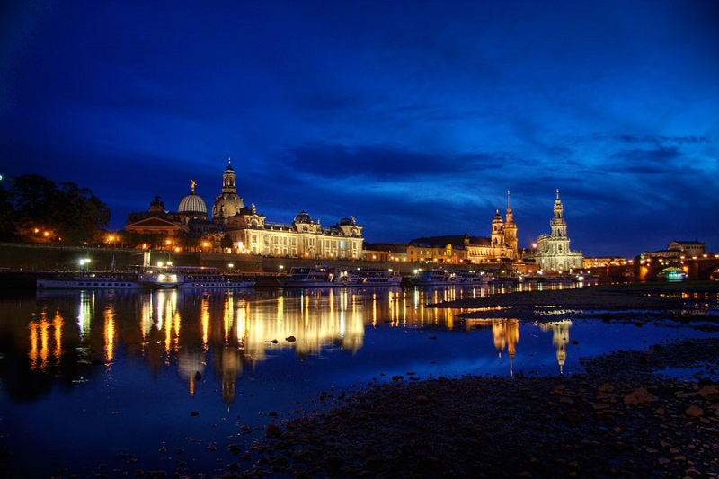

Slide 14
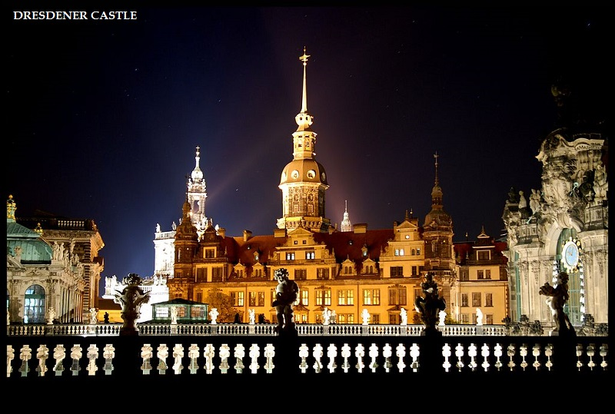

Slide 15
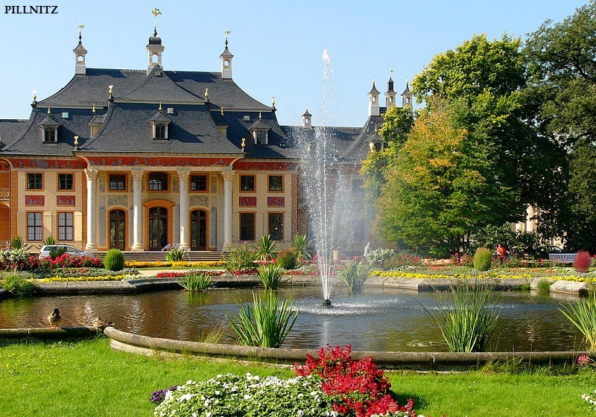

Slide 16
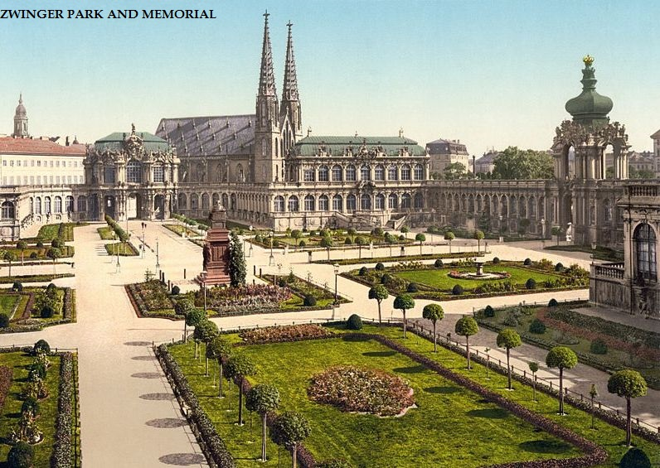

Slide 17
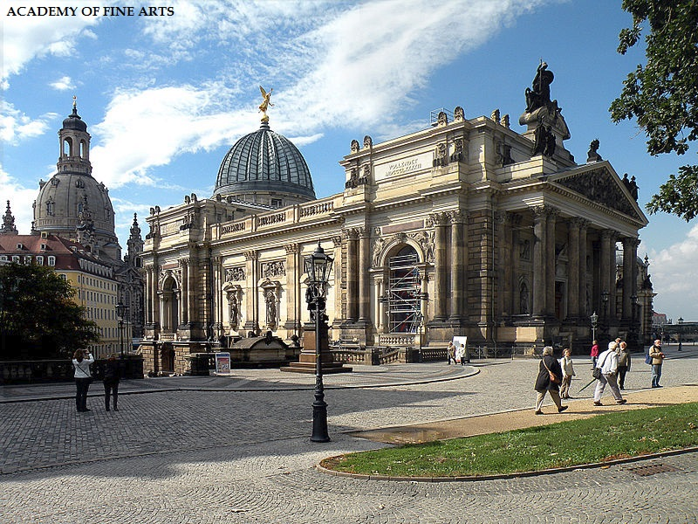

Slide 18
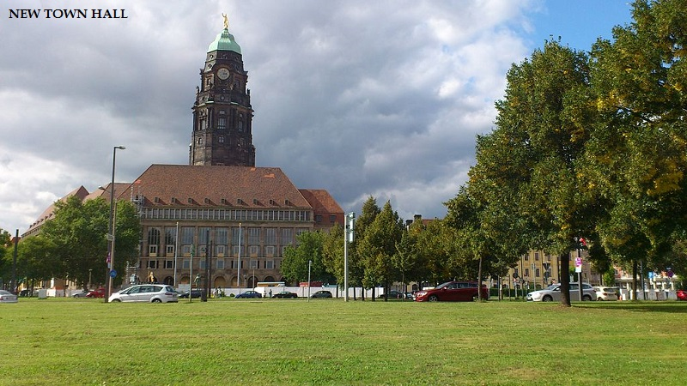

Slide 19
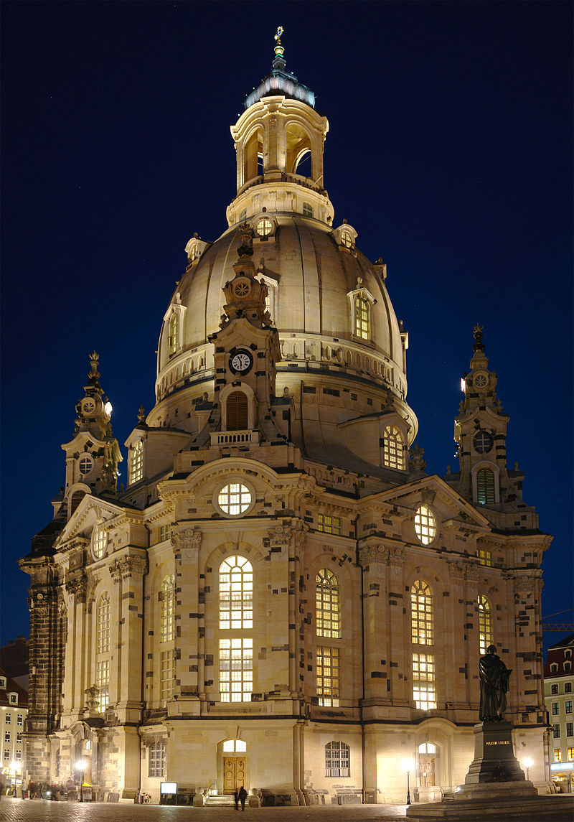
Dresden Frauenkirche

Slide 20
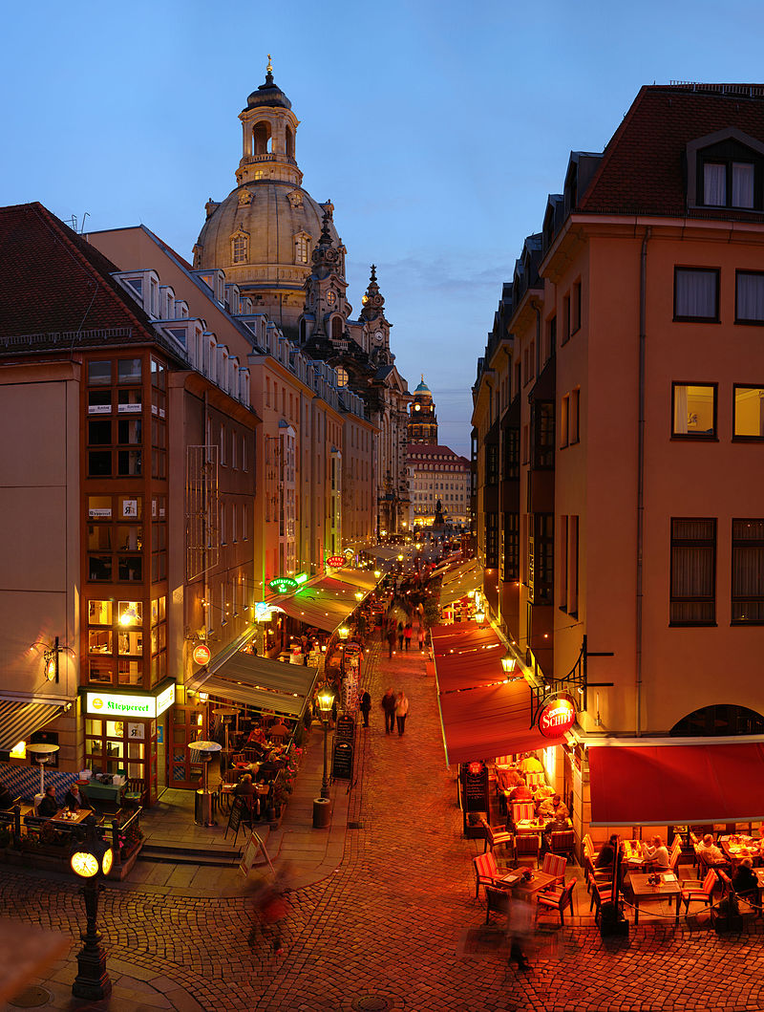

Slide 21
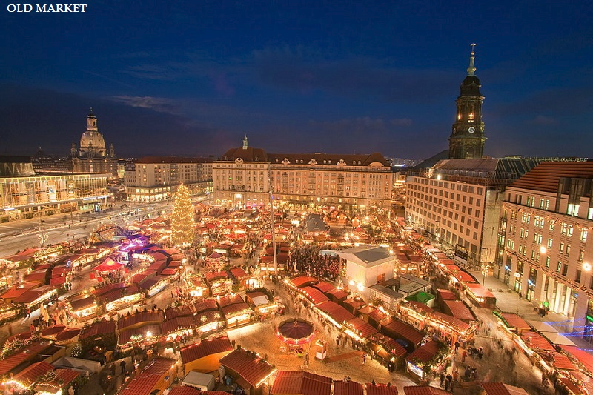

Slide 22
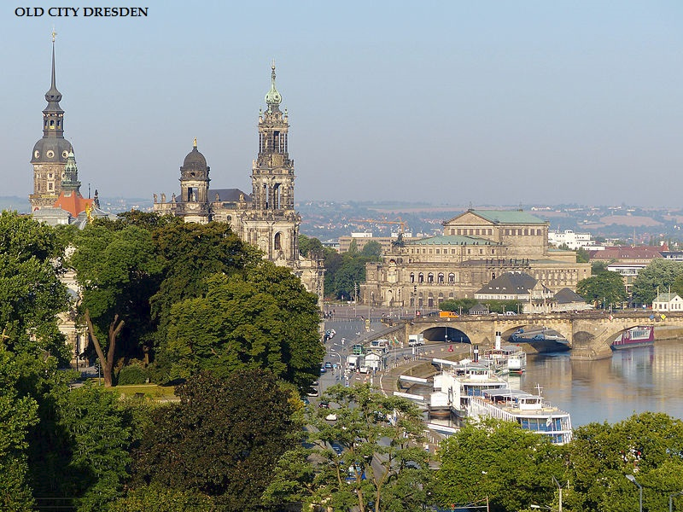

Slide 23
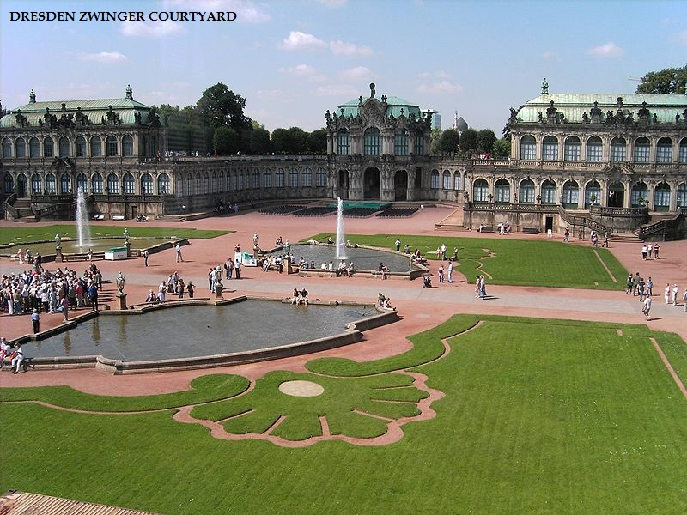

Slide 24
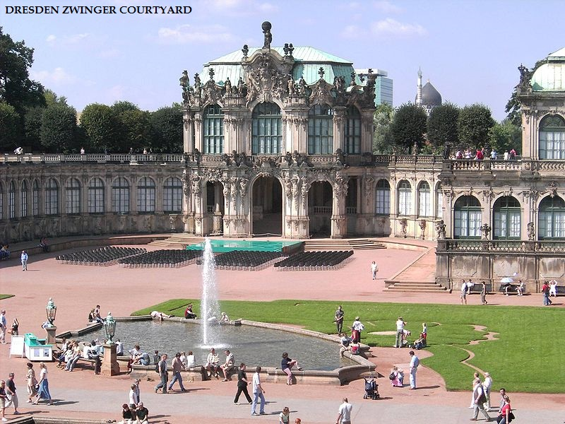

Slide 25
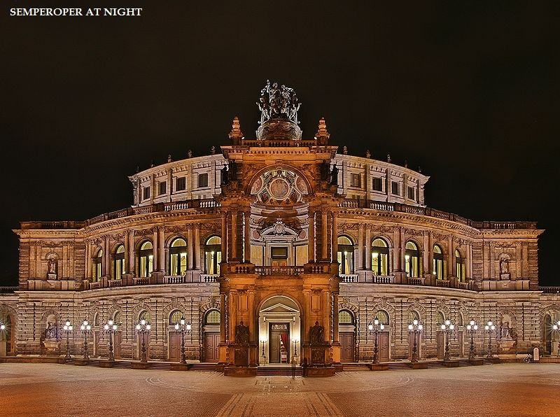

Slide 26
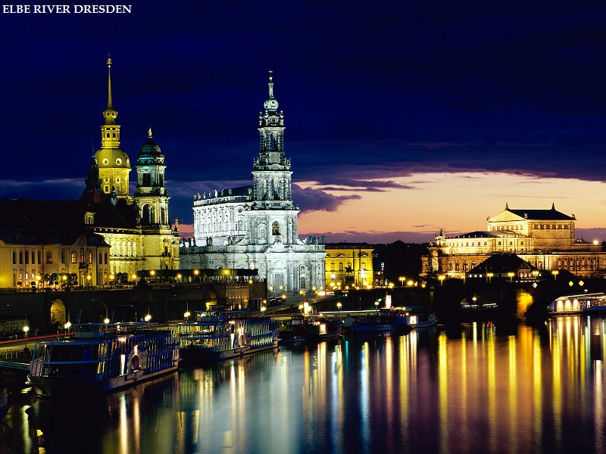

Slide 27
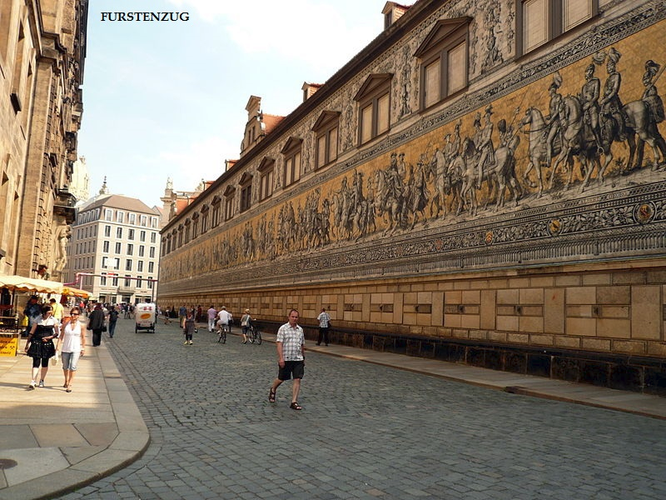

Slide 28
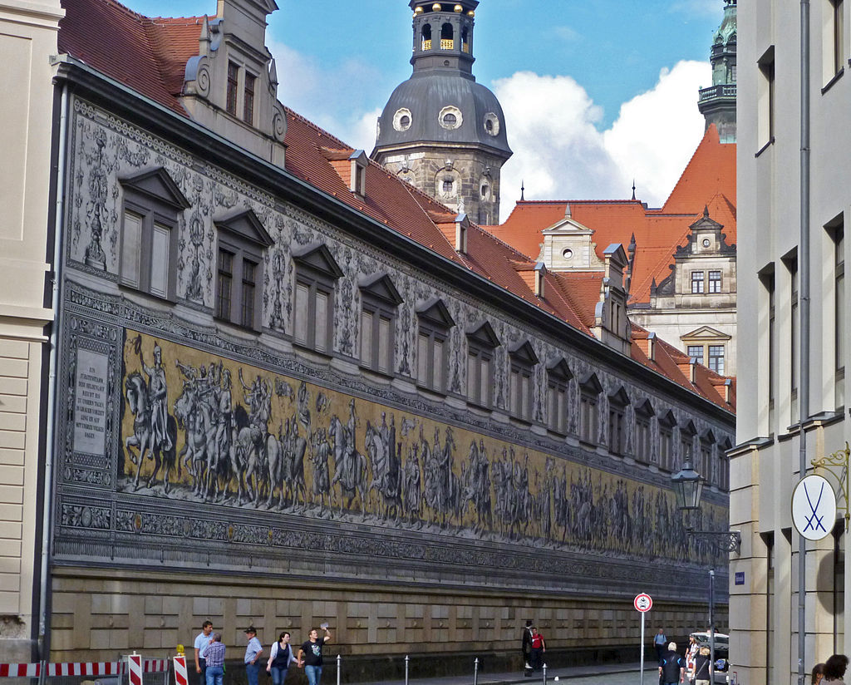

Slide 29
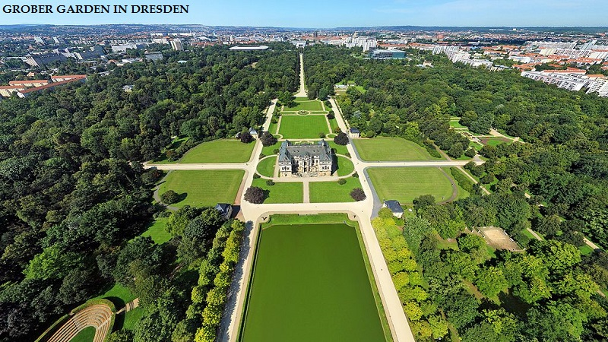

Slide 30
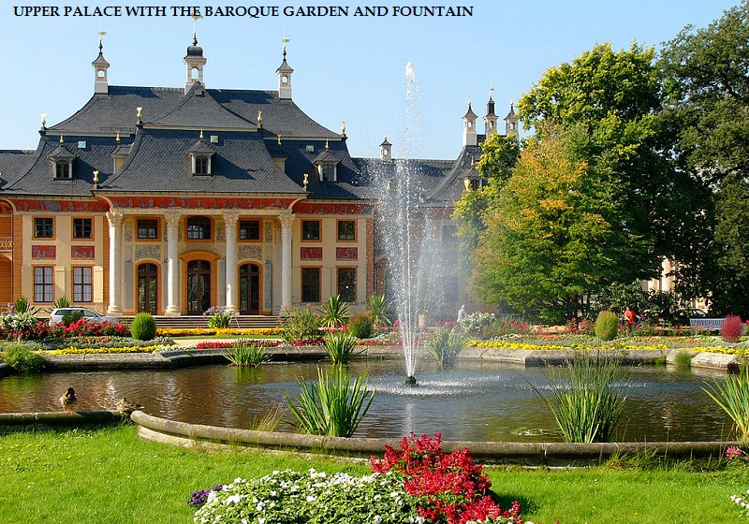

Slide 31
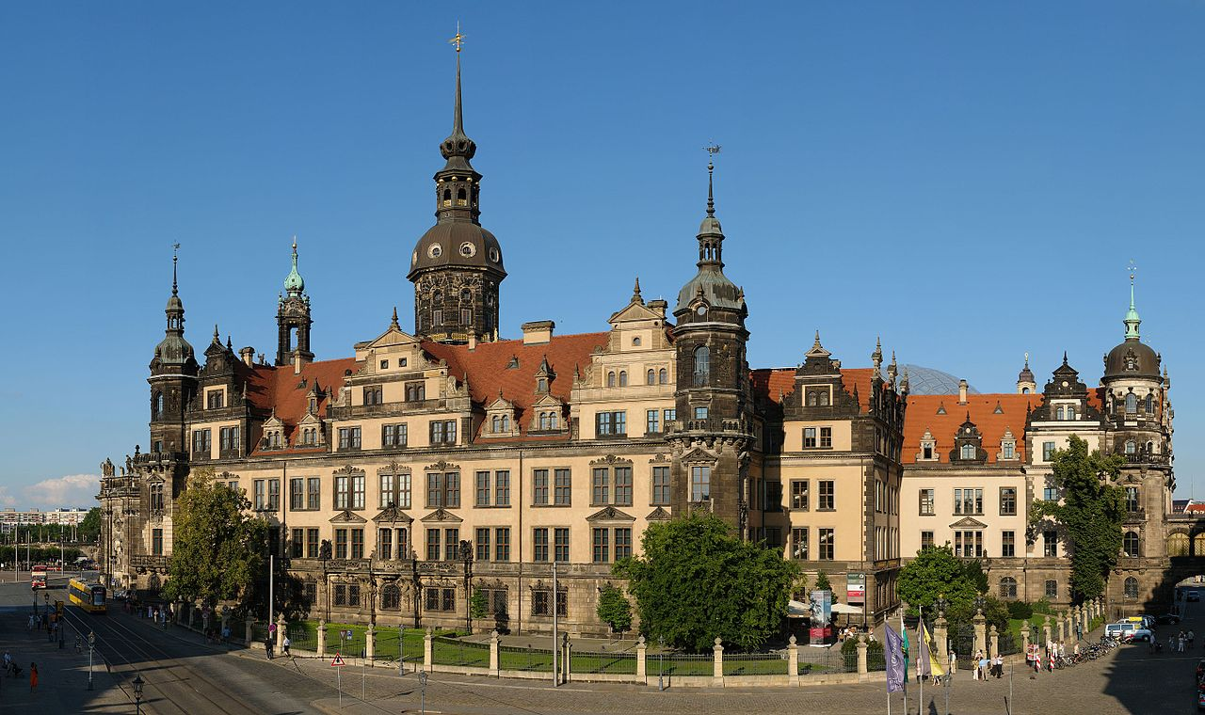
Dresden Castle

Slide 32
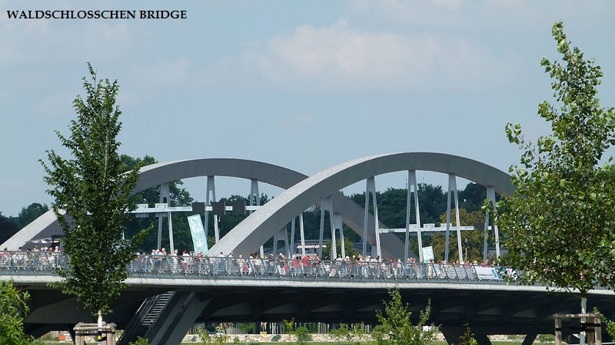

Slide 33
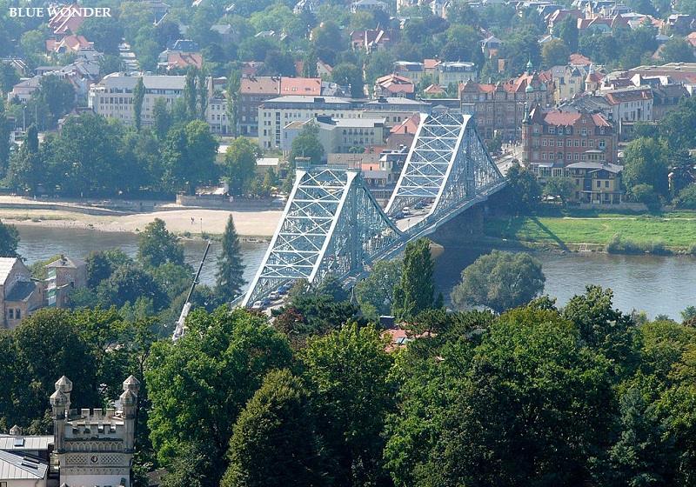

Slide 34
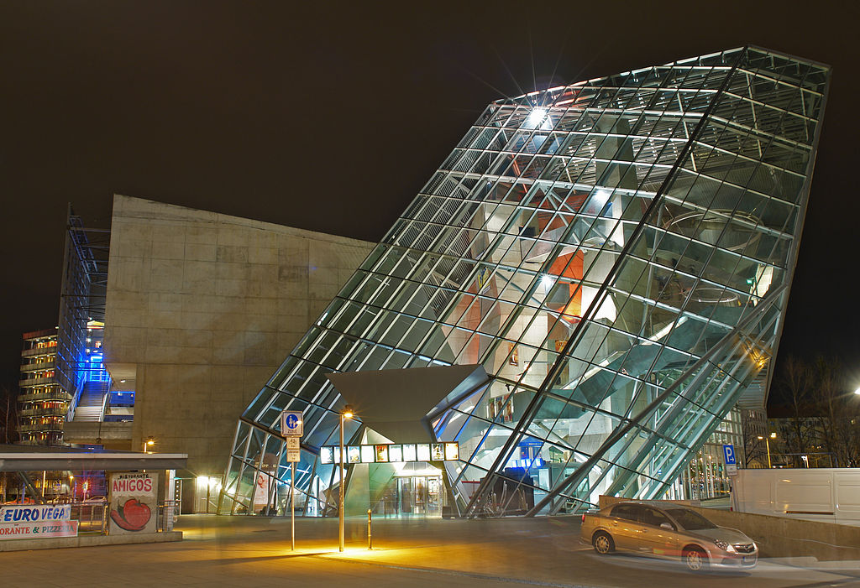

Slide 35
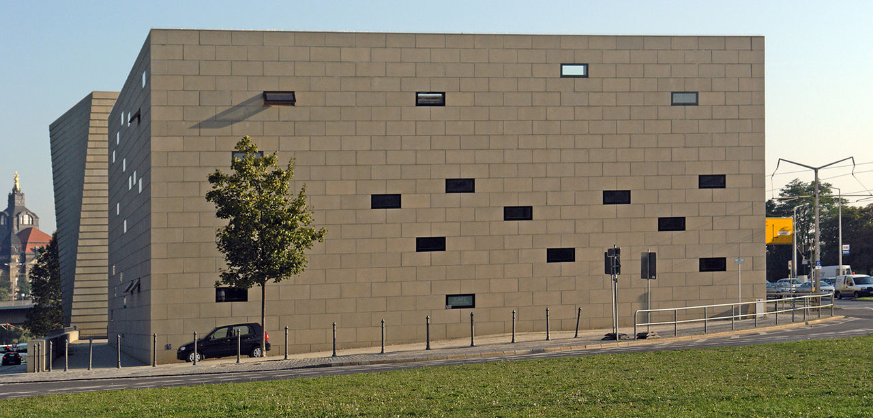
New synagogue

Slide 36
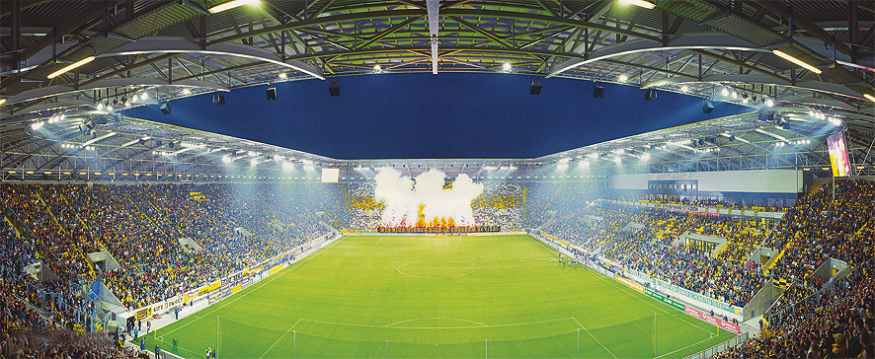
Glücksgas Stadium

Slide 37
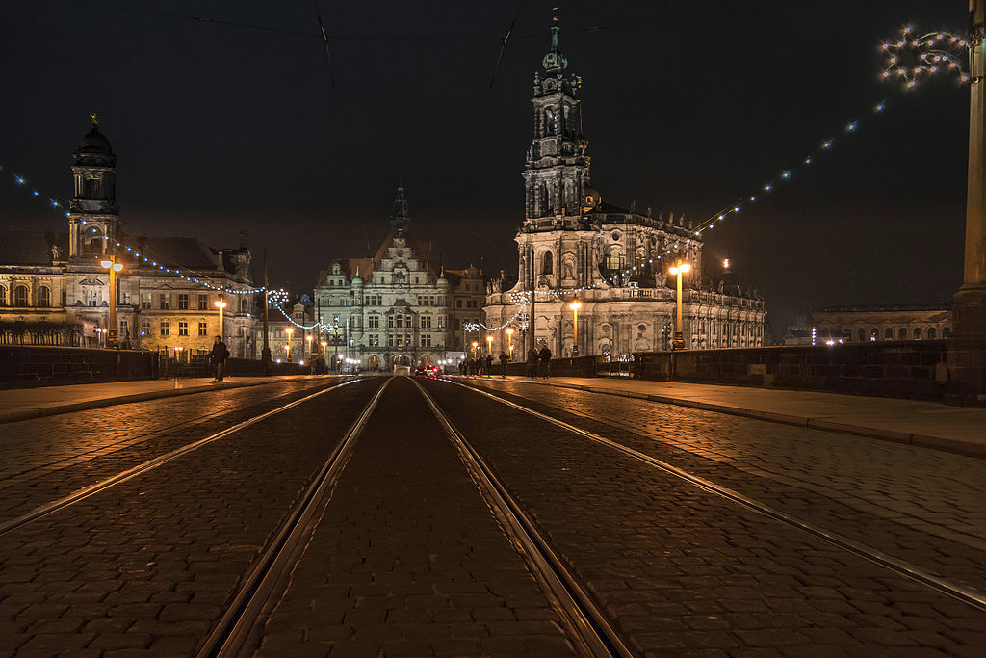

Slide 38
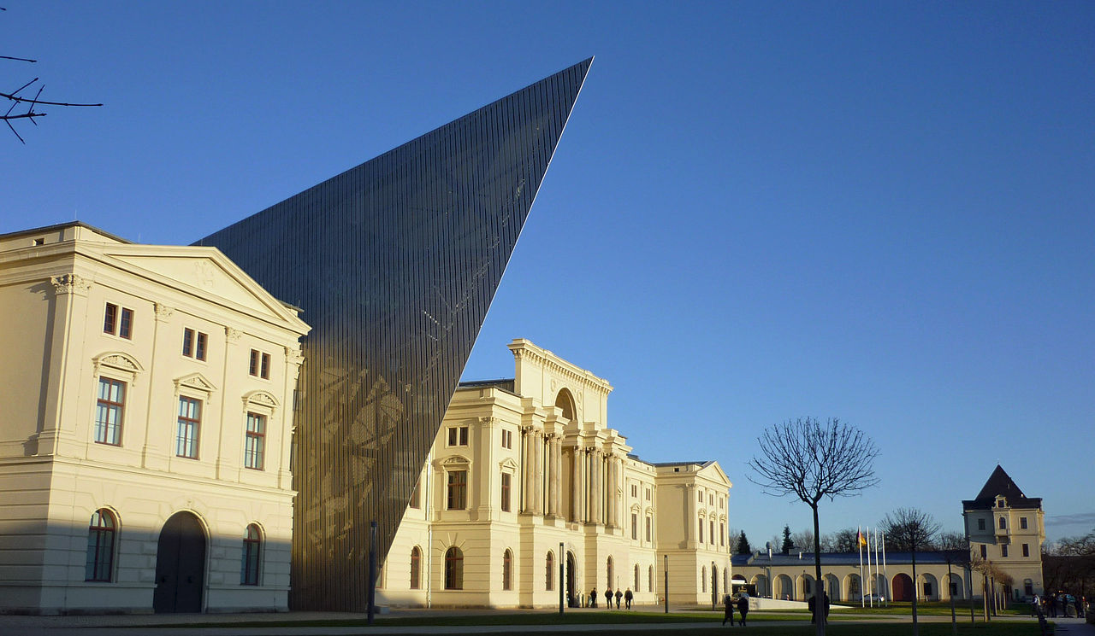
Bundeswehr Military History Museum

Slide 39
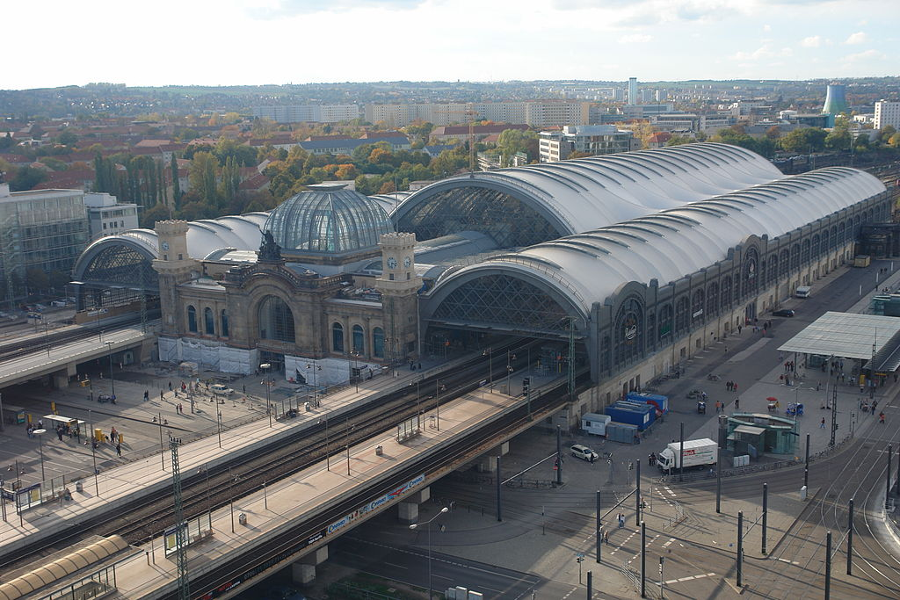
Dresden Central Station

Slide 40
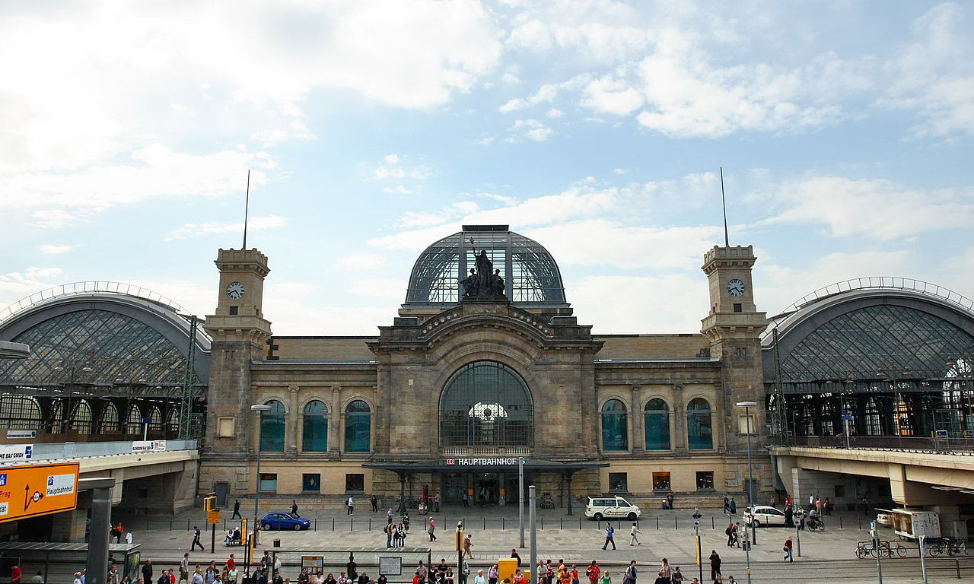

Slide 41
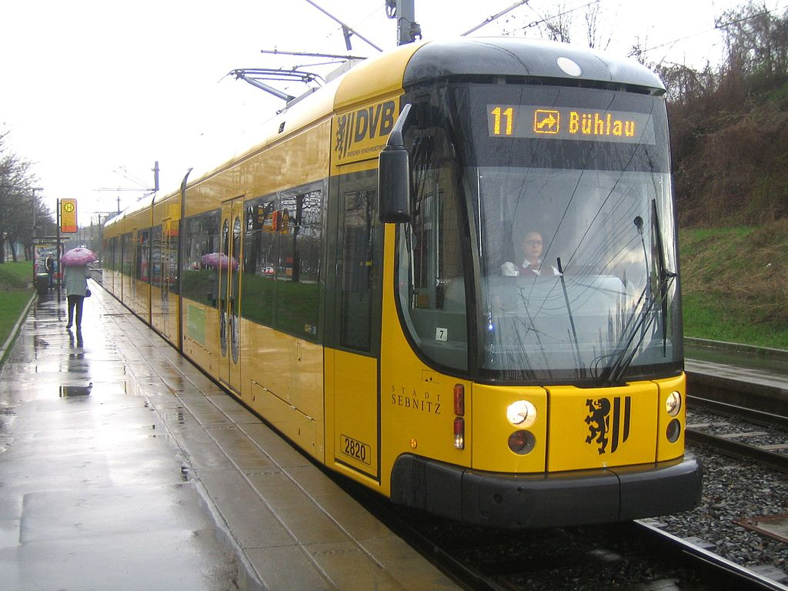

Slide 42
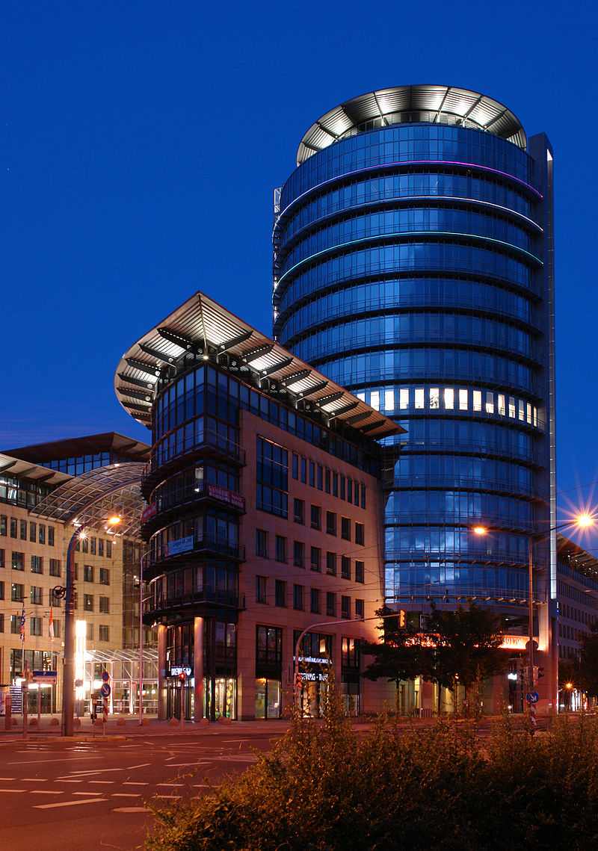
World Trade Center

