Slide 1
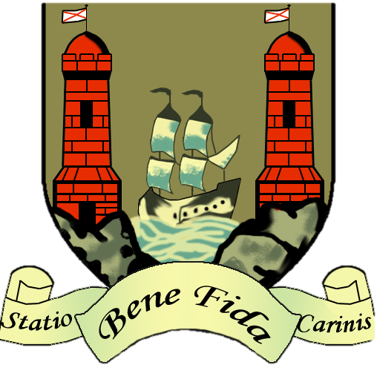
Cork, Ireland
Presented by Name

Slide 2
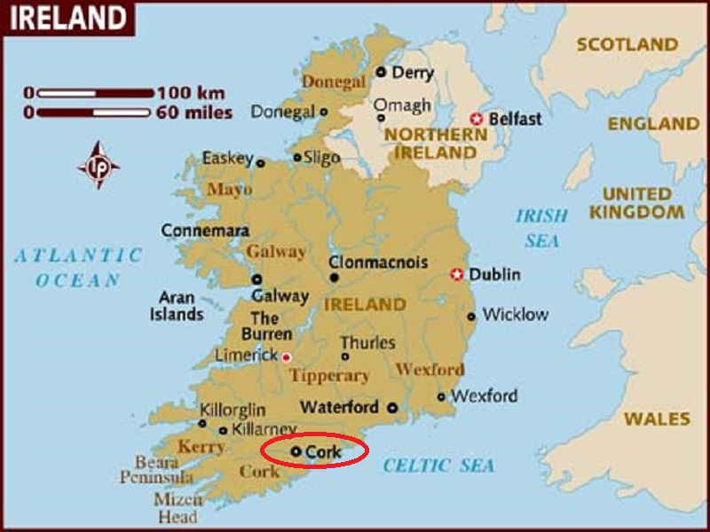
Cork is a city in Ireland, located in the South-West Region, in the province of Munster and is the second largest city in the state and the third most populous on the island of Ireland.

Slide 3
The city is built on the River Lee which splits into two channels at the western end of the city; the city centre is divided by these channels. They reconverge at the eastern end where the quays and docks along the river banks lead outwards towards Lough Mahon and Cork Harbour, one of the world's largest natural harbours.
The city's cognomen of "the rebel city" originates in its support for the Yorkist cause during the English 15th century Wars of the Roses. Corkonians often refer to the city as "the real capital" in reference to the city's role as the centre of anti-treaty forces during the Irish Civil War.

Slide 4
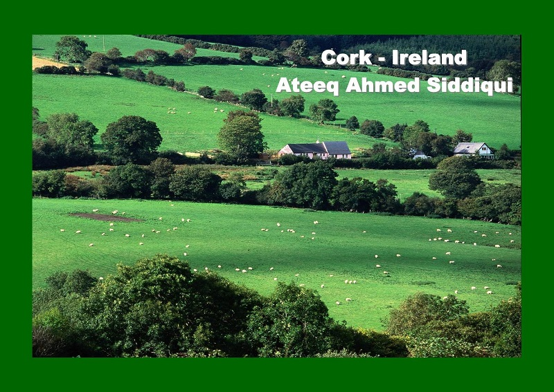

Slide 5
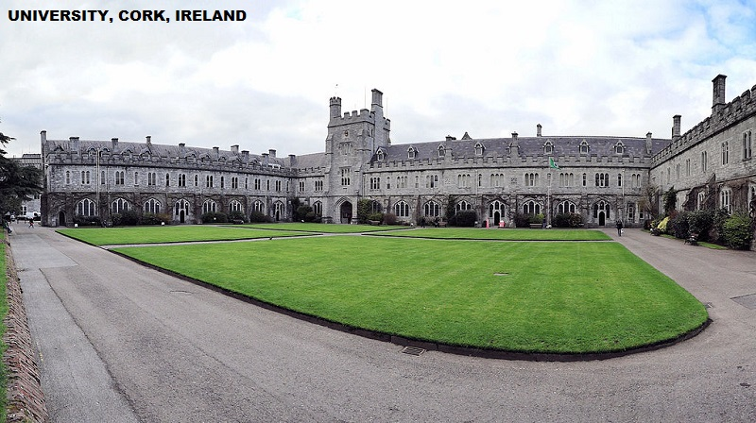

Slide 6
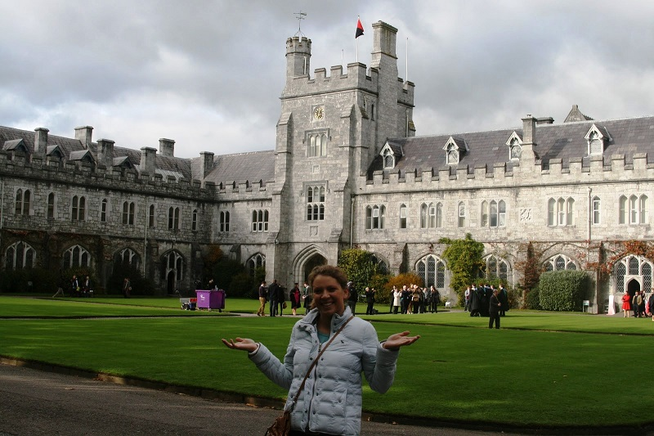

Slide 7
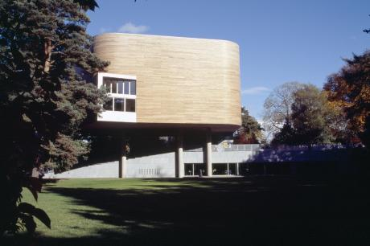
The Lewis Glucksman Gallery at UCC.

Slide 8
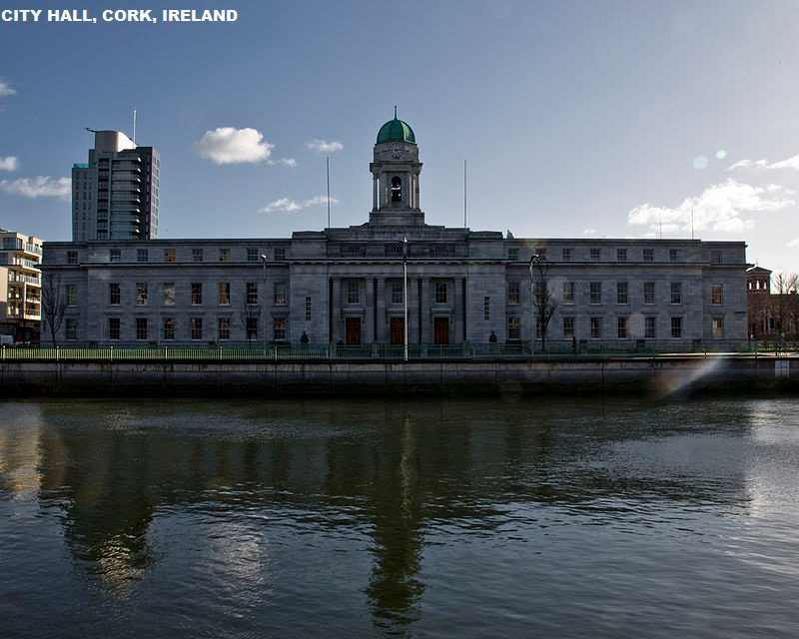

Slide 9
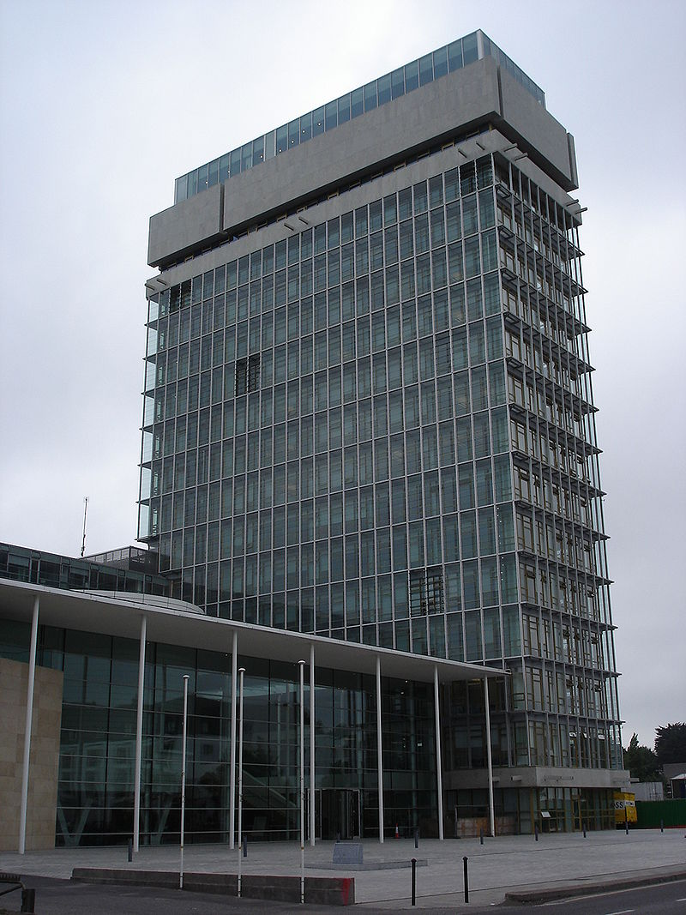
Cork County Hall was Ireland's tallest building for a time and is located on the western side of the city

Slide 10
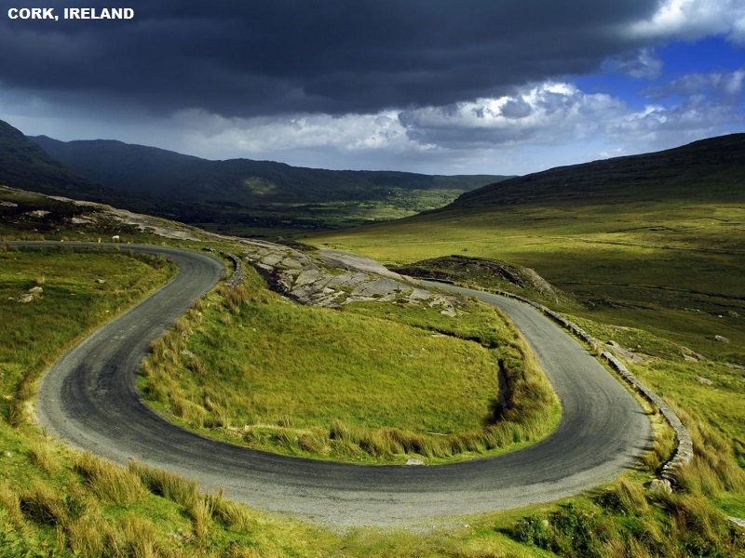

Slide 11
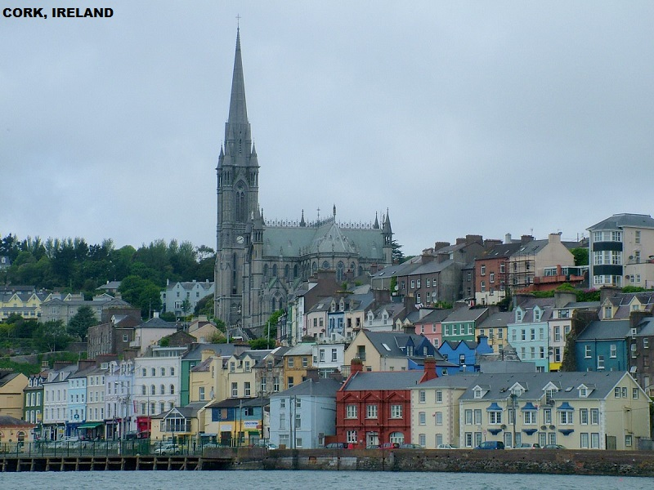

Slide 12
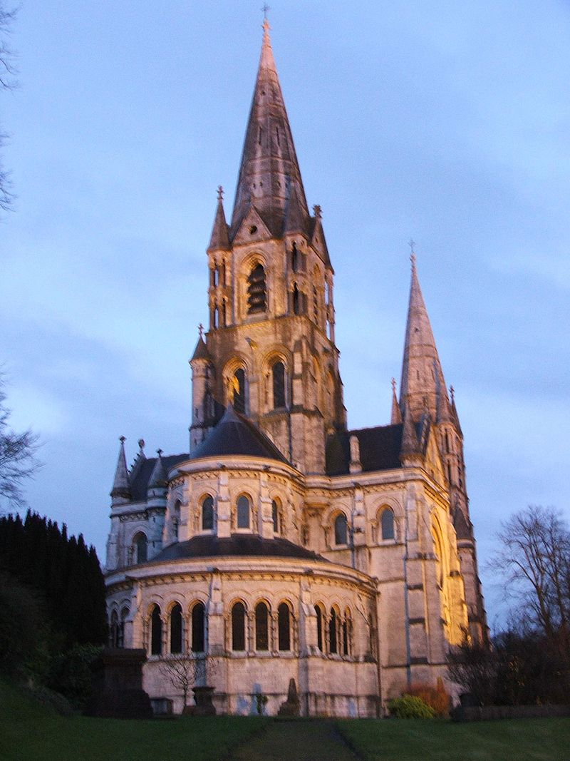
St Finbarre's Cathedral

Slide 13
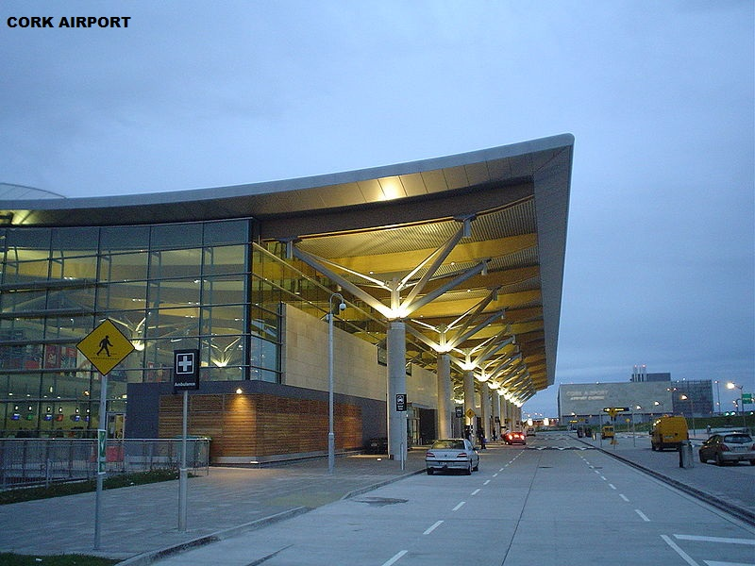

Slide 14
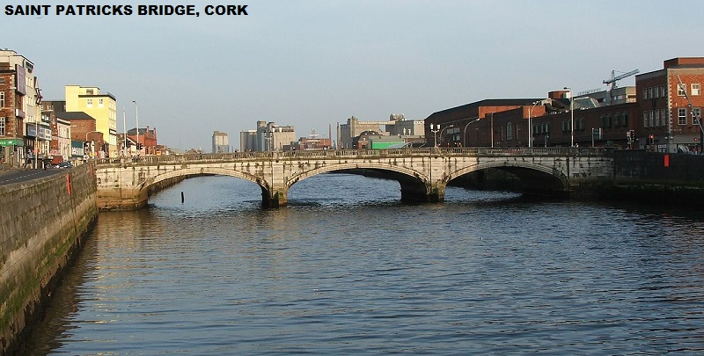

Slide 15
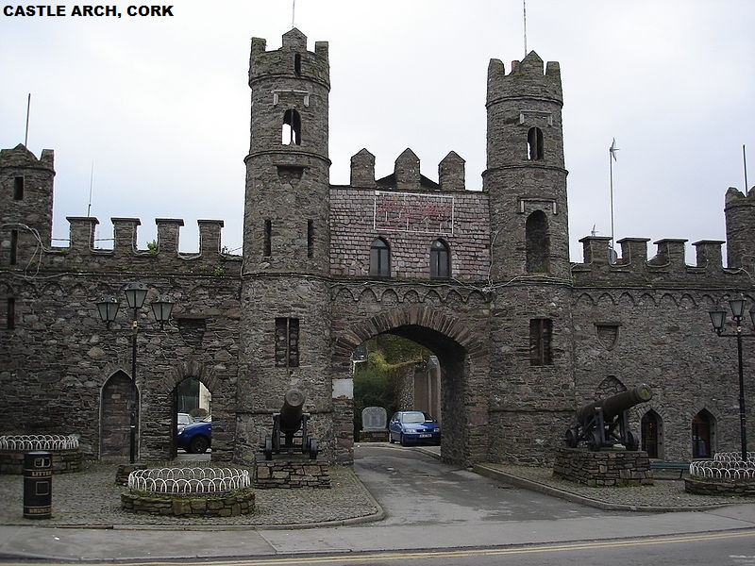

Slide 16
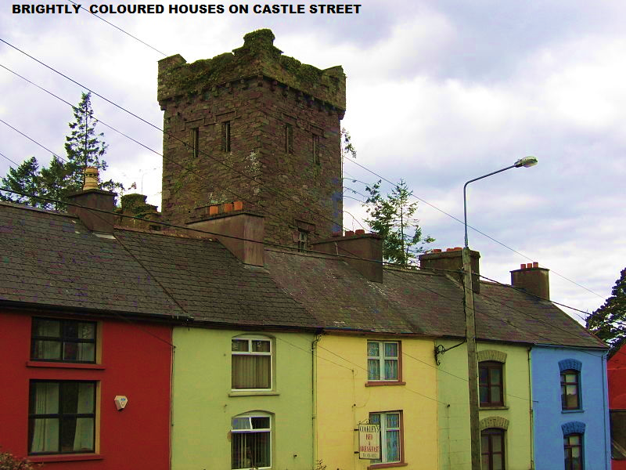

Slide 17
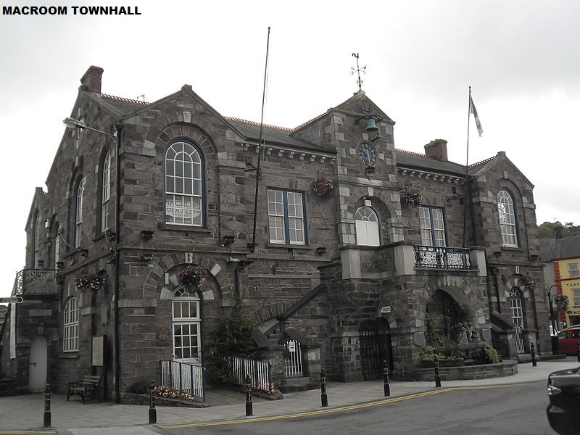

Slide 18
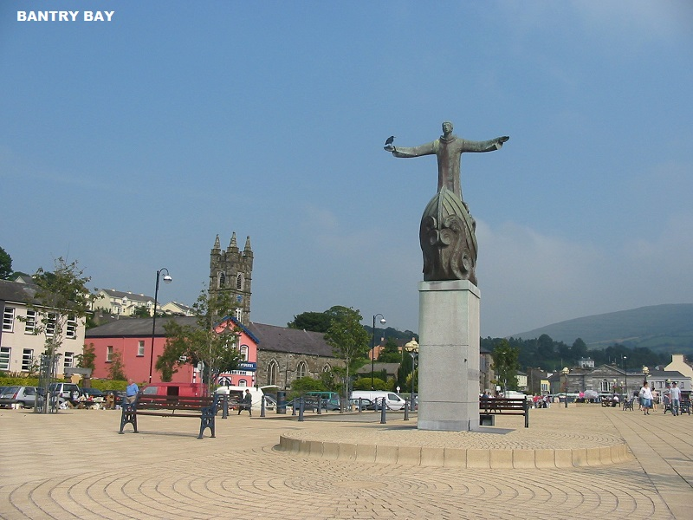

Slide 19
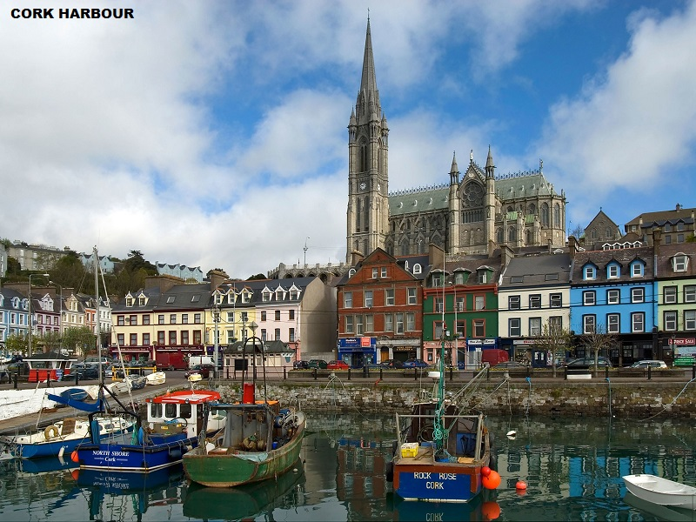

Slide 20
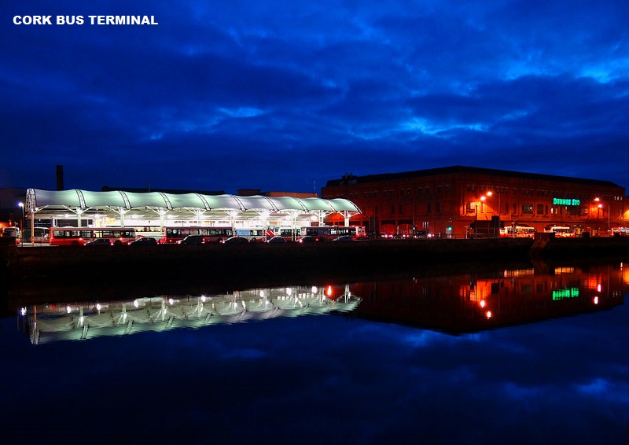

Slide 21
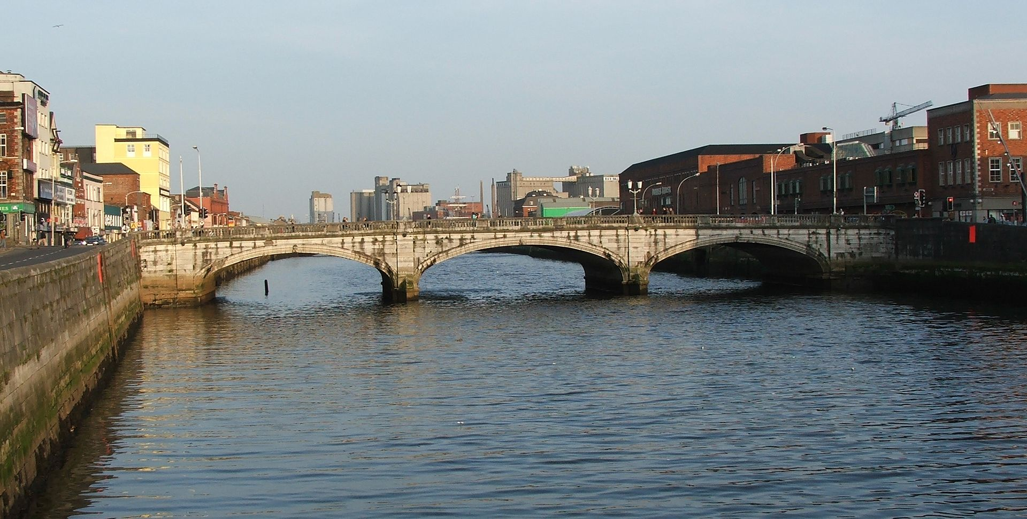
St. Patrick's Bridge

Slide 22
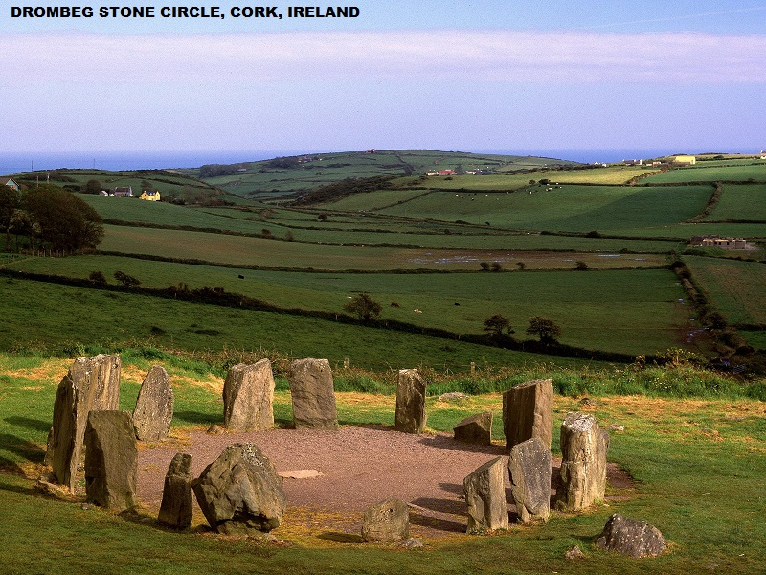

Slide 23
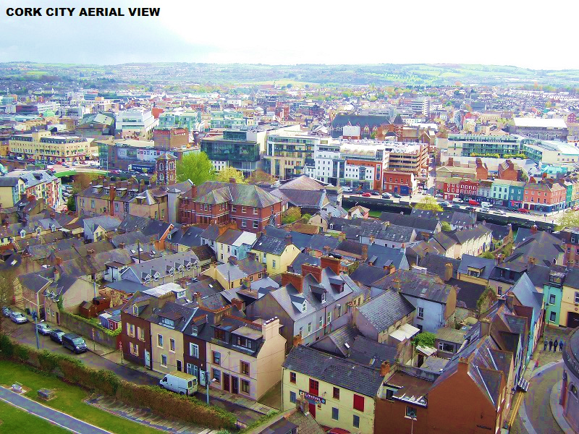

Slide 24
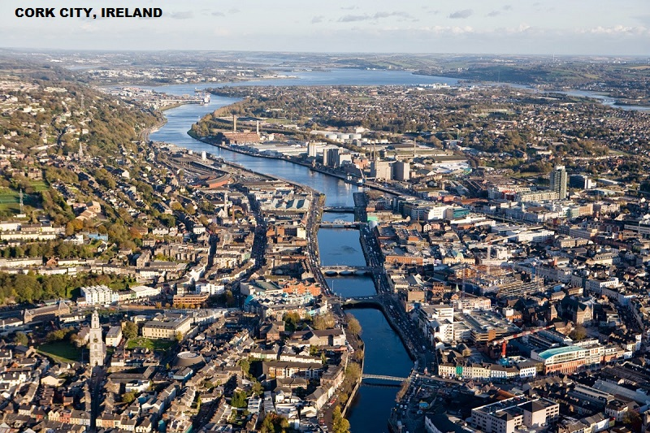

Slide 25
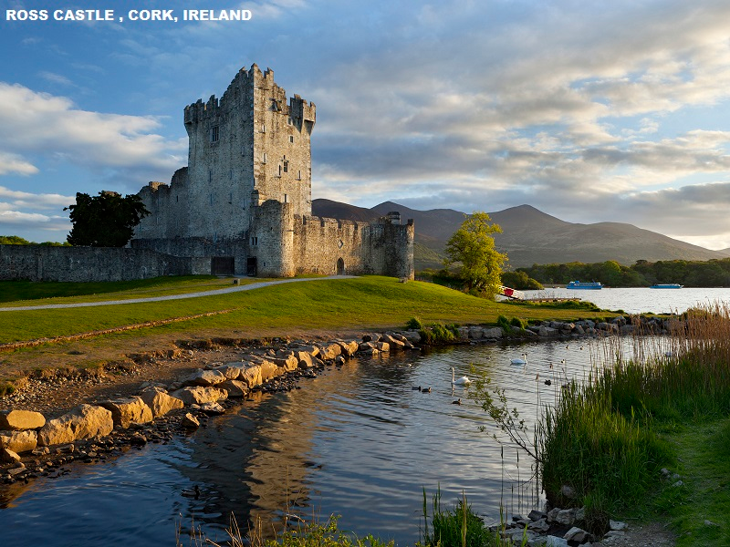

Slide 26
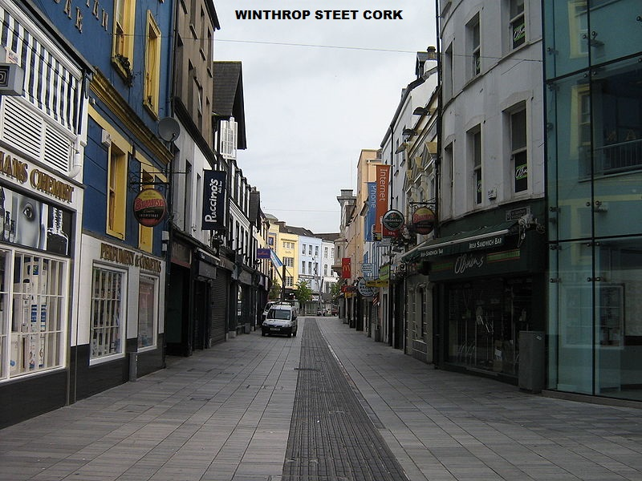

Slide 27
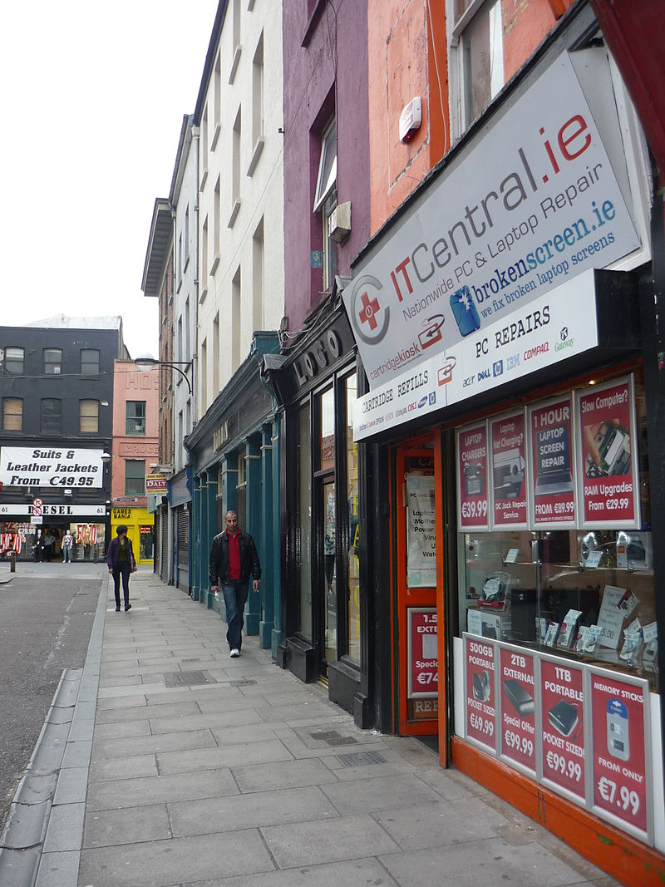
Castle Street

Slide 28
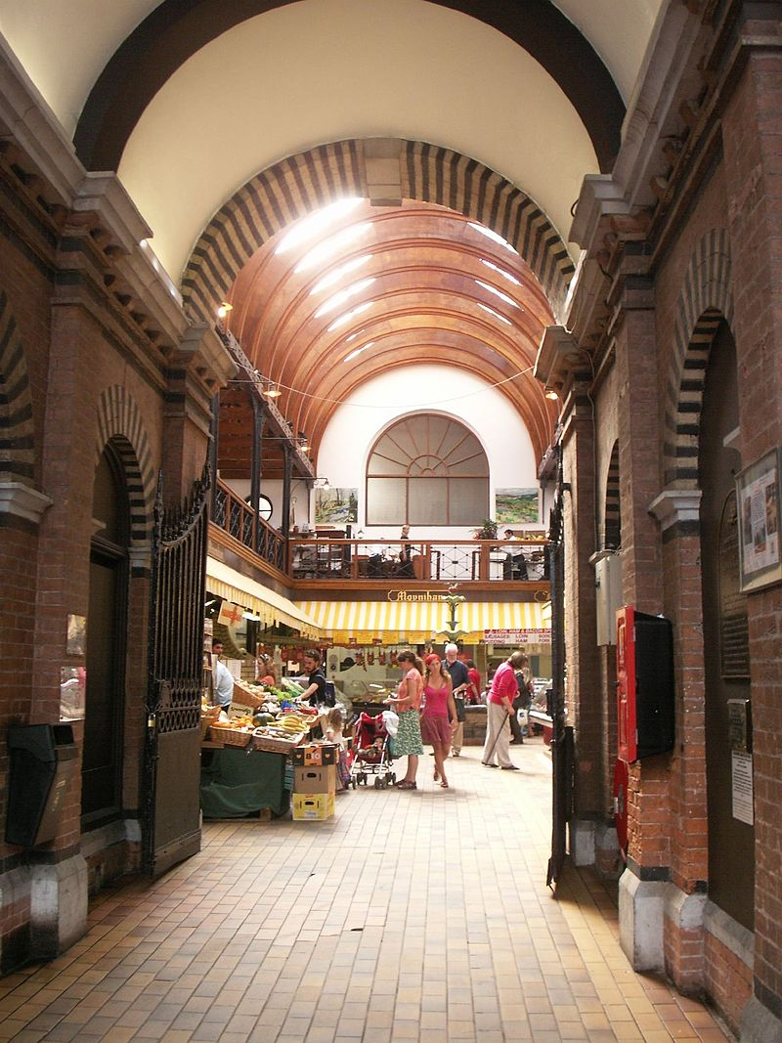
The English Market in Cork.

Slide 29
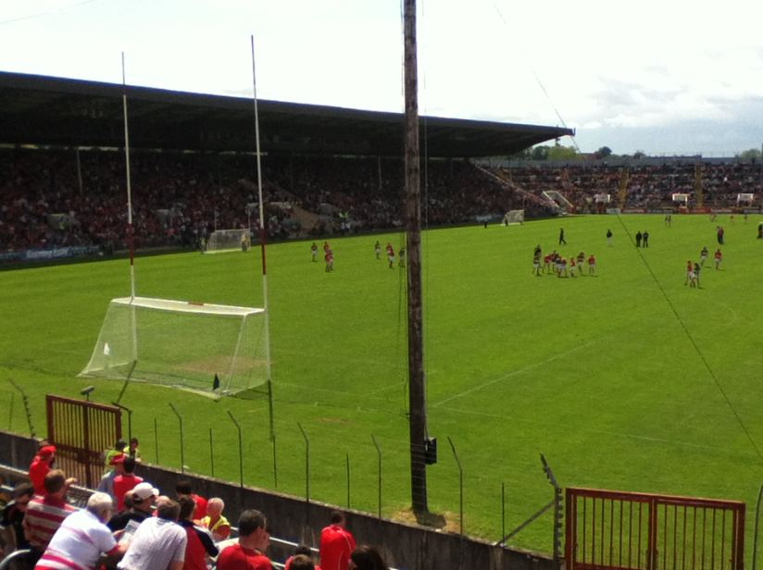
Spectators watch Cork take on Kerry at Páirc Uí Chaoimh in the city

Slide 30
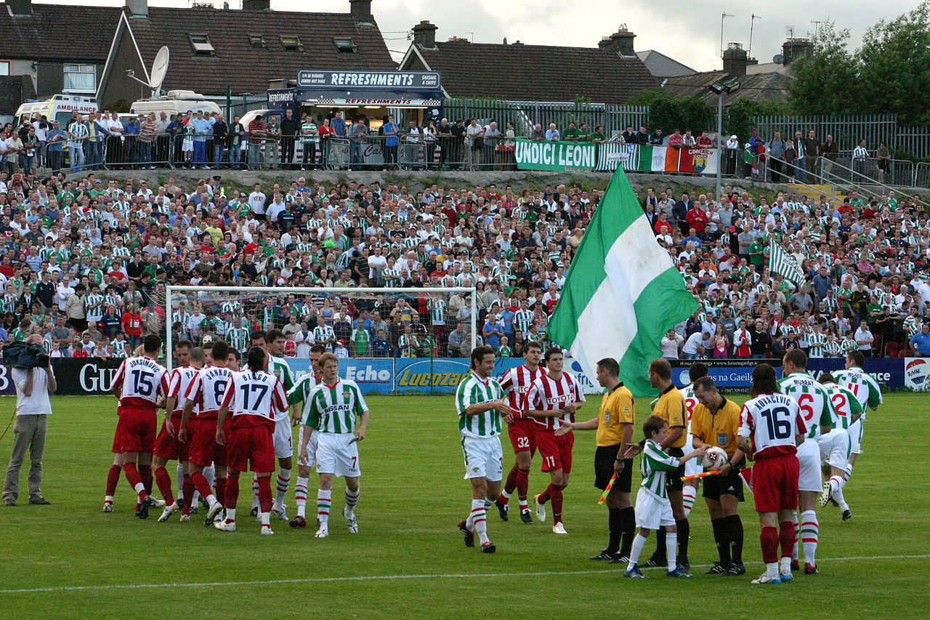
Cork City FC line out against Red Star Belgrade in a 2006 Champions League qualifier

