Slide 1

Bremen, Germany

Slide 2
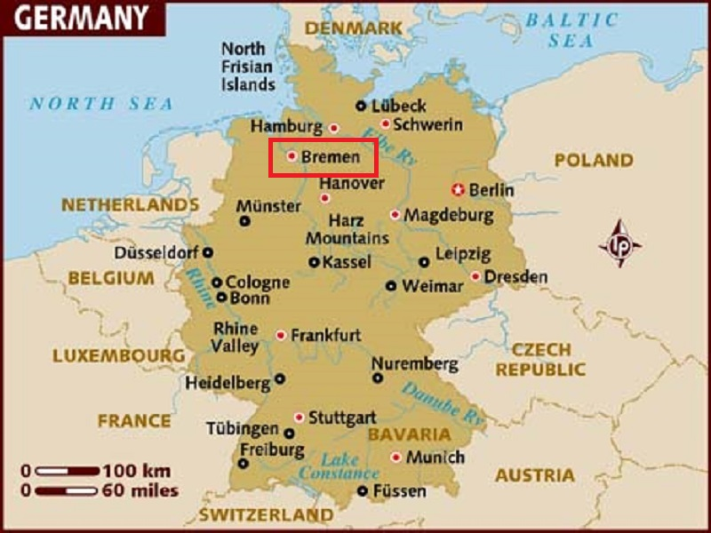
The City Municipality of Bremen is a Hanseatic city in northwestern Germany.

Slide 3
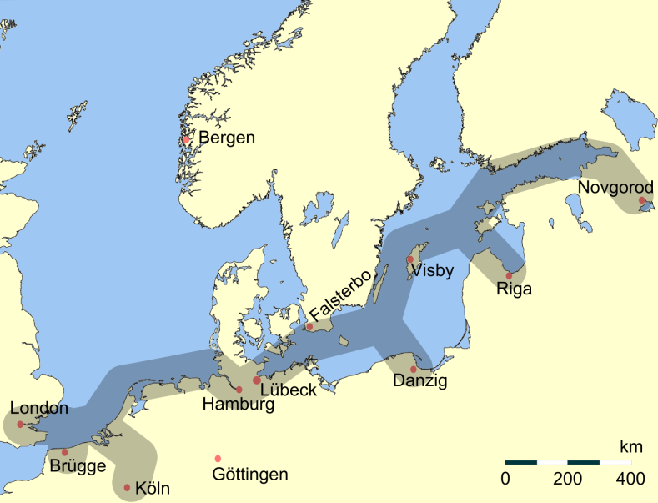
Principle trading routes of the Hanseatic League

Slide 4
As a commercial and industrial city with a major port on the River Weser, Bremen is part of the Bremen/Oldenburg Metropolitan Region, with 2.4 million people. Bremen is the second most populous city in Northern Germany and eleventh in Germany.
Bremen is a major cultural and economic hub in the northern regions of Germany. Bremen is home to dozens of historical galleries and museums, ranging from historical sculptures to major art museums, such as the Übersee-Museum Bremen. Bremen has a reputation as a working class city. Along with this, Bremen is home to a large number of multinational companies and manufacturing centers. Companies headquartered in Bremen include the Hachez chocolate company and Vector Foiltec. Four-time German football champions Werder Bremen are also based in the city.

Slide 5
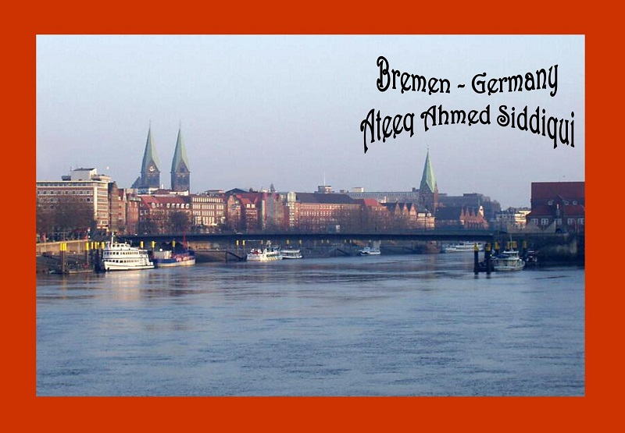

Slide 6
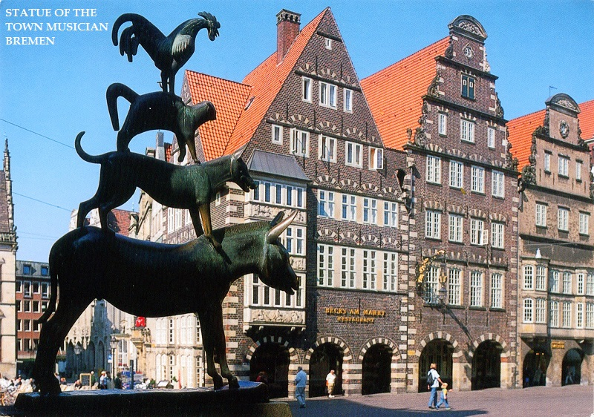

Slide 7
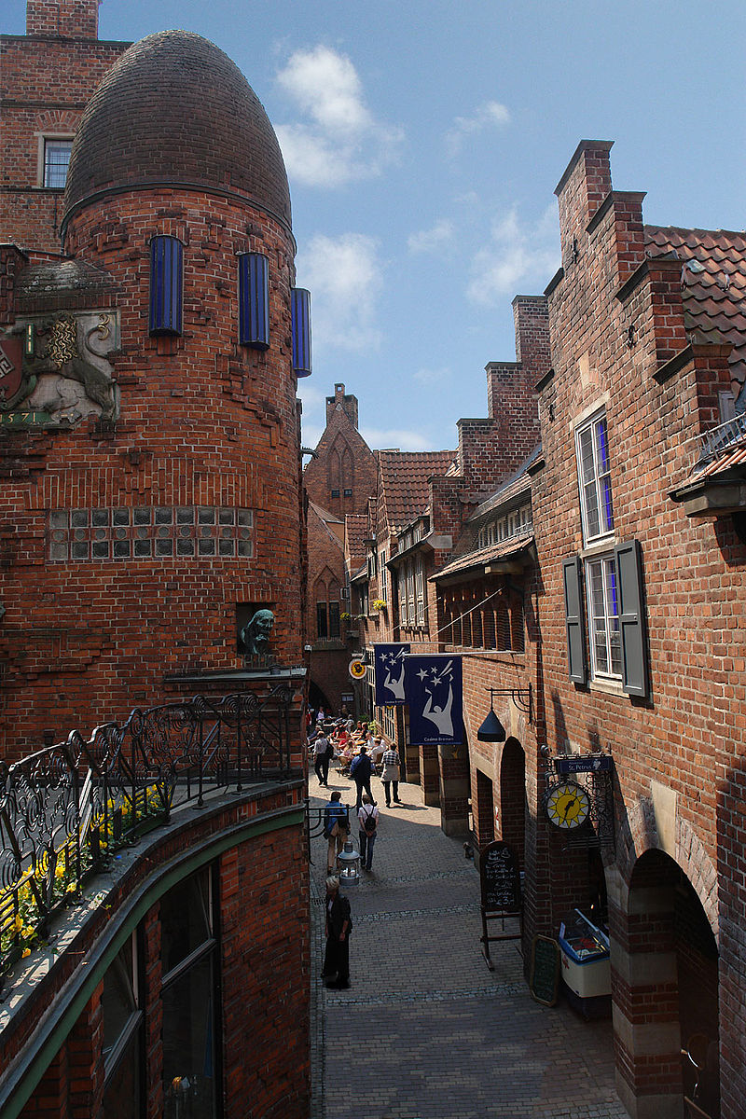
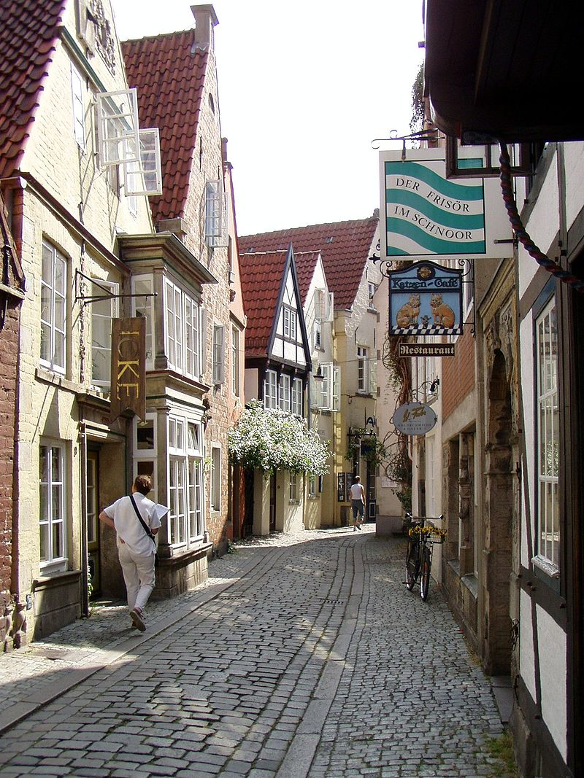
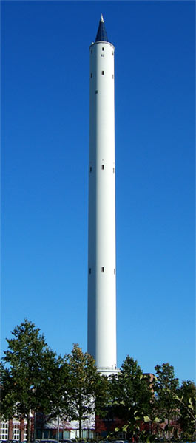

Slide 8
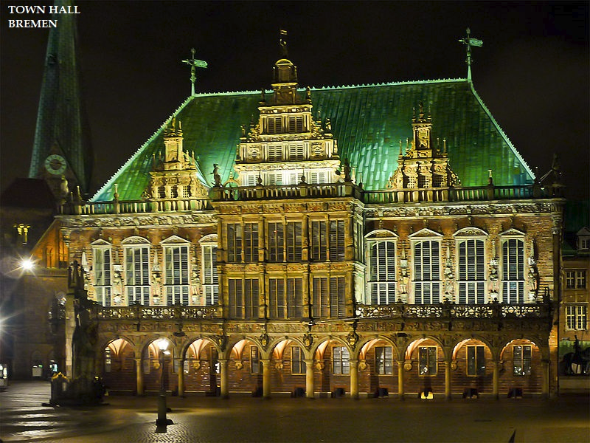

Slide 9
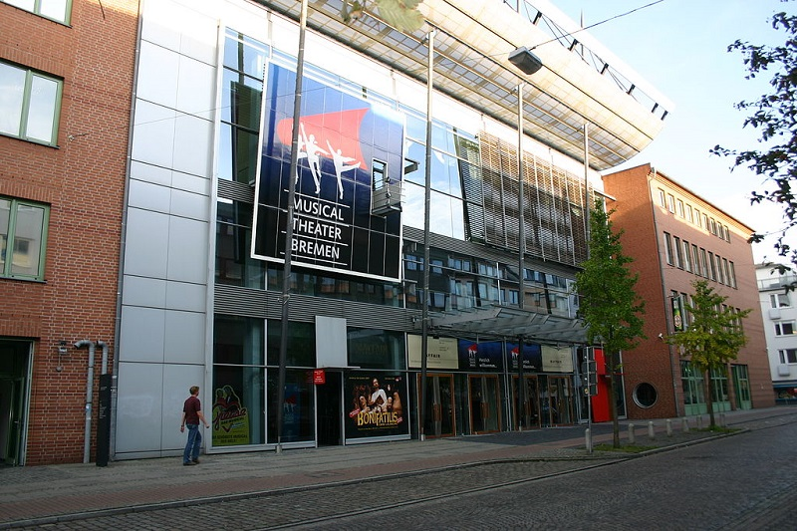

Slide 10
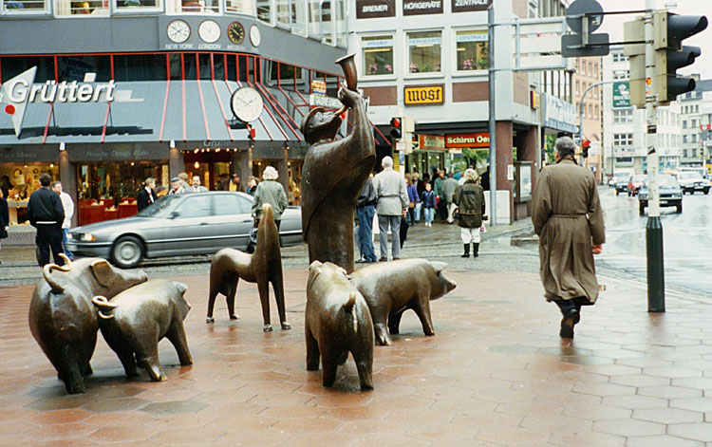

Slide 11
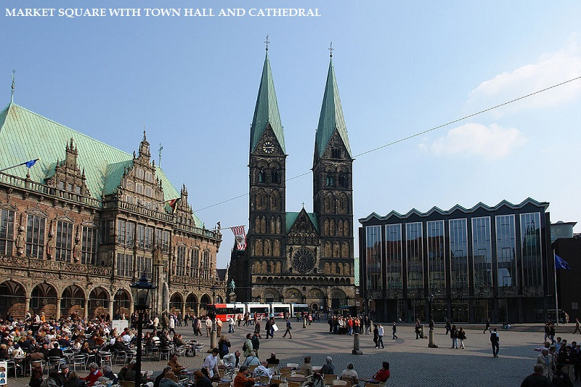

Slide 12
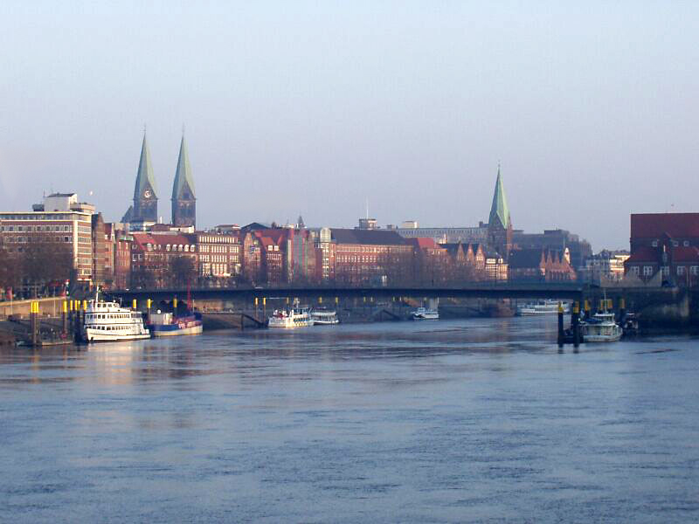

Slide 13
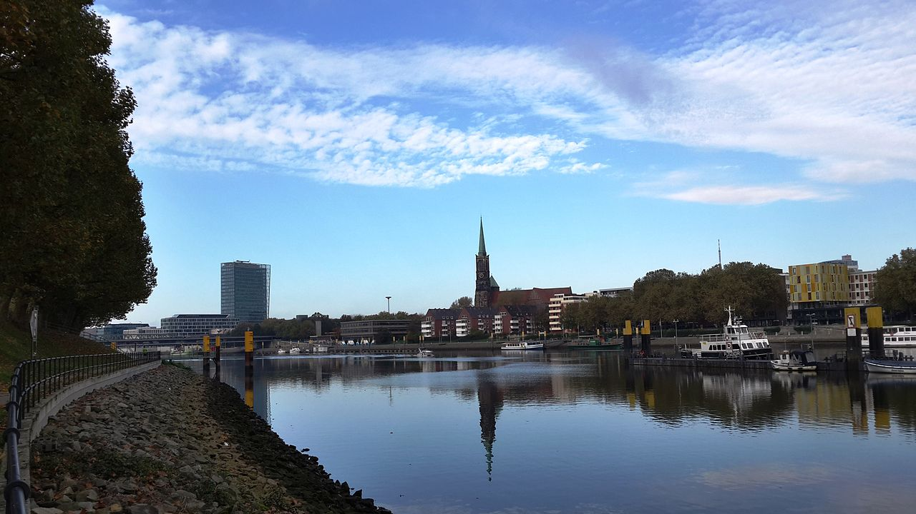

Slide 14
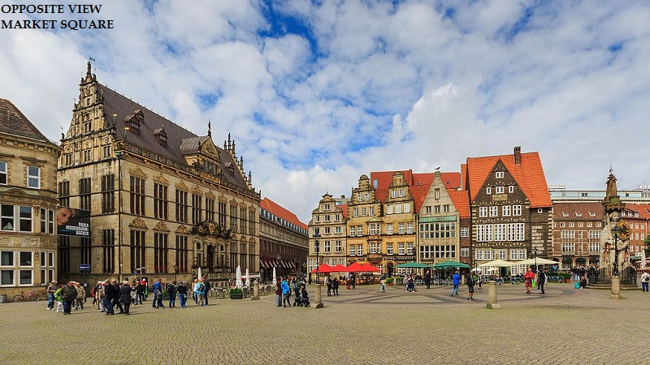

Slide 15
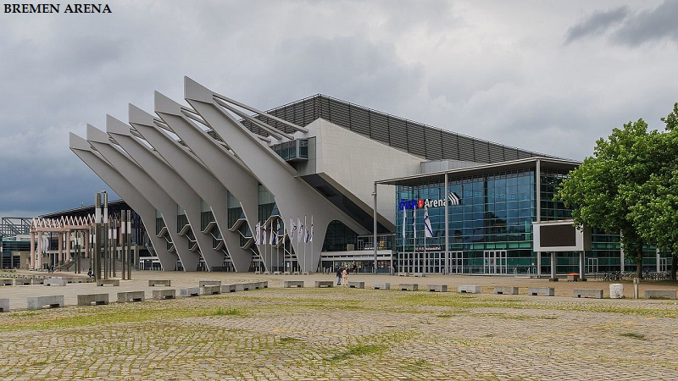

Slide 16
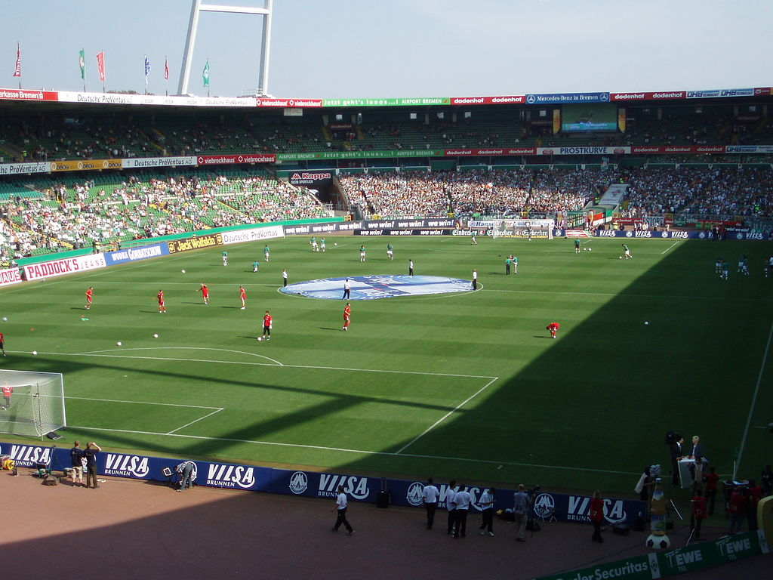

Slide 17
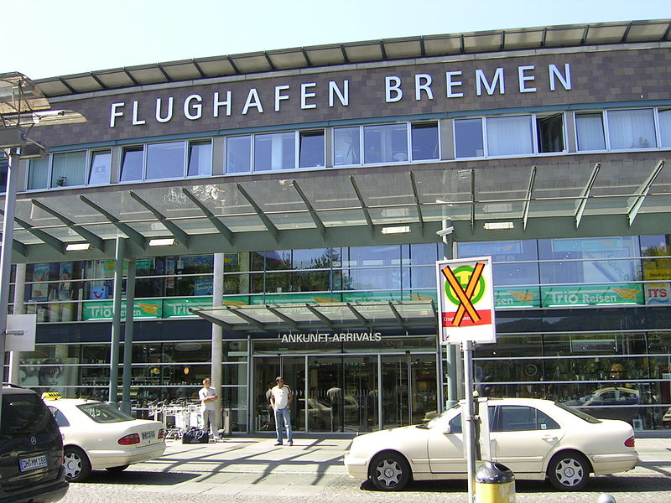

Slide 18
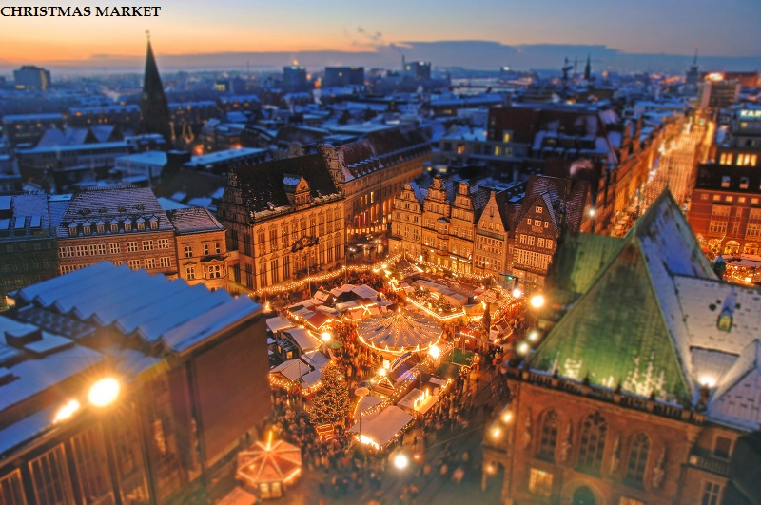

Slide 19
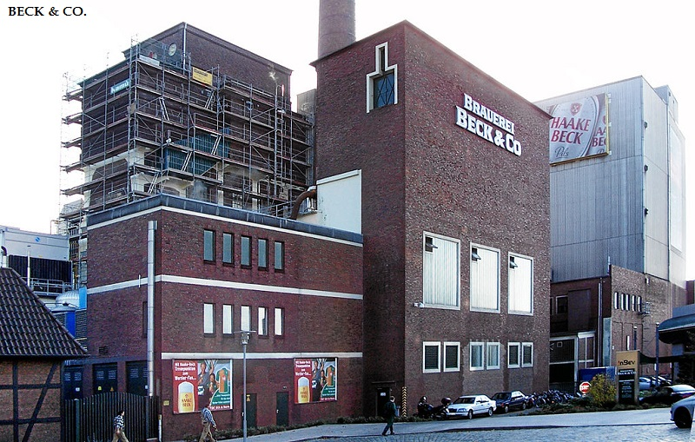

Slide 20
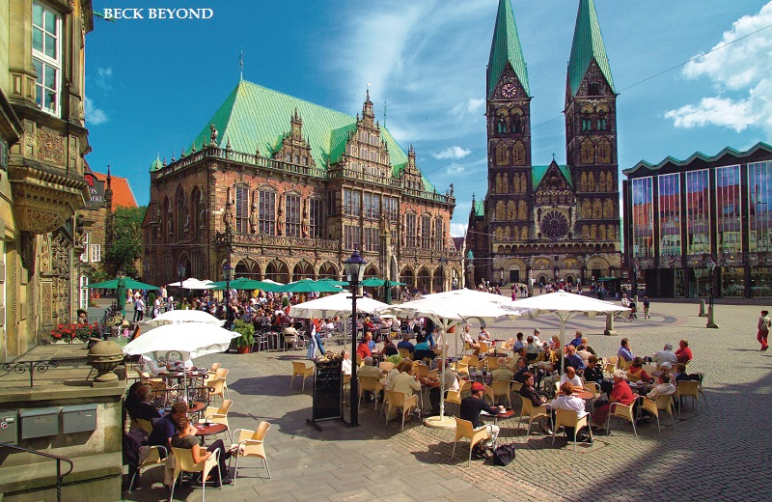

Slide 21
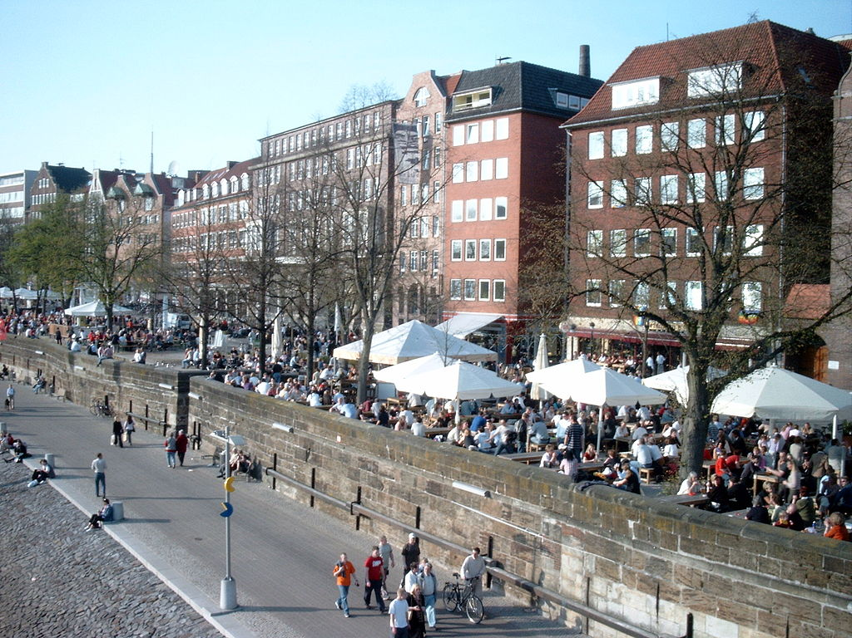

Slide 22
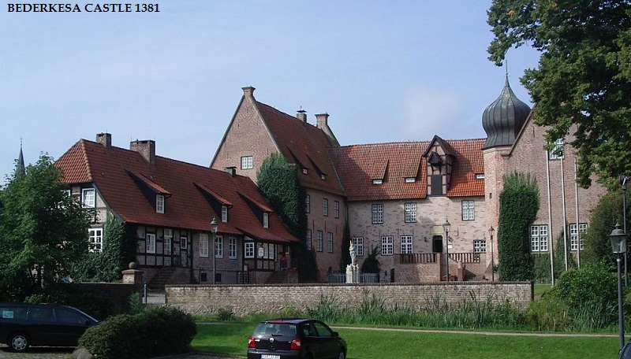

Slide 23
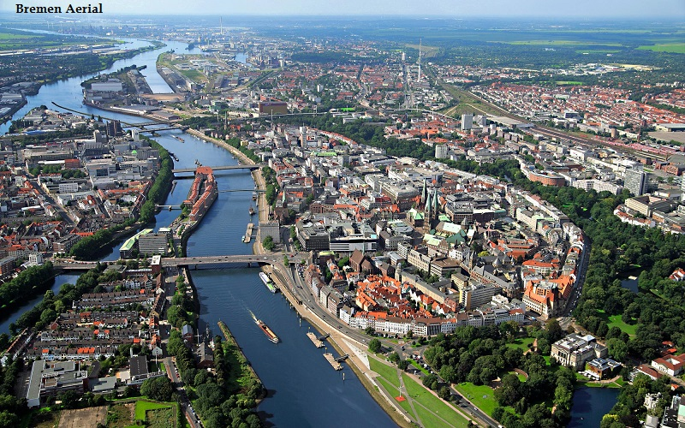

Slide 24
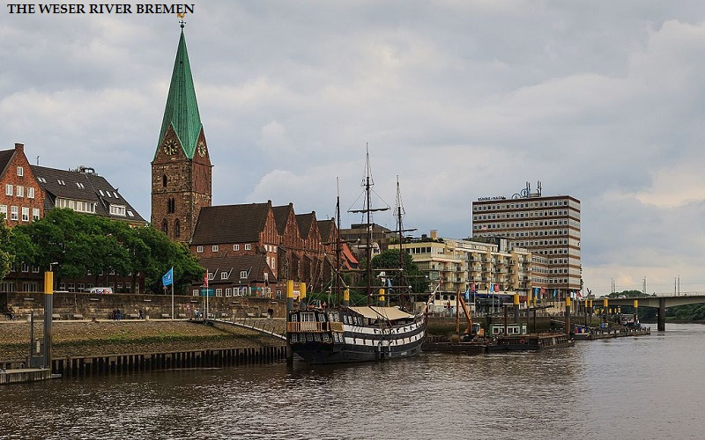

Slide 25
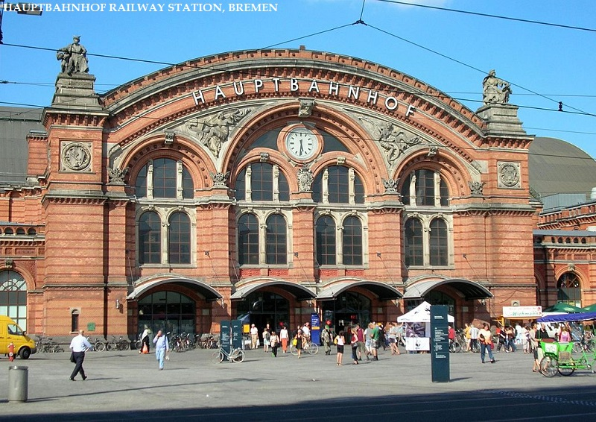

Slide 26
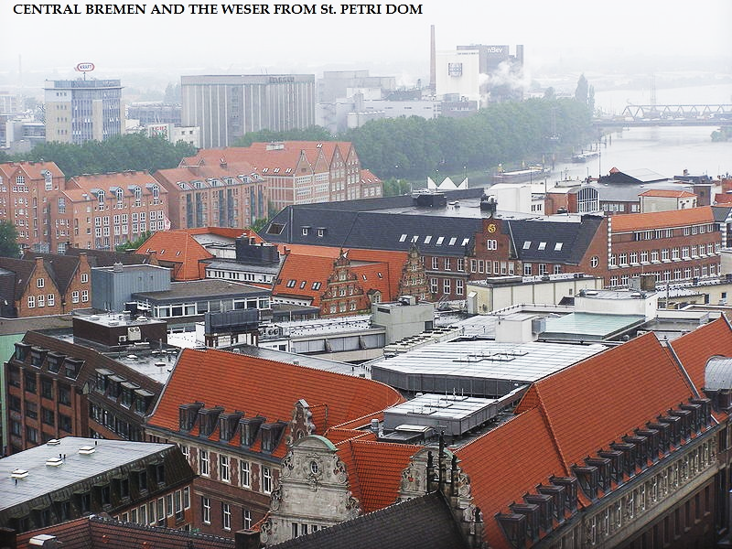

Slide 27
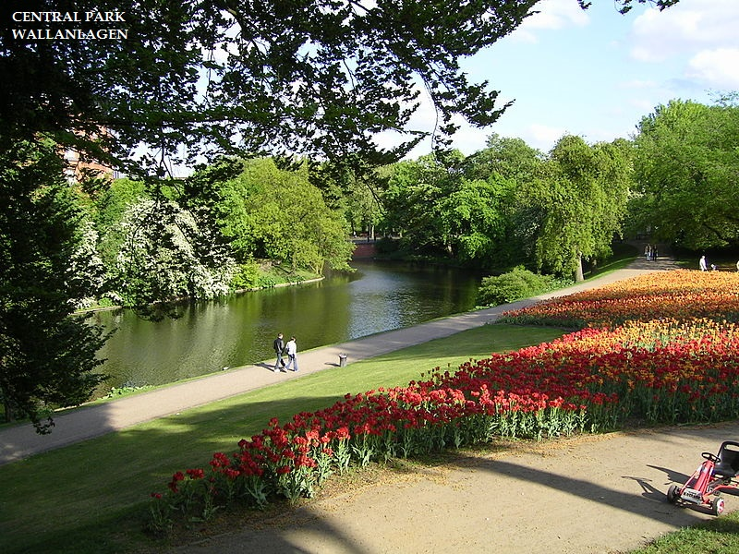

Slide 28
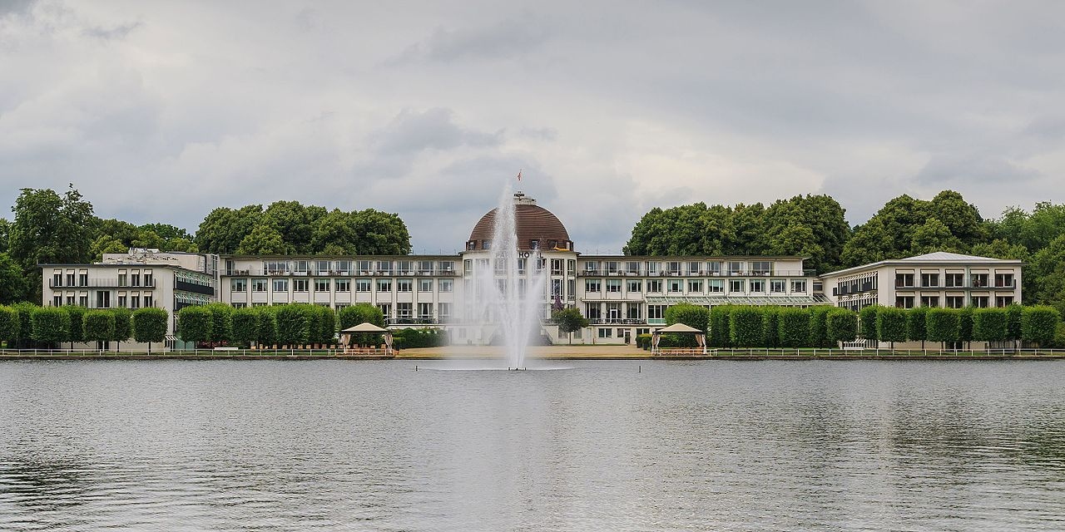

Slide 29
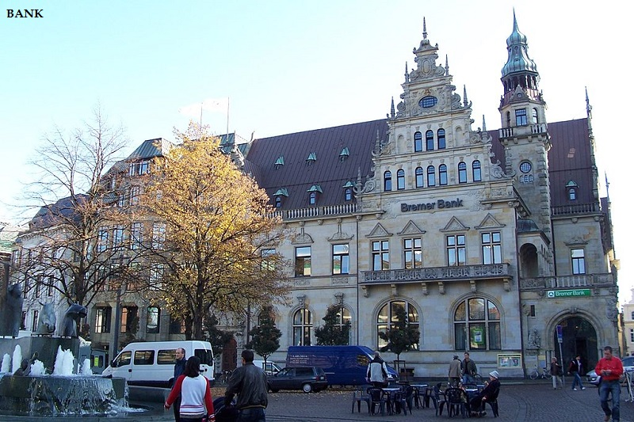

Slide 30


Slide 31
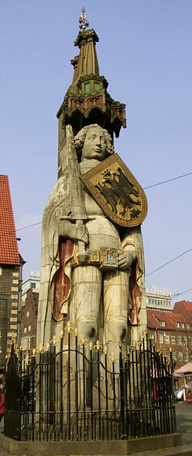
Statue of Roland

