Slide 1
Bordeaux, France

Slide 2
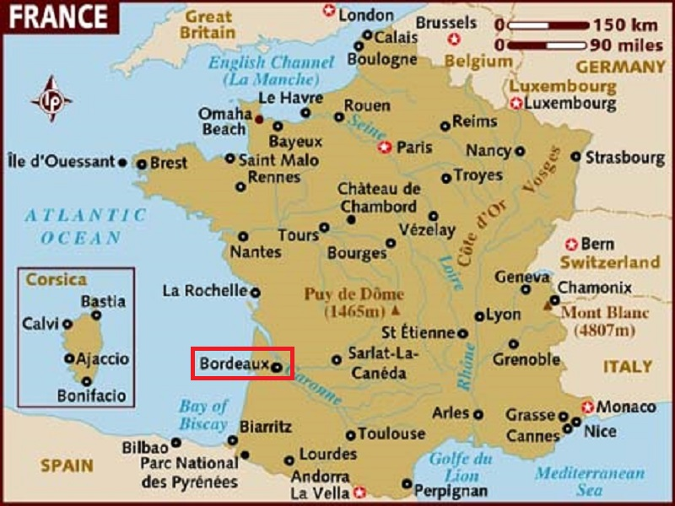
Bordeaux is a port city on the Garonne River in the Gironde department in the southwestern France.

Slide 3
The municipality (commune) of Bordeaux proper has a population of 243,626 (2012). Together with its suburbs and satellite towns, Bordeaux is the centre of the Bordeaux Métropole. With 749,595 inhabitants (as of 2013) and 1,178,335 in the Metropolitan Area, it is the fifth largest in France, after Paris, Lyon, Marseille and Lille, and before Toulouse. It is the capital of the Nouvelle-Aquitaine region, as well as the prefecture of the Gironde department. Its inhabitants are called "Bordelais" (for men) or "Bordelaises" (women). The term "Bordelais" may also refer to the city and its surrounding region.
Bordeaux is the world's major wine industry capital. It is home to the world's main wine fair, Vinexpo, and the wine economy in the metro area takes in 14.5 billion euros each year. Bordeaux wine has been produced in the region since the 8th century. The historic part of the city is on the UNESCO World Heritage List as "an outstanding urban and architectural ensemble" of the 18th century. After Paris, Bordeaux has the highest number of preserved historical buildings of any city in France.

Slide 4
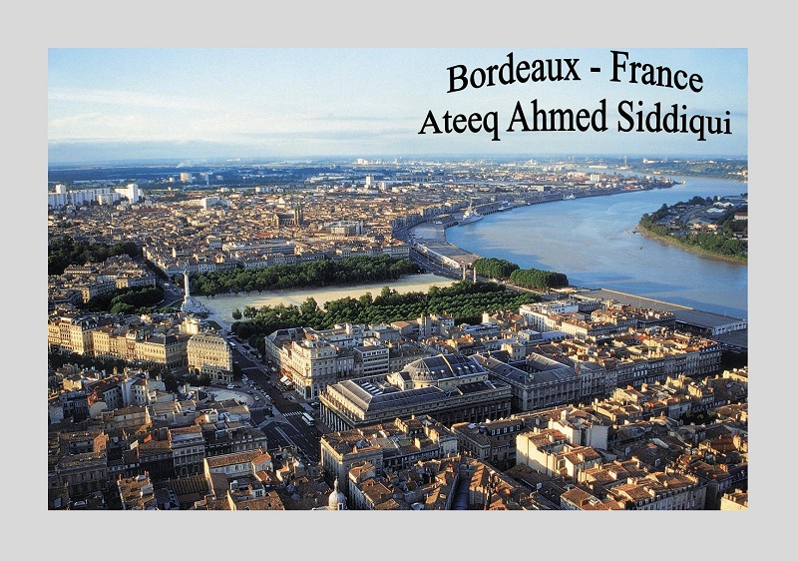

Slide 5
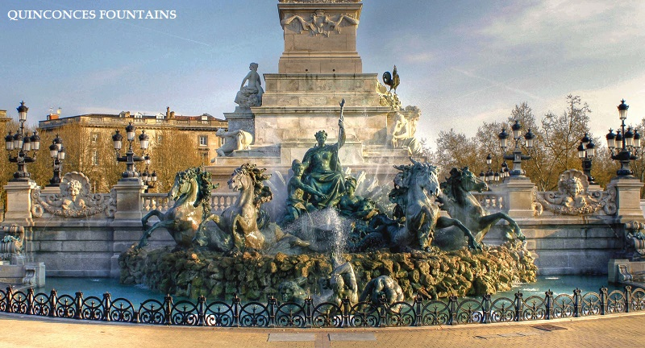

Slide 6
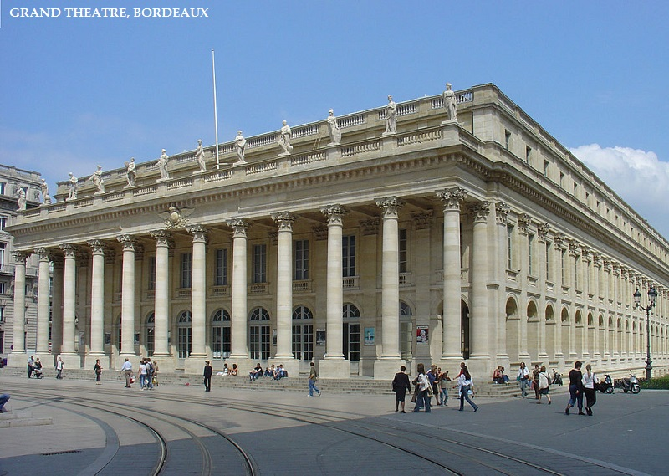

Slide 7
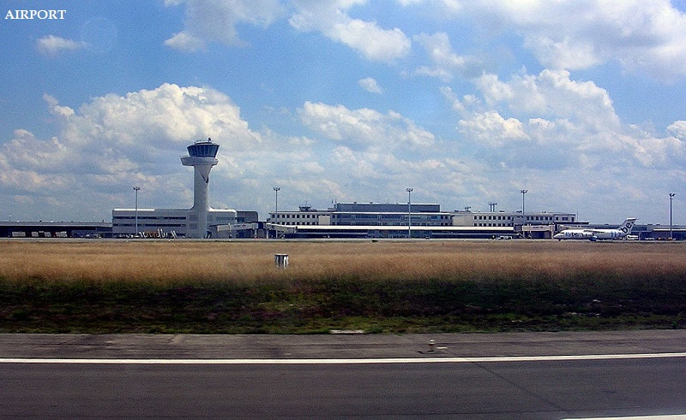

Slide 8
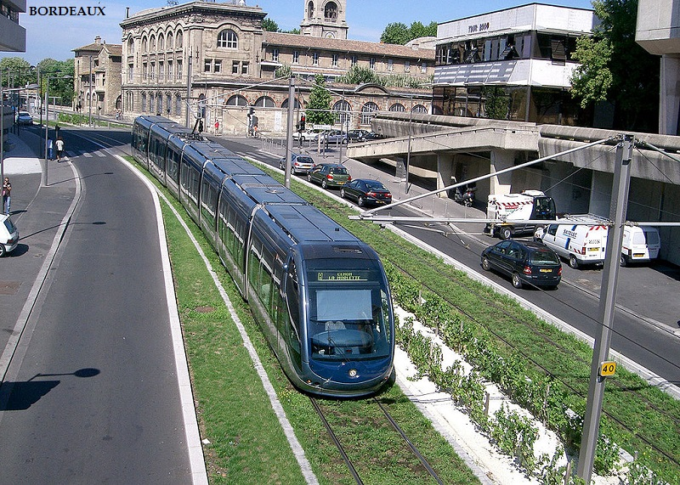

Slide 9
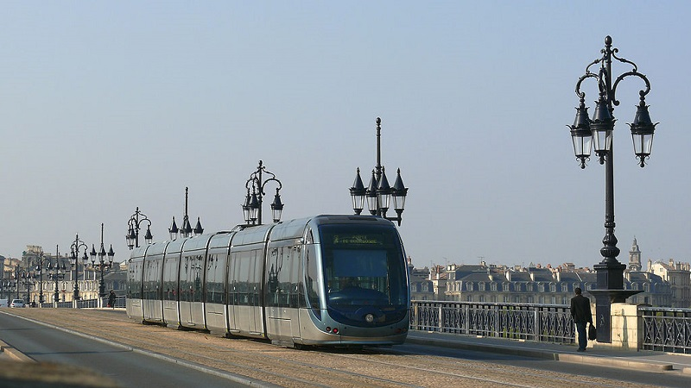

Slide 10
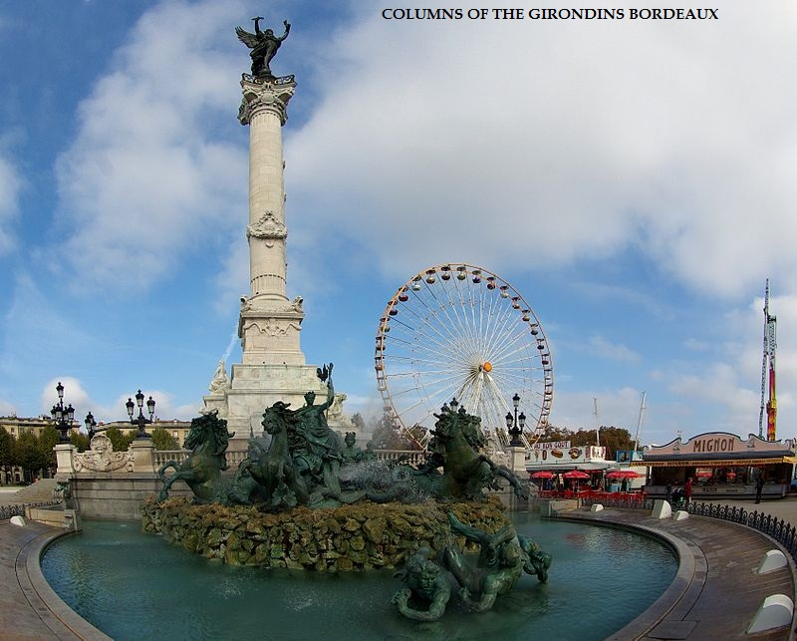

Slide 11
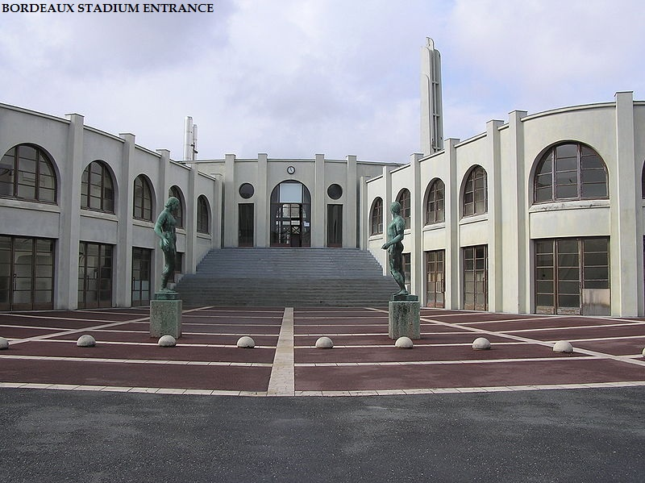

Slide 12
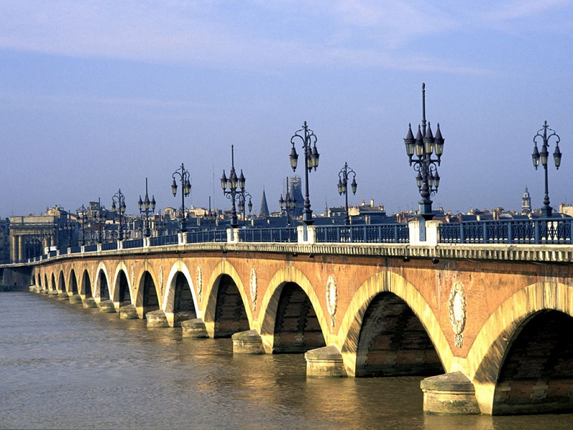

Slide 13
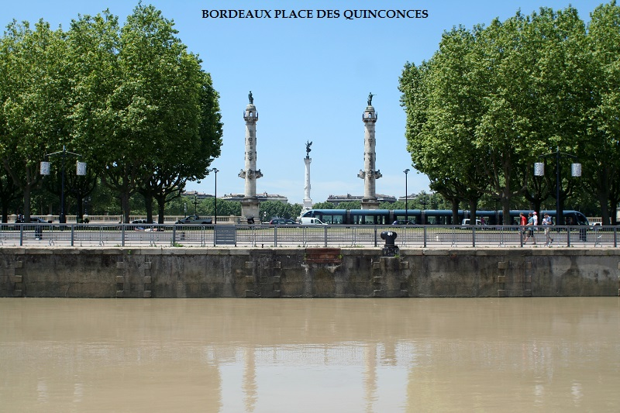

Slide 14
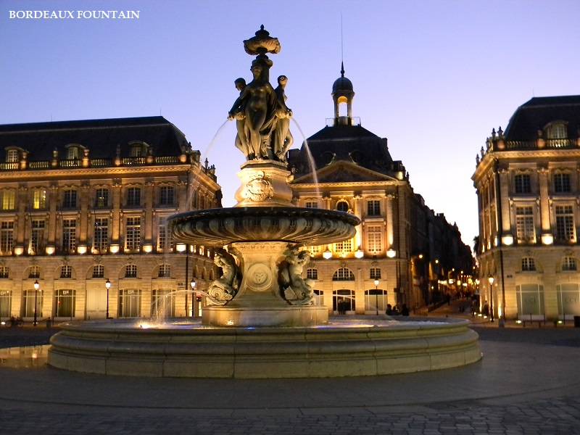

Slide 15
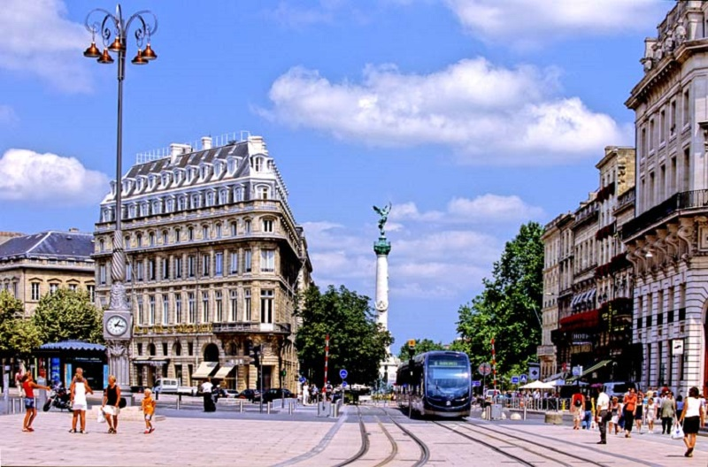

Slide 16
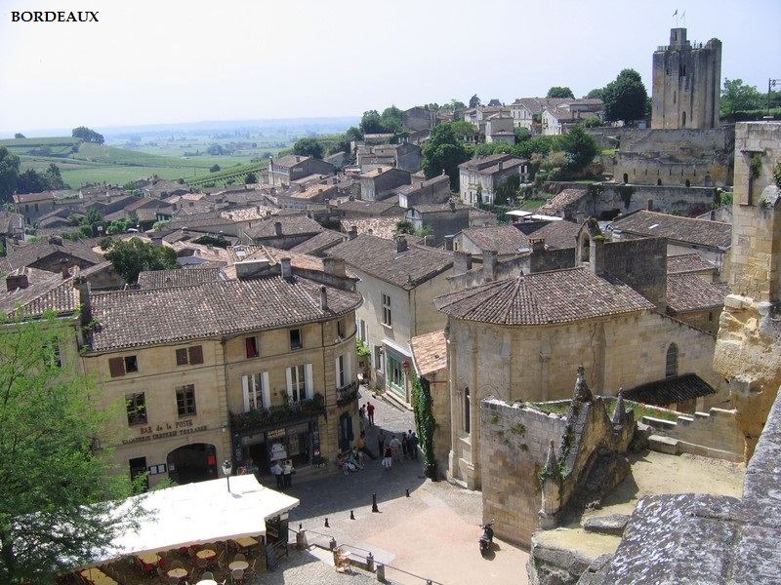

Slide 17
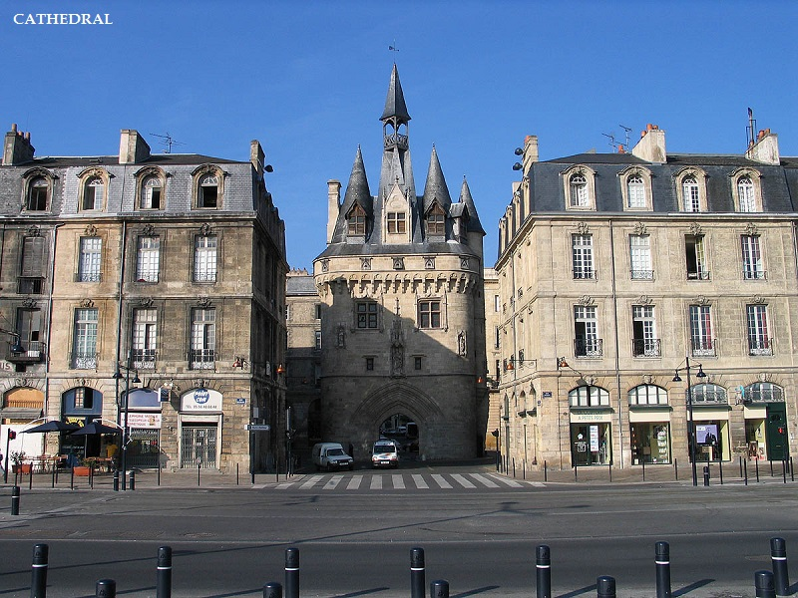
\

Slide 18
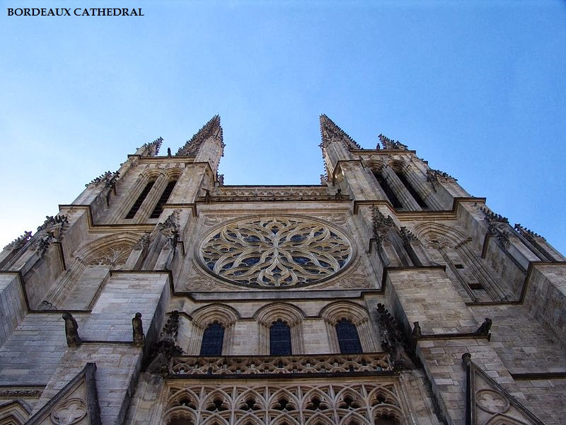

Slide 19
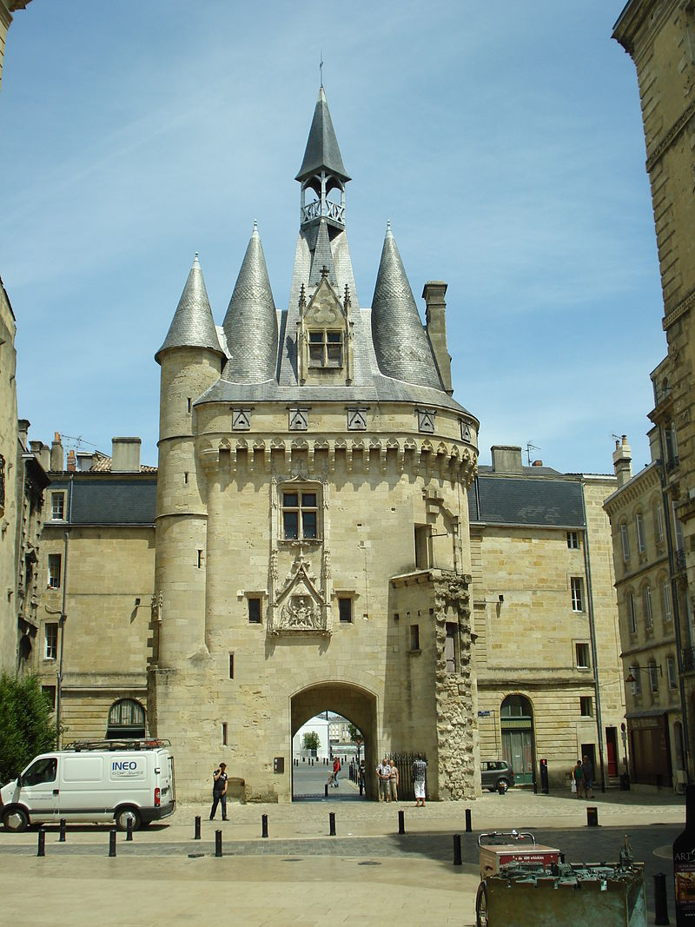
Porte Cailhau

Slide 20
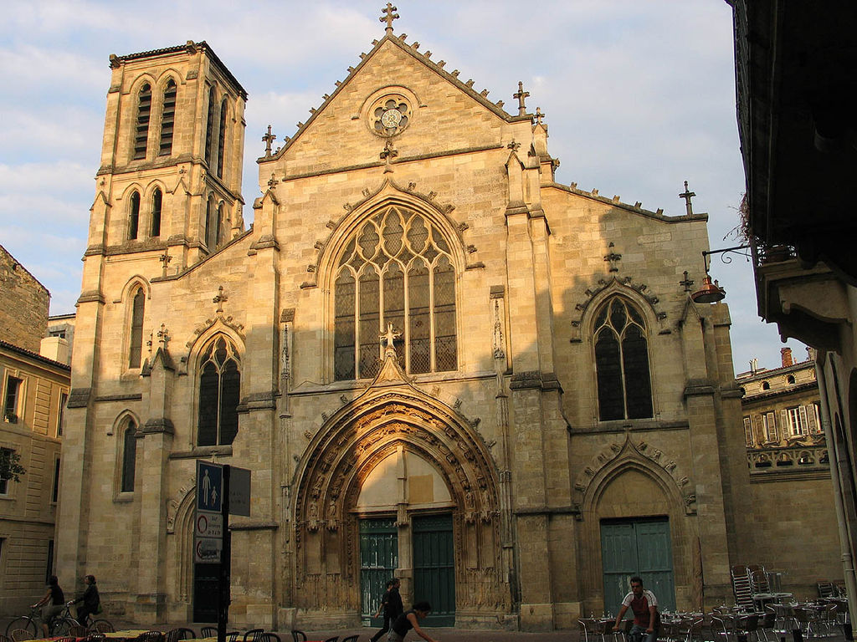
The church of St Pierre

Slide 21
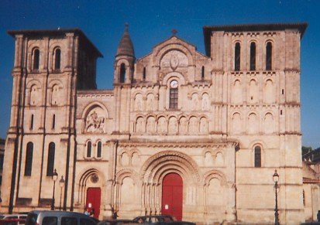
Façade of the Church of the Holy Cross

Slide 22
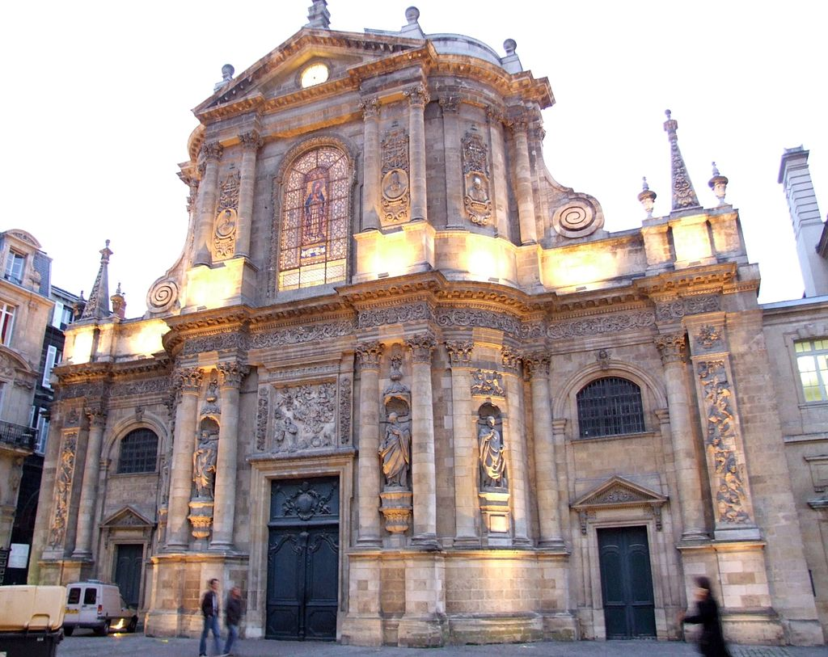
Church of Notre Dame

Slide 23
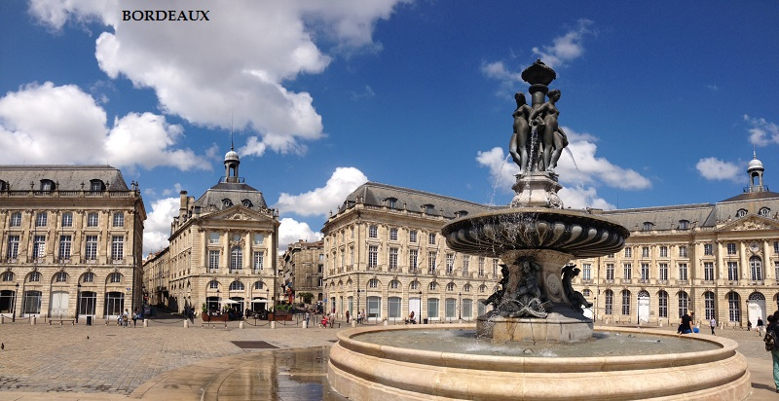

Slide 24
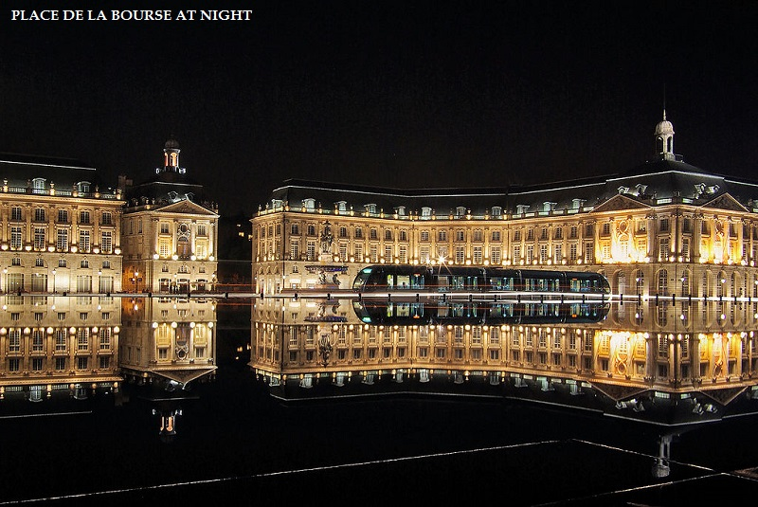

Slide 25
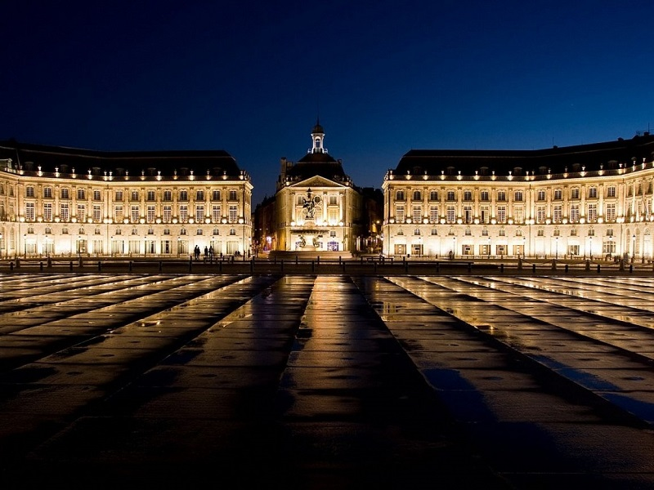

Slide 26
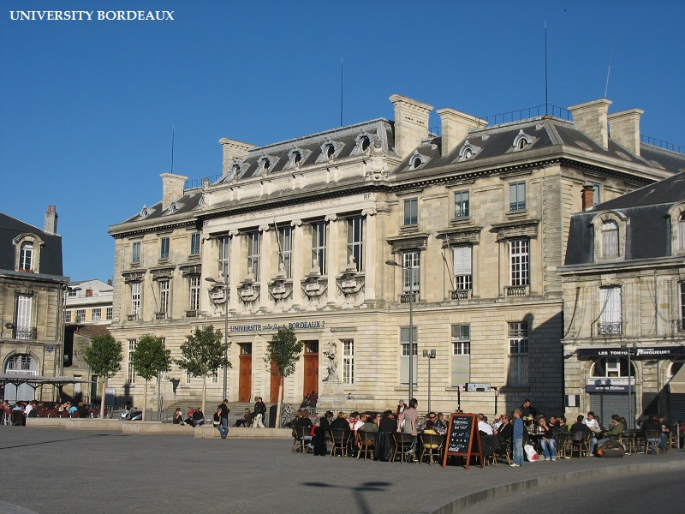

Slide 27
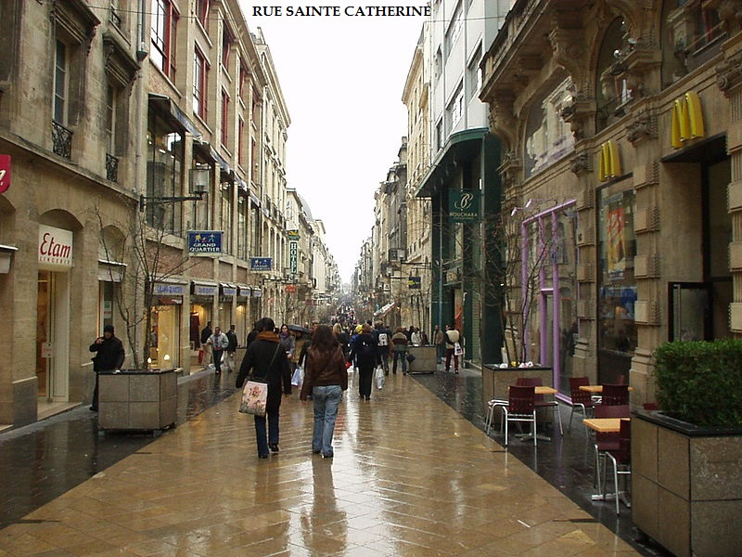

Slide 28
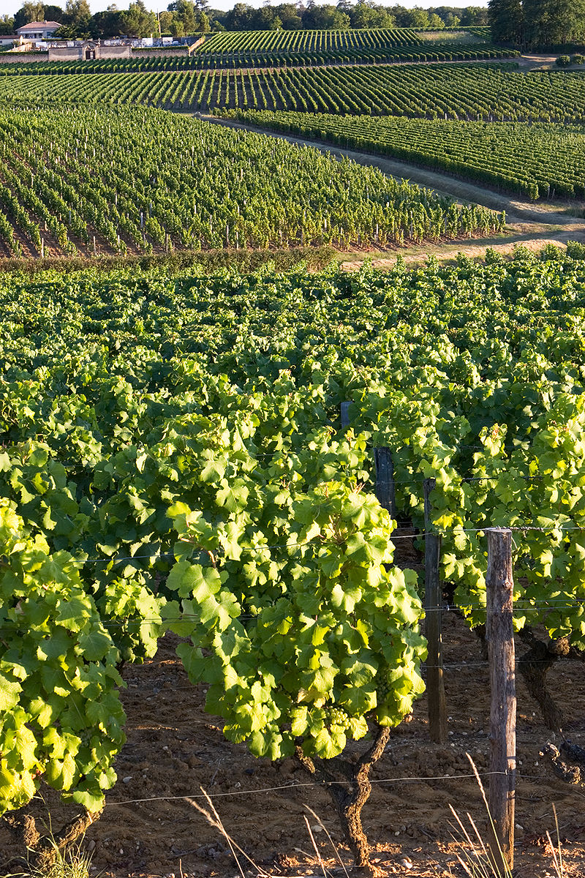
Sauternes vineyard

