Slide 1
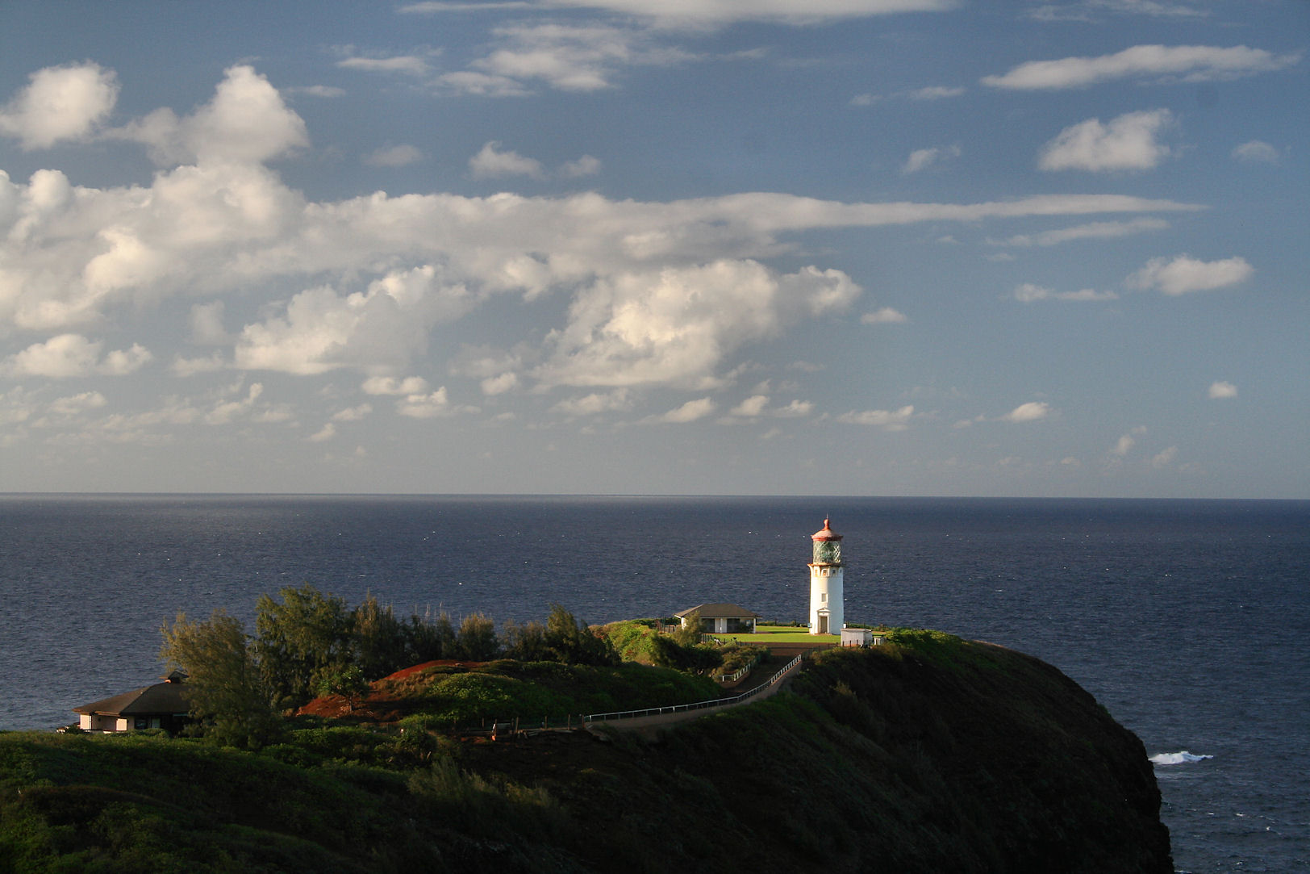
Beijing residents gasp for fresh air in the city of smog
And not just Beijing
By Natalie Thomas and Kim Kyung-Hoon
Notes:
Half-circle picture with accent arcs
(Basic)
To reproduce the shape effects on this slide, do the following:
On the Home tab, in the Slides group, click Layout, and then click Blank.
On the Home tab, in the Drawing group, click Shapes, and then under Basic Shapes, click Arc (third row, 12th option from the left). On the slide, drag to draw an arc.
Select the arc. Under Drawing Tools, on the Format tab, in the Size group, do the following:
In the Shape Height box, enter 7.5”.
In the Shape Width box, enter 7.5”.
Drag the right yellow diamond adjustment handle to the bottom of the slide to create a half-circle.
Under Drawing Tools, on the Format tab, in the bottom right corner of the Shape Styles group, click the Format Shape dialog box launcher. In the Format Shape dialog box, click Fill in the left pane. In the Fill pane, select Picture or texture fill, and then under Insert from, click File.
In the Insert Picture dialog box, select a picture, and then click Insert.
Also in the Format Shape dialog box, in the Fill pane, under Insert from, select Tile picture as texture.
Also in the Format Shape dialog box, click Line Color in the left pane, and then select No line in the Line Color pane.
Also in the Format Shape dialog box, click Shadow in the left pane, and then do the following in the Shadow pane:
Click the button next to Presets, and then under Inner click Inside Diagonal Top Right (first row, third option from the left).
In the Transparency box, enter 70%.
In the Blur box, enter 20 pt.
In the Distance box, enter 20 pt.
Drag the half-circle to the left until the two middle yellow adjustment diamonds are lined up with the left edge of the slide. On the Home tab, in the Drawing group, click Arrange, point to Align, and then do the following:
Click Align to Slide.
Click Align Middle.
Select the arc. On the Home tab, in the Clipboard group, click the arrow under Copy, and then click Duplicate.
Select the second arc. Under Drawing Tools, on the Format tab, in the Size group, do the following:
In the Shape Height box, enter 6.79”.
In the Shape Width box, enter 10.03”.
On the Home tab, in the bottom right corner of the Drawing group, click the Format Shape dialog box launcher. In the Format Picture dialog box, click Fill in the left pane, and then in the Fill pane, select No fill.
Also in the Format Shape dialog box, click Line Color in the left pane. In the Line Color pane, select Solid line and then do the following:
Click the button next to Color, and then under Theme Colors click White, Background 1 (first row, first option from the left).
In the Transparency box, enter 50%.
Also in the Format Shape dialog box, click Line Style in the left pane. In the Line Style pane, in the Width box, enter 1.5 pt.
Drag the second arc left on the slide until the two middle yellow adjustment diamonds are lined up with the left edge of the slide. On the Home tab, in the Drawing group, click Arrange, point to Align, and then do the following:
Click Align to Slide.
Click Align Middle.
Select the second arc. On the Home tab, in the Clipboard group, click the arrow under Copy, and then click Duplicate.
Select the third arc. Under Drawing Tools, on the Format tab, in the Size group, do the following:
In the Shape Height box, enter 6.86”.
In the Shape Width box, enter 9.98”.
On the Home tab, in the bottom right corner of the Drawing group, click the Format Shape dialog box launcher. In the Format Shape dialog box, click Line Color in the left pane, select Gradient line in the Line Color pane, and then do the following:
In the Type list, select Linear.
Click the button next to Direction, and then click Linear Down (first row, second option from the left).
Under Gradient stops, click Add gradient stop or Remove gradient stop until two stops appear in the slider.
Also under Gradient stops, customize the gradient stops that you added as follows:
Select the first stop in the slider, and then do the following:
In the Position box, enter 0%.
Click the button next to Color, and then under Theme Colors click Blue, Accent 1, Lighter 40% (fourth row, fifth option from the left).
In the Transparency box, enter 77%.
Select the second stop in the slider, and then do the following:
In the Position box, enter 100%.
Click the button next to Color, click More Colors, and then in the Colors dialog box, on the Custom tab, enter values for Red: 208, Green: 215, Blue: 222.
In the Format Shape dialog box, in the Line Style pane, in the Transparency box, enter 90%.
Also in the Format Shape dialog box, click Line Style in the left pane. In the Line Style pane, in the Width box, enter 4.25 pt.
On the Home tab, in the Drawing group, click Arrange, point to Align, and then do the following:
Click Align to Slide.
Click Align Left.
Drag the third arc left on the slide until the two middle yellow adjustment diamonds are lined up with the left edge of the slide. Drag the third arc vertically as needed to position it slightly above the second arc on the slide.
To reproduce the background on this slide, do the following:
Right-click the slide background area, and then click Format Background. In the Format Background dialog box, click Fill in the left pane, select Gradient fill in the Fill pane, and then do the following:
In the Type list, select Linear.
Click the button next to Direction, and then click Linear Up (second row, second option from the left).
In the Angle box, enter 270⁰.
Under Gradient stops, click Add gradient stop or Remove gradient stop until four stops appear in the slider
Also under Gradient stops, customize the gradient stops that you added as follows:
Select the first stop in the slider, and then do the following:
In the Position box, enter 0%.
Click the button next to Color, click More Colors, and then in the Colors dialog box, on the Custom tab, enter values for Red: 167, Green: 185, Blue: 197.
Select the second stop in the slider, and then do the following:
In the Position box, enter 30%.
Click the button next to Color, and then under Theme Colors click White, Background 1 (first row, first option from the left).
Select the third stop in the slider, and then do the following:
In the Position box, enter 70%.
Click the button next to Color, and then under Theme Colors click White, Background 1 (first row, first option from the left).
Select the fourth stop in the slider, and then do the following:
In the Position box, enter 100%.
Click the button next to Color, click More Colors, and then in the Colors dialog box, on the Custom tab, enter values for Red: 167, Green: 185, Blue: 197.

Slide 2
BEIJING (Reuters) - For years, Liu Ruiqiang put up with chronic smog in China's capital of Beijing, but he didn't want to take any chances when his daughter was born. The salesman now carries a handheld pollution sensor everywhere. On days when air pollution reaches hazardous levels, his toddler daughter is confined to their home, where a pair of constantly whirring air purifiers make it safer to breathe.

Slide 3
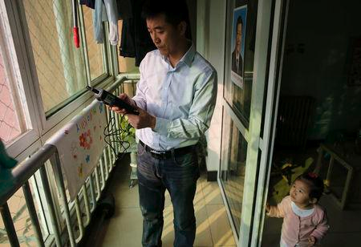

Slide 4
Like millions of Chinese, Liu and his family are paying the price for decades of red-hot economic growth that have lifted hundreds of millions out of poverty, but have taken a toll on the environment due to rapid industrialization. Over the past seven years, levels of particulate matter in Beijing's air smaller than 2.5 micrometers in diameter (PM2.5) averaged nearly five times the recommended daily level set by the World Health Organization, according to data from a monitoring station at the U.S. embassy

Slide 5
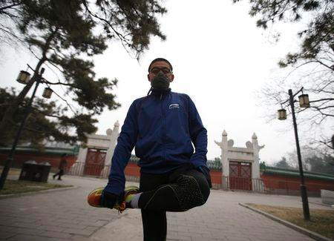
Wang Yan wears a mask as he stretches after jogging in a park on a hazy day in Beijing January 14, 2015.

Slide 6
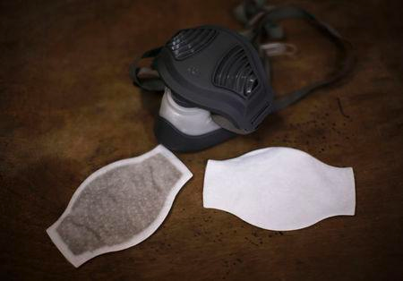
Liu Ke's mask, a new filter (R) and a used filter which he had used for two weeks are seen on a table in Beijing December 19, 2014.

Slide 7
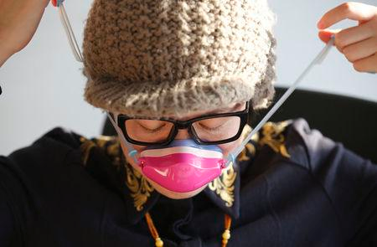
Yong Xiaoyan, puts on a nose mask at her office in Beijing December 11, 2014. The office worker said she has used the mask everyday since she found out she was pregnant and was concerned that Beijing's air pollution could harm her fetus.

Slide 8

J.Kim, takes medicine for his bronchial trouble at his house in Beijing

Slide 9

A model shows a creation at a rehearsal for Chi Zhang's fashion show in Beijing November 22, 2014. Zhang said China's air pollution is one of his prime inspirations and the embellished images of gas masks and the phrase "Fxxk Air Pollution" are trademarks in his creations.

Slide 10
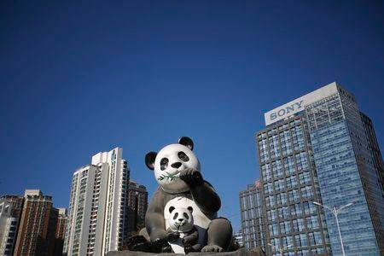
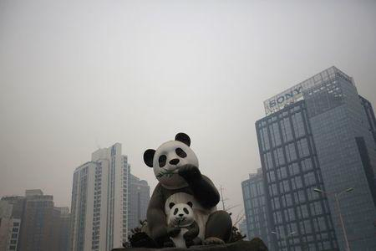
Clear day versus polluted day

Slide 11
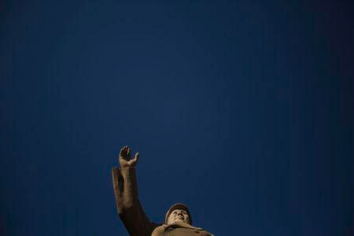
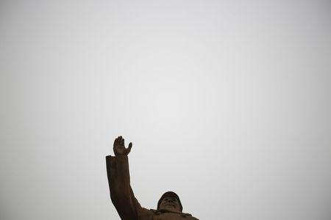
Clear day versus polluted day

Slide 12
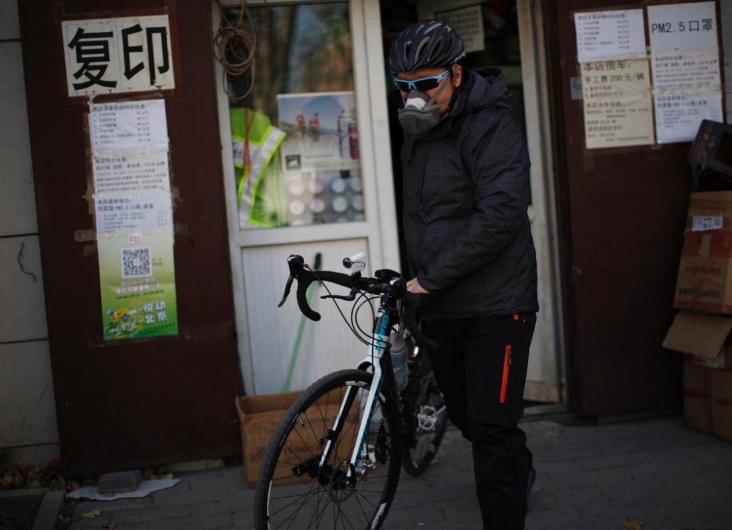
Liu Ke, wears a mask as he carries his bicycle in Beijing December 19, 2014. Liu rides a bicycle almost everyday to avoid Beijing's congested traffic. He said it is necessary for him to wear a mask when air pollution levels increase, to protect himself.

Slide 13
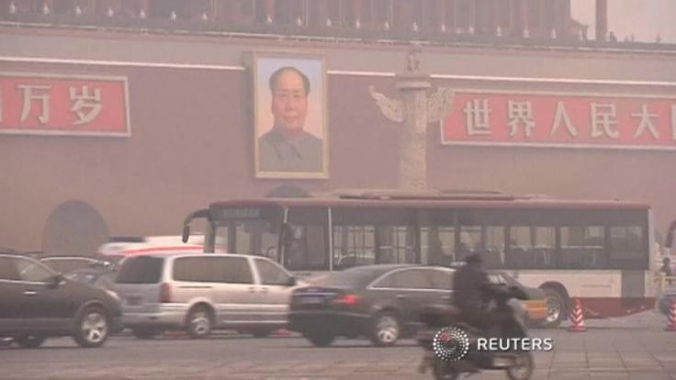
One year after Premier Li Keqiang "declared war" on pollution, the environment is expected to be a top issue when China's top leaders gather for a key meeting later in the week.

Slide 14
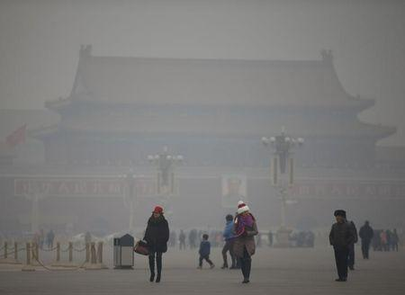
Visitors take a walk during a polluted day at Tiananmen Square in Beijing January 15, 2015.

