Slide 1
Aland Island, Finland

Slide 2
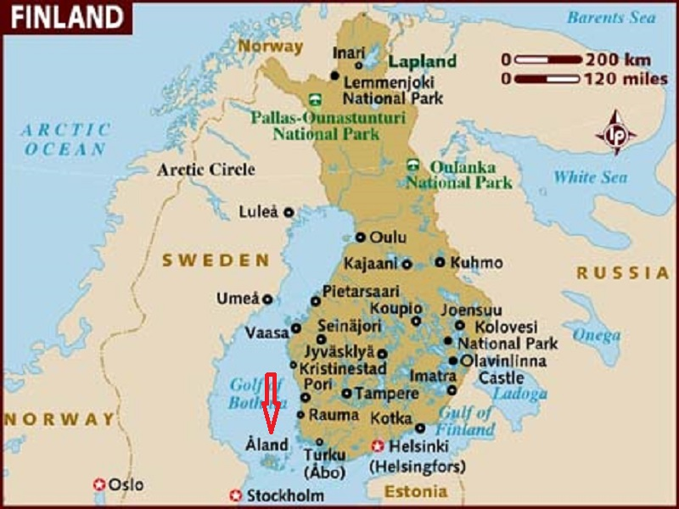
The Aland Islands is a region of Finland that consists of an archipelago at the entrance to the Gulf of Bothnia in the Baltic Sea. The capital and largest city of Aland Islands in Mariehamn

Slide 3
The Åland Islands or Åland is a region of Finland that consists of an archipelago at the entrance to the Gulf of Bothnia in the Baltic Sea. It is autonomous, demilitarised and is the only monolingually Swedish-speaking region in Finland. Collectively, the islands in the archipelago form the smallest region of Finland, constituting 0.49% of its land area and 0.50% of its population. Åland comprises Fasta Åland on which 90% of the population resides and a further 6,500 skerries and islands to its east. Fasta Åland is separated from the coast of Sweden by 38 kilometres (24 mi) of open water to the west. In the east, the Åland archipelago is contiguous with the Finnish Archipelago Sea. Åland's only land border is located on the uninhabited skerry of Märket, which it shares with Sweden. Åland's autonomous status means that those provincial powers normally exercised by representatives of the central Finnish government are largely exercised by its own government.

Slide 4
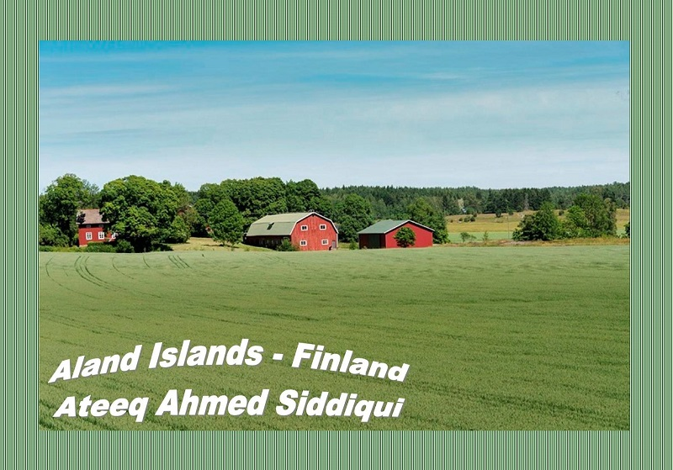

Slide 5
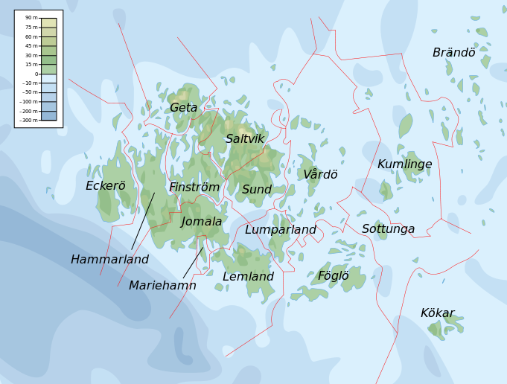

Slide 6
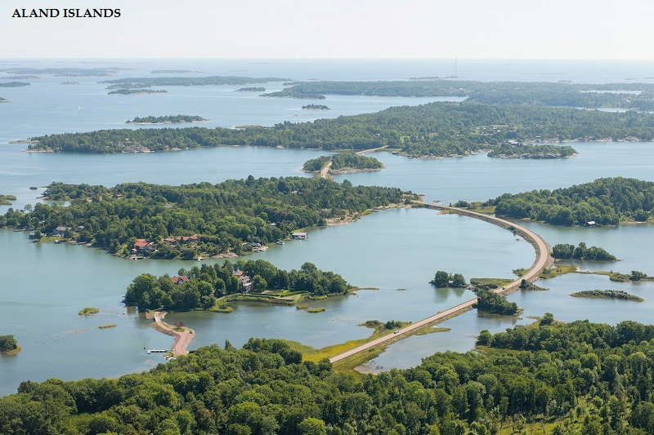
Many bridges

Slide 7
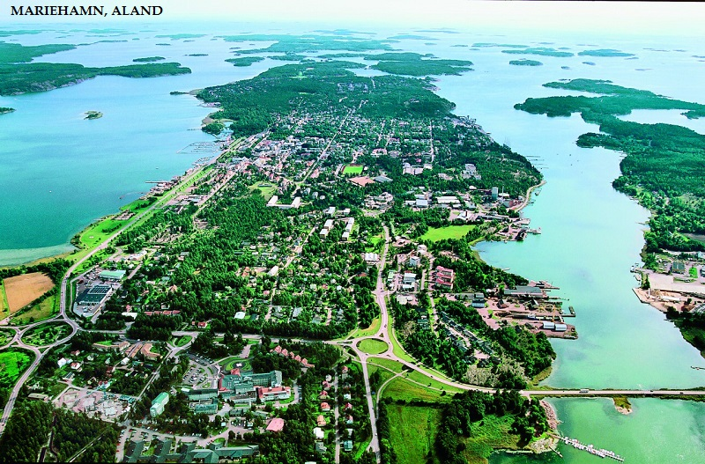

Slide 8
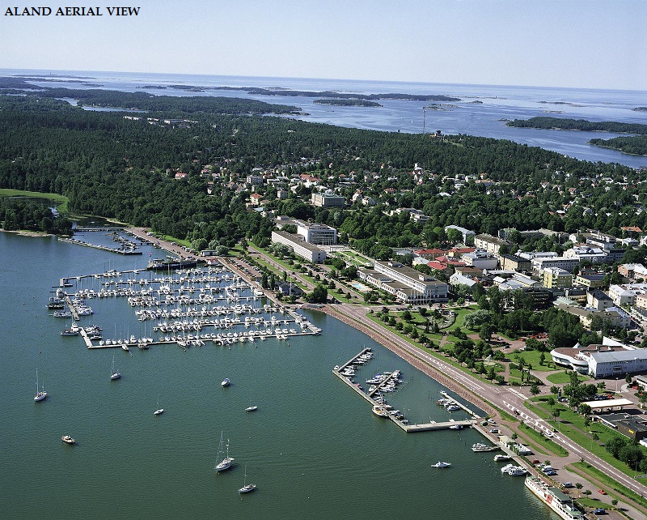

Slide 9
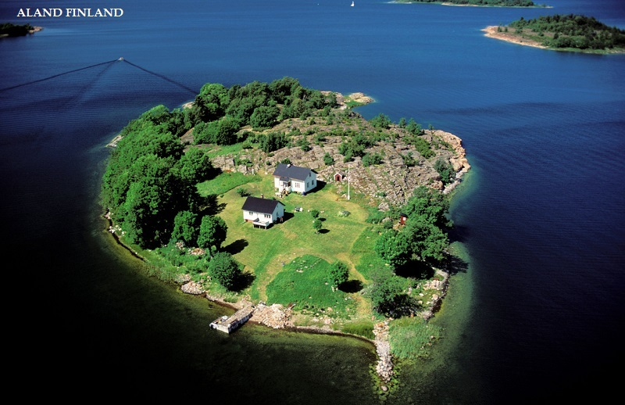
One of the small islands in the archipelago

Slide 10
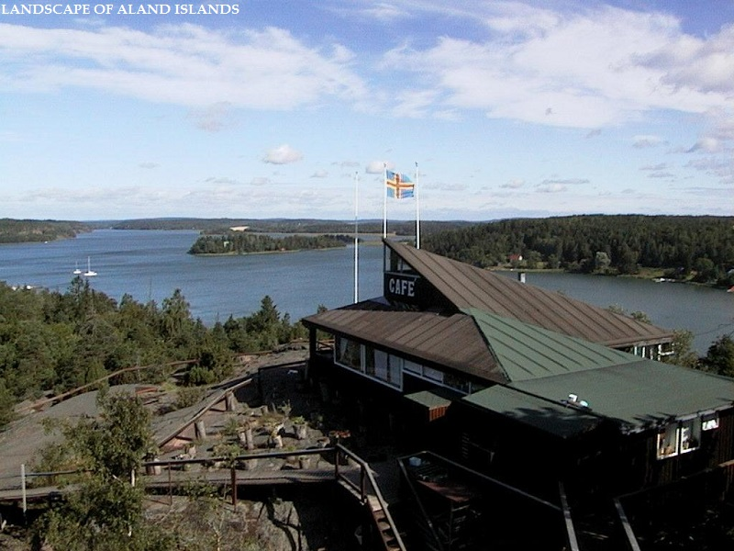

Slide 11
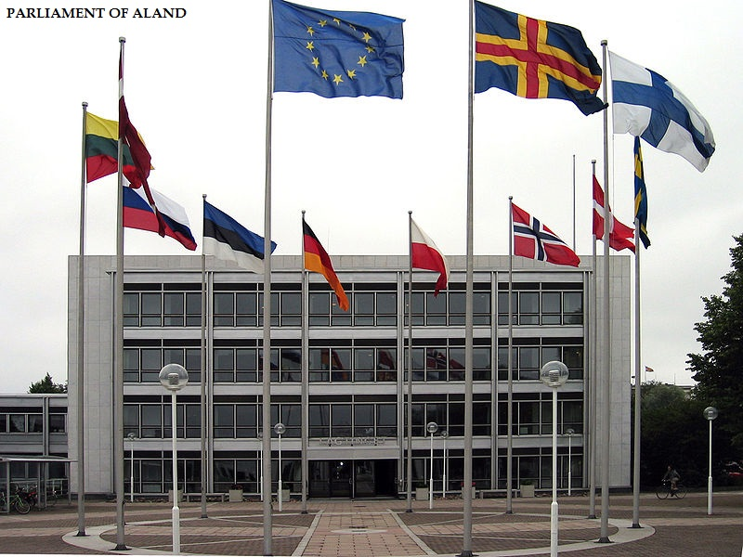

Slide 12
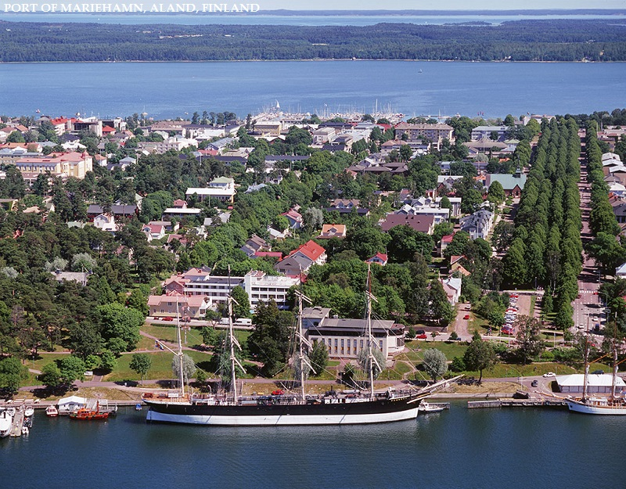

Slide 13
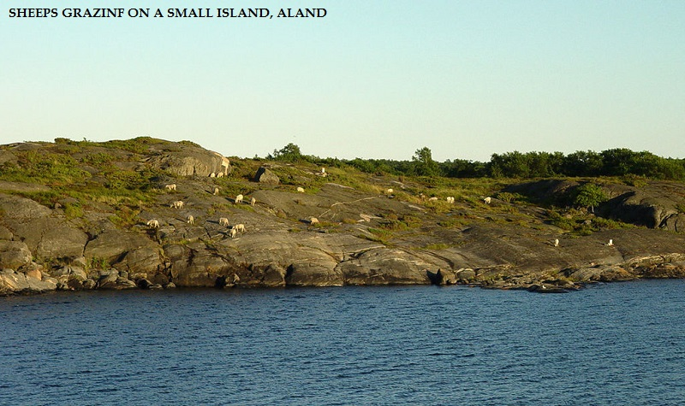

Slide 14
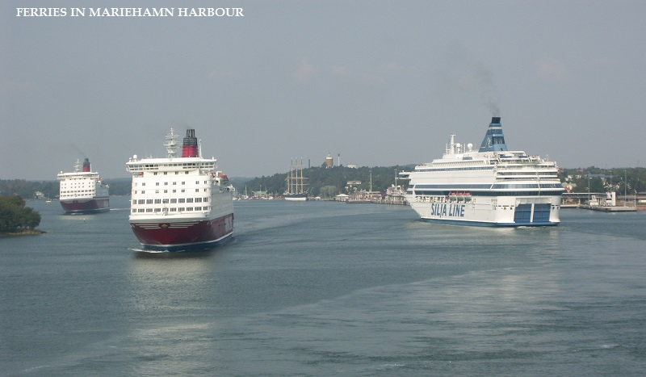

Slide 15
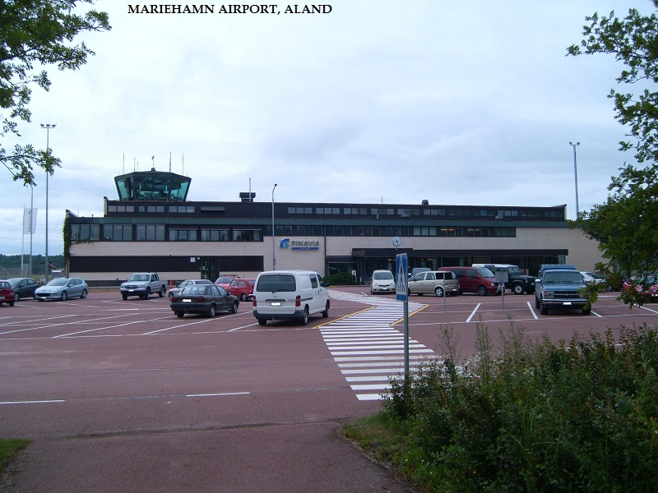

Slide 16
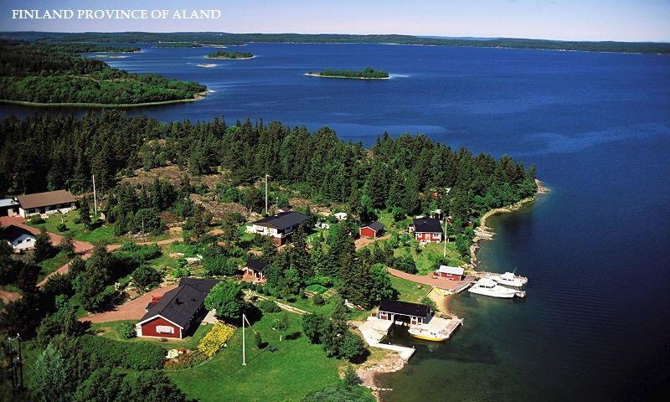

Slide 17
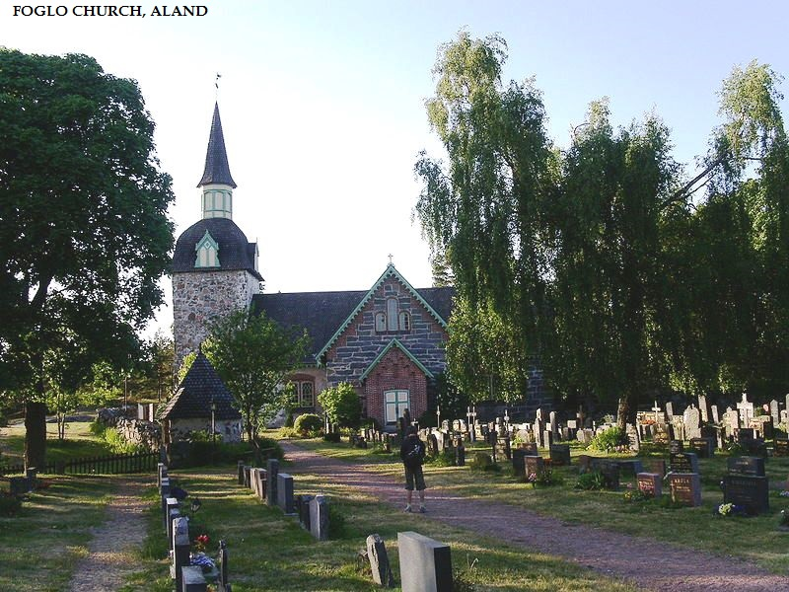

Slide 18
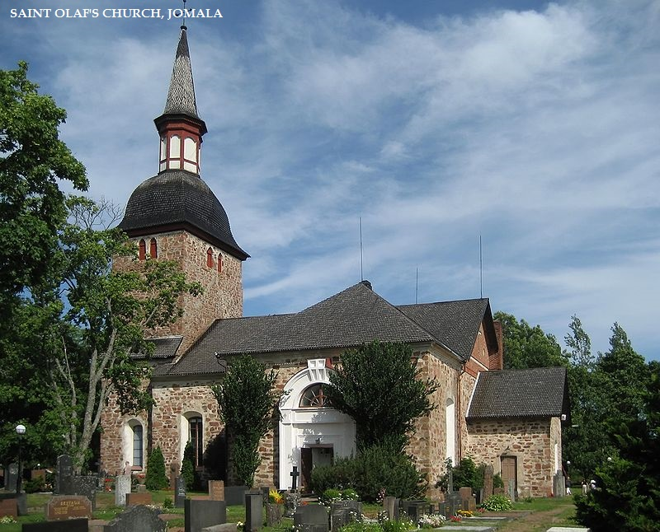

Slide 19
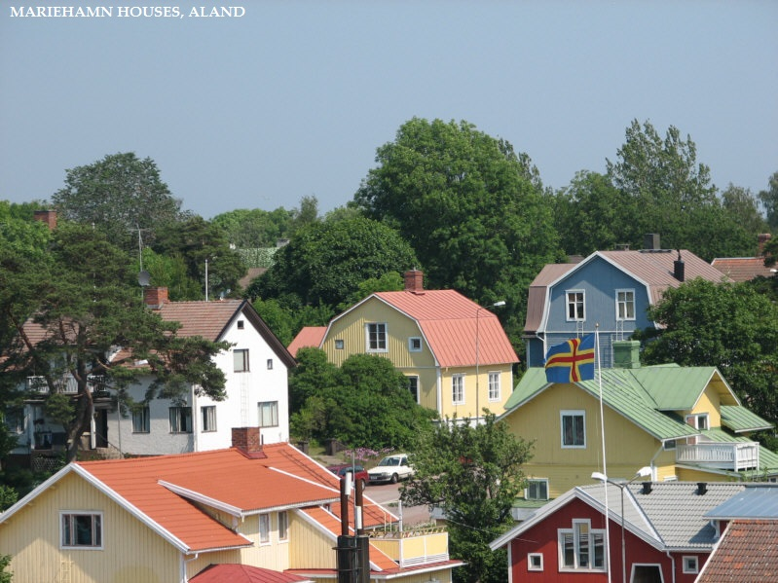

Slide 20
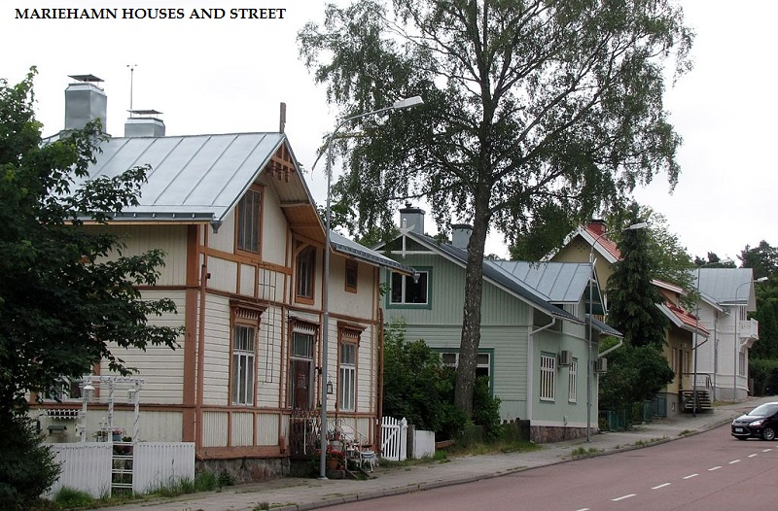

Slide 21
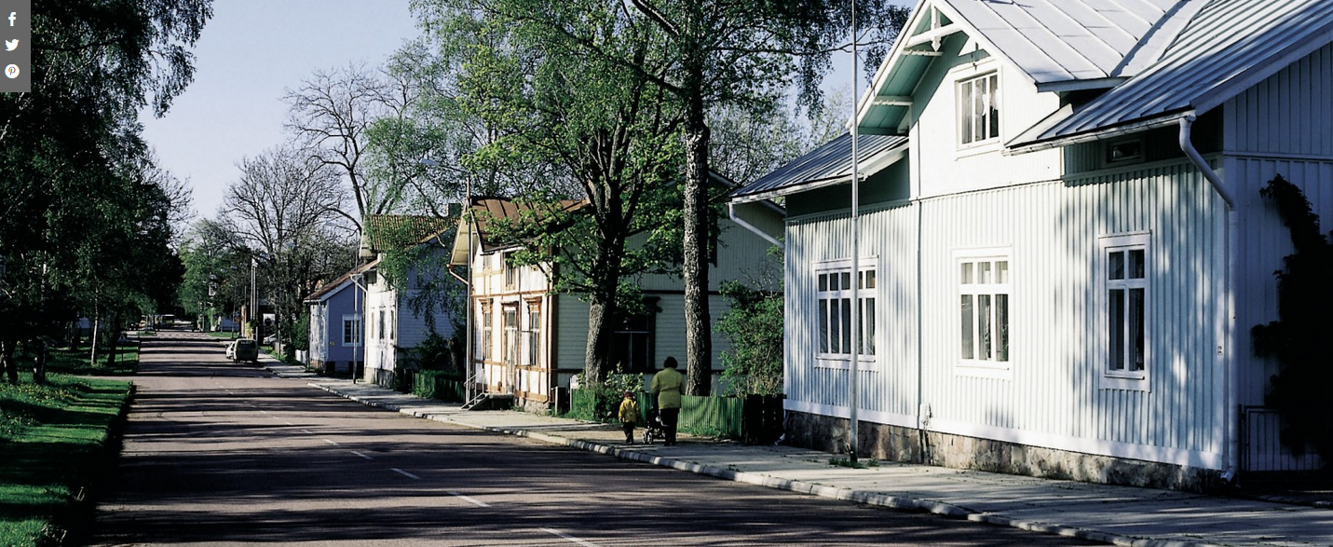

Slide 22
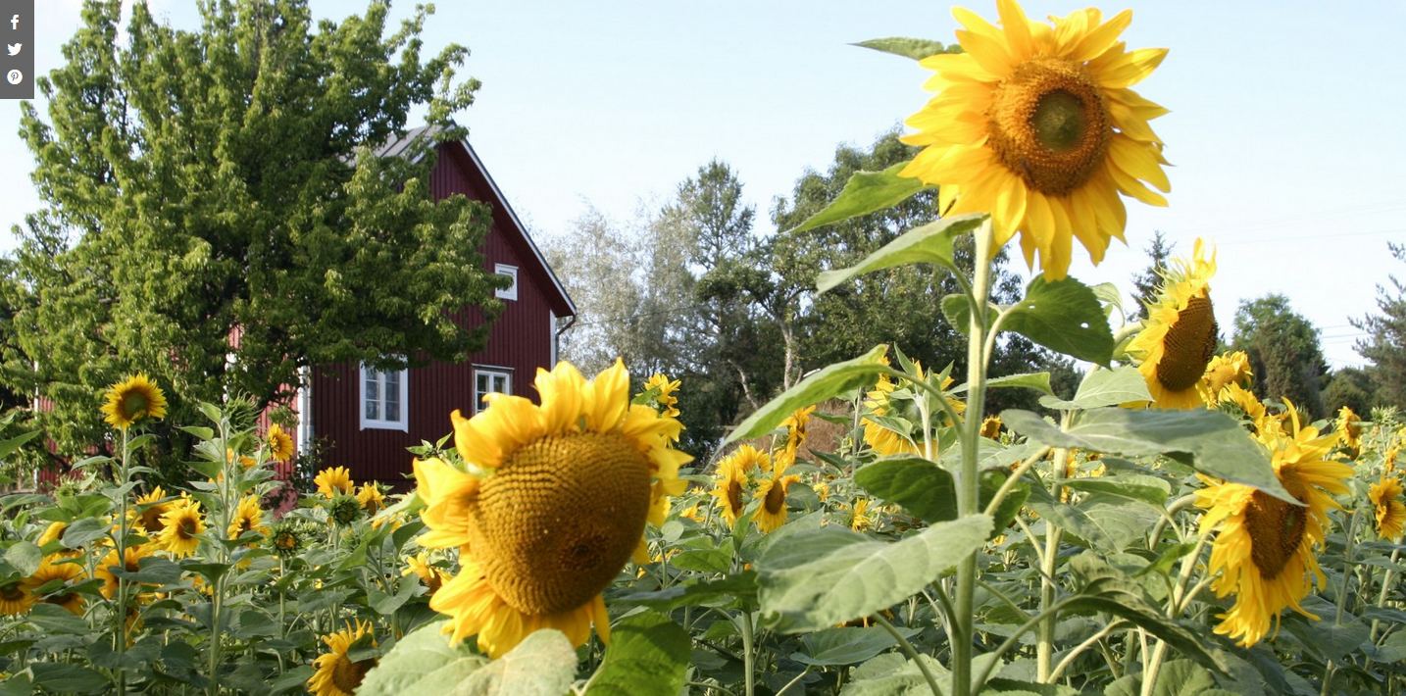

Slide 23
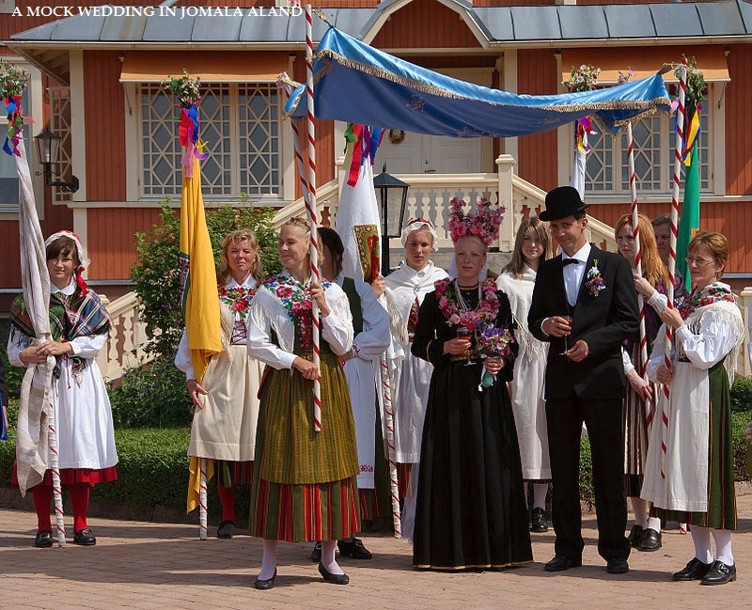
Notice a cultural difference – the bride and gro0m are dressed in black (not white for the bride).

Slide 24
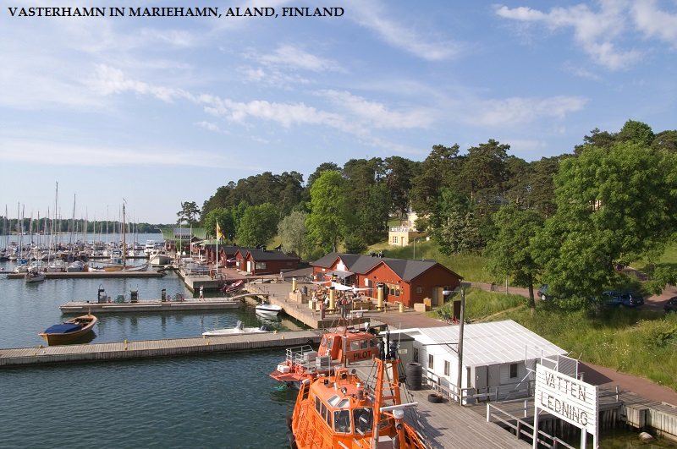

Slide 25
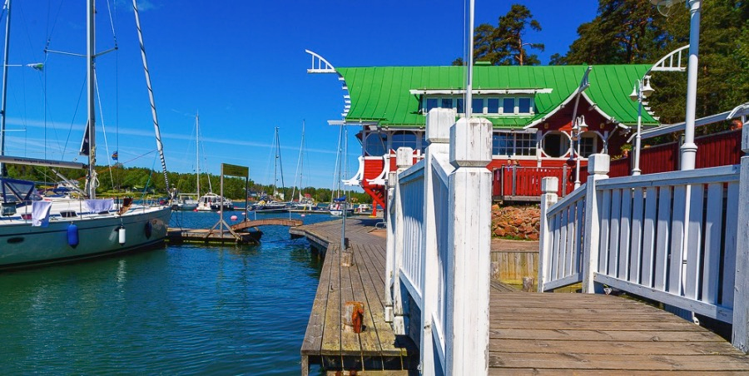

Slide 26
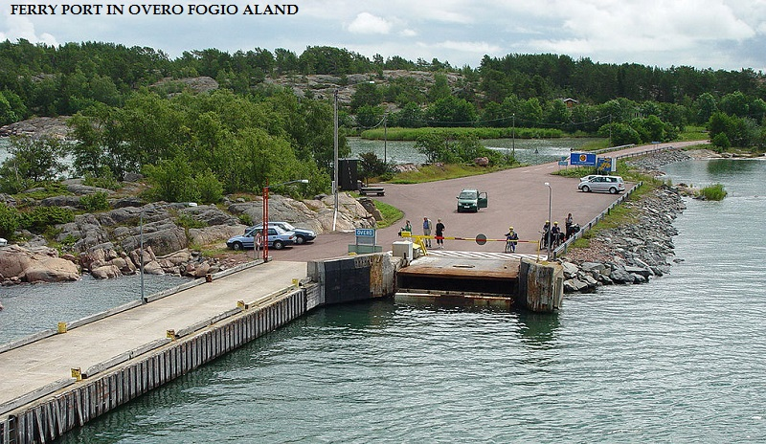

Slide 27
Pink roads
Macadam is a type of road construction pioneered by Scottish engineer John Loudon McAdam around 1820. The method simplified what had been considered state of the art at that point. Single-sized crushed stone layers of small angular stones are placed in shallow lifts and compacted thoroughly. A binding layer of stone dust (crushed stone from the original material) may form; it may also, after rolling, be covered with a binder of fines and small crushed rock
The red granite found around the islands is the rock that is used to create the asphalt (mcadam). Everywhere you drive around in Aland feels different, like you’re on top of a pink road.

Slide 28
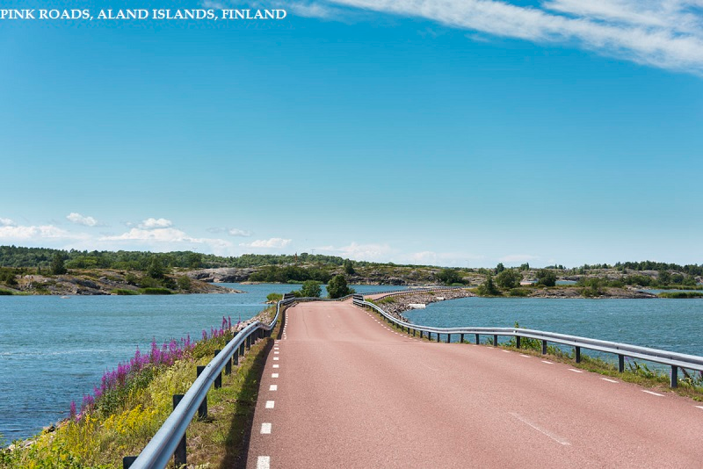

Slide 29
