Slide 1
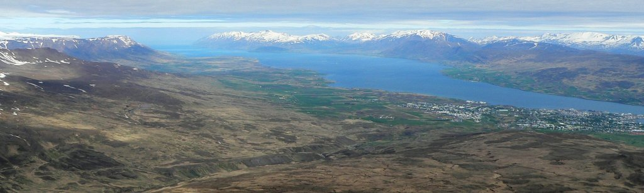
Akureyri, Iceland

Slide 2
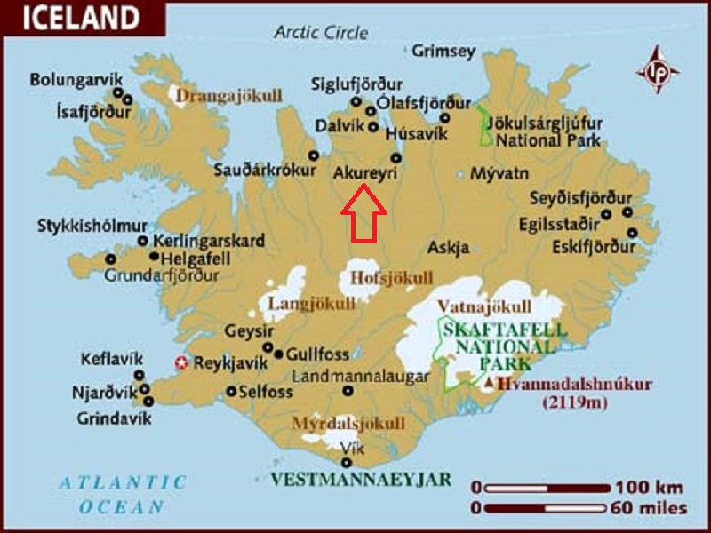
Akureyri is a small city in northern Iceland. It is Iceland's second largest urban area and 4th largest municipality. Akureyri is an important port and fishing centre too.

Slide 3
Nicknamed the Capital of North Iceland, Akureyri is an important port and fishing centre. The area where Akureyri is located was settled in the 9th century but did not receive a municipal charter until 1786. The town was the site of Allied units during World War II. Further growth occurred after the war as the Icelandic population increasingly moved to urban areas.
The area has a relatively mild climate due to geographical factors, and the town's ice-free harbour has played a significant role in its history.

Slide 4
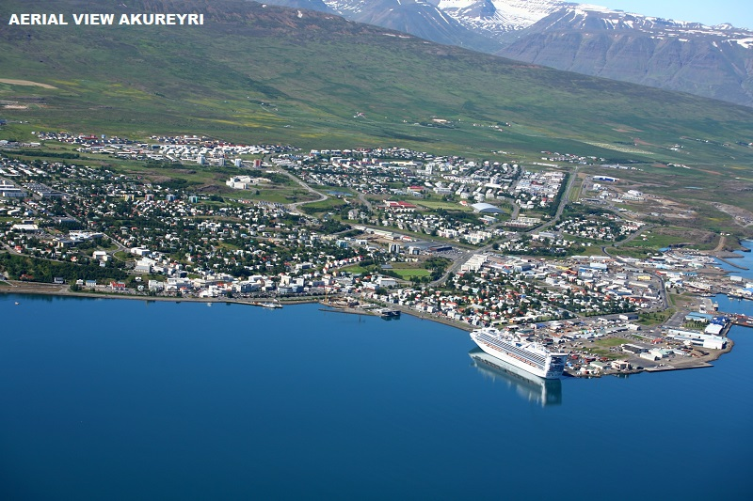

Slide 5
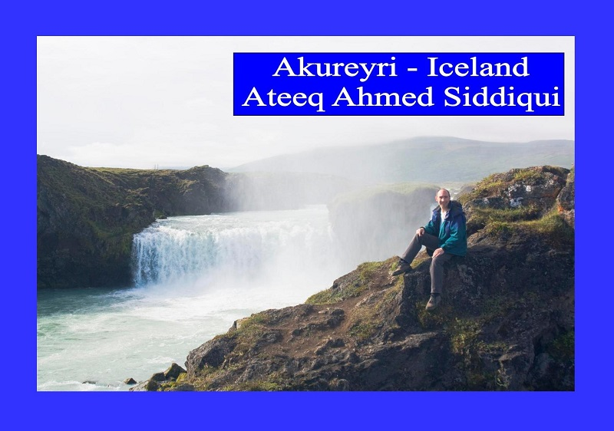

Slide 6
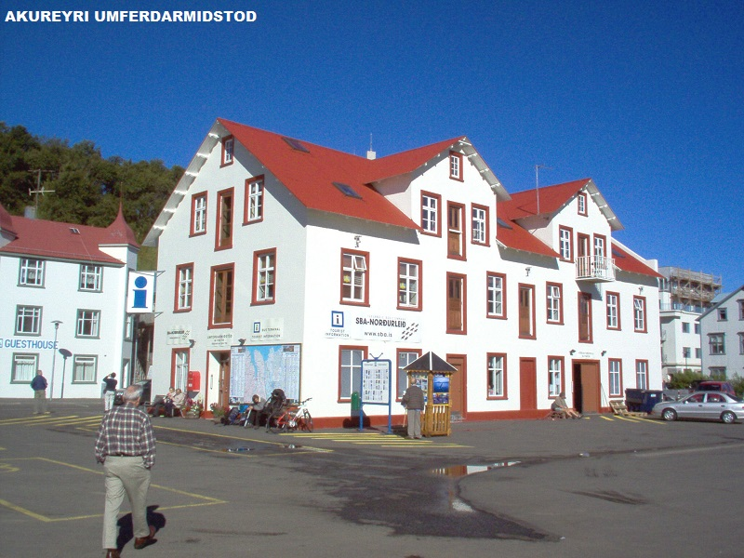

Slide 7
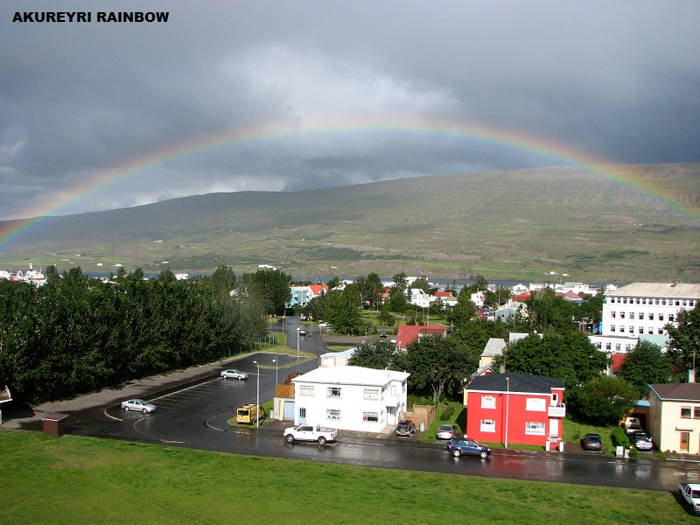

Slide 8
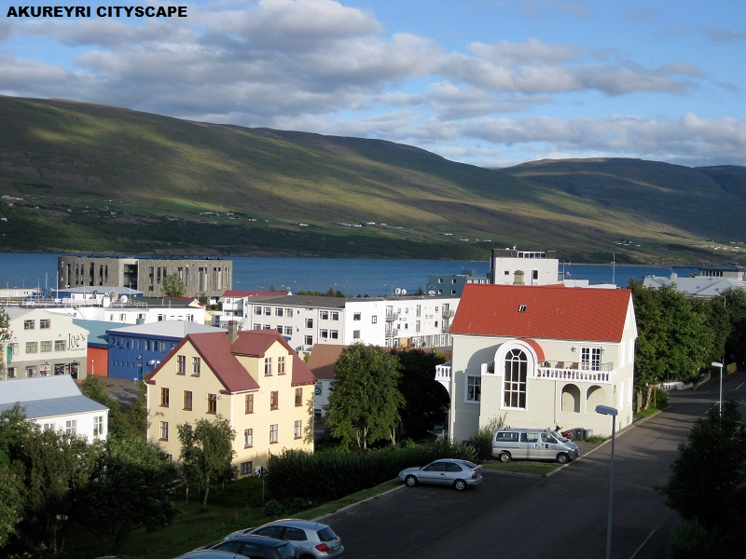

Slide 9
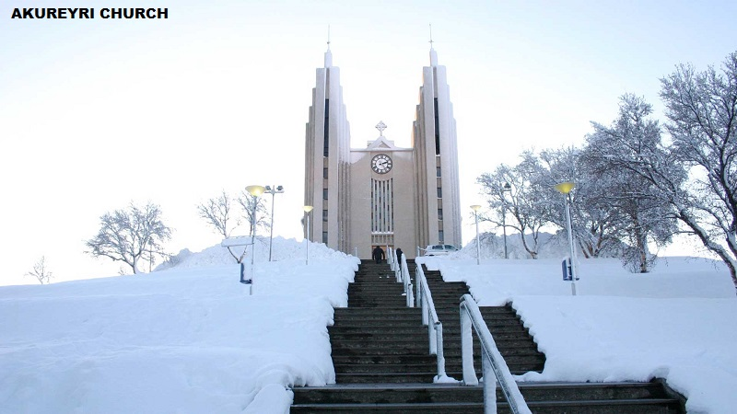

Slide 10
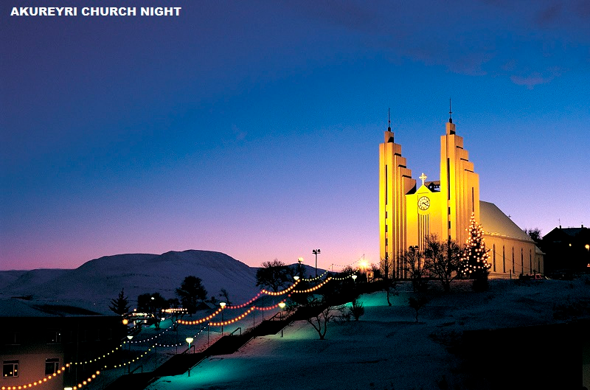

Slide 11
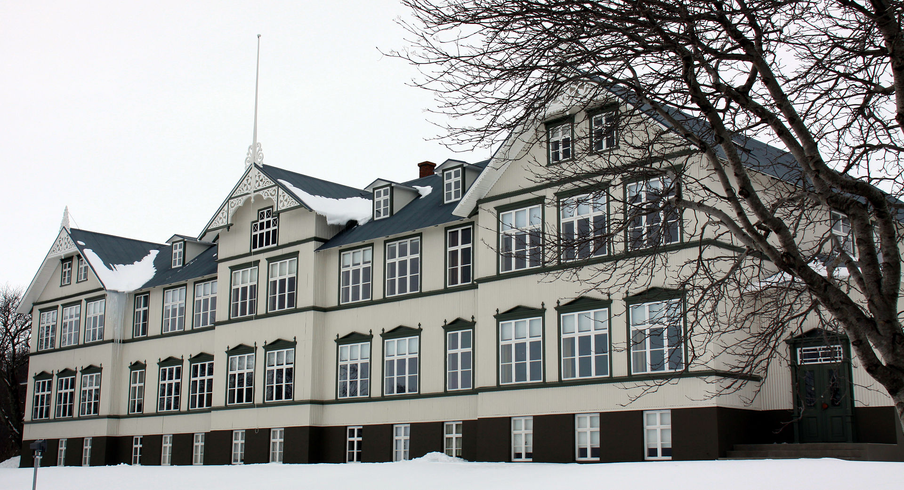
The old building (Gamli Skóli) of the Menntaskóli, i.e. High School precinct in Akureyri.

Slide 12
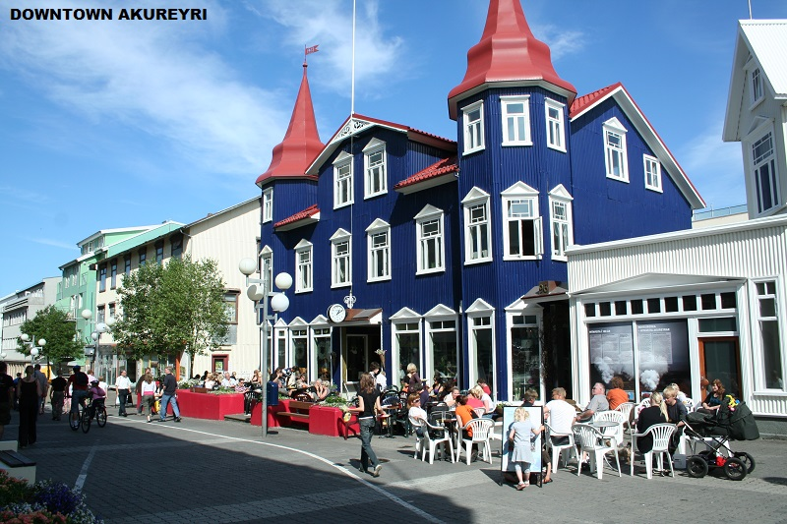

Slide 13
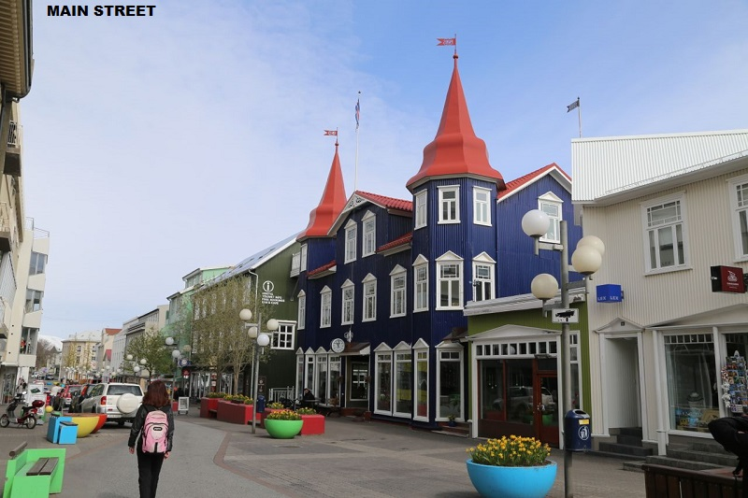

Slide 14
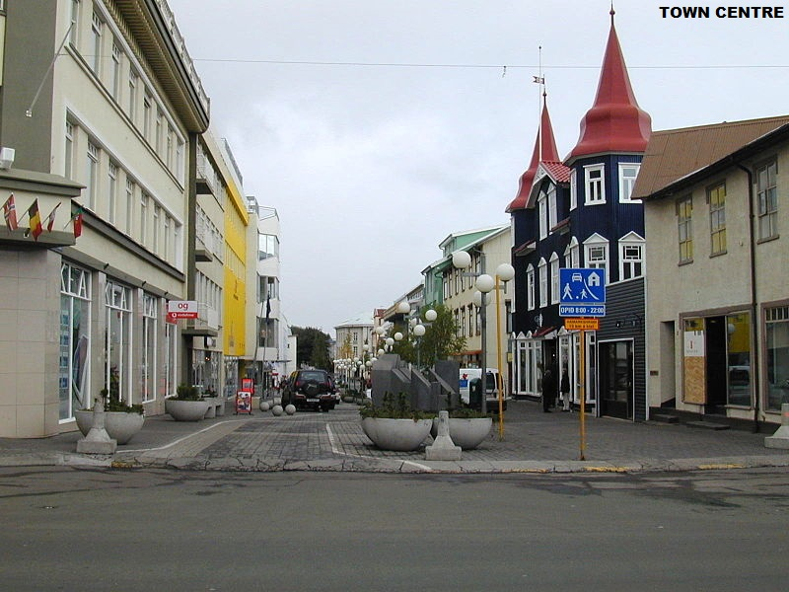

Slide 15
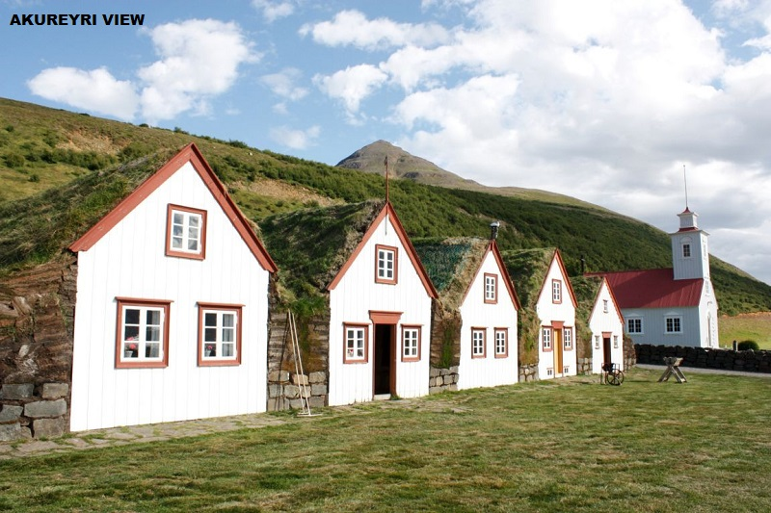

Slide 16
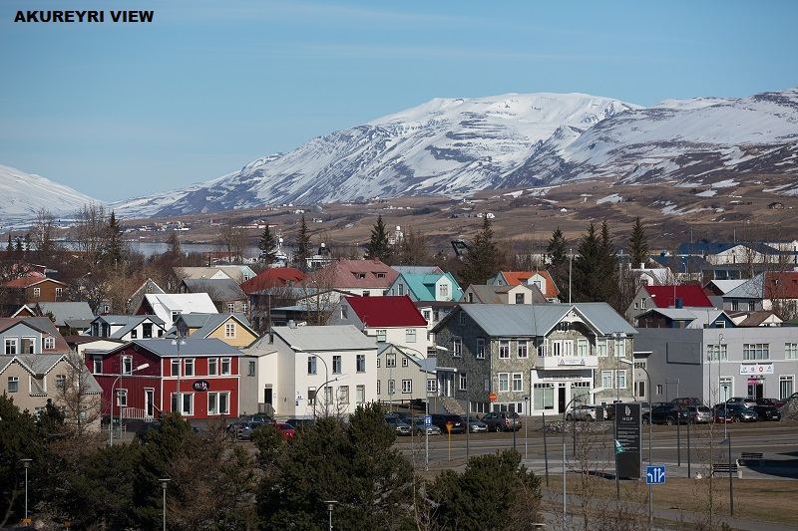

Slide 17
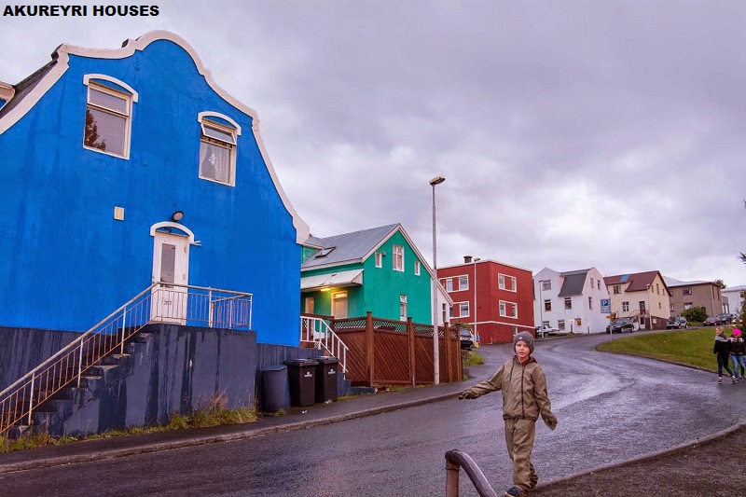

Slide 18
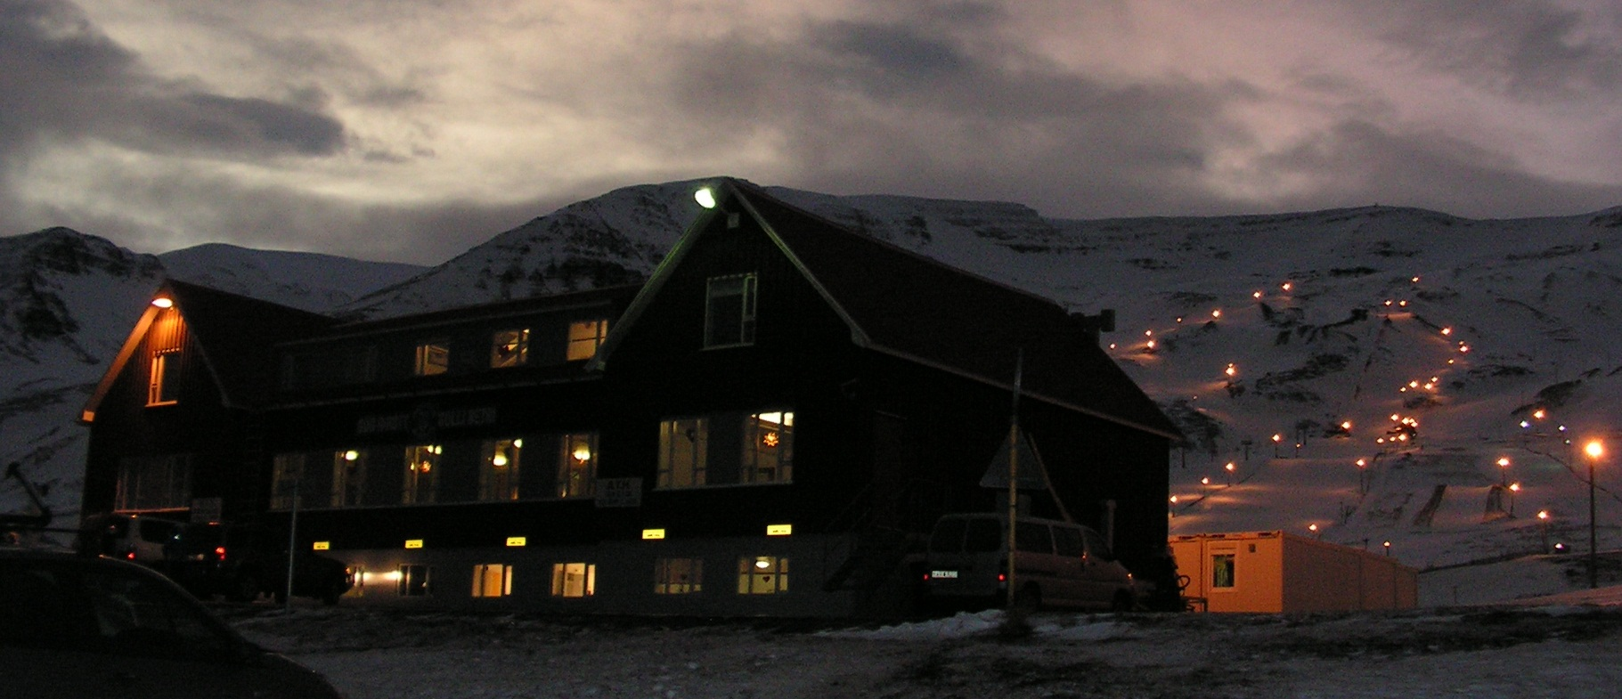
Hlíðarfjall ski slopes just west of the town

Slide 19
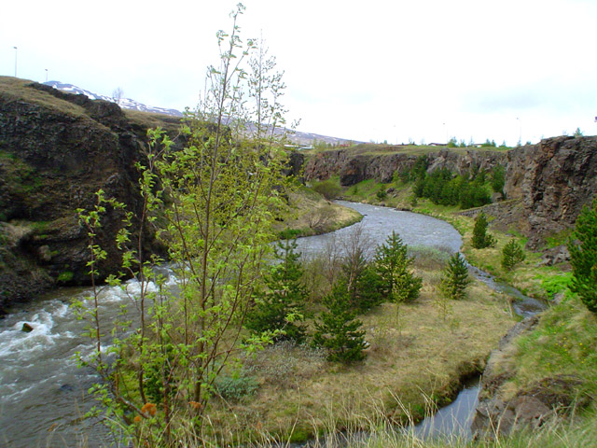
The Glerá River

Slide 20
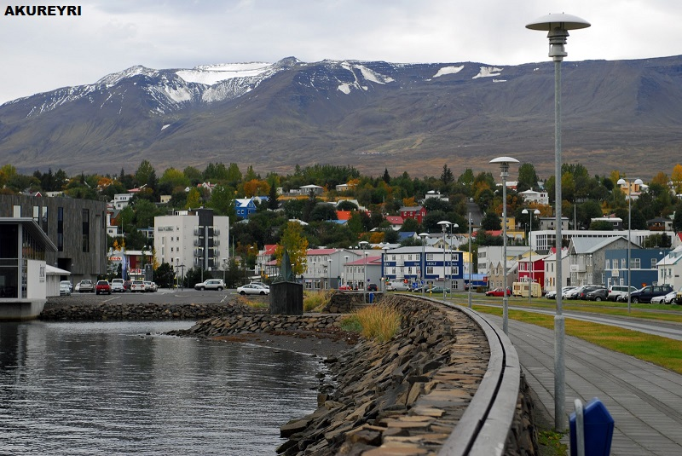

Slide 21
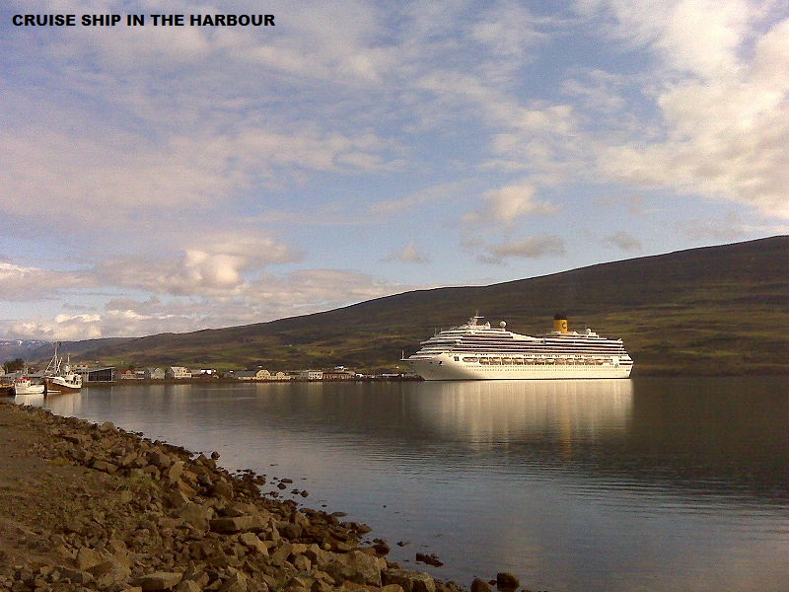

Slide 22
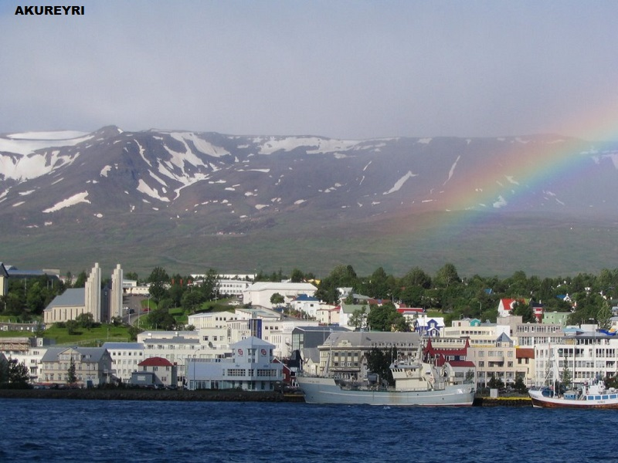

Slide 23
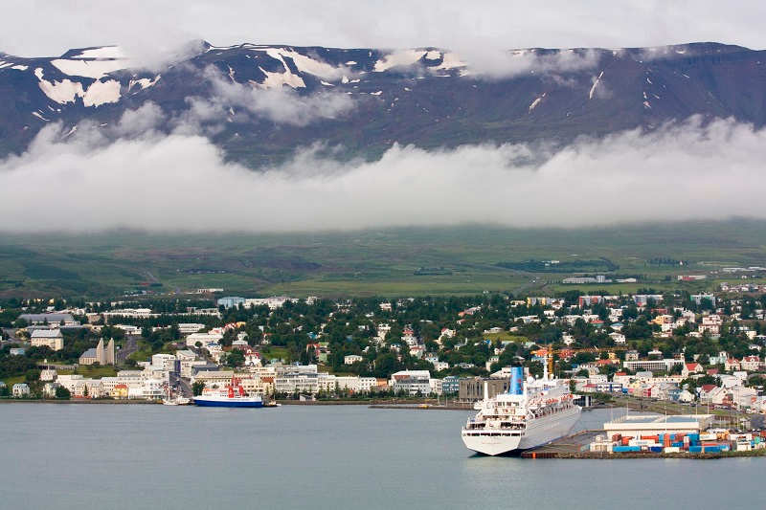

Slide 24
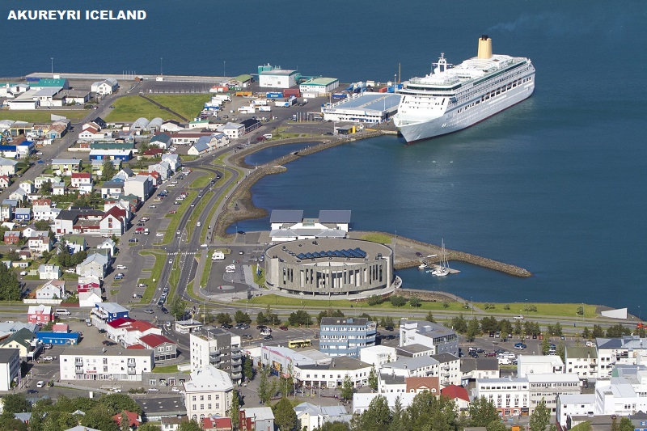

Slide 25
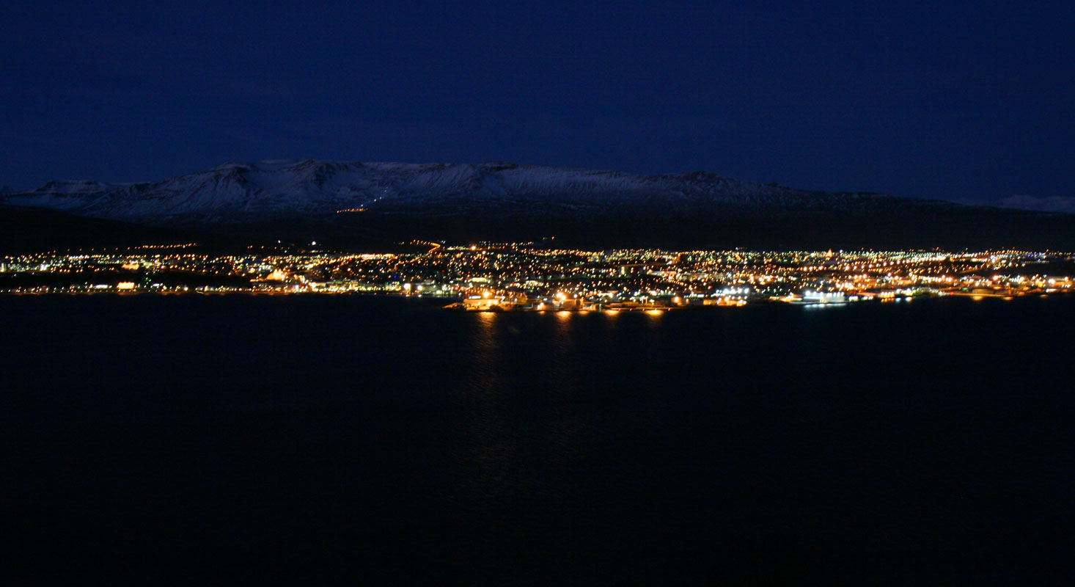
Akureyri, with Hlíðarfjall behind, viewed from the eastern shore of Eyjafjörður

