Slide 1
13 of Italy's Most Charming Small Towns

Slide 2
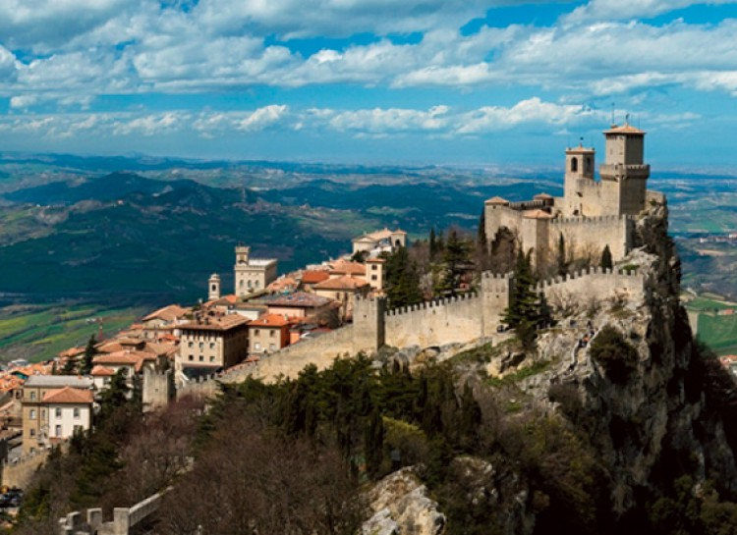
Ravenna
Ravenna, Italy was once the capital of the Byzantine Empire. The town is full of gorgeous mosaics that capture the town’s rich heritage. Do not forget to stop by Dante’s tomb, but take great care to not fall into one of the nine circles of Hell!

Slide 3
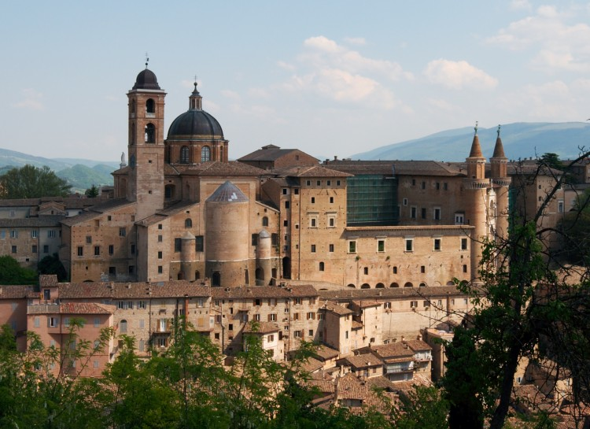
Urbino
Urbino, Italy is the epitome of a picturesque Renaissance town built into a hillside. The Ducal Palace is home to one of the most important collections of Renaissance painting in Italy. No stick figures allowed!

Slide 4
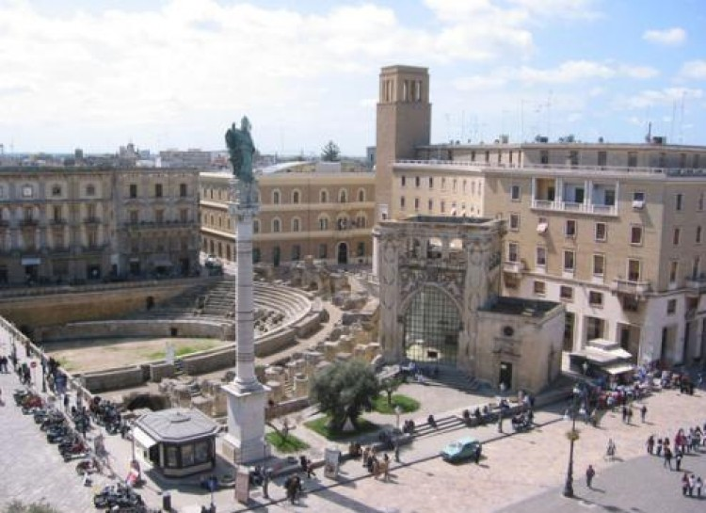
Lecce
Lecce, Italy has earned the nickname of “Florence of the South.” The city was the center of an architectural movement called barocco lecesse. Baroque monuments adorn the city at every corner.

Slide 5
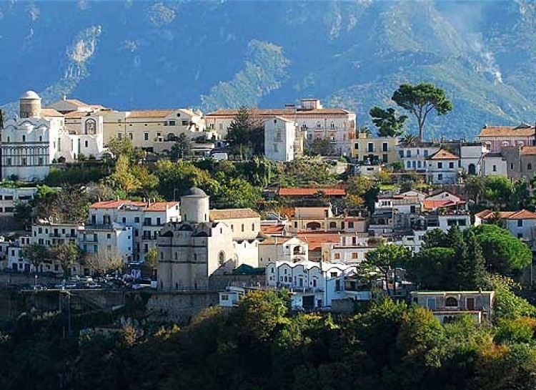
Ravello
Ravello, Italy is filled with beautiful roads that twist through the mountains. Celebrities and writers have sought solace in Ravello for centuries. D.H. Lawrence sought the town of Ravello as a muse and wrote "Lady Chatterley’s Lover" in these mountains.

Slide 6
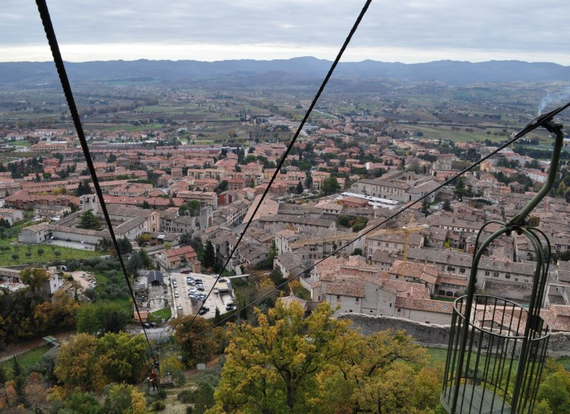
Gubbio
Gubbio, Italy is a beautiful medieval hill town. This town boasts an impressive collection of medieval, Gothic, and Renaissance portraits. In the month of May, Gubbio is the destination for vibrant festivals with hillside processions.

Slide 7
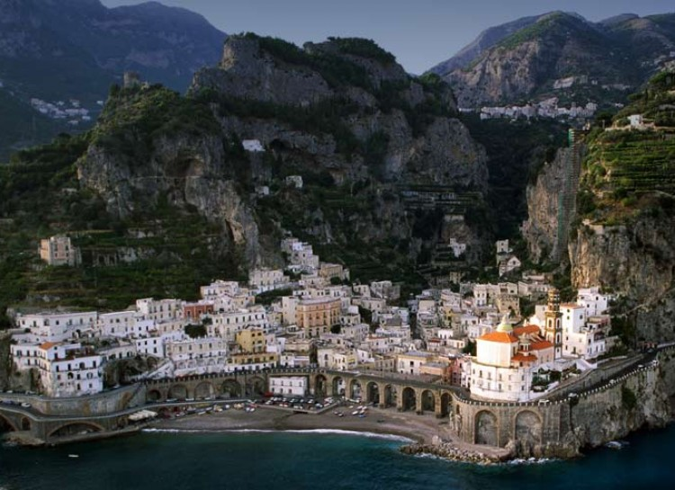
Atrani
Atrani, Italy is a fishing village along the Amalfi coast on the Southwestern edge of Italy. This town has served artists as a source of inspiration including Dutch artist M.C. Escher, who completed a lithograph print in 1931 called Atrani, Coast of Amalfi.

Slide 8
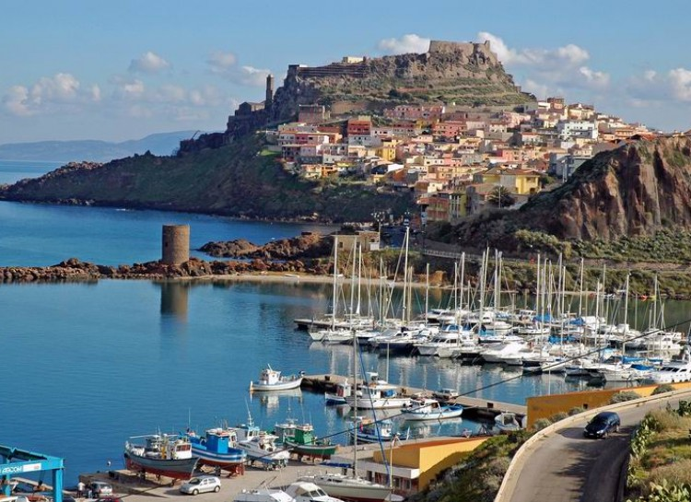
Castelsardo
Castelsardo, Italy is a Sardinian fishing village that still has a medieval foundation. The Castelsardo fortress and museum is a thriving tourist attraction. The Doria castle is ancient and was built at the highest part of the hillside for upmost security.

Slide 9
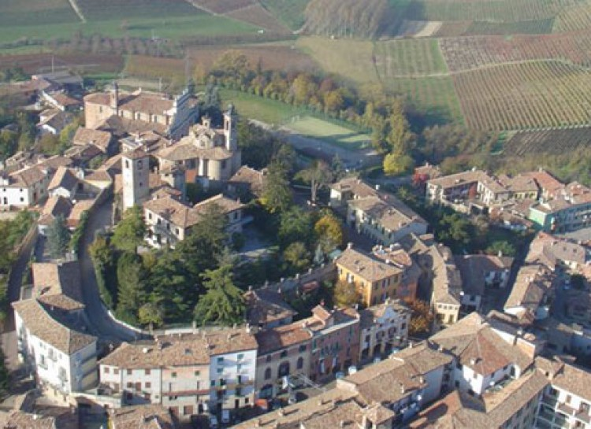
Neive
Neive, Italy is sometimes referred to as the ‘Land of Four Wines.’ Vineyards and local wine makers boast making some of the greatest wine in the world. Everyone knows Italians are serious about their wines.

Slide 10
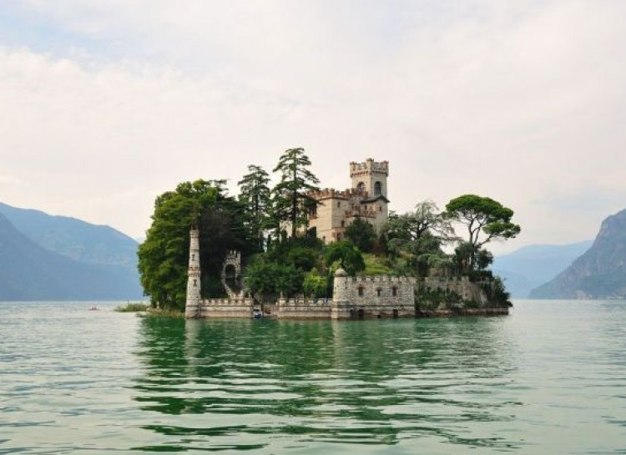
Monte Isola
Monte Isola, Italy is geographically intriguing to say the least! Monte Isola lives up to it's namesake. It is a mountain on an island that is in the middle of a lake! Needless to say, photographers will have amazing photo opportunities.

Slide 11
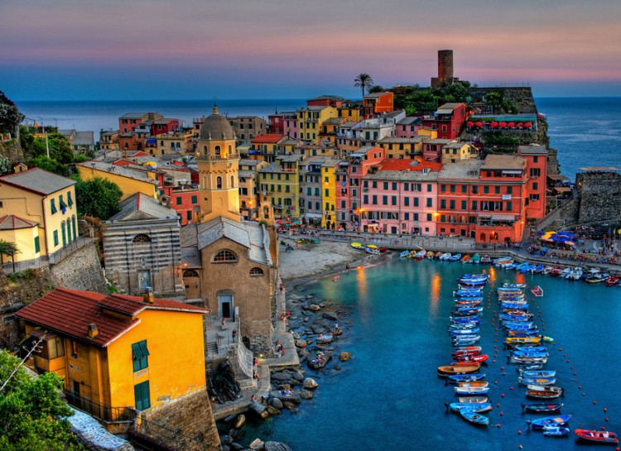
Vernazza
Vernazza, Italy is a charming seaside town that is located on the coast of west Italy. Tourists visit the Cinque Terre National Park to hike the Cinque Terre Trail. Hiking alongside the Mediterranean coast offers travelers spectacular views.

Slide 12
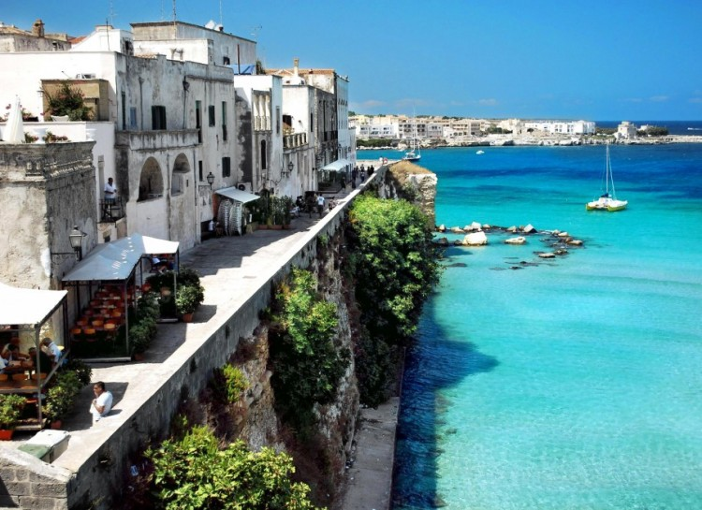
Otranto
Otranto, Italy is a coastal town that boasts scenic beaches. Tourists are drawn to the 12th century mosaic in the town’s Romanesque Cathedral. The mosaic portrays Biblical scenes and subjects as well as figures such as Alexander the Great.

Slide 13
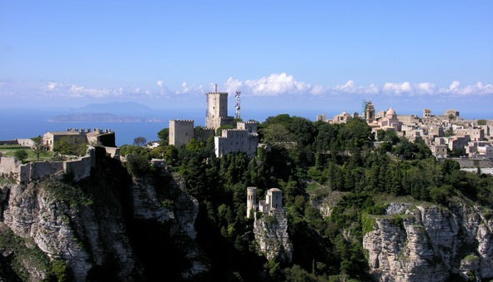
Erice
Erice is located on top of Mount Erice, at around 2,460 ft. above sea level, overlooking the city of Trapani, the low western coast towards Marsala, the dramatic Punta del Saraceno and Capo San Vito to the north-east, and the Aegadian Islands on Sicily's north-western coast, providing spectacular views. They often live in the clouds.

