Slide 1
10 Most Dangerous Cities in The World to Travel
Isn’t this sad?

Slide 2
It’s now easier than ever to visit distant locations around the world. Some places, however, are best avoided due to dangerous conditions. Certain dangerous places, on the other hand, are also desirable tourist destinations. If you do decide to visit such places, you should at least be aware of the risks and take sensible precautions. Here, in descending order, are the 10 most dangerous cities in the world.

Slide 3
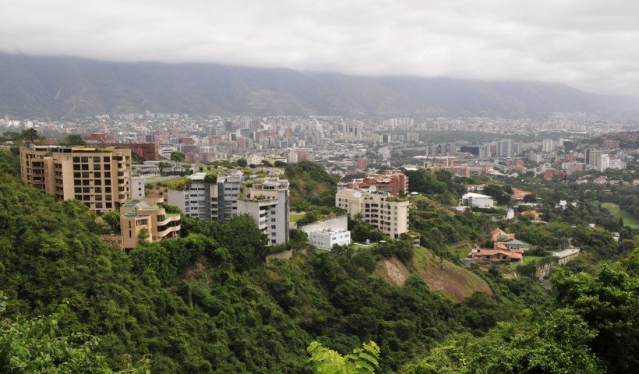
10. Caracas, Venezuela
This is the capital city of Venezuela and it is presently facing a crisis involving drug gangs. Street crimes such as muggings and theft are also common, making this an undesirable destination for most tourists. Many other cities in Venezuela also have high crime rates.

Slide 4
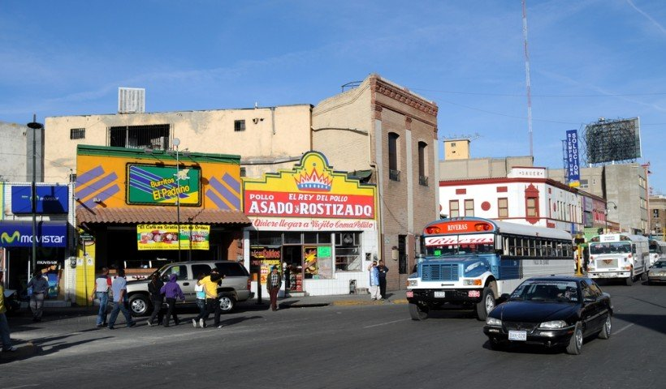
9. Ciudad Juarez, Mexico
Mexico’s problems with drug traffickers are well known and Ciudad Juarez is one of the nation’s most violent cities right now. Police are often employed or paid off by drug gangs, which means that many crimes go unpunished.

Slide 5
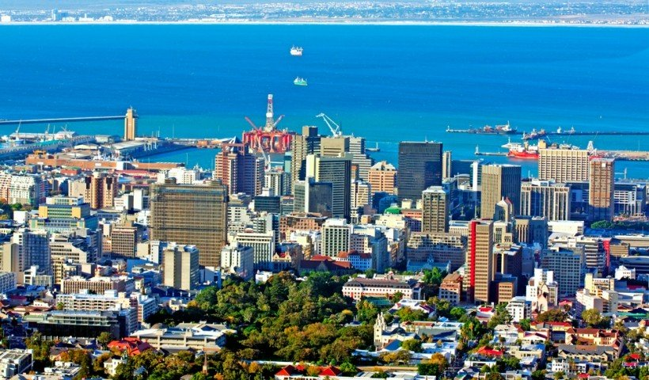
8. Cape Town, South Africa
Due to the prevalence of poverty and social unrest in this city, it is suffering from an extremely high crime rate. Although many tourists are drawn to South Africa because of its natural beauty and proximity to nature preserves and other attractions, Cape Town can be a dangerous place. It is possible to enjoy a visit to this city if you avoid the more dangerous sections and don’t travel alone at night.

Slide 6
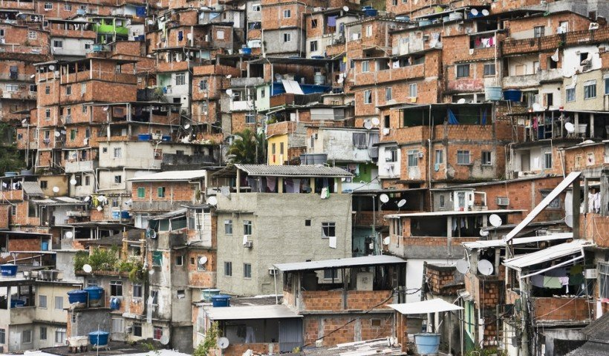
7. Rio de Janeiro, Brazil
Many cities in Brazil have very high crime rates, and some are more dangerous than Rio de Janeiro. Yet since Rio is by far the most popular tourist destination in Brazil, it’s worth focusing on here. Rio is actually safer than it was a decade ago, but street crimes are still common in many areas, especially at night. It’s possible to enjoy the resorts and beaches of this city, but common sense precautions should be taken.

Slide 7
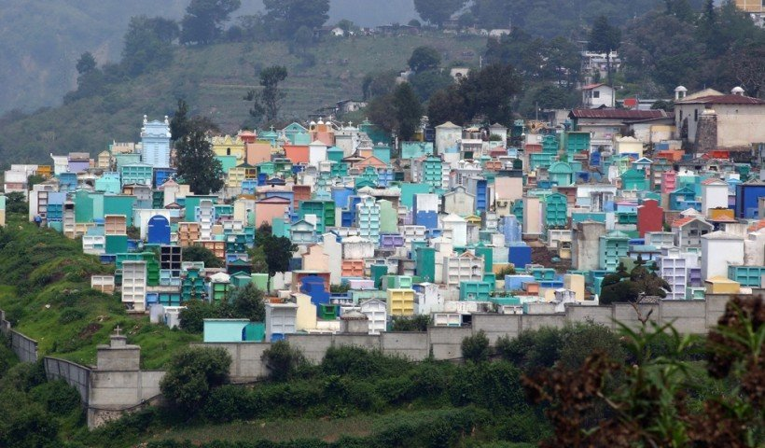
6. Guatemala City, Guatemala
Although Guatemala, a Central American nation on the Caribbean, has many tourist attractions, it’s a nation that is plagued with drug violence. It has a high murder rate and other common crimes include street robberies, bus holdups and carjackings. It’s advisable if visiting Guatemala to remain in safer regions and avoid Guatemala City.

Slide 8
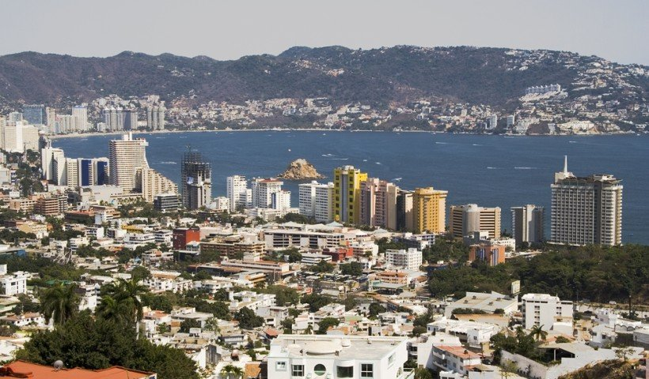
5. Acapulco, Mexico
Not long ago, this city was considered a safe and luxurious resort area. While tourism to Acapulco is still popular, drug violence has now made this into a dangerous area. Recent statistics reveal that this city has one of the world’s highest murder rates -142 per 100,000 people. People visiting Acapulco are advised to remain on the property of the resorts where they are staying, as most of the crime occurs in surrounding areas.

Slide 9
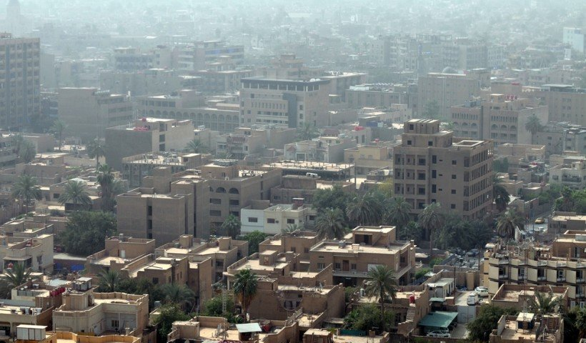
4. Baghdad, Iraq
Bombings, gunfire and other violent events are common in Iraq. This country has been on the “do not travel” list for Americans for many years and Baghdad remains a dangerous place. The future of Iraq is extremely uncertain as U.S. troops are departing from the country. This is another war-torn country that is not likely to be safe anytime soon. Since the violence in Baghdad usually consists of unpredictable outbreaks of terrorism, it’s not a place that people should visit without a good reason.

Slide 10
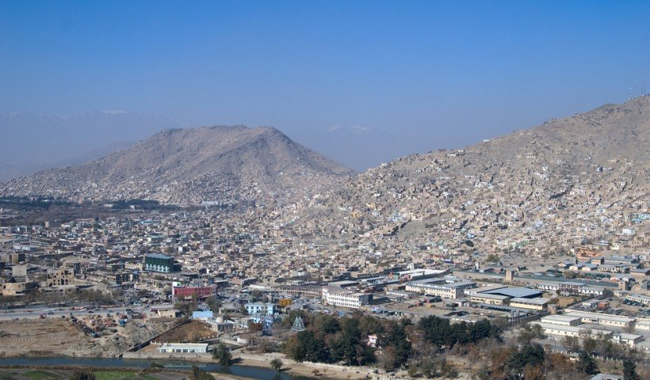
3. Kabul, Afghanistan
This has been one of the most dangerous cities in the world for some time. It is still a war zone, although U.S. troops are gradually being removed from the country. Terrorist attacks, including many bombings are common. Kabul is facing a very uncertain future and will probably be a very dangerous place for the foreseeable future. Like Baghdad, Kabul is a city where violence can occur at any time.

Slide 11

2. Karachi, Pakistan
Pakistan is experiencing a great deal of political unrest, and crime as well as terrorism is rampant. Assassinations are common, as well as suicide bombings and gang warfare. Karachi is one of the centers of this violence and tourists are advised to avoid this city.

Slide 12
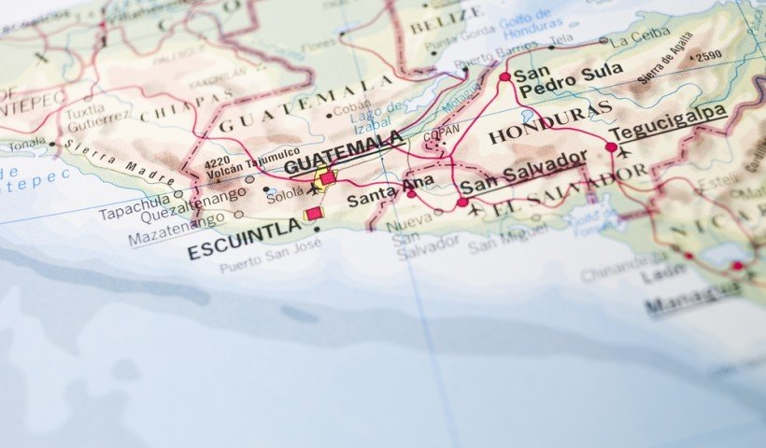
1. San Pedro Sula, Honduras
This city has ranked as one of the world’s most violent for several years now. According to many sources, it has the highest homicide rates in the world -169 per 100,000 people. Arms trafficking is a big problem, and illegal firearms are prevalent throughout the city. This is a city that tourists would do well to avoid.

