Slide 1
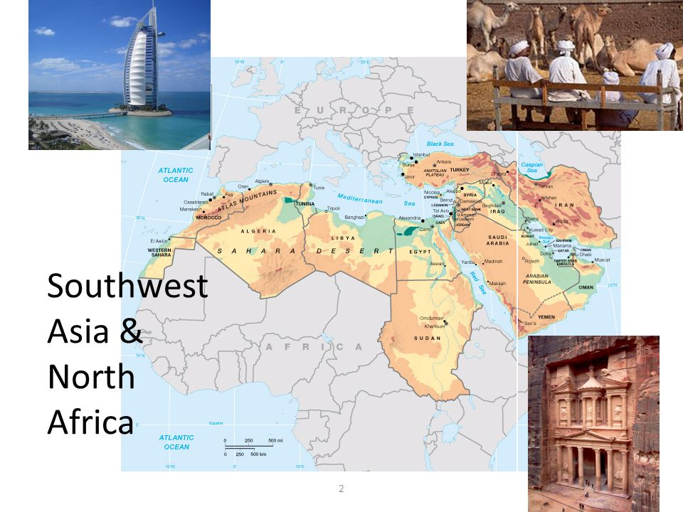
Atlas of North Africa and Southwest Asia
Atlas

Slide 2
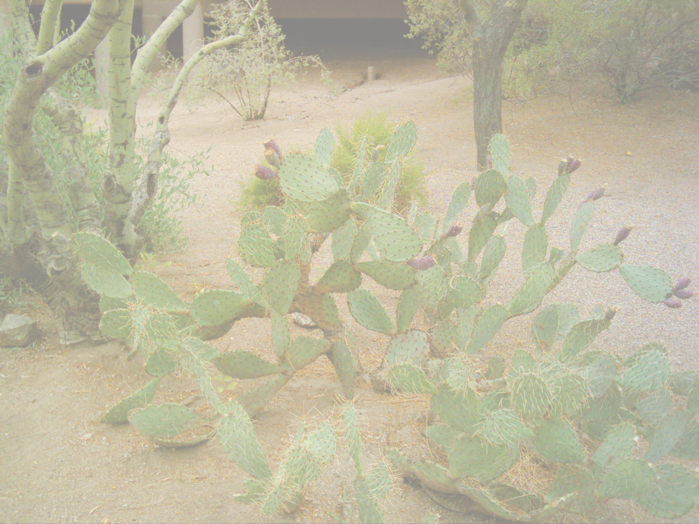
Physical and Cultural Features of
N. Africa & S.W. Asia
Desert, Semi-arid Grasslands, Exotic Streams, Mountains, Plateaus, Interior Drainage Basins
Variety of people, languages & birthplace of religions and ancient civilizations

Slide 3
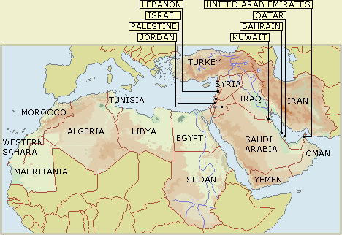
North Africa & the middle East

Slide 4
Crossroads of Continents
Africa Europe Asia

Slide 5
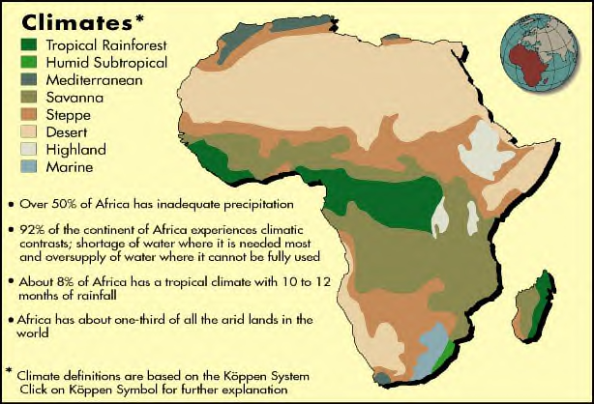
North Africa’s CLIMATES
North Africa’s major climates are
Arid (Desert) & Semi-arid (Steppe)

Slide 6
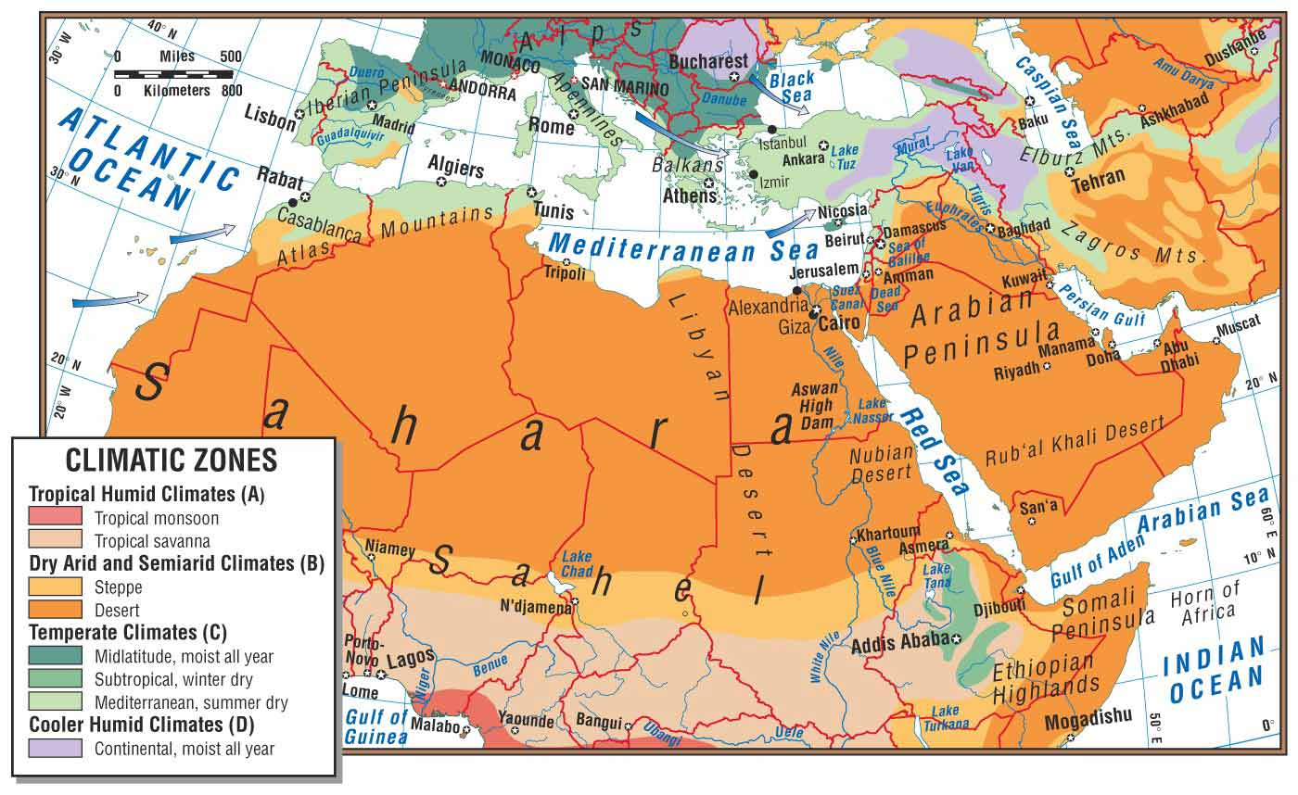
Climate

Slide 7
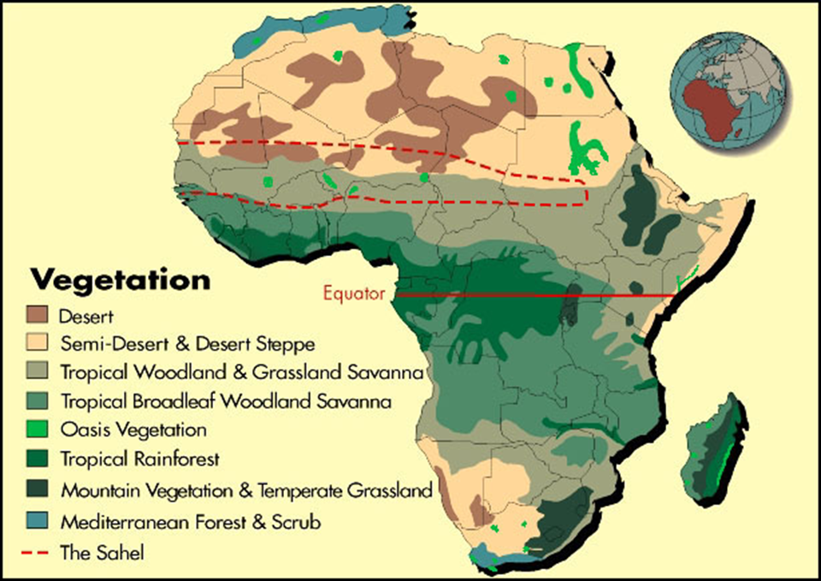

Slide 8
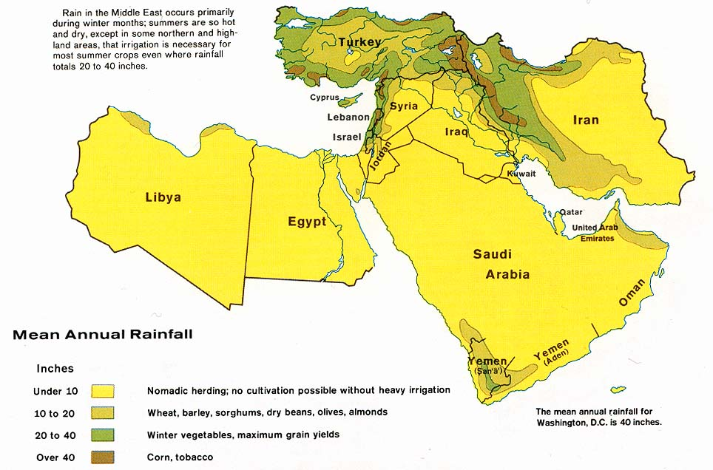

Slide 9
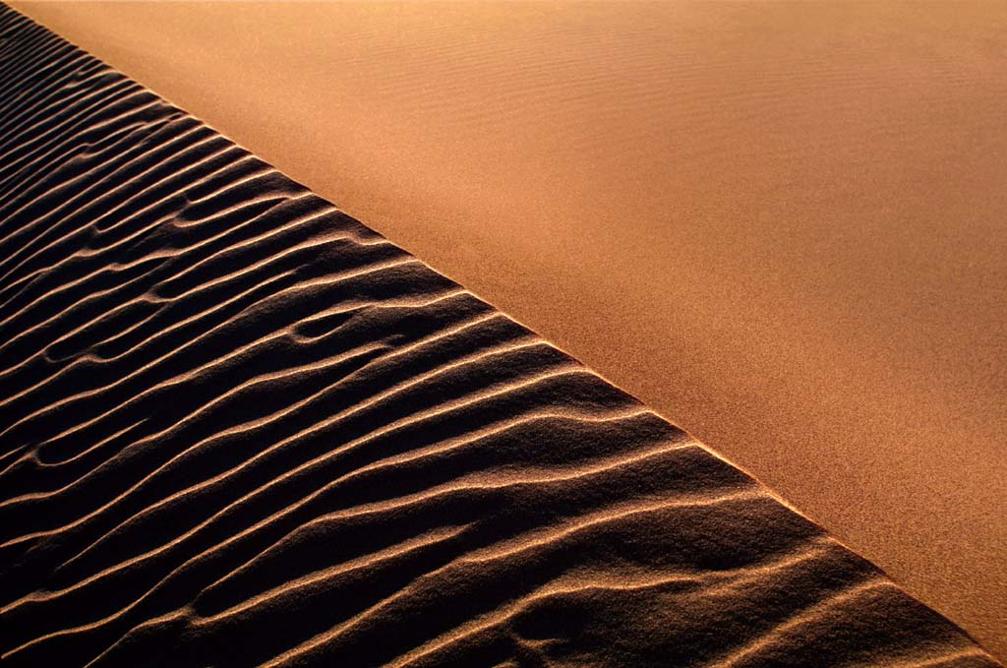
Sahara Desert
The Sahara is the world’s 2nd largest desert, stretching 3.5 million square miles.
Antarctica is the largest.

Slide 10
Sahara Desert’s Borders
Atlantic Ocean on the west
Atlas Mountains and the
Mediterranean Sea on the north
Red Sea and Egypt on the east
Sudan and the valley of the
Niger River on the south.

Slide 11
Sahara
Averages less than five inches of rain each year.
Temperatures there can run to the extreme
  -freezing at night
  -Can be more than 130 degrees Fahrenheit at the peak of day.

Slide 12
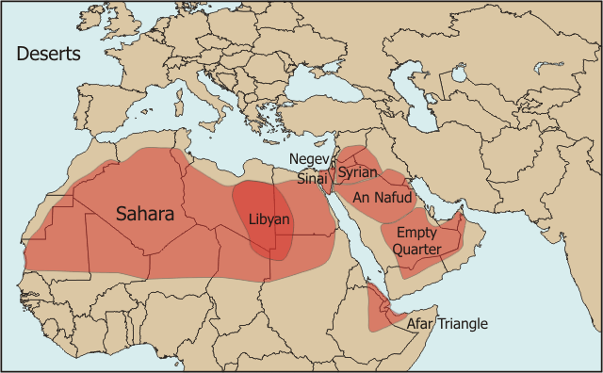

Slide 13
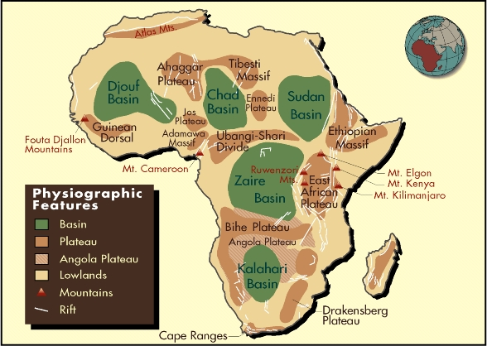

Slide 14
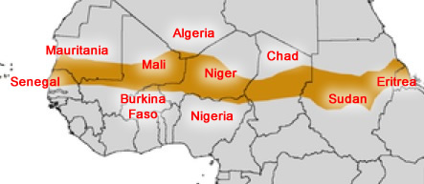
Sahel
-Steppe region below Sahara that is spreading into a desert region.

Slide 15

The Arabian Peninsula is mostly desert
* The Rub 'al-Khali, or "Empty Quarter" is a large desert in Saudi Arabia. It is the largest area of continuous sand in the world.
*The climate is extremely arid. Few places
receive more than 7 in of rain a year, and
no permanent streams exist. Summer
temperatures reach as high as 130 F in some
areas.

Slide 16
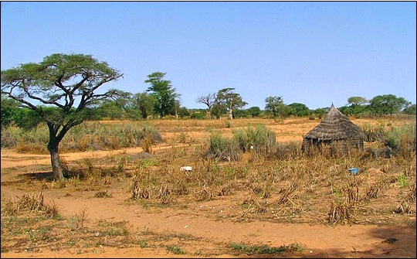
Desertification

Slide 17
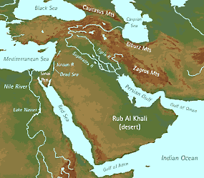
The Arabian Peninsula is primarily steppe and desert climate as well

Slide 18
Mountains and highlands

Slide 19
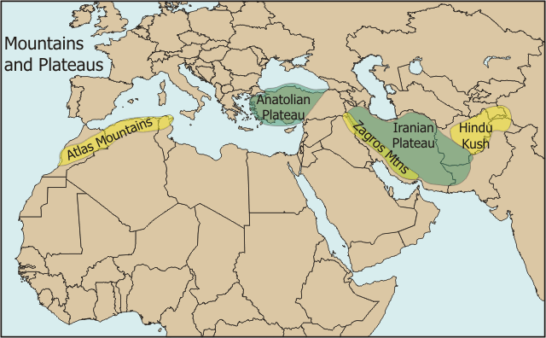

Slide 20
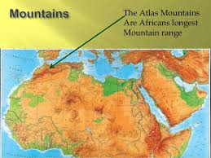
Atlas Mountains
Separates the northern moist Mediterranean climate from the arid south.

Slide 21
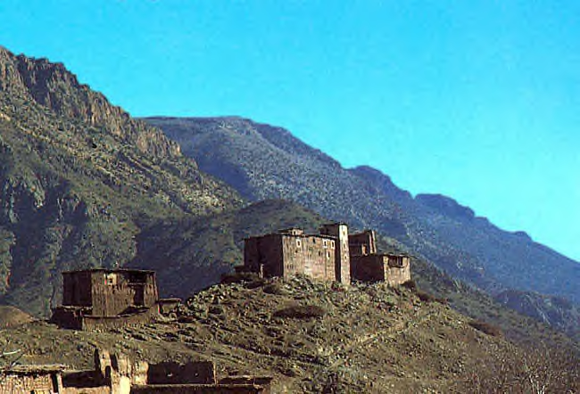
Atlas Mountains in Morocco
Atlas Mountains of Morocco

Slide 22
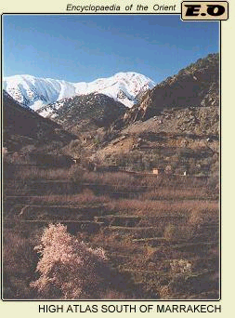

Slide 23
Middle East Mountains
Taurus
  Spreads across Turkey
  Highest Point- Mt. Ararat-16, 583 ft., Biblical historians believe Noah’s Ark landed here.
Zagros
  Extend through southwestern Iran, and through northern Iraq
  Highest point- Zard Kuh, 14, 921 ft.

Slide 24
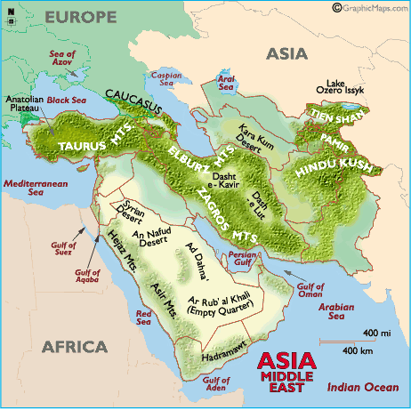

Slide 25

Water
Water is the most precious resource for this region of deserts and steppe areas.
  Many areas (ex. Nile River Valley) dependent on seasonal floods.
  The alluvial soil around the river and the delta regions are especially good for farming.

Slide 26
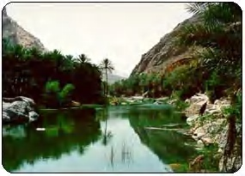
Wadis
Wadis dry streambeds that fill with water only after rainfall in a desert or steppe region.

Slide 27
OASES
Oasis is a place where water comes to the surface in desert area.
"oasis" is believed to come from an ancient Egyptian word, "wah," meaning "fertile place in the desert."
About 75 percent of the Sahara's population live in oases

Slide 28
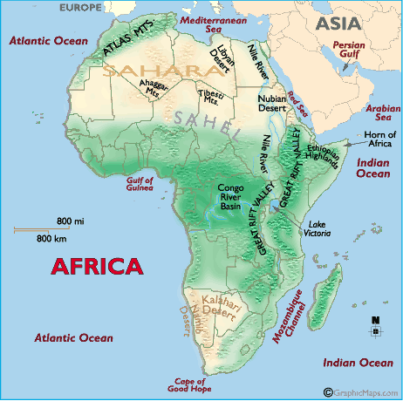
Major African Water Features
Mediterranean
Sea
Red Sea
Arabian Sea
Persian/Arabian
Gulf
Nile River

Slide 29
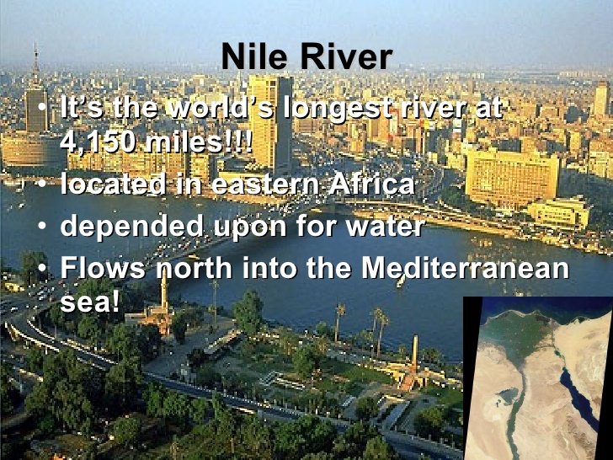

Slide 30
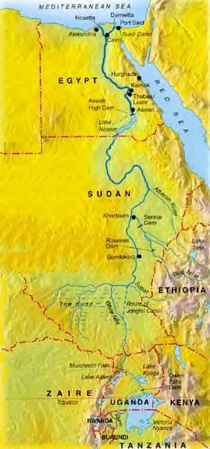
*The Nile and its tributaries flow though nine countries.

Slide 31
The Nile River
Length: From White Nile Source to
Mouth- 4184 miles, longest river
in the world
Name: The Nile gets its name from the
Greek word "Nelios", meaning
River Valley.
Sources: The White Nile: Lake Victoria,
Uganda.
The Blue Nile: Lake Tana,
Ethiopia.

Slide 32
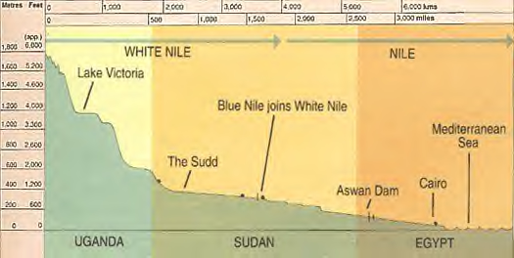
The Nile River flows South to North, where accumulation of sediment forms a delta.

Slide 33
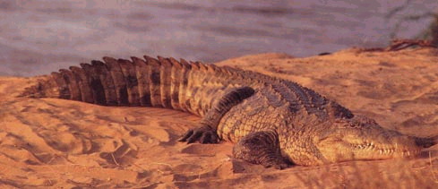
Everyday Activities on the Nile
Tourism
Farming
Fishing
Sometimes you’ll even see crocodiles!

Slide 34
ASWAN DAM on the Nile River
The Dam was created in 1971
The Dam wall is 365 feet high
Created artificial lake- Lake Nasser, which covers 300 miles

Slide 35
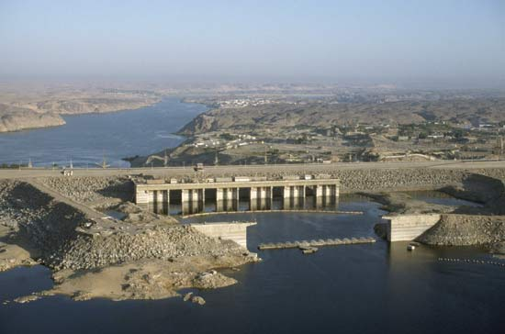

Slide 36
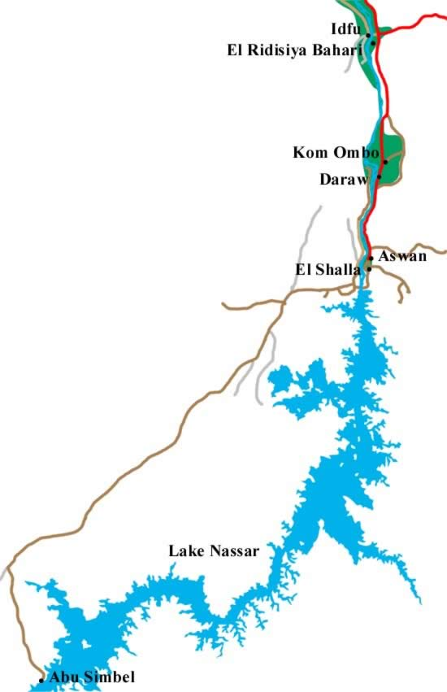
Positive effects of Dam
Prevents flooding
Controls irrigation
Can plant 3 crops instead of only 1 a year
Creates Hydroelectric power- supplies Egypt with 40% of its electricity
Amount of farmland has increased by 2.9 million acres

Slide 37
Negative Effects of Dam
New layer of fertile soil no longer deposited by annual flood, must use fertilizers
  Very expensive
  Run off pollutes river, pollution kills fish
New soil not added to Delta, which causes erosion

Slide 38
Water flow has decreased.
  Stagnant water allows disease to increase.
  Salt content has increased, which can ruin crops
  Some experts think weight of Lake Nasser may be producing earthquakes

Slide 39
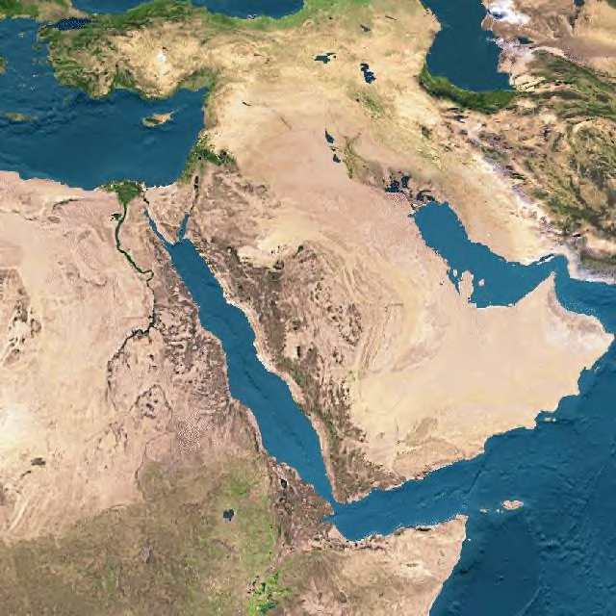
Sinai Peninsulalocated between Egypt and the Arabian Peninsula

Slide 40
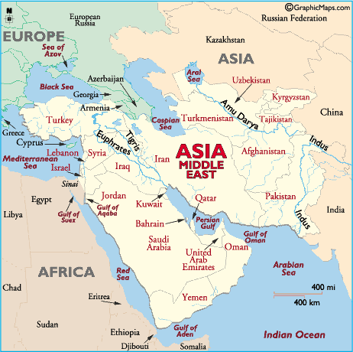
Major Water Features
Tigris River
Euphrates River
Persian Gulf
Red Sea
Arabian Sea
Mediterranean Sea
Caspian Sea
Black Sea

Slide 41
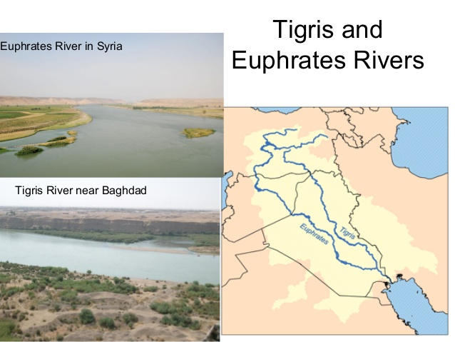
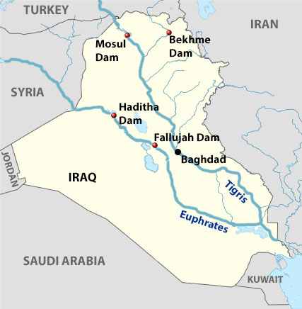

Slide 42
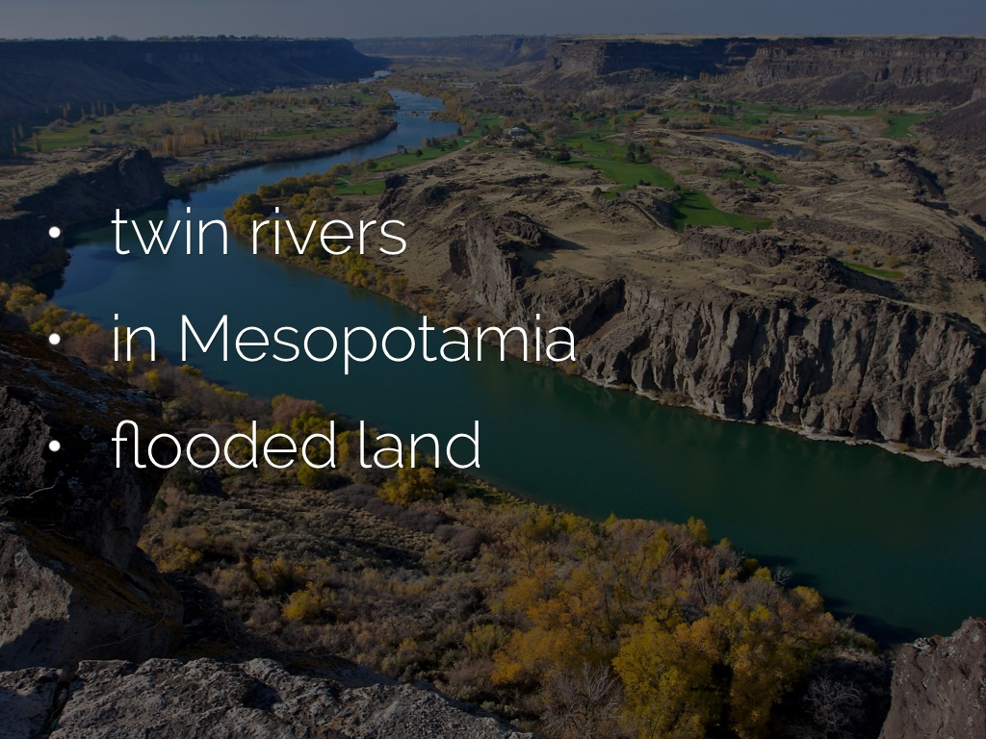

Slide 43
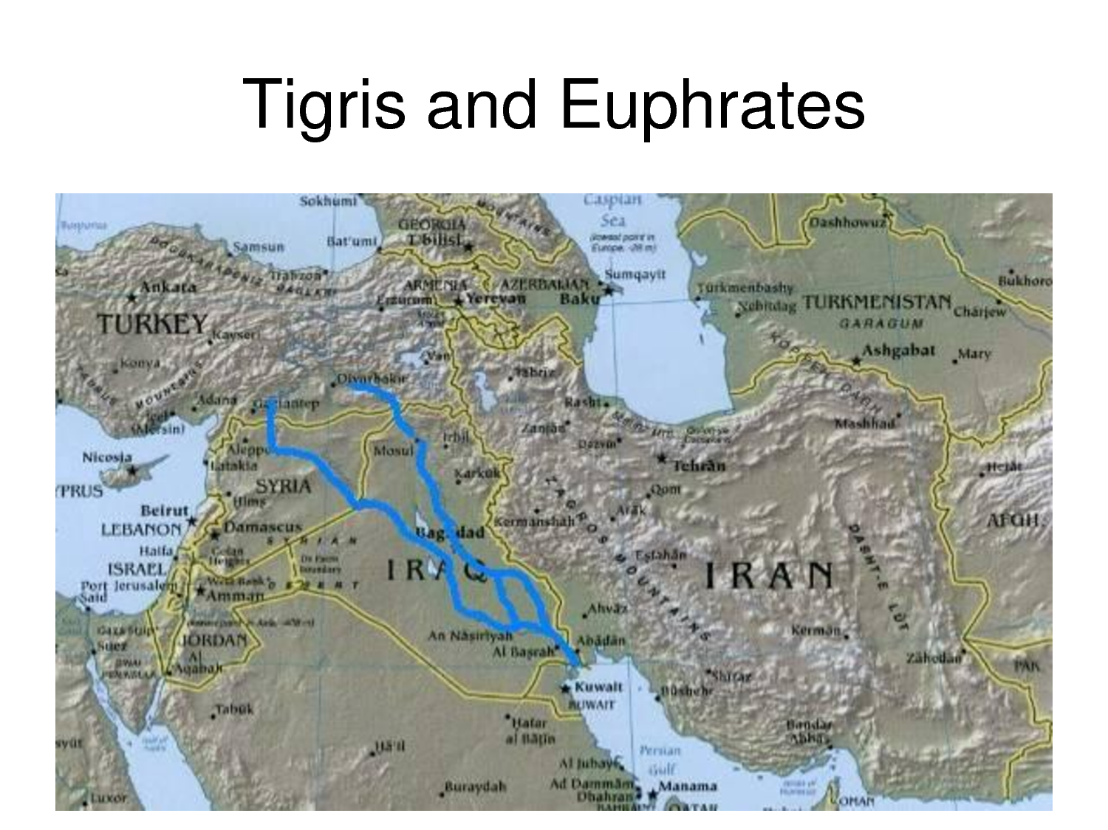

Slide 44
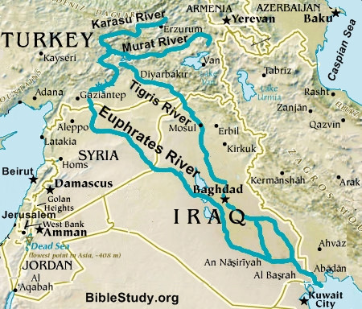
Major Rivers

Slide 45
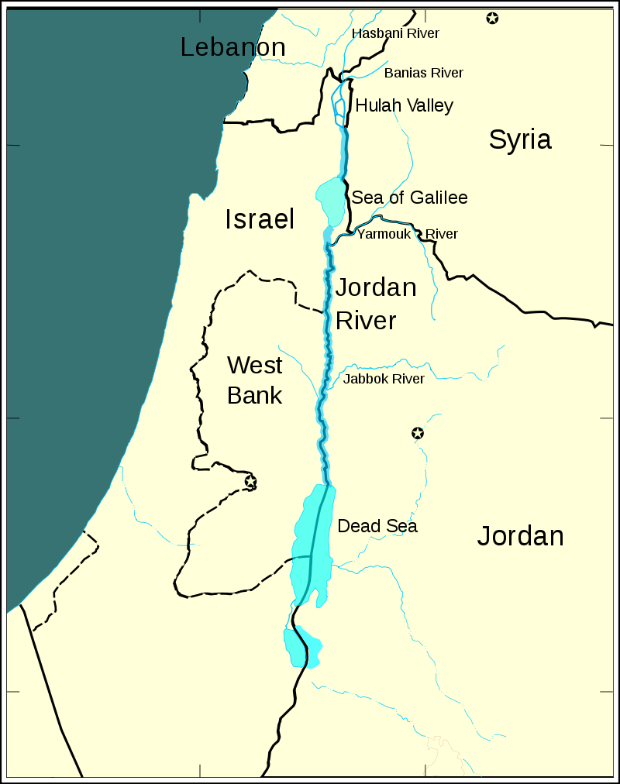
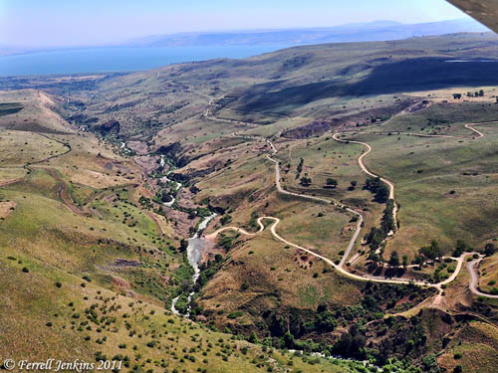
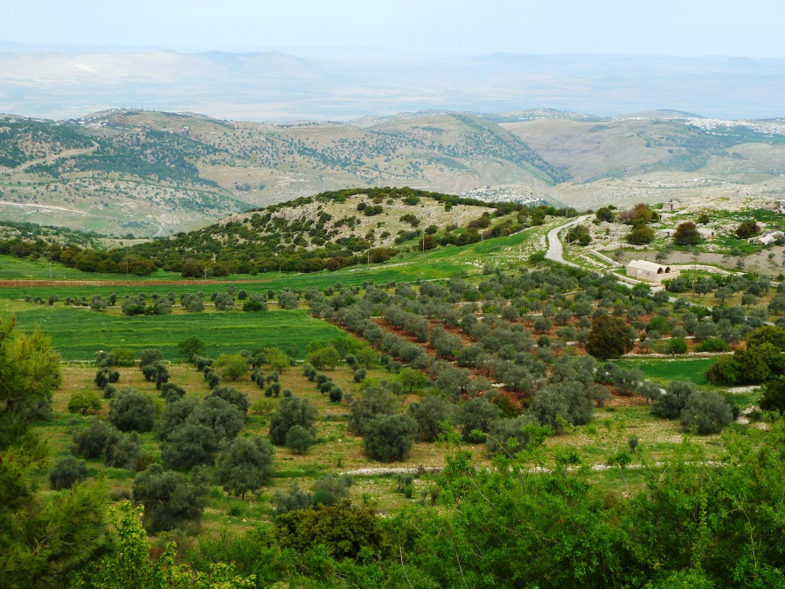
Jordan River

Slide 46
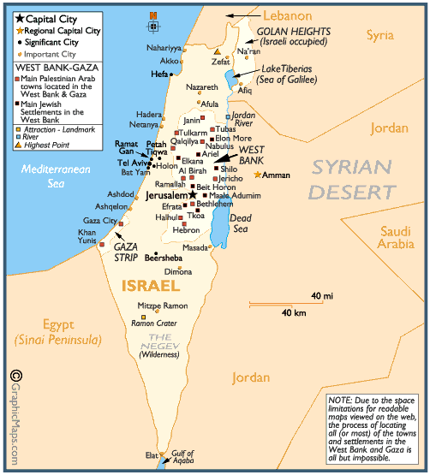
Major Water Features
Jordan River
Dead Sea

Slide 47
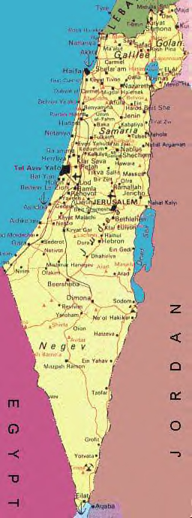
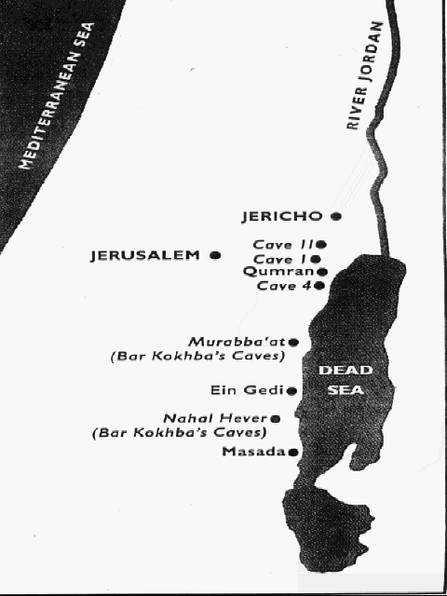
DEAD SEA

Slide 48
Dead Sea
Lowest point on Earth- 1,320 feet below sea level
Saltiest water in the world
You float in its waters!
Average of 330 days of full sunshine a year

Slide 49
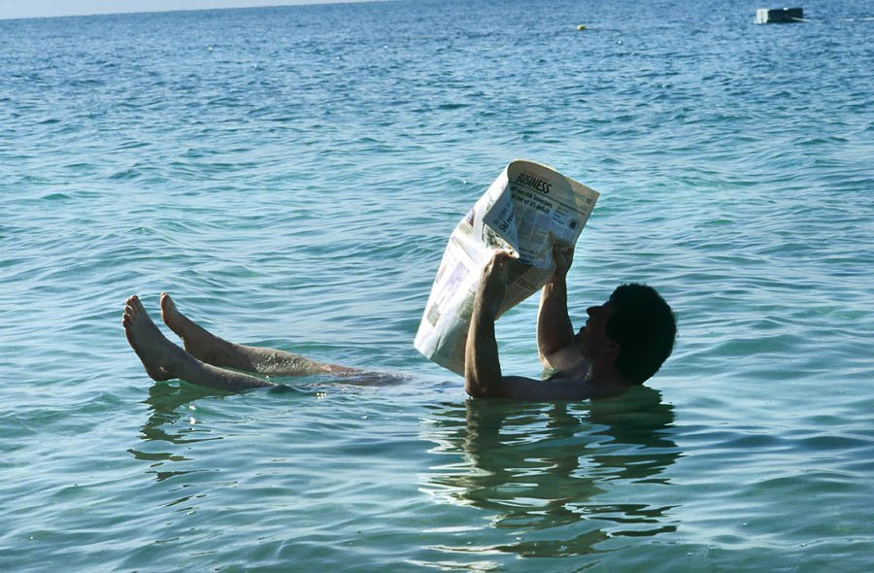
Dead Sea Floater

Slide 50
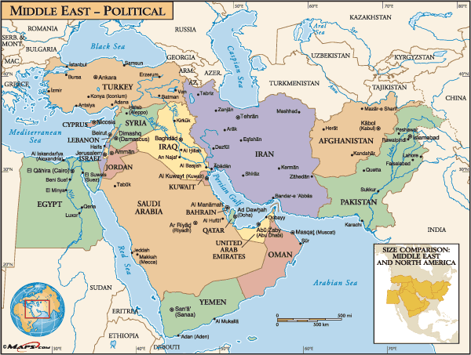
Strategic Water Locations
Whoever controls these water features has the ability to regulate whose ships can pass through them. Much of the world’s commerce passes through these narrow, strategic water bodies.

Slide 51
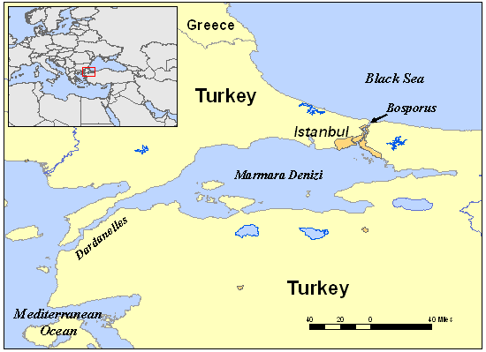
Bosporus & Dardanelles Straits

Slide 52
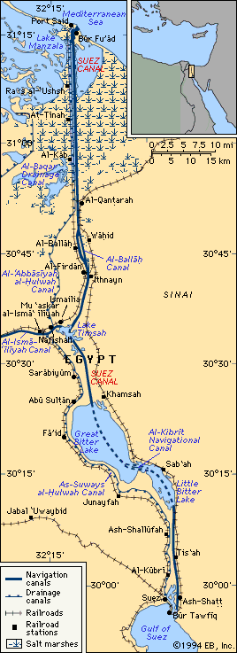
Suez Canal
*The 101-mile waterway connects the Mediterranean Sea to the Red Sea.
* The Suez Canal is used to transport goods to and from all three continents.

Slide 53
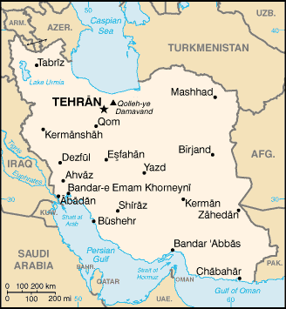
Strait of Hormuz

Slide 54
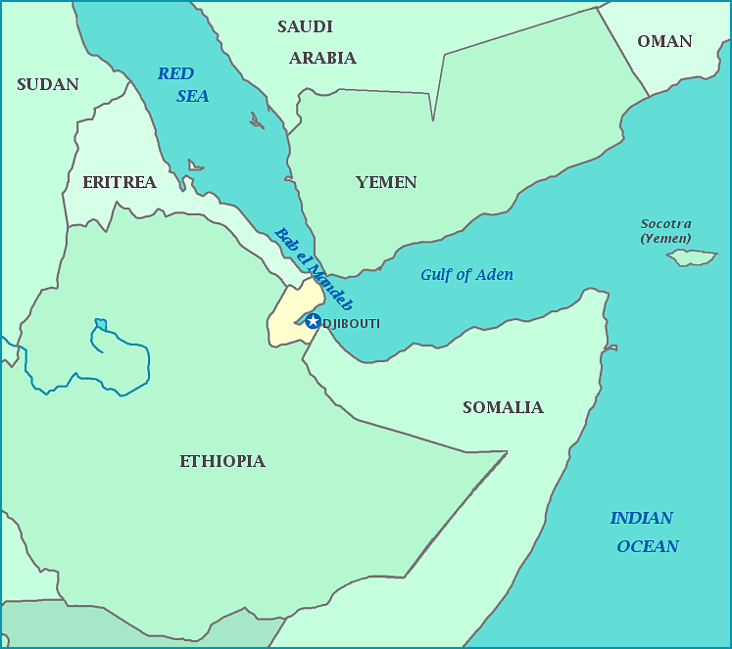
Bab el Mandeb

Slide 55
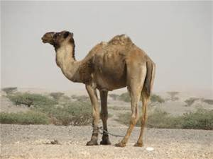
The Camel, the ship of the desert!

Slide 56
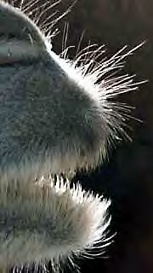
I am the tip of a camel’s nose and mouth! I am very important to the camel, because my nostrils can close up completely to keep out the sand. My mouth helps the camel get the most protein and energy out of poor-quality food in the desert. By swallowing and regurgitating all day, chewing and chewing and chewing with sideways grinding motions, my special mouth pulverizes food and sucks out every last bit of nutrition.

Slide 57
CAMELS
People have been using camels for over 4,000 years mostly as pack animals and for transportation. They use their hair for felt, and they are used for their meat and milk as well. They dried manure can even be used as fuel.

Slide 58
  Camels can be gross! They spit, burp, and even worse!
  Camels have adapted to their environment. The secret is in its blood cells (erythrocytes), which can absorb water and expand up to 240% their original size! Camels can drink 40 gallons of water at once and store it in their blood. The humps store 80 lbs. of fat which nourishes the camel in times of scarce food. When the camel uses the fat, the humps shrink. When it eats again, the humps swell up.

Slide 59
Camels have a third eyelid that goes over the eye like swimming goggles to protect its eyes from the sand!
The camel's feet are huge and they allow them to walk on the sand like snow shoes.
Camels live about 40 years and have 1 baby every 12-15 months.

Slide 60
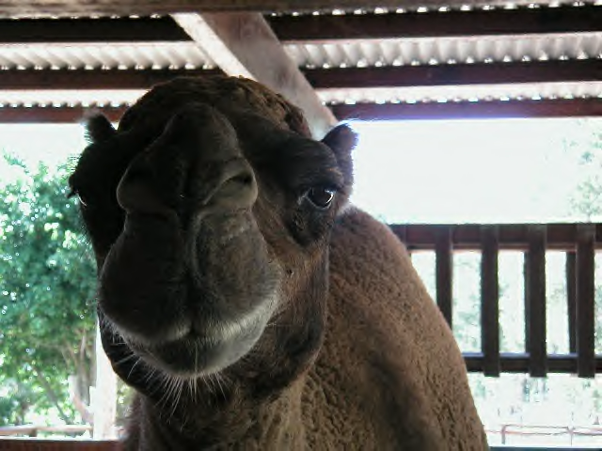

Slide 61
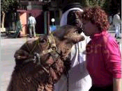

Slide 62
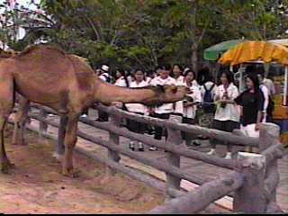

Slide 63

Camel in the Desert

Slide 64

Camal Racing

Slide 65


Slide 66
Wildlife of the Desert

Slide 67

Horned Viper

Slide 68

Houbara

Slide 69

Fennec Fox

Slide 70

Jeroba

Slide 71

Desert Hedgehog

Slide 72

Monitor

Slide 73

Sand Cat

Slide 74

Scarab Beetle

Slide 75

human geography

Slide 76

The Fertile Crescent

Slide 77
The Fertile Crescent
*Greeks called this region Mesopotamia, which means "between the rivers."
*Many different civilizations developed in this small region.
-First came the Sumerians, who were replaced in turn by the Assyrians and the Babylonians.
-Today this land is known as Iraq

Slide 78


Slide 79


Slide 80


Slide 81


Slide 82
Practice Maps

Slide 83


