Slide 1
Russian Realm Atlas

Slide 2
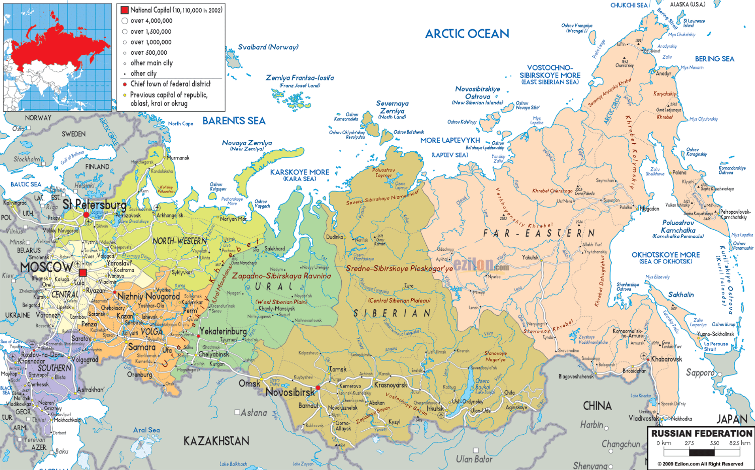
Major regions in Russia

Slide 3
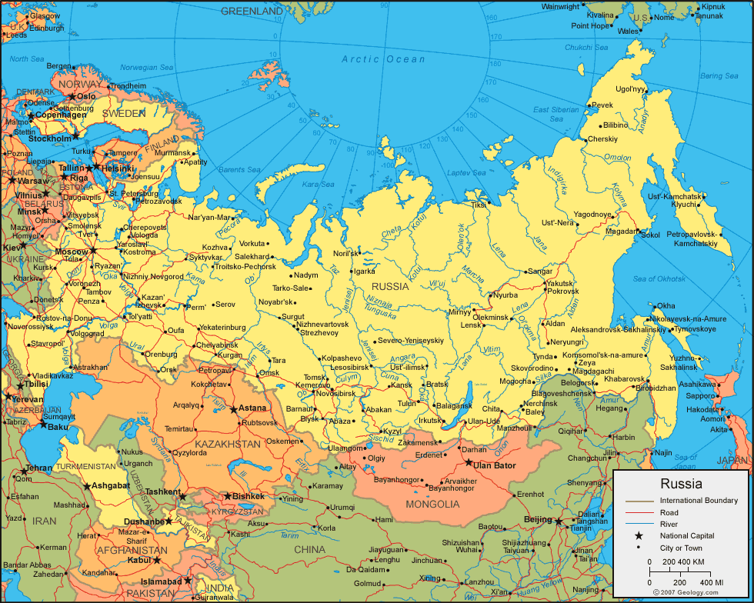

Slide 4
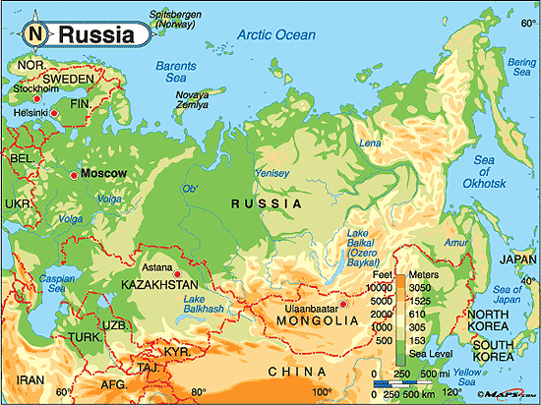

Slide 5
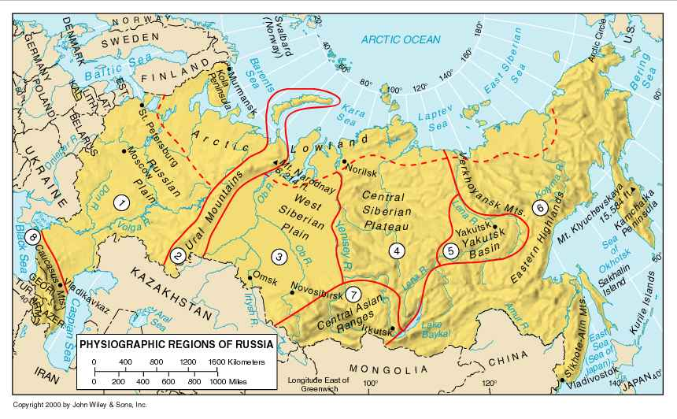

Slide 6
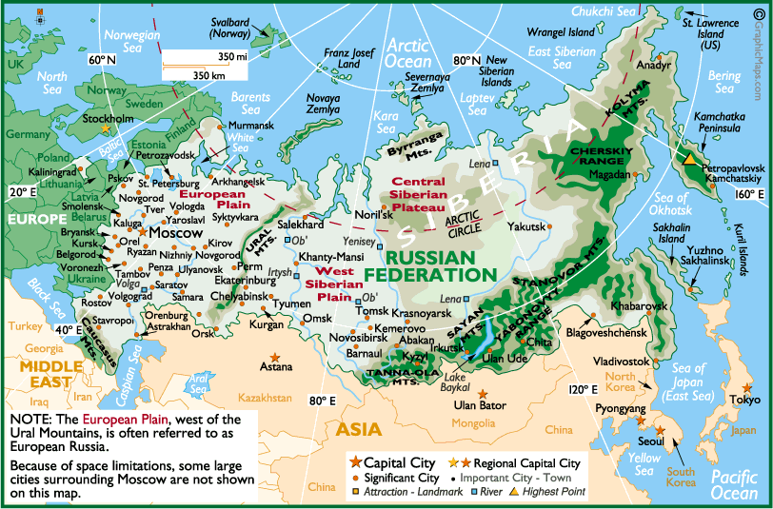

Slide 7
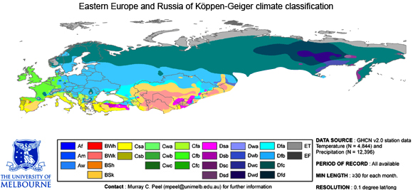

Slide 8
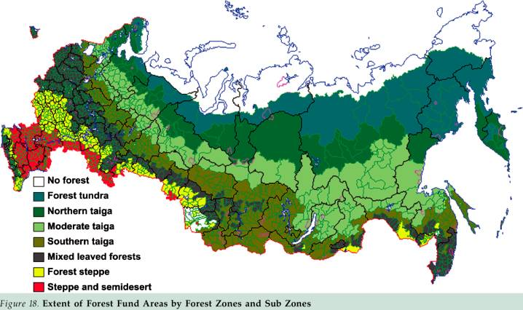

Slide 9
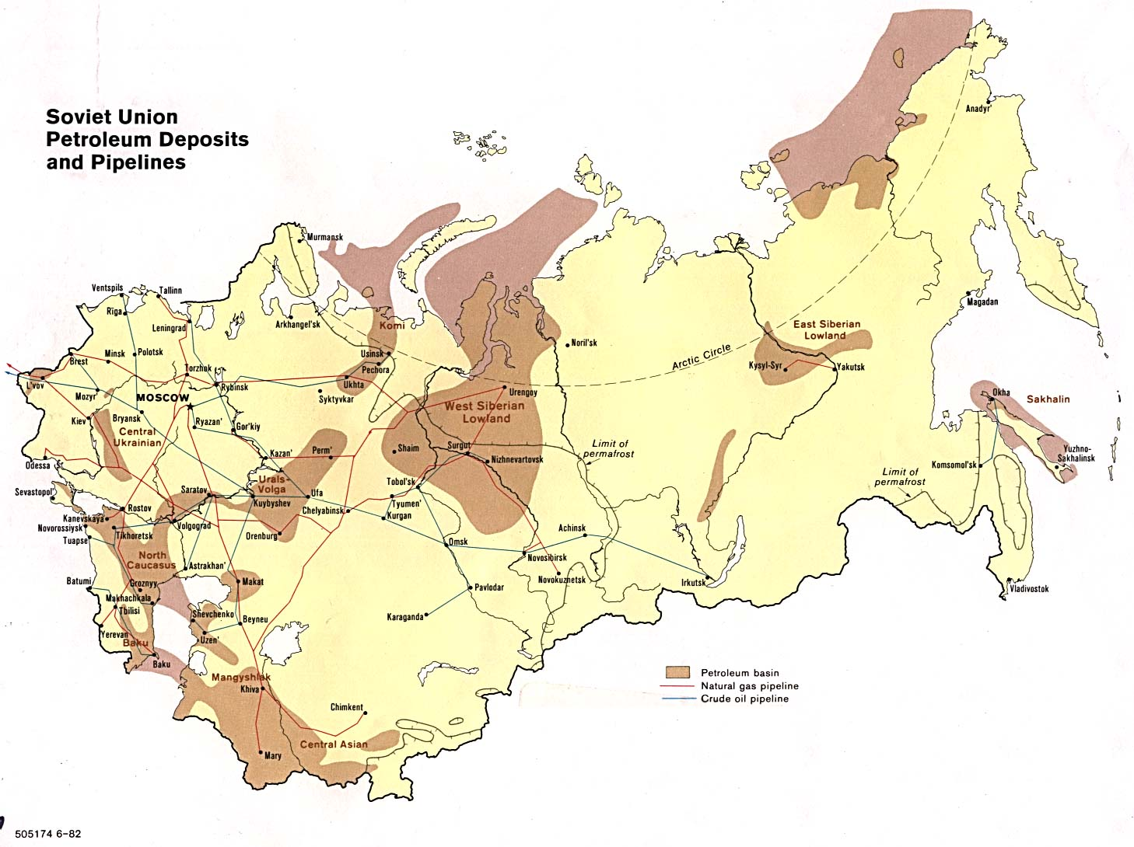

Slide 10
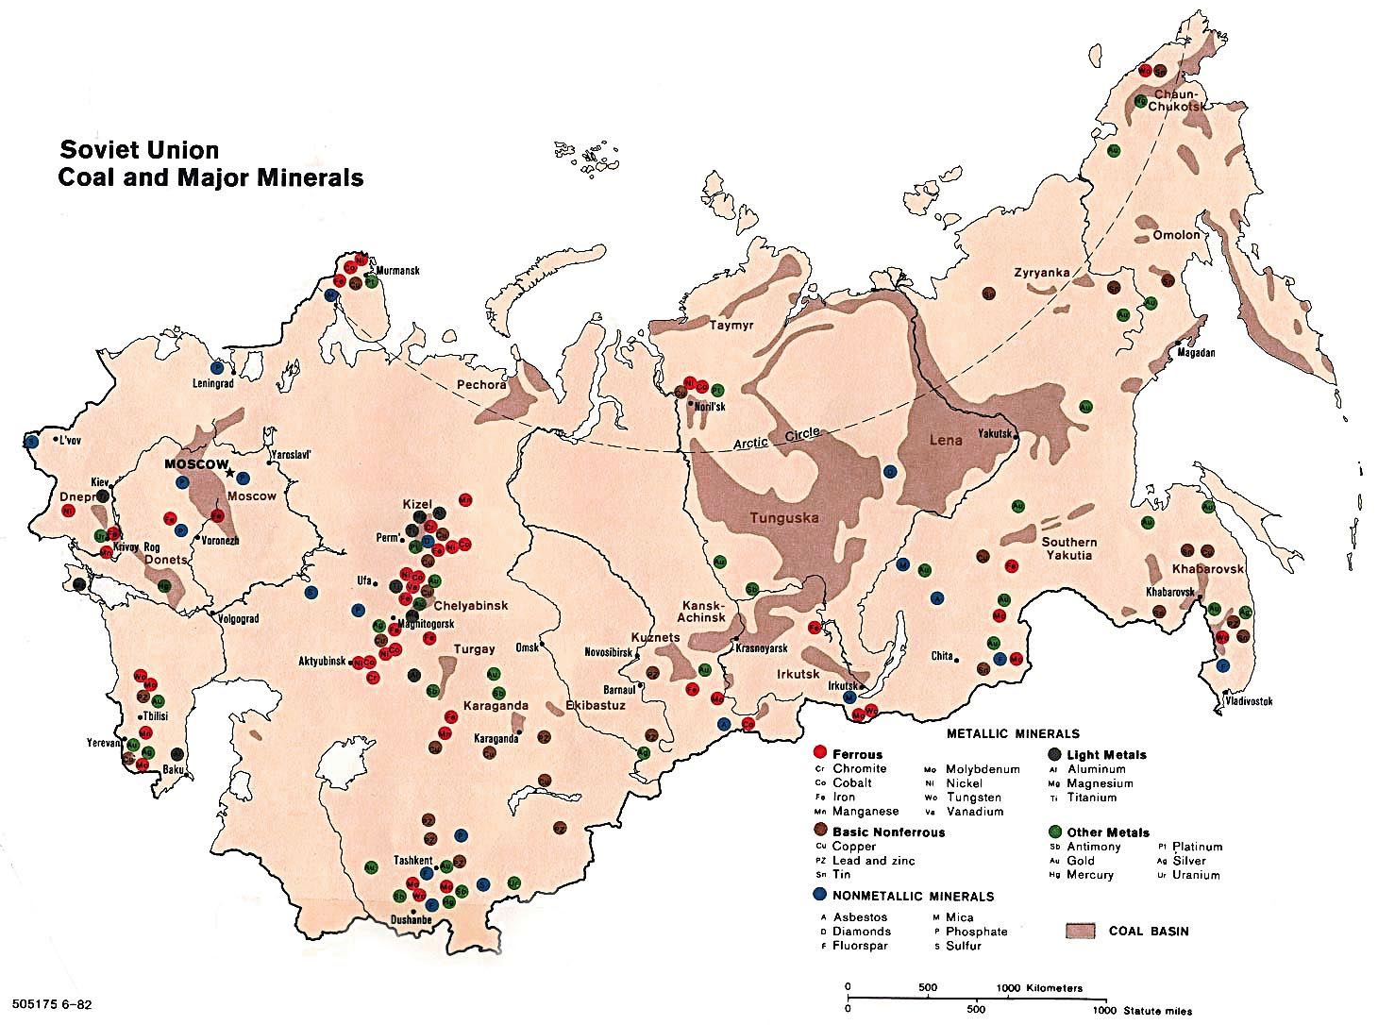

Slide 11
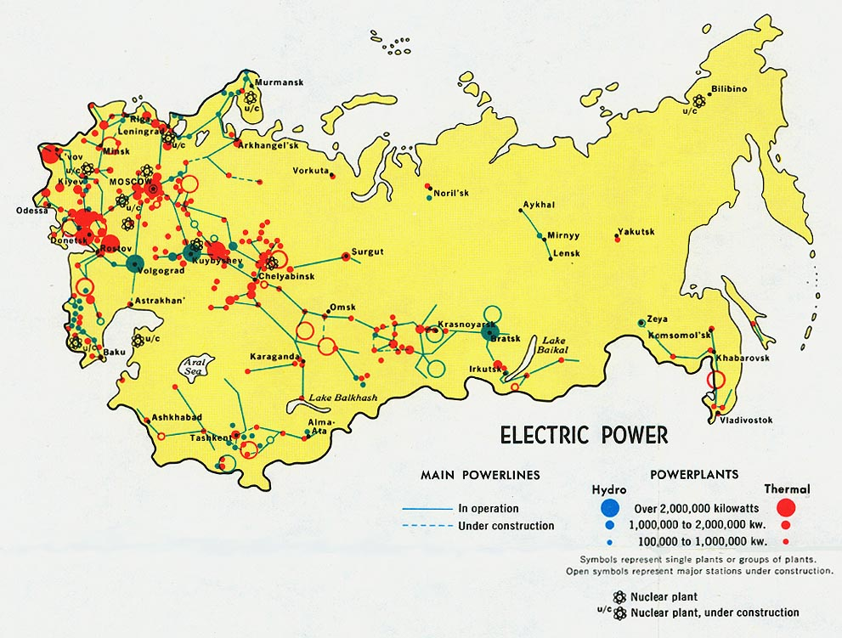

Slide 12
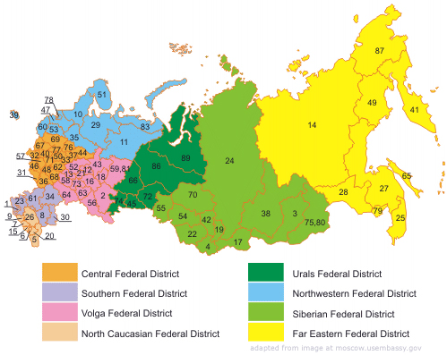
Political Divisions Within Russia

Slide 13
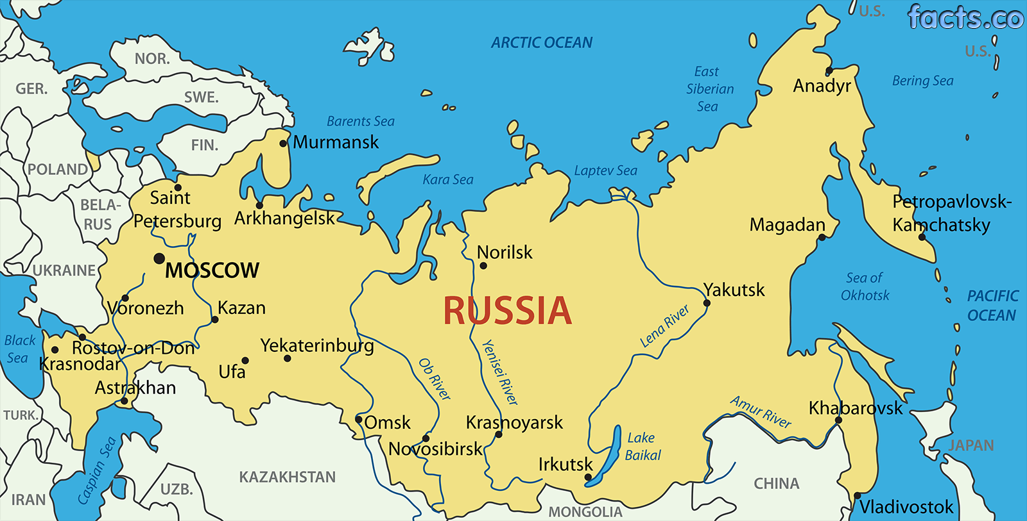
Major Cities

Slide 14
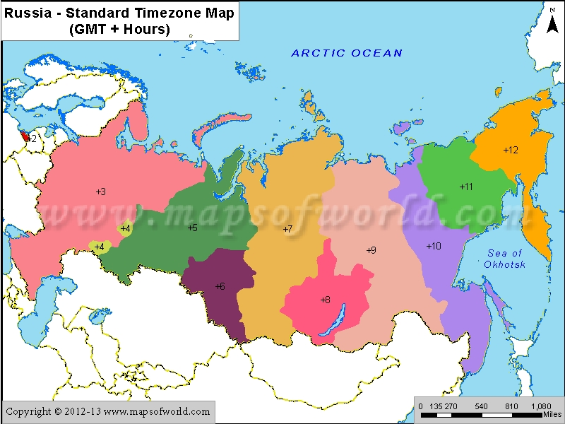

Slide 15
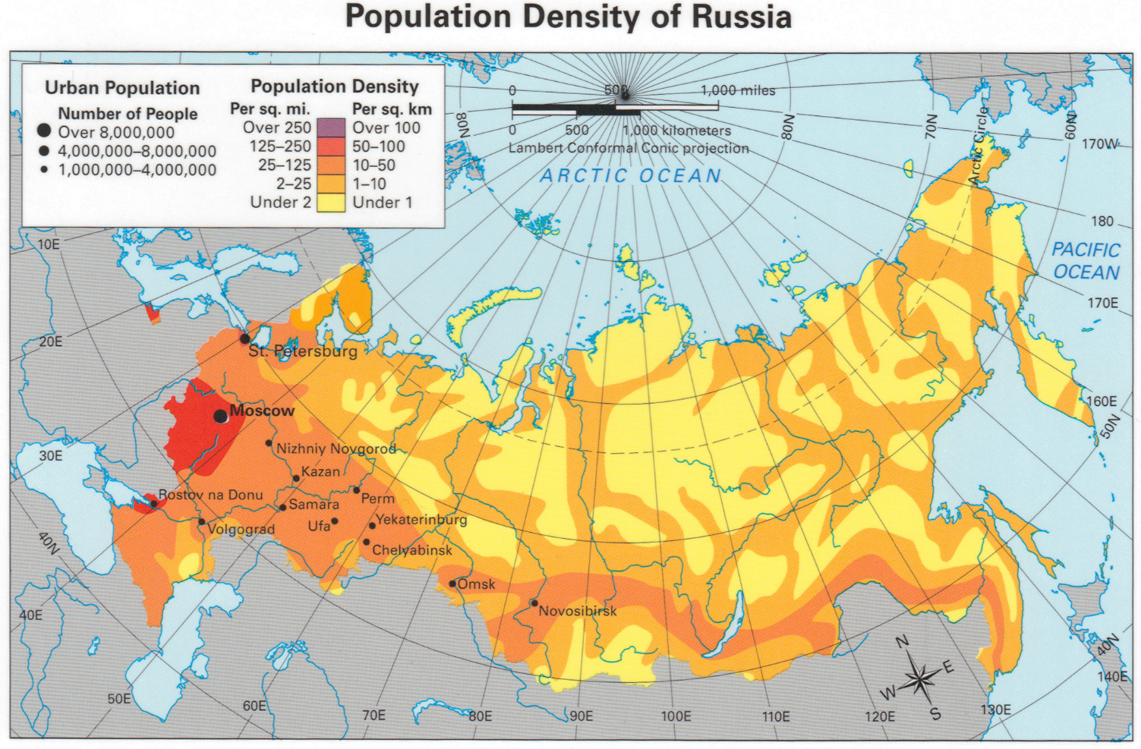

Slide 16
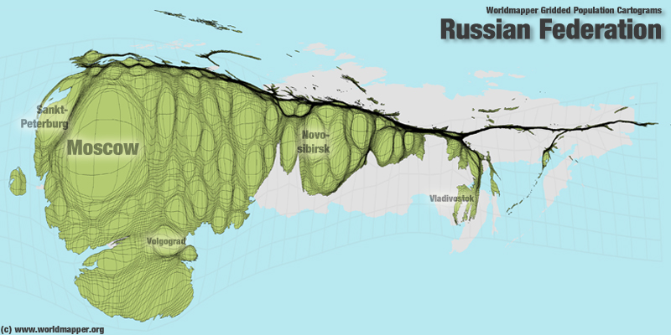

Slide 17
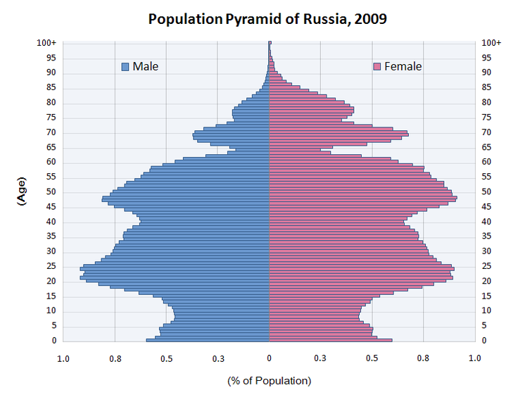

Slide 18
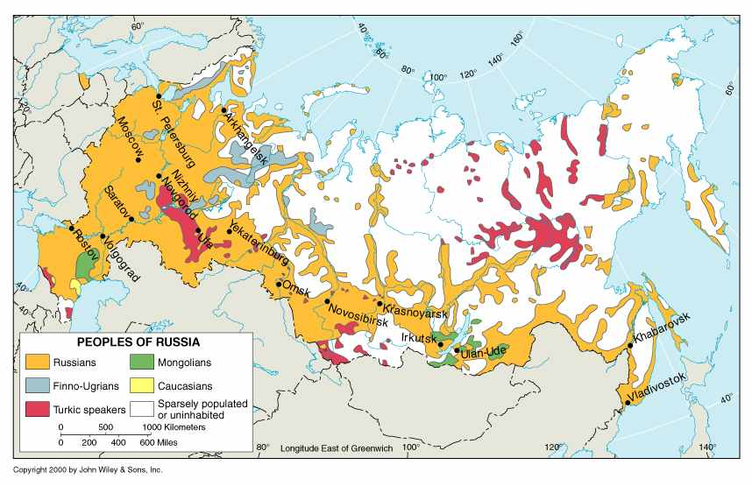

Slide 19
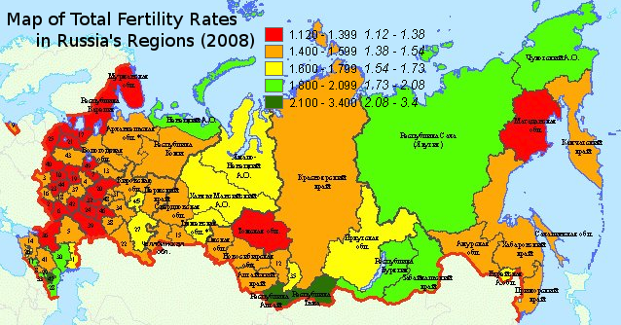
A rate of 2.1 is zero population growth. Below that number, the population is declining, and above it, the population is increasing.

Slide 20
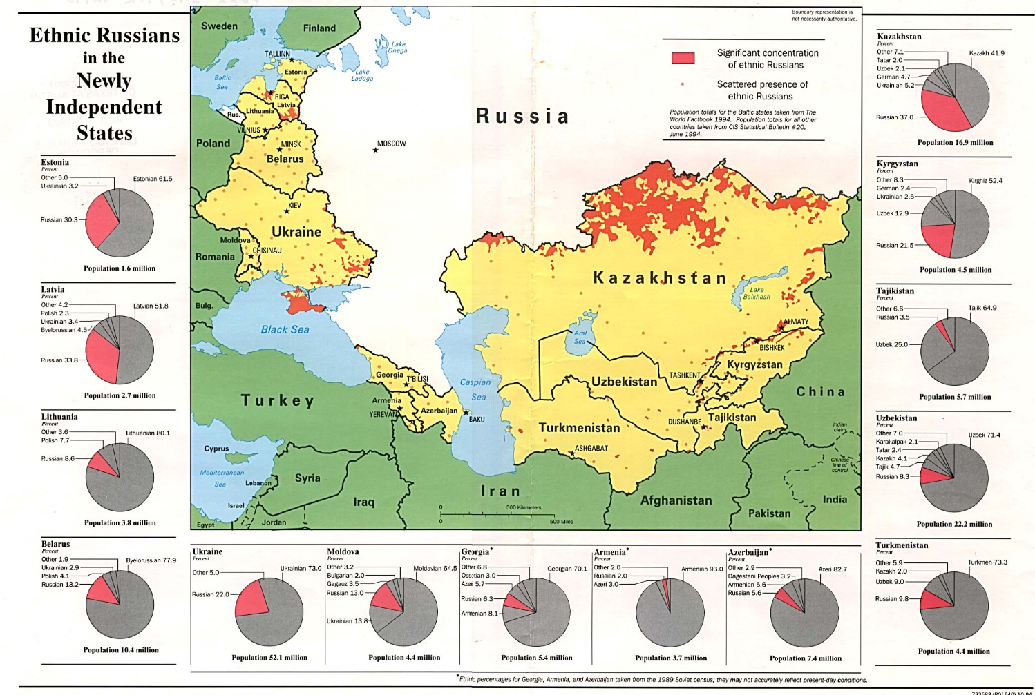

Slide 21
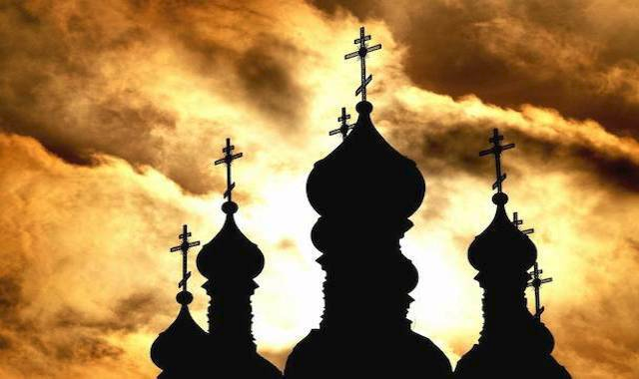
Division within russia

Slide 22
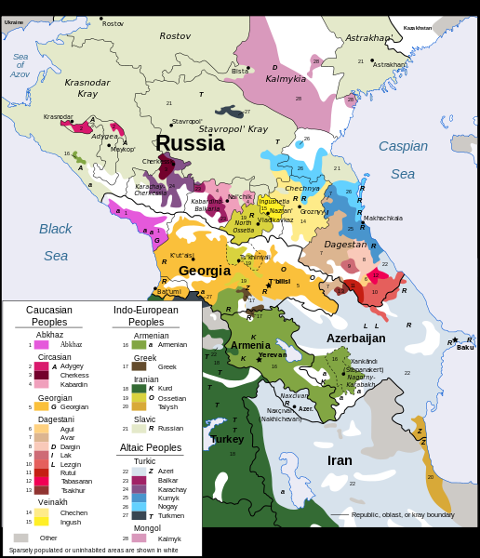
Ethnic diversity in the Transcaucasia Region

Slide 23
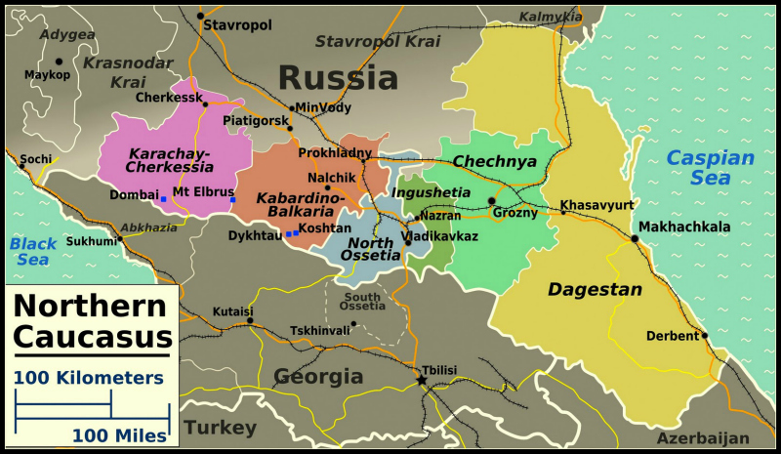
Moscow has crushed the attempt of Chechnya to separate from Russia out of the fear that this would encourage other areas to seek separation.

Slide 24
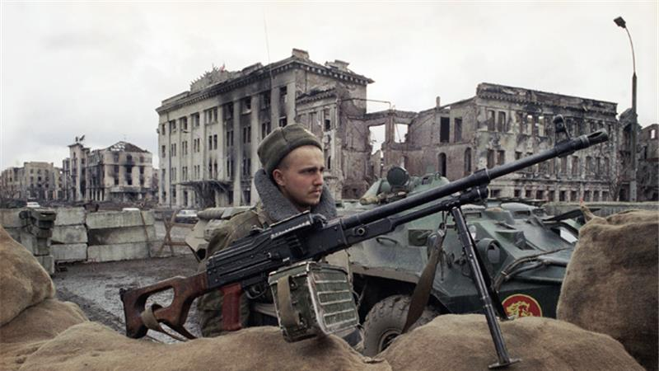
Russian troops entered Chechnya in December 1994 to quash the breakaway region's independence drive

Slide 25
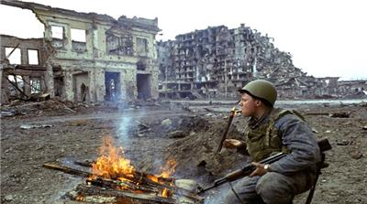
The capital of Chechnya in December, 1994

Slide 26
12 November 2015
Ever sensitive to the possibility of secessionist sentiments, the Kremlin has made clear that it will crack down hard on any nascent movements. Putin signed a law last year that significantly expanded the possible punishment for anyone calling for a region’s secession from Russia: Article 280.1 of the Criminal Code stipulates up to five years in prison for separatist calls if they are made in a media outlet or online, including on social networks. In September, a court in Tatarstan sentenced activist Rafis Kashapov to three years in jail on such charges.

Slide 27
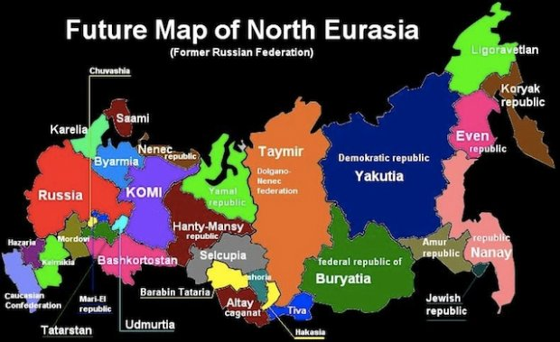
Moscow fears that allowing one region to secede from the federation could result in this.

Slide 28
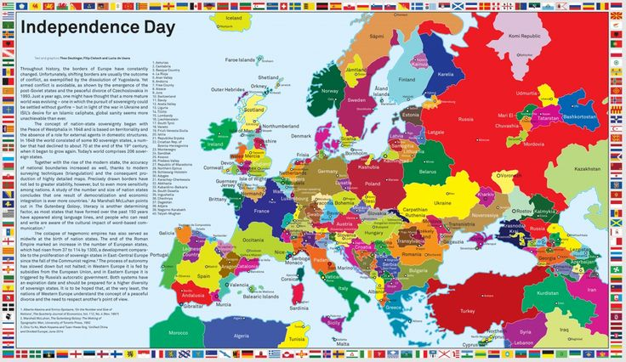
If all separation movements in Europe and European Russia succeeded the map might look like this.

Slide 29
Russian Aggressive actions and/or assistance

Slide 30
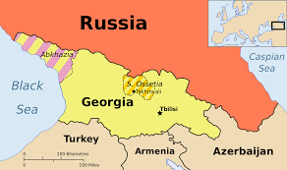
Russia supported and assisted in the separation of Abkhazia and S. Ossetia from Georgia

Slide 31
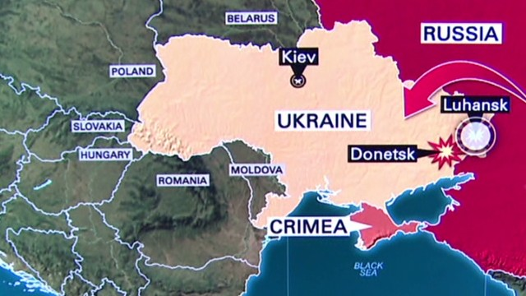
Russia seized and annexed the Crimea and supports rebels in eastern Ukraine with both weapons and military personel

Slide 32
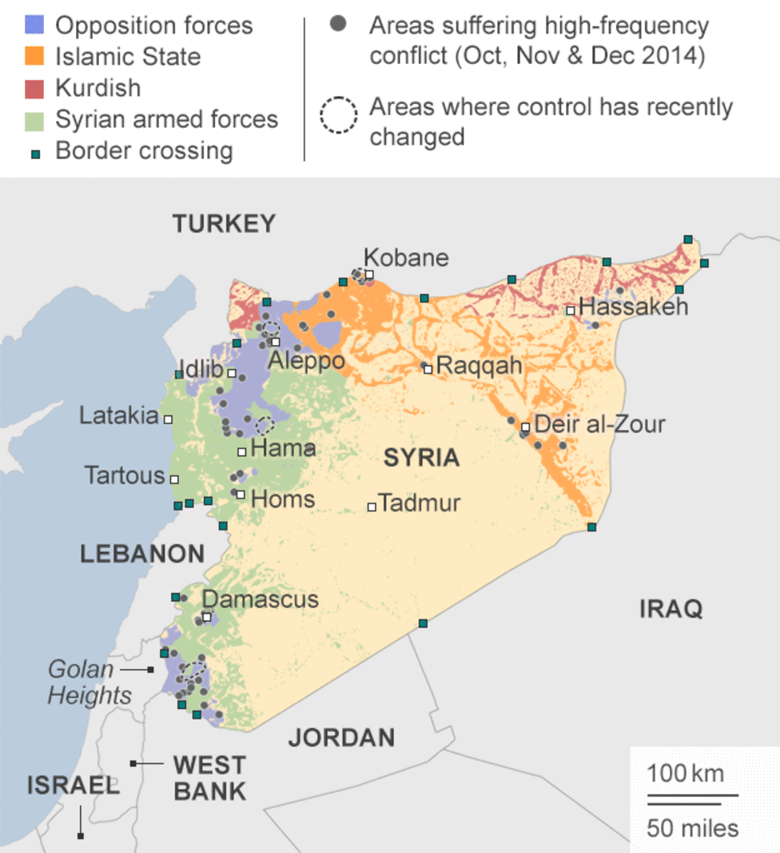
Claiming to be bombing in Syria to defeat ISIS and “terrorists,” Russia is actually helping the dictator, Assad, and mostly bombing anti-Assad rebels.

Slide 33
Iran
Russia has sold military weapons to the government of Iran. Iran supports many of the terrorist groups in North Africa and Southwest Asia.

Slide 34
Practice Maps

Slide 35
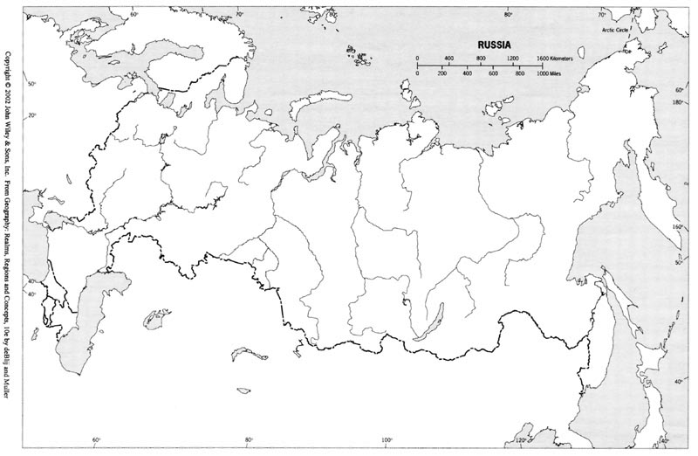

Slide 36
