Slide 1
LATIN AMERICA
Atlas Introduction
Geography
Anderson
Additions by Joe Naumann

Slide 2
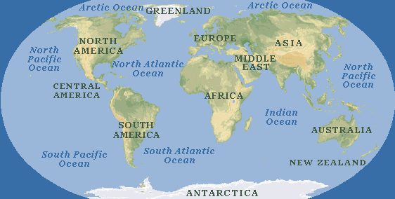
Where is Latin America?
Find Mexico on a World Map...
…and move southward

Slide 3
Latin America

Slide 4
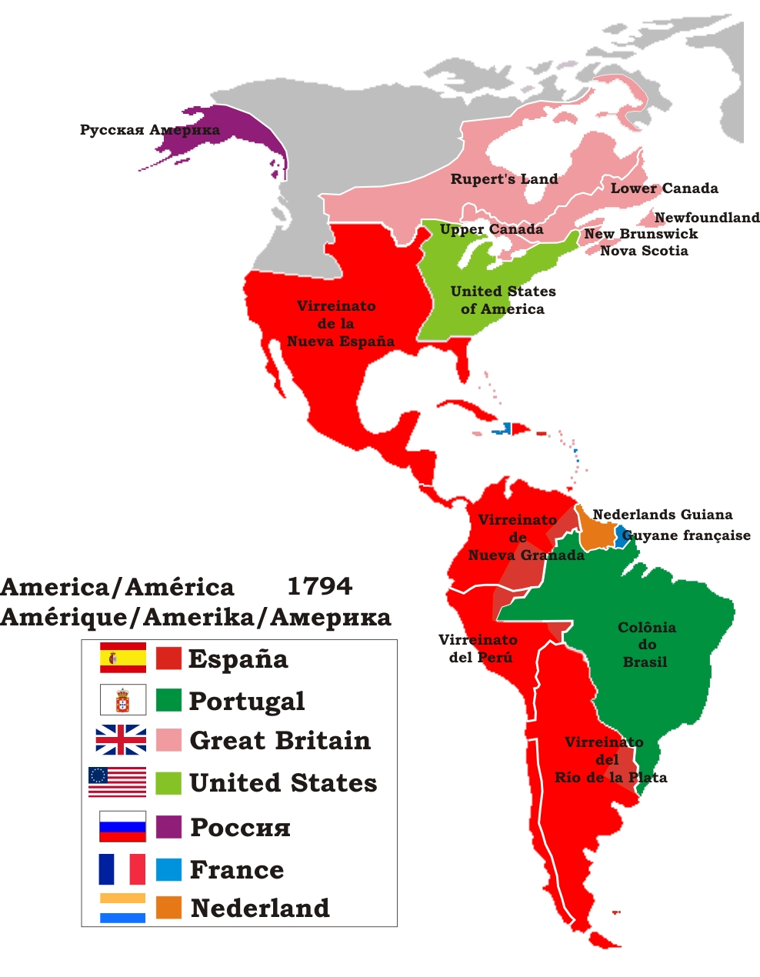

Slide 5
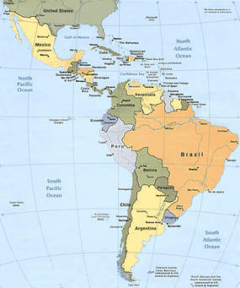

Slide 6
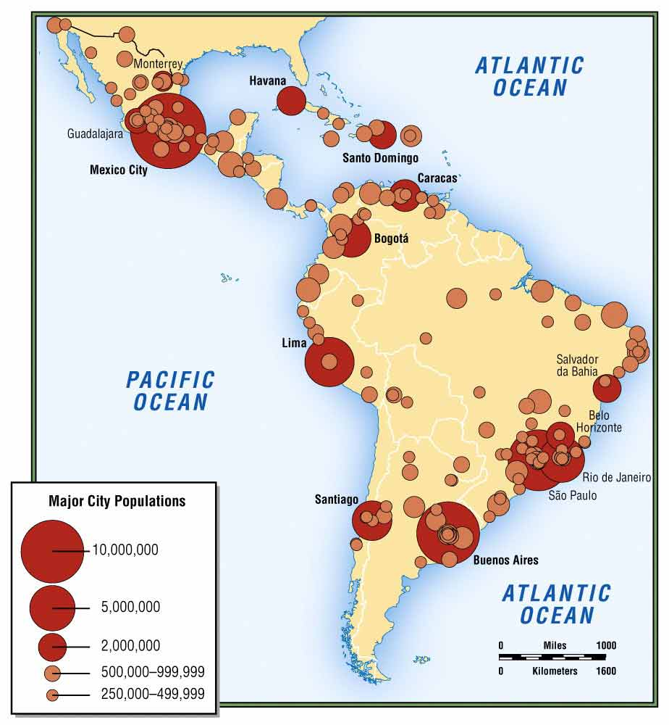

Slide 7
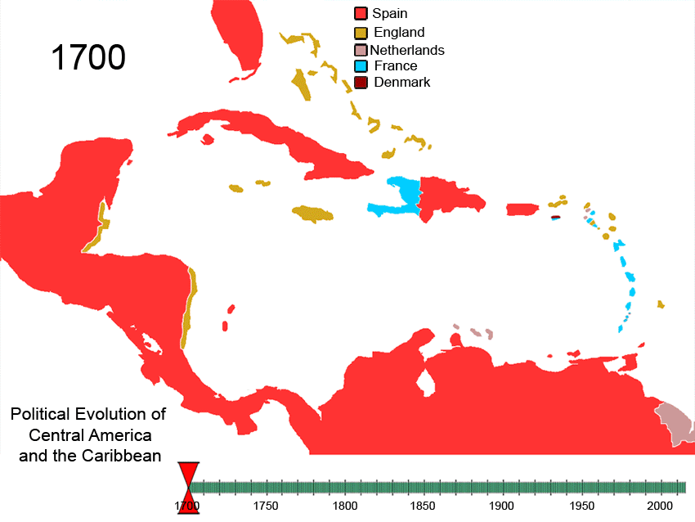

Slide 8
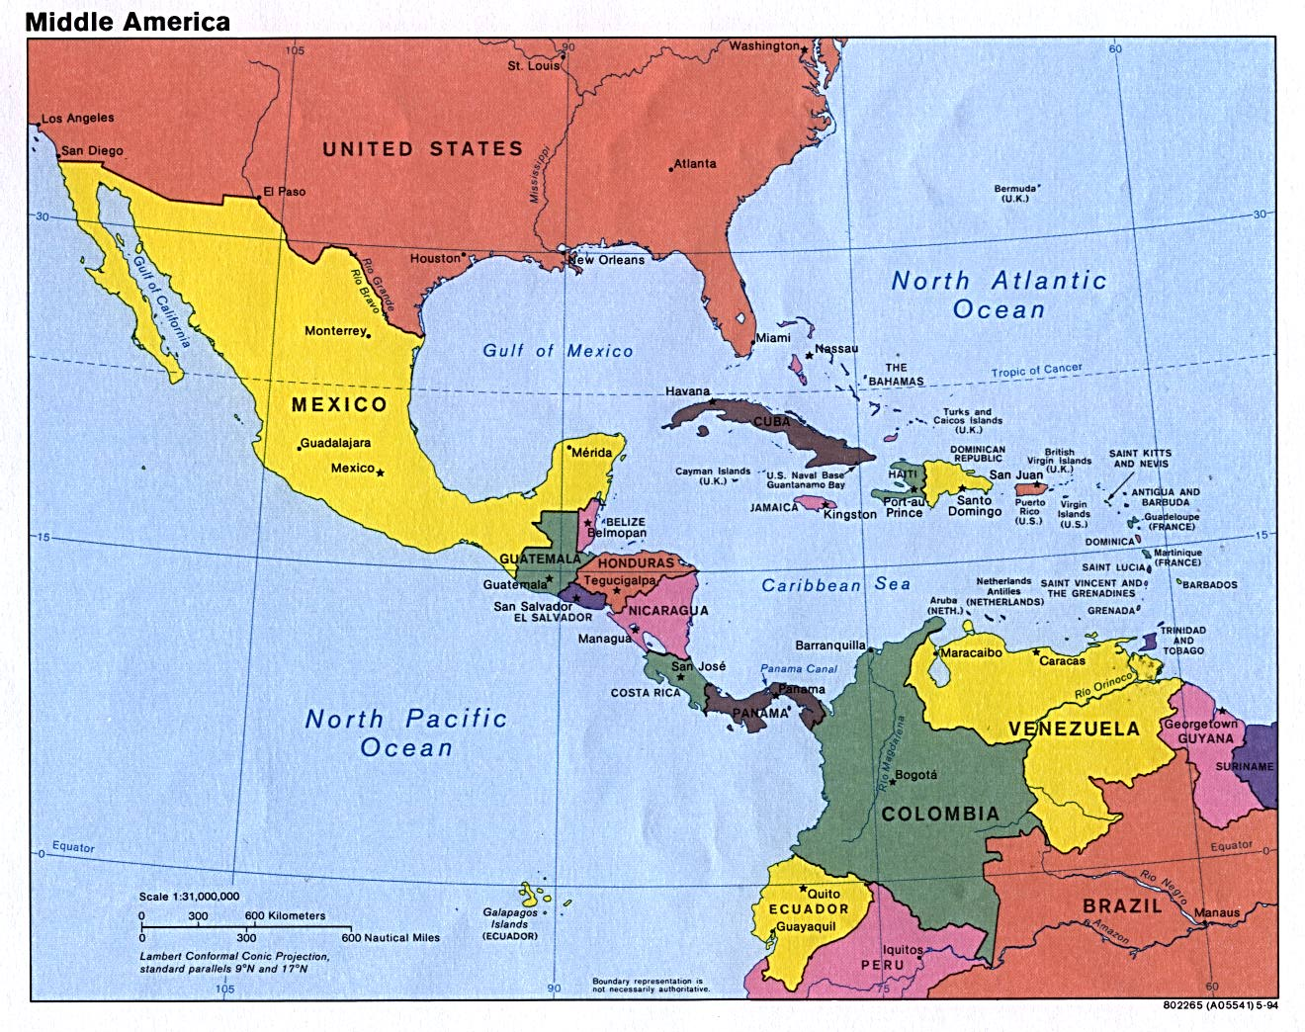

Slide 9
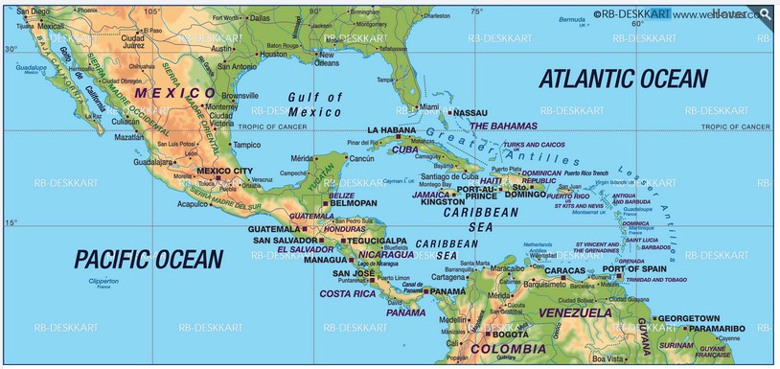
Middle America

Slide 10
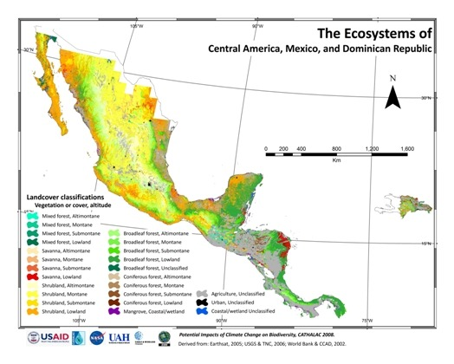

Slide 11
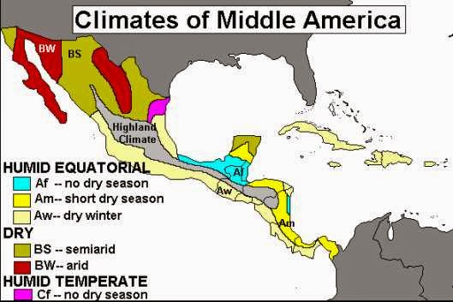

Slide 12
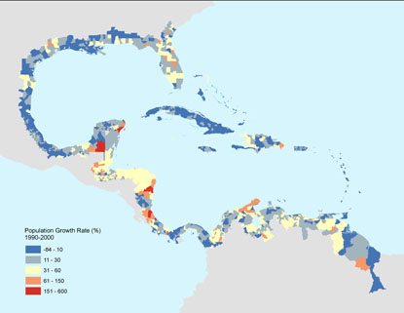

Slide 13
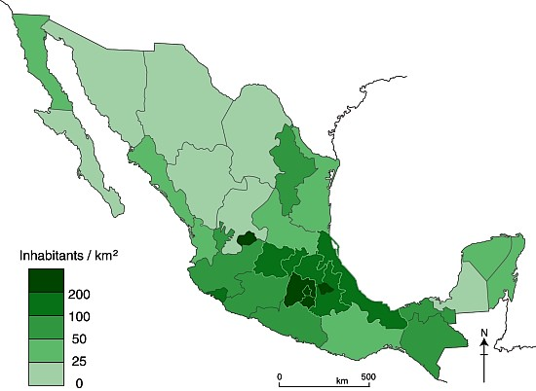
Population Density

Slide 14
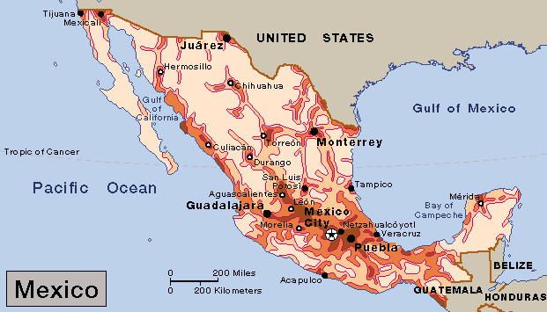
Population Density

Slide 15
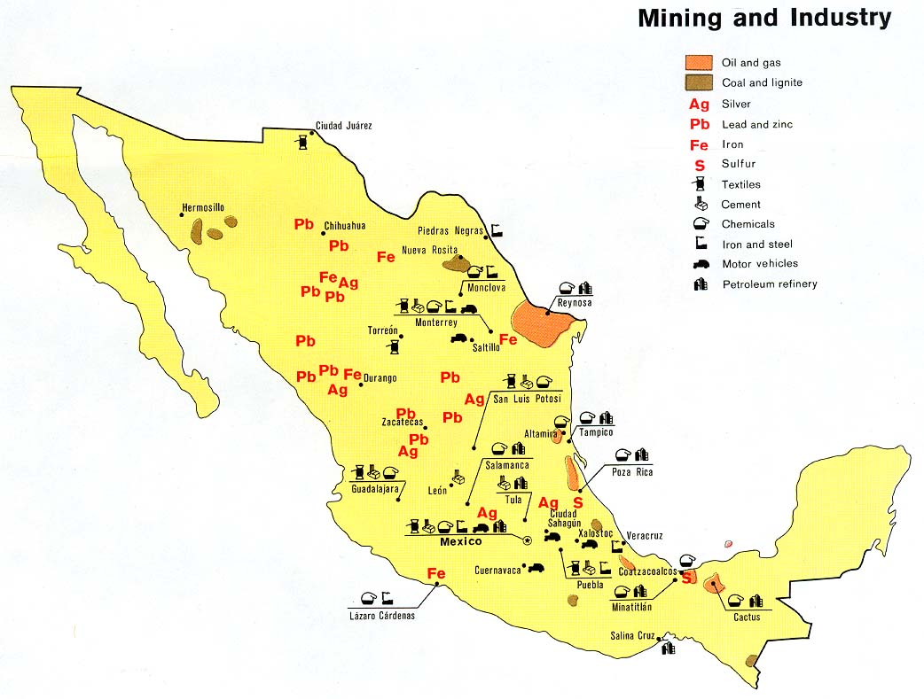

Slide 16
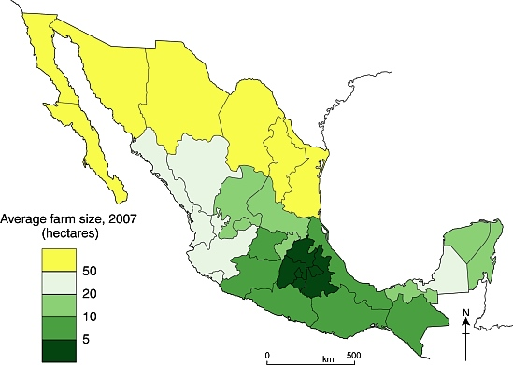

Slide 17
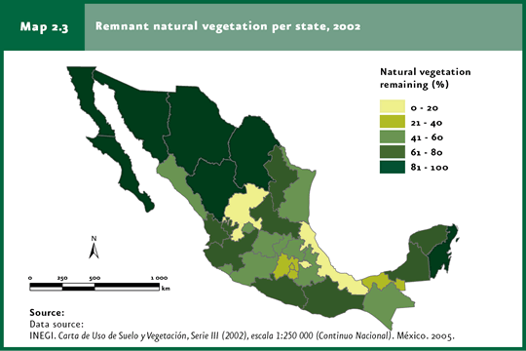

Slide 18
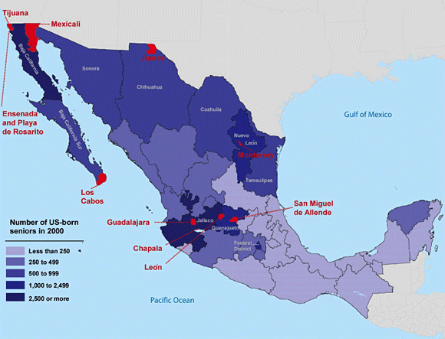
U.S. Citizens Retired in Mexico

Slide 19
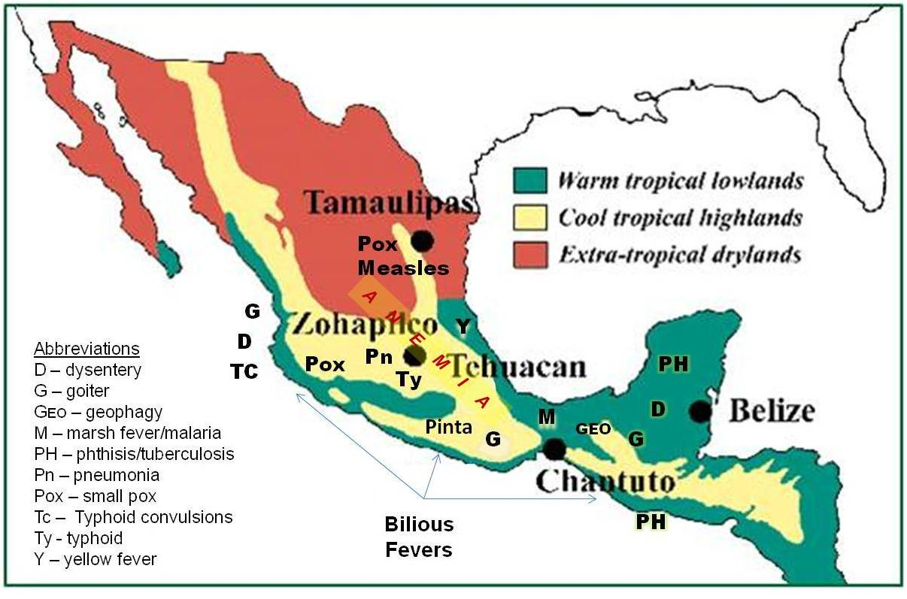

Slide 20
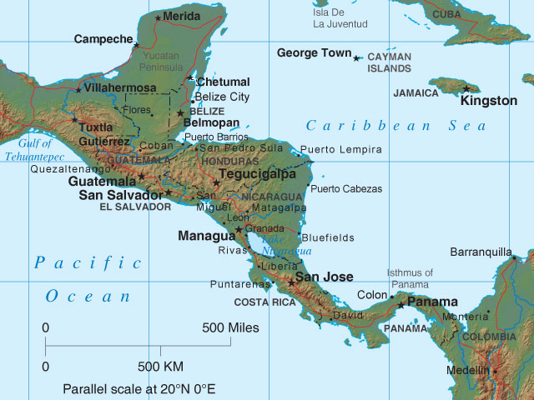
Central America

Slide 21
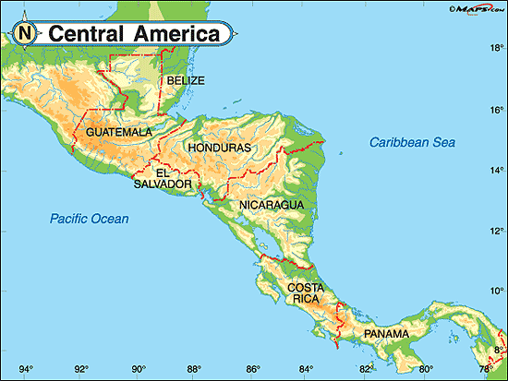

Slide 22
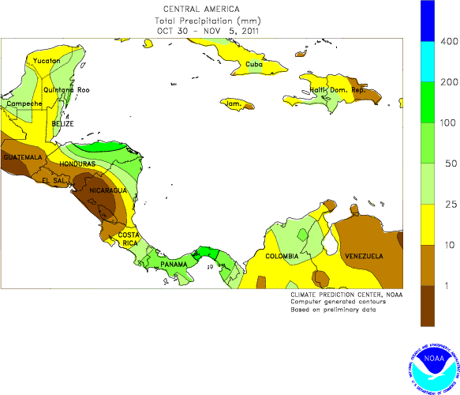

Slide 23
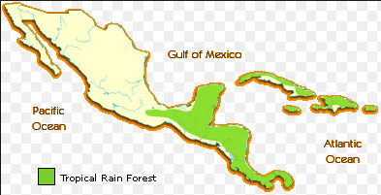

Slide 24
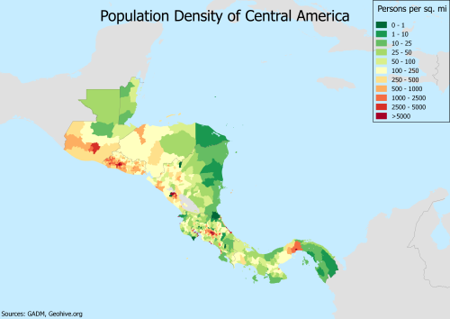

Slide 25
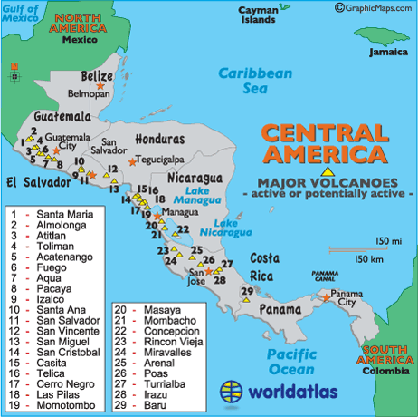

Slide 26
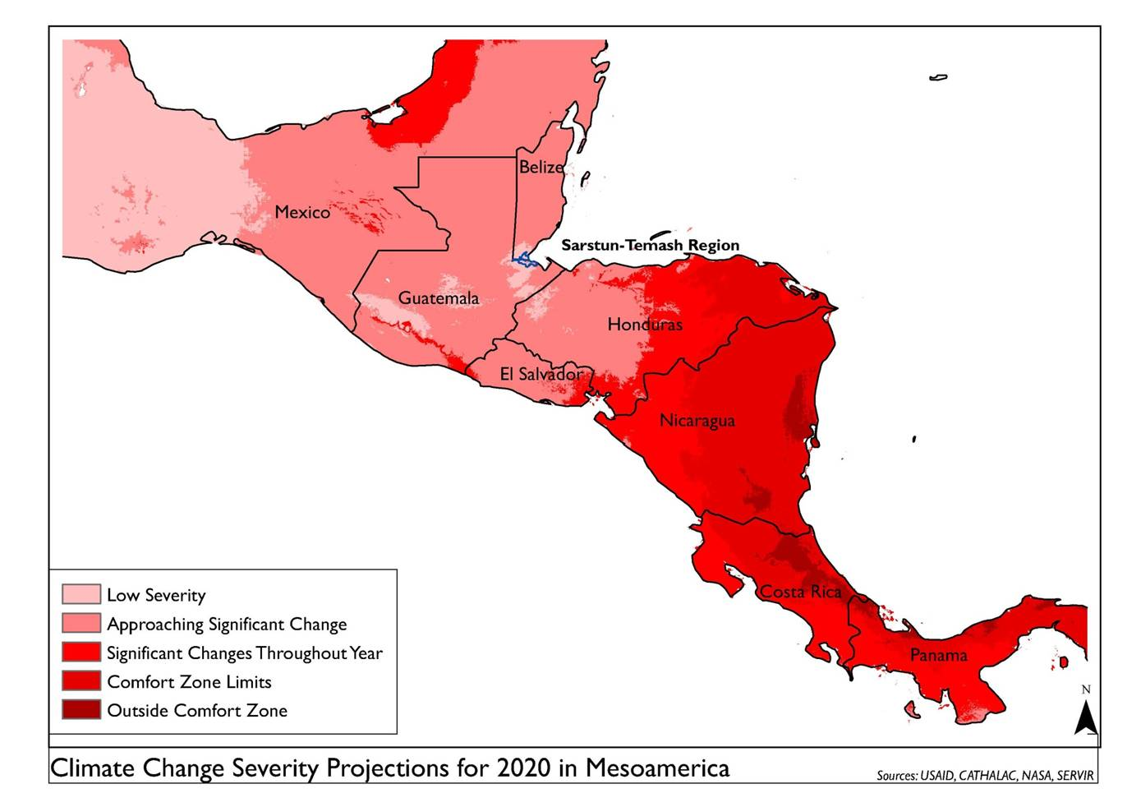

Slide 27
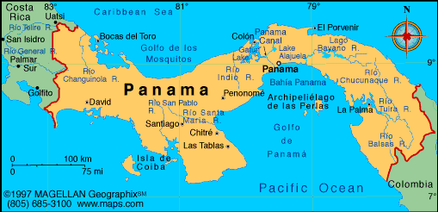
Strategic Location

Slide 28
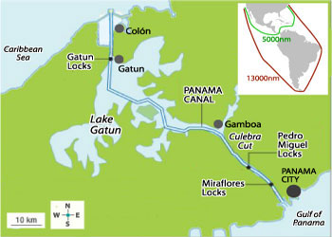

Slide 29
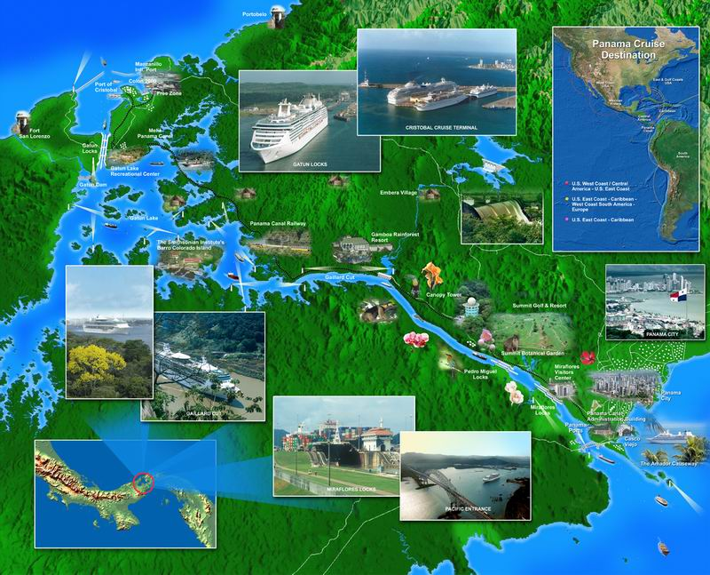

Slide 30
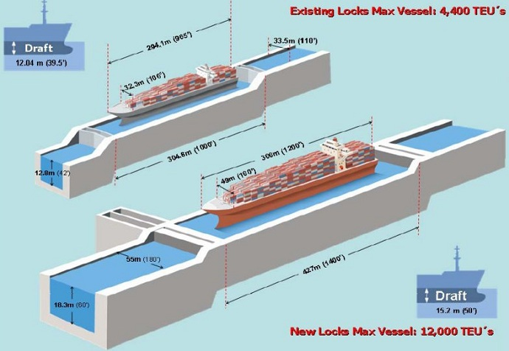
New, Larger Locks Due to Open

Slide 31
The Panama Canal expansion project, also called the Third Set of Locks Project, is intended to double the capacity of the Panama Canal by 2016 by creating a new lane of traffic and allowing more and larger ships, the New Panamax size, which are about one and a half times the current maximum width and length (known as Panamax) and can carry over twice as much cargo. By January, 2016, Panama's President Varela indicated that he anticipated the expansion to be complete around May, 2016

Slide 32
The project is planned to:
Build two new sets of locks, one each on the Atlantic and Pacific sides, and excavate new channels to the new locks. Each set of locks will have three chambers with water-saving basins.
Widen and deepen existing channels.
Raise the maximum operating level of Gatun Lake.

Slide 33
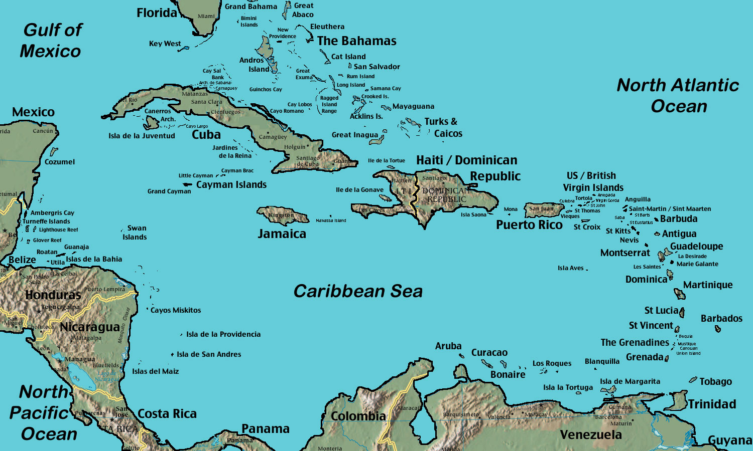
Caribbean Islands

Slide 34
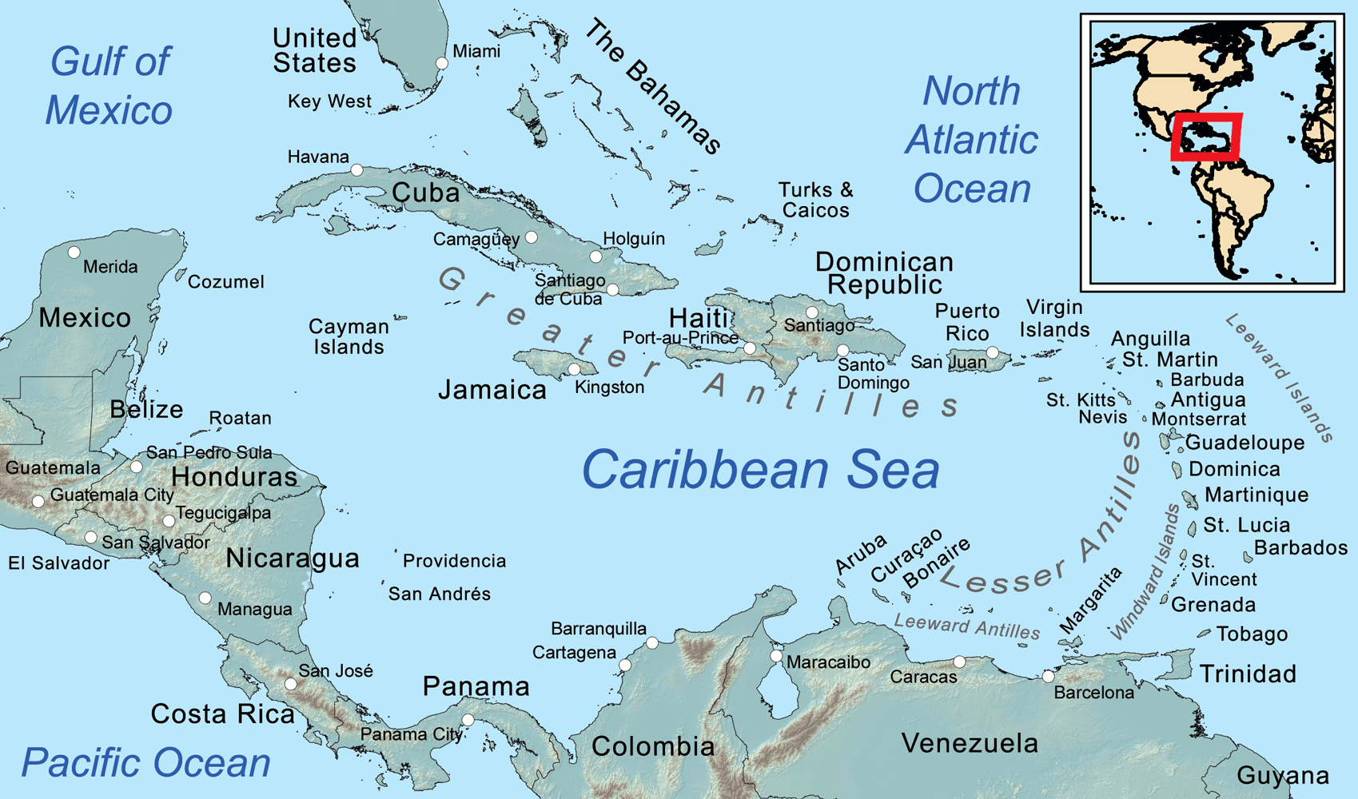

Slide 35
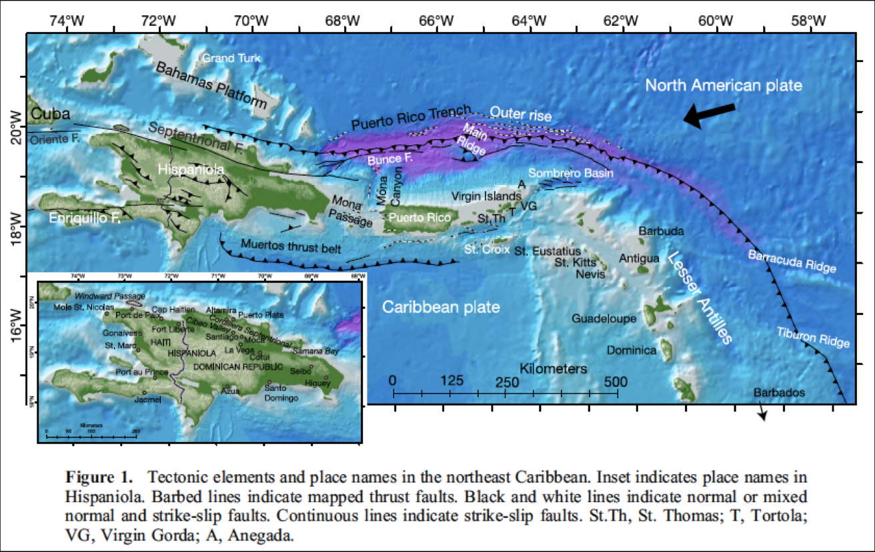

Slide 36
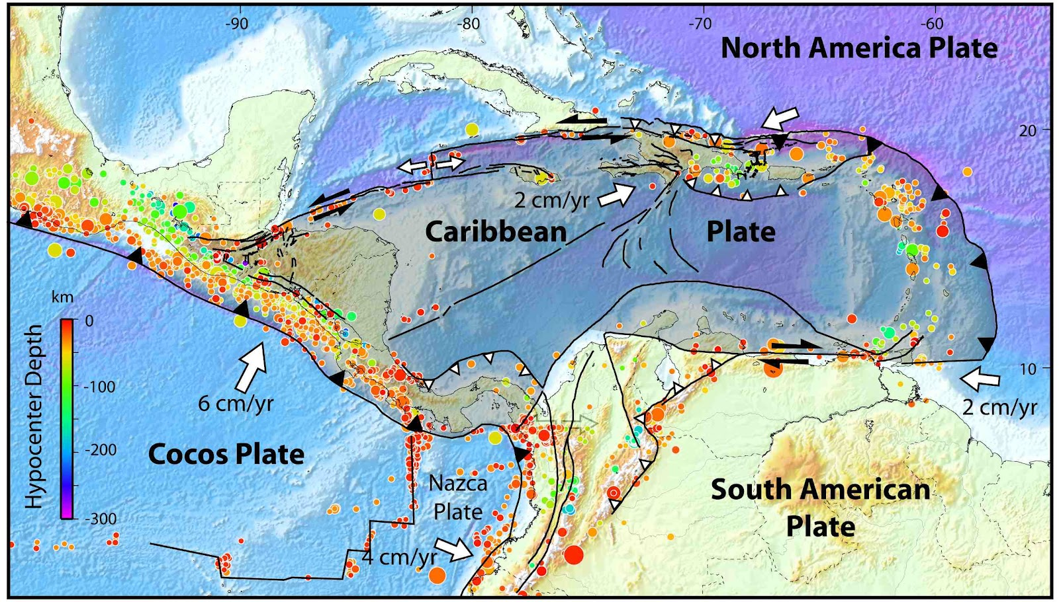
Plate Tectonics – Earthquakes and Volcanoes

Slide 37
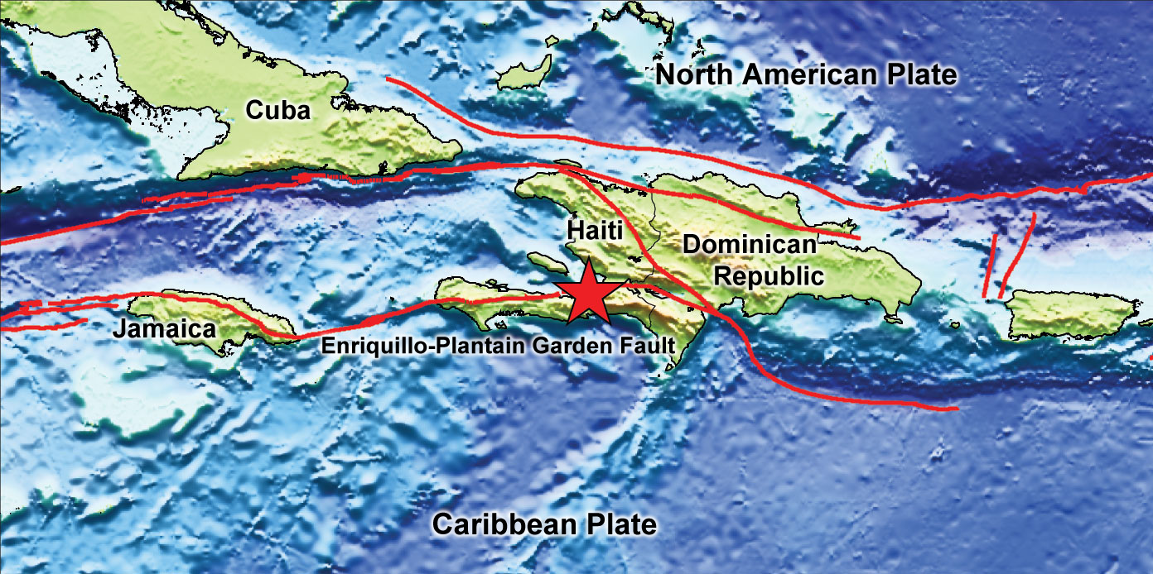
Remember the terrible earthquake in Haiti?

Slide 38
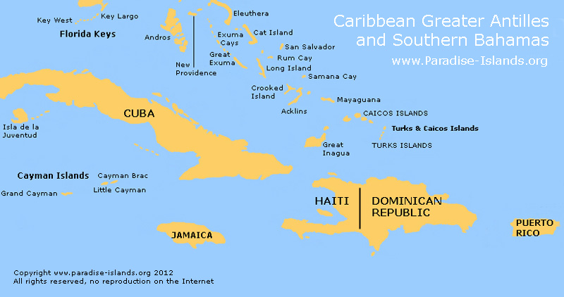

Slide 39
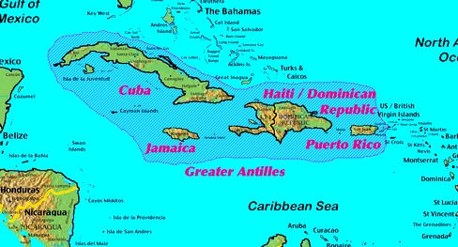

Slide 40
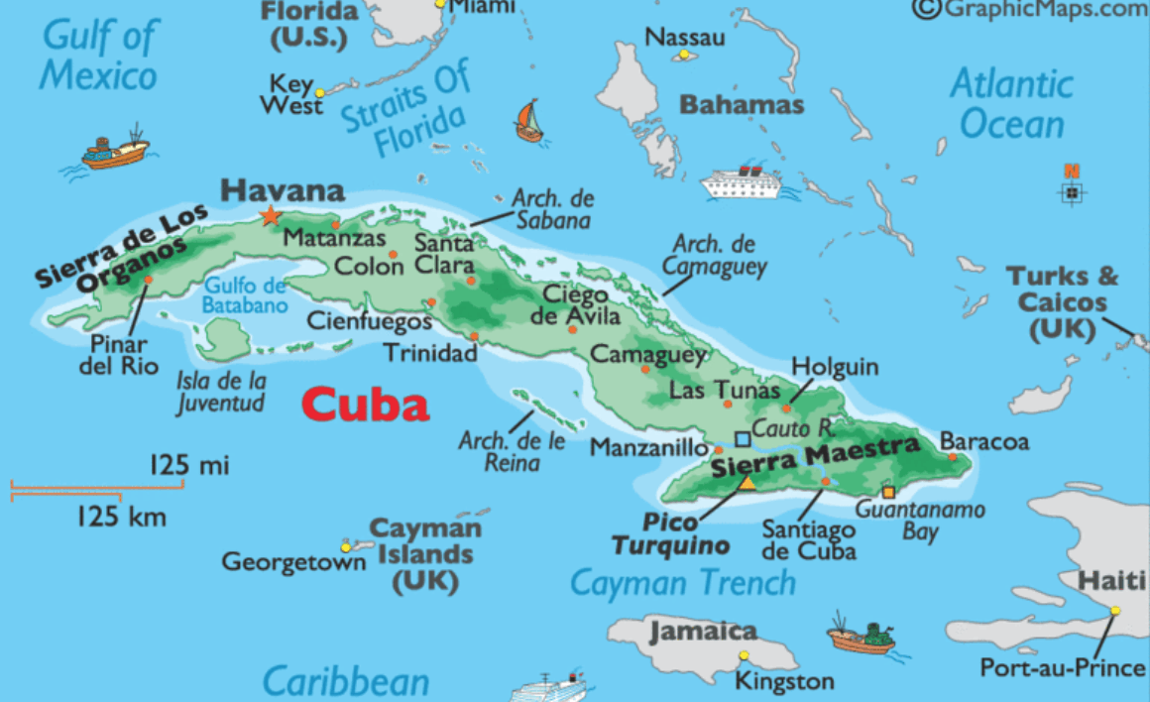

Slide 41
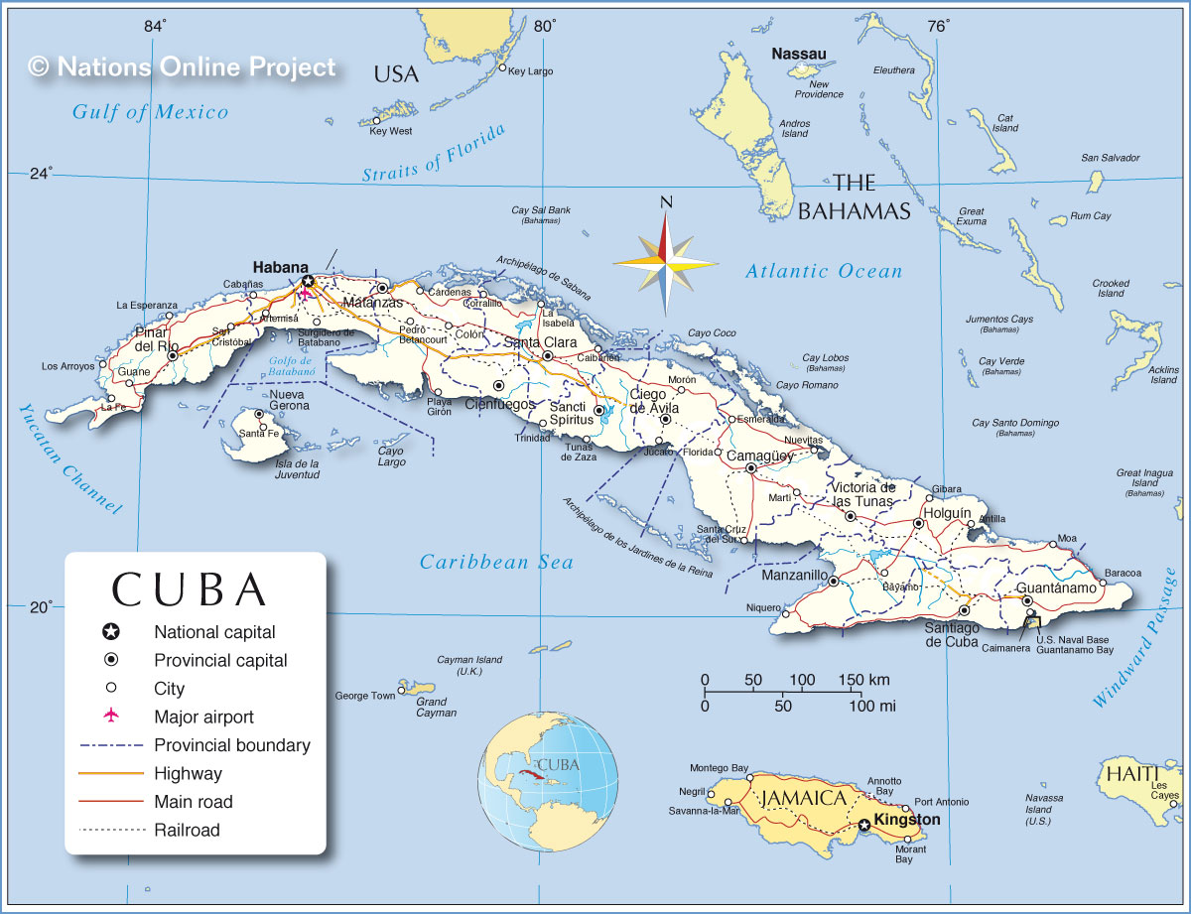

Slide 42
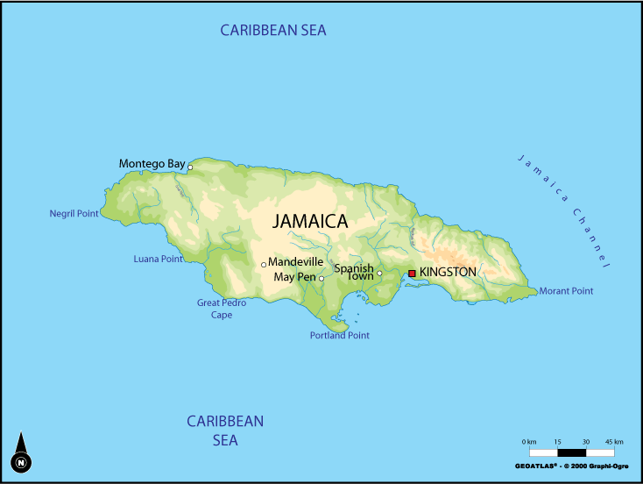

Slide 43
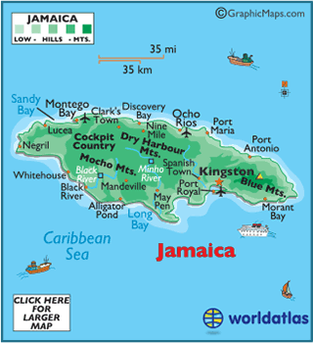

Slide 44
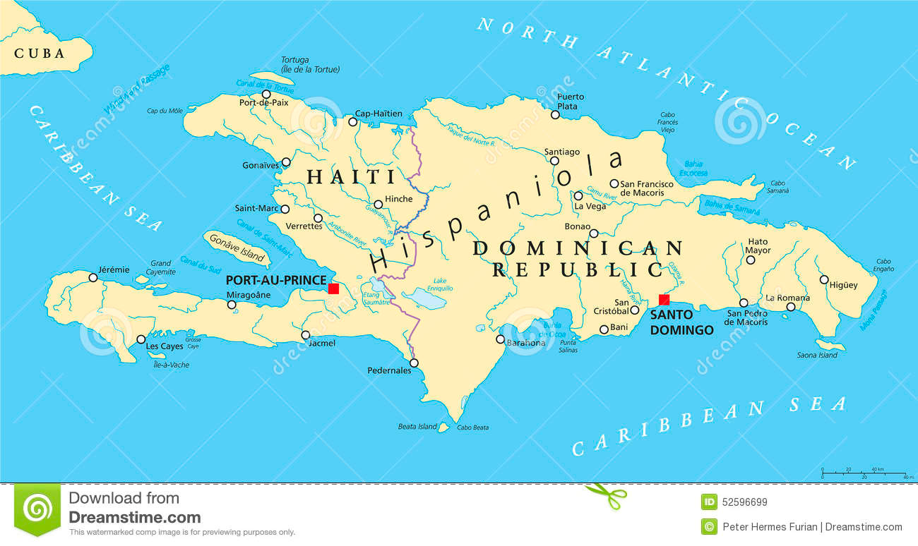

Slide 46
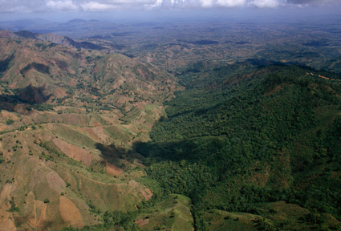
Haiti Dominican Republic
Haitians cleared their forests and ruined their ecology.

Slide 47
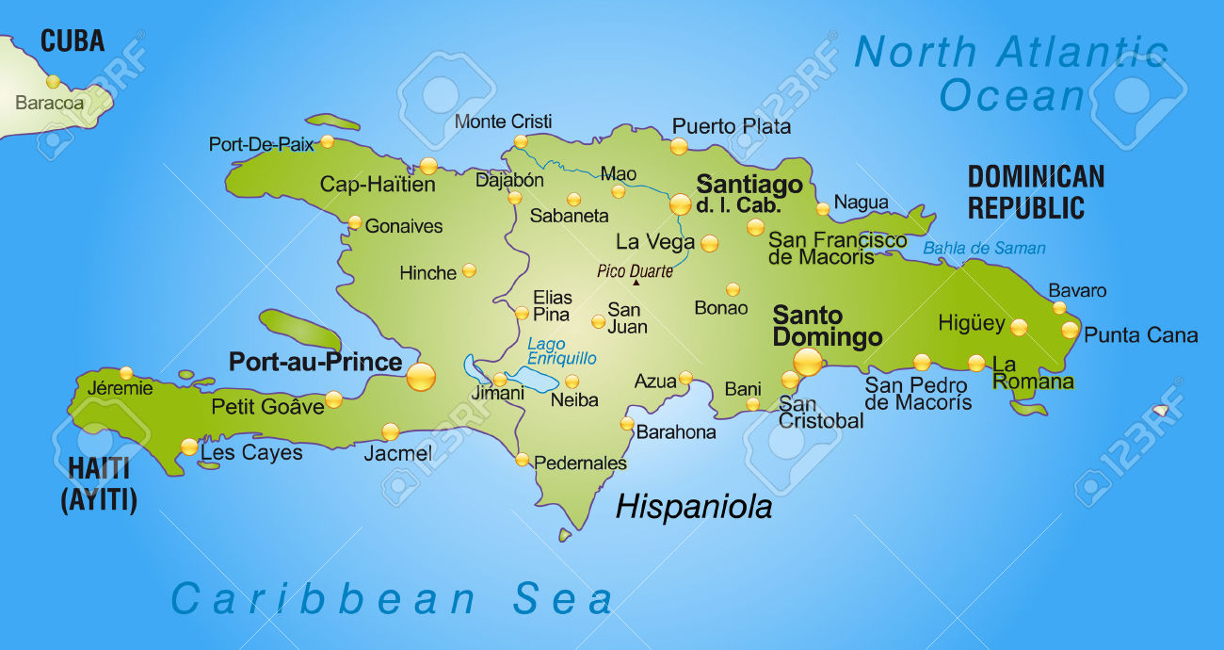

Slide 48
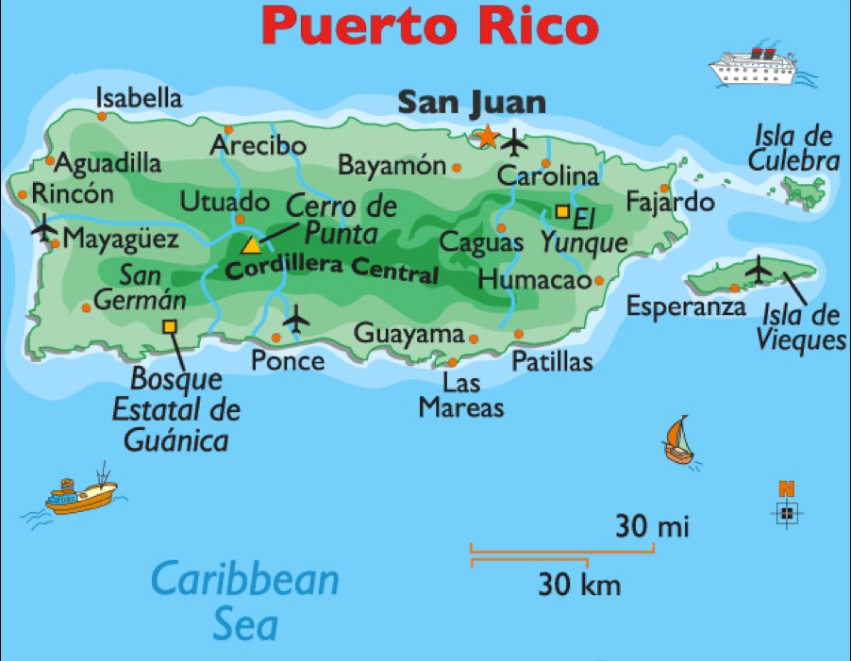

Slide 49
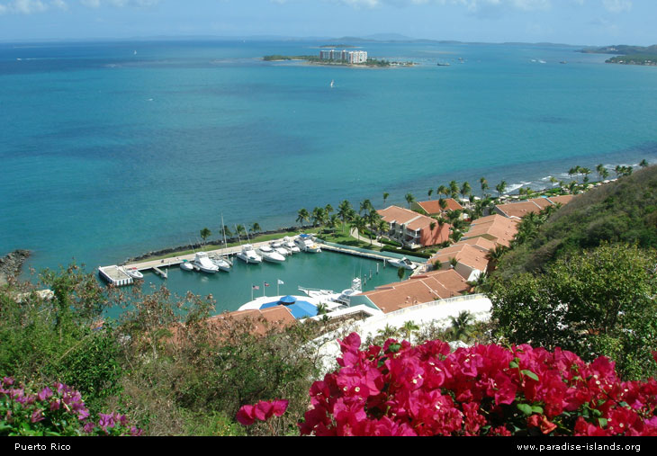

Slide 50
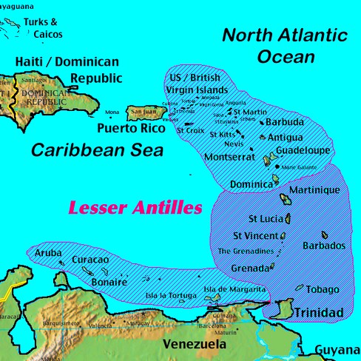

Slide 51
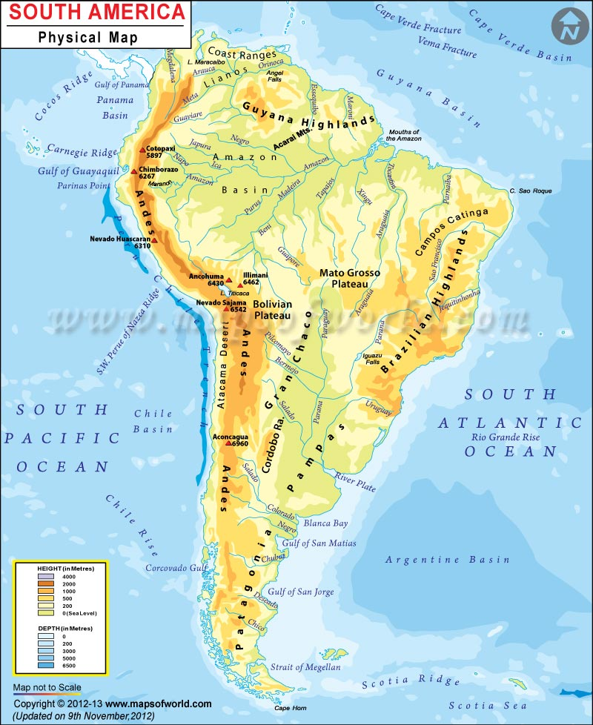

Slide 52
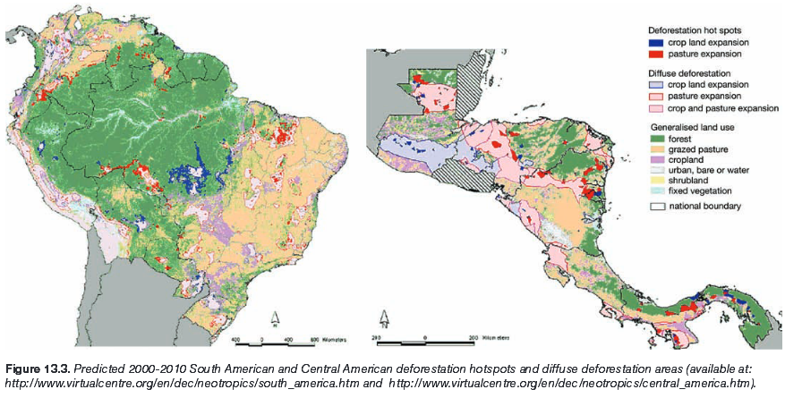

Slide 53
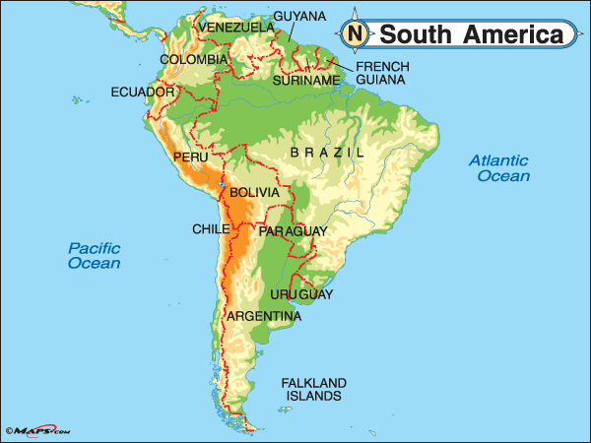

Slide 54
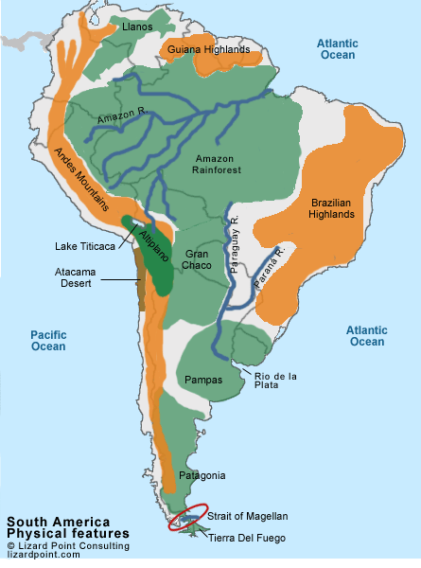

Slide 55
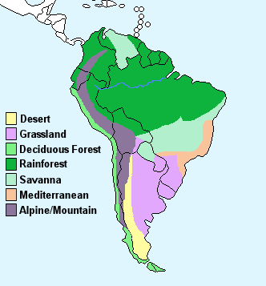
Vegetation

Slide 56


Slide 57


Slide 58


Slide 59


Slide 60


Slide 61


Slide 62

WHY is it called
Latin America?
And Spanish just about everywhere else!!!
Portuguese is spoken in Brazil
Latin is a language
The two widely spoken languages are Latin-based
www.skokienet.org/ festival/cultures.html

Slide 63
What physical characteristics do we need to know?
CLIMATE
In Central America and northern South America, it is TROPICAL
In northern Mexico and southern South America, it is TEMPERATE

Slide 64
Along with climate,
In the Southern Hemisphere:
Remember that SEASONS are REVERSED:desrever

Slide 65
When it is winter in the USA...
…it is summer in South America (and southern Africa & Australia & Antarctica)

Slide 66

Physical Features
Mountains in Latin America:
Sierra Madres split along Mexico’s coasts
Andes along west coast of South America
Just like the west coast of the USA, the Andes mountains are VOLCANIC

Slide 67

Mountains in Latin America can be split into agricultural “zones” as you move higher up the mountain. This is called “vertical zonation”
Snow caps
Sierra Madres
Tierra Fria no crops, just grazing
Tierra Templada crops that like temperate land
ANDES MOUNTAINS: The longest chain and 2nd highest mountains in the world!!
Tierra Caliente crops that like hot temperatures

Slide 68

Another look at Vertical Zonation in the Andes Mts.

Slide 69
But California can handle the earthquakes MUCH better because of building codes and earthquake-proof structures that are built in the states. Unfortunately, Chile, Peru, and other countries in Latin America don’t follow any type of building codes and whole villages can be wiped out in an earthquake!!!
Along with volcanoes, western South America and parts of Central America experience EARTHQUAKES
due to the constant motion of the Earth’s tectonic plates-
Just like in California!!

Slide 70
Greater (Bigger) Antilles
More Physical Features:
There are MANY islands in Latin America
The Caribbean Islands are called the “West Indies” or the “Greater and Lesser Antilles”
The Caribbean Islands are well known for their agriculture and tourism
Lesser (Smaller) Antilles

Slide 71
The Galapagos Islands (off the west coast of Ecuador) are known for their Tortoises and other scientific studies of plants and animals.
Ga-LAP-ah-goes Islands
Does Charles Darwin ring a bell?

Slide 72
The Falkland Islands are controlled by the United Kingdom
The British defeated the Argentines in the Falkland Island War of 1982
These islands have a HUGE military advantage because of the location to the Strait of Magellan...
...esp. if the Panama Canal is blocked during wartime
“Falkland Islands (Isla Malvinas) Administered by the UK (claimed by Argentina)”
Notes:
72

Slide 73
Other Physical Chars.
Grasslands: huge, flat plains in Latin America- known for agriculture
The Llanos are in Venezuela; the Gran Chaco are in Paraguay;and the most famous are the Pampas in Argentina

Slide 74

We’re usually found in grassland ranches…like the Llanos in Venezuela
Or the Pampas of Argentina….
where the best beef cattle in the world is raised!!
Llanos
Latin American Cowboys are called Gauchos
Pampas

Slide 75



Unfortunately, we’re being cut down and set aflame to make room for interior farmland and construction!!!!
OUCH!!! This is called “Slash and Burn” Agriculture
Rainforests:
Costa Rica and Brazil~ Amazonia (in Brazil) is the largest in the world!
“Amazonia”
http://www.ran.org/info_center/about_rainforests.html

Slide 76


Coastal Deserts: West Coast of South America ATACAMA DESERT in Chile
This clip art is actually “wrong” to use for the Atacama…there are cacti shown!!
One of the hottest and driest places on Earth. 1/16”/yr
THIS is more like it!!!
But why can places be so dry???
The “rain shadow” effect is part of the reason
www.uni-magdeburg.de/ abp/picturegallery.htm

Slide 77

RAIN SHADOW EFFECT
Windward side of the mountains
Leeward Side or “protected” side of the mountains
ANDES
Pacific Ocean
http://www-cs-students.stanford.edu/~amitp/simblob/rain-shadow.png
The Andes Mountains create rain shadows on leeward slopes and cause moisture to be blocked. That’s how we see such dry areas in Latin America. The Andes are so high that they block moisture from the ocean and create grasslands and deserts on the other side of the mountains.

Slide 78
Orinoco River
I'm the Rio de la Plata.
I’m actually not a river, but an estuary… the large water feature where fresh water from a river meets the salt water of the sea.
Rio Grande
The AMAZON!!
The largest river in the world!!
Parana River
Rivers in Latin America

Slide 79
IMPACTS of Physical Features?:
Location of urbanization?
People settle along coasts
High population growth rate?
YES! Arable land means more food
Large cities are called: MEGACITIES
Sao Paulo Rio Mexico City

Slide 80



Slide 81


Slide 82


Slide 83


Slide 84


Slide 85


Slide 86


Slide 87


Slide 88


Slide 89


Slide 90


Slide 91


Slide 92


Slide 93


Slide 94


Slide 95


argentina

Slide 96



Slide 97


Slide 98



Slide 99


Slide 100


Slide 101


Slide 102



Slide 103


Slide 104


Chile

Slide 105



Slide 106




Slide 107

Central Chile
Mediterranean climate
Most dense population
High percentage of European citizens
Center of government and business

Slide 108


Wine Producing Locations

Slide 109



Slide 110



Slide 111


Slide 112


Slide 113
Other Topics of Interest

Slide 114

Drug “Lords” control some parts of Colombia

Slide 115

Low world oil prices have hurt the economy, causing trouble for the first Post-Chavez government

Slide 116


Special Islands

Slide 117

Easter Island (Chile)

Slide 118


Slide 119

Galapagos Islands

Slide 120


Slide 121
And the MOST important factor from Latin America???
Of course!!!!
Didn’t YOU think coffee too?

