Slide 1
The
Geography
of the
Indian subcontinent
Ms. Susan M. Pojer - Chappaqua, NY
Additions by Joe Naumann - UMSL

Slide 2
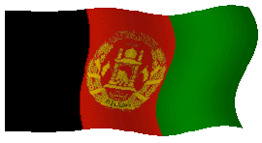


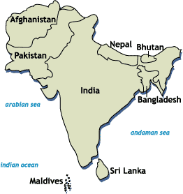





South Asia

Slide 3
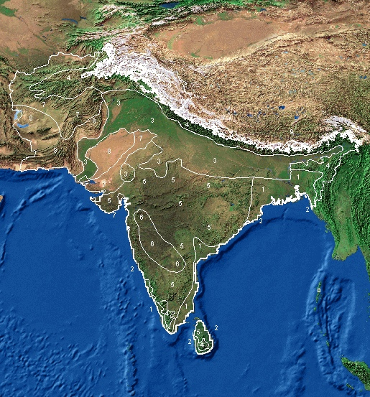
Satellite View of South Asia

Slide 4
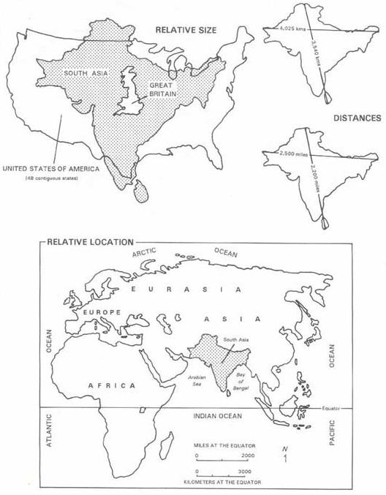
The
Size of
South
Asia

Slide 5
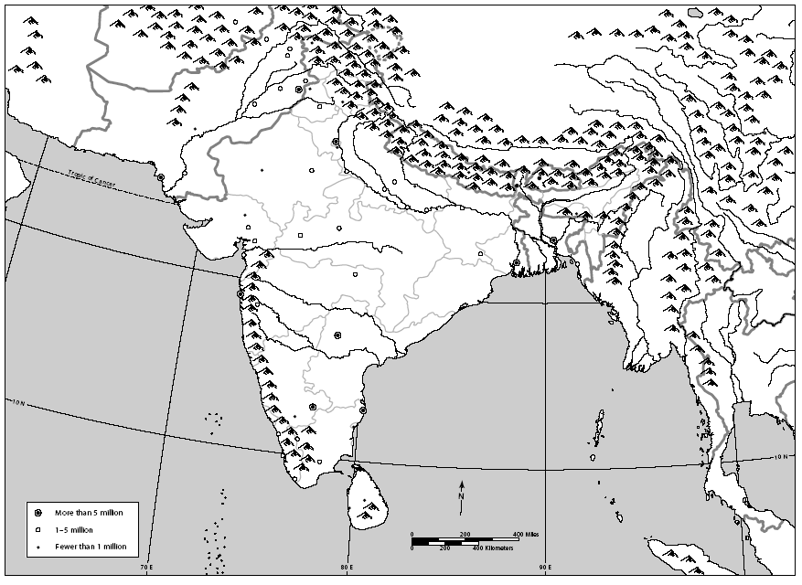
Countries
Afghanistan
China
Iran
Nepal
Bhutan
Pakistan
Myanmar
India
Bangladesh
Sri Lanka

Slide 6
cities
Kabul
Islamabad
Lahore
Kathmandu
New Delhi
Karachi
Benares
Thimbu
Dacca
Bombay
Calcutta
Madras
Colombo

Slide 7
Topography
of
South Asia

Slide 8
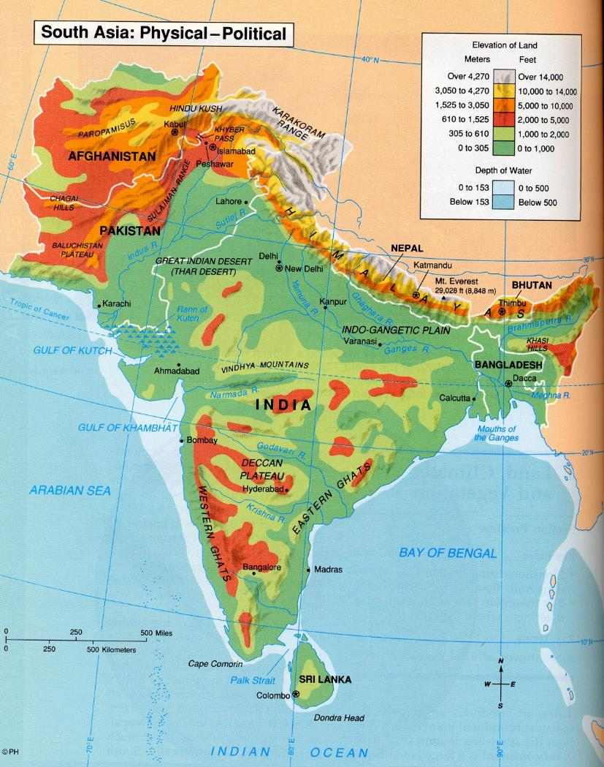
South
Asia:
Physical
Map

Slide 9
Bodies of Water
Indus R.
Brahmaputra R.
Ganges R.
Bay of
Bengal
Arabian Sea
Indian Ocean

Slide 10
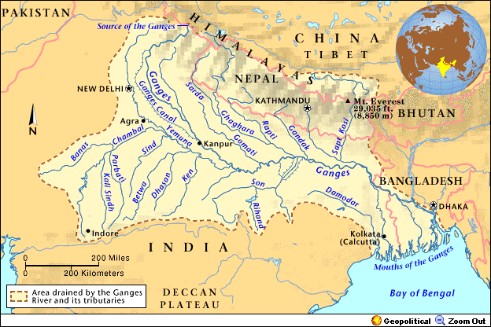
The Ganges River System
1,560 miles long

Slide 11
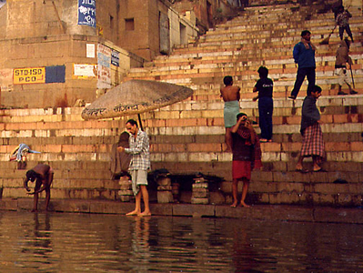
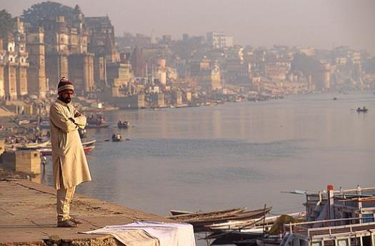
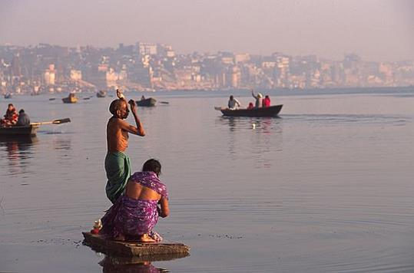
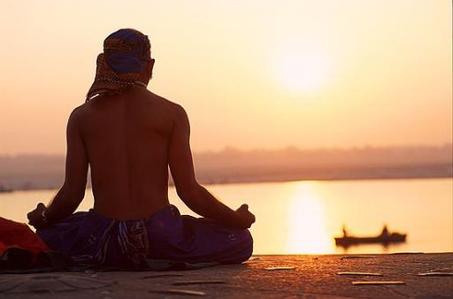
“Mata Ganga” (Mother Ganges)

Slide 12
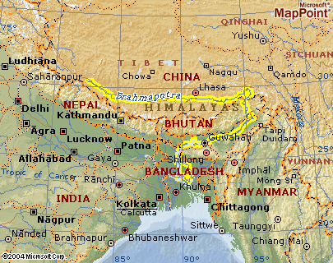
The Brahmaputra River System
1,800 miles long

Slide 13
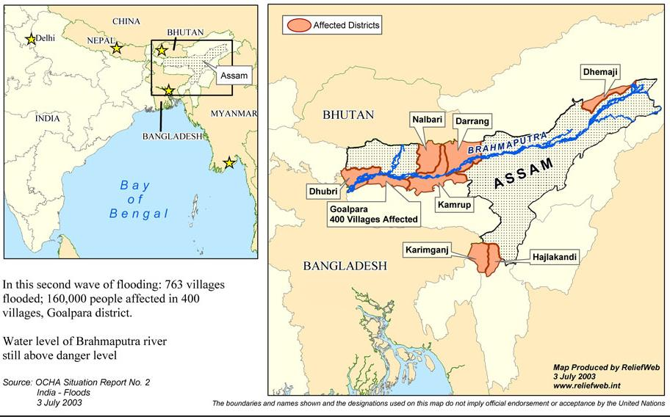
Floods on the Brahmaputra: 2003

Slide 14
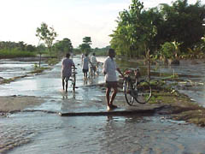
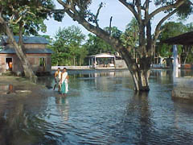
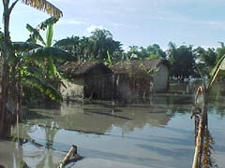
Flooding on the Brahmaputra

Slide 15
Valleys / Plains
Indo-Gangetic
Plain

Slide 16
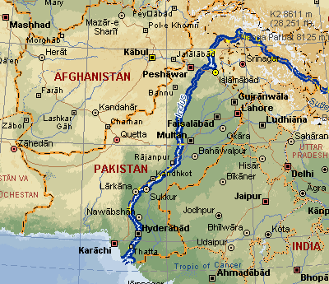
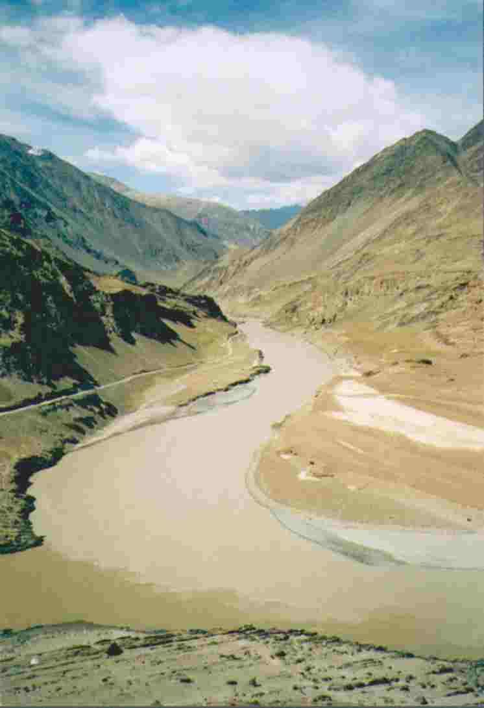
The Indus River System
1,975 miles long

Slide 17
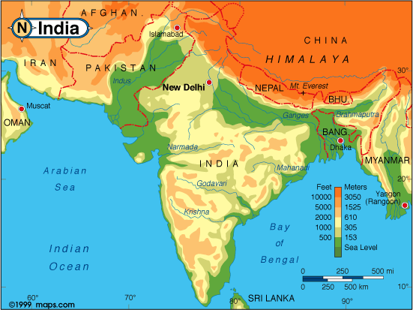
Elevation Levels

Slide 18
Mountains & Peaks
Hindu Kush
Khyber
Pass
I I
Karakoran Mts.
Mt. Everest
▲
Himalayas
Vindhya Hills
Eastern Ghats
Western Ghats

Slide 19
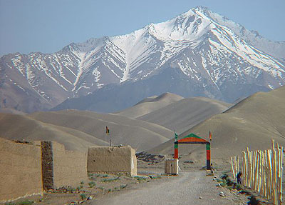
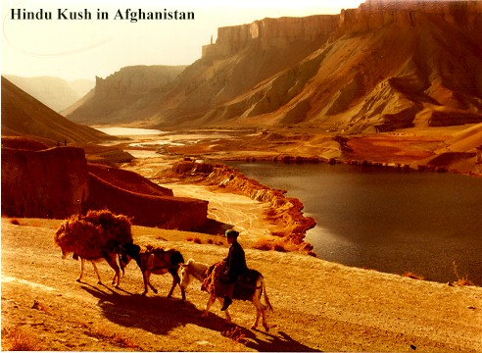
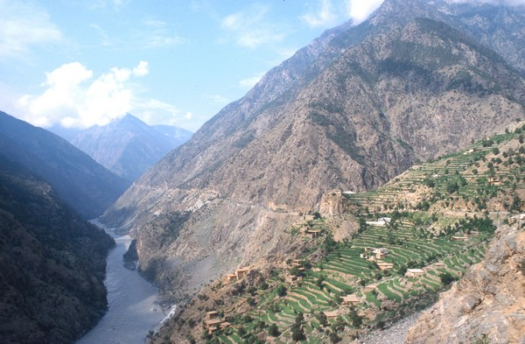
Hindu Kush

Slide 20
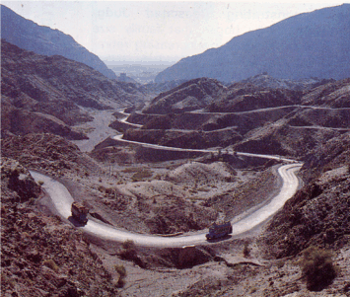
The Khyber Pass

Slide 21
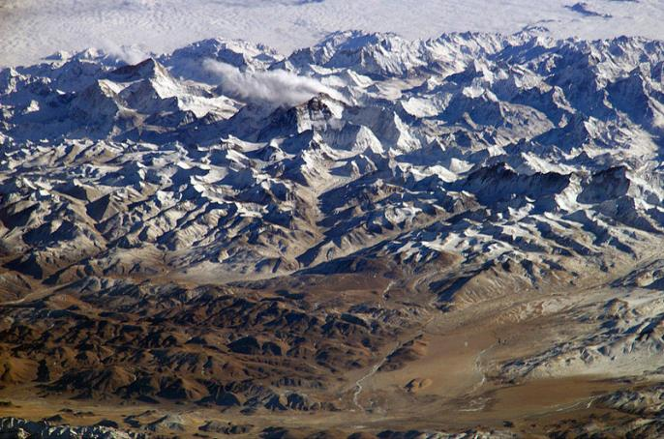
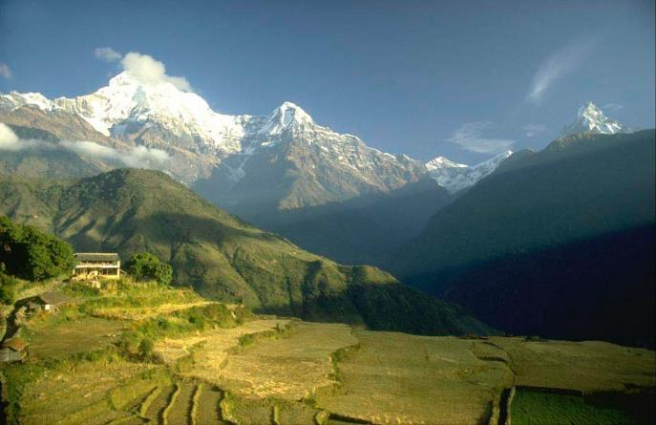
The Himalayas
“him” [snow]
“aalaya” [home]
Mt. Everest is
29,035 feet. It
is the highest
mt. peak in the
world.

Slide 22
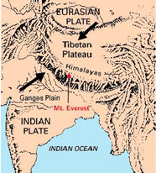
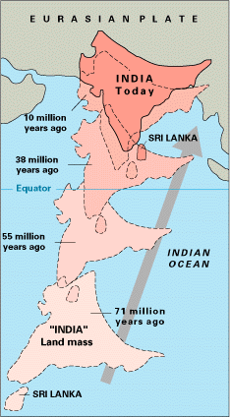
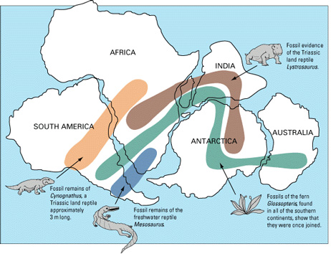
The Himalayas

Slide 23
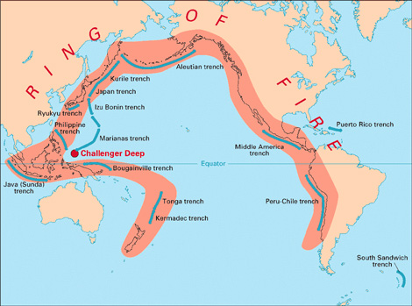
“Fire Rim of the Pacific”

Slide 24
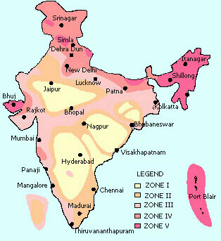
Earthquake Zones in India

Slide 25
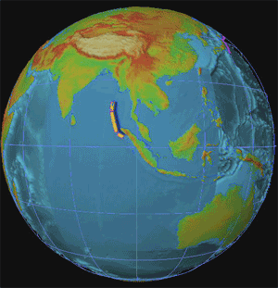
2004 Earthquake In Indonesia:
Tsunami Devastates Indian Ocean Coastlines!

Slide 26
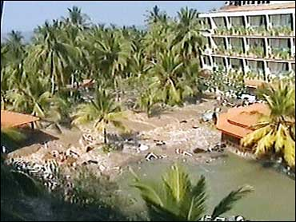
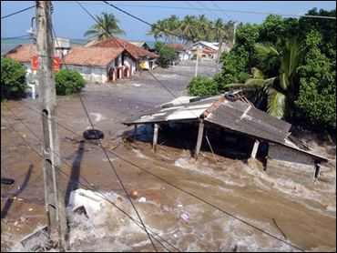
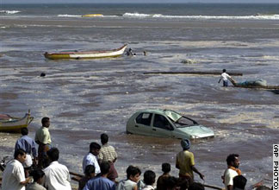
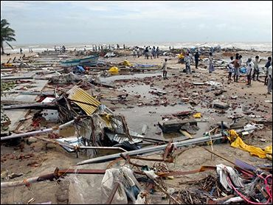
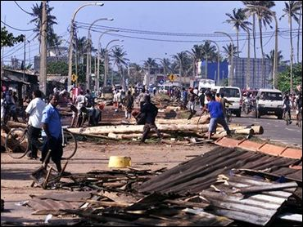
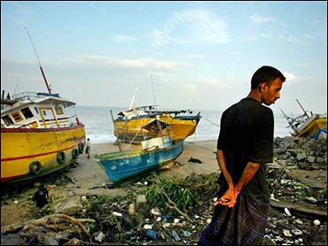
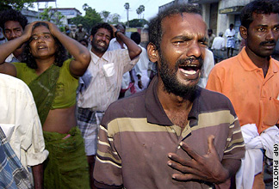
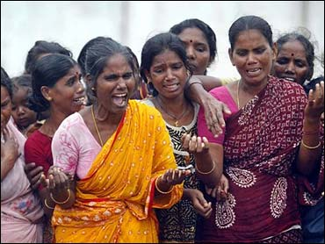
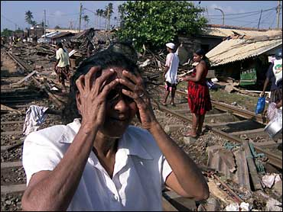
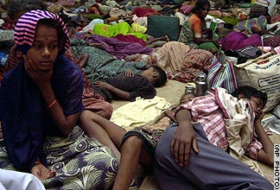
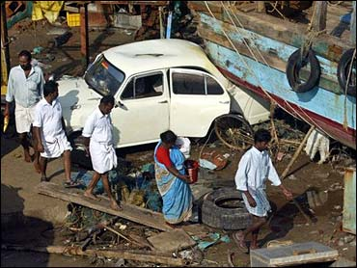
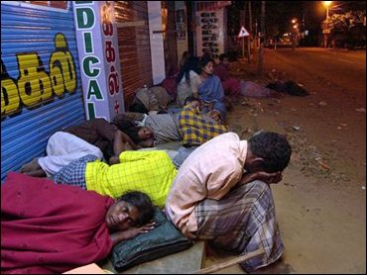
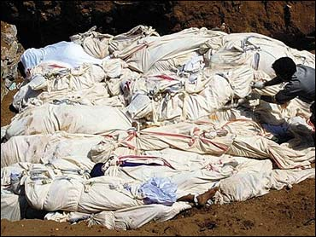
the Tsunami’s Devastation
100,000s dead!

Slide 27
Deserts / Plateaus
Tibetan
Plateau
Thar
Desert
Deccan
Plateau

Slide 28
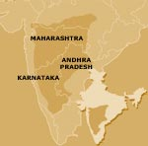
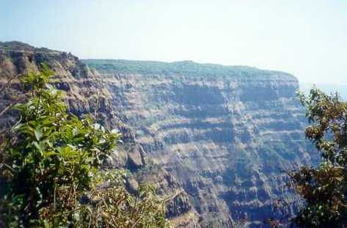
The Deccan Plateau
31,800 square miles in size.
Elevation range: 2,000 – 8,000 feet high.
From the Sanskrit word, “dakshina” [“the south”].

Slide 29
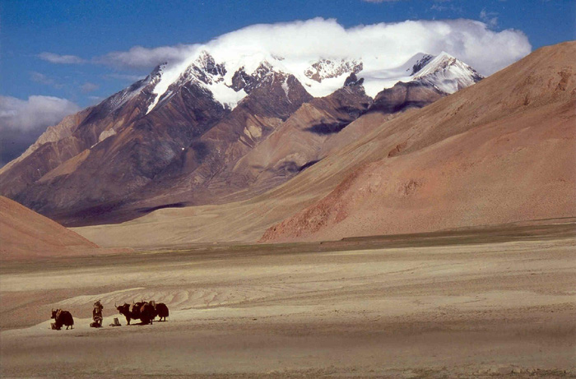
The tibetan Plateau
The “Roof of the World.”
average elevation is 16,400 feet.

Slide 30
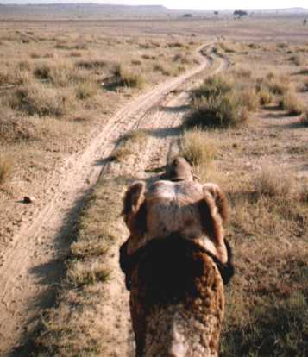
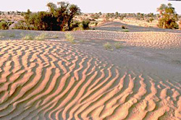
The Thar Desert
The Great Indian Desert
200 - 1500 feet in elevation.
up to 127ºF in July.

Slide 31
Other
Kashmir
Punjab

Slide 32
Completed Map
Hindu Kush
Khyber
Pass
I I
Karakoran Mts.
Tibetan
Plateau
Kashmir
Punjab
Mt. Everest
▲
Indus R.
Brahmaputra R.
Himalayas
Indo-Gangetic
Plain
Thar
Desert
Ganges R.
Vindhya Hills
Bay of
Bengal
Deccan
Plateau
Eastern Ghats
Western Ghats
Arabian Sea
Indian Ocean

Slide 33
Climate
of
South Asia

Slide 34
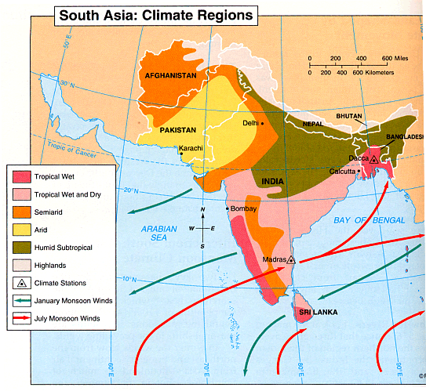
Climate Regions of South Asia

Slide 35

Winter Monsoons: Nov.-April

Slide 36

Summer Monsoons: May-Oct.

Slide 37

Temperature

Slide 38

Global Areas of Malaria

Slide 39
Vegetation
of
South Asia

Slide 40

Major Farming Systems
of South Asia

Slide 41

Economic Activities
& Resources

Slide 42

Silk Cultivation

Slide 43

Tiger regions

Slide 44
Demographic
Data
for
South Asia

Slide 45

Indian States &
Union Territories

Slide 46

Population Density

Slide 47

Population Density

Slide 48

Language Families in South Asia

Slide 49

Per Capita Income in India

Slide 50

Language in India alone

Slide 51

Religions

Slide 52

Literacy Rate in India

Slide 53

Pakistan
True peace does not exist between Pakistan and India – the dispute over Jammu and Kashmir has never been settled. UN peace-keeping troops have supervised the transition zone between Pakistan and India for more than 60 years.

Slide 54


Slide 55


Slide 56


Slide 57


Slide 58


Slide 59


Slide 60


Slide 61


Slide 62


Slide 63


Slide 64


Slide 65


Slide 66


Slide 67


Slide 68


Slide 69

Bangladesh
The Ganges and Brahmaputra River Deltas make up more than half of the country; therefore, yearly flooding is a major hazard and problem.

Slide 70


Slide 71


Slide 72


Slide 73


Slide 74



Slide 75


Slide 76


Slide 77


Slide 78


Slide 79


Slide 80


Sri Lanka
Sri Lanka (formerly Ceylon), a tiny island nation south of India in the Indian Ocean, is a rugged land of rainforest, diverse wildlife and endless beaches. It’s famed for its ancient Buddhist ruins, including the 5th-century citadel Sigiriya, with its palace and frescoes, and the sacred city of Anuradhapura. Its flavorful cuisine reflects its history as a maritime hub and cultural melting pot.

Slide 81



Slide 82

Climate

Slide 83


Slide 84



Slide 85


Slide 86


Slide 87



Slide 88

Exports to USA

Slide 89



Slide 90

Cultural Triangle of Sri Lanka encompasses World Heritages sites of Anuradhapura, Polonnaruwa, Sigiriya, Dambulla & Kandy.

Slide 91

Sri Lankan Civil War
The Sri Lankan Civil War was an armed conflict fought on the island of Sri Lanka. Beginning on 23 July 1983, there was an intermittent insurgency against the government by the Liberation Tigers of Tamil Eelam (the LTTE, known as the Tamil Tigers), an independent militant organization which fought to create an independent Tamil state in the north and the east of the island. After 26 years, the Sri Lankan military defeated the Tamil Tigers in May 2009, ending the civil war.

Slide 92


Slide 93

Tamil Controlled Land
2005 2007

Slide 94
Nepal and Bhutan
Mountain Kingdoms
Bhutan–Nepal relations refer to the bilateral relations between the Bhutan and Nepal. Relations were formally established in 1983.[citation needed] The two Himalayan countries are both landlocked, separated only by the Indian state of Sikkim. Both countries are bordered by India and the People's Republic of China.

Slide 95

Sandwiched between two giants

Slide 96


Slide 97


Slide 98


Slide 99


Slide 100


Slide 101


Slide 102


Slide 103



Slide 104


Slide 105


Slide 106


Slide 107


Slide 108


