Slide 1
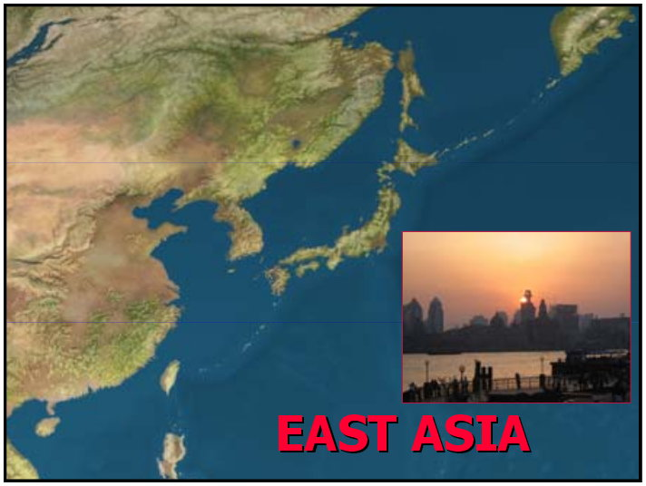
East Asia Atlas
Historical, Physical, Cultural

Slide 2
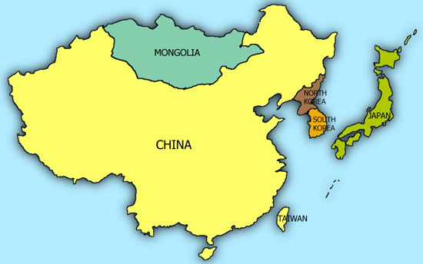

Slide 3
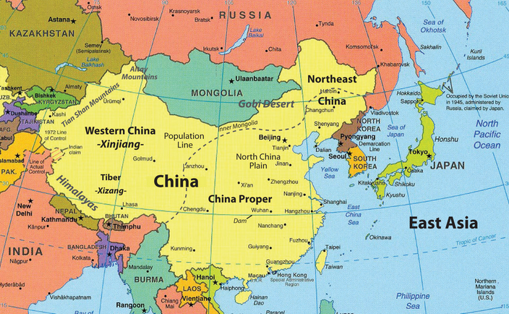

Slide 4
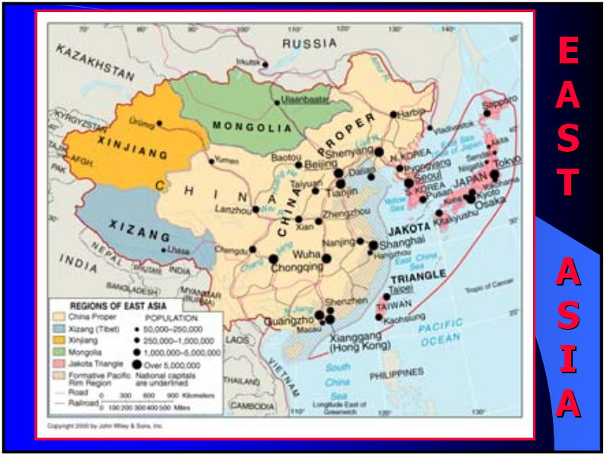

Slide 5
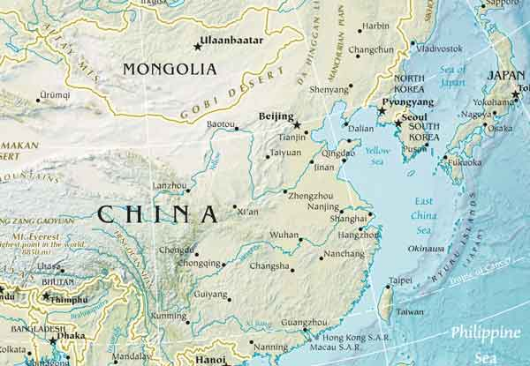

Slide 6
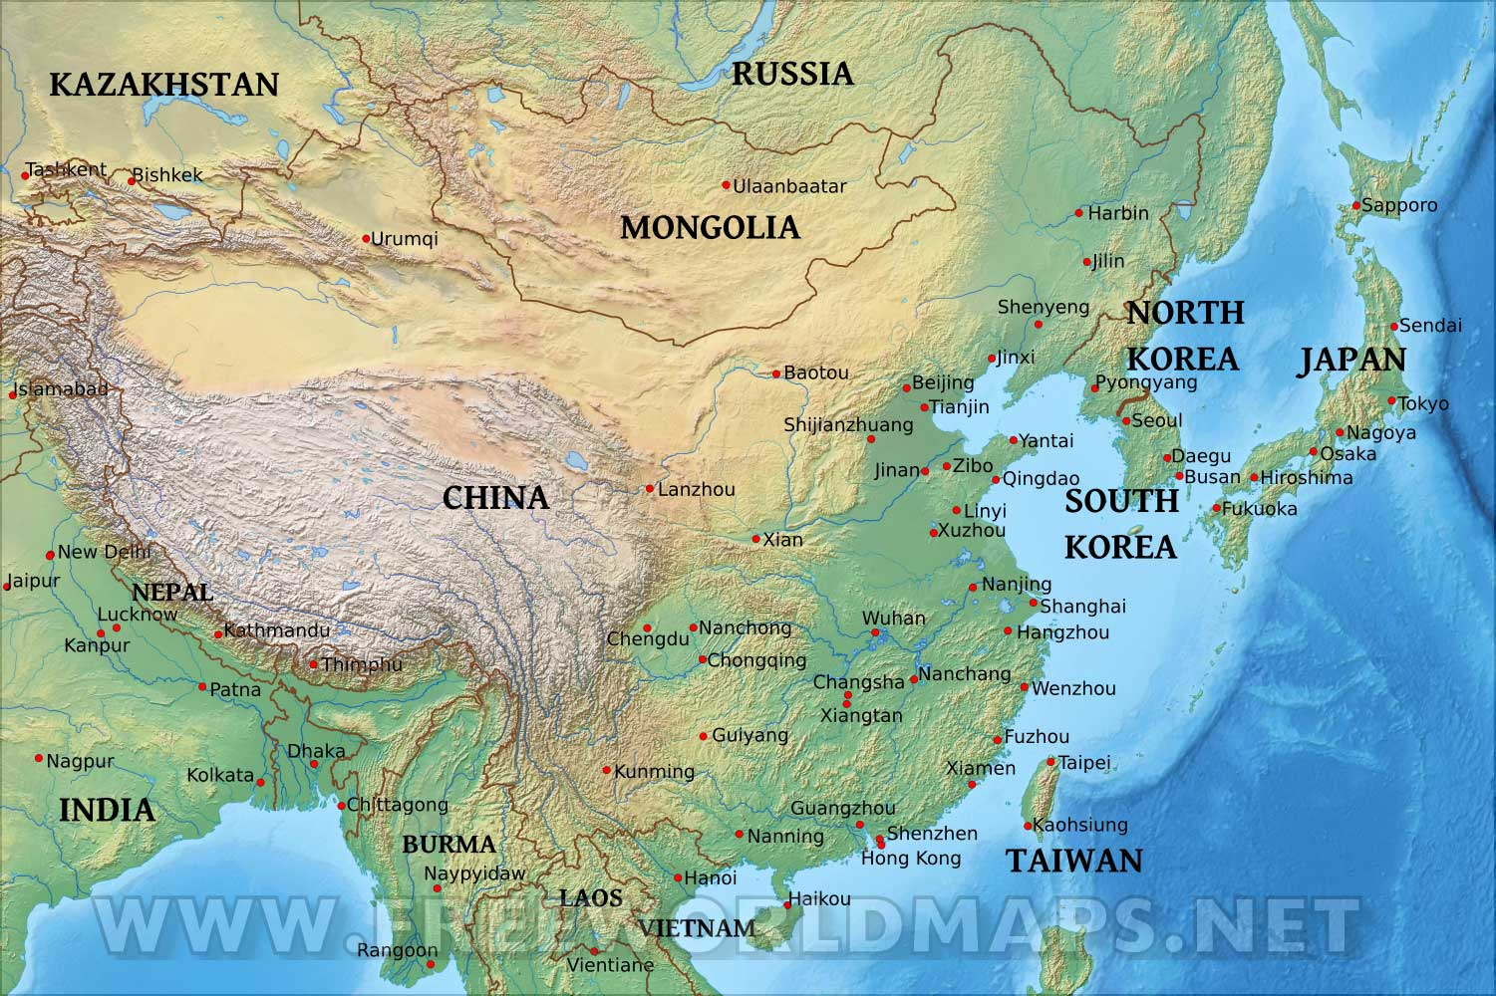

Slide 7
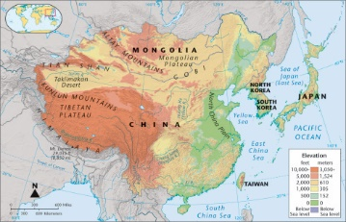

Slide 8
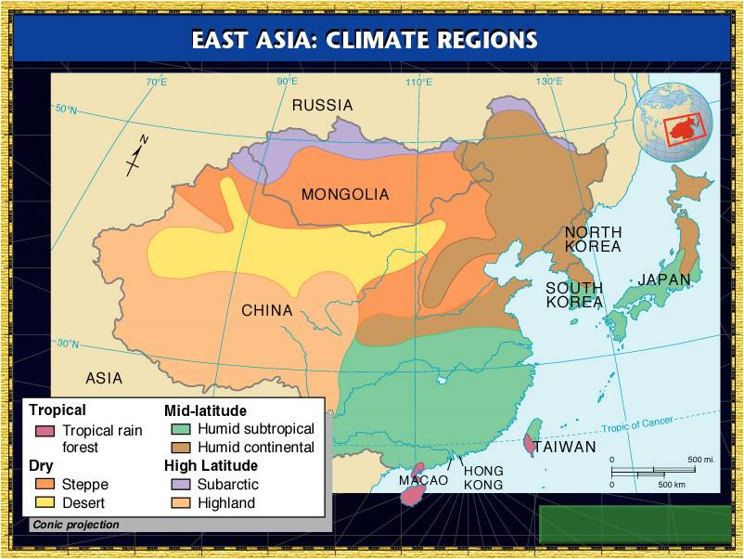

Slide 9
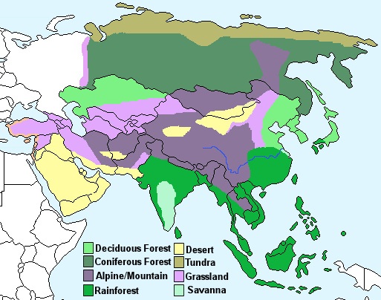

Slide 10
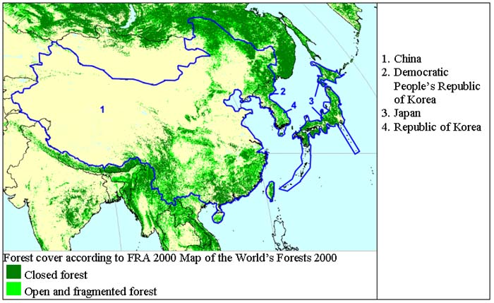

Slide 11
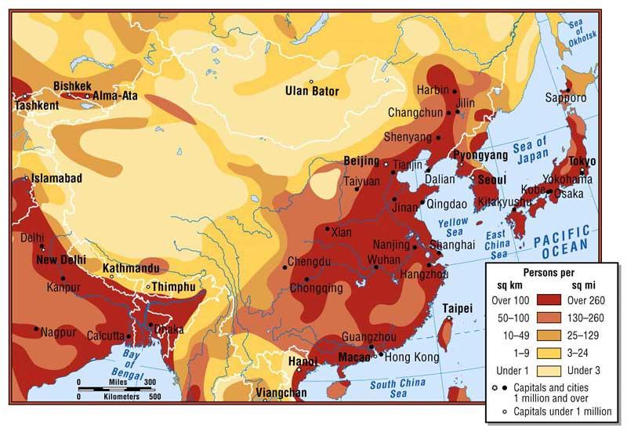

Slide 12
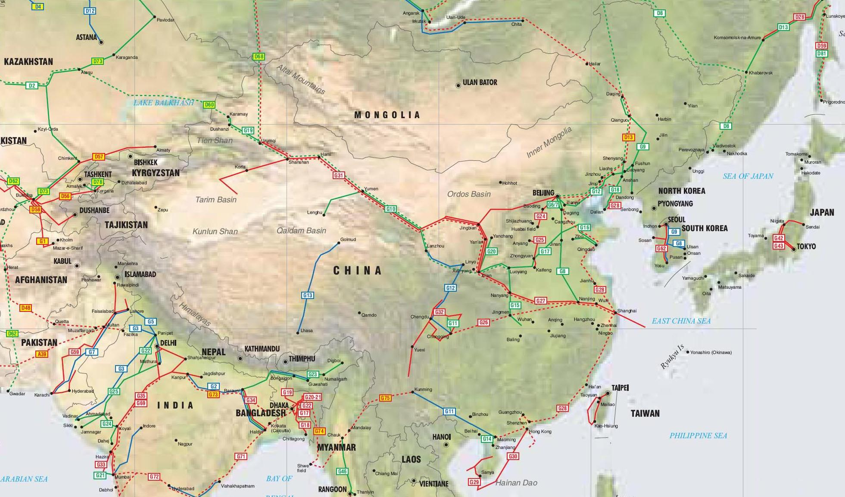
Pipelines

Slide 13
CHINA

Slide 14
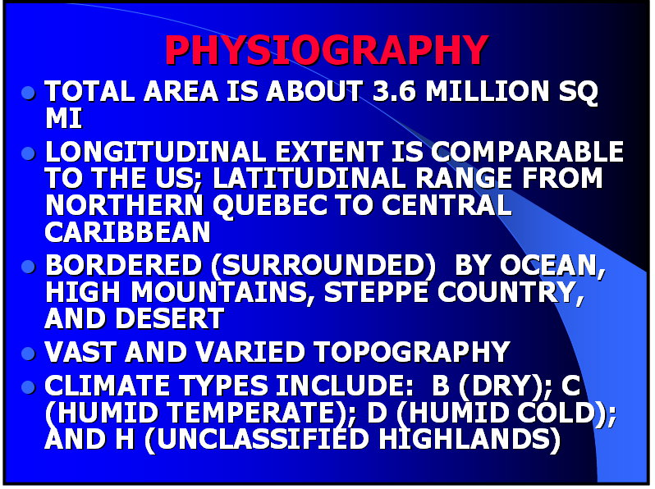

Slide 15
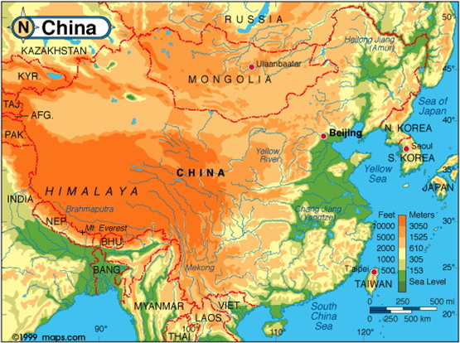

Slide 16
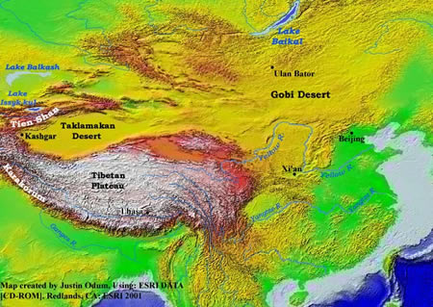

Slide 17
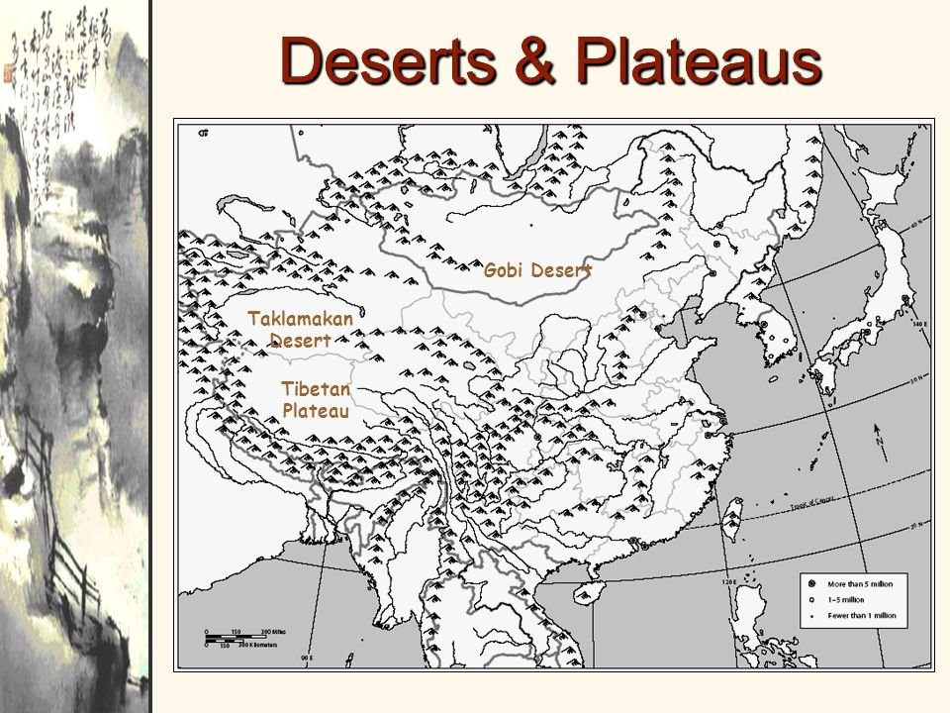

Slide 18
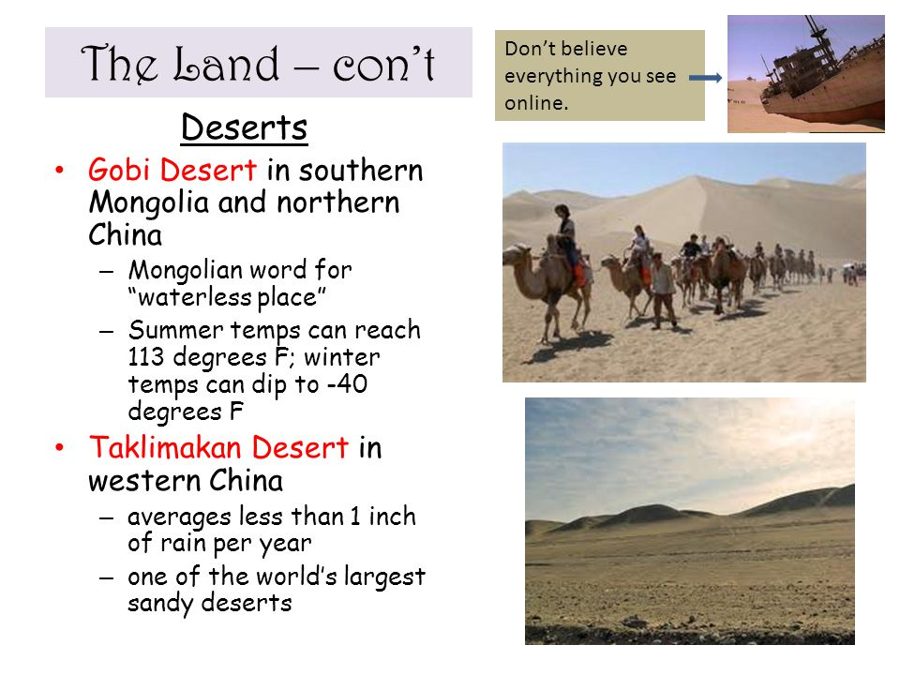

Slide 19
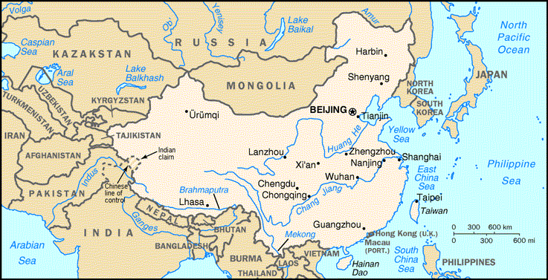
Major Rivers

Slide 20
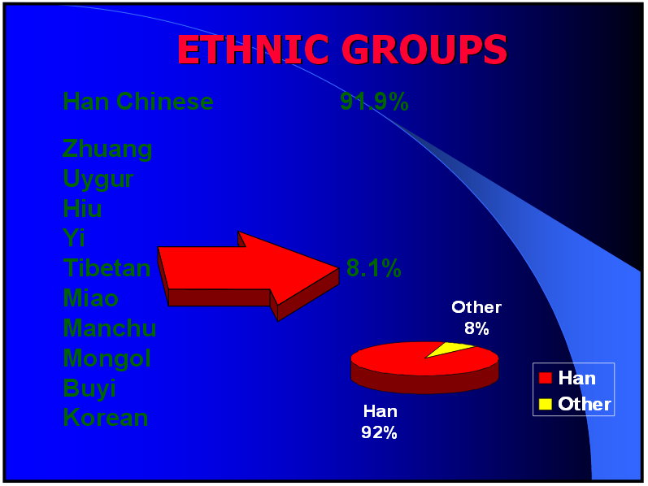

Slide 21
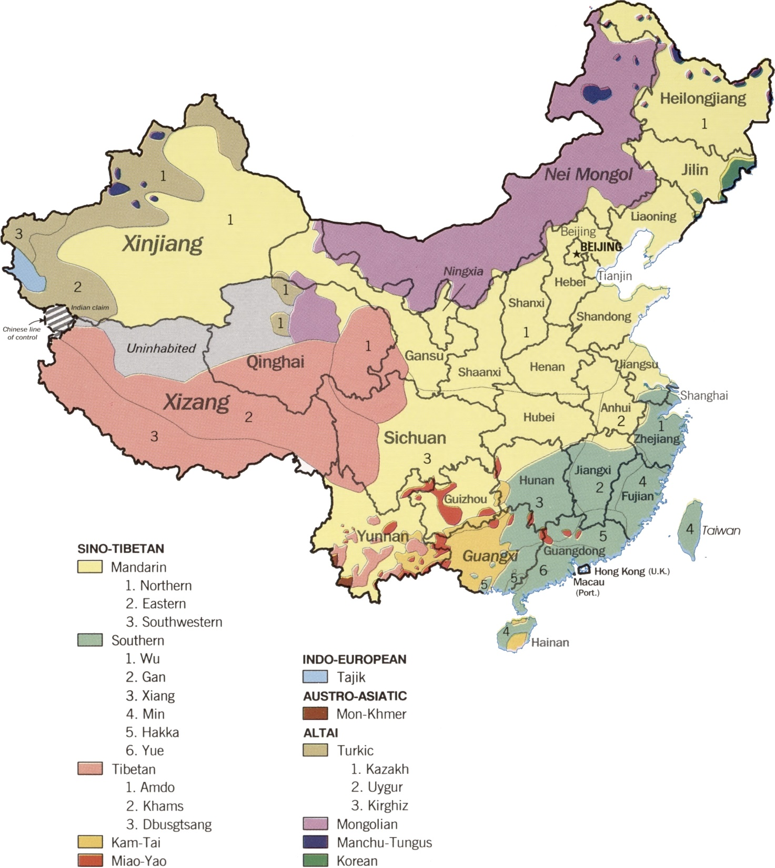
Languages of China

Slide 22
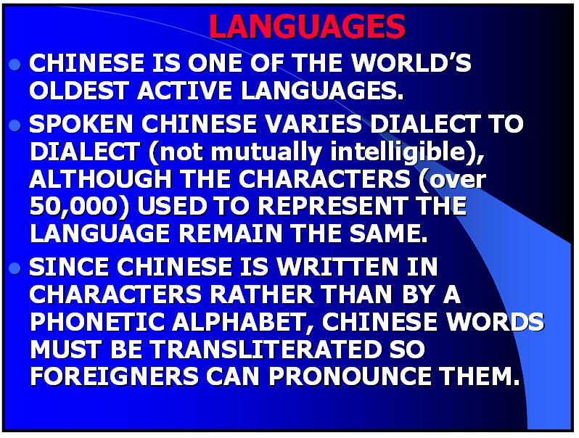

Slide 23
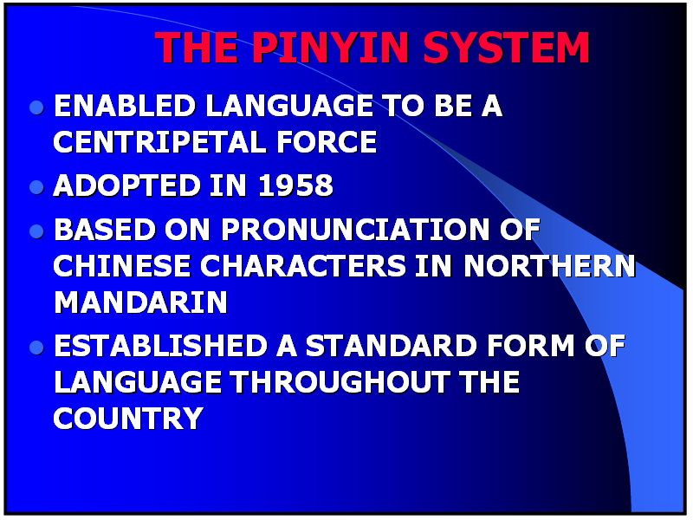

Slide 24
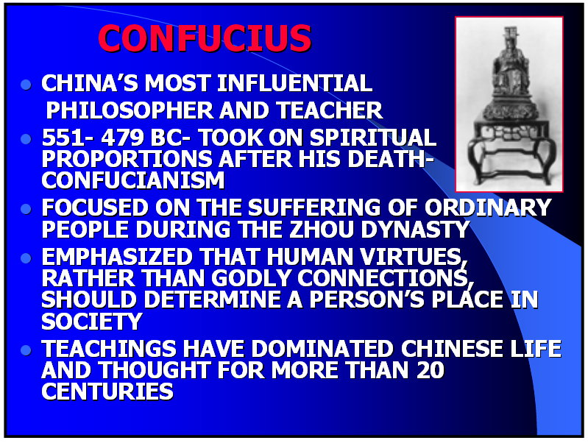

Slide 25
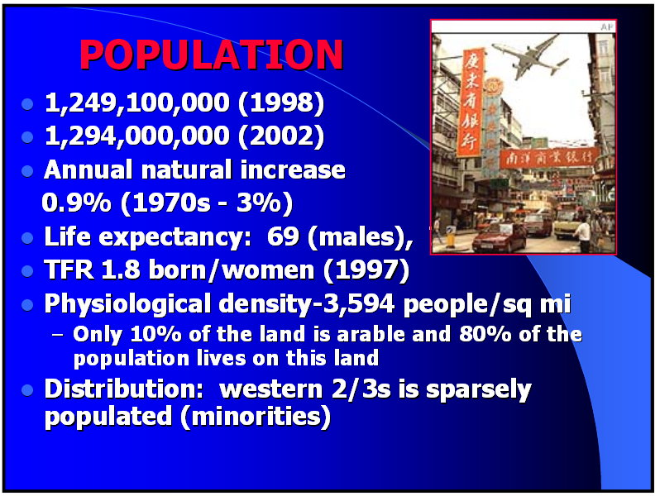

Slide 26
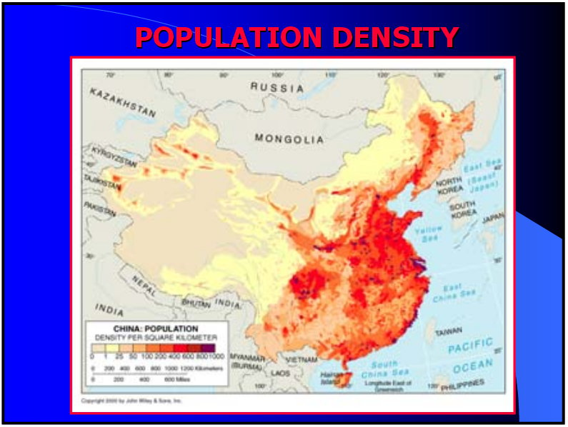

Slide 27
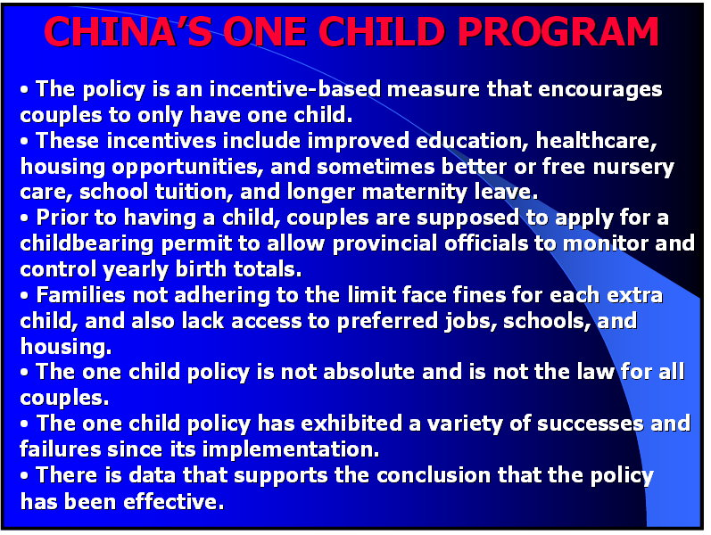

Slide 28
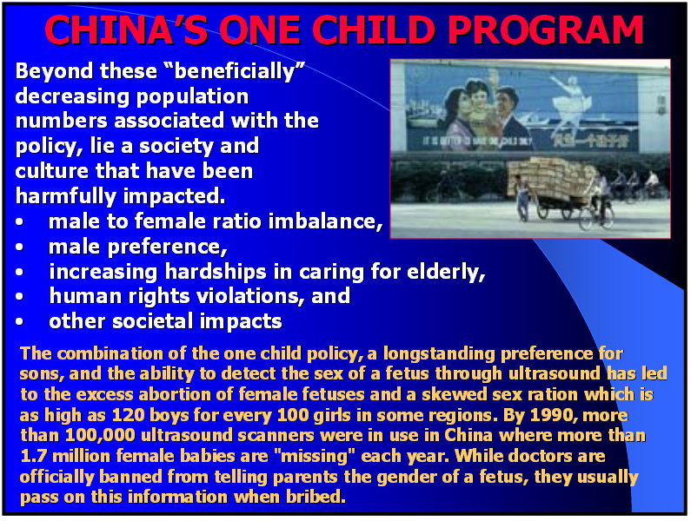

Slide 29
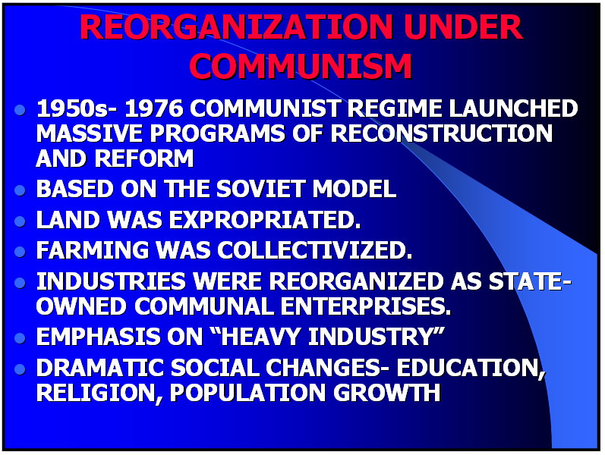

Slide 30
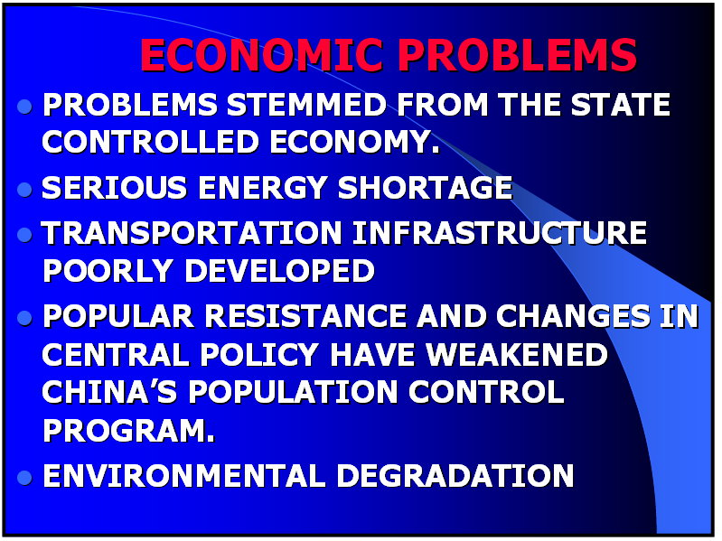

Slide 31
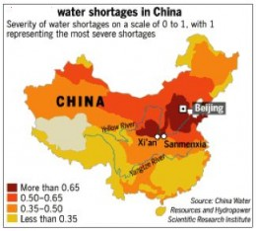

Slide 32
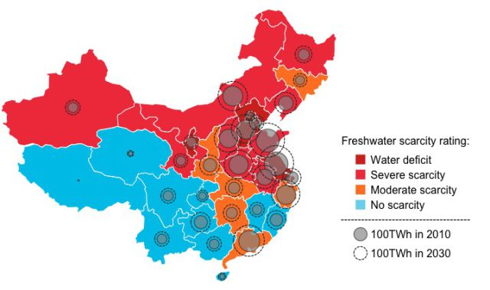

Slide 33
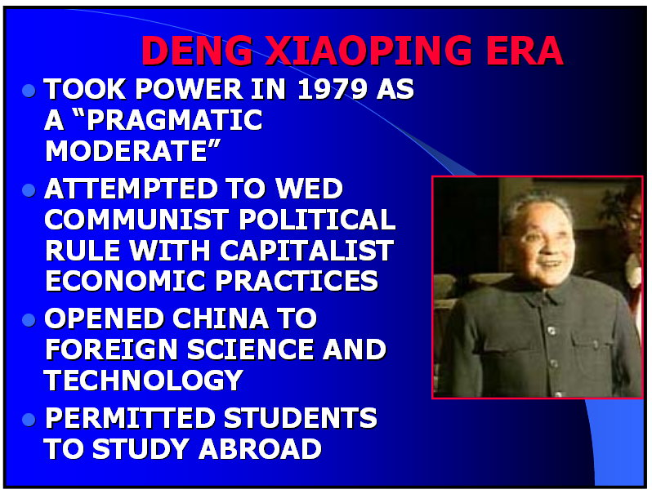

Slide 34
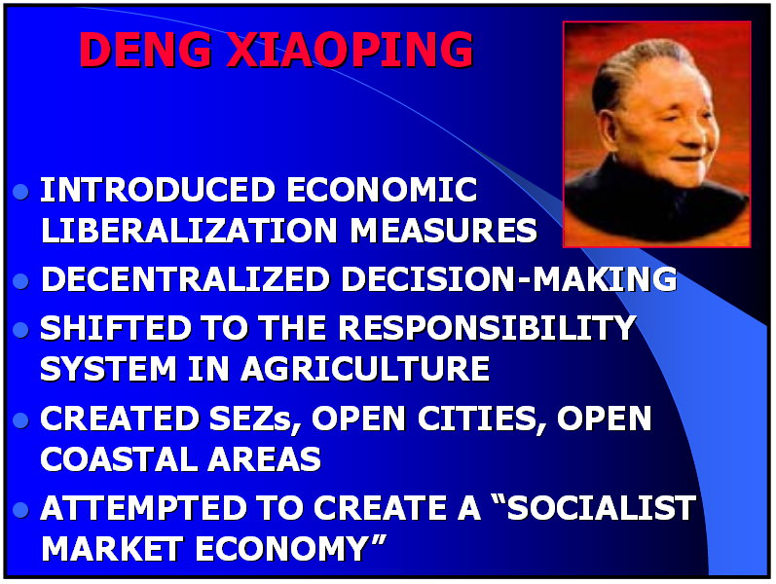

Slide 35
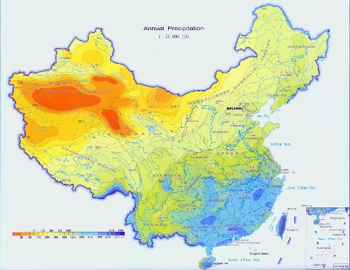

Slide 36
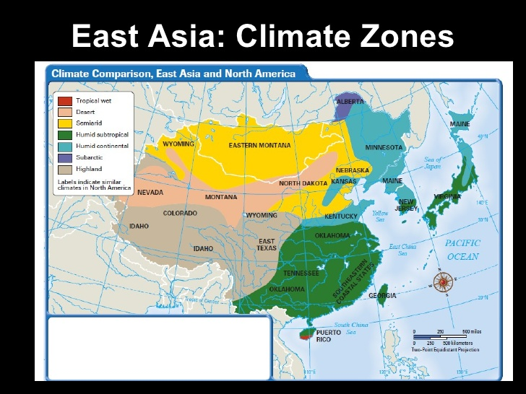

Slide 37
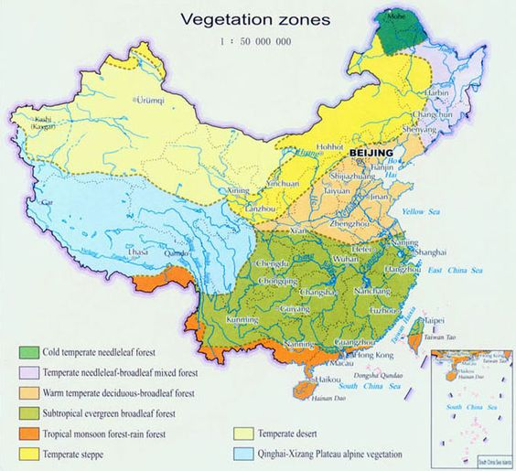

Slide 38
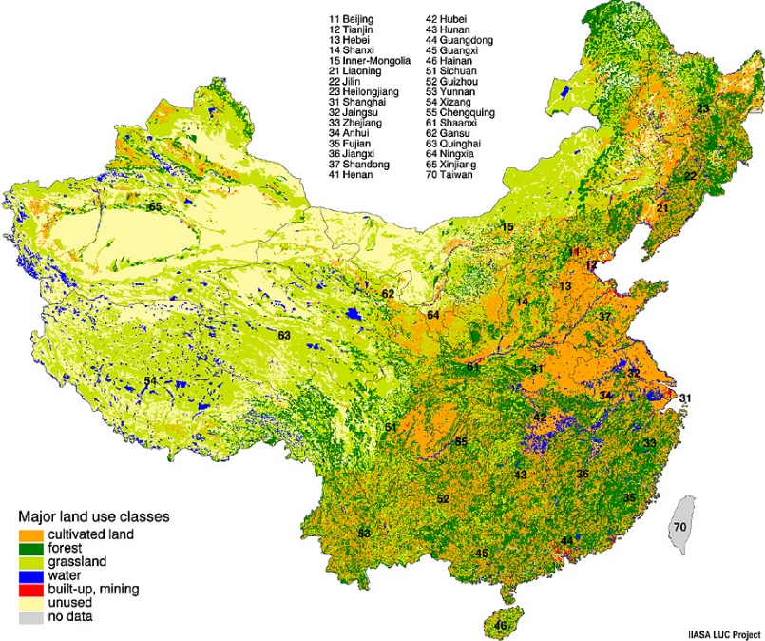

Slide 39
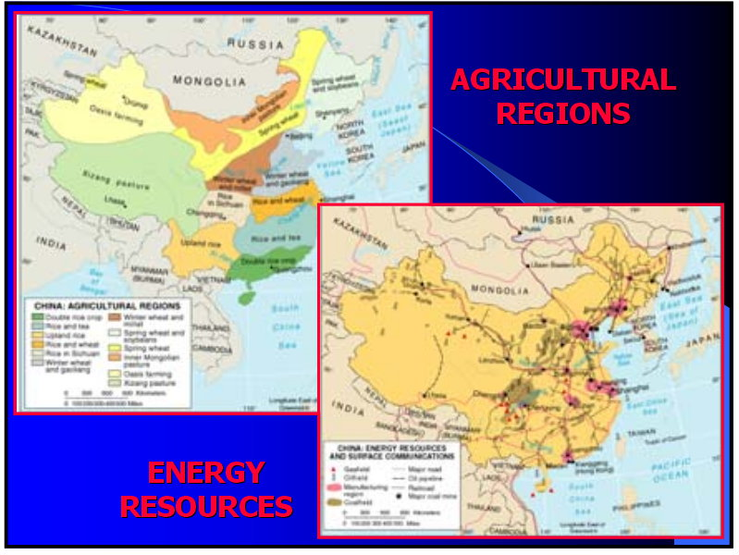

Slide 40
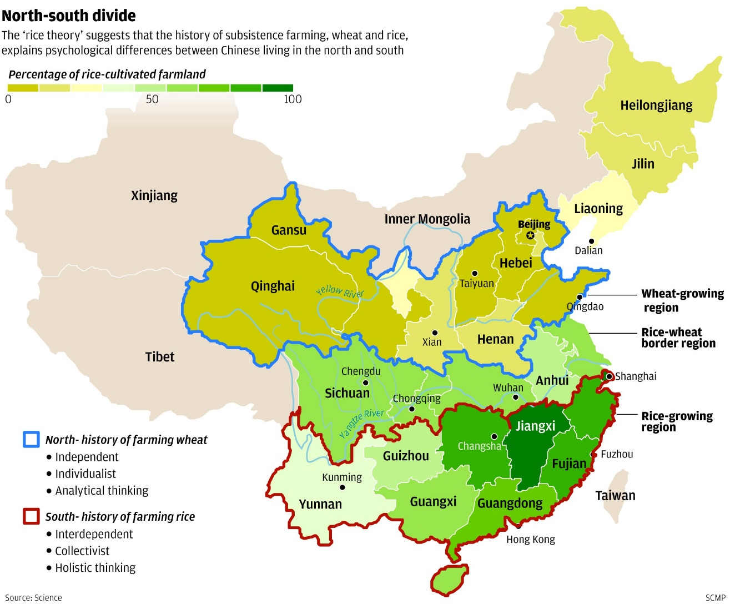

Slide 41
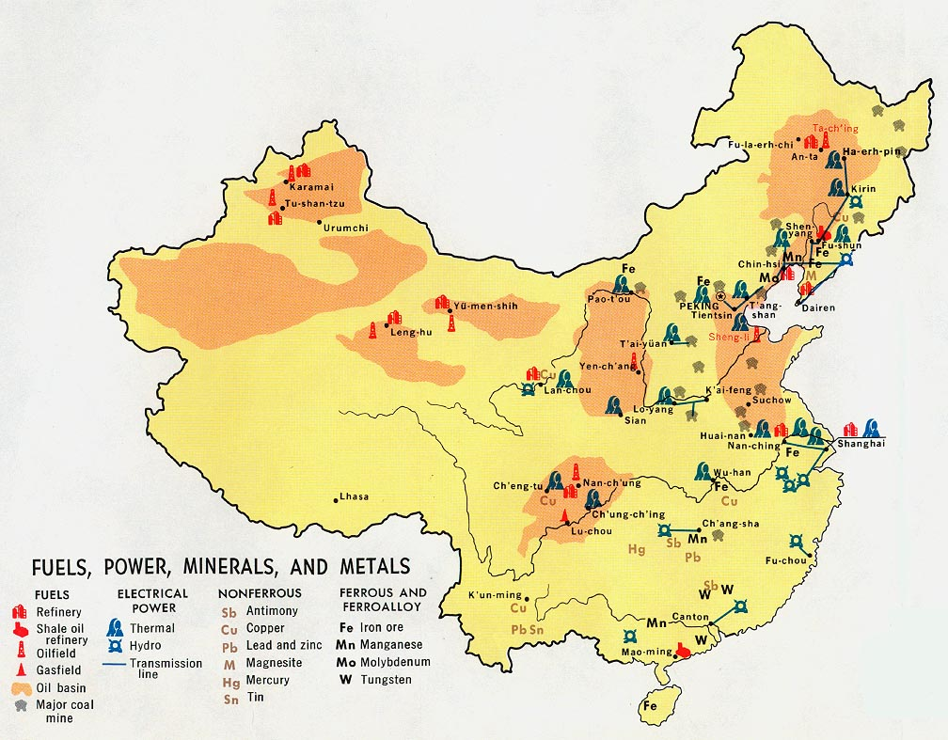

Slide 42
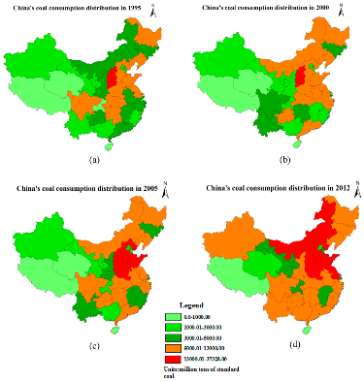

Slide 43
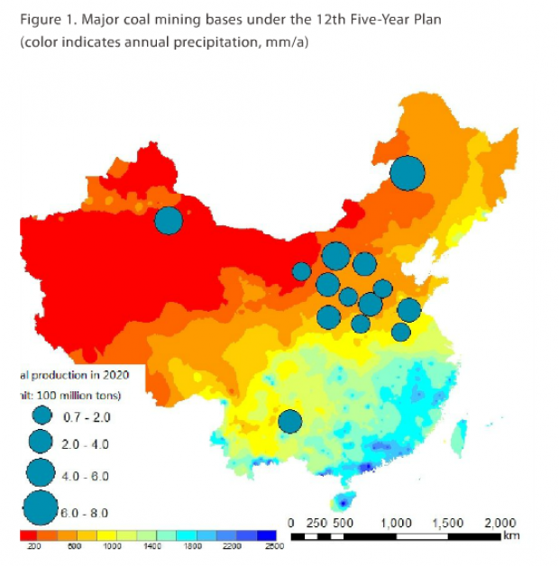

Slide 44
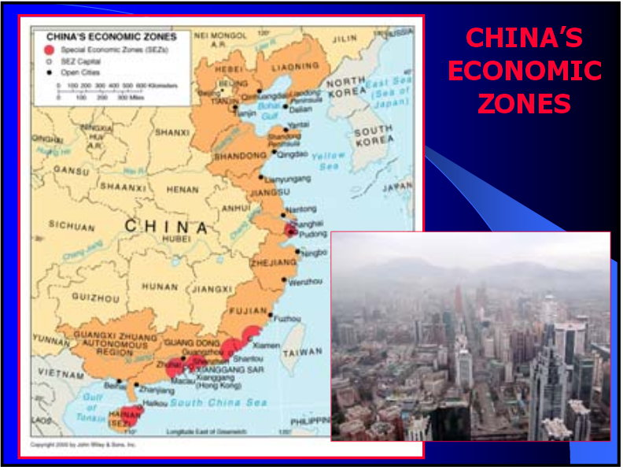

Slide 45
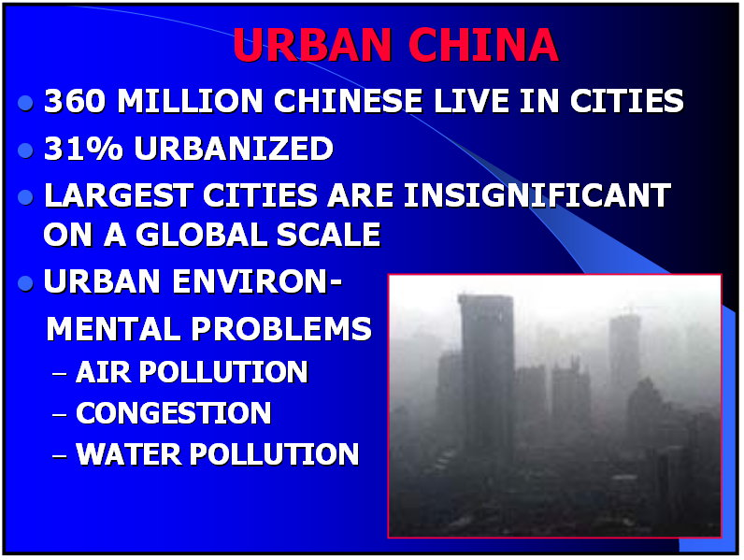

Slide 46
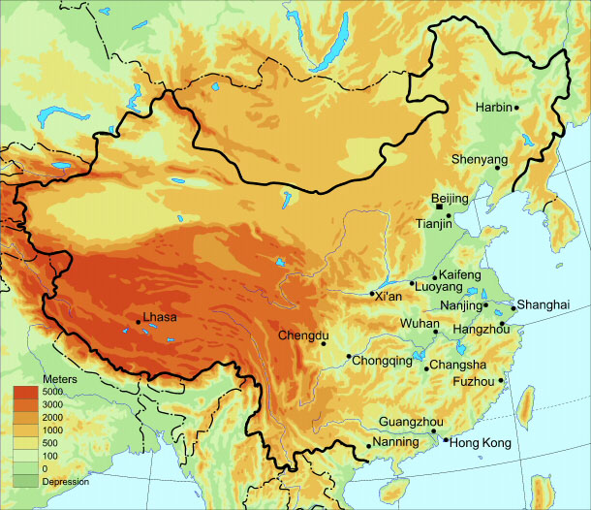

Slide 47
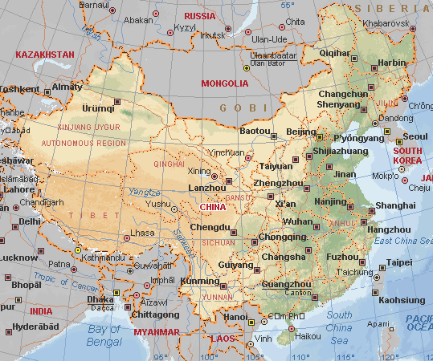

Slide 48
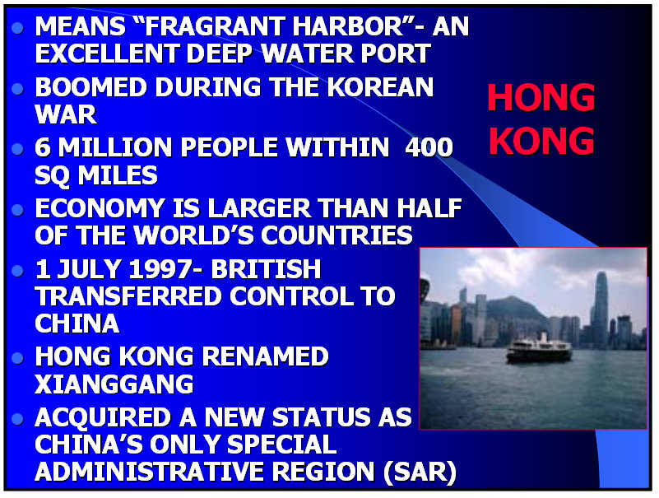

Slide 49
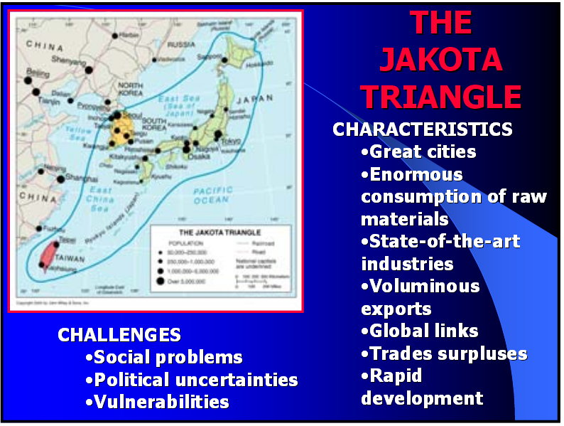

Slide 50
Japan

Slide 51
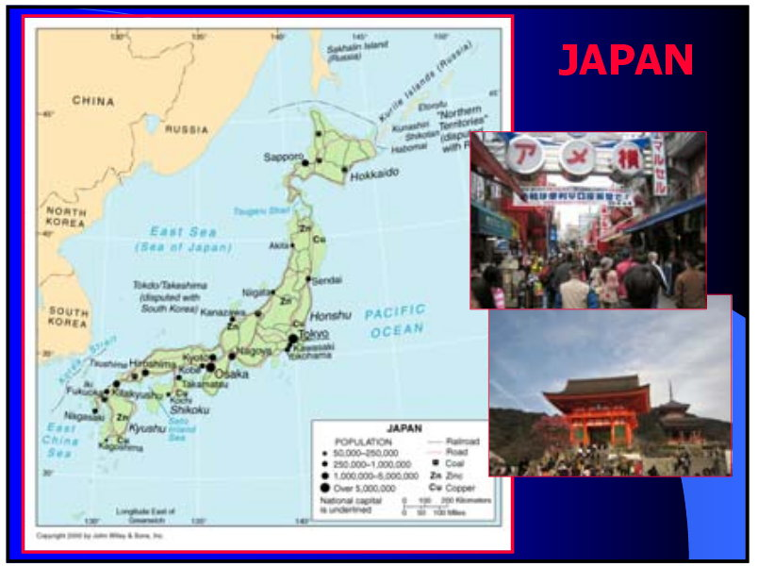

Slide 52
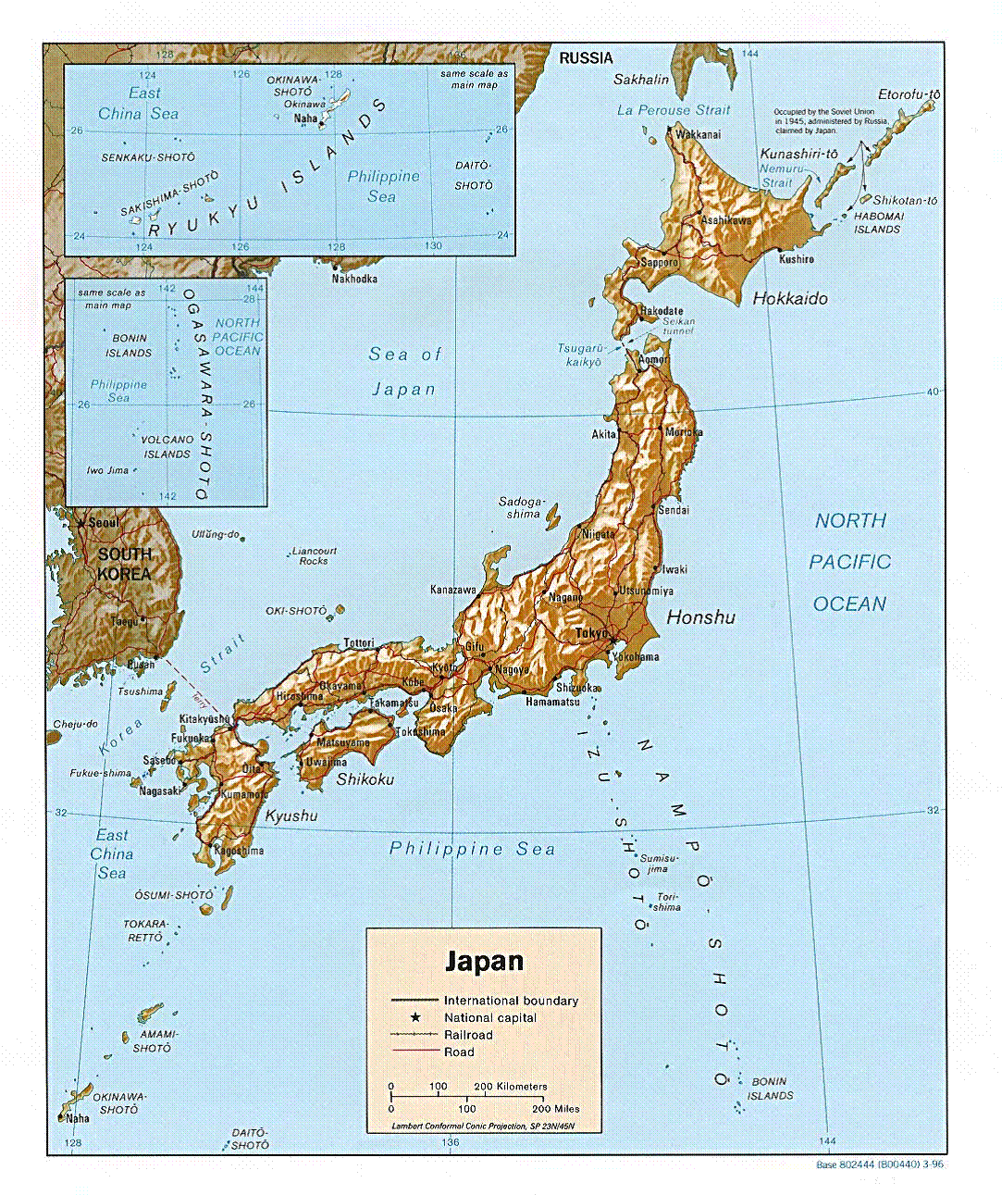

Slide 53


Slide 54


Slide 55


Slide 56


Slide 57


Slide 58


Slide 59


Slide 60


Slide 61


Slide 62


Slide 63


Slide 64


Slide 65

Central Honshu

Slide 66

Historic range of the Ainu people

Slide 67


Slide 68


Slide 69

Humid Continental
Humid Subtropical

Slide 70

Four Seasons Climates

Slide 71


Slide 72


Slide 73


Slide 74


Slide 75


Slide 76


Slide 77


Slide 78

2011

Slide 79


Slide 80


Slide 81


Slide 82
Korea

Slide 83


Slide 84



Slide 85



Slide 86

Four Seasons Climates

Slide 87


Slide 88


Korean War Period

Slide 89


Slide 90


Slide 91


Slide 92


Slide 93
South Korean Government since 1948
First Republic 1948–1960
Second Republic 1960–1961
Military rule 1961–1963
Third Republic 1963–1972
Fourth Republic 1972–1979
Fifth Republic 1979–1987
Sixth Republic 1987–present
South Korea's history is marked by alternating periods of democratic and autocratic rule. Civilian governments are conventionally numbered from the First Republic of Syngman Rhee to the contemporary Sixth
Democratic Republic.

Slide 94

North Korean Government since 1948
The politics of North Korea takes place within the framework of the official state philosophy, Juche, a concept created by Hwang Chang-yŏp and later attributed to Kim Il-sung. In practice, North Korea functions as a one-party state under a totalitarian family dictatorship, described even as an absolute monarchy with Kim Il-sung and his heirs as its rulers.

Slide 95


Slide 96


Slide 97


Slide 98


Slide 99


Slide 100


Slide 101


Slide 102


Slide 103


Slide 104


Slide 105


Slide 106


Slide 107

Transportation
Noice that the is a much finer network in South Korea.

Slide 108


Slide 109


Slide 110


Slide 111


Slide 112

The South is more likely to attract tourists.

Slide 113
Korean War has never officially ended.
The Demilitarized Zone (DMZ)

Slide 114


Slide 115

North’s violations of the DMZ

Slide 116


Slide 117


Slide 118

T

Slide 119
Taiwan

Slide 120


Slide 121


Slide 122


Slide 123



Slide 124


Slide 125


Slide 126


Slide 127


Slide 128


Slide 129


Slide 130
Mongolia

Slide 131


Slide 132


Slide 133


Slide 134

Transportation

Slide 135


Slide 136


Slide 137


Slide 138


Slide 139

Mineral Wealth

Slide 140


Slide 141


Slide 142

Population Density

Slide 143
Study & Practice Maps

Slide 144


Slide 145


