Slide 1
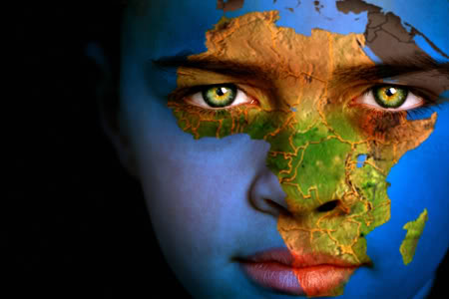
Landforms, Resources, And People of Africa
Objective: Identify major features in Africa

Slide 2
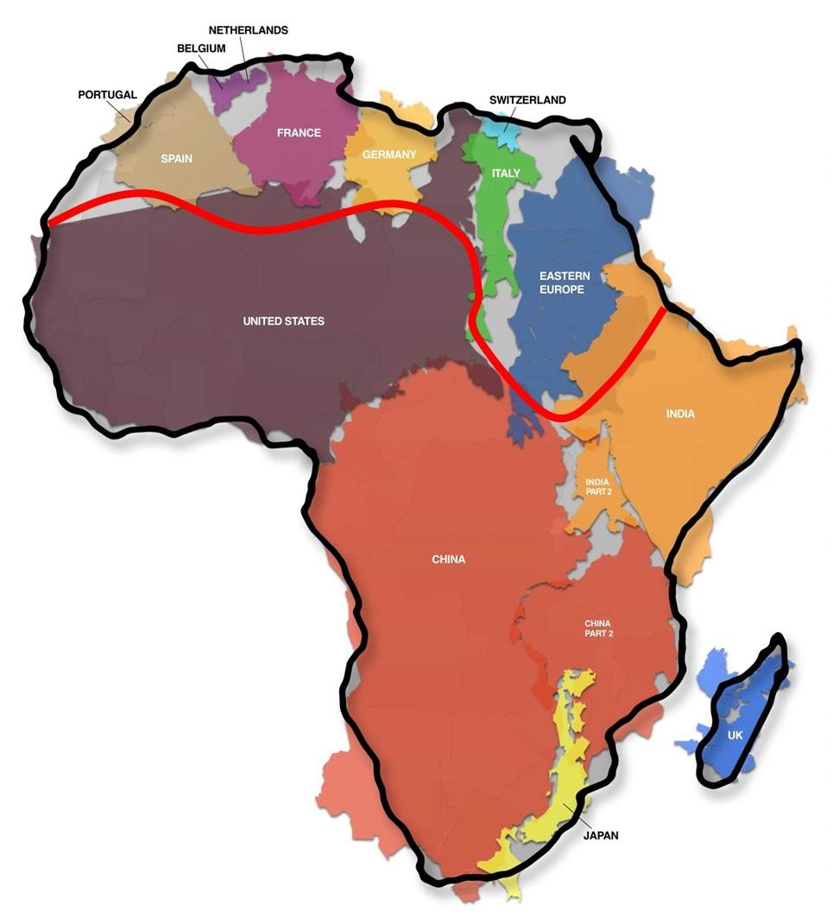
Getting a sense of the size

Slide 3
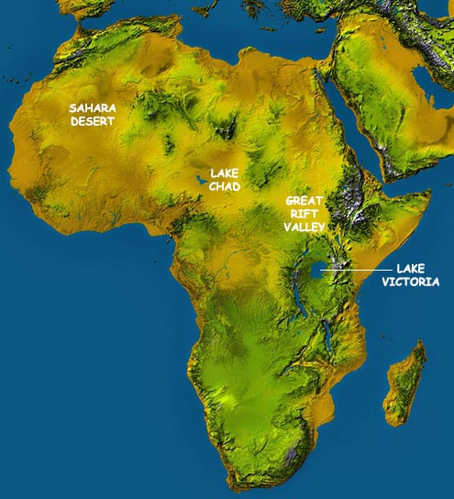
Overview of the Topography

Slide 4
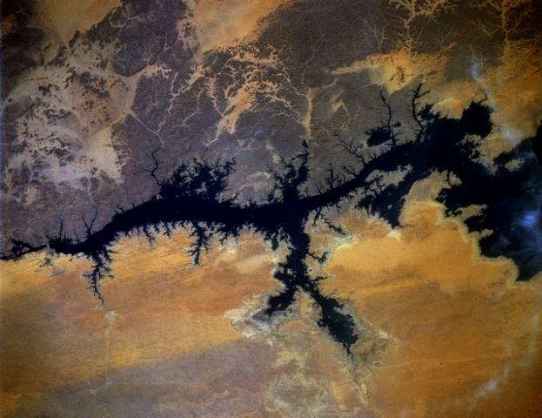
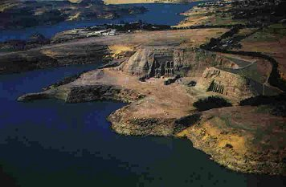
North Africa
When the Egyptians constructed the Aswan High Dam, they also built the largest human-made lake in the world-Lake Nasser. Lake Nasser is over 300 miles long!

Slide 5
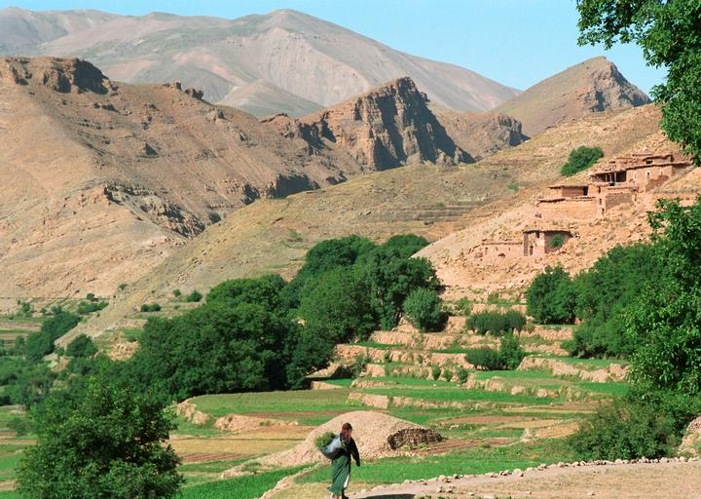
Mountains in North Africa
The Atlas Mountains are found in Morocco and Algeria

Slide 6
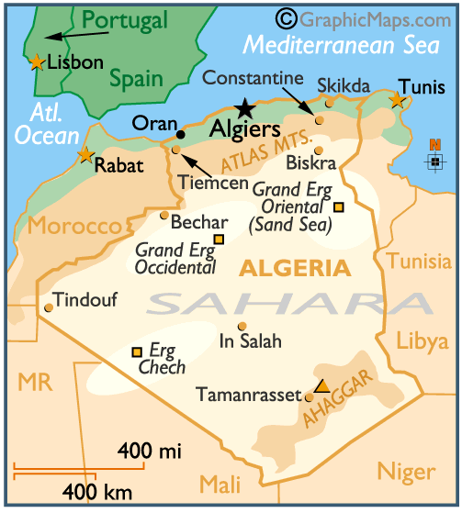
The Atlas Mountains of Morocco and Algeria
The Atlas mountain range is the longest range in Africa. They cause a great amount of rainfall on the northern coast . It is along this northern coast where most of North Africa’s population lives.

Slide 7
Rivers of North Africa
The Nile River- Egypt
The Nile River is the longest river in the world (4,145 miles long) It begins near the equator and empties into the Mediterranean Sea.
The river floods annually creating a very fertile strip of land along its banks and in its flood plain.
90% of Egypt’s population lives along the Nile River.

Slide 8
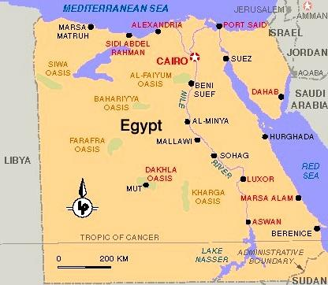
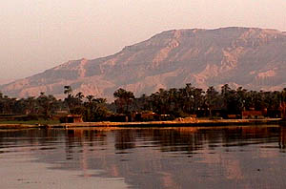
The Nile River - Egypt

Slide 9
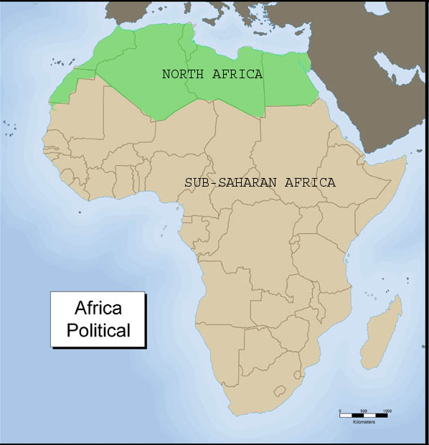
Africa South of the Sahara

Slide 10
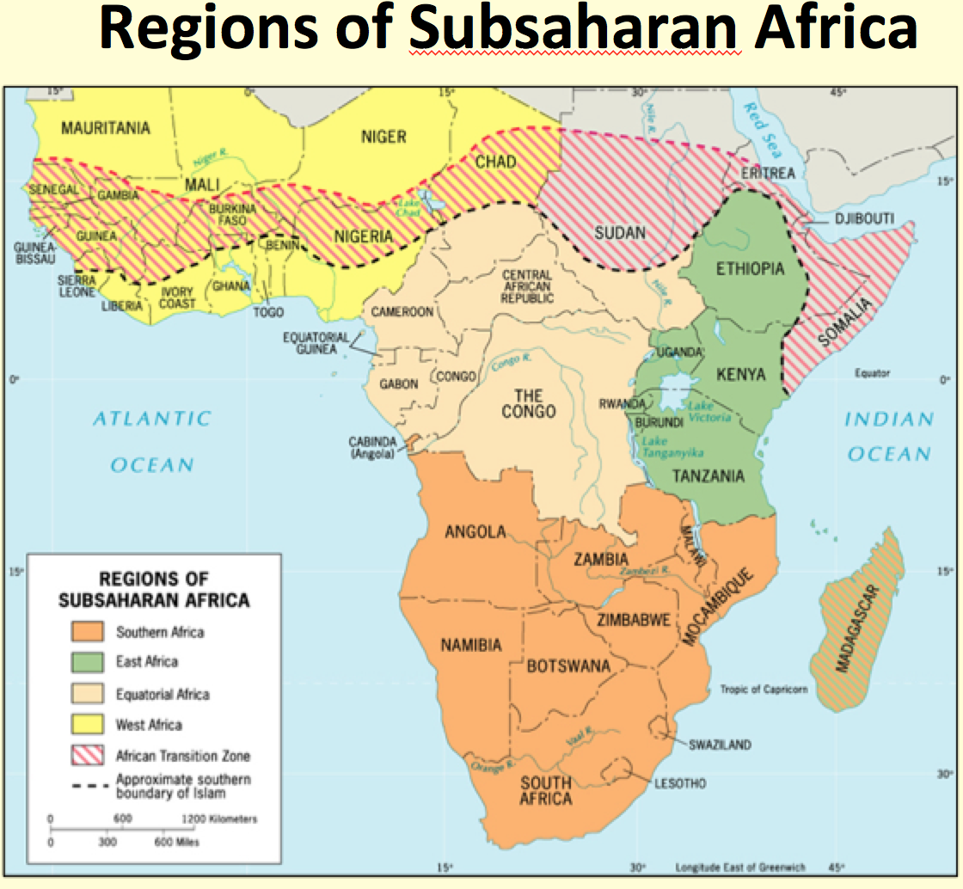
Regions of Africa

Slide 11
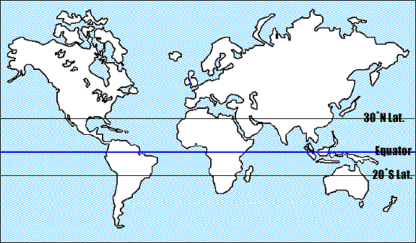
Sub Saharan Africa
-only region in the world to lay almost entirely in the tropics

Slide 12
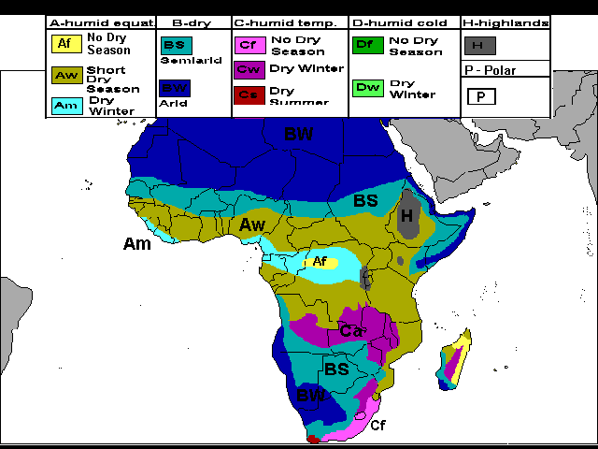
Climate Map

Slide 13
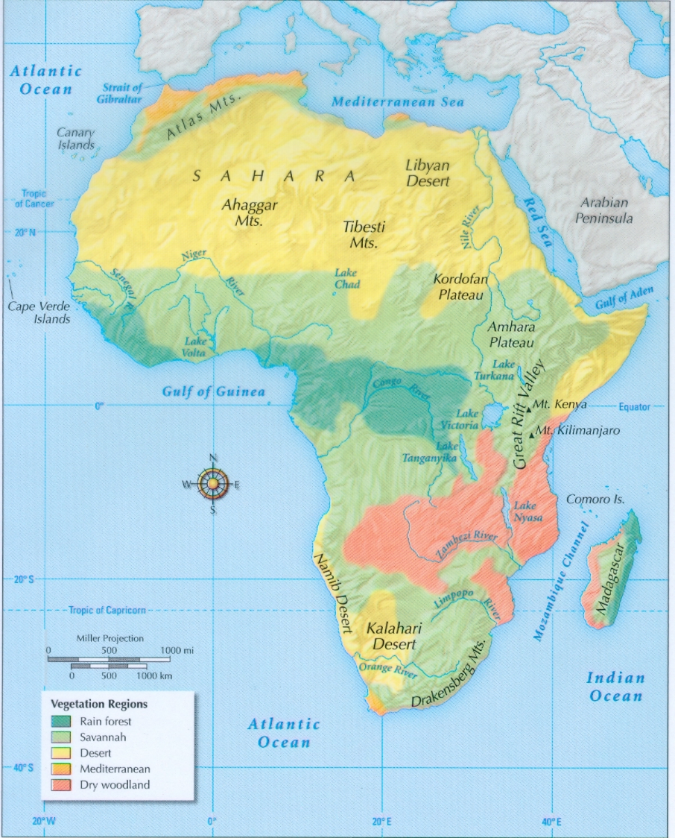
Vegetation Regions

Slide 14
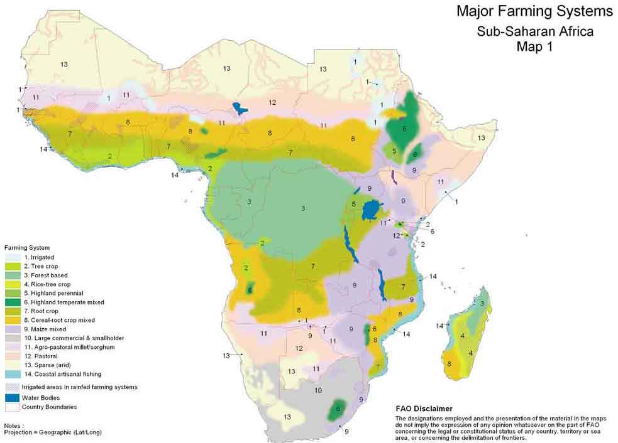

Slide 15
Population Patterns
world’s fastest growing population.
youngest population- nearly 50% of its people are 15 years old or younger.
more than 2,000 different cultural groups, 800 languages and hundreds of dialects.

Slide 16
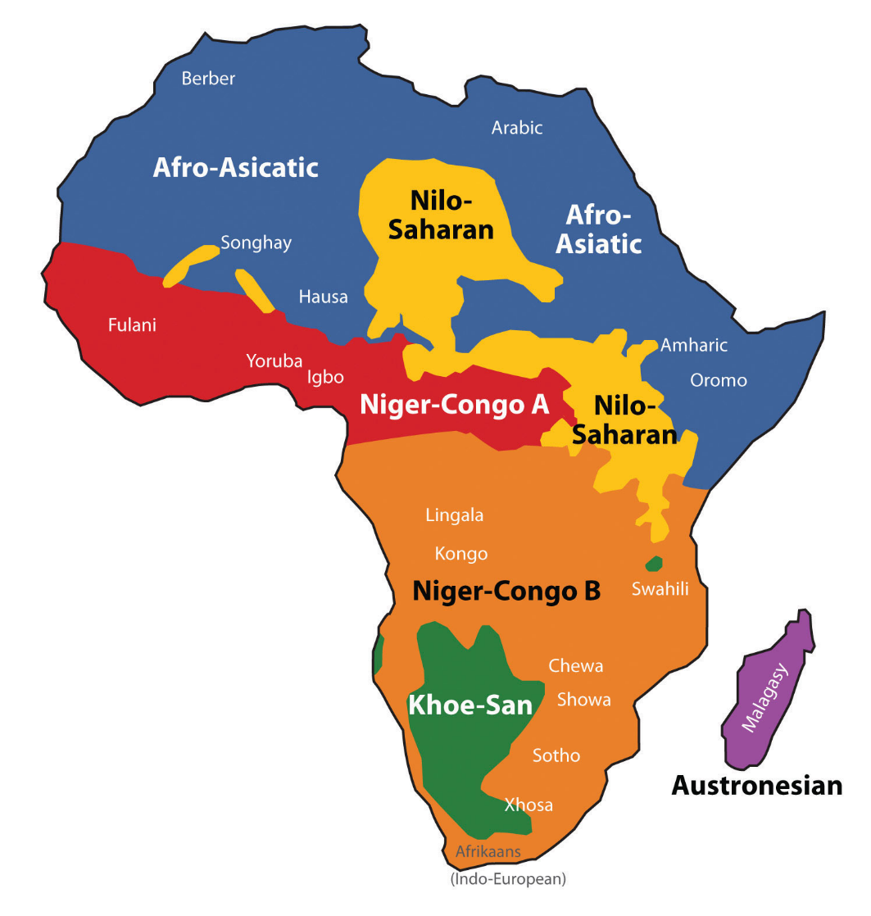

Slide 17
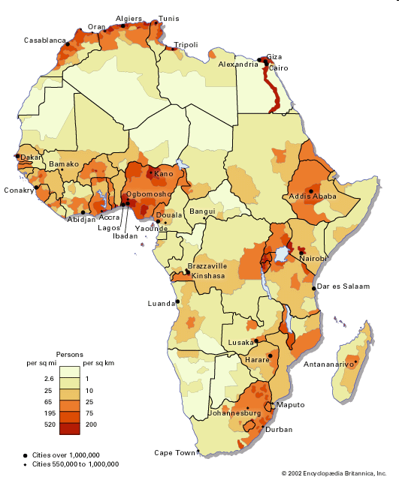
Population Density of Africa

Slide 18
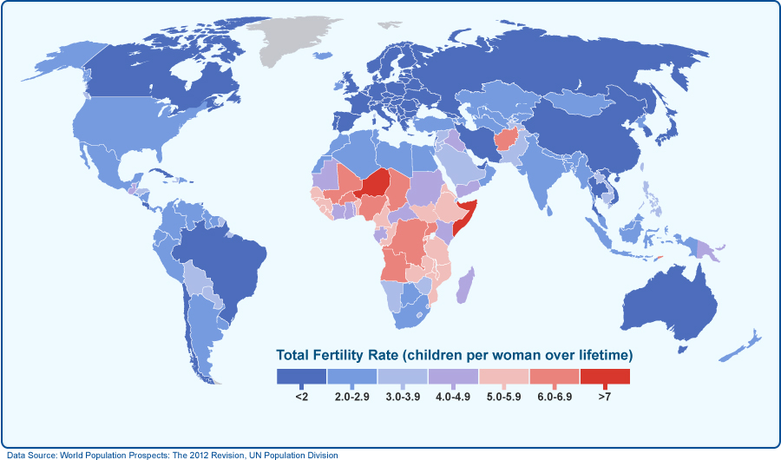
A rate of 2.1 is replacement rate – above 2.1 means population growth

Slide 19
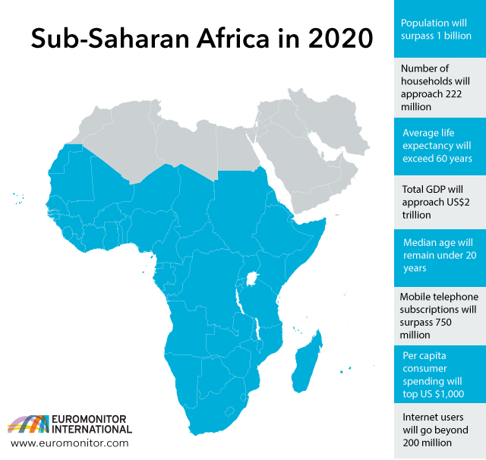

Slide 20
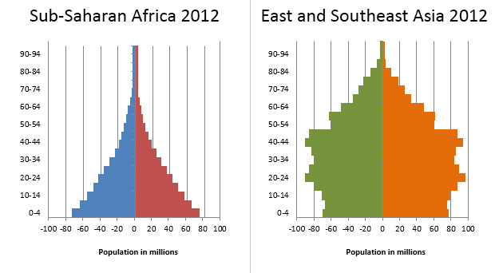

Slide 21
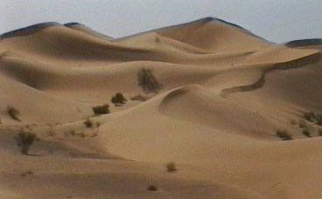
The Environment
Droughts, over-farming and overgrazing have contributed to the spread of desert areas
Sahel-region between the Sahara and the rain forests near the western African coast

Slide 22
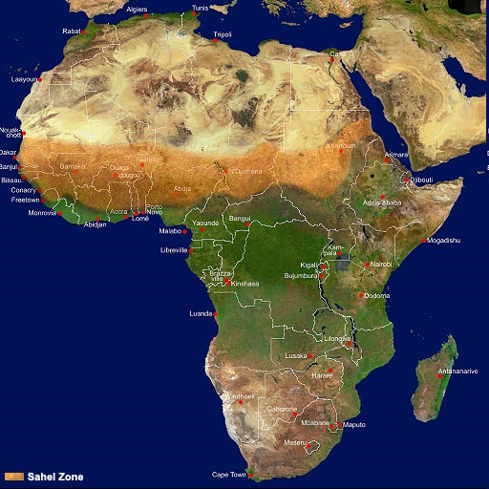

Slide 23
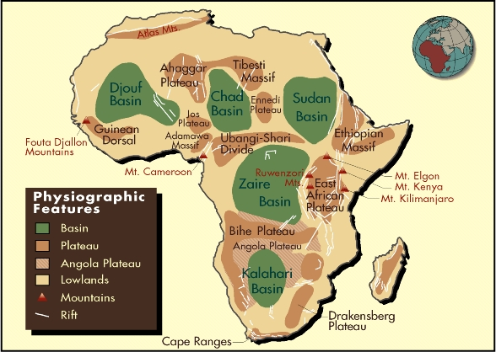

Slide 24
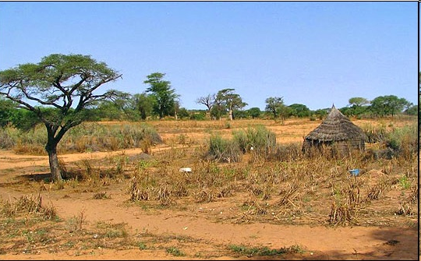
Sahel

Slide 25
Physical Geography
The eastern and southern areas are called “High Africa”
the elevation is generally more than 3,000 feet above sea level.
The Equator runs through the middle of Africa. 90% of the continent lies within the tropics.

Slide 26
Major Land Features
Mountains and Highlands:
The Great Rift Valley
Plateaus
Rivers and Waterfalls
Lakes – Victoria

Slide 27
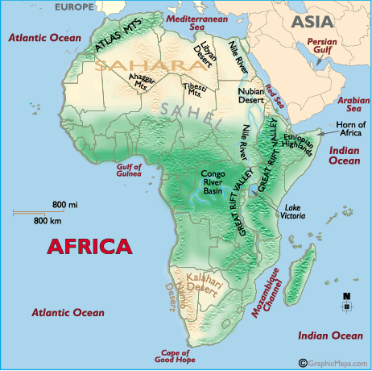
Mountains and Highlands
Ruwenzori Mountains
Eastern Highlands
Volcanic Peaks
Drakensberg Mtns

Slide 28
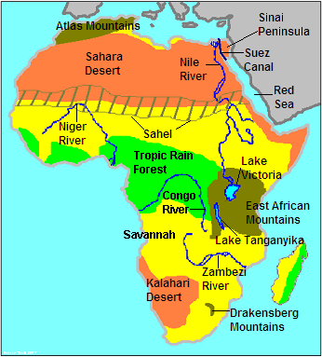

Slide 29
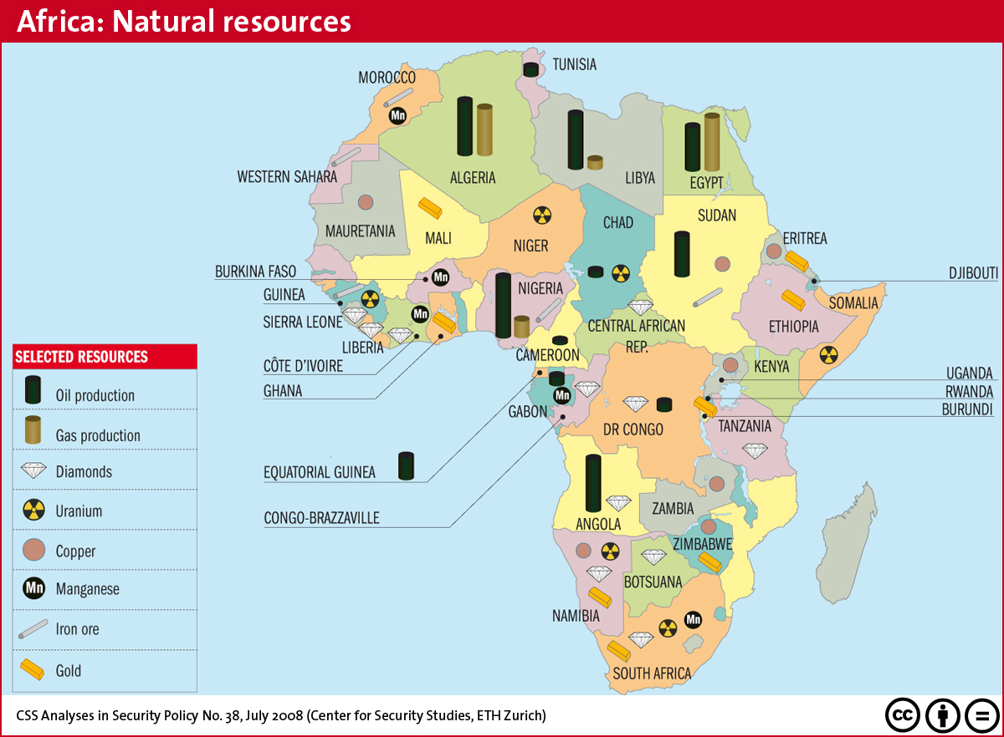

Slide 30
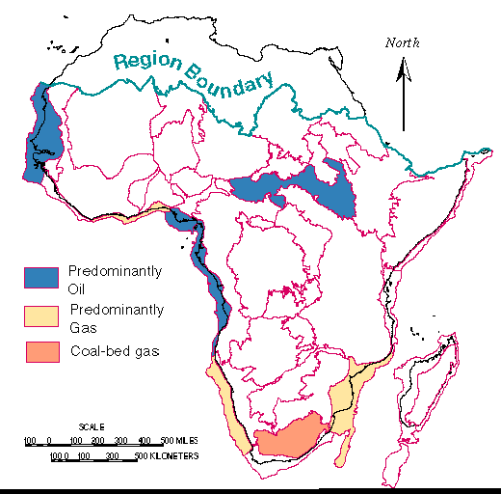

Slide 31
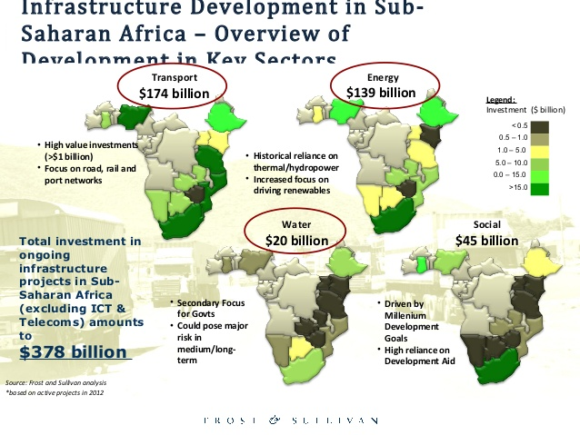

Slide 32
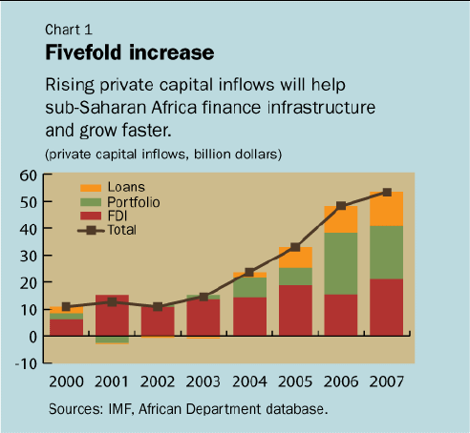

Slide 33
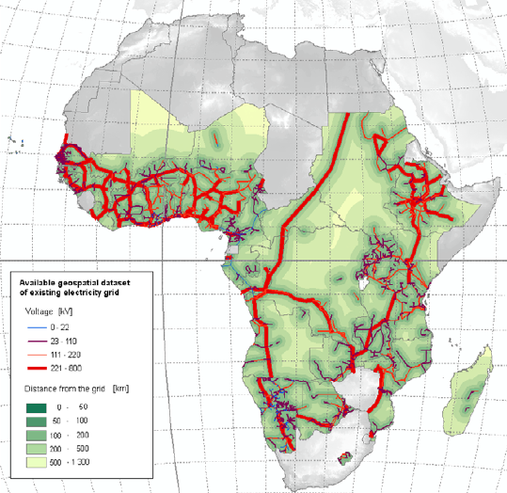

Slide 34
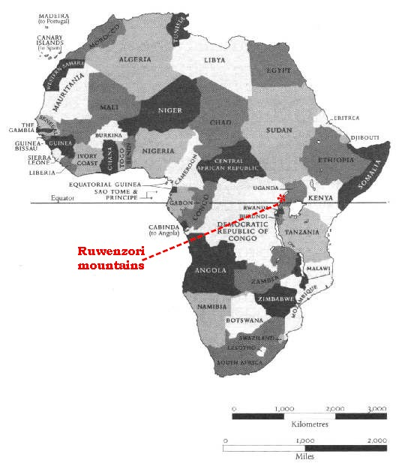
The Ruwenzori Mountains of Uganda
The 'Mountains of the Moon' lie along the western border of Uganda, on the border with the DRC.
The Ruwenzori Mountains region became a National Park in 1991.

Slide 35
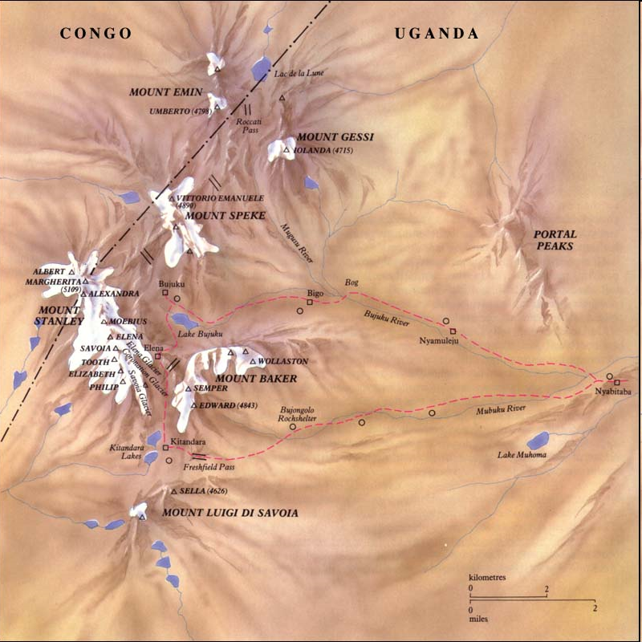
Mount Stanley

Slide 36
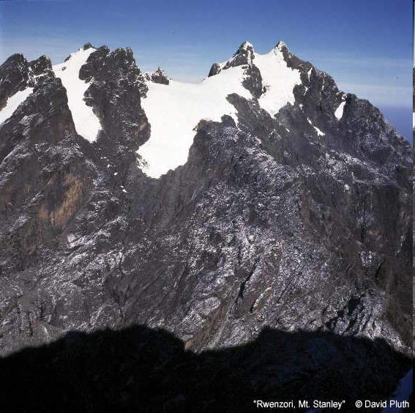
16763 ft (5109 m)
Highest point in Congo and Uganda
Major Peaks:
Margherita Peak: 16763 ft Alexandra Peak: 16703 ft
Albert Peak: 16690 ft
Location: Ruwenzori Mountains, Congo-Uganda border

Slide 37
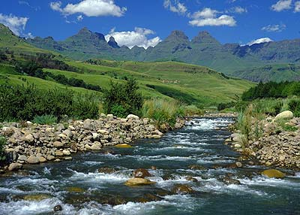
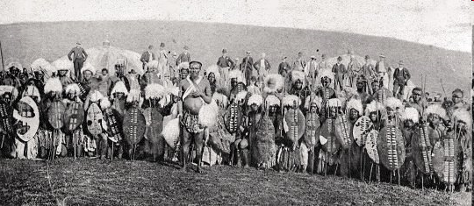
The Drakensberg Mountains
in South Africa, located in the heart of the Zulu kingdom.
Dragon’s Mountain

Slide 38
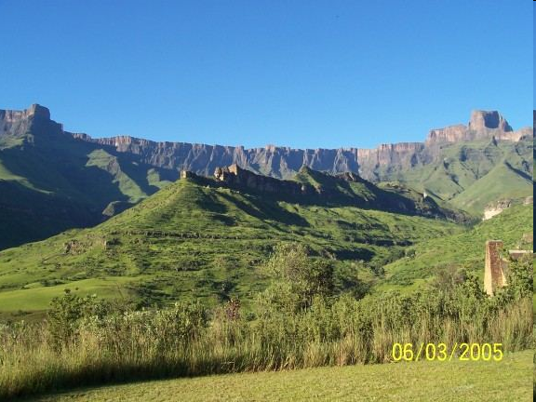
Drakensberg Mountains

Slide 39
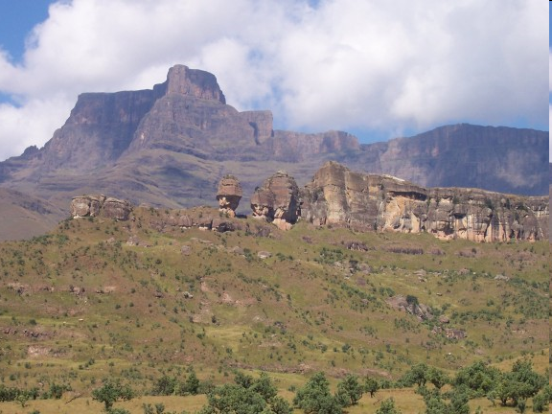
Drakensberg Mountains – Policemen’s Helmets

Slide 40
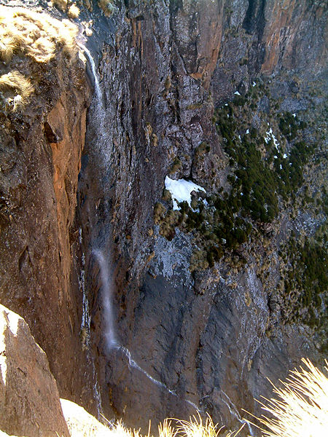
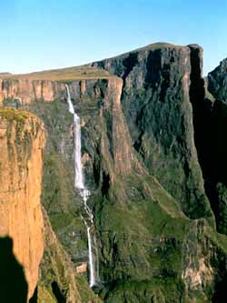
Tugela Falls
world's second highest waterfall.
The total drop is 3,110 feet

Slide 41
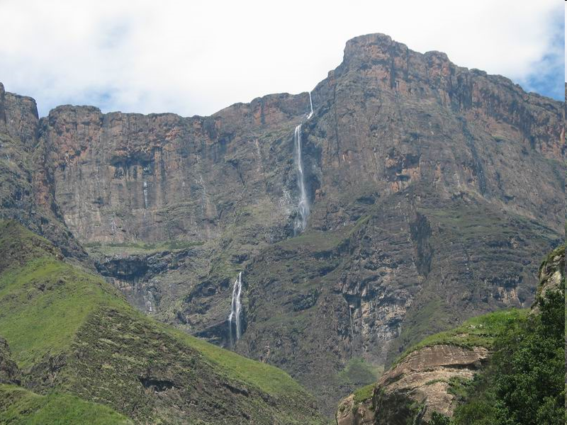
3 of the 5 cascades can be seen here

Slide 42
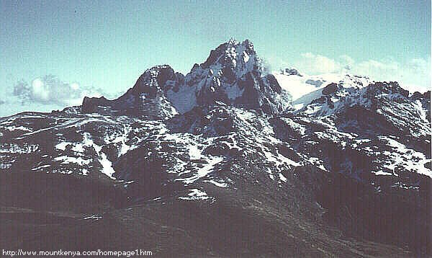
Volcanic Peaks of Kenya and Tanzania
Mount Kenya is the 2nd highest mountain in Africa. It is an extinct volcano.
It dominates the Central Kenyan highlands, towering just seventy miles north of Nairobi, and ten miles south of the Equator.

Slide 43
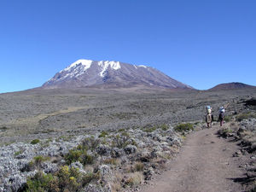
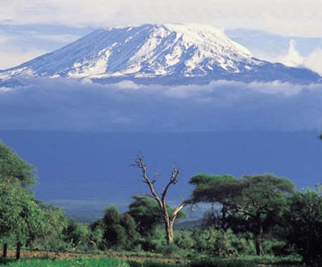
Mount Kilimanjaro
Africa’s highest mountain
Like Mt. Kenya, is an inactive volcano
Located in Tanzania

Slide 44
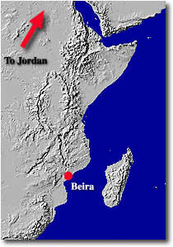
The Great Rift Valley
Stretches from the Jordan River to the Zambezi River in Mozambique.
created by great tectonic forces below the earth’s surface that has cracked the surface.

Slide 45
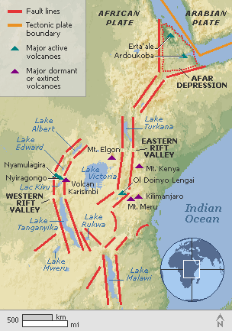
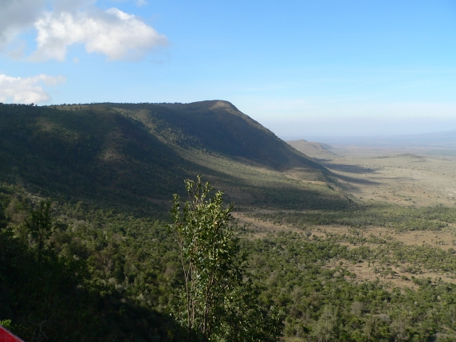
The Great Rift Valley

Slide 46
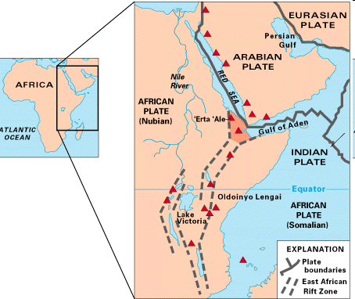
Map of East Africa showing some of the historically active volcanoes(red triangles) and the Afar Triangle (shaded, center) -- a so-called triple junction (or triple point), where three plates are pulling away from one another: the Arabian Plate, and the two parts of the African Plate (the Nubian and the Somalian) splitting along the East African Rift Zone.

Slide 47
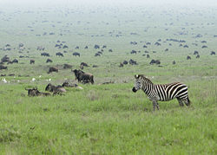
Serengeti Plain
Grassland in Northern Tanzania and southern Kenya
Ideal for grazing animals

Slide 48
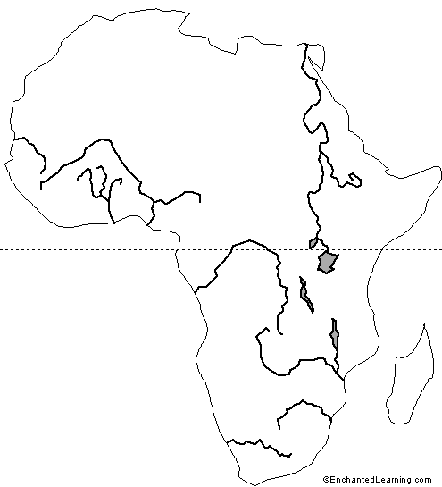
Rivers
Six great rivers run through Africa:
Nile River
Niger River
Zaire River
Zambezi River
Limpopo
Orange River

Slide 49




Postcards From the Niger River

Slide 50


The Zaire River
2nd longest river in Africa. It flows through tropical rainforest and grasslands to the Atlantic Ocean.
It flows north and crosses the Equator where it then drops down the mighty Boyoma Falls, a spectacular waterfall.

Slide 51


Also called the Congo River
Hydroelectric dam on Congo River
Tiger fish from the Congo River

Slide 52

Zambezi River
Africa’s 4th largest river system
runs through 6 countries from central Africa to Indian Ocean.
less developed than others in terms of human settlement and many areas along it’s banks enjoy protected status.

Slide 53


Postcards From the Zambezi River

Slide 54

The Limpopo River
The enormous Limpopo Heartland spans 3 diverse countries of Mozambique, South Africa and Zimbabwe
includes South Africa's popular Kruger National Park.

Slide 55

Kruger National Park
more wildlife species than any other game sanctuary in Africa, including 10,000 elephants

Slide 56

The Orange River
rises in the Lesotho Highlands and flows west across the Republic of South Africa.
It passes the South edge of the Kalahari Desert, and winds through the Namib Desert before draining into the Atlantic Ocean in South Africa. It forms the border between South Africa and Namibia.

Slide 57



Orange River

Slide 58

Lake Victoria
Largest lake in Africa by surface area
Bordered by Kenya, Uganda, Tanzania
High population densities around lake

Slide 59


Slide 60
Plateaus
Africa is a continent of plateaus
The coastal plains extend only about 20 miles inland and a sudden rise in land occurs. This extreme rise in the topography has made access into the interior very difficult.
highest overall elevation of the continents with the average of sub-Sahara Africa at 2,000 feet above sea level.

Slide 61
Colonial Past and Present political structure
Legacy of Colonialism
Demographics leading to weakened tribal structures
Unrealistic boundaries drawn by ignorant Europeans
Economies based on the export of primary products
Uncoordinated transportation systems that don’t connect countries
Improved health facilities
Educational systems (more or less depending on the European power)
Improved port facilities
Meager to fair attempts to establish democratic governments (most failed)

Slide 62


Slide 63


Slide 64


