Slide 1
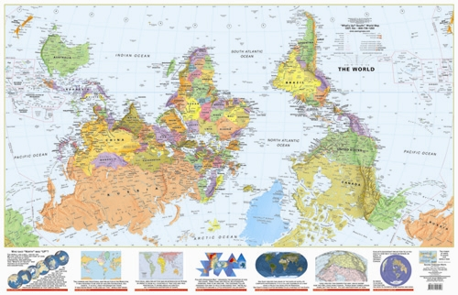
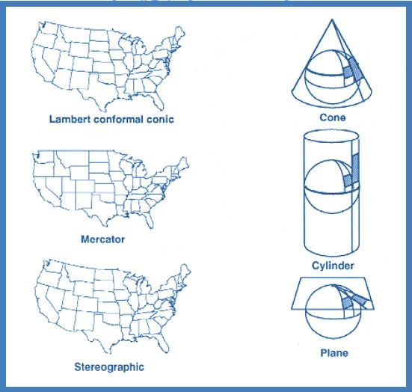
Geodesy and Map Projections
Borrowed and expanded by Joe Naumann, UMSL

Slide 2
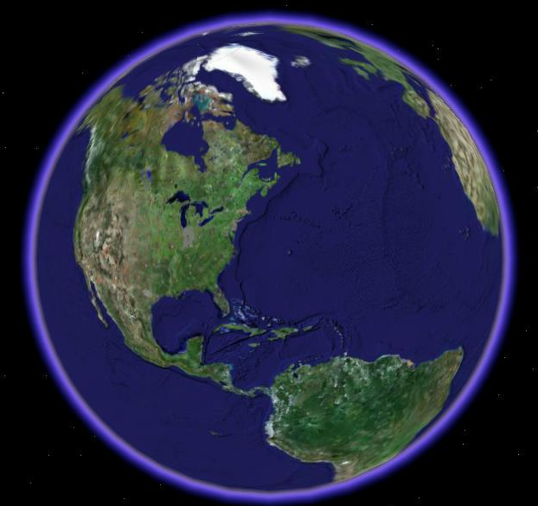
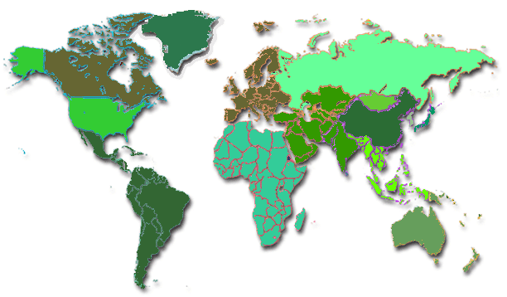
What is a Map Projection?
It is how we represent a three dimensional Earth on a flat piece of paper
However…
The process of transferring information from the Earth to a map causes every projection to distort at least one aspect of the real world – either shape, area, distance, or direction.

Slide 3
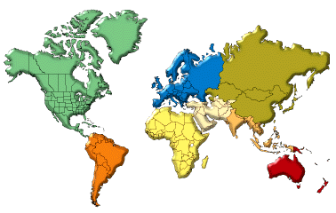
Is this a “good” map of the Earth?
Notes:
Rhumb line—A rhumb line is a line on the surface of the Earth cutting all meridians at the same angle. A rhumb line shows true direction. Parallels and meridians, which also maintain constant true directions, may be considered special cases of the rhumb line. A rhumb line is a straight line on a Mercator projection. A straight rhumb line does not show the shortest distance between points unless the points are on the Equator or on the same meridian. A navigator can proceed between any two points along a rhumb line by maintaining a constant bearing, or compass direction.

Slide 4
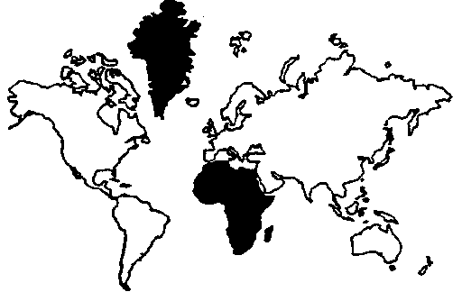
Mercator Projection and the “Greenland Problem”
Also known as Northern Hemisphere dominant projection

Slide 5
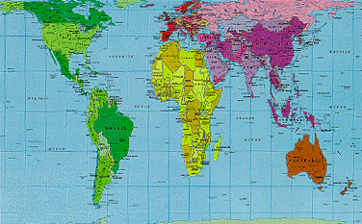
How about this?
Infamous Peters projection of 1974 - Equal Area, True Direction
Shape (conformality) and Distance Not Preserved

Slide 6
The Answer → It depends
A “good” map is one that is being successfully used for its intended purpose and was created in a precise and accurate manner
Always a trade-off in errors
  Shape (Conformal)
  Distance
  Area
  Direction (Local angles)
Can only keep one or two of these accurate
OR compromise between all four
Errors may not be significant for small study areas but they do exist

Slide 7
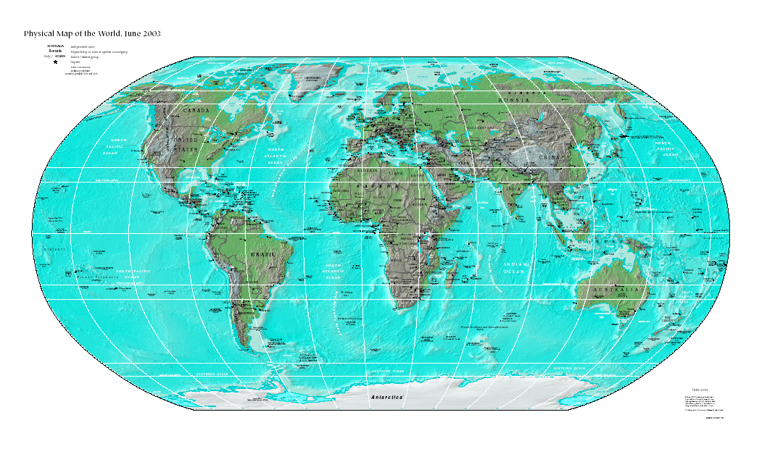
Robinson Projection --
a compromise projection

Slide 8
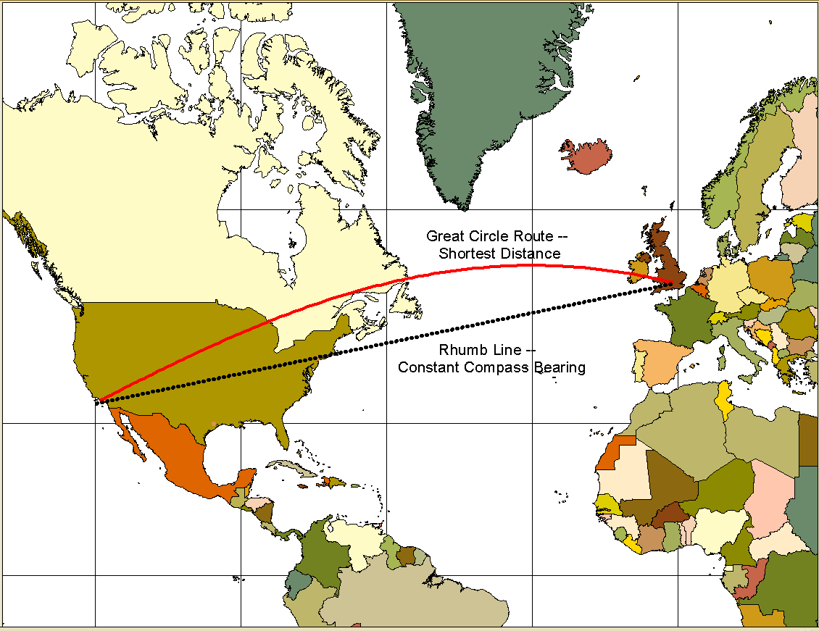
Shortest distance between two points????
Mercator Maps used as Charts in Navigation (Ships and Planes)

Slide 9
Basic Definitions
Geodesy - The science of determining the size and shape of the earth and the precise location of points on its surface.
Map Projection - the transformation of a curved earth to a flat map.
Coordinate systems – Any set of numbers, usually in sets of two or three, used to determine location relative to other locations in two or three dimensions

Slide 10
Types of Coordinate Systems
(1) Global Cartesian coordinates (x,y,z): A system for the whole earth
(2) Geographic coordinates (φ, λ, z)
(3) Projected coordinates (x, y, z) on a local area of the earth’s surface
The z-coordinate in (1) and (3) is defined geometrically; in (2) the z-coordinate is defined gravitationally

Slide 11
Global Cartesian Coordinates (x,y,z)
Z
Greenwich
Meridian
O
•
Y
X
Equator
Extremely cumbersome and difficult to relate to other locations when
translated to two dimensions.

Slide 12
Geographic Coordinates
(Latitude and Longitude)
(φ, λ, z)
Latitude (φ) and Longitude (λ) defined using an ellipsoid, an ellipse rotated about an axis
Elevation (z) defined using geoid, a surface of constant gravitational potential
Earth datums define standard baseline values of the ellipsoid and geoid (more on this later….)
Usually used in general purpose atlases and maps and textbooks.

Slide 13
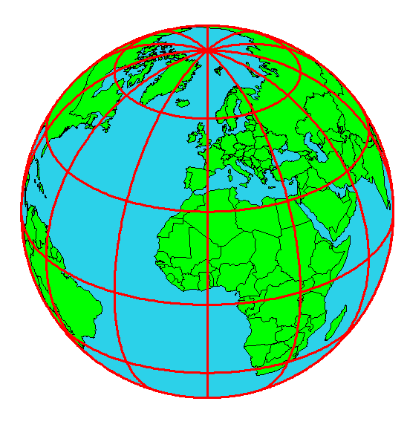
Origin of Geographic Coordinates
Equator
(0,0)
Prime Meridian

Slide 14
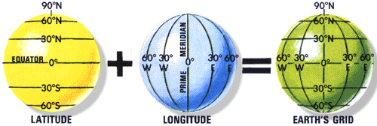
Latitude and Longitude
Lines of latitude are called “parallels”
Lines of longitude are called “meridians”
The Prime Meridian passes through Greenwich, England

Slide 15
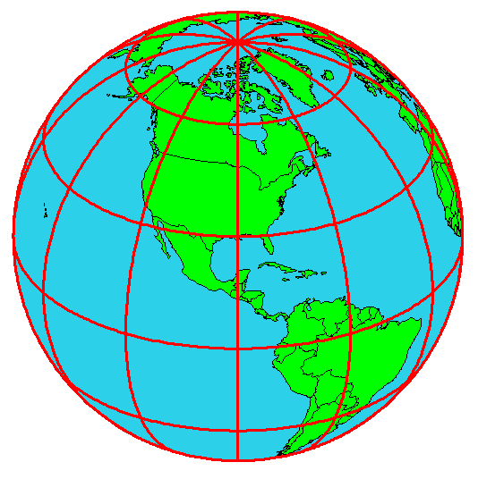
Latitude and Longitude in North America
60 N
30 N
120 W
60 W
90 W
0 N

Slide 16
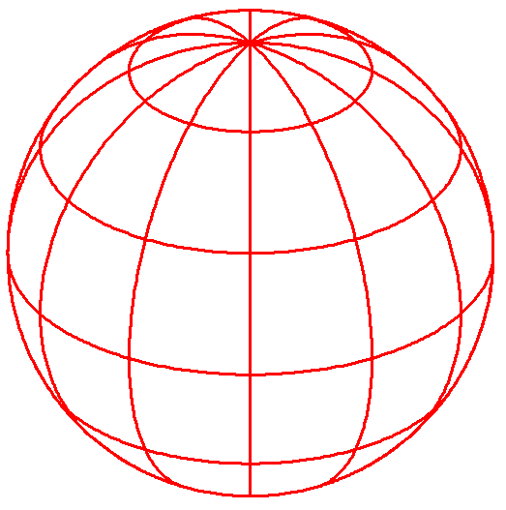
Length on Meridians and Parallels
(Lat, Long) = (φ, λ)
Length on a Meridian:
AB = R_{e} Δφ
(same for all latitudes)
R
Δλ
D
30 N
R
C
R_{e}
Δφ
B
0 N
R_{e}
Length on a Parallel:
CD = R Δλ = R_{e} Δλ Cos φ
(varies with latitude)
A

Slide 17
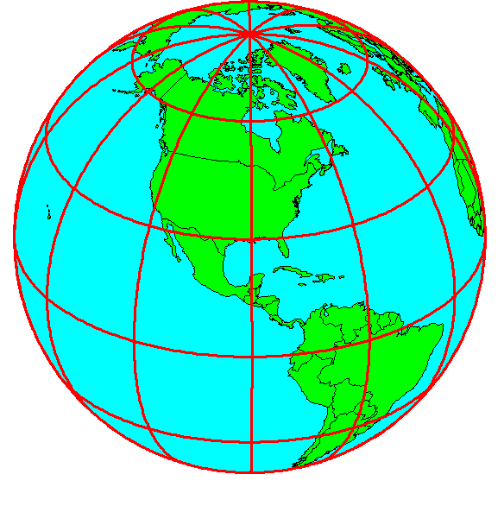
How Do We Define the Shape of the Earth?
It is actually a spheroid, slightly larger in radius at the equator than at the poles
We think of the
earth as a sphere

Slide 18
Ellipsoid or Spheroid
Rotate an ellipse around an axis
Z
b
O
a
Y
a
X
Rotational axis

Slide 19
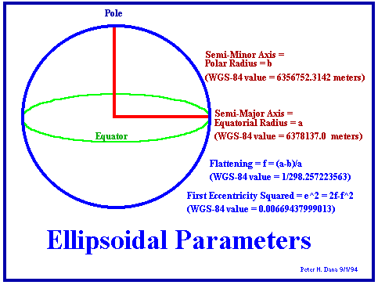
Selection of the Spheroid is what determines
the SIZE of the Earth

Slide 20
Horizontal Earth Datums
(Making sure we are where we think we are….)
What is a datum????
An earth datum is defined by a specific ellipse and an axis of rotation
NAD27 (North American Datum of 1927) uses the Clarke (1866) ellipsoid on a non geocentric axis of rotation
NAD83 (NAD,1983) uses the GRS80 ellipsoid on a geocentric axis of rotation
WGS84 (World Geodetic System of 1984) uses GRS80, almost the same as NAD83

Slide 21
Representations of the Earth
Mean Sea Level is a surface of constant
gravitational potential called the Geoid
Sea surface
Ellipsoid
Earth surface
Geoid
Since the Geoid varies due to local anomalies, we must approximate it with a ellipsoid

Slide 22
Geoid and Ellipsoid
Earth surface
Ellipsoid
Ocean
Geoid
Gravity Anomaly

Slide 23
North American Datum of 1927
(a very common horizontal datum – “old” data)
Uses the Clarke 1866 Spheroid which minimizes error between the spheroid
and the geoid at Meades Ranch, Kansas. (The center of the U.S.; unfortunately,
not the world.)
1866 Spheroid
(Clarke)
Spheroid
Center
Meades Ranch, Kansas
Mass Center of Earth
Earth surface
Geoid

Slide 24
North American Datum of 1983
(a very common horizontal datum – “newer” data)
Uses the GRS80 Spheroid which minimizes error between the spheroid
and the geoid on average around the world. (Resulting in a spheroid center much closer to the mass center of the Earth.)
GRS80 Ellipsoid
Ellipsoid
Center
Meades Ranch, Kansas
Earth surface
Mass Center of Earth
Geoid

Slide 25
Vertical Earth Datums
A vertical datum defines the “zero reference” point for elevation, z
NGVD29 (National Geodetic Vertical Datum of 1929)
NAVD88 (North American Vertical Datum of 1988)
Takes into account a map of gravity anomalies between the ellipsoid and the geoid which are relatively constant.
Earth surface
Ellipsoid
Ocean
Geoid
Gravity Anomaly

Slide 26
Map Projection
Flat Map
Cartesian coordinates: x,y
(Easting & Northing)
Curved Earth
Geographic coordinates: φ, λ
(Latitude & Longitude)
Notes:
DRM

Slide 27
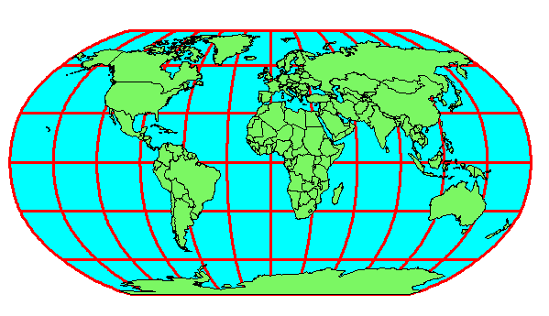
Earth to Globe to Map
Map Scale:
Map Projection:
Representative Fraction
Globe distance
Earth distance
Scale Factor
Map distance
Globe distance
=
=
(e.g. 1:24,000)
(e.g. 0.9996)

Slide 28
Geographic and Projected Coordinates
(φ, λ)
(x, y)
Map Projection

Slide 29
Projection onto a Flat Surface
(Three Broad Classes by Light Source)

Slide 30
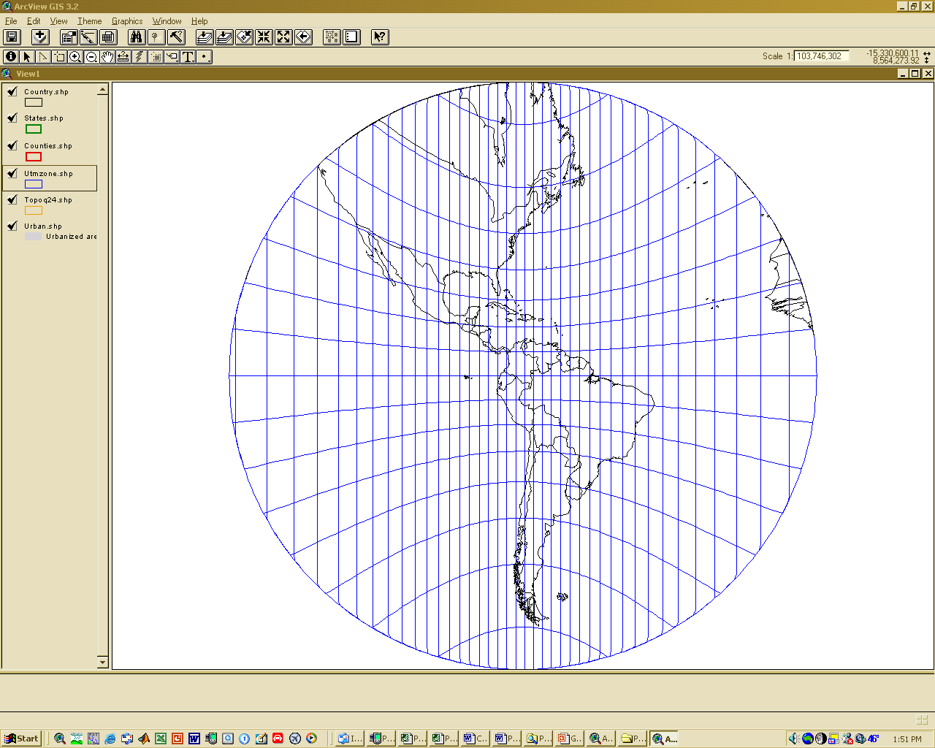
Gnomonic Projection

Slide 31
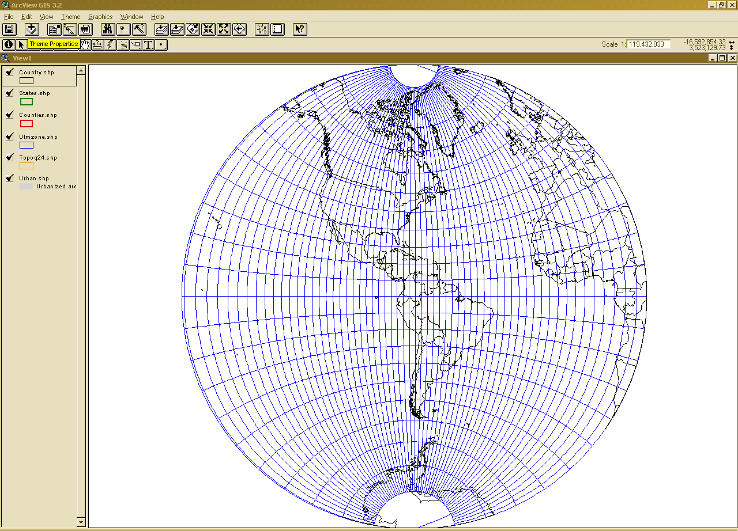
Stereographic Projection

Slide 32
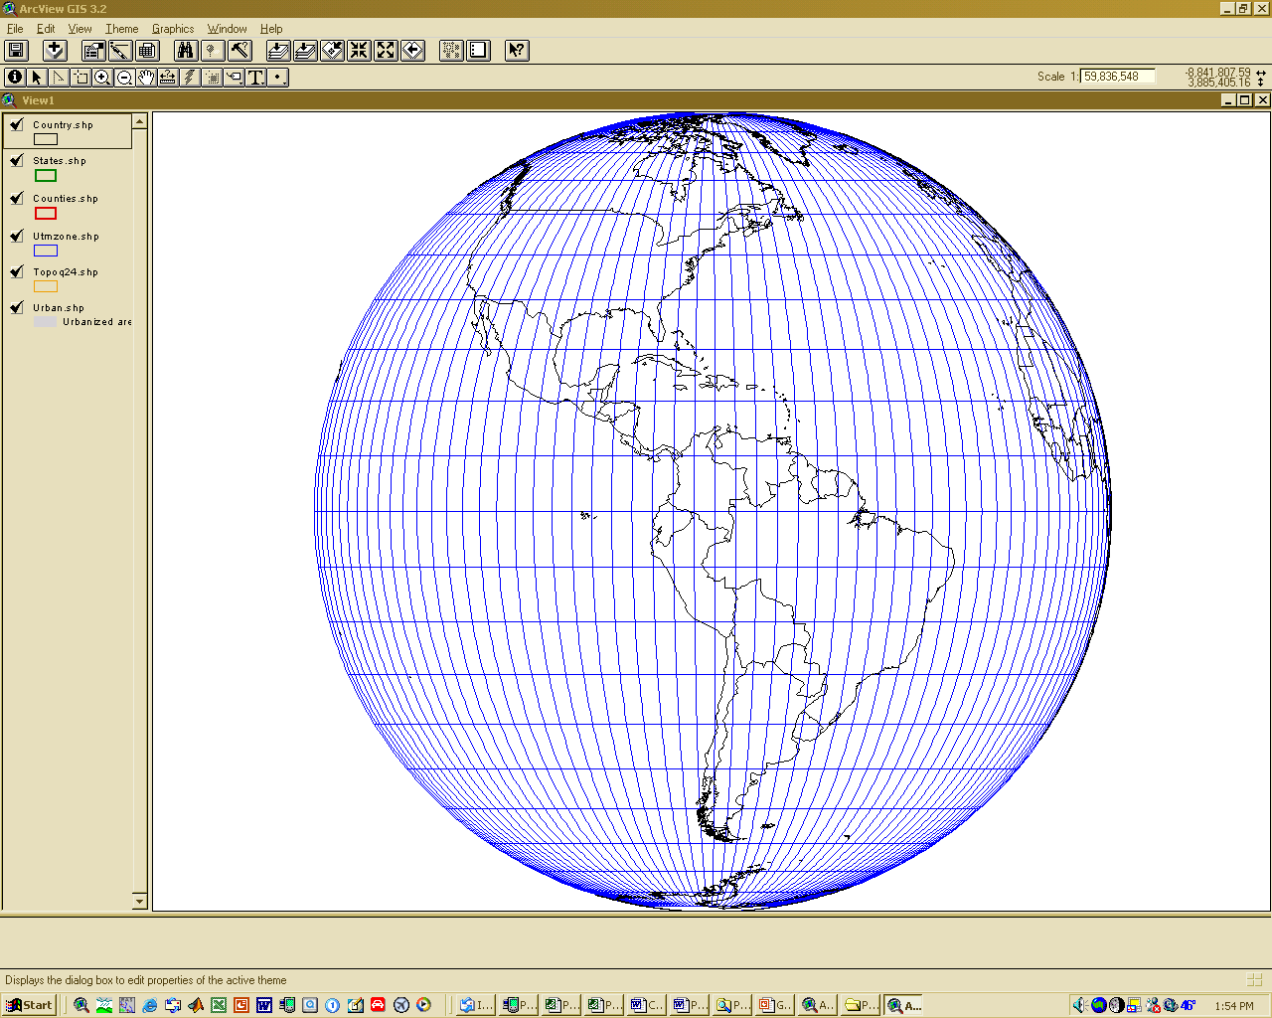
Orthographic Projection

Slide 33
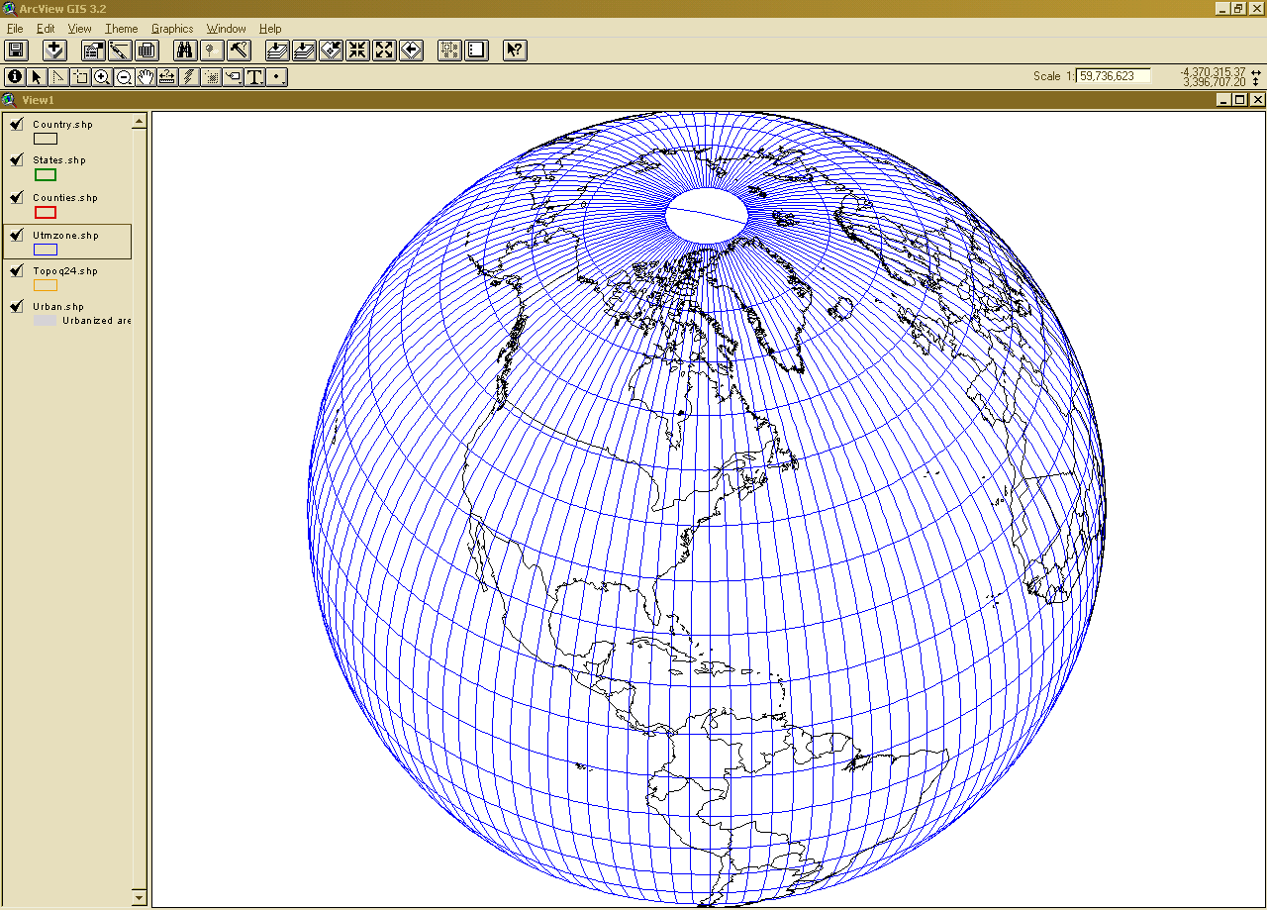
World from Space – Orthographic Projection

Slide 34
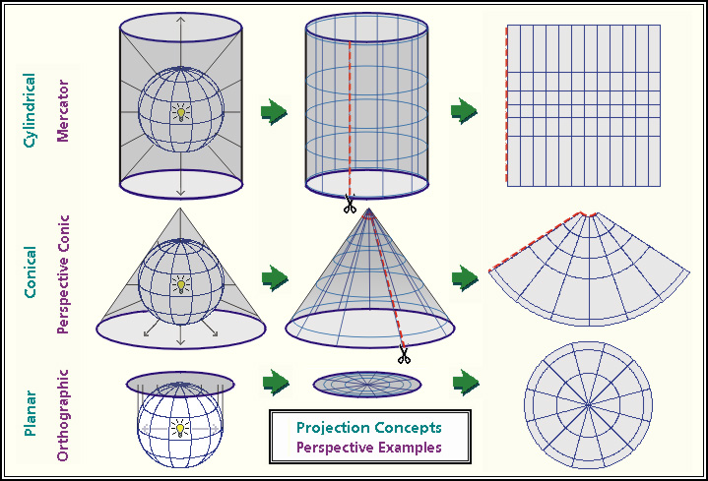
Types of Projections

Slide 35
Types of Projections
Equal Area: maintains accurate relative sizes. Used for maps that show distributions or other phenomena where showing area accurately is important. Examples: Lambert Azimuthal Equal-Area, the Albers Equal-Area Conic. Often used for small scale world maps or hemispheric maps.
Conformal: maintains angular relationships and accurate shapes over small areas. Used where angular relationships are important, such as for navigational or meteorological charts. Examples: Mercator, Lambert Conformal Conic. Easier for younger students to learn the continents by shape.
Equidistant: maintains accurate distances from the center of the projection or along given lines. Used for radio and seismic mapping, and for navigation. Examples: Equidistant Conic, Equirectangular.
Azimuthal or Zenithal: maintains accurate directions (and therefore angular relationships) from a given central point. Used for aeronautical charts and other maps where directional relationships are important. Examples: Gnomonic projection, Lambert Azimuthal Equal-Area. Often used for maps of countries or large regions of continents
View maps critically: Does this map show the selected information accurately or does it show a bias of its maker (has compromised accuracy)?

Slide 36
Conic Projections
(Albers, Lambert)
The lines where the cone is tangent or secant are the places with the least distortion.

Slide 37
Planar or Azimuthal
(Lambert)

Slide 38
Cylindrical Projections
(Mercator)
The lines where the cylinder is tangent or secant are the places with the least distortion.
Transverse
Oblique

Slide 39
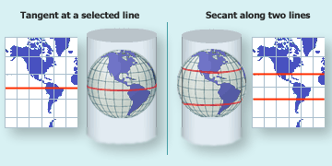
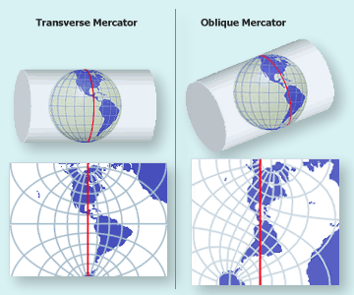
Mercator Projections

Slide 40
Projections Preserve Some
Earth Properties
Area - correct earth surface area (Albers Equal Area) important for mass balances
Shape - local angles are shown correctly (Lambert Conformal Conic)
Direction - all directions are shown correctly relative to the center (Lambert Azimuthal Equal Area)
Distance - preserved along particular lines
Some projections preserve two properties
Some projections preserve none of the above but attempt to minimize distortions in all four
The degree and kinds of distortion vary with the projection used. Some projections are suited for mapping large areas that are mainly north-south in extent, others for large areas that are mainly east-west in extent.

Slide 41
Coordinate Systems
Hydrologic calculations are done in Cartesian or Planar coordinates (x,y,z)
Earth locations are measured in Geographic coordinates of latitude and longitude (φ,λ)
Map Projections transform (φ,λ) (x,y)

Slide 42
Coordinate System
A planar coordinate system is defined by a pair
of orthogonal (x,y) axes drawn through an origin
Y
Origin
X
(x_{o},y_{o})
(φ_{o},λ_{o})

Slide 43
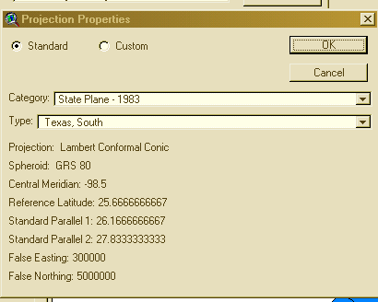
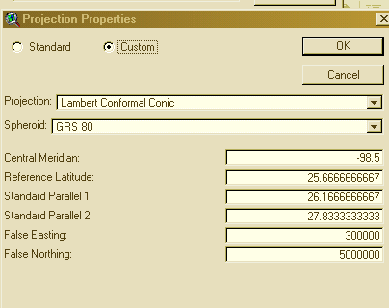
Commonly used coordinate systems and associated projections
State Plane (Texas, California, etc)
  Usually is a Lambert Conformal Conic projection (not always)
    Reference meridian
    Two standard parallels
    Good for East-West areas
    Commonly used by state and local governments for GIS databases
    Broken into appropriate sections representing areas of the state
  Coordinate System is in Feet
  False Easting (FE), False Northing (FN)
    Reference Latitude
    Central Meridian
    (0 + FE, 0 + FN) is origin of coordinate system

Slide 44
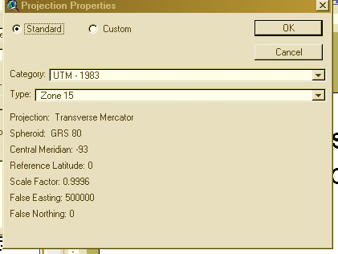
Universal Transverse
Mercator Coordinate System
Uses the Transverse Mercator projection
Each zone has a Central Meridian (λ_{o}), zones are 6° wide, and go from pole to pole
60 zones cover the earth from East to West
Reference Latitude (φ_{o}), is the equator
(Xshift, Yshift) = false easting and northing so you never have a negative coordinate
  This time in METERS!!!!!
Commonly used by federal govt
agencies such as USGS (also a few
states)

Slide 45
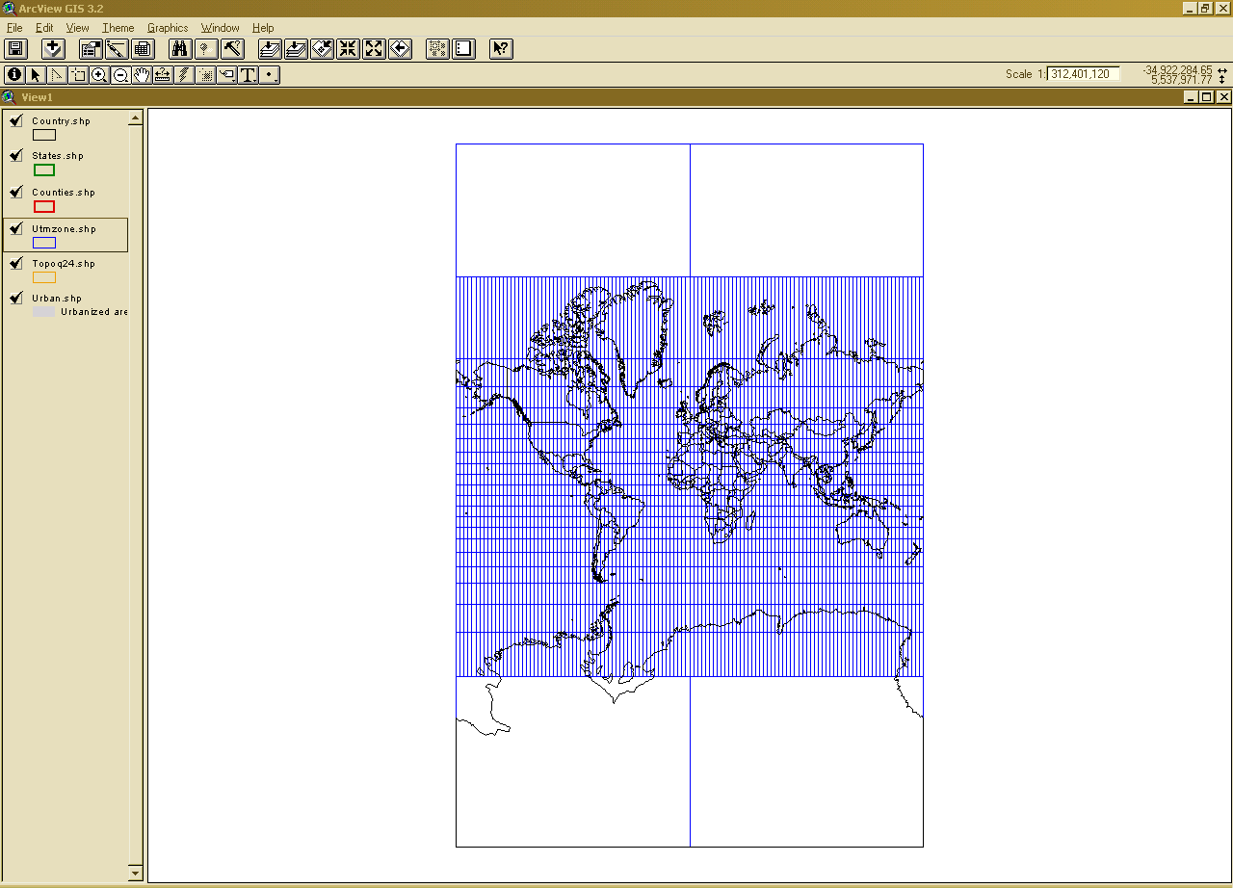
Mercator
Projection
The only map on which a straight line drawn anywhere within its bounds shows a particular type of direction, but distances and areas are grossly distorted near the map's polar regions.

Slide 46
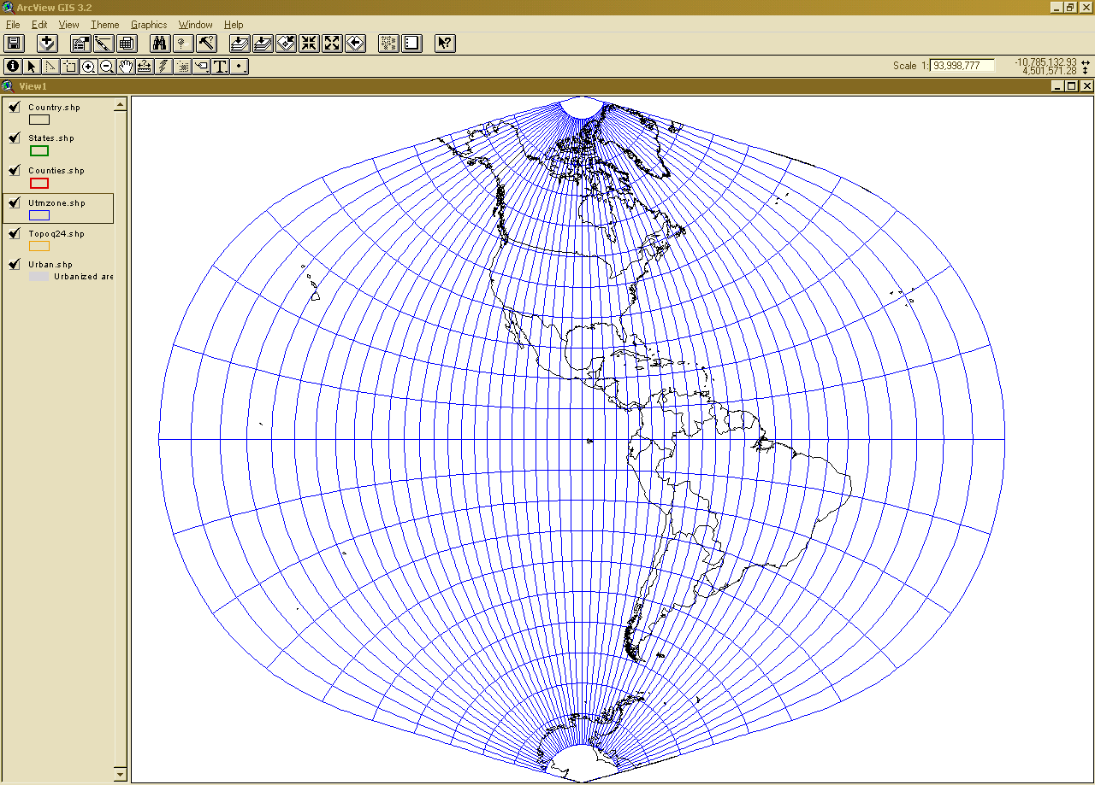
UTM Projection (Zone 15)

Slide 47
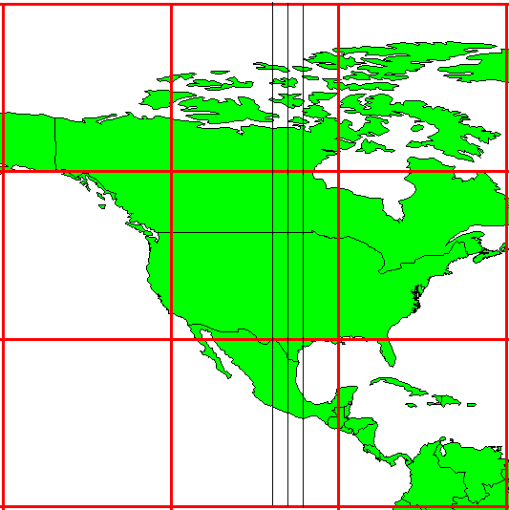
UTM Zone 14
-99°
-102°
-96°
6°
Origin
Equator
-120°
-90 °
-60 °

Slide 48
Universal Transverse Mercator Projection

Slide 49
Summary Concepts
Two basic locational systems: geometric or Cartesian (x, y, z) and geographic or gravitational (φ, λ, z)
Mean sea level surface or geoid is approximated by an ellipsoid to define a horizontal earth datum which gives (φ, λ) and a vertical datum which gives distance above the geoid (z)

Slide 50
Summary Concepts (Cont.)
To prepare a map, the earth is first reduced to a globe and then projected onto a flat surface
Three basic types of map projections:
  conic
  cylindrical
  Planar/azimuthal
A particular projection is defined by a datum, a projection type and a set of projection parameters

Slide 51
Summary Concepts (Cont.)
Standard coordinate systems use particular projections over zones of the earth’s surface
Types of standard coordinate systems:
  UTM
  State Plane
  Others too numerous to mention
Do not confuse the coordinate system of a set of datum for its projection
  Example: A shapefile that uses the Texas State Plane Coordinate System is in the Lambert Conformal Conic Projection

Slide 52
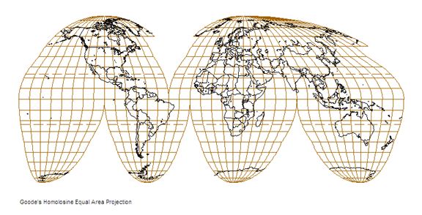
Interrupted projections to maintain equal-area and be relatively conformal
Good for studying land areas, but not very good for ocean studies.

Slide 53
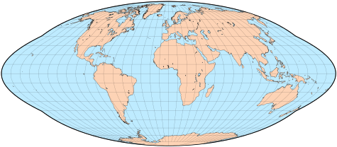
What you get if you don’t interrupt
Areas may be equal (proper proportions); however, shapes are greatly distorted the farther one gets from the center of the projection

Slide 54
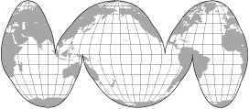
Adapted to Keep Oceans together

Slide 55
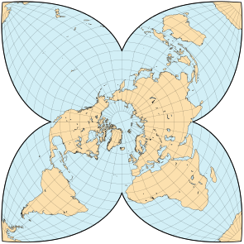
Unusual Special Purpose Projections

Slide 56
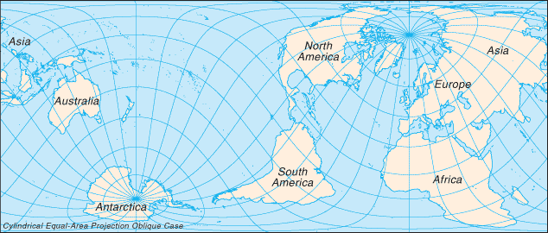
Cylindrical equal-area projection with oblique orientation

Slide 57
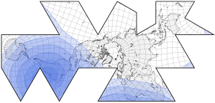

Slide 58
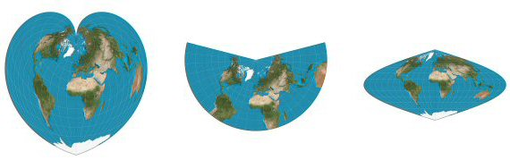
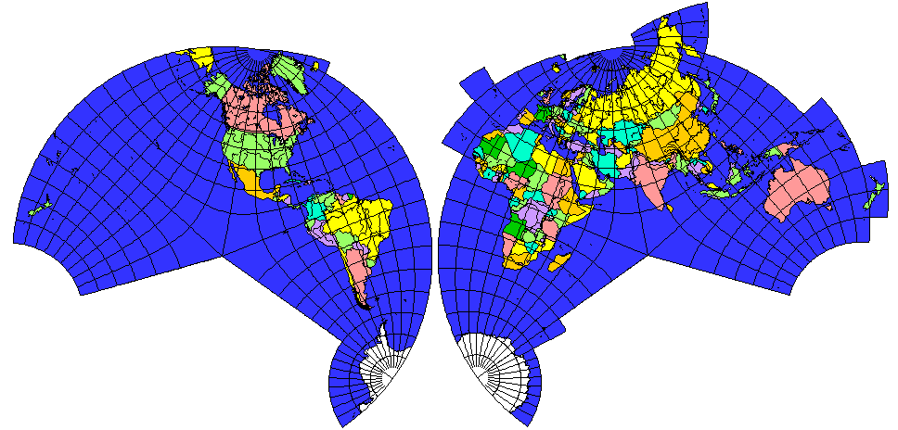

Slide 59
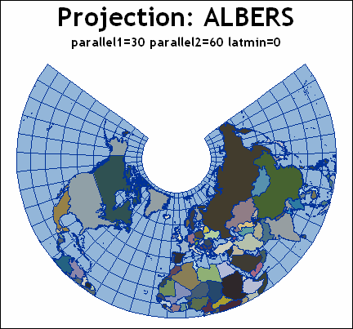

Slide 60
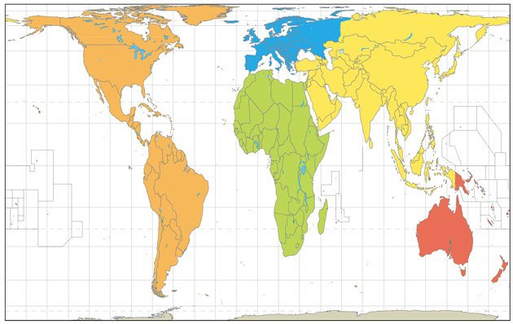
Peters is an equal-area projection which became the centerpiece of a controversy surrounding the political implications of map design

Slide 61
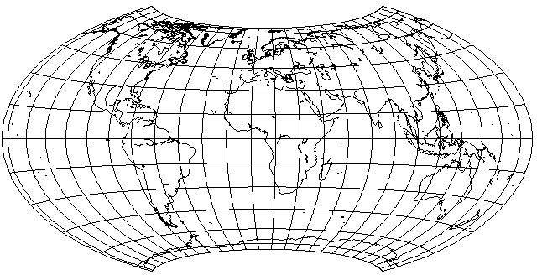
The Hammer-Aitoff Projection

Slide 62
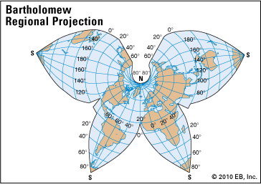

Slide 63
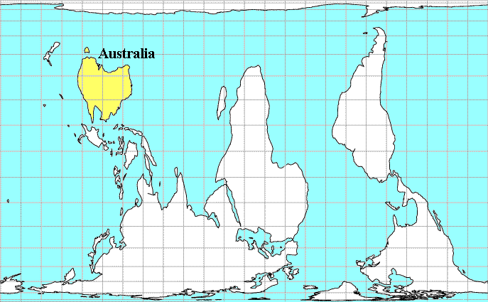
This orientation is used in Australian geography textbooks (probably N.Z. too)

Slide 64
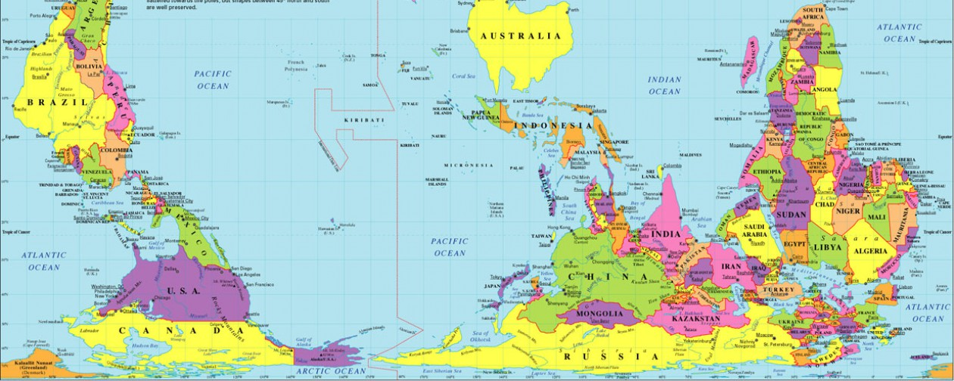
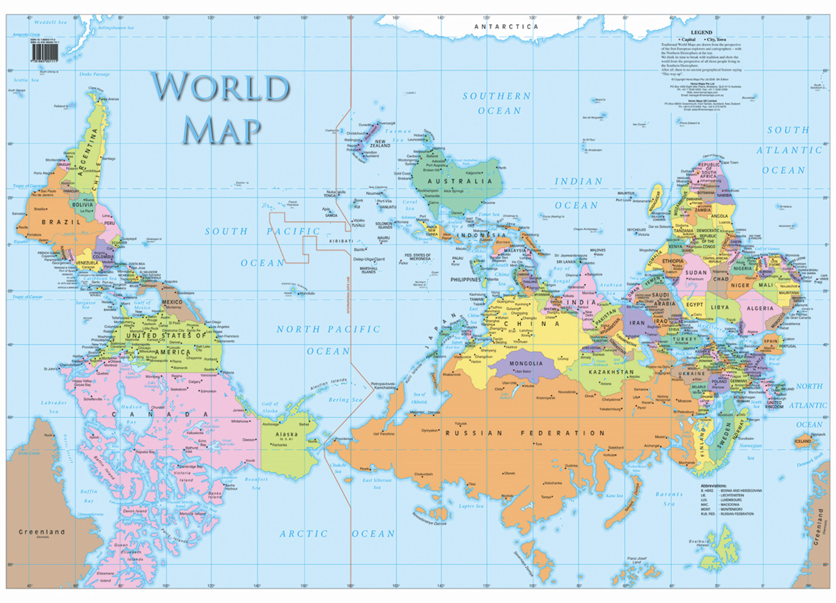

Slide 65
This is only a sample – the variety is almost endless
The cartographer (map maker) will, one hopes, make choices carefully to truthfully communicate graphic information about the earth and parts. Unfortunately some people or groups want to push a particular agenda rather than truthfully inform people. Example: The Soviet Union was about 2.5 times larger than the U.S.A. (a fact). However, some overly militant Americans would show the countries on a Mercator projection and the Soviet Union would look 3.5 to 4 times bigger than the U.S. – their purpose was to scare people into supporting greater defense spending during the Cold War. See the next slide.

Slide 66
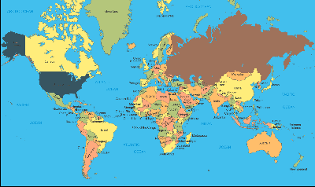
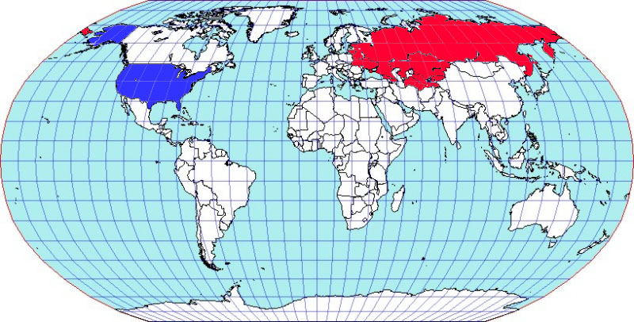
Ro
Mercator Projection – conformal but distorts area, particularly at high latitudes.
Robinson equal-area projection keeps areas in correct proportion but distorts shape somewhat at high latitudes.

Slide 67
What does all this mean???
Careful attention must be paid to the projection, datum and coordinate system for every piece of GIS data used.
Failure to use data from the same system OR change the data (re-project) it to the desired system will result in overlay errors
  Can range some small to SIGNIFICANT
  Real danger is when the errors are small (possibly unnoticed)
Shapefiles, images, grids all have this data inherent in their very creation.
  Usually included in a system of files known as “metadata” or xxxxxx.PRJ file.
Not only must a person select the projection which will most accurately convey the information to the viewer, but attention must also be paid to obtaining data from the same data system so that the computer will properly merge the layers
Gone are the days of the creatively hand-drawn maps of my youth. The thrill upon successful completion was fantastic, but GIS can be much more precise.

Slide 68
Turned upside down yet??????
Excellent website: http://erg.usgs.gov/isb/pubs/MapProjections/projections.html

