Slide 1
Atlas
A book of maps and facts about geography.
The Complete Library Skills

Slide 2
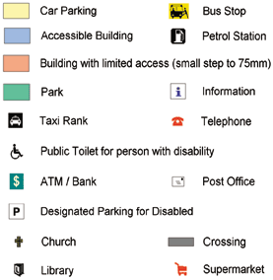
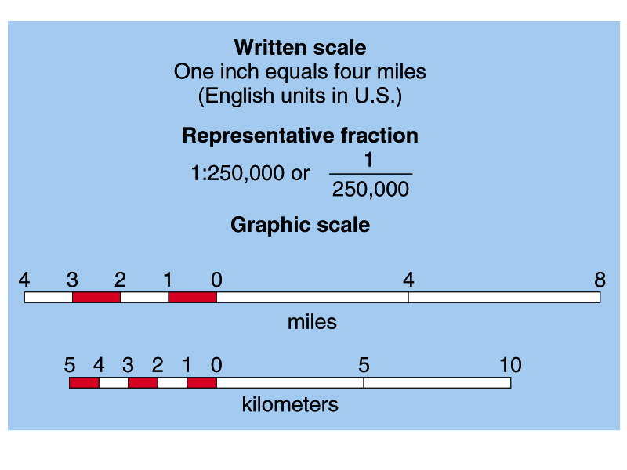
Atlas Vocabulary:
Legend and Scale:
They help you read a map.
A legend or key will tell you what the colored areas mean and what the symbols stand for.
The scale helps you relate a distance on the map to the actual distance in km or miles – sometimes it is marked of on a number line

Slide 3
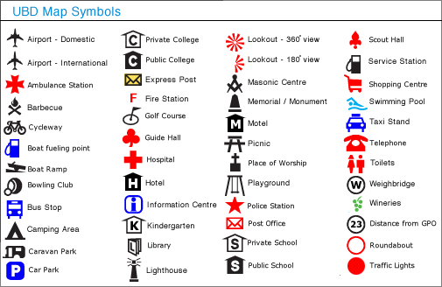
Map Symbols – Usually shown in the legend or key of the map

Slide 4
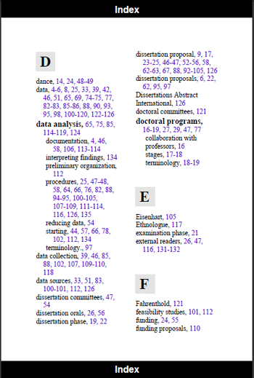
Vocabulary cont.
Index: will tell you on which page in the atlas you will find the place you are looking for.

Slide 5
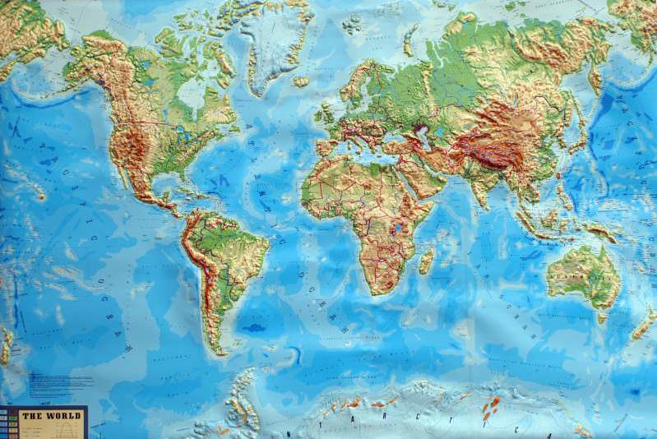
Types of Maps:
1.Relief-show physical geography

Slide 6
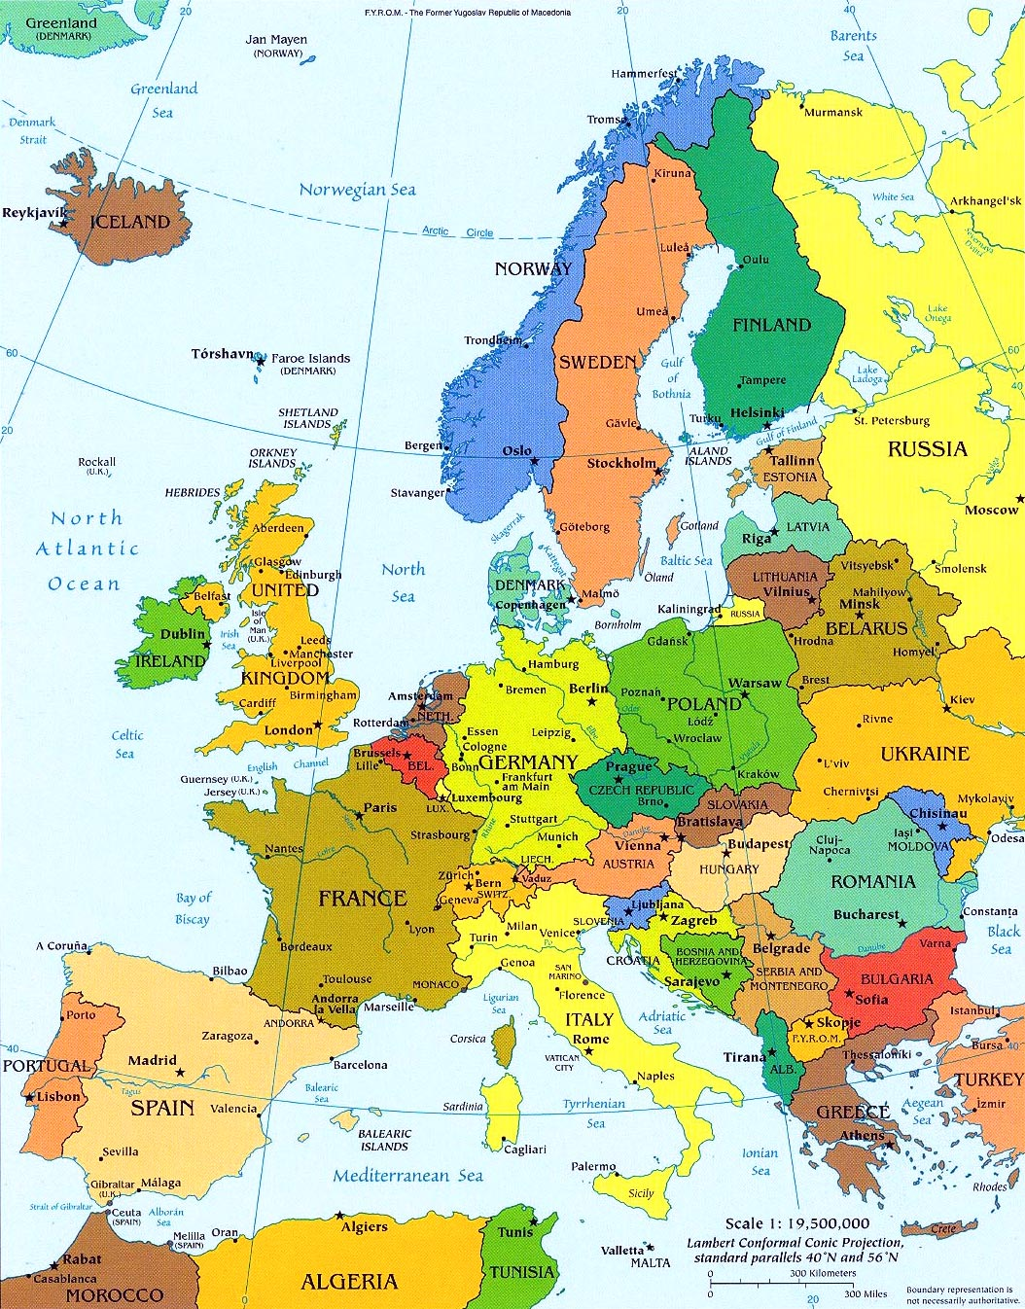
2.Political Map- shows by a color plan countries, boundaries, and principal and capital cities.

Slide 7
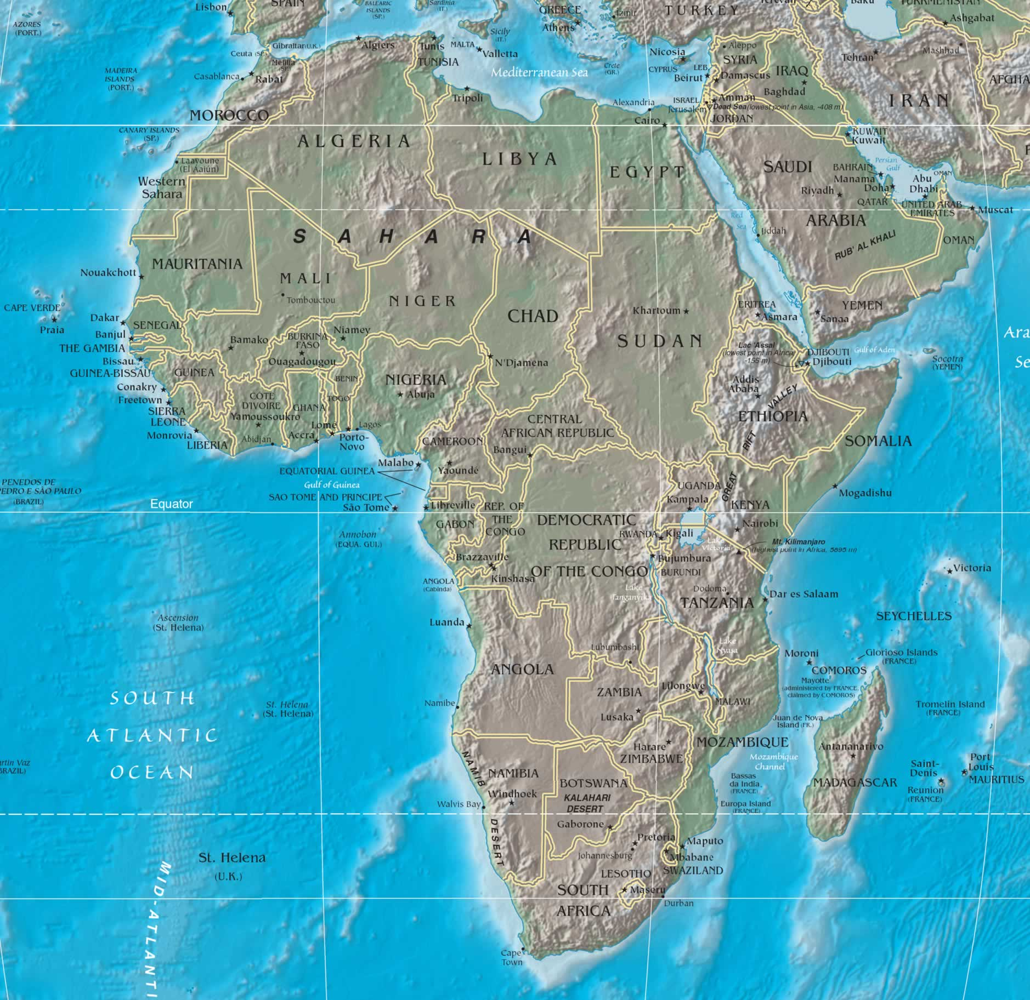
A physical-political map combines the features of both the physical map and the political map

Slide 8
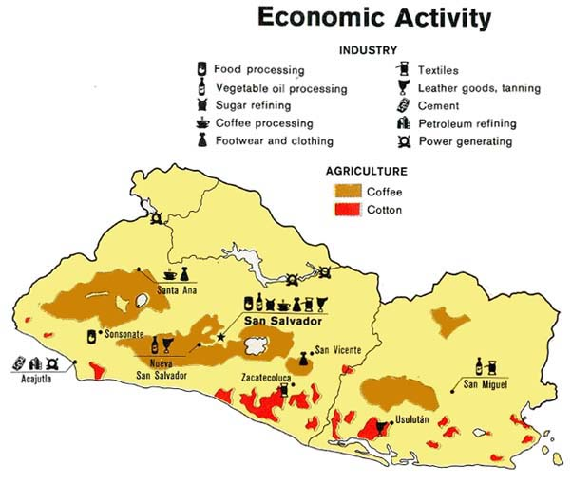
3. Economic Map- shows were products are grown and where various industries are.

Slide 9
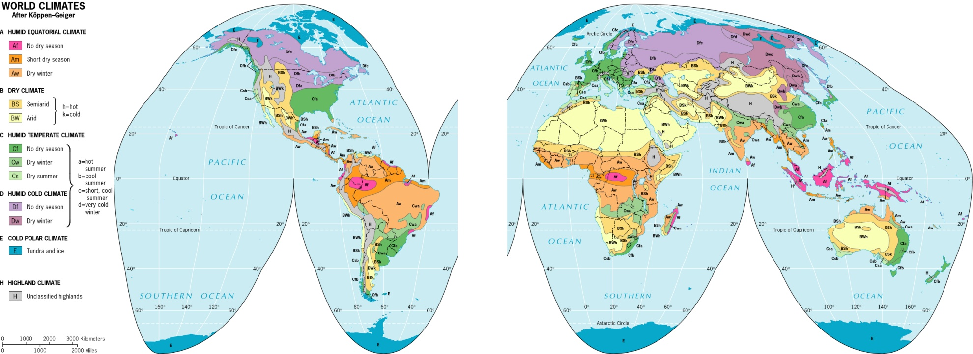
Examples of other maps include:
A. Climate

Slide 10
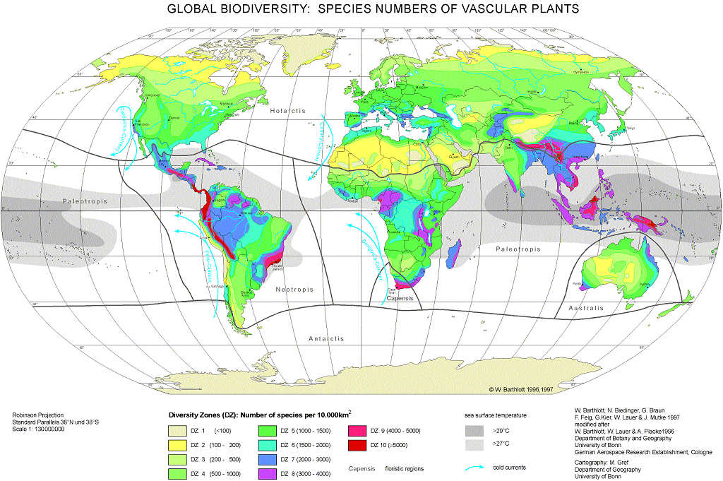
Other maps cont.
B. Biodiversity

Slide 11
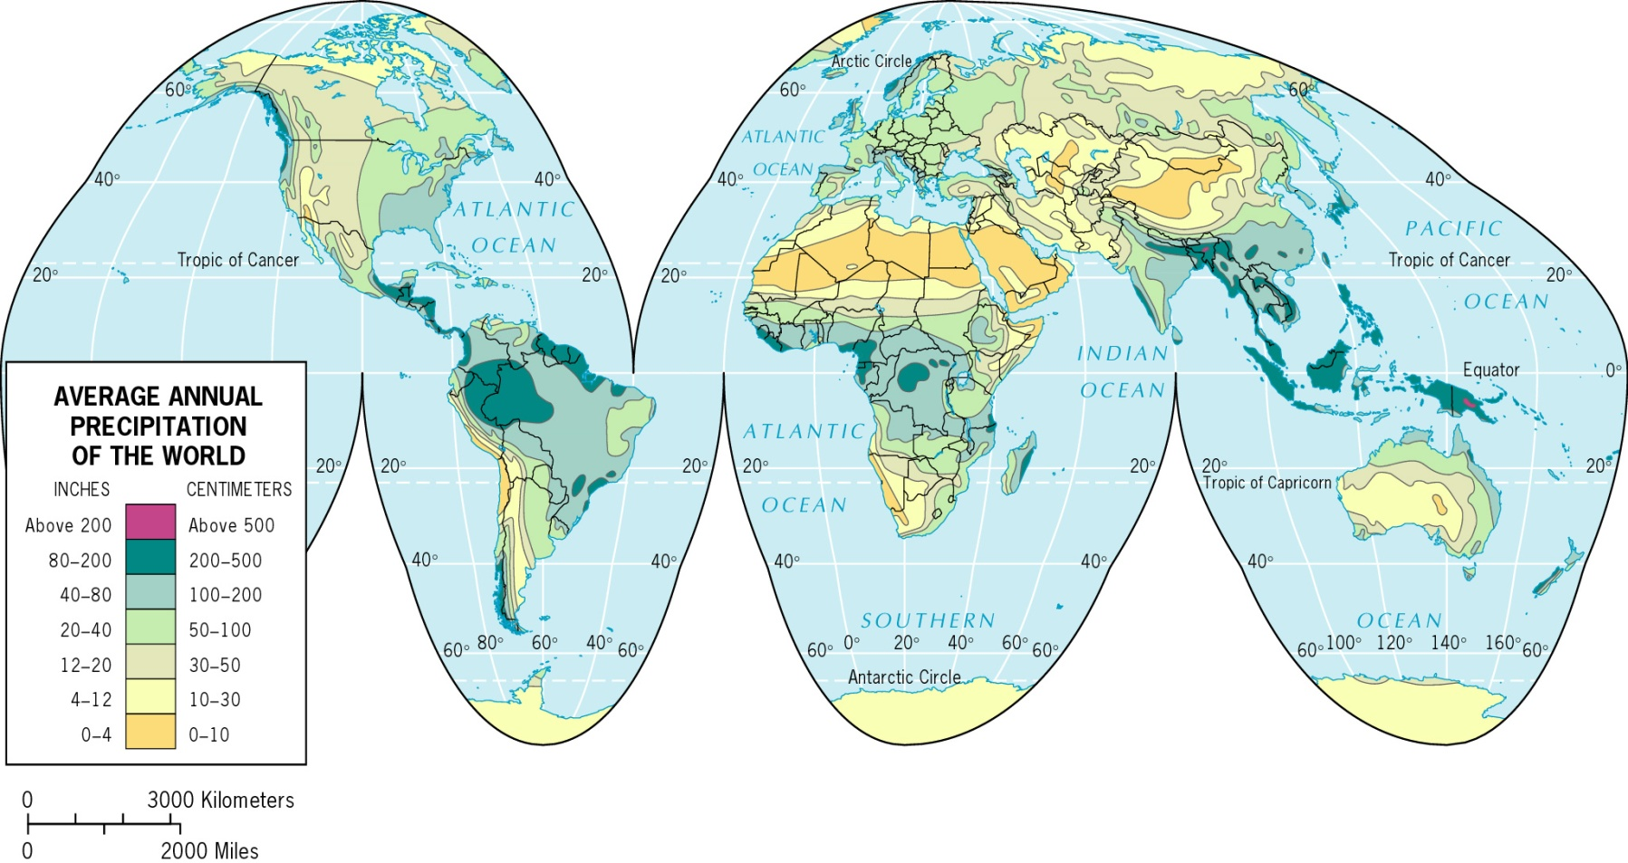
Other Maps. cont.
C. Precipitation

Slide 12
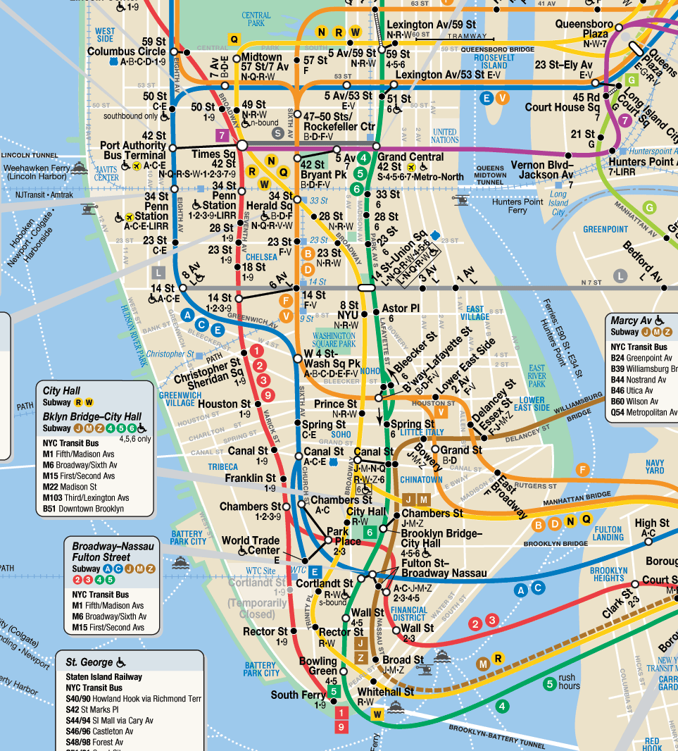
Other Maps cont.
D. Transportation (Road map)
In addition to roads, the map might also show railroads, airports, usable rivers, canals, and seaports

Slide 13
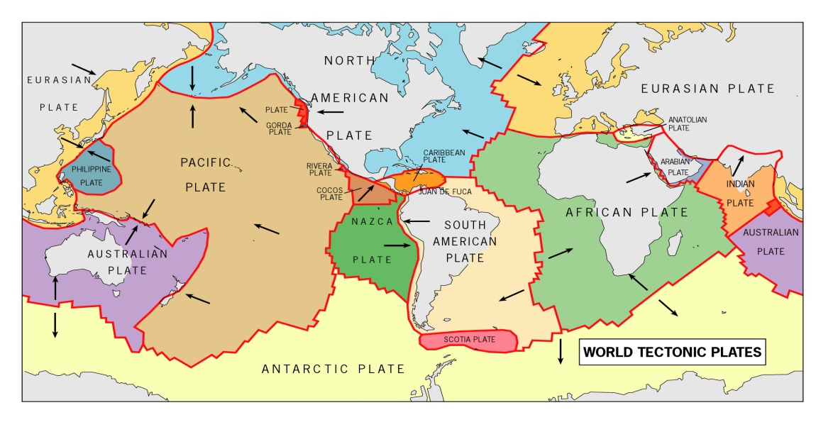
E. Tectonic plates

Slide 14
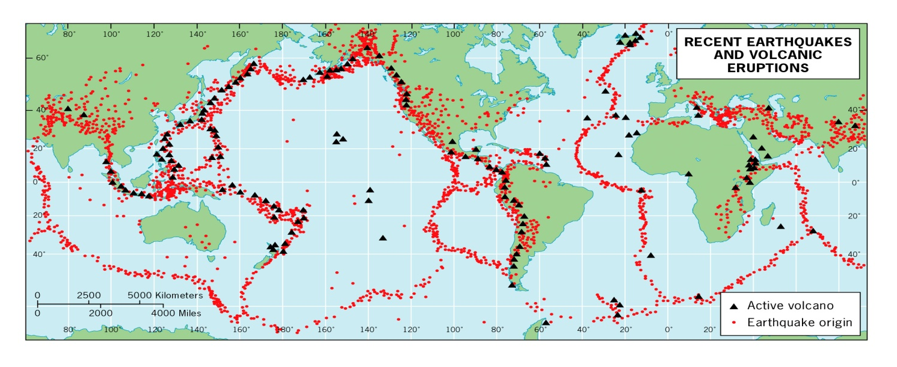
F. Volcanic Activity and Earthquakes

Slide 15
The map subjects are almost limitless:
Maps can be used to show anything that has spatial characteristics, some of the topics (just a sample) are:
  Natural vegetation
  Population density
  Migration routes
  Mineral deposits
  Disease occurrences
  Tourist site locations
  Ethnic diversity
  Which languages are spoken in various places
  Election results
  Commercial routes within or among countries
  Etc.

Slide 16
Some atlases specialize in one kind of information.
Historical atlas
Biblical atlas
Economic atlas
Atlas of diseases
Agricultural atlas
Climate and meteorology atlas
Civil War (actually any war) atlas
Major religions atlas
Demographic atlas
Etc.

Slide 17
References
Turrell, Linda. The Complete Library Skills-Grade 5. Mineappolis, Minnesota. T.S. Denison & Company Inc.
Google images
http://images.google.com/images?um=1&hl=en&rlz=1T4ADBR_enSV295SV296&q=maps

