Slide 1
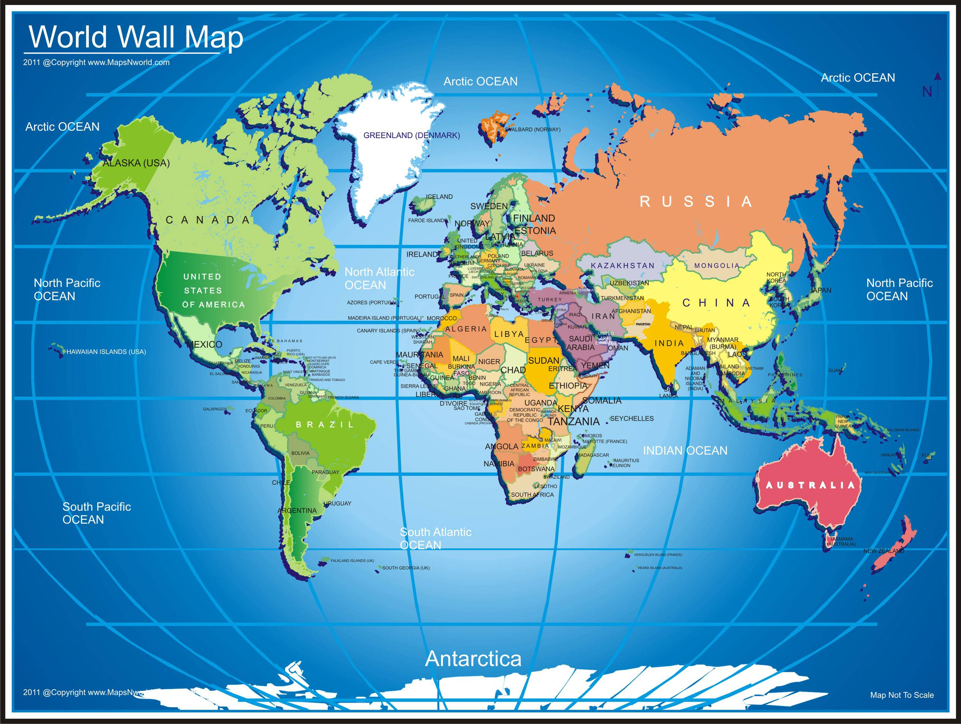
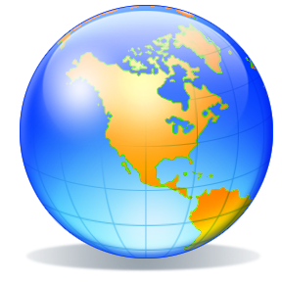
Maps & Globes
Atlas: A collection of maps made into a book

Slide 2
What are The goals?
Understands and applies basic mapping elements such as symbols, compass rose, labels, and a key to read and construct maps that display information about neighborhoods or local communities.
Draw conclusions, make informed decisions, apply knowledge to new situations, and create new knowledge. 2.3 Responsibilities 2.3.1 Connect understanding to the real world.

Slide 3
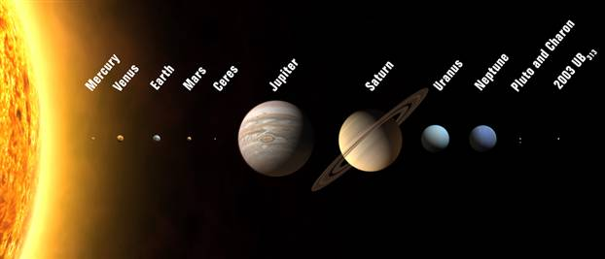
Solar System Perspective (scale)

Slide 4
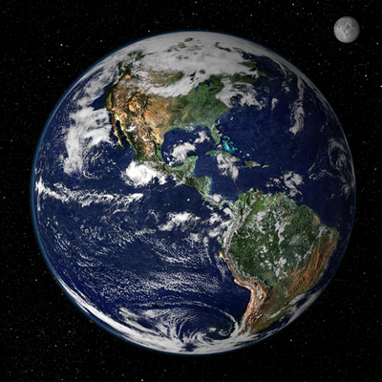
The Blue Marble – Our Home.

Slide 5
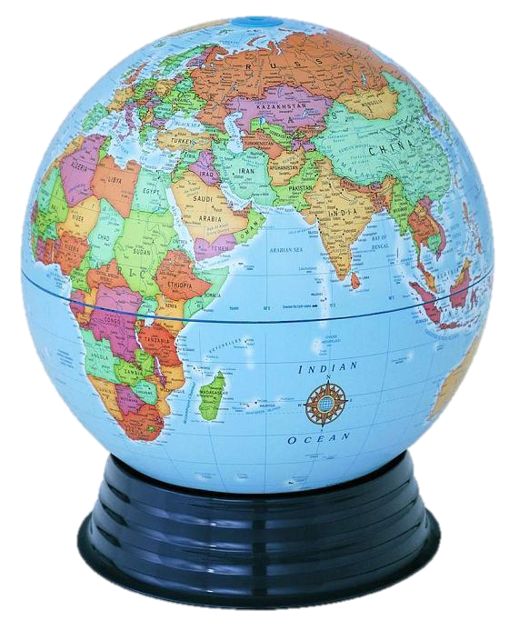
Globe – A scale model of the earth

Slide 6
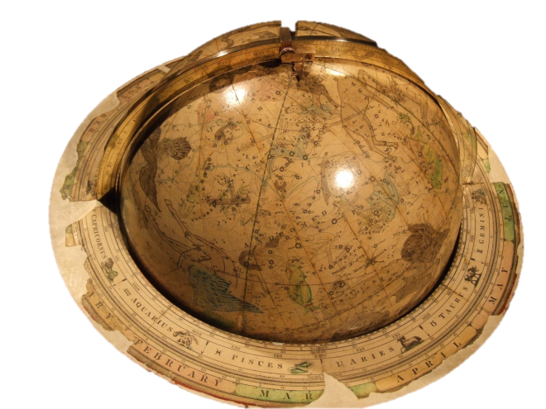

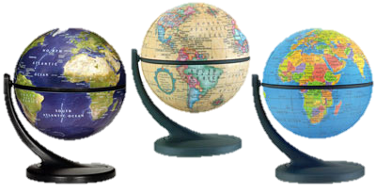
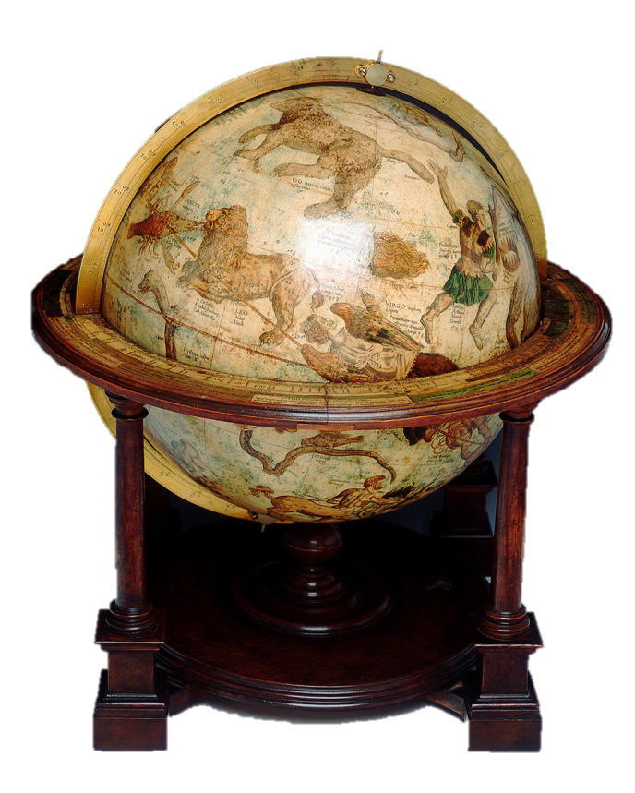

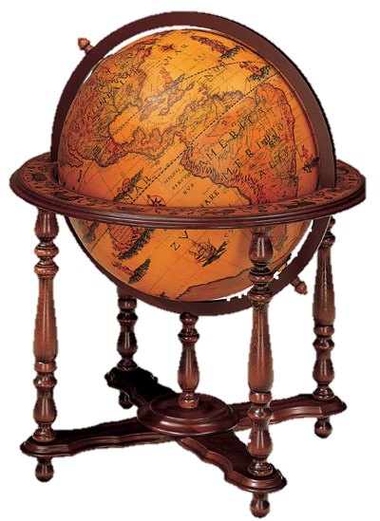
Globes

Slide 7
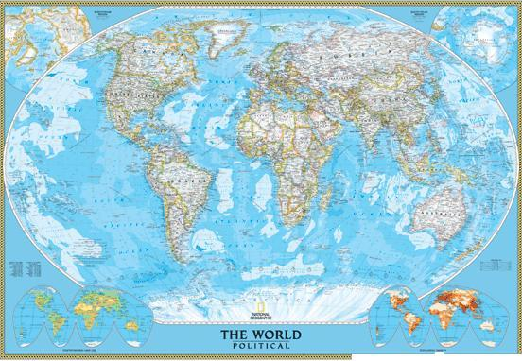
World Map: A 3 dimensional entity displayed as a 2 dimensional object

Slide 8
Distortion
Whenever one transfers the surface of a sphere to a two-dimensional plane there will be some form of distortion. This cannot be avoided; however, each arrangement of meridians and parallels presents some aspect accurately or in an easily used form while distorting other aspects. These arrangements are called projections. In small scale maps, the selection of which type of projection is used can be a very important decision.

Slide 9
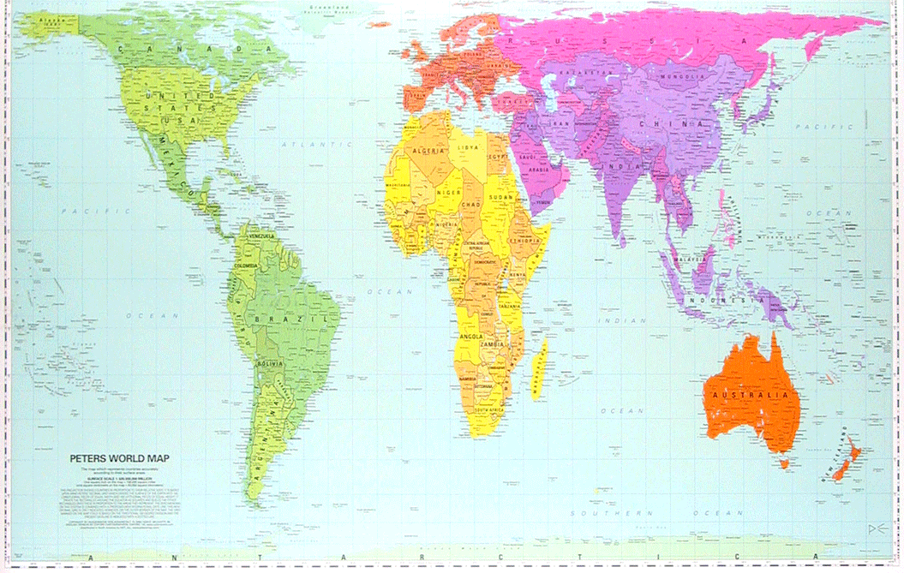
Peter’s Projection keeps countries in the correct proportion (area) but distorts shape.

Slide 10
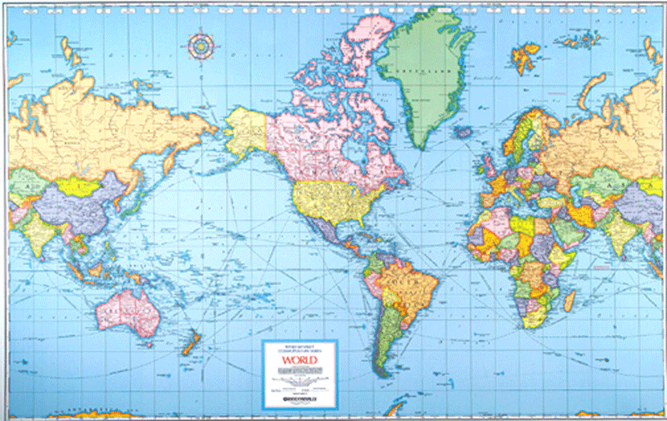
Mercator projections have realistic shape were used for navigation, but areas are greatly distorted.

Slide 11
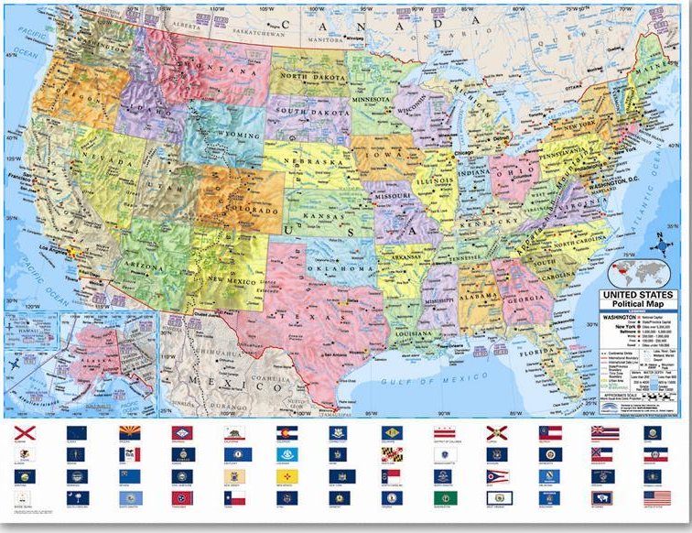
Small Scale Map: large area with little detail

Slide 12
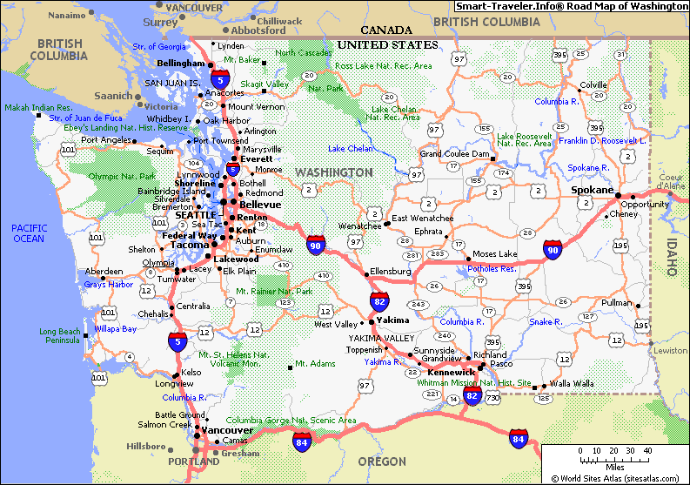
Larger-scale map: smaller area & more detail

Slide 13
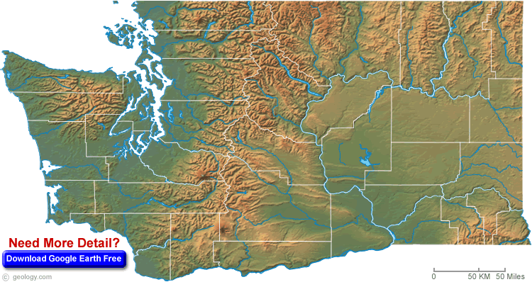
Physical map with county boundaries

Slide 14
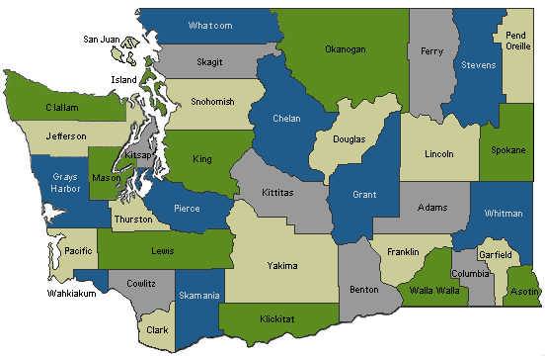
Political map with county names
Notes:
Pierce Co. Raspberries & Strawberries

Slide 15
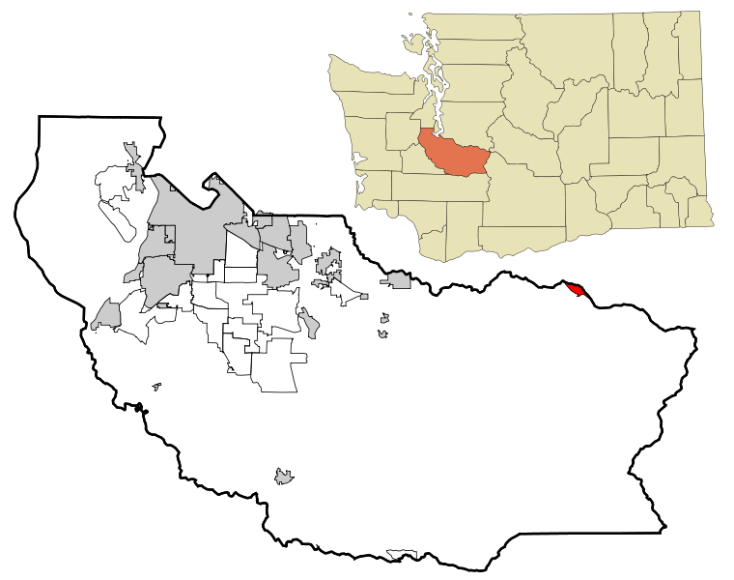
Larger-scale map: smaller area (one county) and more detail

Slide 16
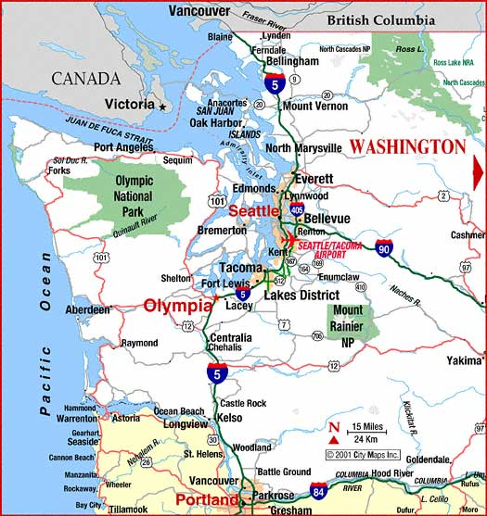
Large scale map – small area with much more detail

Slide 17
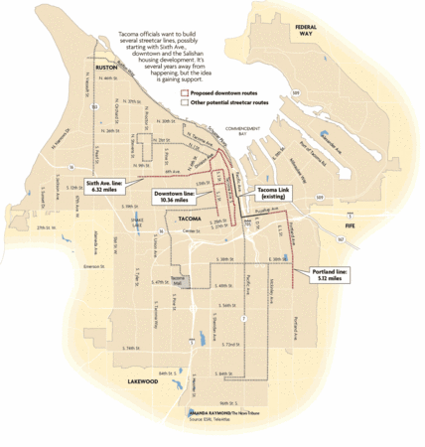
Larger Scale – even smaller area with much greater detail – some city street names

Slide 18
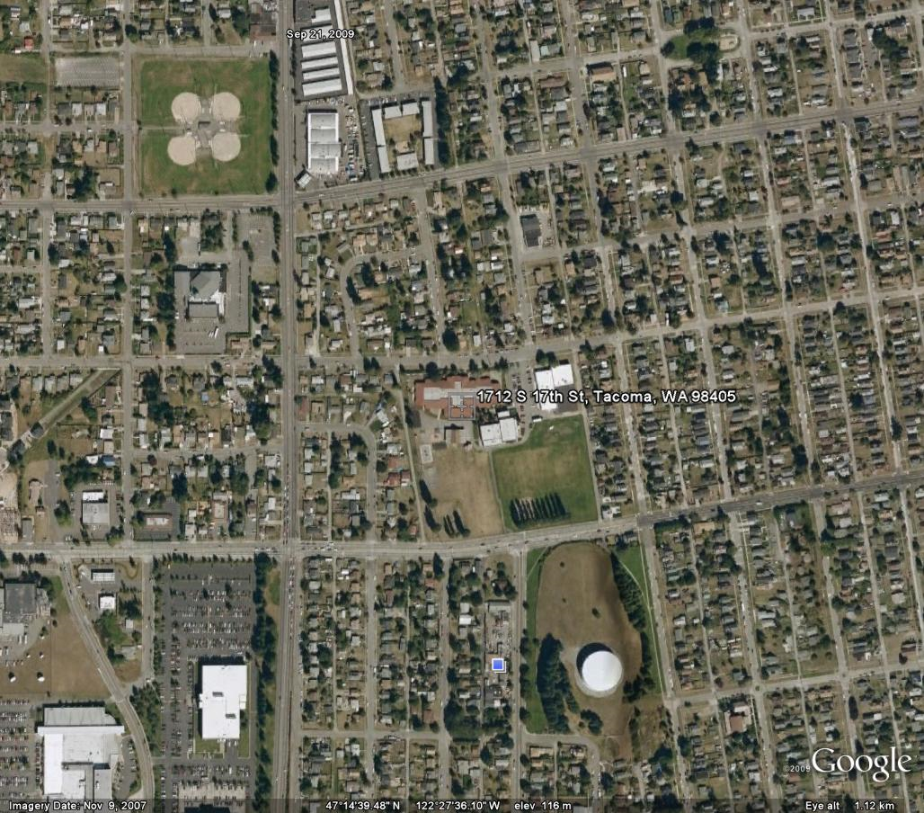
Satellite image at much larger scale – a neighborhood showing houses
Stanley Elementary

Slide 19
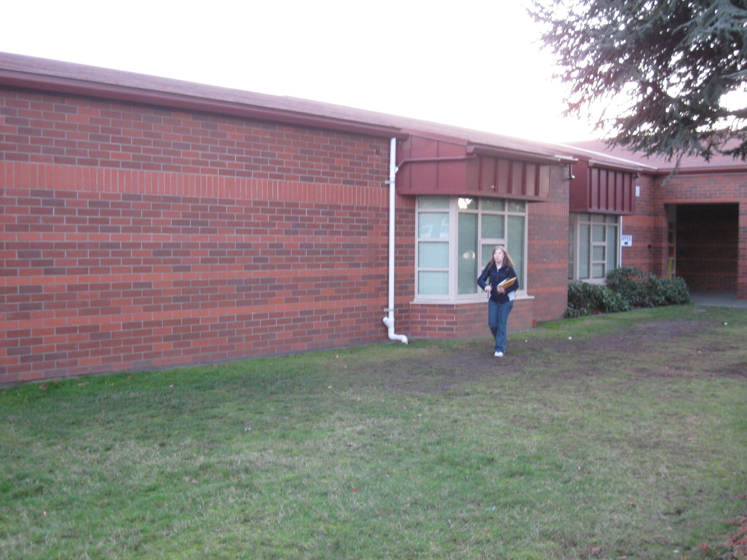

Slide 20
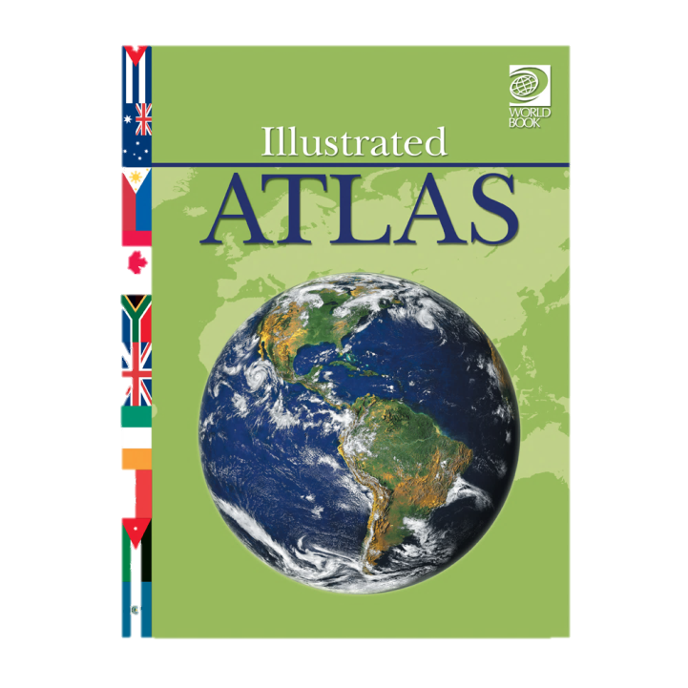
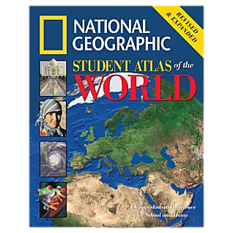
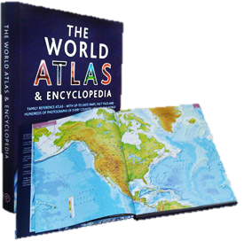
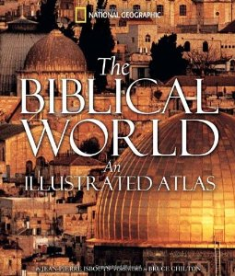


Atlases

Slide 21
What Did we cover?
Learned the difference between a globe and a map.
Explained what a map is.
Understand that difference between small-scale and large-scale maps
Have seen an introduction to Google Earth.
Viewed scale examples from the solar system scale to a specific neighborhood.
Learned the definition of an Atlas

