Slide 1
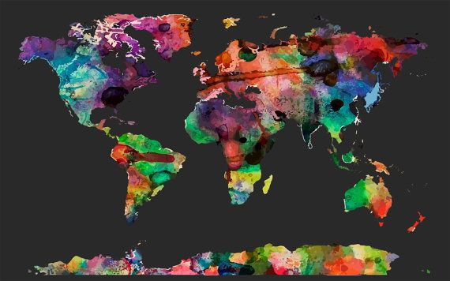
Handy Quick-Reference Atlas

Slide 2
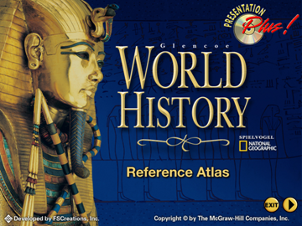


Splash Screen

Slide 3
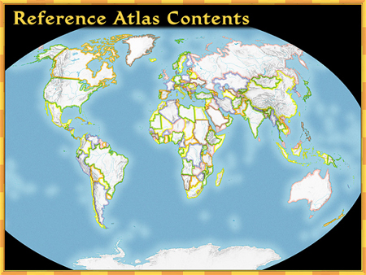

Contents
The Arctic
Northern
Asia
North
America
Europe
Southern
Asia
Africa
Southeast
Asia
South
America
Oceania
Antarctica
Click on a hyperlink to view a region.

Slide 4
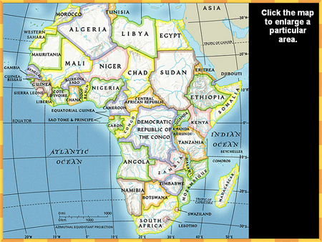
Africa Contents

Slide 5
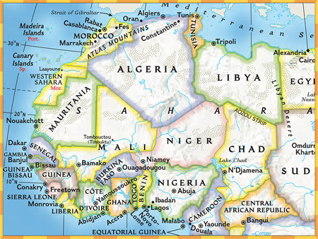

West Africa

Slide 6
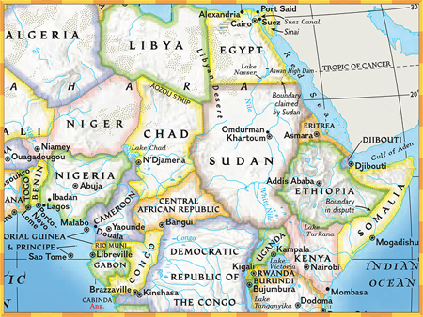
East Africa

Slide 7
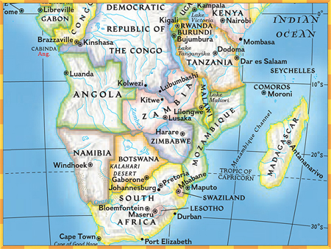
Southern Africa

Slide 8
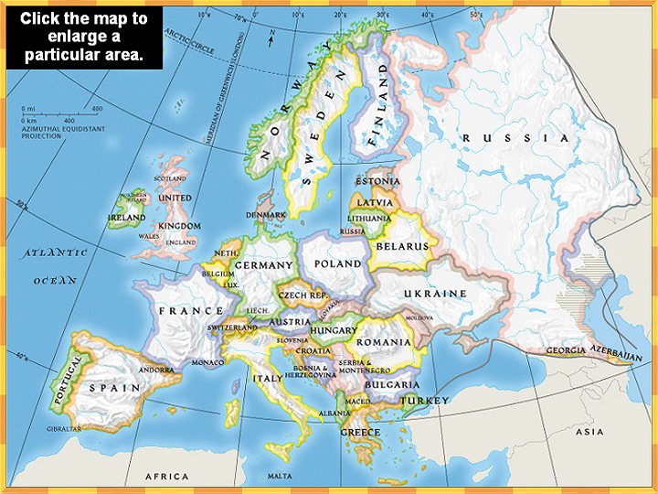
Europe Contents

Slide 9
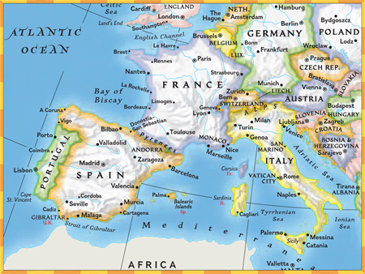
Southwestern Europe

Slide 10
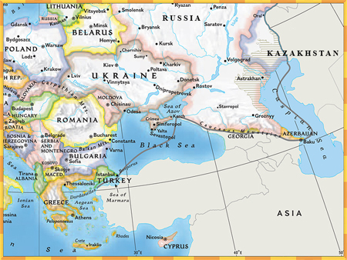
Southeastern Europe

Slide 11
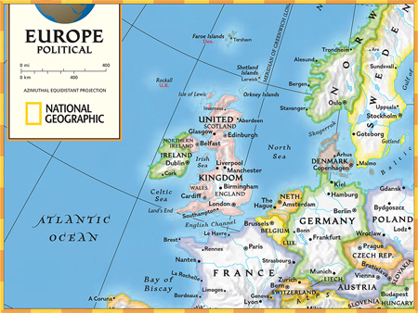
Northwestern Europe

Slide 12
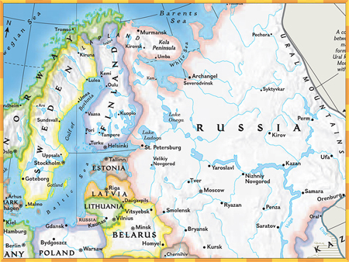
Northeastern Europe

Slide 13
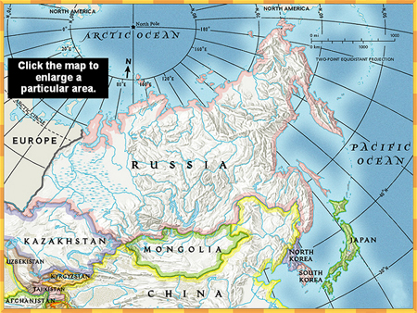
North Asia

Slide 14
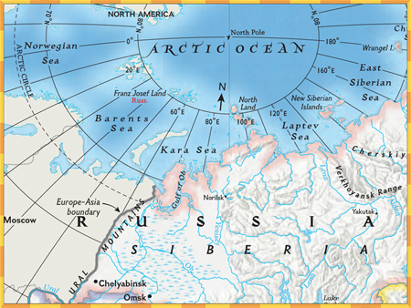
North Asia Northwest

Slide 15
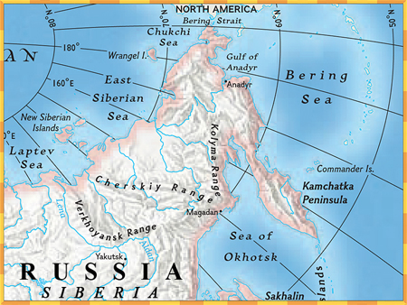
North Asia Northeast

Slide 16
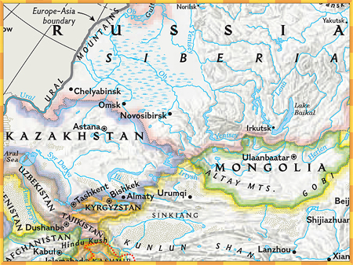
North Asia Southwest

Slide 17
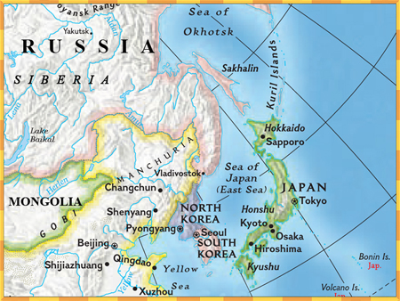
North Asia Southeast

Slide 18
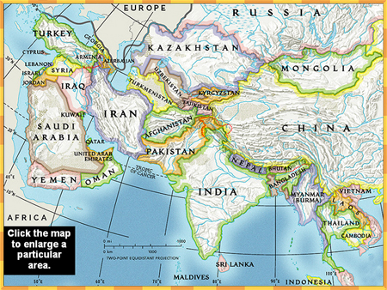
Southern Asia Contents

Slide 19
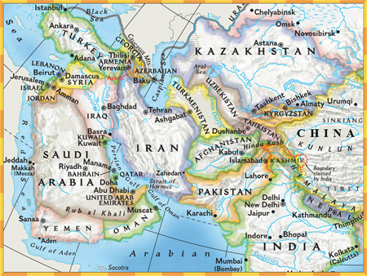
Southern Asia West

Slide 20
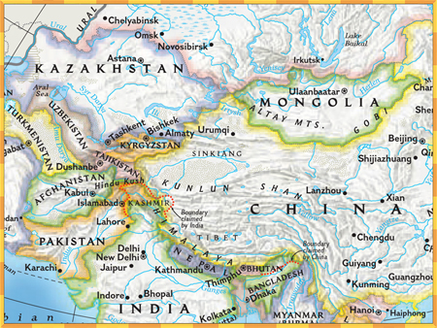
Southern Asia Northeast

Slide 21
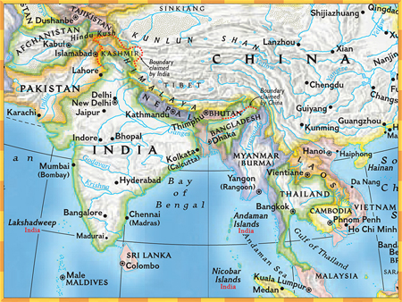
Southern Asia Southeast

Slide 22
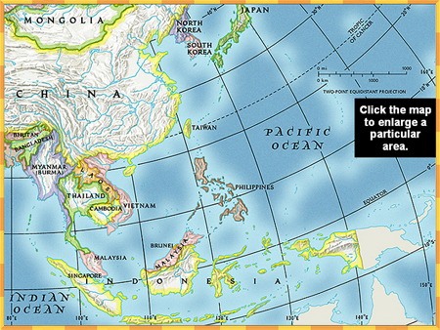
Southeast Asia Contents

Slide 23
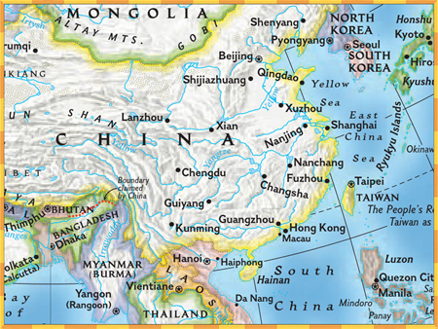
Southeast Asia Northwest

Slide 24
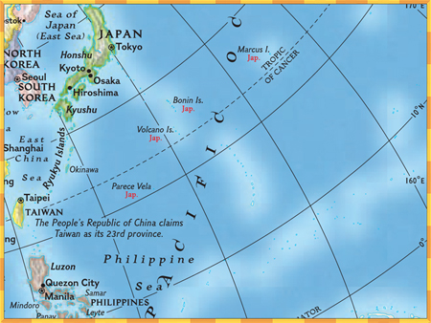
Southeast Asia Northeast

Slide 25
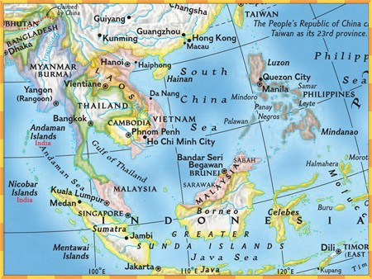
Southeast Asia Southwest

Slide 26
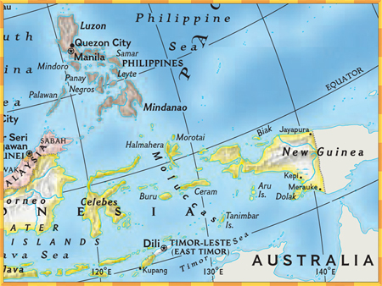
Southeast Asia Southeast

Slide 27
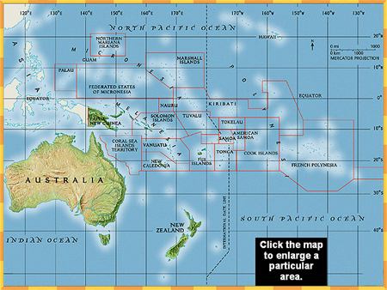
Oceania Contents

Slide 28
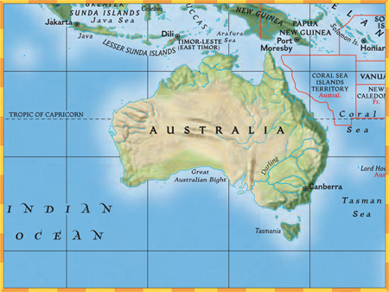
Australia

Slide 29
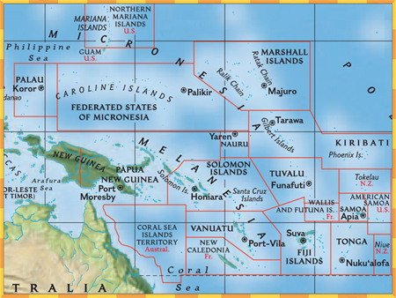
Northwestern Oceania

Slide 30
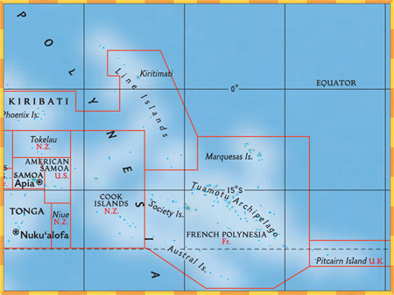
Northeastern Oceania

Slide 31
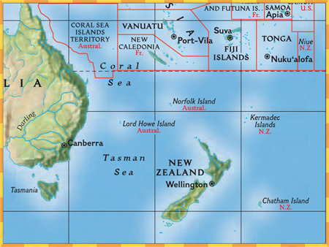
Southeastern Oceania

Slide 32
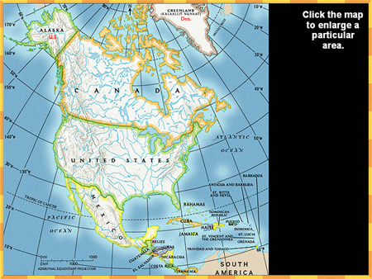
North America Contents

Slide 33
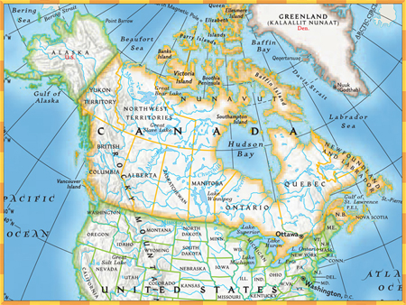
Northern North America

Slide 34
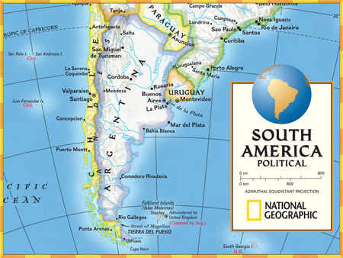
Southern North America

Slide 35
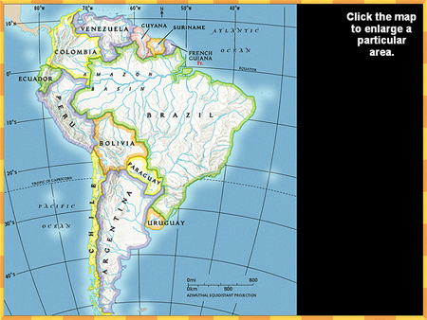
South America Contents

Slide 36
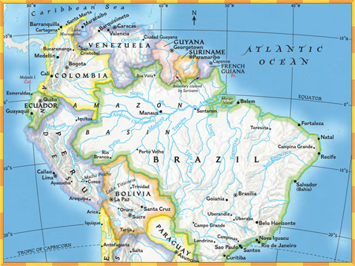
Northern South America

Slide 37
Southern South America

Slide 38
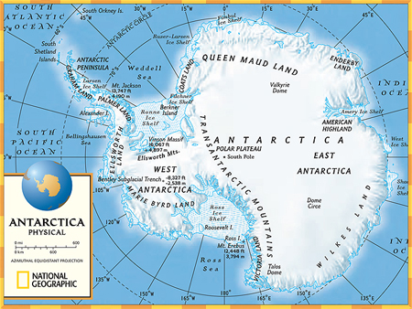
Antarctica

Slide 39
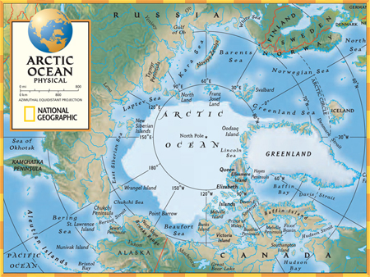
The Arctic

Slide 40
Thanks for visiting

Slide 41



End of Slide Show

