Slide 1
Computer maps and weather (climate) data
Climate is the average annual pattern of precipitation and temperature at a specific location

Slide 2
Computer temperature maps for January 18, 2016

Slide 3
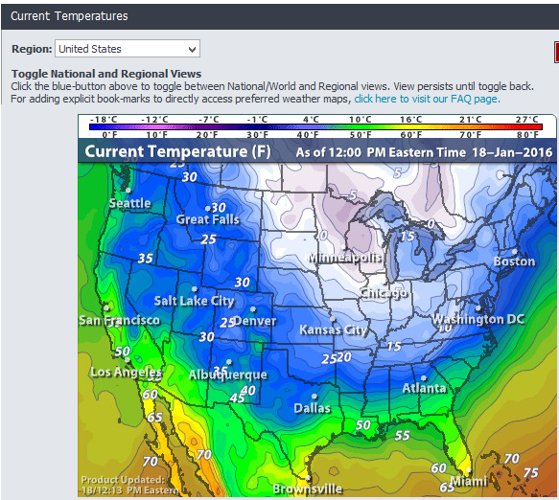
Current temp

Slide 4
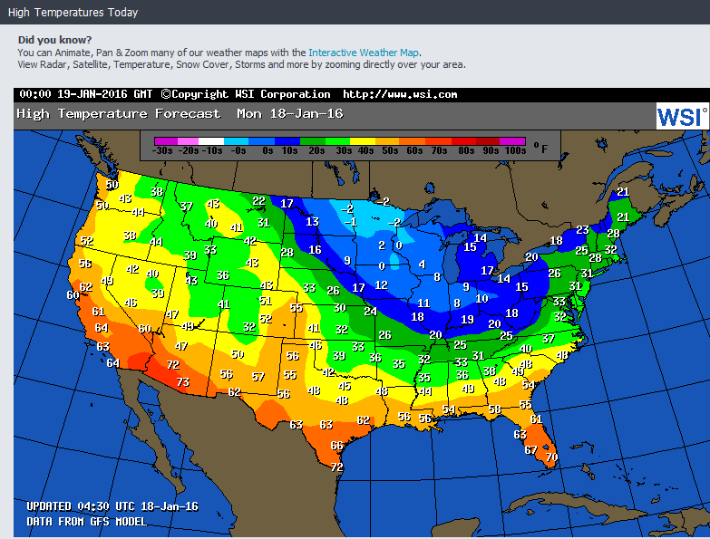
Expected high temp for the day

Slide 5
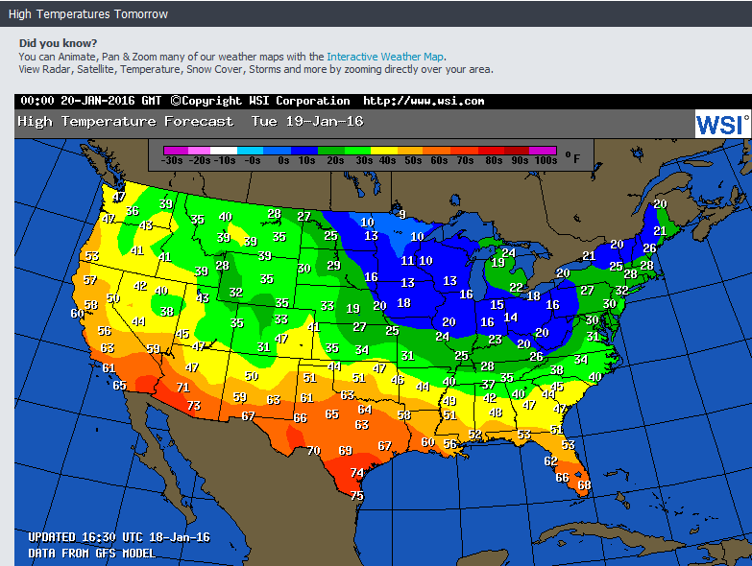
The farther one predicts from today’s conditions, the less accurate the results may be.

Slide 6
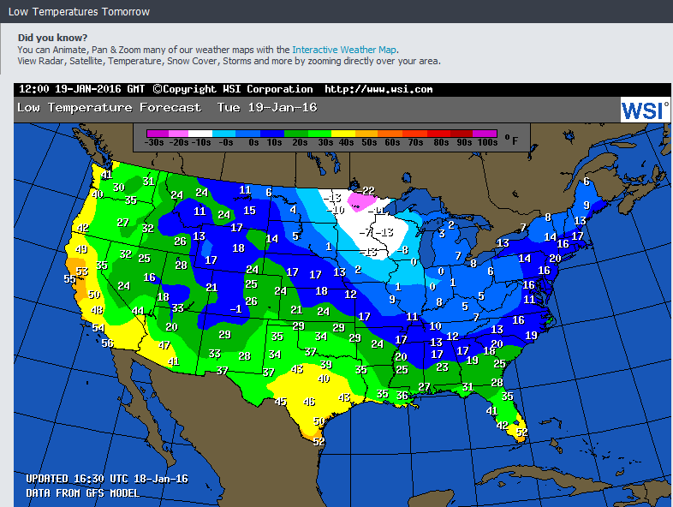
Good to know when you go to bed so you will be prepared in the morning

Slide 7
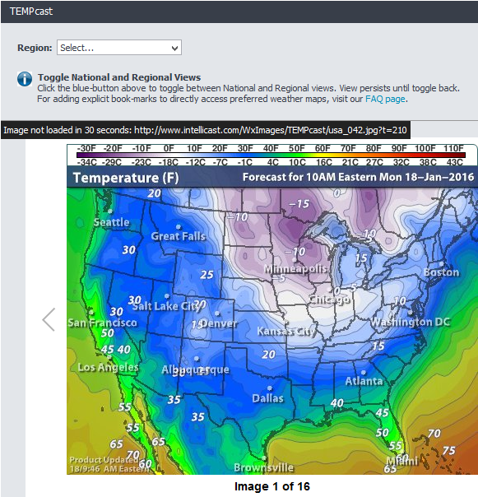
One can get maps that predict the temperatures for the next 15 hours. One can also get maps of city regions.

Slide 8
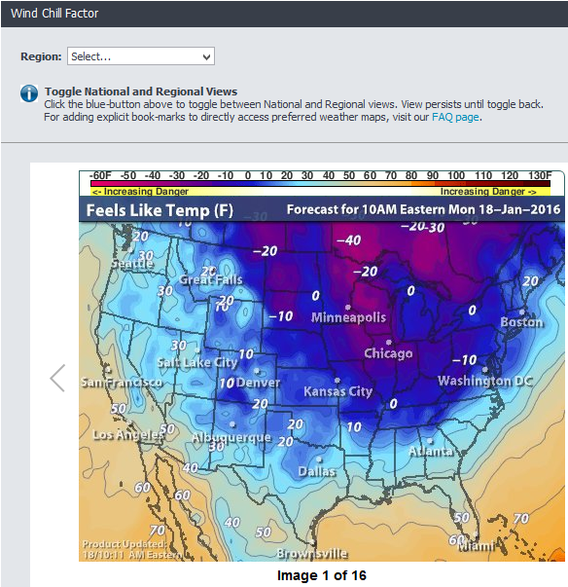
One can get maps that predict the Wind Chill for the next 15 hours. One can also get maps for City regions

Slide 9
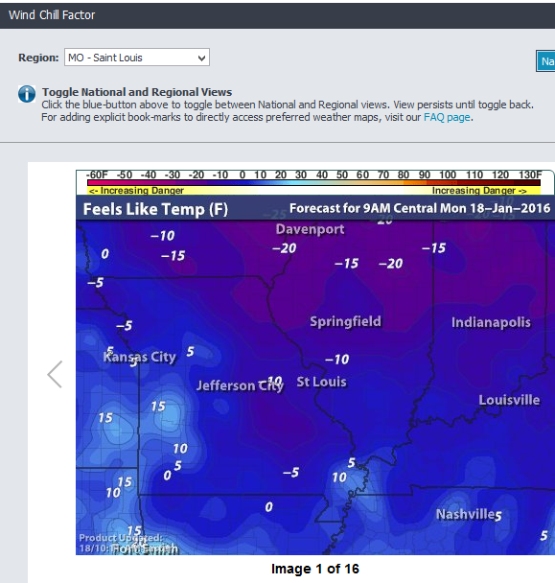
These also are available for the next 15 hours.

Slide 10
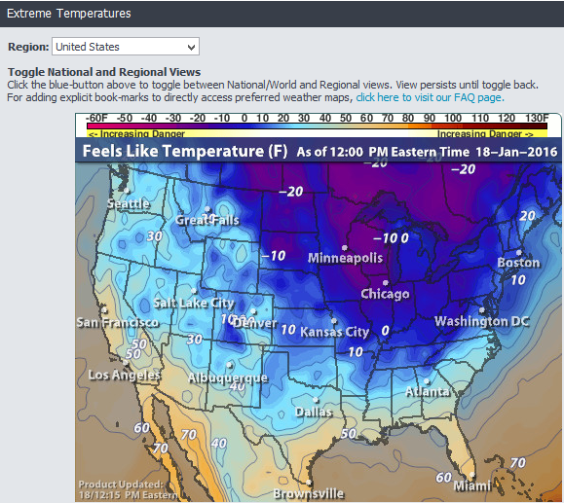
Also available for city regions for the next 15 hours

Slide 11
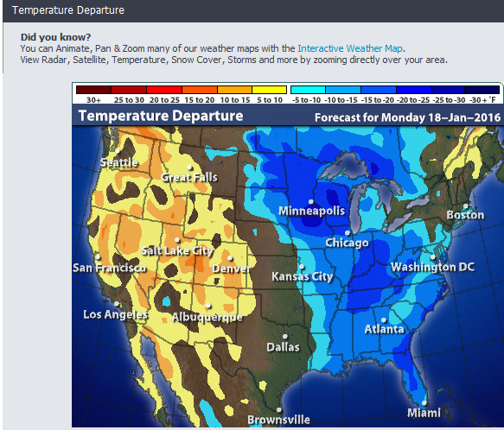
Shows how different today is from the average for the day

Slide 12
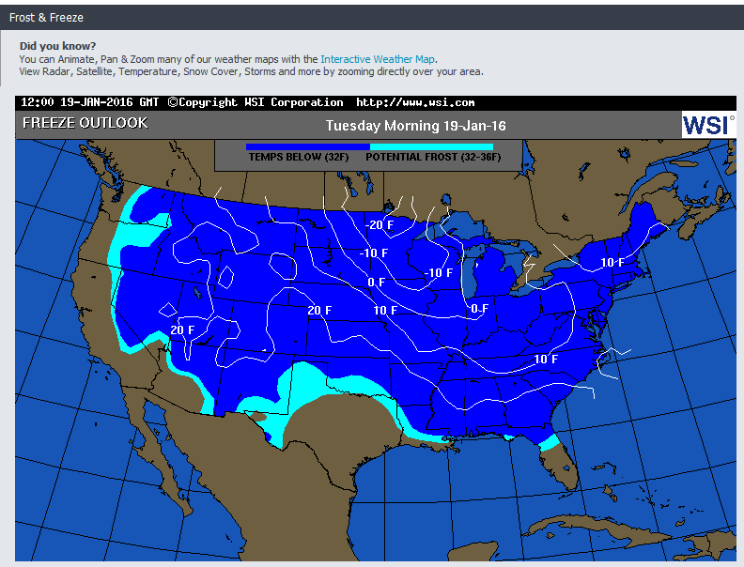
Farmers and gardeners are more interested in this in the spring of the year

Slide 13
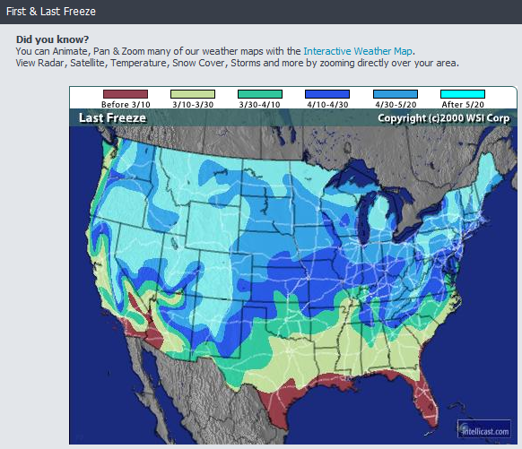
Shows when farmers and gardeners are most nervous trying to decide when to plant which seeds. Nature does not always pay attention to the averages.

Slide 14
Now lets see what we can learn about precipitation

Slide 15
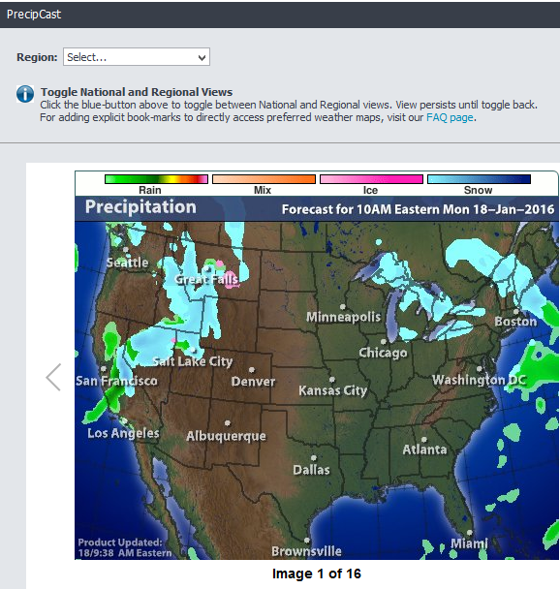
One can get maps that predict the type of precipitation possible for the next 15 hours. One can also get maps of city regions.

Slide 16
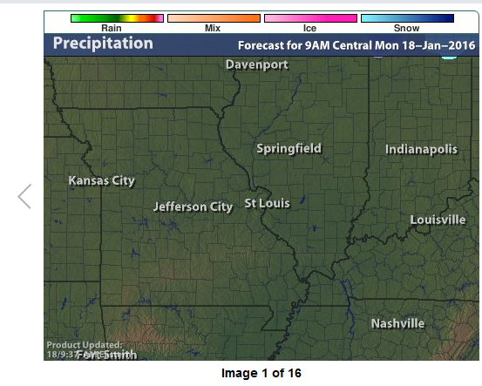
For January 18, 2016, conditions are rather uniform all around St. Louis, Missouri

Slide 17
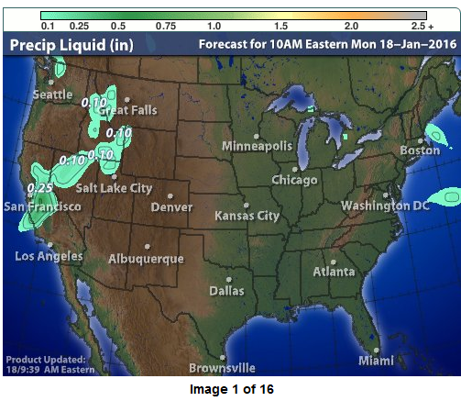
Shows the possible quantity of precipitation in liquid measure for the next 15 hours

Slide 18
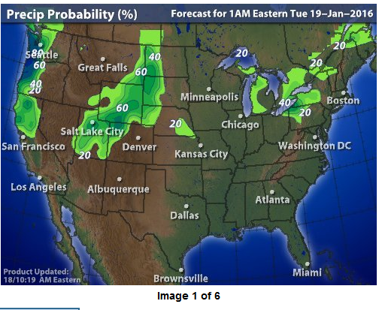
Shows the probability of precipitation for the next 3 days. City regions can also be selected

Slide 19
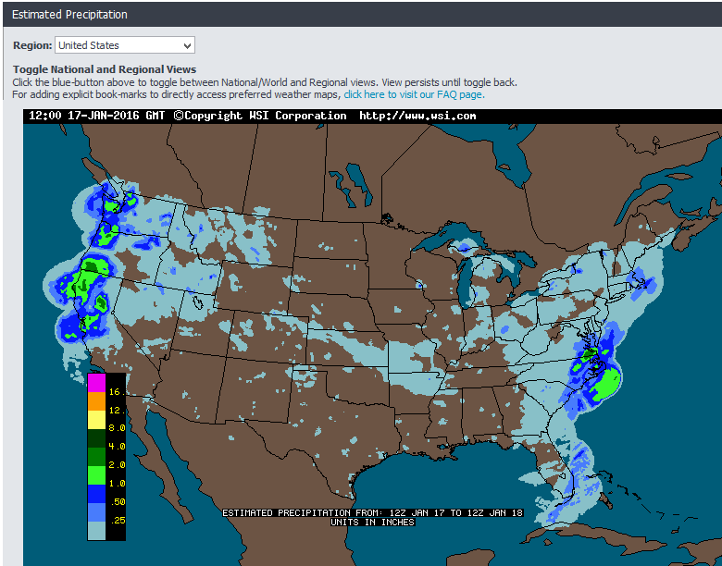

Slide 20
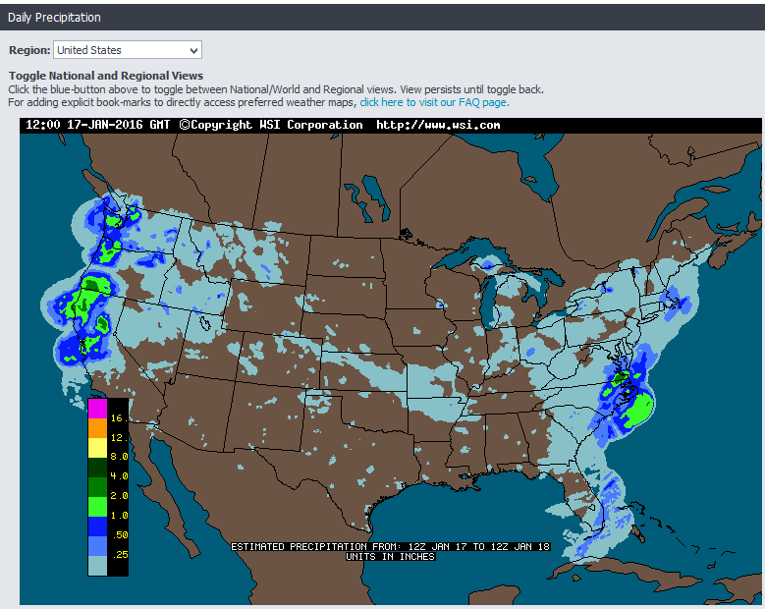

Slide 21
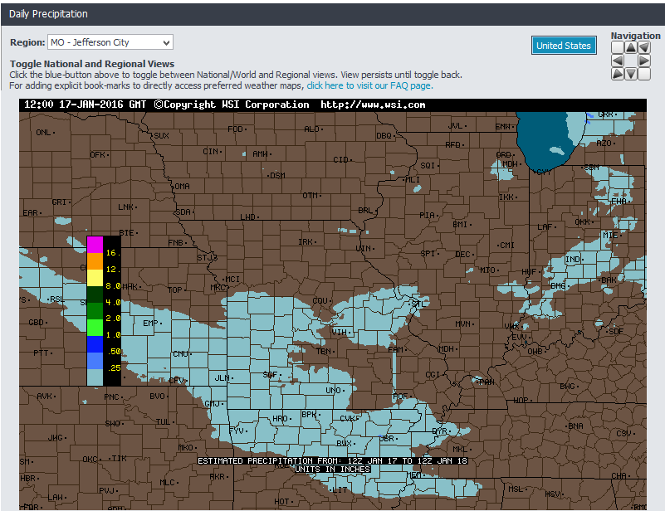

Slide 22
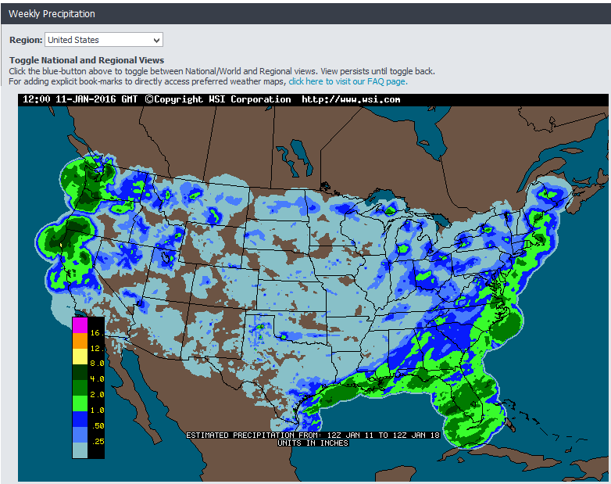

Slide 23
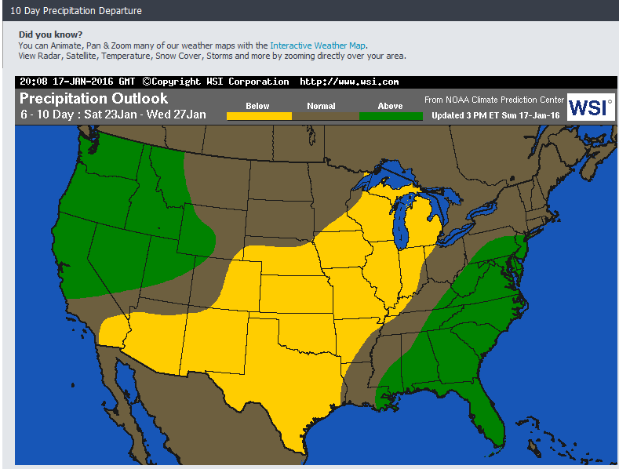

Slide 24
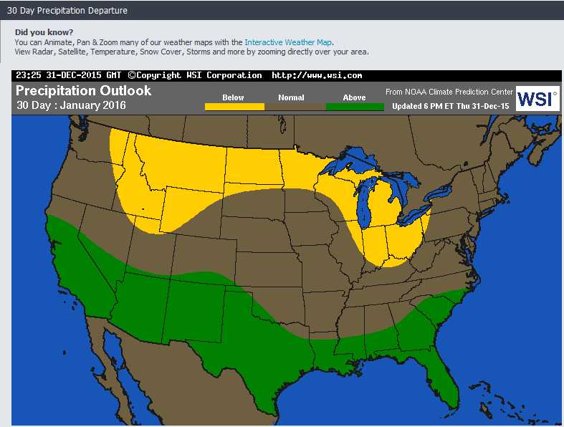

Slide 25
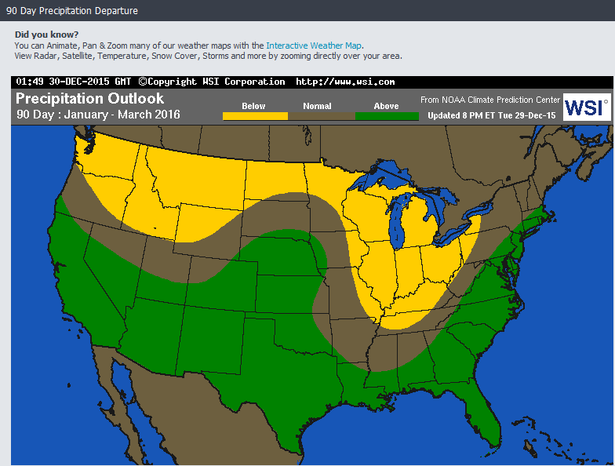

Slide 26
Other data available that impact weather, and thereby climate

Slide 27
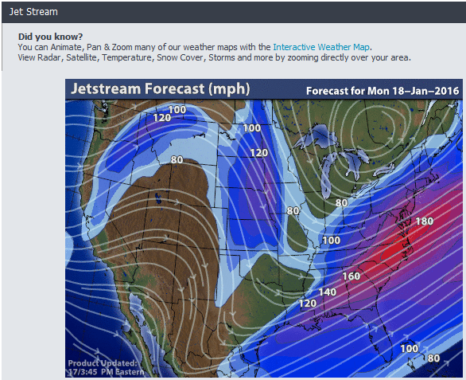
Jet streams affect the movement of the air masses at lower altitudes – jet streams do not stay in one pattern, they move about.

Slide 28
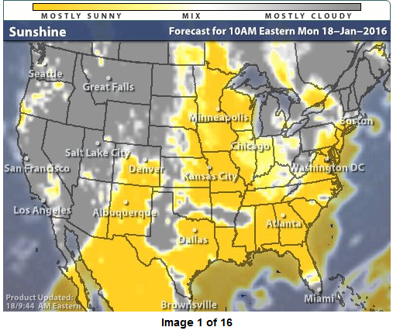

Slide 29
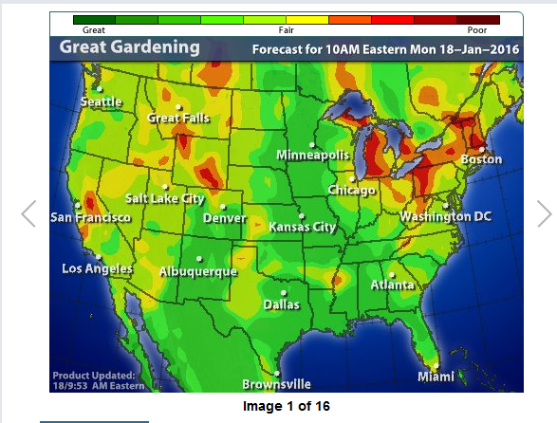

Slide 30
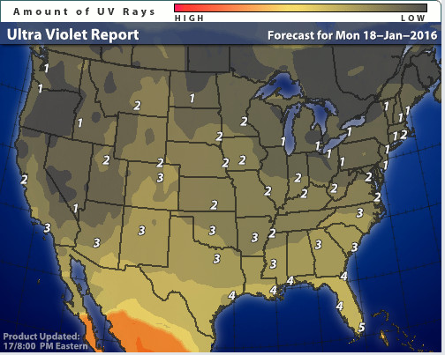

Slide 31
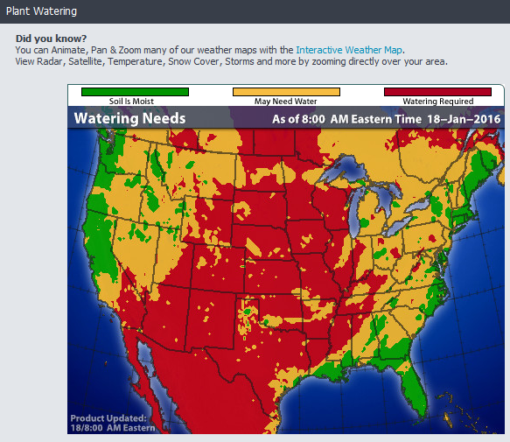
If an area remains red long enough, then it is having a drought. If it stays green too long, there may be agricultural problems of another sort and possibly flooding

Slide 32
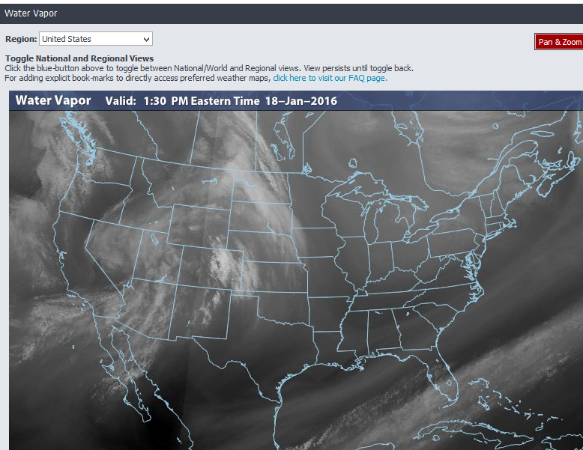
When the water vapor is abundant (high humidity), the chance of precipitation increases

Slide 33
Weather
the state of the atmosphere at a place and time as regards heat, dryness, sunshine, wind, rain, etc. Put very simply, weather is what hits you in the face when you walk out the door.

Slide 34
climate
the average course or condition of the weather at a place usually over a period of years as exhibited by temperature, wind velocity, and precipitation. Usually the average ANNUAL PATTERN of temperature and precipitation arrived at over a long period of time – the longer the time period, the more reliable are the results.

Slide 35
Climate change
Climate change is a condition that is always going on as factors beyond the earth (sun actions) and within and on the earth change. The proof is that we can accurately establish that there have been 4 ice ages on earth with long warm periods between them. Currently the earth is warming more rapidly than nature would have it warm because humans have filled the atmosphere with gasses (CO² being the major one) that hold heat. This will change conditions for many habitats, affecting the plants and animals that have been living there, but are now experiencing conditions that are less than ideal for them. If they can, they will migrate to areas where the habitat is more suitable for them.
Some countries are being threatened with shrinking or going out of existence as sea level rising (it is rising) puts most or all of them under water: Marshall Islands, Maldives Islands, the cayes off the coast of Belize, just to mention an few of those threatened. Most seacoast cities around the world are going to have serious problems.
Problem: If a farmer can no longer successfully grow the crop he/she is used to growing, can he/she find an alternate crop that is equalably marketable, or is he/she economically wiped out?

Slide 36
Why do you think Climate study is important?
For many, or even most people on the Earth it influences:
  What kind of cloths are appropriate throughout the year
  What foods are locally available
  How varied one’s wardrobe (clothes) needs to be
  What the features are of the home they need to protect them from whatever extremes nature presents where they are located
  What kind of agriculture can be practiced in the area
  What diseases they may be exposed to
  What kind of recreation is available
  Machinery maintenance
  The potential for much of a tourist industry
  Etc.

