Slide 1
President Obama in South & Southeast Asia
November 2010

Slide 2
India
Obama called for India becoming a permanent member of the UN Secutiry Council
Laid the groundwork for a large amount of exports to India
  Predicted the creation of 50,000 jobs in the US to produce those exports
Agreed to cooperate in anti-terrorism efforts

Slide 3
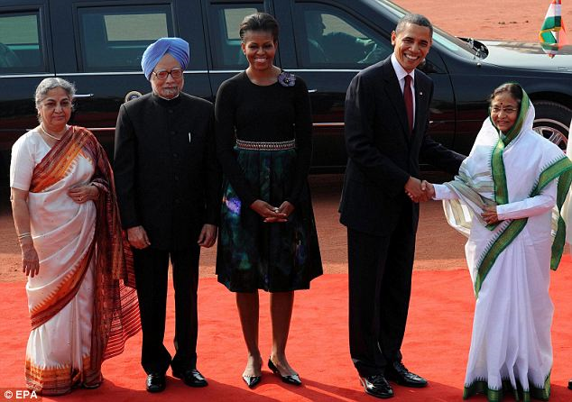
Welcoming Ceremony

Slide 4
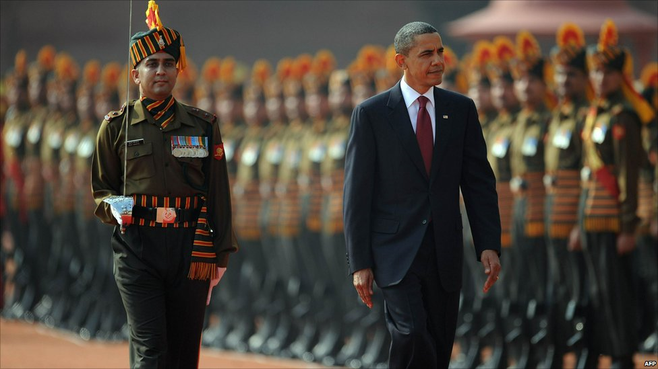

Slide 5
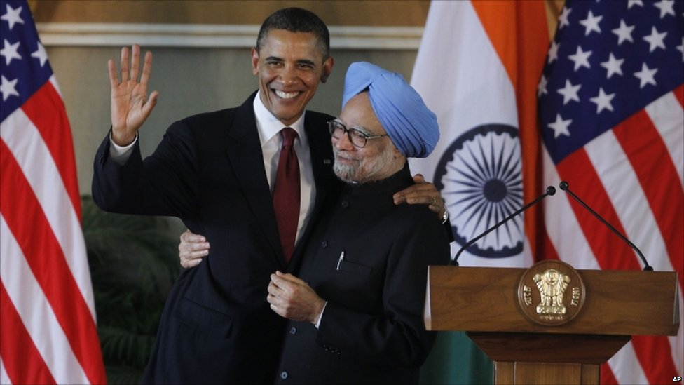
With Indian Prime Minister

Slide 6
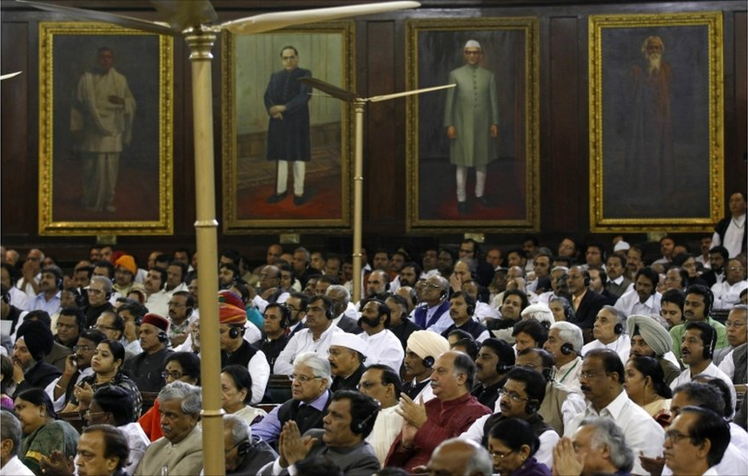
Addresses Parliament

Slide 7
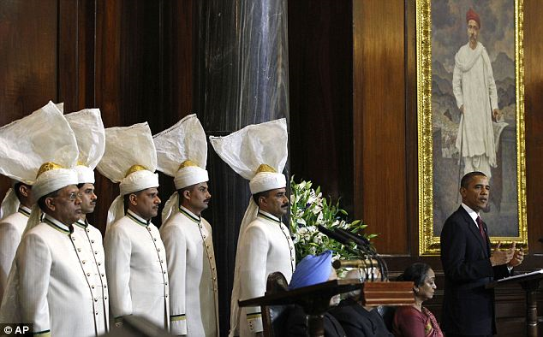
Presidential Address

Slide 8
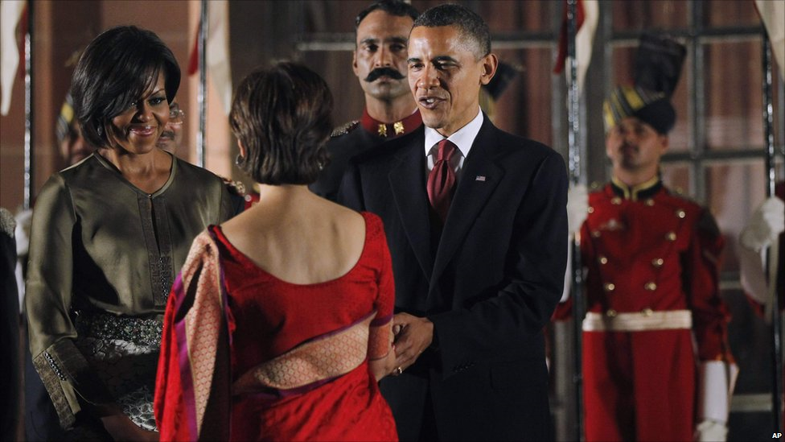
At a State Dinner

Slide 9
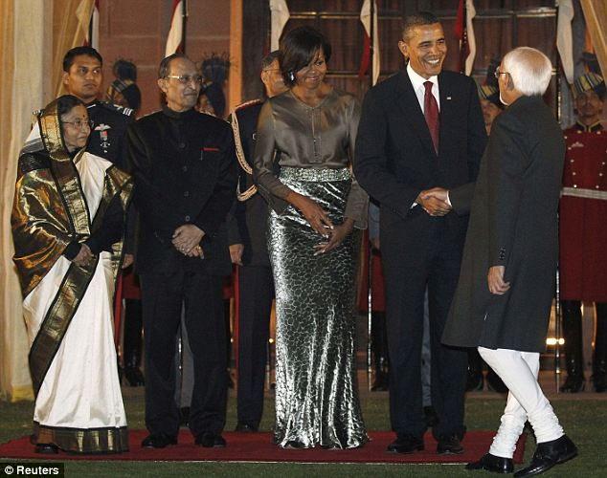

Slide 10
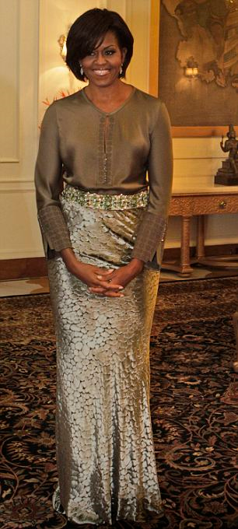
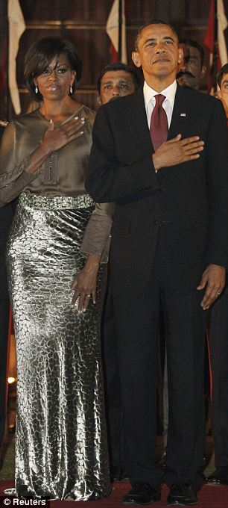

Slide 11
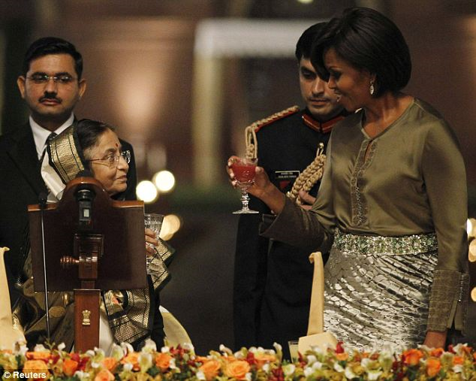

Slide 12
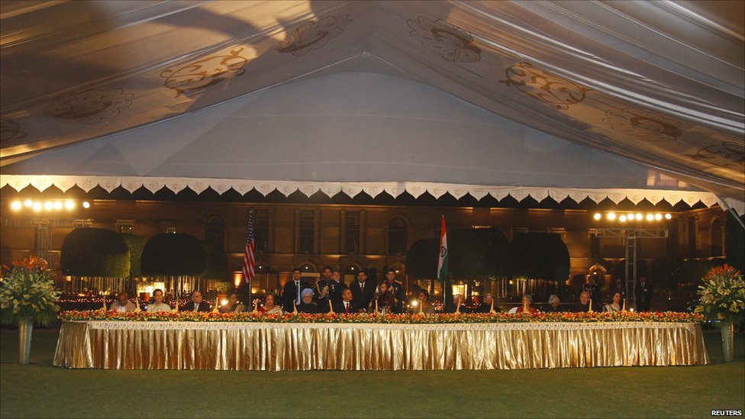

Slide 13
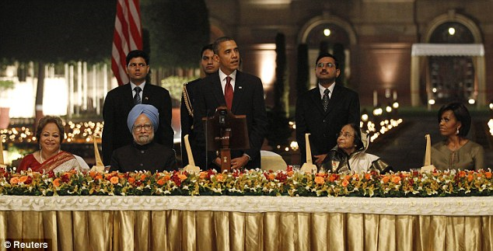

Slide 14
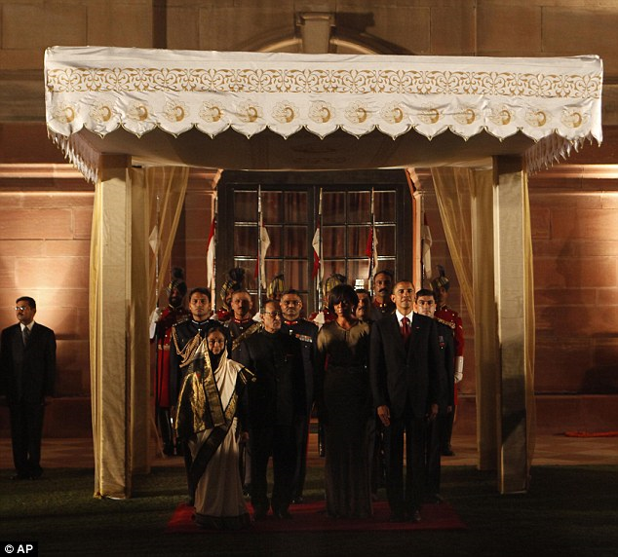

Slide 15
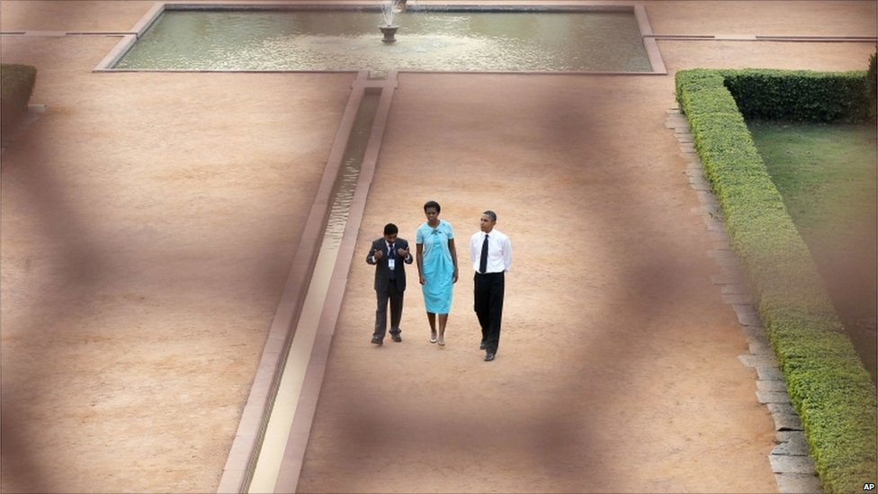

Slide 16
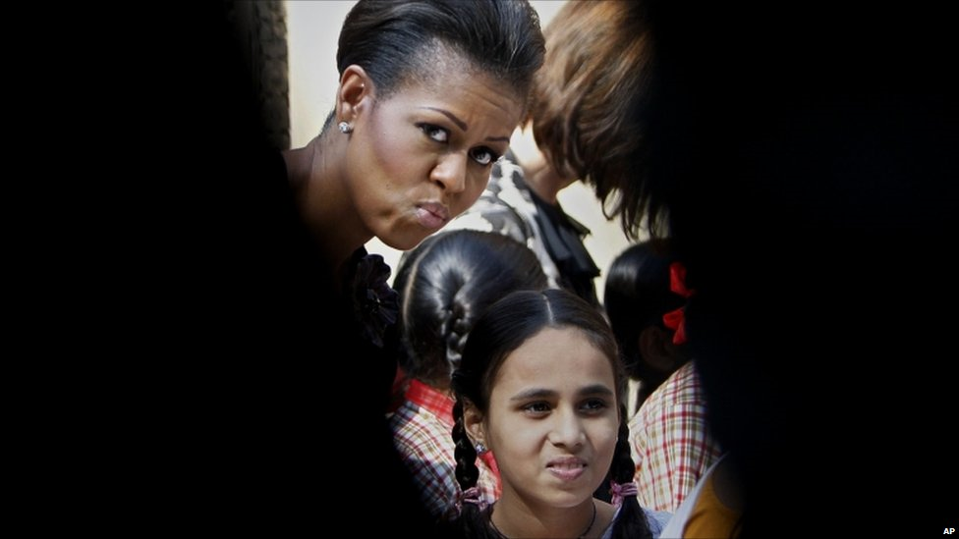

Slide 17
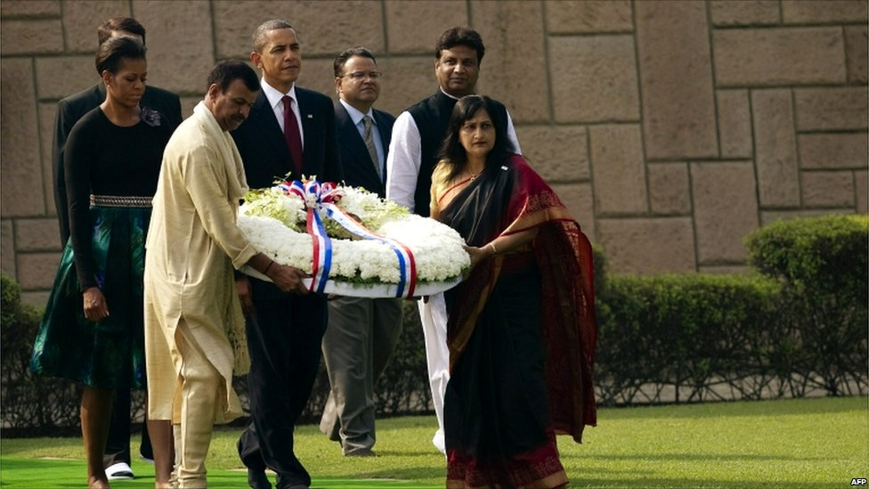
The Obamas took off their shoes to lay a wreath at Raj Ghat, the Mahatma Gandhi memorial in New Delh, earlier in the day

Slide 18
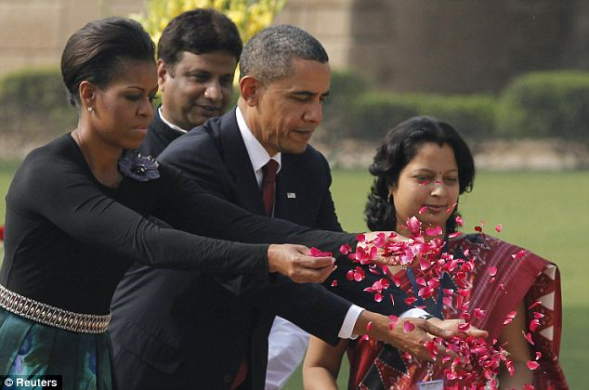
Scattering flowers at the Gandhi Memorial

Slide 19
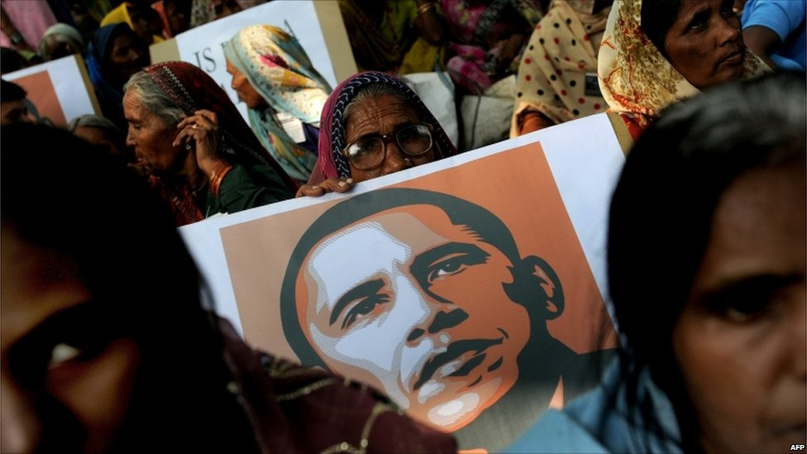

Slide 20
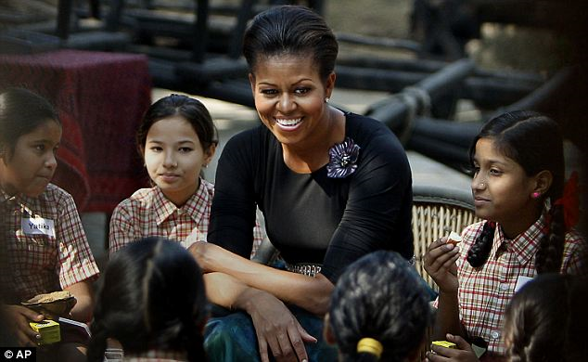
Mrs. Obama talks with school girls

Slide 21
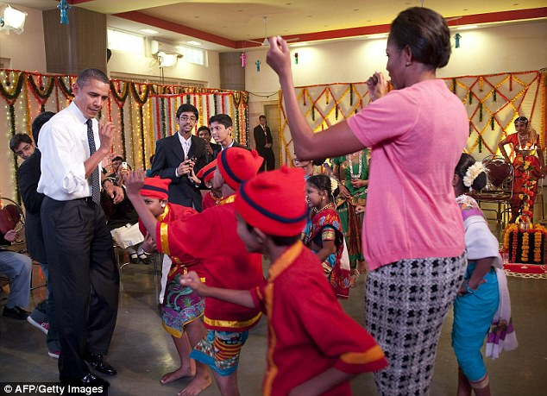
Students celebrating the Hindu Diwali festival with the Obamas

Slide 22
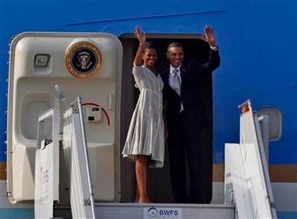
Leaving India & going to Indonesia

Slide 23
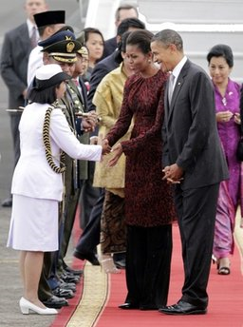
Arriving in Indonesia

Slide 24
Obama planned to later tour the country's largest mosque and make a speech that will give him another opportunity to convince Muslims that the U.S. is not waging a war on Islam, but on terrorism, and needs the help of moderates to fight it.

Slide 25
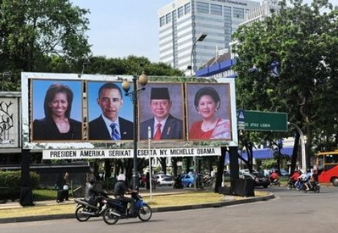
Jakarta is Prepared

Slide 26
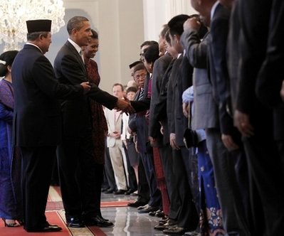
The Obamas greet the Indonesian President’s staff.

Slide 27
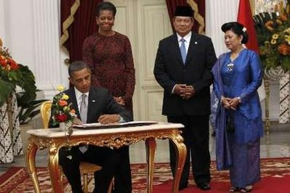
US President & Indonesian President

Slide 28
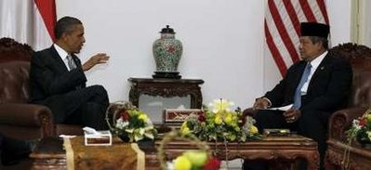
The Presidents talk

Slide 29
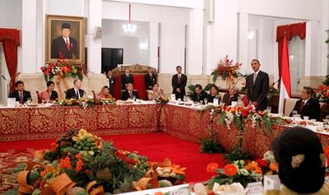
State Dinner in Jakarta

Slide 30
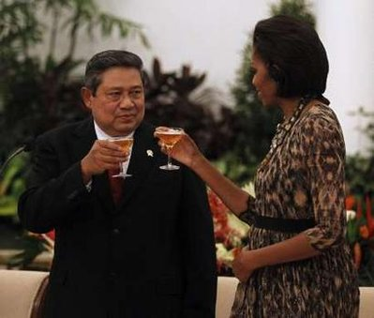
Michelle toasts Indonesian President

Slide 31
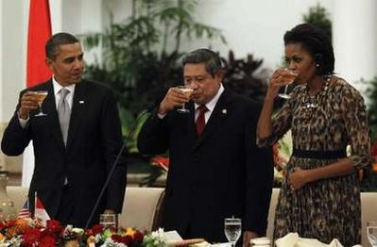
Toasts at the State Dinner

Slide 32
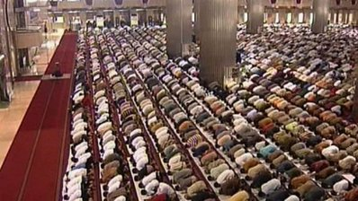
Pres. Obama planned to visit a mosque to stress the US is not at war with Islam.

