Slide 1
At Home With a Dictator and With His People
A Study in Contrasts

Slide 2
A Not Untypical Dictatorship
The contrasts you will see may be a little more extreme than many dictatorships, but the material that follows does illustrate well the differences between the ruler and the ruled in dictatorships such as:
Egypt (1971-2011)
Iran under the Shah (and maybe today)
Iraq under Saddam Hussein
Burma (Myanmar)
Belarus
Uzbekistan
Etc.

Slide 3
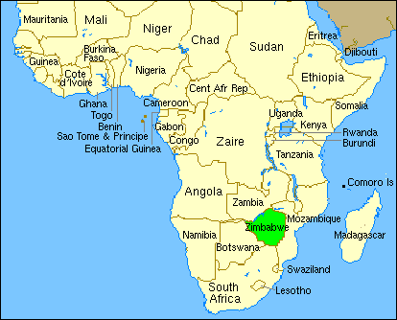

Slide 4
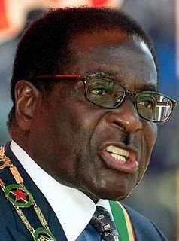
Meet Robert Mugabe,
Born 21 February 1924, he is the second and current “President” of Zimbabwe. One of the leaders of the liberation movement against white-minority rule, he was elected into power as the head of government since 1980, as Prime Minister from 1980 to 1987, and as the first executive head of state since 1987. (He may have the title of President gained through questionable elections; however, he is really a dictator.)

Slide 5
Let’s visit Robert’s home . . . .

Slide 6
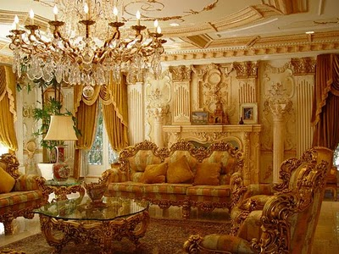

Slide 7
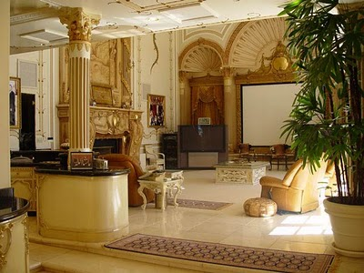

Slide 8
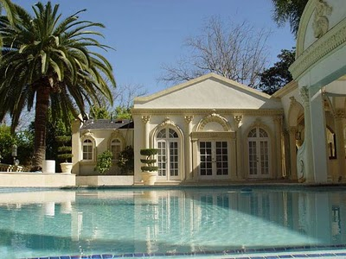

Slide 9
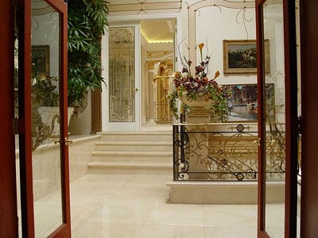

Slide 10
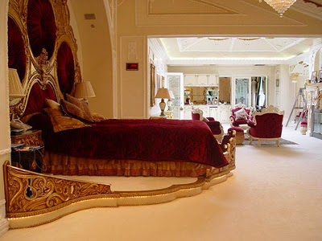

Slide 11
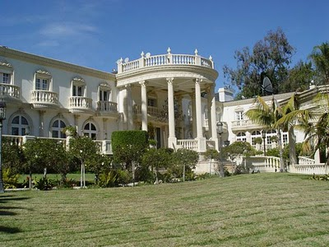

Slide 12
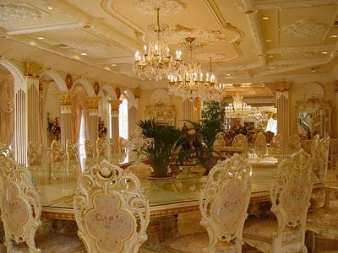

Slide 13
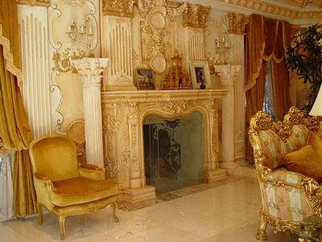

Slide 14
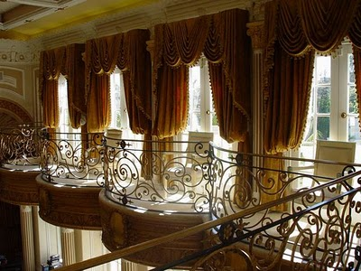

Slide 15
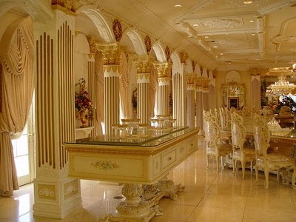

Slide 16
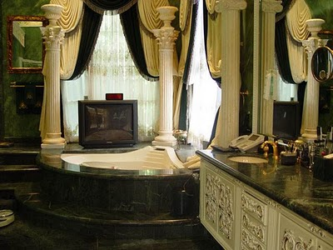

Slide 17
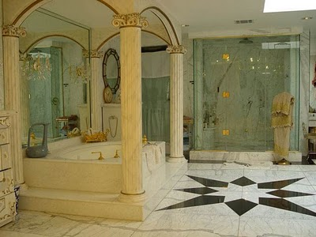

Slide 18
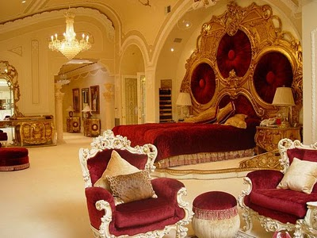

Slide 19
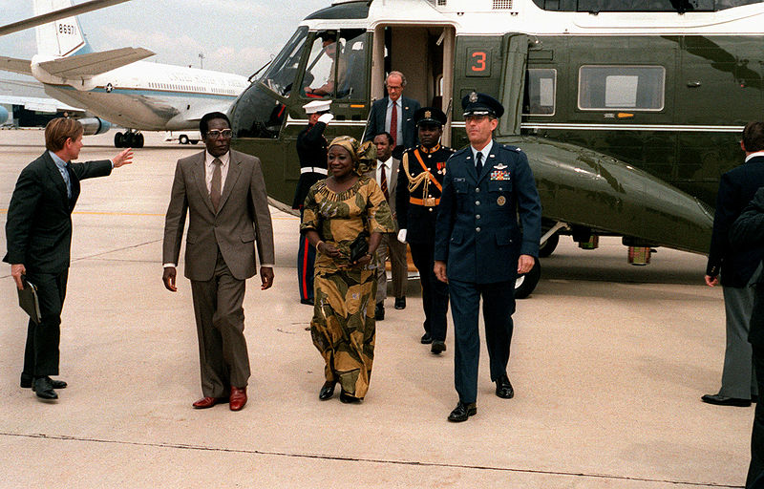
Visiting the USA – Andrews Airforce Base, 1983

Slide 20
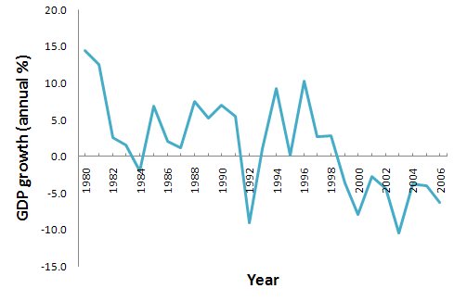
Economic Disaster

Slide 21
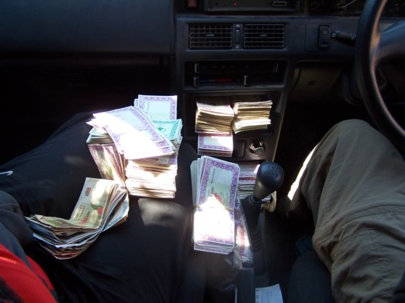
“At $450,000Z to the dollar, we became millionaires after changing $3US. This photo is what $200US looks like.” US visitor’s remark

Slide 22
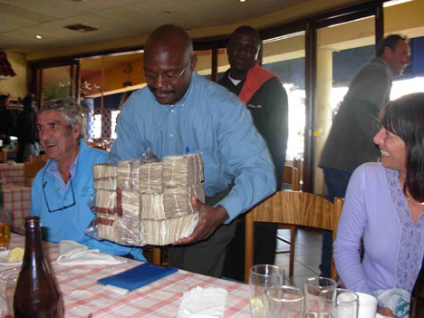
Beyond Hyper-Inflation
Gas ran around $35,000,000 (Zimbabwe dollars) to fill the tank. Crazy stuff. We had to walk around with our backpacks full of money just to go and buy a pizza. The smallest bill is $20,000.
What it takes to buy a beer!

Slide 23
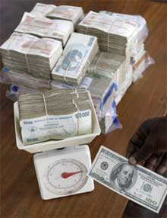
Converting Zimbabwe dollars for US dollars

Slide 24
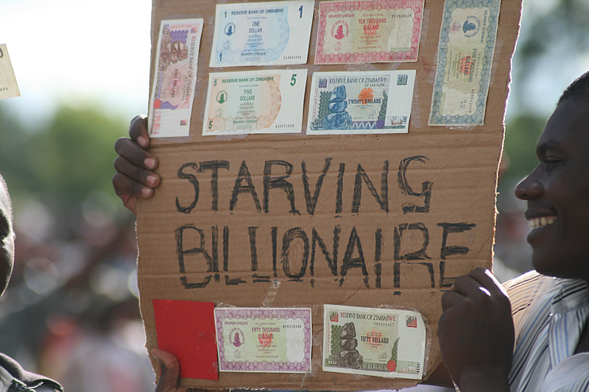

Slide 25
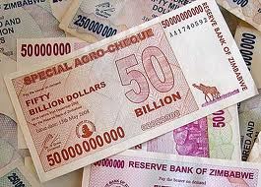
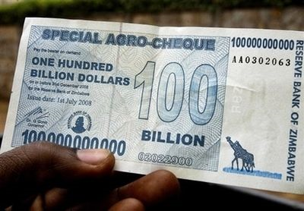

Slide 26
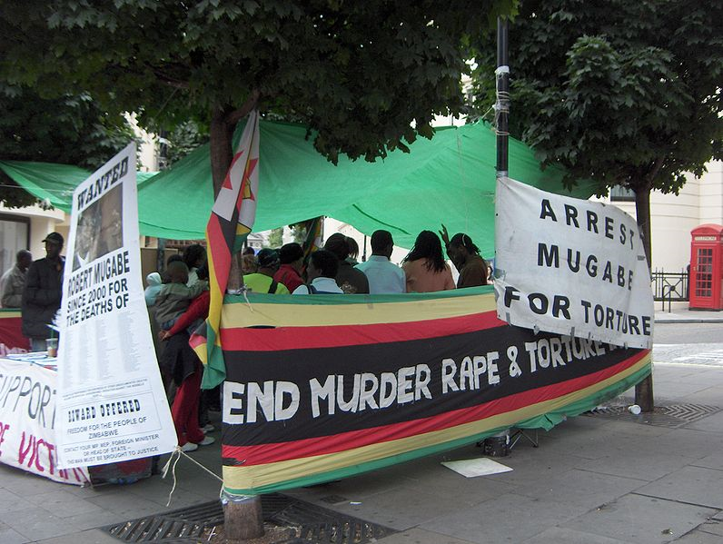
Example of foreign criticism: a demonstration against Mugabe's regime next to the Zimbabwe embassy in London

Slide 27
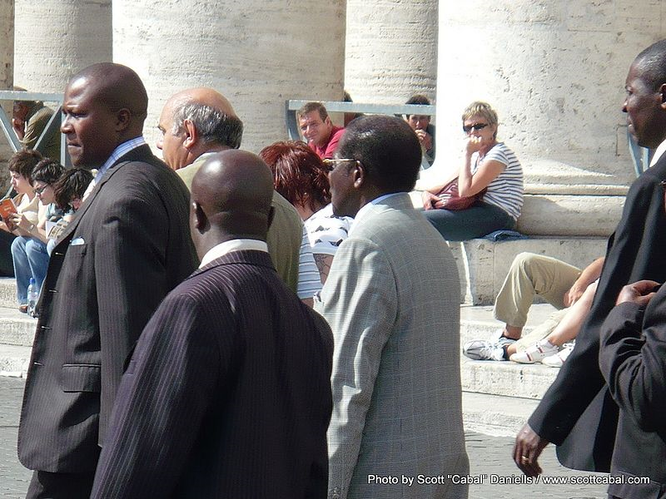
Robert Mugabe visiting Vatican City in 2008, while in Rome for a UN Food Conference-a permitted exception from his travel ban.

Slide 28
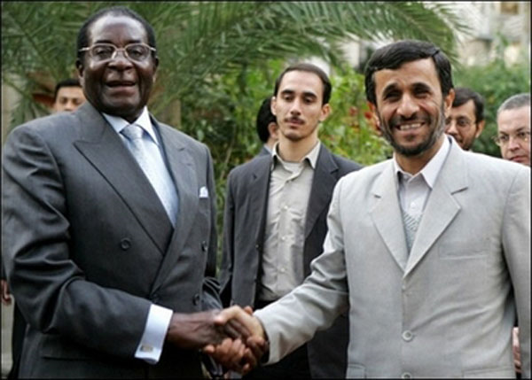
“Birds of a feather flock together . . . .?” Mugabe & Ahmadinejad

Slide 29
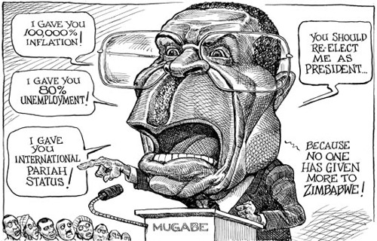

Slide 30
Let’s visit His Countrymen and Countrywomen
Just contrast that pad with most Zimbabweans living in grinding poverty with a 95% unemployment rate and hyperinflation that topped-out at 6.5 quindecillion novemdecillion percent (6.5 x 10108%!) ... fact is, the poor wretches he's ruled over for thirty years have never had it so bad:

Slide 31
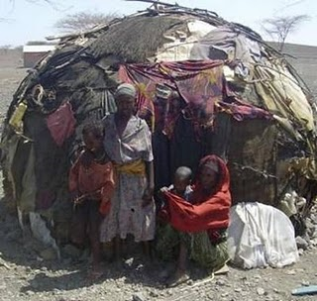

Slide 32
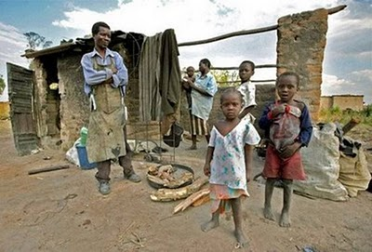

Slide 33
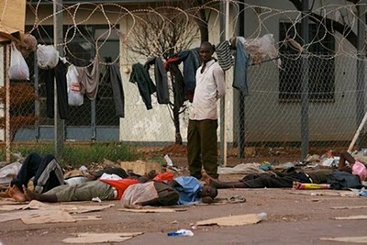

Slide 34
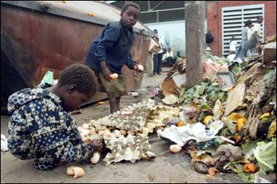

Slide 35
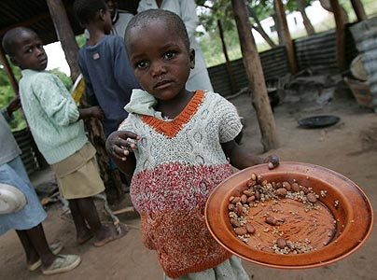
Five million face hunger in Zimbabwe, UN says

Slide 36
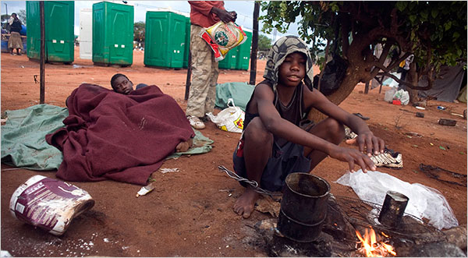

Slide 37
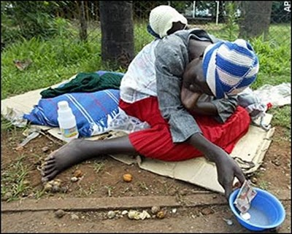

Slide 38
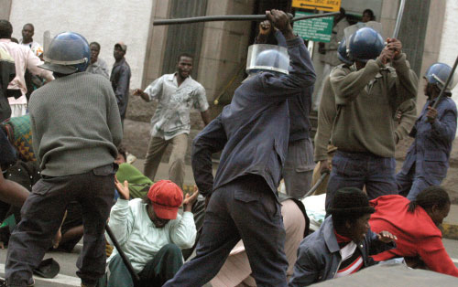

Slide 39
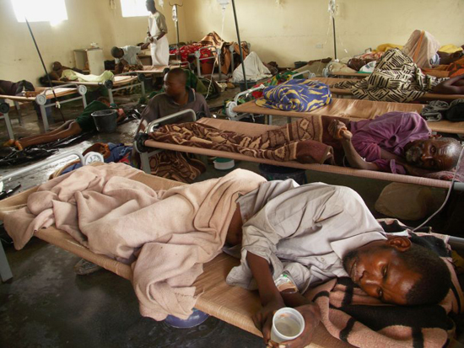
Zimbabwe: MSF Has Treated More Than 45,000 Cholera Patients (2009)

Slide 40
Zimbabwe was not so very long ago considered the "bread basket of Africa"- but Mugabe's ill-advised and brutal confiscation of white farms put an end to that, as most properties were handed to privileged ZANU-PF (Mugabe’s Political Party) cronies who are not interested in working the land... basically shutting-down the most vital and successful sector of the economy. Thus, even with millions starving in the streets of Harrare, Zimbabwe is a already today a net food importer.

Slide 41
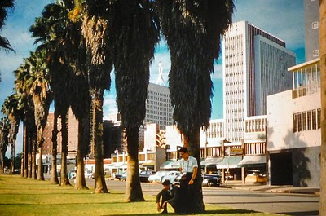
Urban Developmen t
Government funds usually encouraged urban development over rural/agricultural improvements

