Slide 1
2011 Post-Egyptian Protests in the Region
As of 3/24/2011

Slide 2
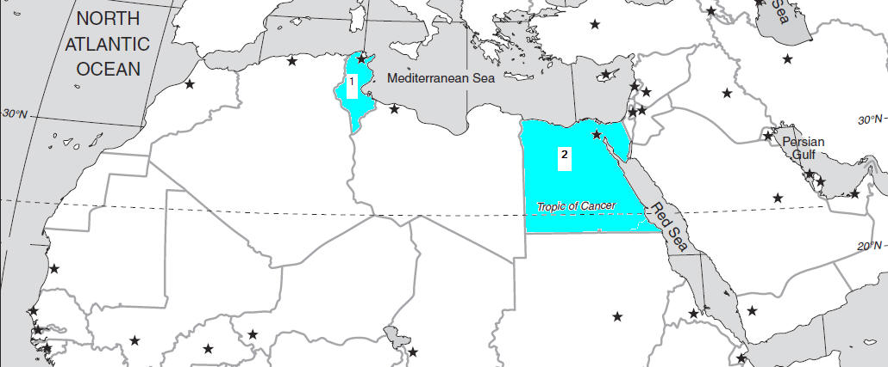

Slide 3
In the Beginning . . .
There was Tunisia
The president was forces from office by protests of the people
There was Egypt
Encouraged by Tunisia, massive street protests forced President Mubarak from office
The military is promising free elections within six months.
And then there is . . . . . . .
Encouraged by events in Tunisia and Egypt

Slide 4
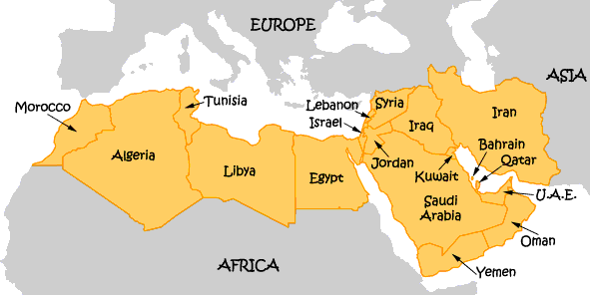

Slide 5
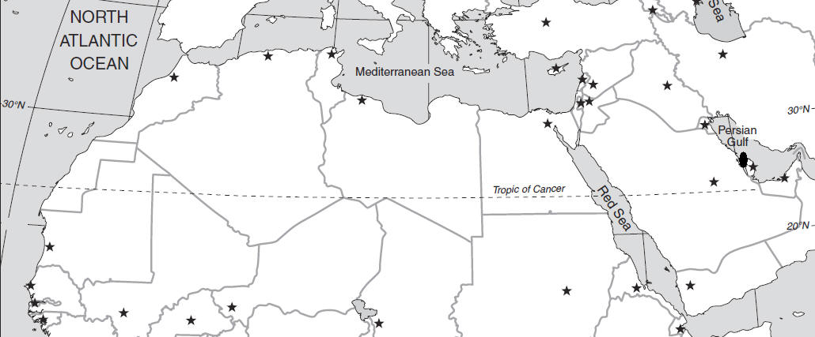
Bahrain

Slide 6
The Situation
Bahrain's Sunni monarchy looks particularly vulnerable in the face of an increasingly restless Shiite majority.
The tiny island nation, located in the Persian Gulf between Saudi Arabia and Iran, is home to the US Navy's Fifth Fleet and critical to broader regional operations – including deterrence of Iranian aggression.
At least 10 protesters have been killed.

Slide 7
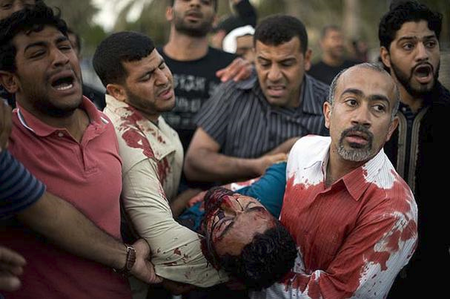

Slide 8
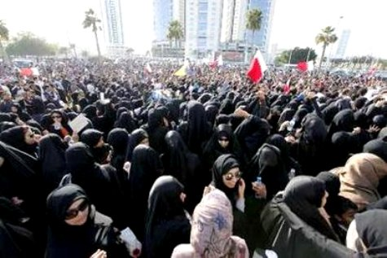

Slide 9
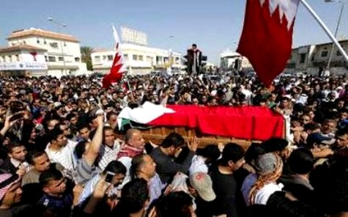

Slide 10
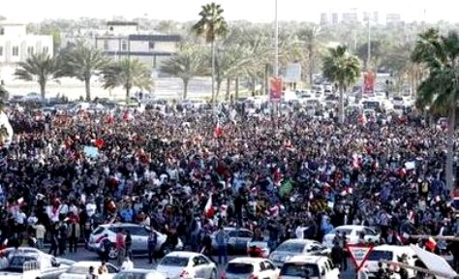

Slide 11
Protesters Take Bahrain Square as Forces Leave – 2-19-2011
Thousands of jubilant protesters surged back into the symbolic heart of Bahrain on Saturday as the government withdrew its security forces, calling for calm after days of violent crackdowns.
It was a remarkable turn after a week of protests that had shifted by the hour between joy and fear, euphoric surges of people power followed by bloody military crackdowns, as the monarchy struggled to calibrate a response to an uprising whose counterparts have toppled other governments in the region.

Slide 12
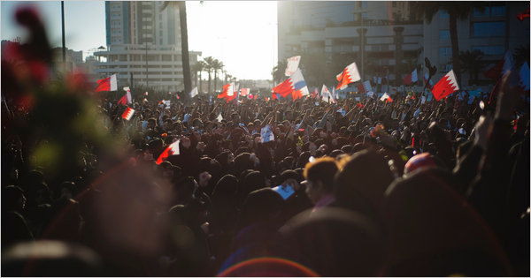

Slide 13
Saudi Arabia sends troops
Saudi Arabian troops were sent to bolster the forces of the King of Bahrain.
Protests have been stopped by force . . . At least for the present.
Some view the situation as basically a human rights issue – Shiites want proportionate representation in government and a parliament with some real authority.
Saudi Arabia sees it as a sectarian problem – Iran influencing the Shiite majority to support Iran in the region. This is not acceptable to Saudi Arabia.

Slide 14
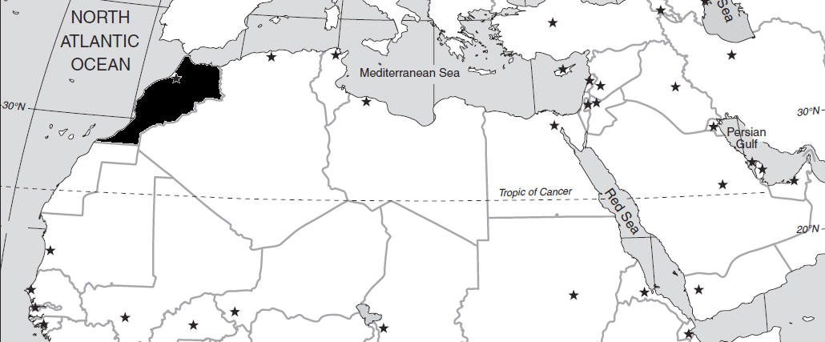
Morocco

Slide 15
The Situation
RABAT: Moroccan authorities have okayed an anti-government protest being planned on the popular social networking site Facebook, a media report said.
The media report said several Moroccan youth movements have announced on Facebook that they are planning to organise an Egypt-style anti-government protest Feb 20, a move apparently welcomed by the government.

Slide 16
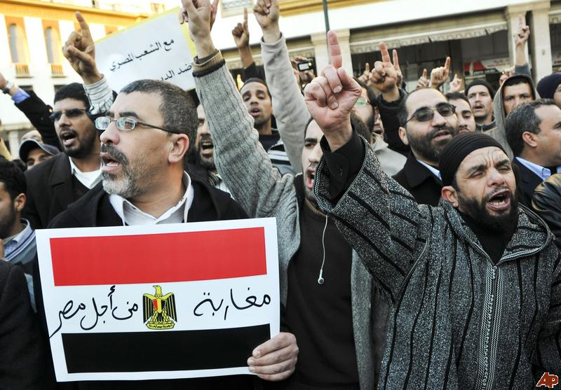

Slide 17
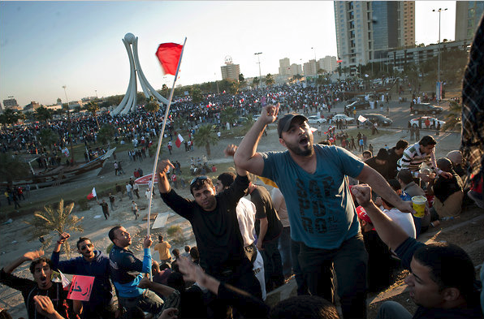

Slide 18
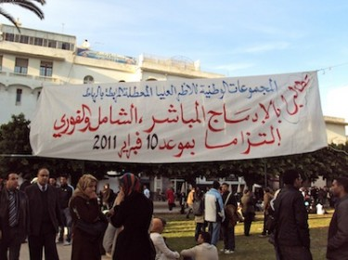

Slide 19
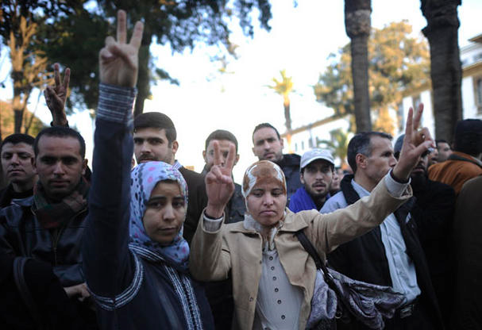

Slide 20
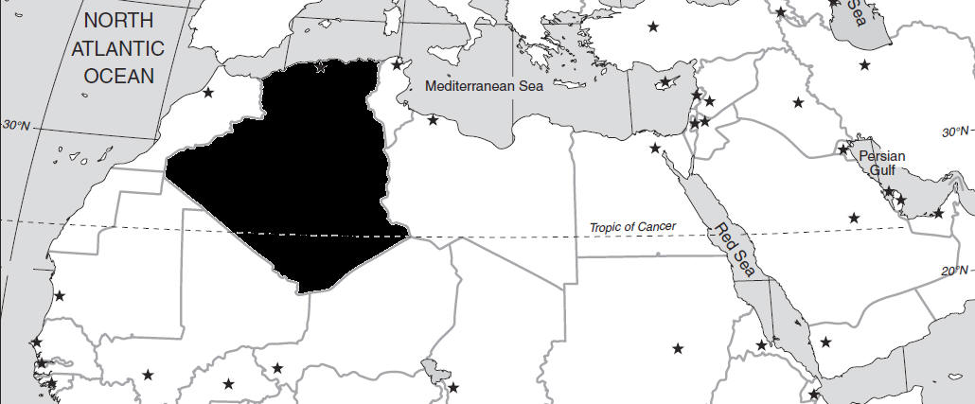
Algeria

Slide 21
The Situation
In Algeria, which has promised to repeal a 19-year-old state of emergency in response to protests, the military chose a civil war after the ruling party canceled elections that the Islamic Salvation Front looked set to win in 1991. There is no guarantee they won't chose that route again.

Slide 22
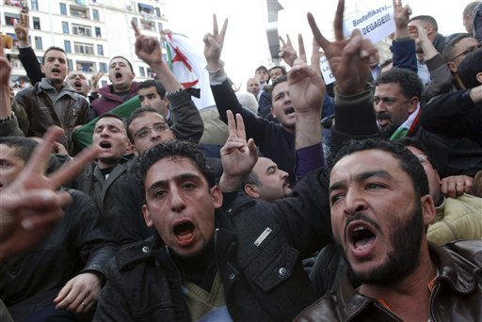

Slide 23
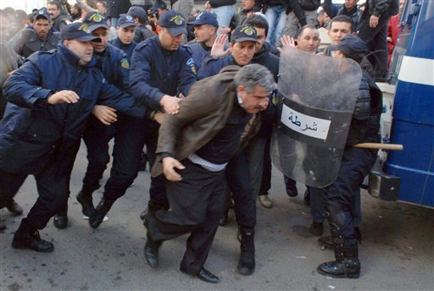

Slide 24
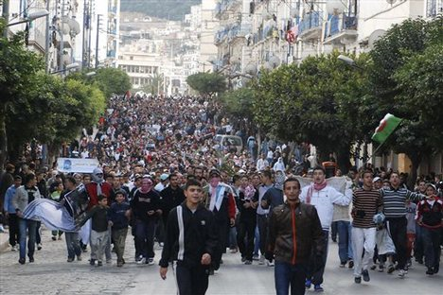

Slide 25
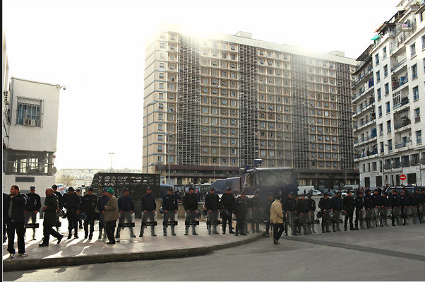
2/19/2011
In Algeria, riot police clashed with protesters who tried to stage a rally in central Algiers on Saturday.

Slide 26
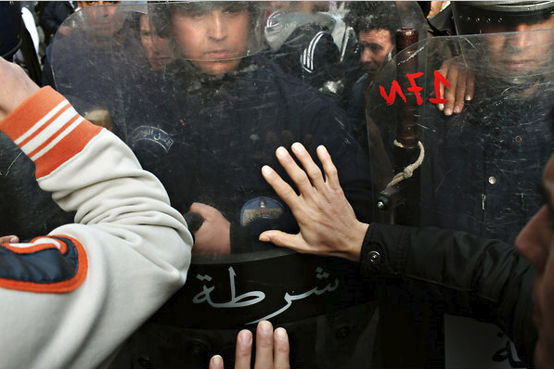

Slide 27
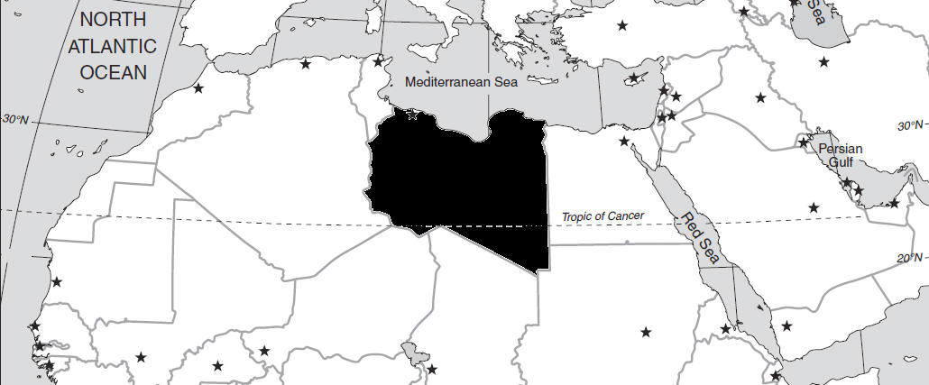
Libya

Slide 28
The Situation
TRIPOLI, Feb. 18 (Xinhua) -- At least 20 people in Libya's second largest city of Benghazi and seven in Derna in eastern Libya were killed in anti-government protests, Oea newspaper reported on its website Friday.
The bodies of the protesters in Benghazi were found Friday morning, it said. The protest, which broke out on Wednesday, demands the government to give more civil rights to the people.
The protesters chanted slogans such as "we want constitution," "Dialogue but no killing," and "No corruption," the report said.

Slide 29
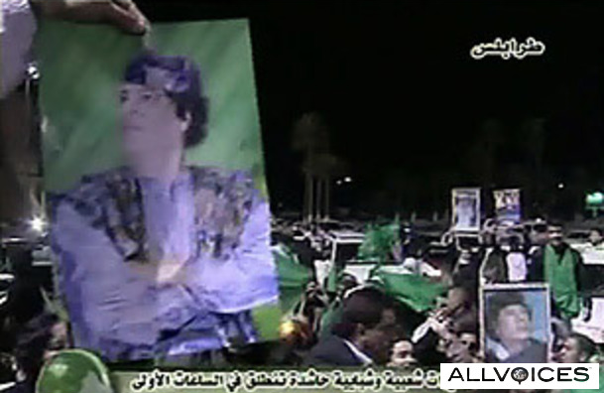

Slide 30
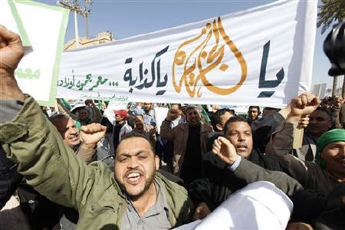

Slide 31
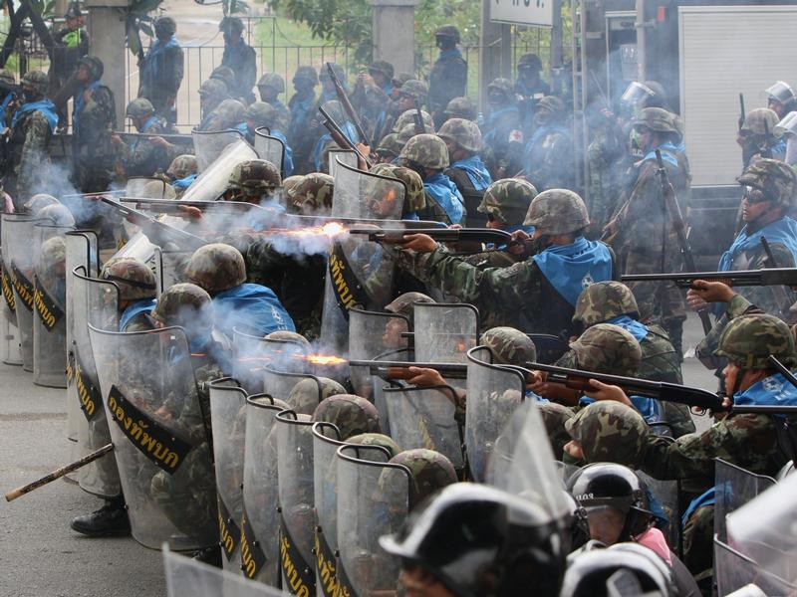

Slide 32
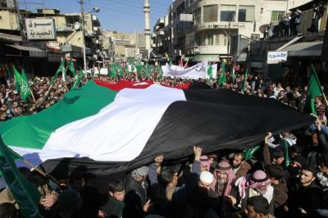

Slide 33
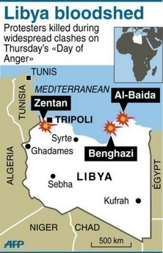

Slide 34
Libyan protesters defied a fierce crackdown by Moammar Gadhafi's regime, returning Sunday (2/20/2011) to a square outside a court building in the flashpoint city of Benghazi to demand the overthrow of longtime ruler Moammar Gadhafi.

Slide 35
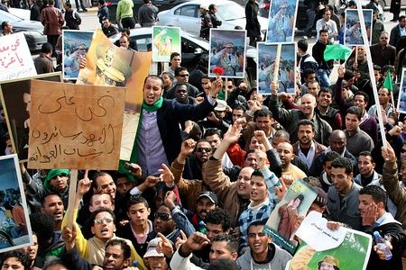

Slide 36
Sunday 2/20/2011
Libyan forces fired machine-guns at mourners marching in a funeral for anti-government protesters in the eastern city of Benghazi Sunday, a day after commandos and foreign mercenaries loyal to Moammar Gadhafi pummeled demonstrators with assault rifles and other heavy weaponry.
A doctor at one Benghazi hospital said 15 people died in Sunday's clashes. Earlier he said his morgue had received at least 200 dead from six days of unrest.

Slide 37
A deadly cycle has emerged: Security forces fire on funeral marches, killing people, creating more funerals.

Slide 38
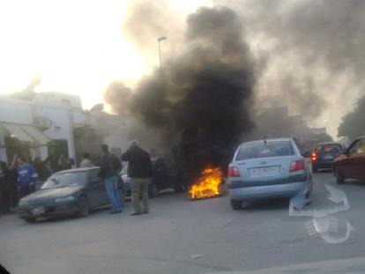

Slide 39
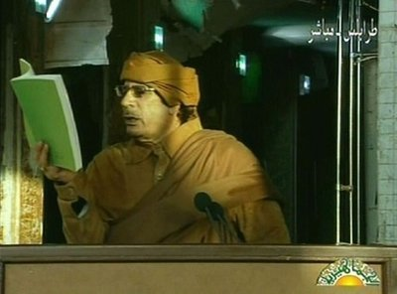
Moammar Gadhafi delivering a nationwide address pledging to fight to the death if necessary – I will not be removed!

Slide 40
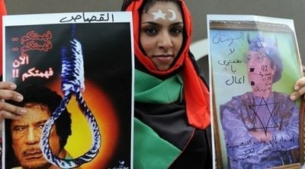

Slide 41
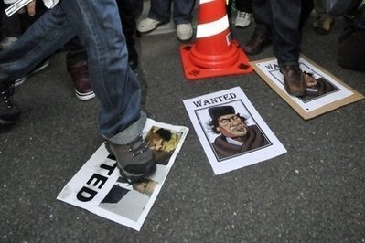

Slide 42
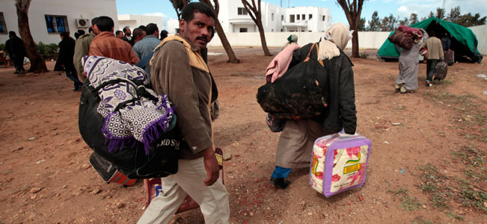
Clampdown in Libyan capital as protests close in
Egyptian men working in Libya fleeing the country at the Tunisia-Libyan border.

Slide 43
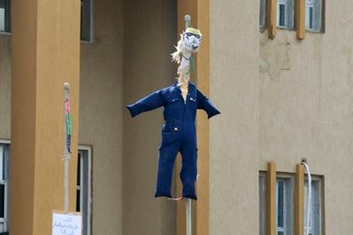
Effigy representing Libyan Leader Moammar Gadhafi

Slide 44
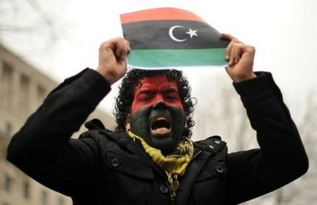
A demonstrator holding the former Libyan flag protests against Moamer Kadhafi's regime

Slide 45
No Fly Zone
March 18, 2011 – UN authorizes use of military force to protect civilians in Libya
US & allies (Arab League, Britain, France, etc.) establish no-fly zone. Bombers strike at Libyan air defenses and attack capabilities. They also tanks and attack equipment headed for rebel-held cities.
Some Arab League countries seem uncomfortable with the actions taken to establish a no-fly situation.

Slide 46
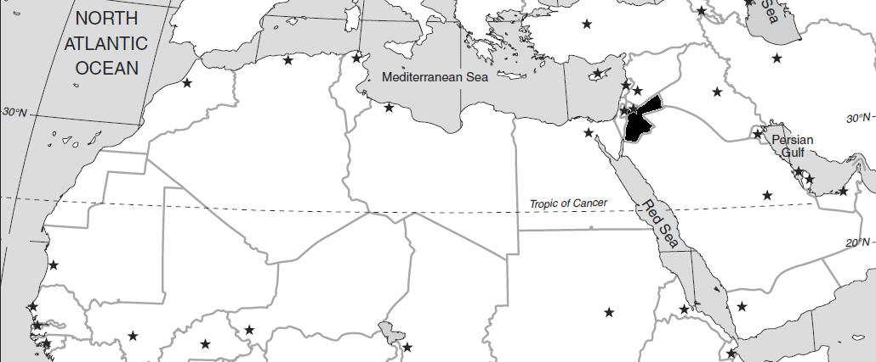
Jordan

Slide 47
The Situation
Jordan, the only Arab nation apart from Egypt that has made peace with Israel, seems a less likely candidate for fast change. King Abdullah II still has a fair degree of legitimacy in the eyes of important sectors of his public,
"We all know that Jordan is not Tunisia and it's not Egypt," says Nimer al-Assaf, deputy general secretary of the Islamic Action Front, the political wing of the Muslim Brotherhood. "Our regime here is not like any other regime in the Arab countries ... [it] has never been an aggressive or bloody regime at all." In recent discussions between Islamic party leaders and the king, he adds, the protests in Egypt and Tunisia didn't even come up.

Slide 48
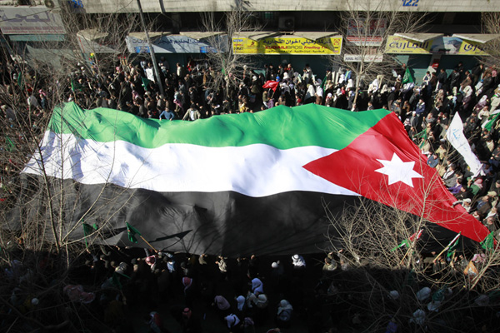

Slide 49
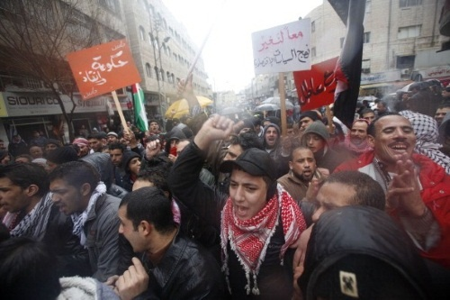

Slide 50
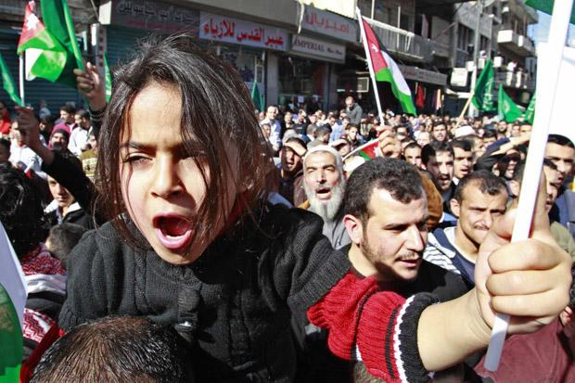

Slide 51
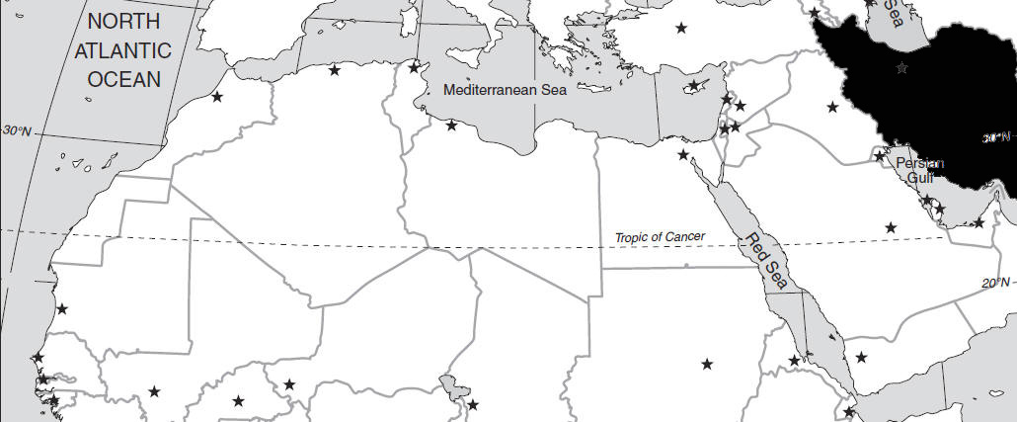
Iran

Slide 52
The Situation
TEHRAN, Iran -- Clashes between Iranian police and hundreds of thousands of protesters wracked central Tehran on Monday as security forces beat and fired tear gas at opposition supporters hoping to evoke Egypt's recent popular uprising.

Slide 53
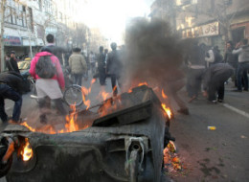

Slide 54
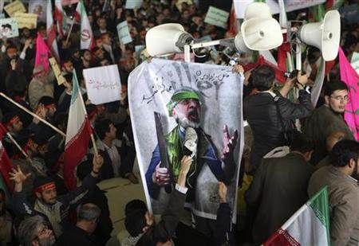

Slide 55
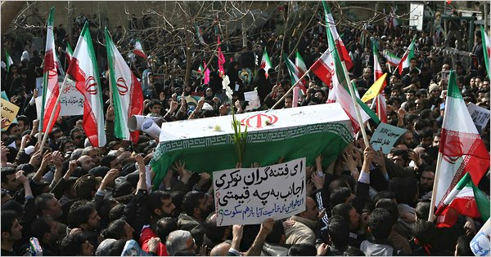

Slide 56
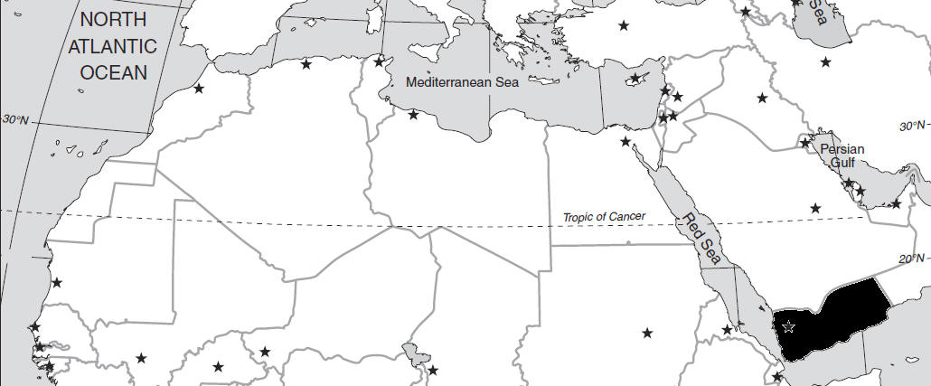
Yemen

Slide 57
The Situation
In Yemen, the region's poorest country that lacks a unified political opposition, protests have remained small although they've taken on a harsher antigovernment tone since Mubarak's ouster. The use of social-networking websites that were so crucial to starting protests in Egypt and Tunisia is limited, and the young student protesters have yet to connect with the general population.

Slide 58
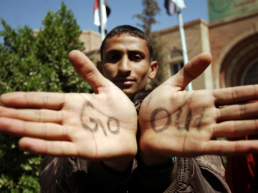

Slide 59
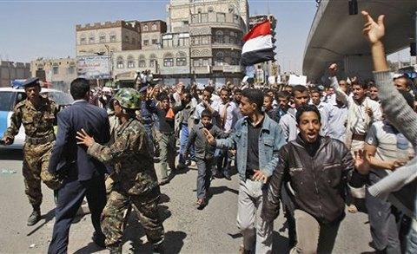

Slide 60
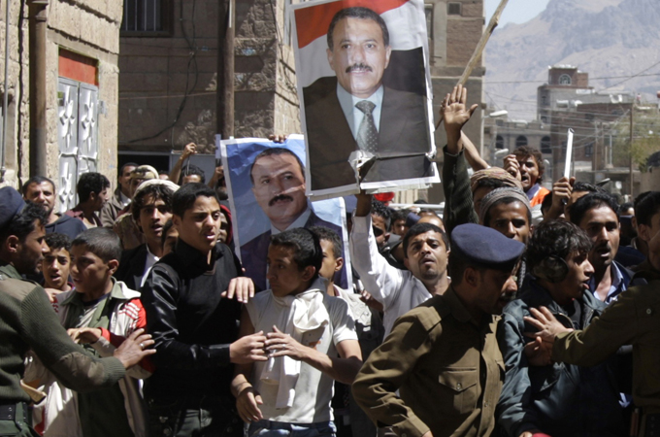
/

Slide 61
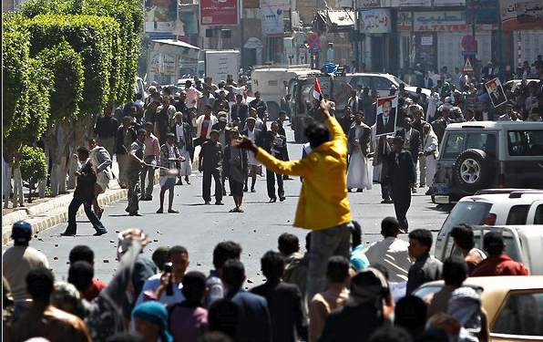
2/19/2011
In Yemen, antigovernment protesters clashed with government supporters in Sana, the capital.

Slide 62
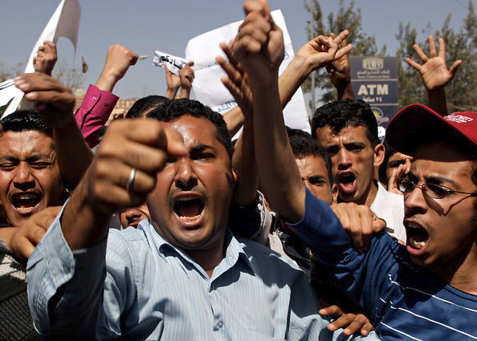

Slide 63
Some high military leaders have taken the side of the protesters
President refuses to step down until Jan. 1, 2012 and he wants to know who will succeed him before he steps down.
Protesters want the president to resign immediately – they now have the backing of some of the military. The situation is very tense.

Slide 64
Additional tensions
Kuwait
Djibouti

Slide 65
Kuwait 2/20/2011
Protesters in Kuwait clashed with security forces on Saturday, the second-straight day of unrest in the nation, CNN reported.
The demonstration occurred in Sulaibiya, just north of Kuwait City, witnesses and a government official said. Hundreds of protesters demanding greater rights for longtime residents who are not citizens of the country demanded the release of people arrested in demonstrations Friday.

Slide 66
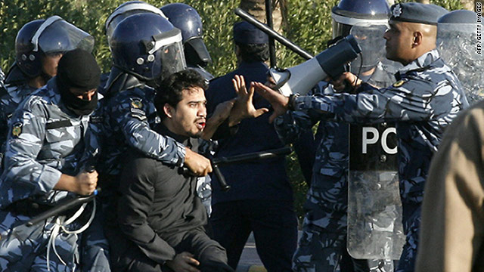

Slide 67
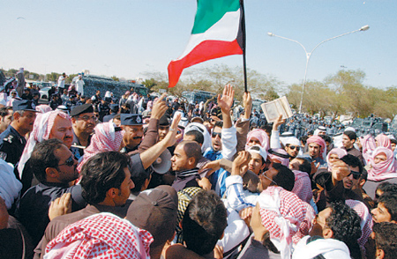
20 hurt in the protest

Slide 68
Djibouti 2/20/2011
Authorities in Djibouti have detained three top opposition leaders a day after protesters demanded the departure of President Ismail Omar Guelleh. Djibouti's chief prosecutor, Djama Souleiman, said Aden Robleh, Mohamed Daoud and Ismail Guedi were taken into custody Saturday.
Souleiman told AFP the three were detained in connection with violent clashes Friday between protesters and security forces.

Slide 69
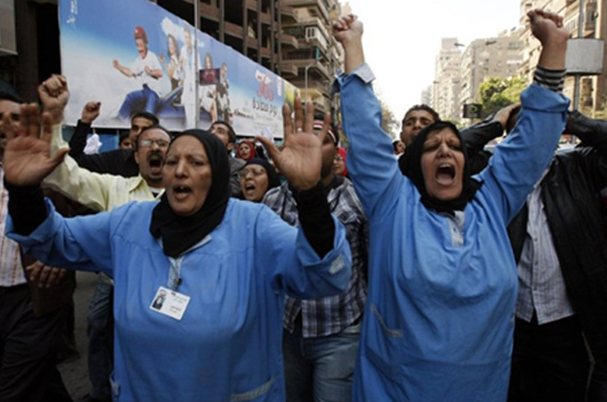

Slide 70


Slide 71

Unrest Encircles Saudis, Stoking Sense of Unease
As pro-democracy uprisings spread across the Middle East, the rulers of Saudi Arabia — the region’s great bulwark of religious and political conservatism — are feeling increasingly isolated and concerned that the United States may no longer be a reliable backer, officials and diplomats say.

Slide 72
Saudi Arabia is far less vulnerable to democracy movements than other countries in the region, thanks to its vast oil wealth, its powerful religious establishment and the popularity of its king.

