Slide 1
The Morning Glory Cloud Formation
Pictures From Australia

Slide 2
The Morning Glory
The Morning Glory is a very rare meteorological phenomenon. It can be observed in Northern Australia's Gulf of Carpentaria. A Morning Glory cloud is a roll cloud that can be up to 620 miles (1000 kilometers) long, 0.5 to 1.2 miles (1 to 2 kilometers) high, and can move at speeds up to 37 mph (60 km/h). Enjoy the beautiful photos.

Slide 3
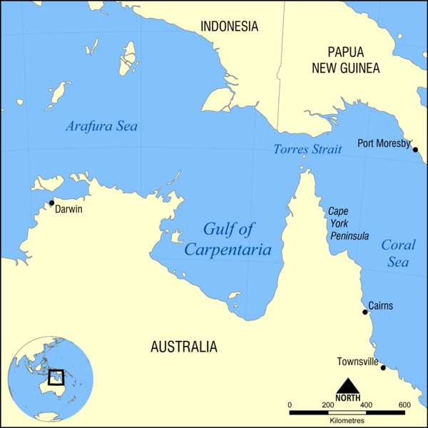

Slide 4
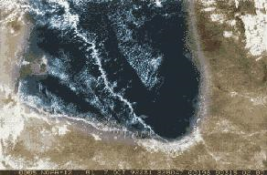
Satellite photo of a Morning Glory cloud over the Gulf of Carpentaria

Slide 5
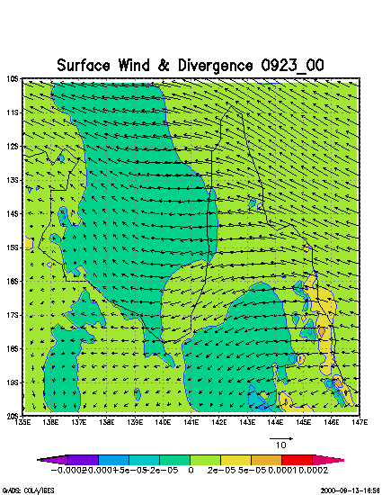

Slide 6
Causes
Despite being studied extensively, the Morning Glory cloud is not clearly understood. Regardless of the complexity behind the nature of this atmospheric phenomenon, some conclusions have been made about its causes. Through research, one of the main causes of most Morning Glory occurrences is due to the mesoscale circulations associated with sea breezes that develop over the peninsula and the gulf. On the large scale, Morning Glories are usually associated with frontal systems crossing central Australia and high pressure in northern Australia. Locals have noted that the Morning Glory is likely to occur when the humidity in the area is high, which provides moisture for the cloud to form, and when strong sea breezes have blown the preceding day.

Slide 7
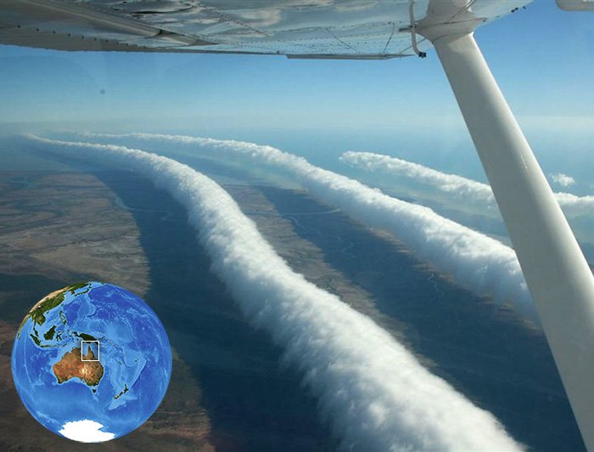

Slide 8
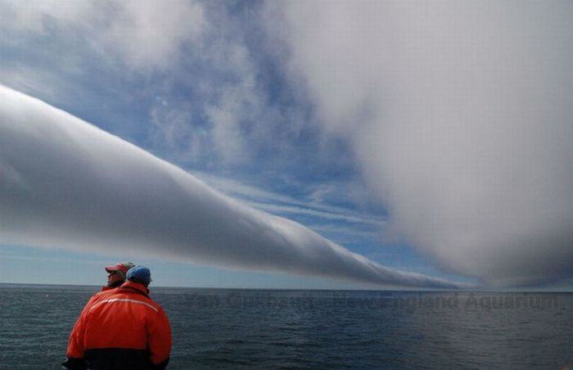

Slide 9
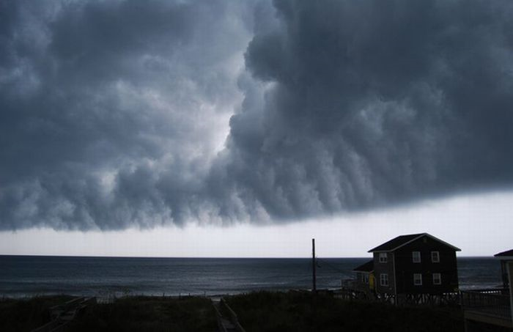

Slide 10
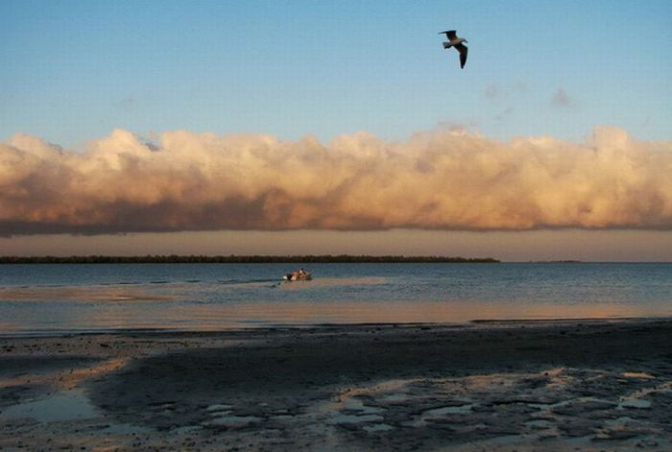

Slide 11
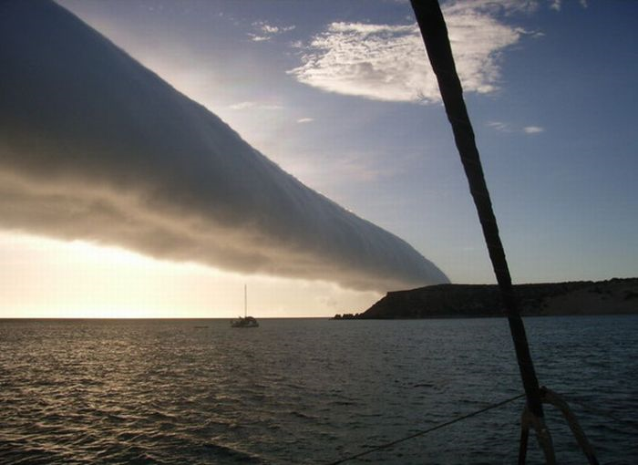

Slide 12
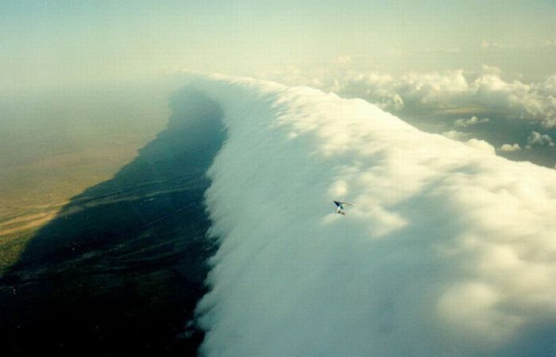

Slide 13
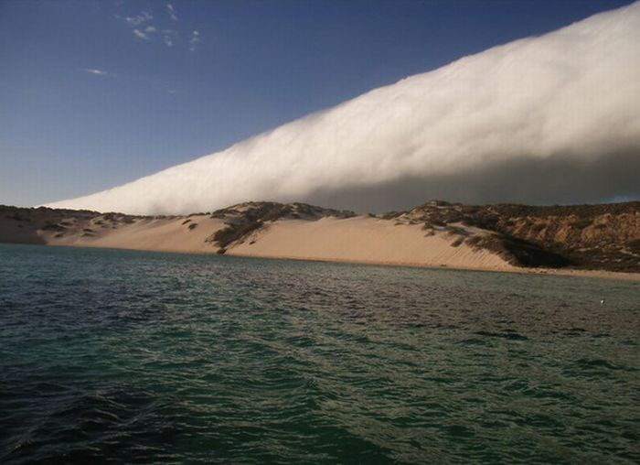

Slide 14
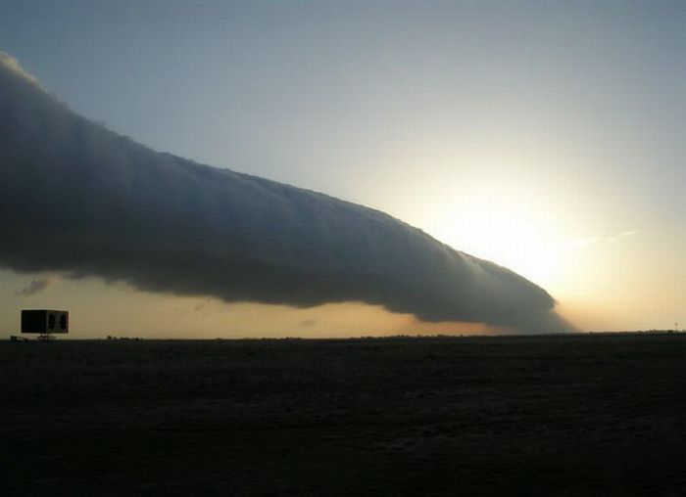

Slide 15
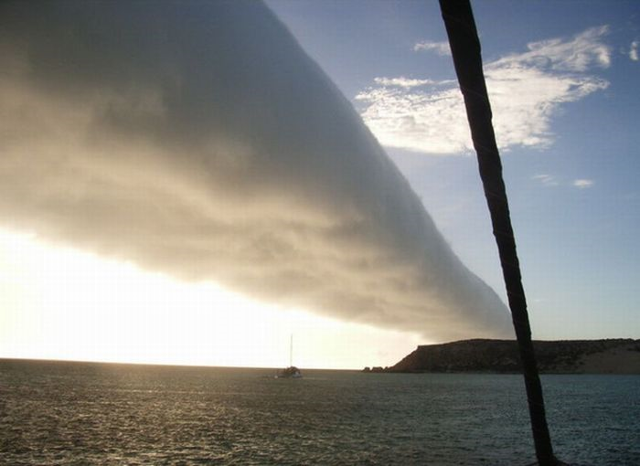

Slide 16
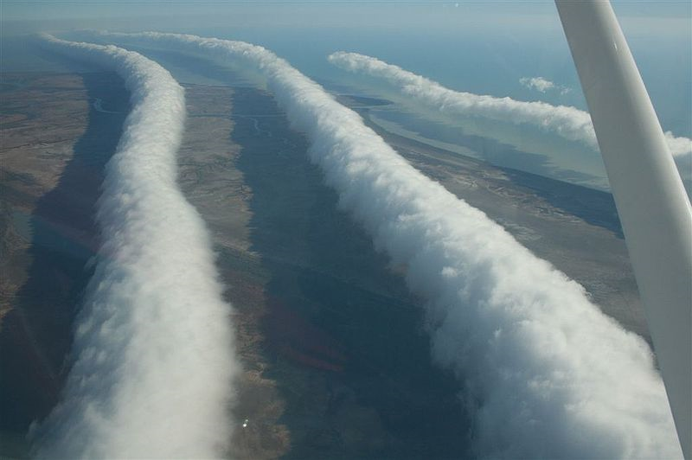

Slide 17
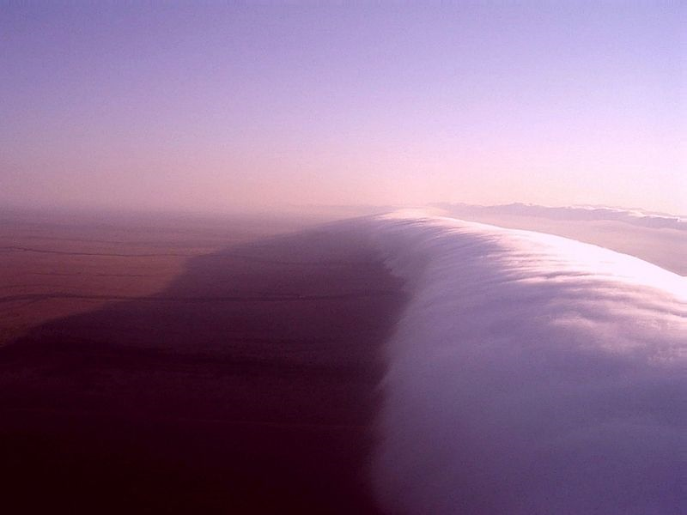

Slide 18

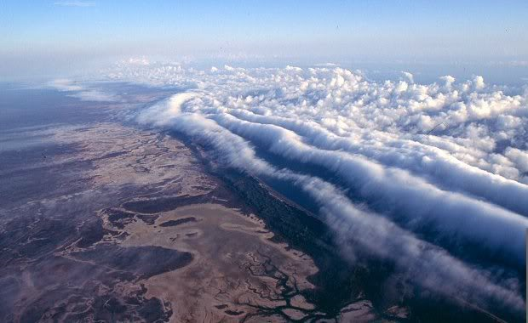

Slide 19
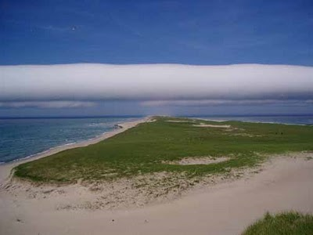
Morning glory clouds have also been documented elsewhere, like the following in Sable Island, Canada, which, funnily enough, is itself shaped like a wave:

Slide 20
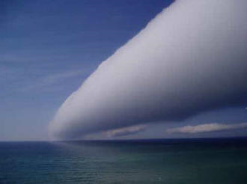

Slide 21
