Slide 1
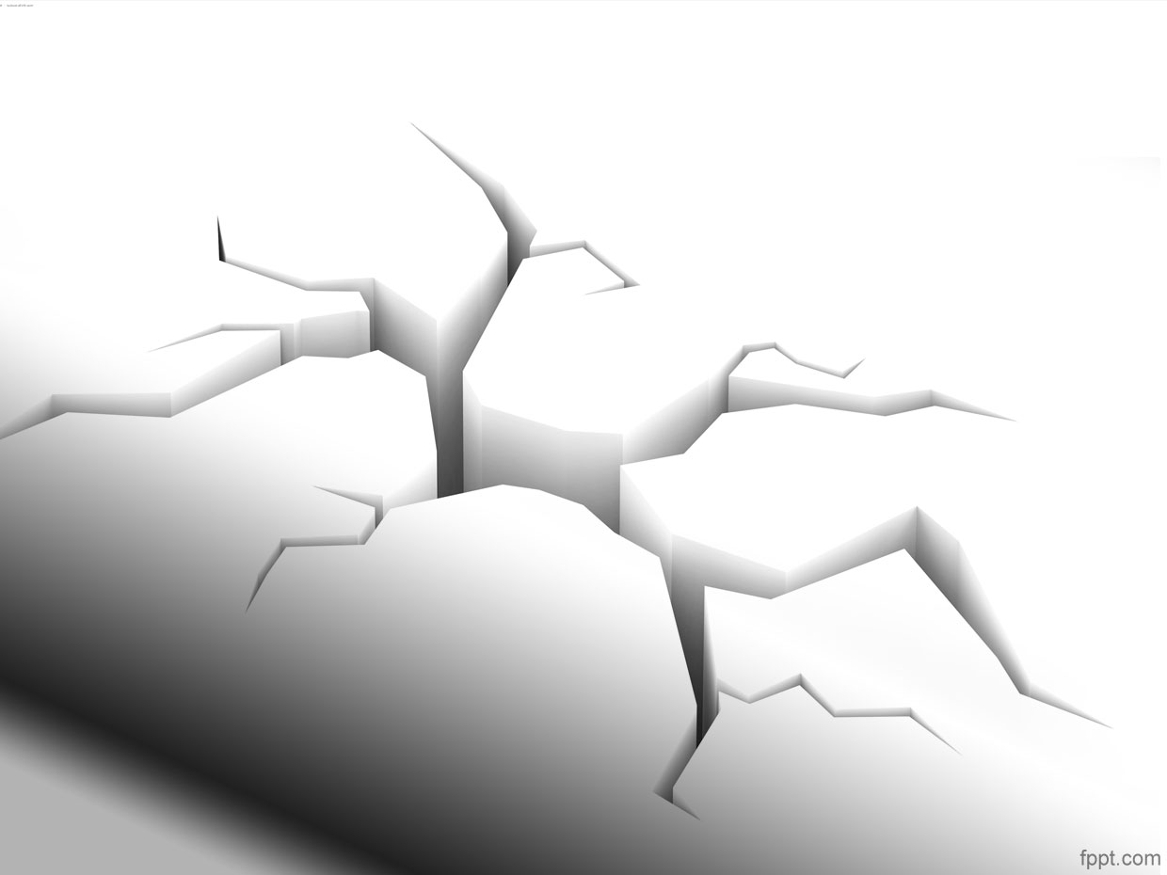
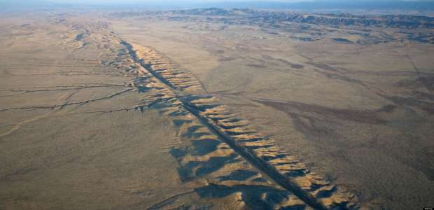
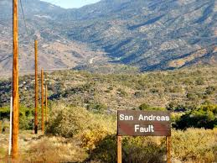
San Andreas Fault
The Gorgeous San Andreas Fault
By Linda & Dr. Dick Buscher
June 27, 2014

Slide 2
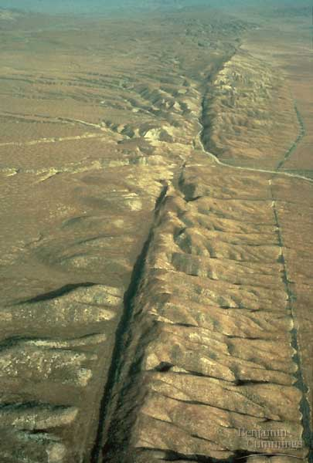
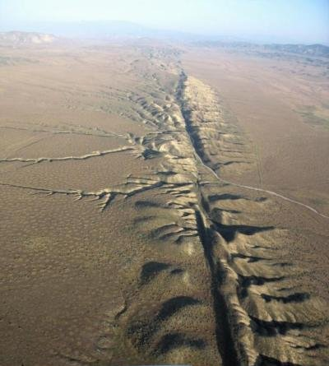

Slide 3
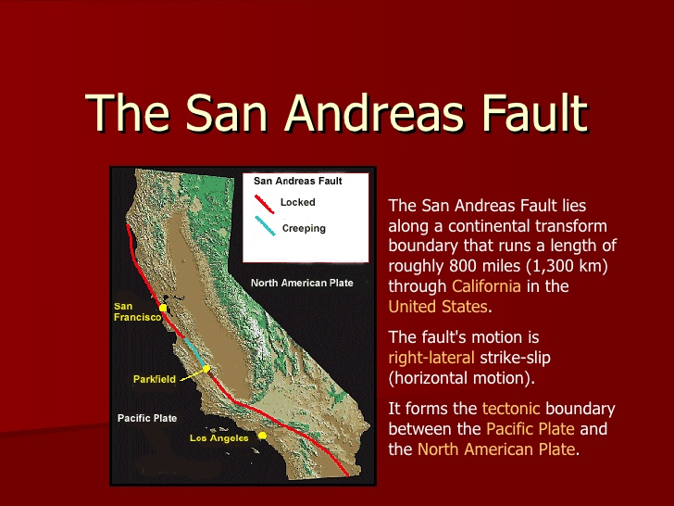

Slide 4
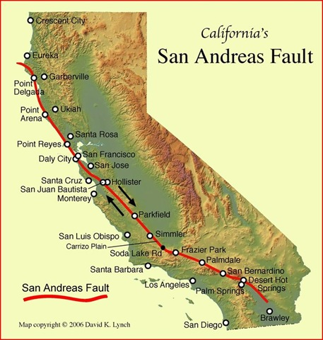

Slide 5
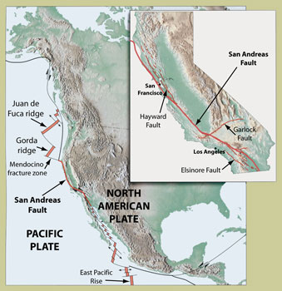

Slide 6
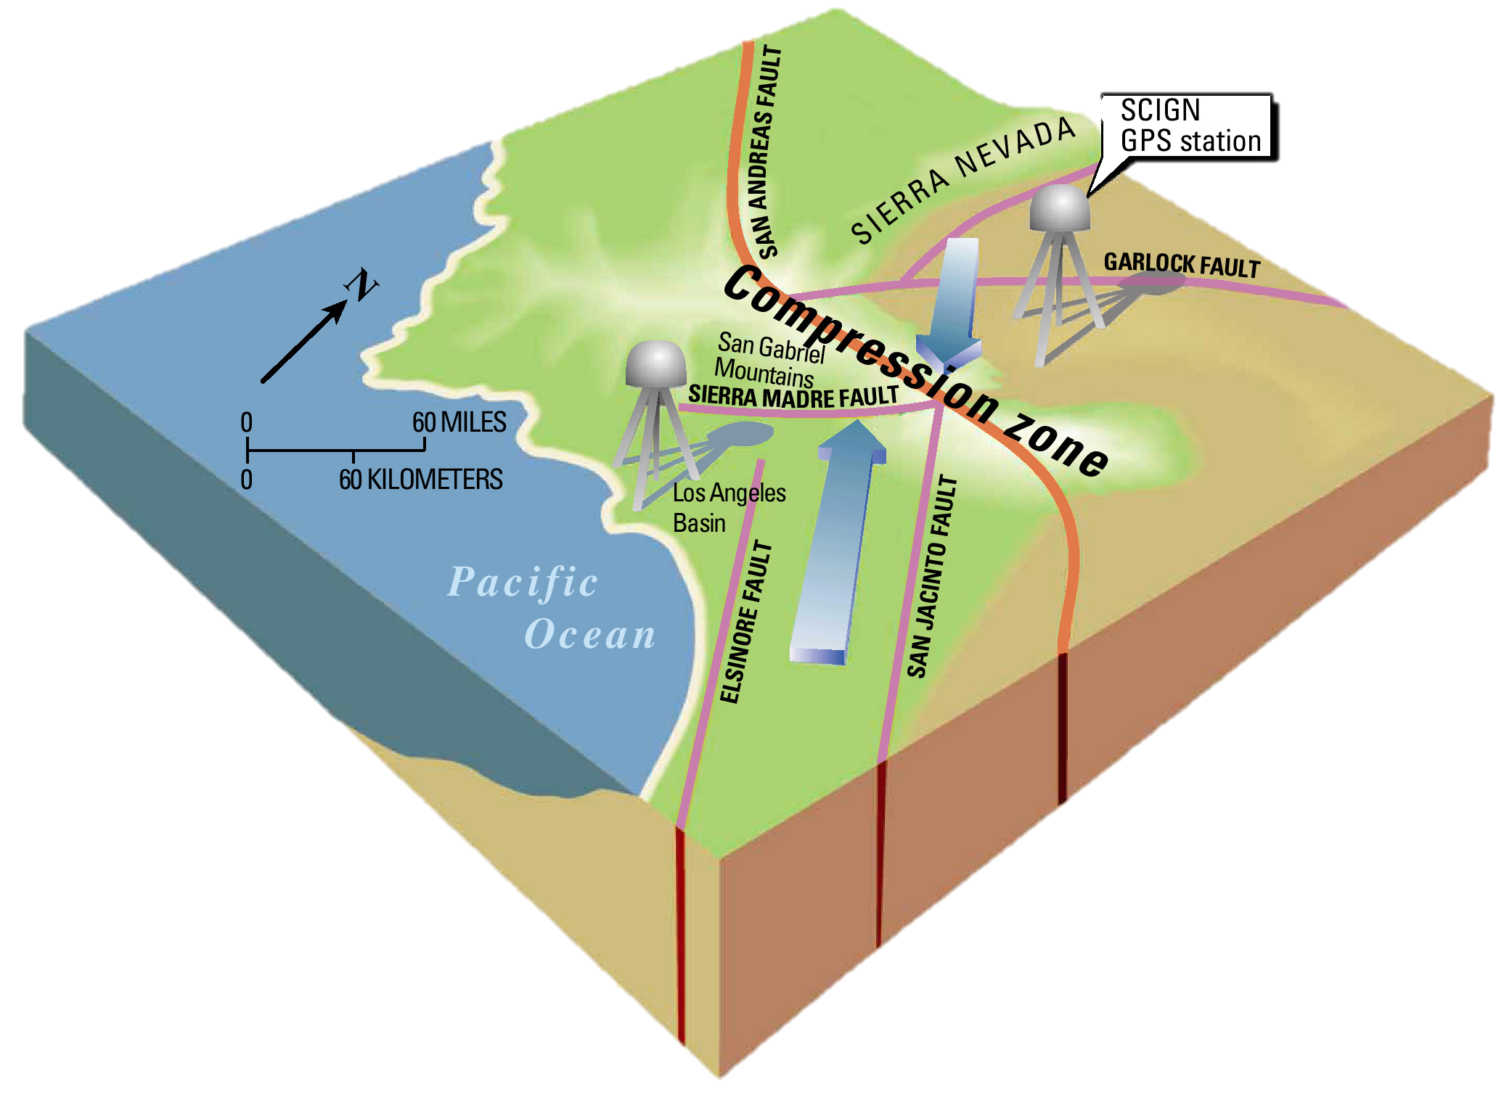

Slide 7
San Andreas Fault
The San Andreas Fault is the most famous fault in the world. In the Colorado Desert of Southern California it begins near the Salton Sea and expresses itself in parts of the Coachella Valley by a range of small mountains, known as the Indio Hills that are fractured and run in various directions as a result of the collision of the Pacific and North American Continental Plates.

Slide 8
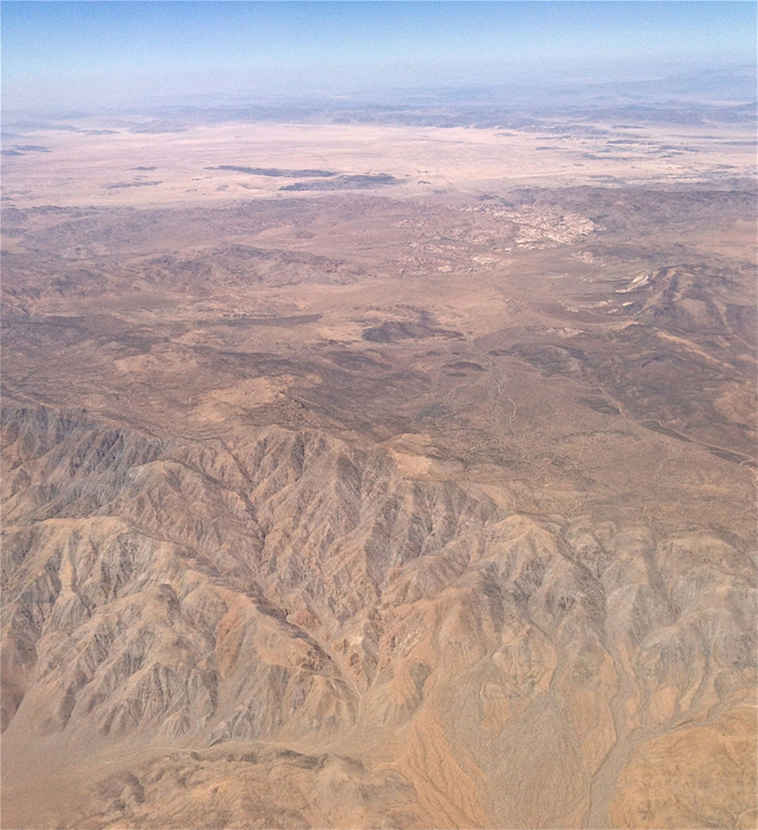

Slide 9
Great tectonic forces
The Indio Hills represent a fault zone that displays the visual evidence of the great tectonic forces that have been at work in this area for some 28 million years. The Indio Hills Fault Zone, which lies just north of Interstate Highway-10, has a width in this area of the Coachella Valley of about 1.5 miles (2.4 kilometers).

Slide 10
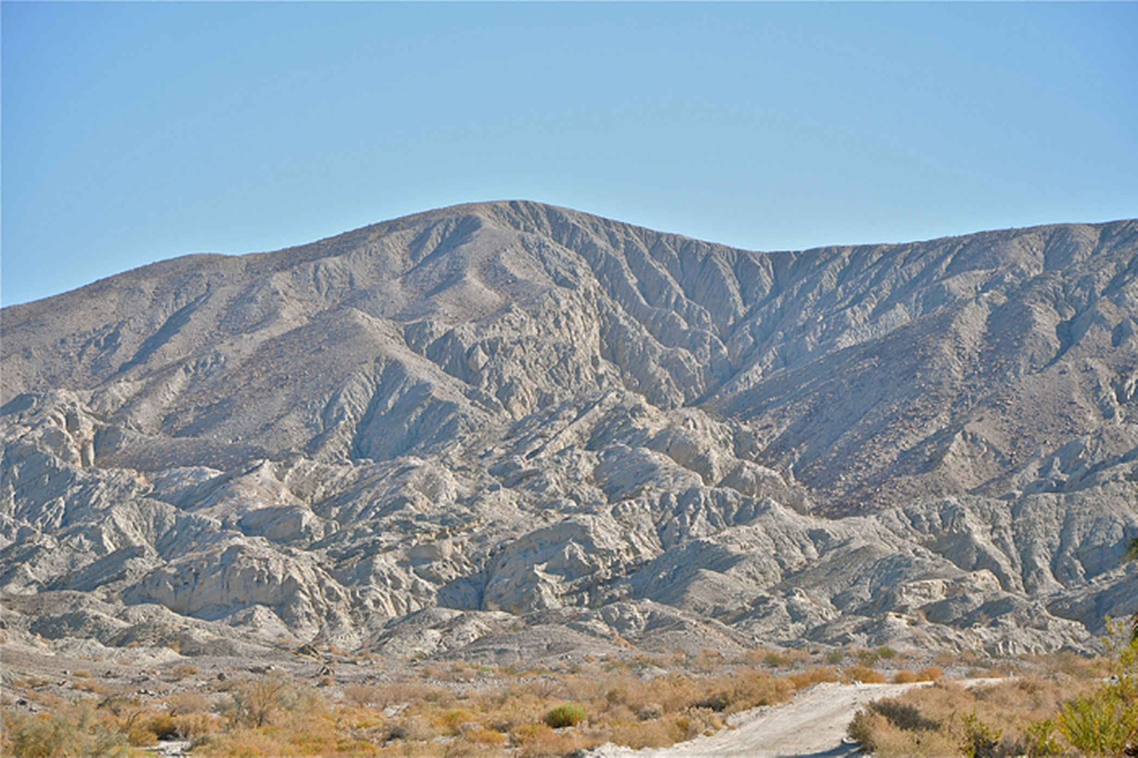

Slide 11
Desert oases
Fissures found here were created from the colliding continental plates and have allowed an easy route for the deep, underground water to seep to the surface along the southern edge of this fault zone. With groundwater readily available, an extensive green belt of natural, desert oases are found running along the side of this rugged, Indio Hills' terrain.

Slide 12
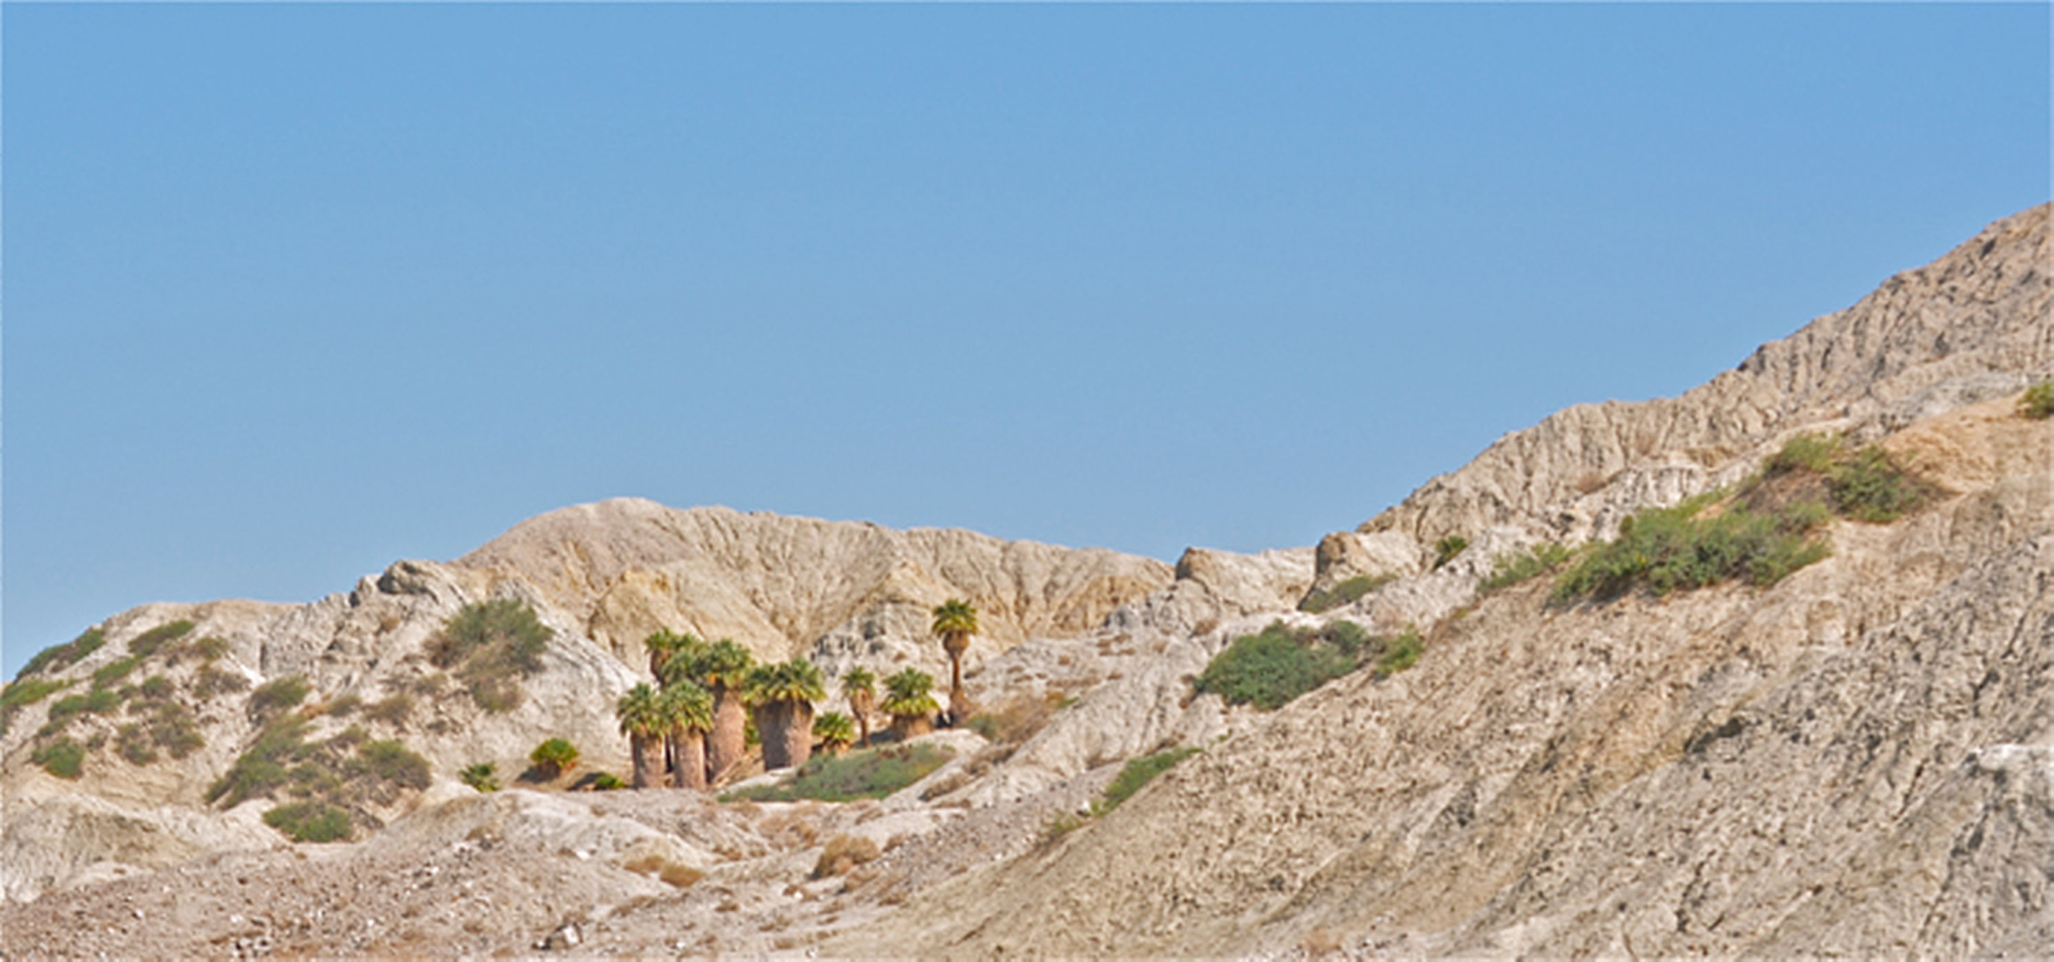

Slide 13
Fan palms
There are 24 identified oases found along the 800 miles (1,290 km) of the San Andreas Fault. Eleven of these oases are found in the Indio Hills Fault Zone and are home today to over one-fourth of the known indigenous California fan palms, Wahingtonia filifera. This species of palm dates back to the mid-Cenozoic Era, a time when they were found along the Pacific Coast as far north as present day Oregon. The permanent water supply along the fault line allows for their continual growth today in this dry Colorado Desert environment.

Slide 14
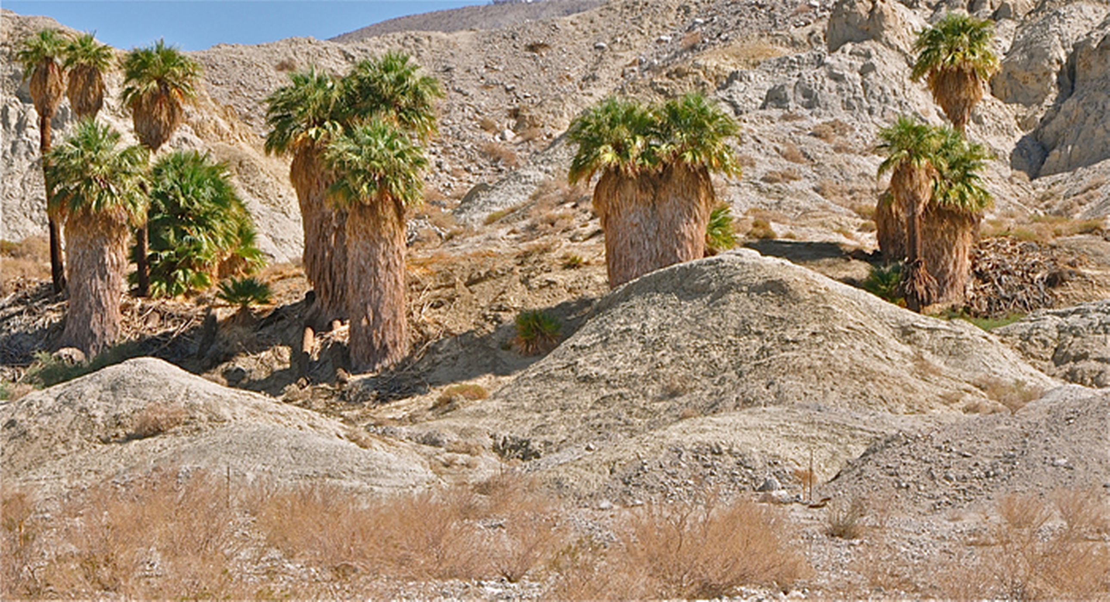

Slide 15
Twists and turns
From its beginning near the Salton Sea to its ending near Eureka, California, the San Andreas Fault runs in a generally northwest direction for, as a crow flies, some 700 miles (1,130 km). But this famous fault does not run in a straight line. In fact here in the Indio Hills area, the San Andreas Fault runs in a nearly direct east/west line. When accounting for all the twists and turns along its entire length, the San Andreas Fault is nearly 800 miles long. The east/west alignment in the Indio Hills also results in a more violent collision of the two continental plates, which is expressed here in rocks being thrust upward at extreme angles.

Slide 16
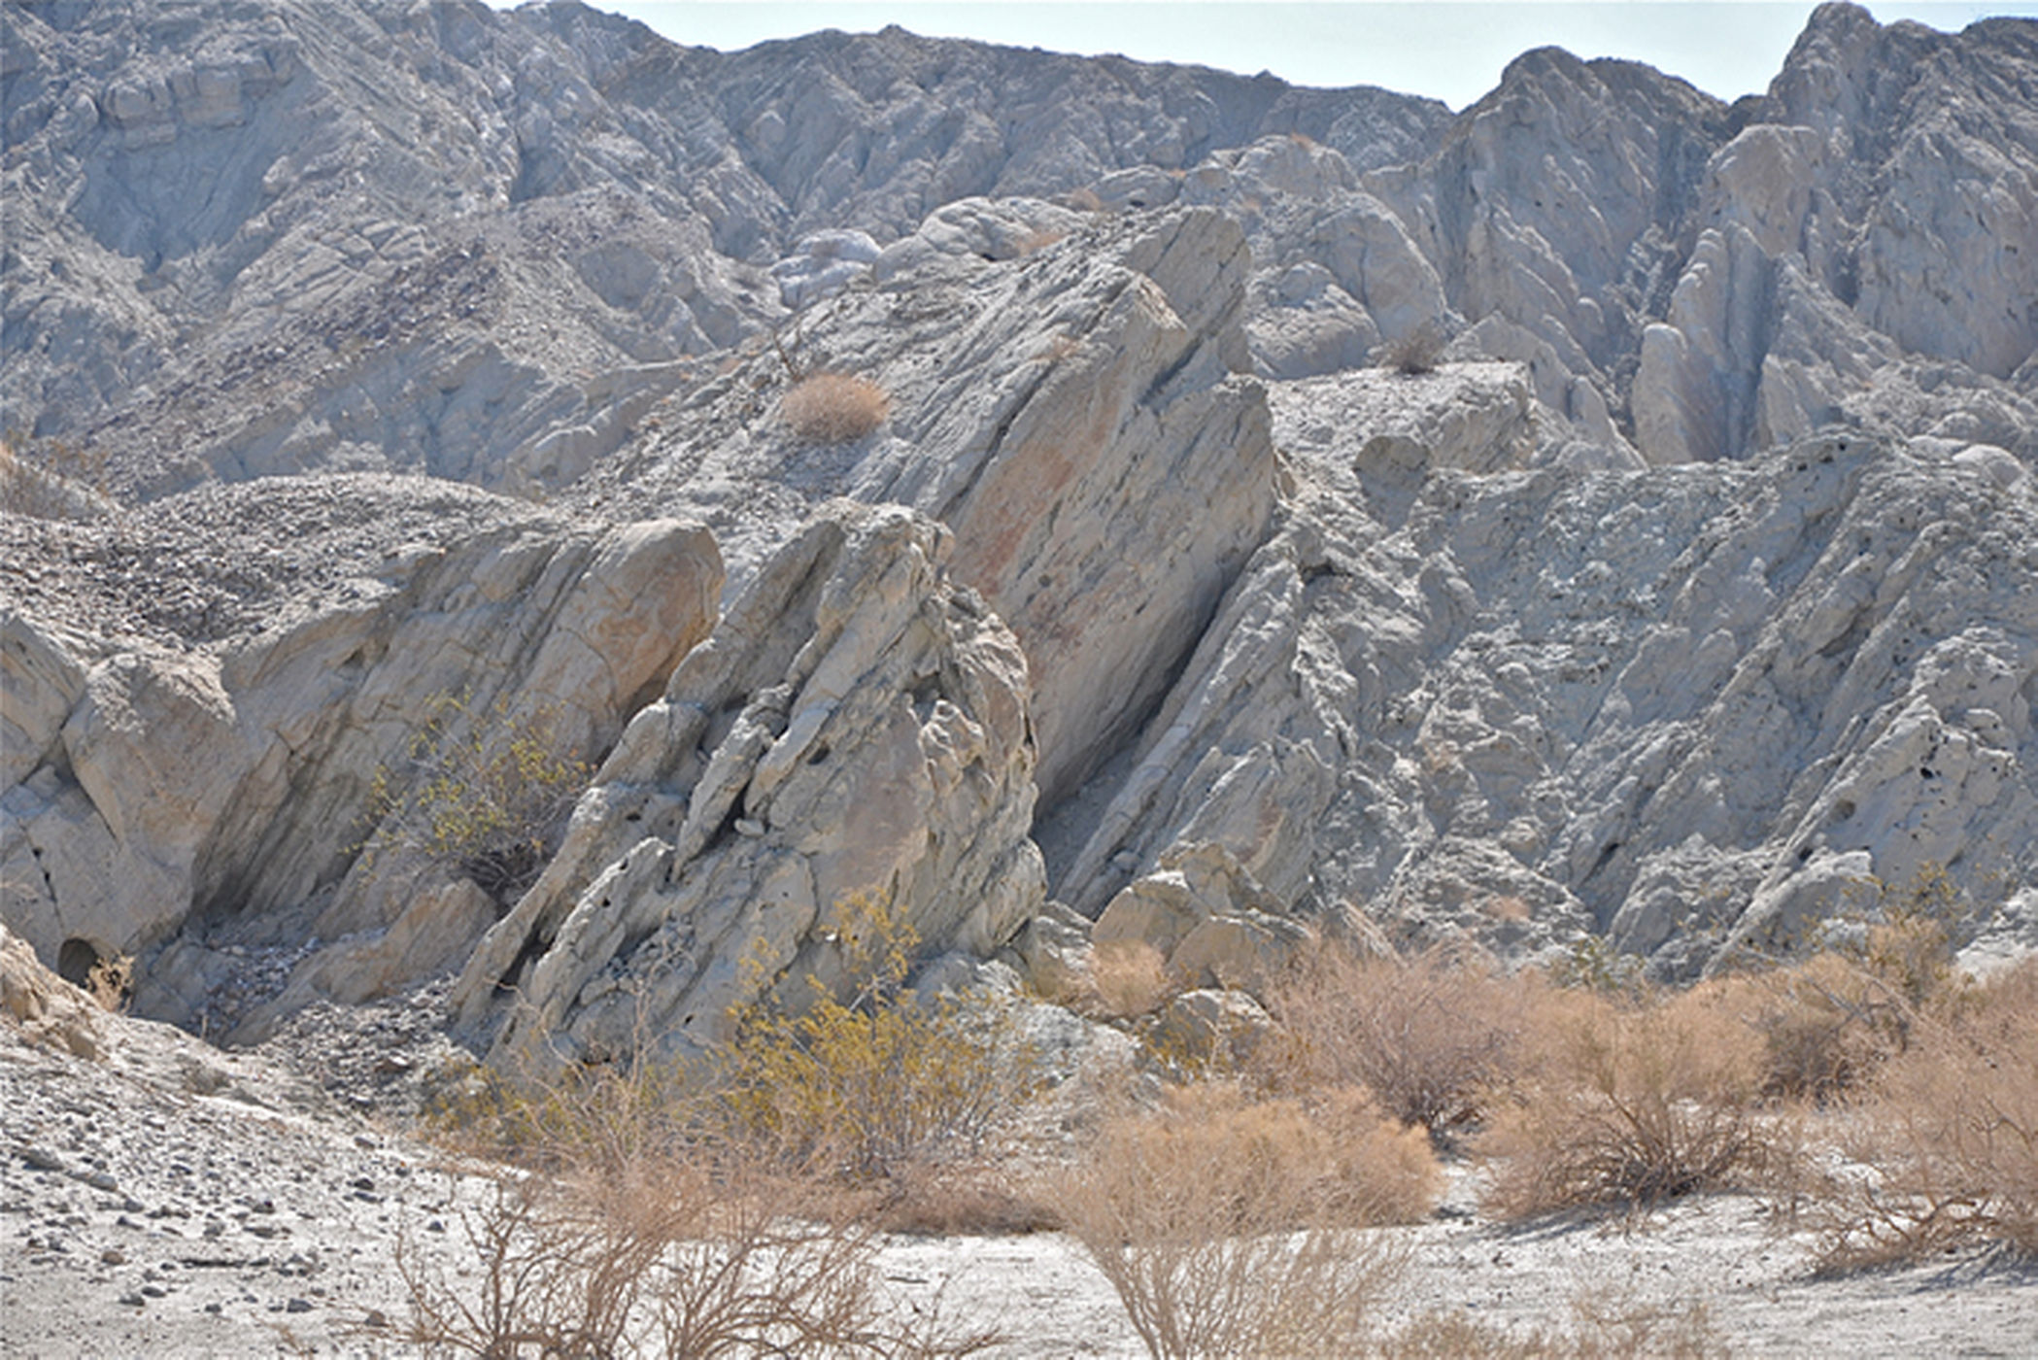

Slide 17
Linear valleys
The San Andreas Fault cuts some 20 miles (32 km) deep from the Earth’s crust into the viscous rock material found in the outer mantle. Geologist Andrew Lawson, who recognized how a remarkably arranged set of valleys near San Francisco, California, seemed to align in an almost straight line, named it in 1895. The San Andreas Lake, which was named by the Spanish missionaries in 1774, was found in one of those valleys, and Lawson applied that name to the entire geological fault he believed to be running underground.

Slide 18
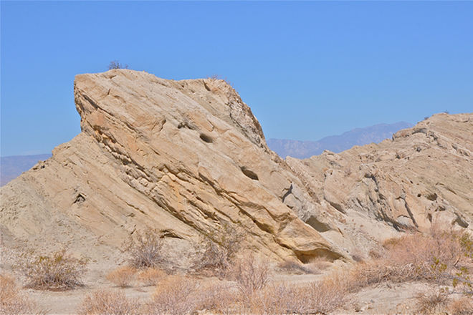

Slide 19
Wind caves and arches
Within the Indio Hills Fault Zone, a wide variety of rocks and sediments make up the stark landscape. Common metamorphic rocks found within the fault zone include granite, mica-schist, amphibolite and migmatitic paragneiss. Common sedimentary rocks include recrystallized limestone, conglomerate, shale, siltstone and sandstone. Volcanic intrusives are also common throughout the region. Eroded wind caves, windows and arches make for a diverse and geologically interesting land to explore.

Slide 20
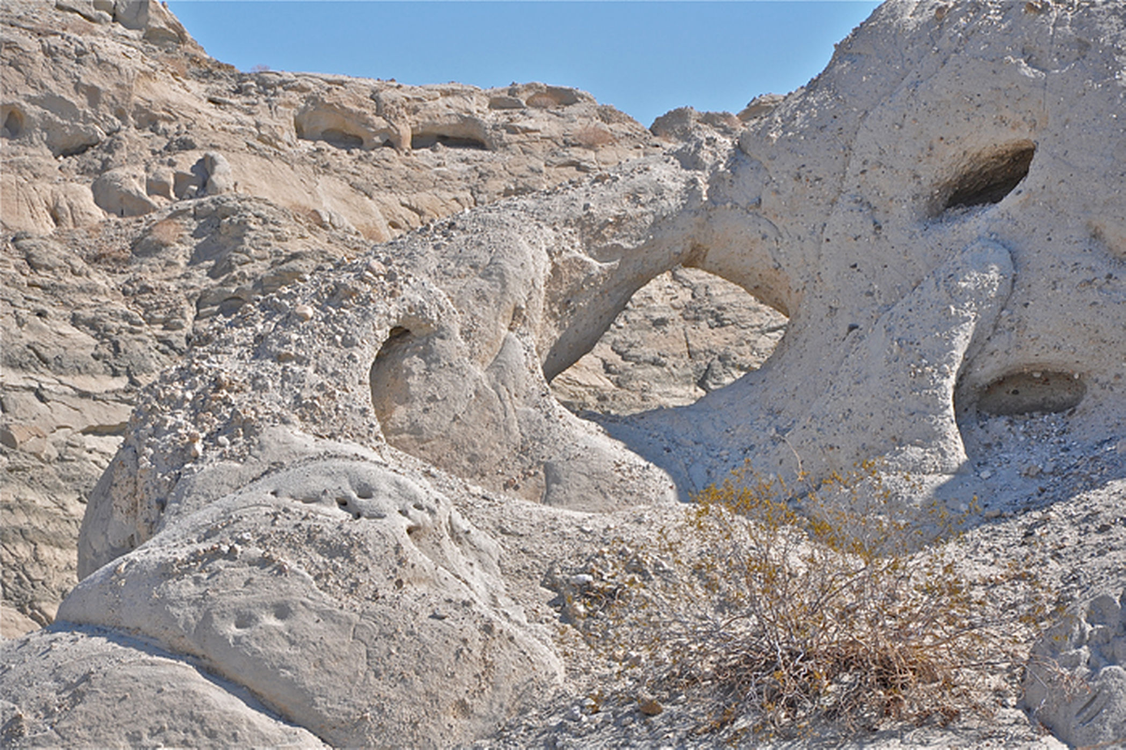

Slide 21
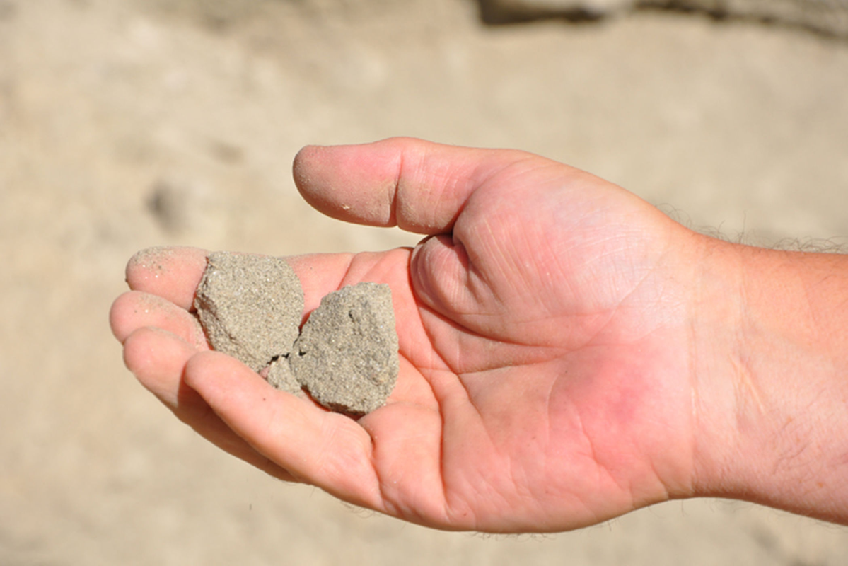
Friction makes a gouge
Fault gouge is common within the Indio Hills fault zone. Fault gouge is a geological term for the ground-up and crushed rock produced by friction when two sides of a fault line move.

Slide 22
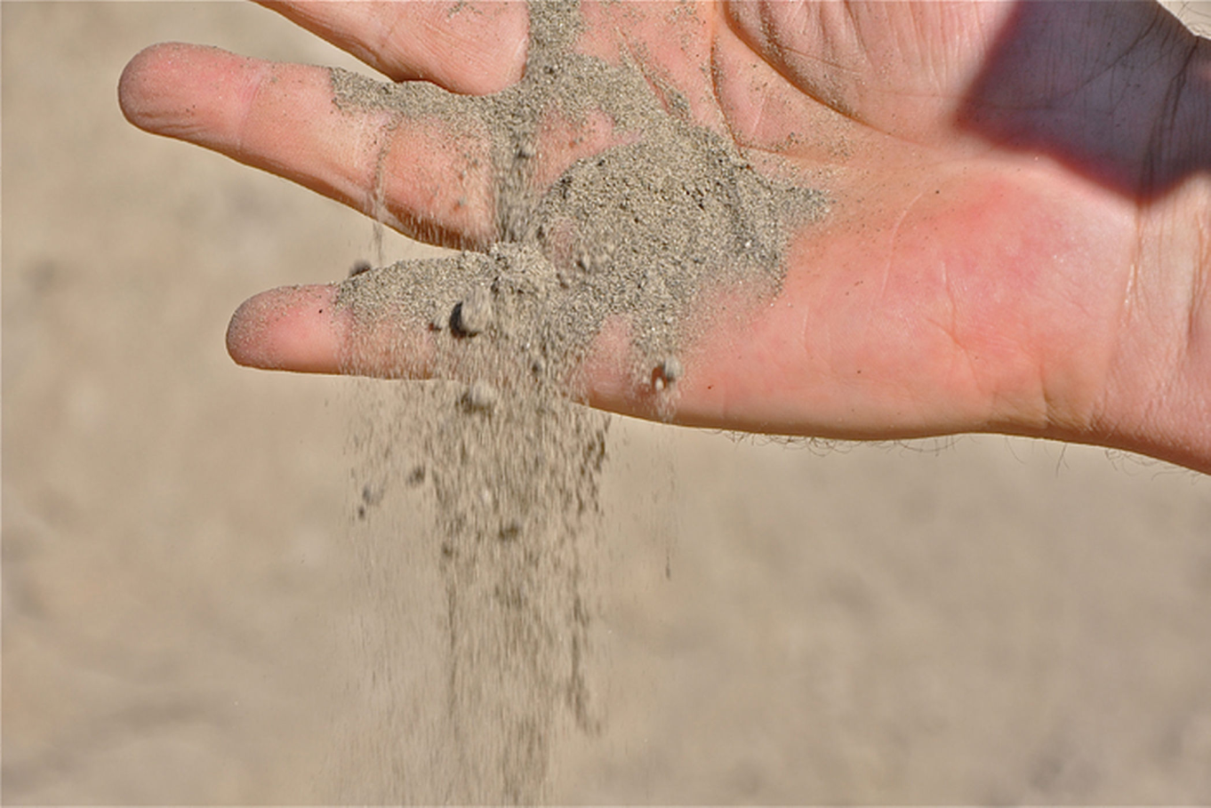
Crumbling
Fault gouge is an unconsolidated type of rock that can be easily crumbled into very small and fine grains.

Slide 23
Slot canyons
Slot Canyons are found throughout the Indio Hills Fault Zone. Some slot canyons create narrow trails that twist and turn for nearly a mile through the stark and barren landscape of the fault zone. Local lore suggests that when a hiker passes through one of these narrow canyons, one hand can actually rest upon the Pacific Plate while the other hand can rest on the North American Plate.

Slide 24
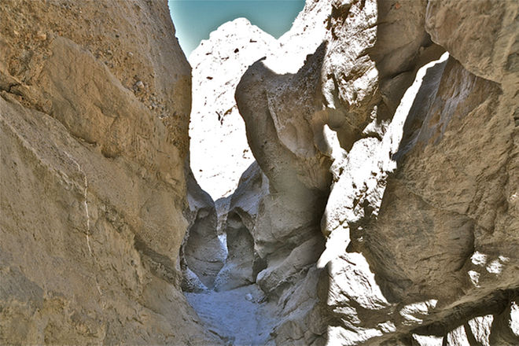

Slide 25
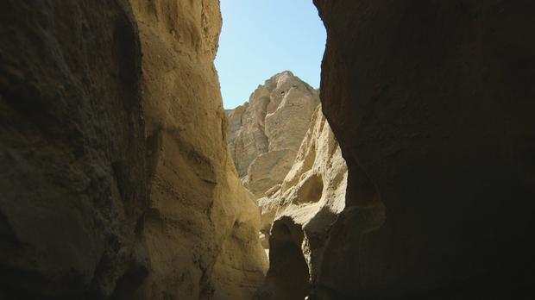

Slide 26
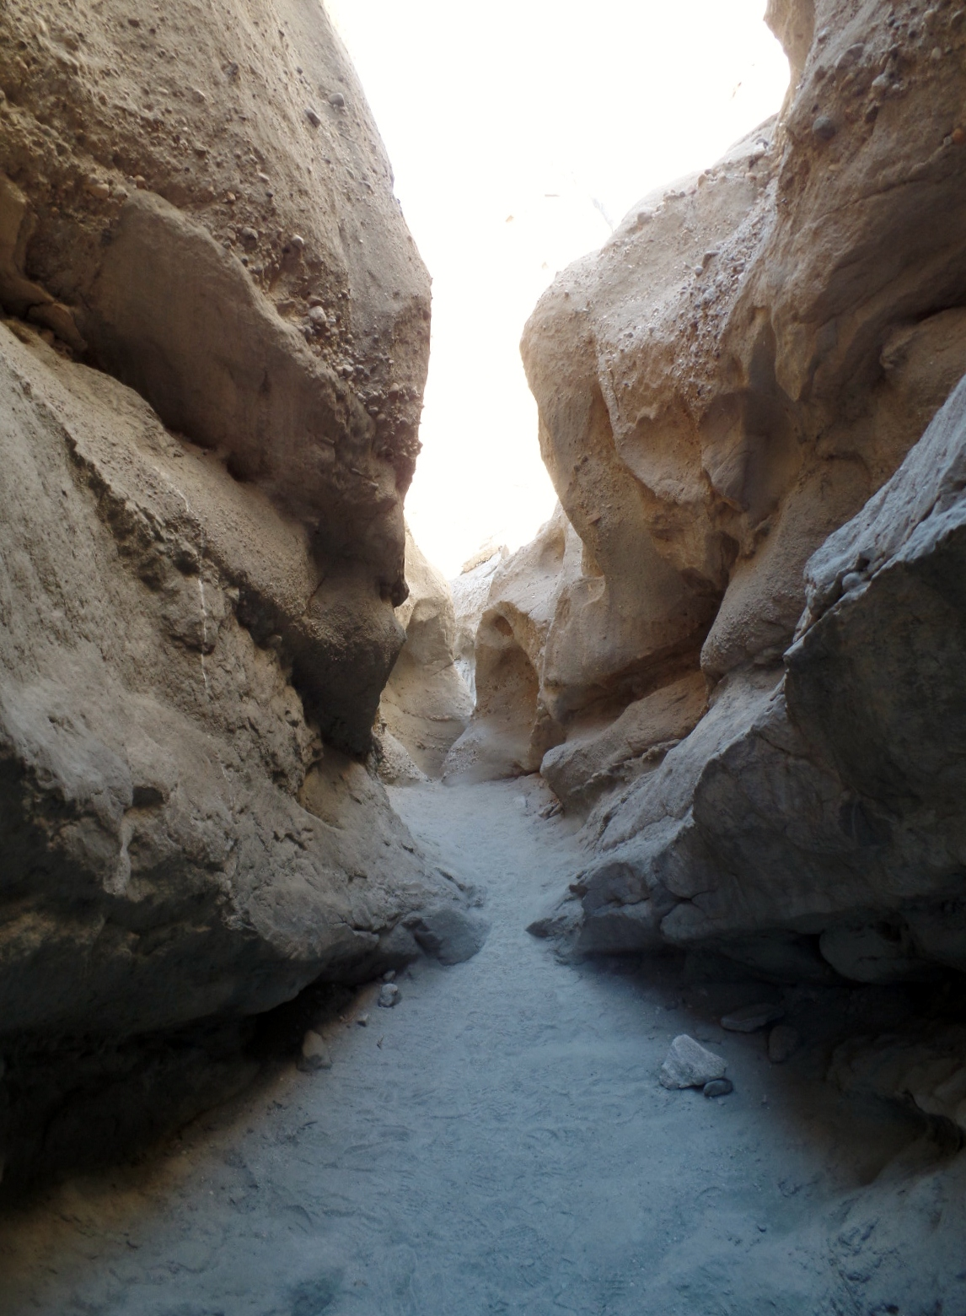

Slide 27
Cheesebush
Even in the extreme dryness of the Colorado Desert, life is found in the Indio Hills Fault Zone. Cheesebush, Hymenoclea salsola, is a common green plant that has adapted well to this dry, low desert region. The plant is so named because of the distinctive odor of cheese that emits from its stems and leaves. It is a member of the daisy family and is also known by the common names white burrobush and desert pearl.

Slide 28
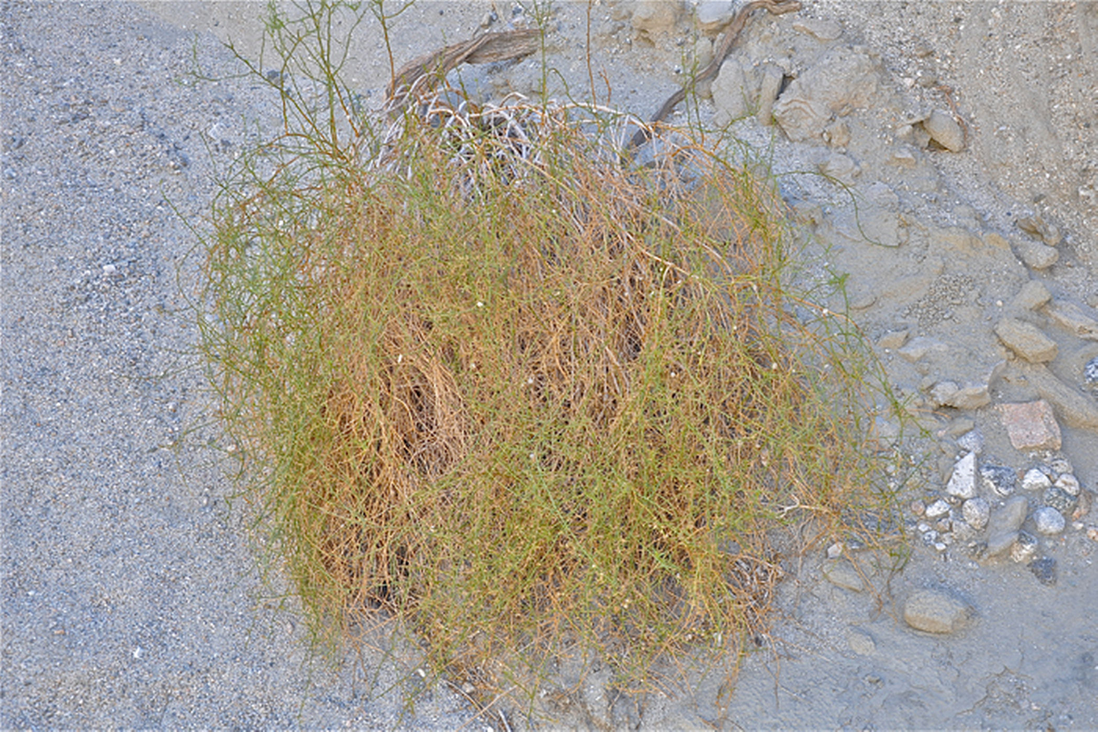

Slide 29
Milky secretions
Desert Milkweed, Asclepias subulata, is also commonly found in the sandy washes throughout the fault zone. Desert milkweed is a perennial plant that can grow to a height of 3 to 5 feet (0.9 to 1.5 meters). When a stem is broken, it exudes milky latex that contains rubber. Various Native Americans used the desert milkweed as a medicinal plant. Other perennial desert plants such as creosote bush, Larrea tridentate, and brittlebush, Encelia farinose, are commonly found.

Slide 30
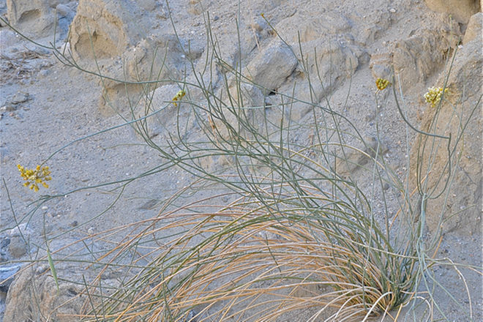

Slide 31
Struggling to survive
Two small Smoke Trees, Dalea spinosa, struggle to survive in an extremely dry wash of the Indio Hills Fault Zone. These perennial plants get their name from their golden, plumelike growth that can look like rising smoke from a distance. The trees tend to have small, crooked trunks with a scaly, gray-brown bark.

Slide 32
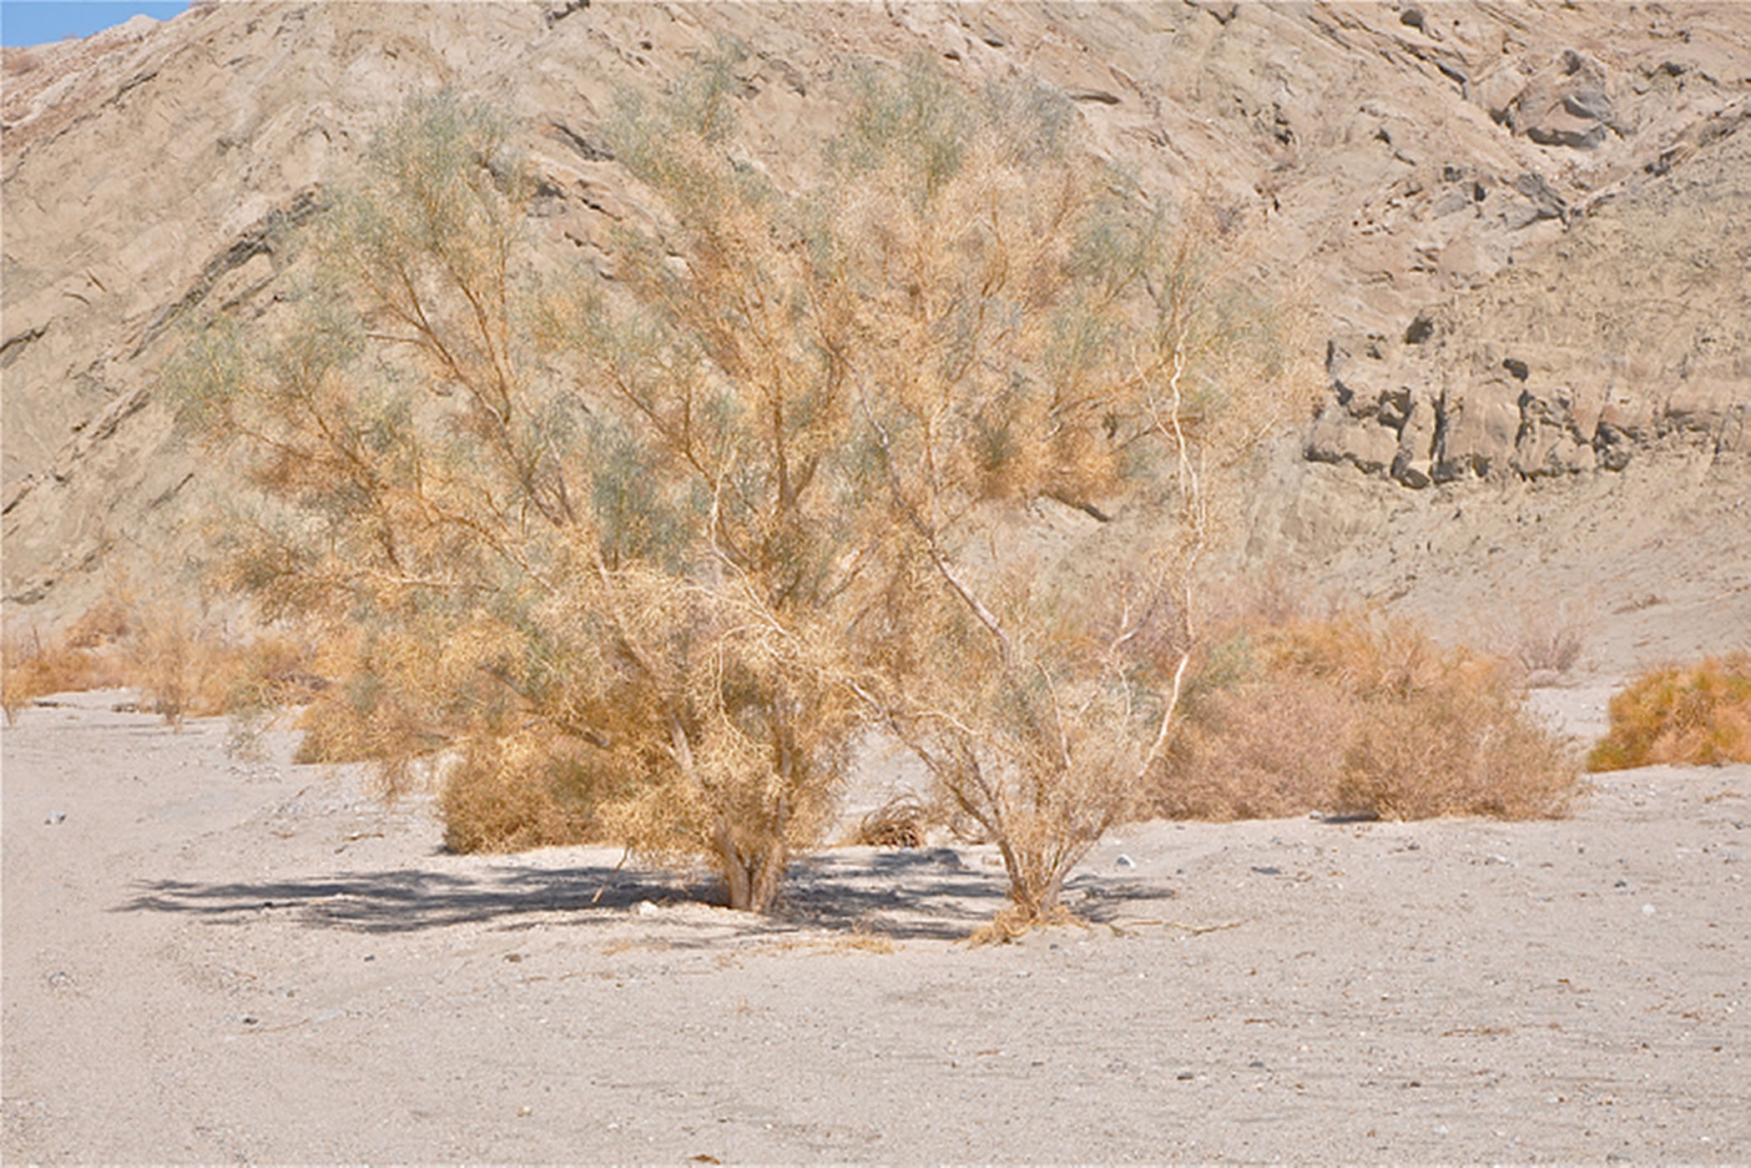

Slide 33
Spectacular blooms
Since the smoke tree is a member of the pea family, its late springtime bloom is quite spectacular. The flowers reach about one-half inch in size and are a rich purple or violet color. The flowers grow in 1.5–inch clusters along the leafless twigs. In this harsh, desert environment, the blooming smoke trees add an incredible contrast to the predominant brown-toned landscape in which they grow.

Slide 34
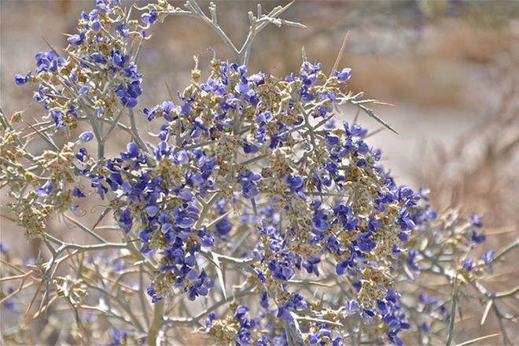

Slide 35
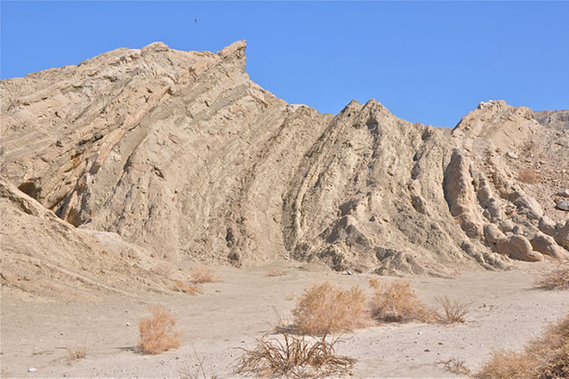
The Wave
Throughout the Indio Hills Fault Zone of the San Andreas Fault, bent and broken rocks create a unique and interesting landscape. Locals have given many of the features names like "The Wave" shown here.

Slide 36
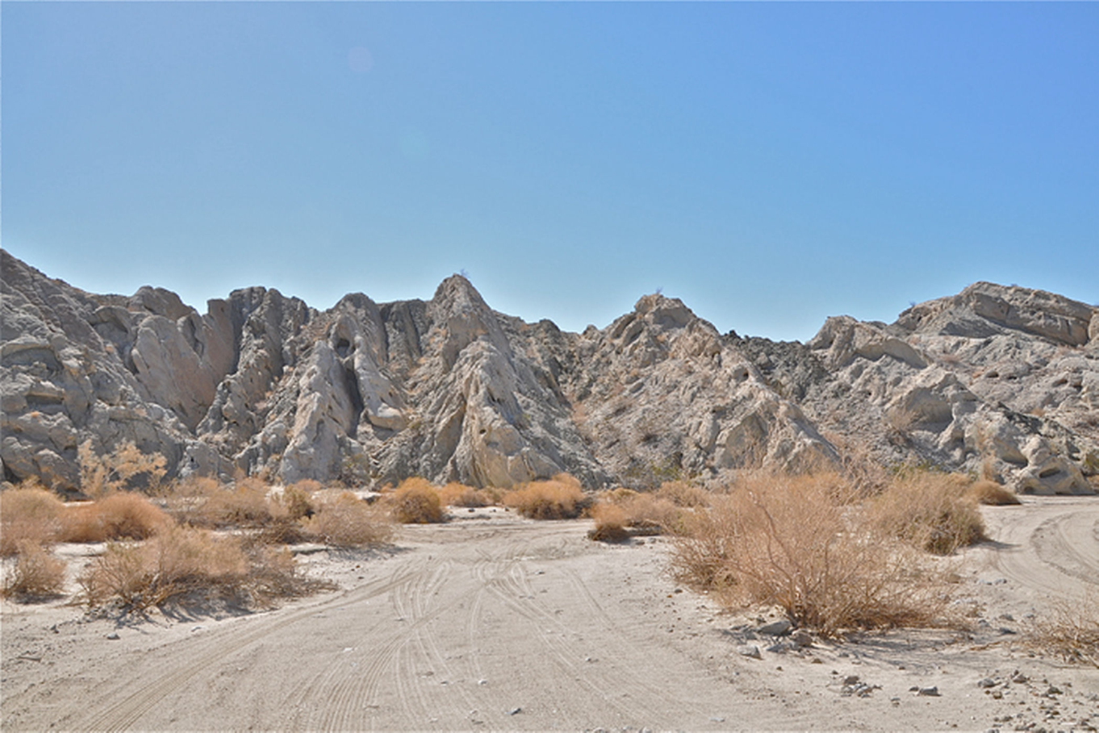
Mythical dragon
And here in the imagination of some, a mythical dragon's spiny back is formed by a series of uplifted ridges.

Slide 37
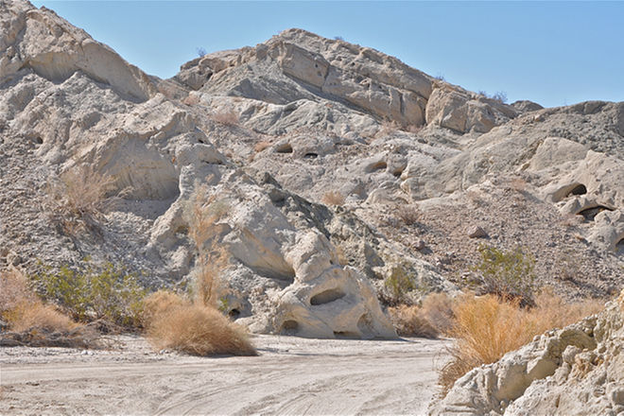
Flaring nostrils
And the flaring nostrils of that dragon’s head were created by the weathering force of blowing wind.

Slide 38
Colliding plates
Massive rocks are thrust upwards, but in opposite directions throughout the fault zone, giving visual testament to the powerful geological forces still at work when the Pacific and North American continental plates collide and grind along a region known as the San Andreas Fault.

Slide 39
