Slide 1
Mount Etna volcano erupts again
Sicily, Italy

Slide 2

May 26-27, 2016
CATANIA, Italy (Reuters) - Italy's Mount Etna, Europe's highest and most active volcano, has once again erupted, spewing red torrents of lava into the sky.
Wednesday's eruption was short but explosive, with bubbling lava filling one of the craters the whole day. There was still some sporadic activity on Thursday.
Mountain guides working on the 3,330 meter (10,925 ft)volcano on the island of Sicily brought up groups of tourists to watch the spectacle.

Slide 3
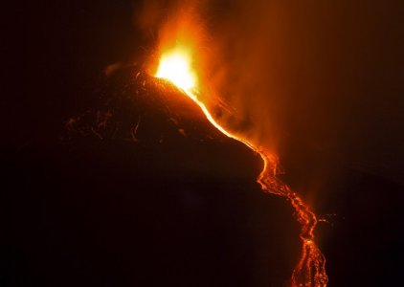
Spectacular

Slide 4
"It is erupting from the central crater, it is magnificent," American tourist Mary Canaval said during a climb on Wednesday.
The volcano can burst into action several times a year. The last major eruption was in 1992.

Slide 5
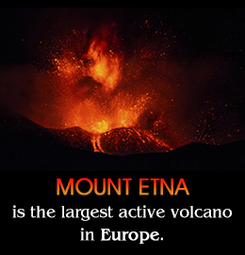
Pictures of various eruptions of Mt. Etna

Slide 6
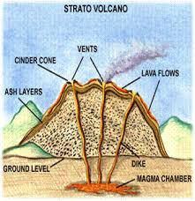
Structure of Mt. Etna

Slide 7
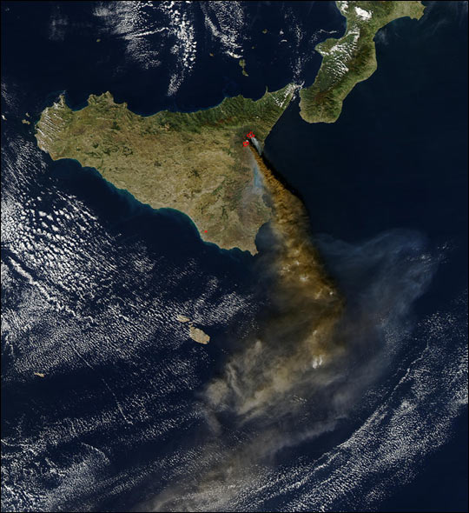
Satellite view October 28, 2002

Slide 8
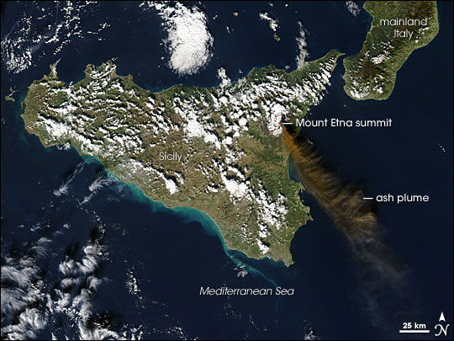
November 24, 2006

Slide 9
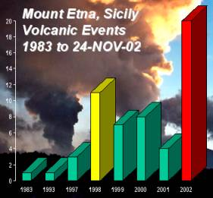

Slide 10
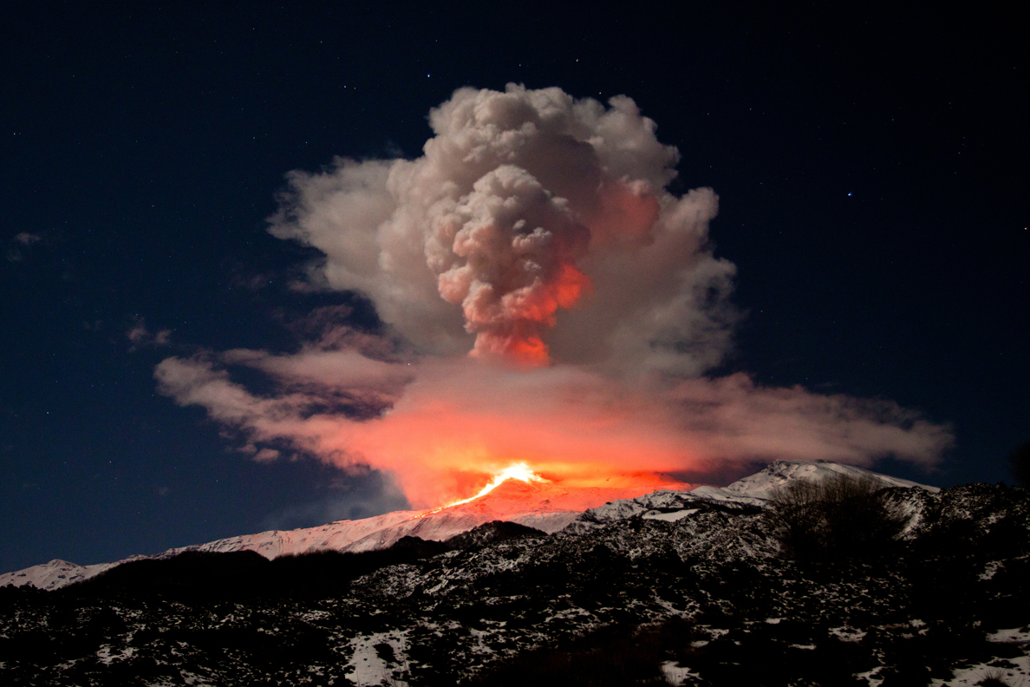

Slide 11
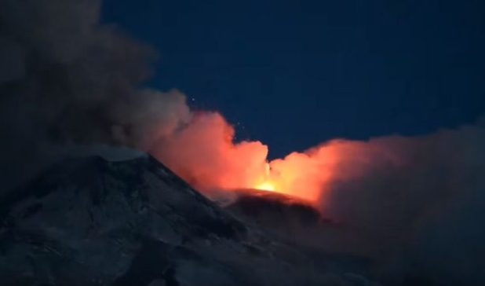
Night pictures are the more spectacular

Slide 12
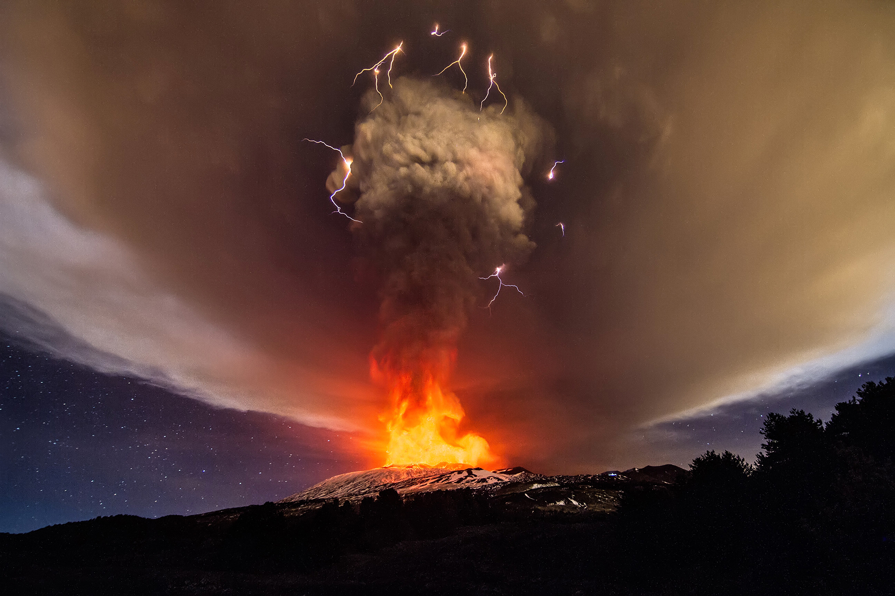
With lightning!

Slide 13
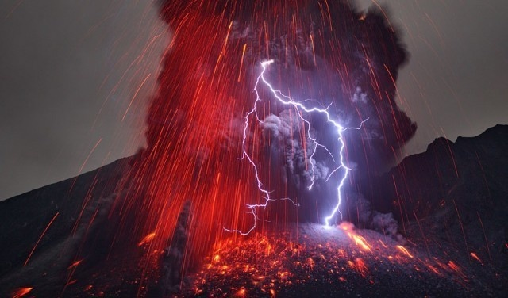

Slide 14
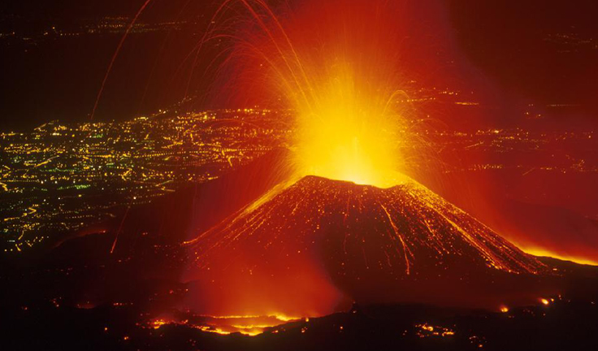

Slide 15
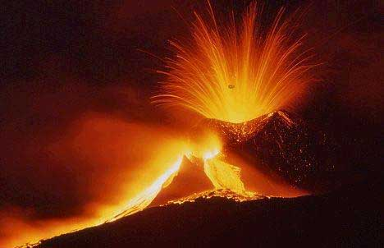

Slide 16
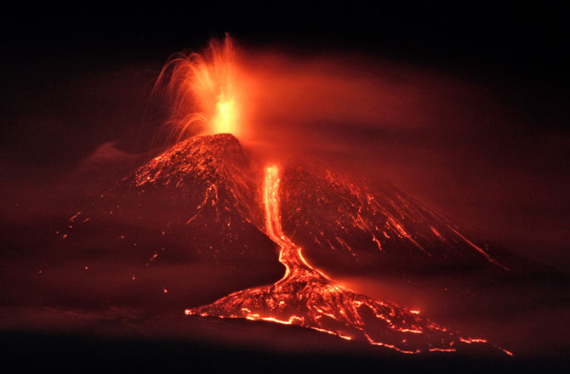

Slide 17
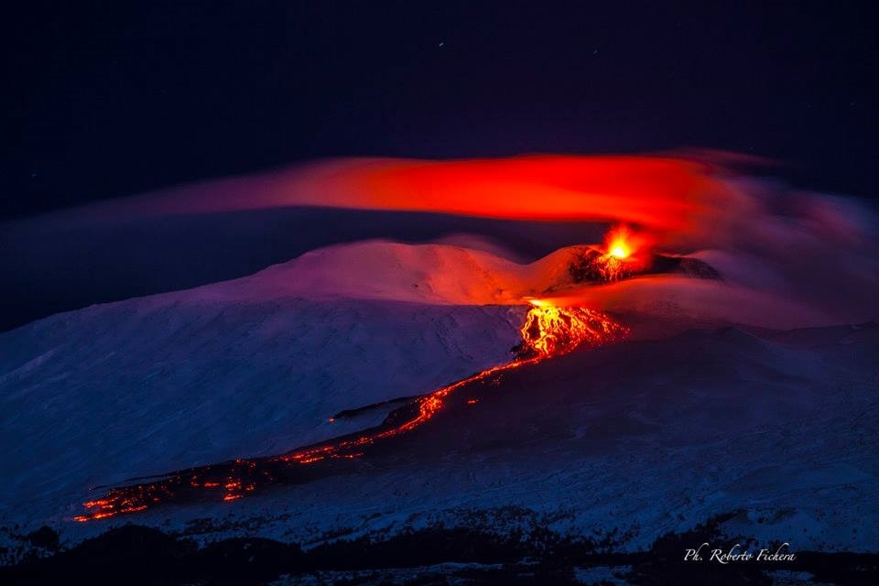
02/01/2015

Slide 18
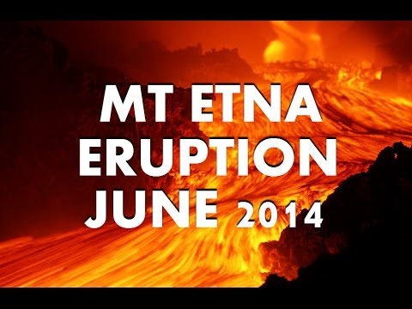

Slide 19
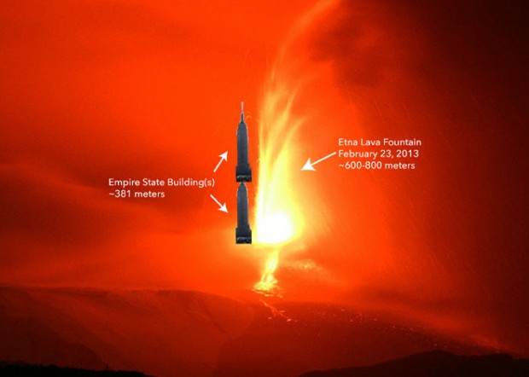

Slide 20
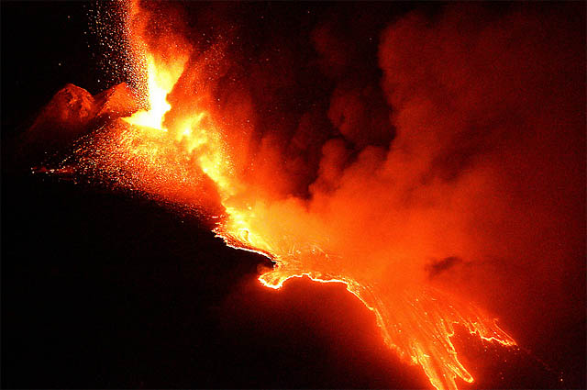
July 2011

Slide 21
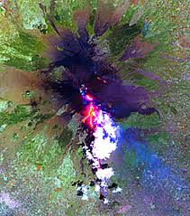
August 2001

Slide 22
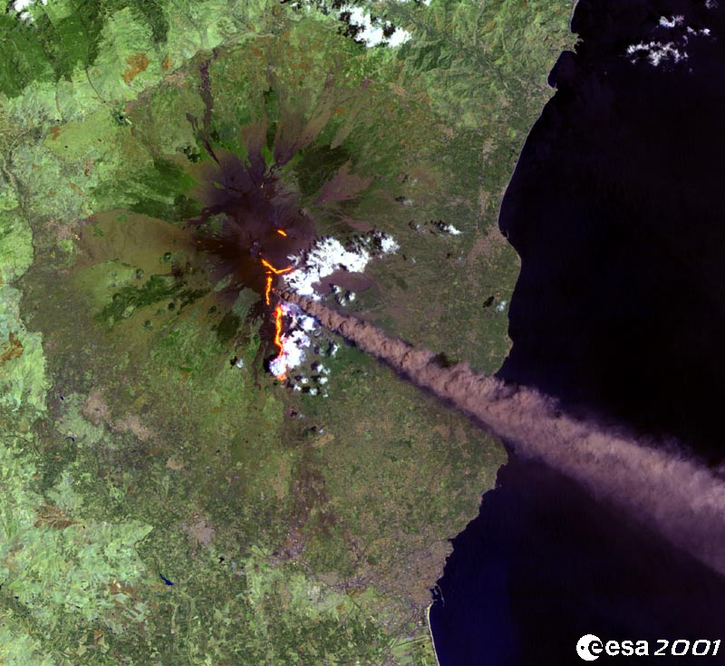
July 2001

Slide 23
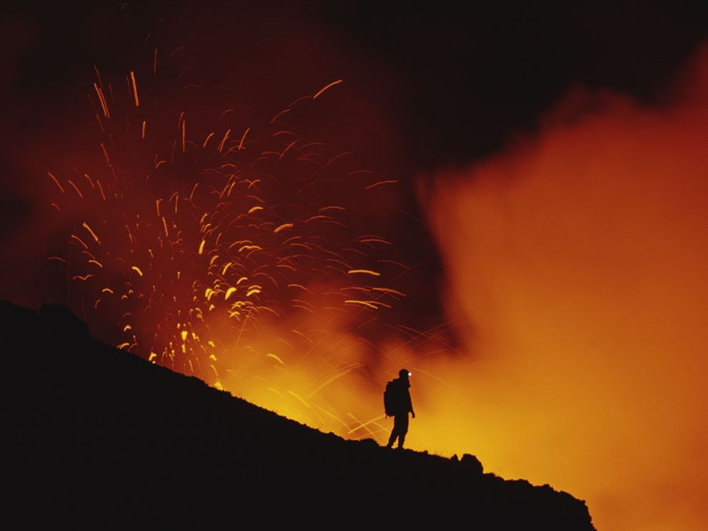

Slide 24
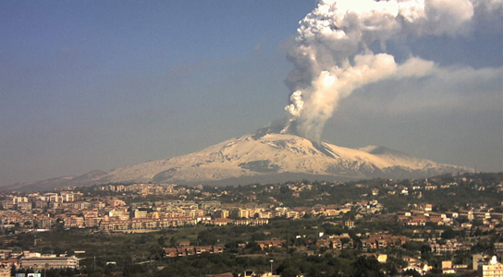

Slide 25
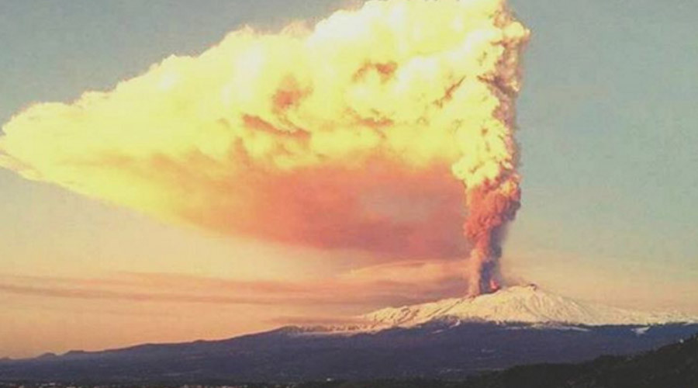

Slide 26
