Slide 1
Massive crater opens up in German town
November 1, 2010

Slide 2
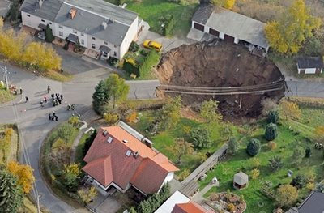

Slide 3
Massive Crater Opened Up In Germany, Swallowed A Car
German CraterAccording to several news sites, a massive crater has opened up in the middle of a housing estate in Schmalkalden, a small town in Germany‘s central hill country, 120km northeast of Frankfurt. The hole, about 20m deep and 40m wide swallowed a car. Germany occasionally experiences potholes when water creates cavities in areas of karst rock or ancient mines collapse.

Slide 4
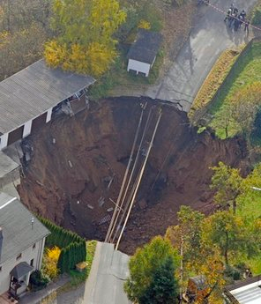

Slide 5
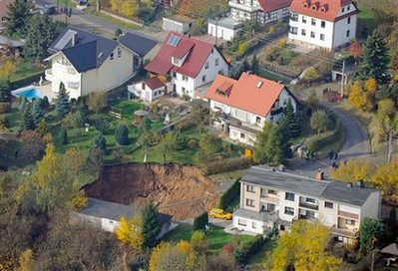

Slide 6
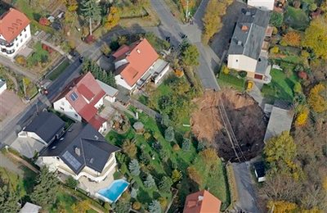

Slide 7
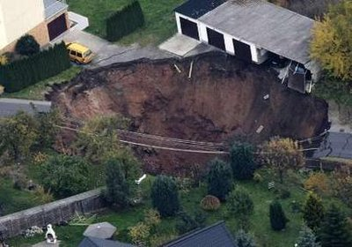

Slide 8
