Slide 1
Inside the heart of the volcano: Explorers descend 650ft into magma chamber for the first time
By Daily Mail Reporter
3rd May 2011

Slide 2
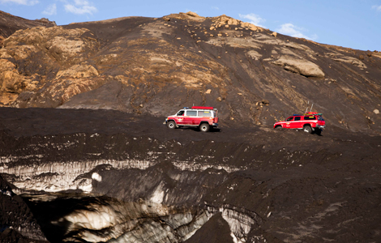

Slide 3
For the first time in history scientists have descended 650ft into the magma chamber of a volcano.
These incredible images show one explorer gently lowering himself into the heart of the dormant Thrihnukagigur volcano in Iceland.
Known as a 'sleeping volcano' because it could come back to life at any time, Thrihnukagigur is credited with helping to create the Atlantic island we call Iceland when it last erupted 3,000 years ago.

Slide 4
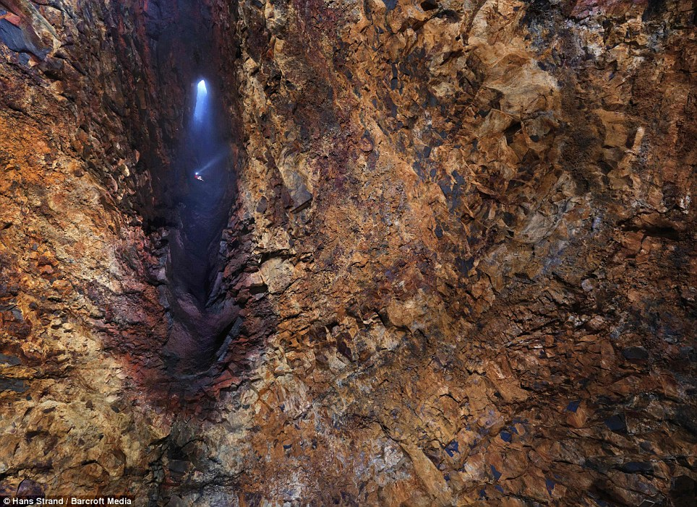
Going down: A scientist descends 650ft into the magma chamber of Iceland's dormant Thrihnukagigur volcano

Slide 5
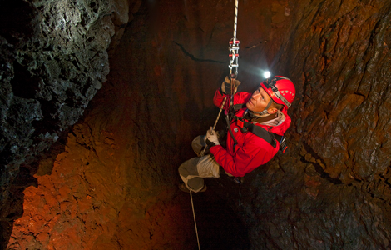

Slide 6
Only now - 50 years since the first man went into space - have human beings visited the only magma chamber on the planet currently safe to explore.
University of Iceland volcano researcher, Dr Freysteinn Sigmundsson, 44, used the pioneering expedition to build on his work on Iceland's most notorious volcano, Eyjafjallajokull
Last March Eyjafjallajokull caused global chaos when it erupted, grounding aeroplanes and leaving hundreds of thousands of people stranded.
Dr Sigmundsson described the feeling of being the first scientist to witness a magma chamber from the inside - which was tinged an eerie red thanks to the rusted iron ore that lined the chamber walls.
'I felt small compared to the forces of nature,' he said.
'I was deeply touched by the beauty and tranquillity of the volcano interior.
'As a volcanologist, I felt privileged to be able to observe with my own eyes the interior of an active volcano, from within its active plumbing system.

Slide 7
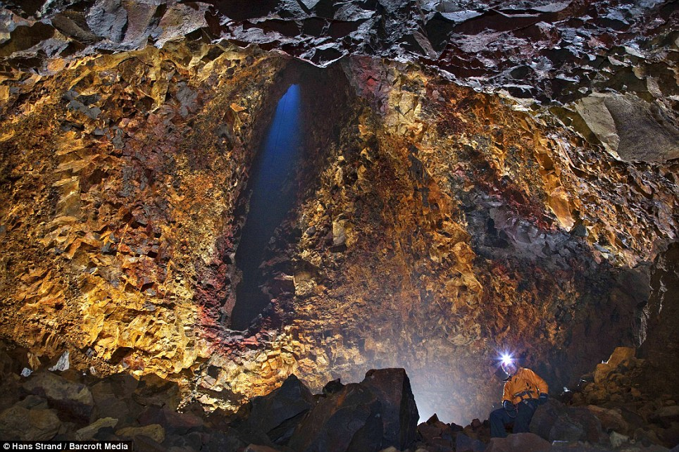
Beacon of hope: The scientists believe that their studies will greatly improve their understanding of volcanoes

Slide 8
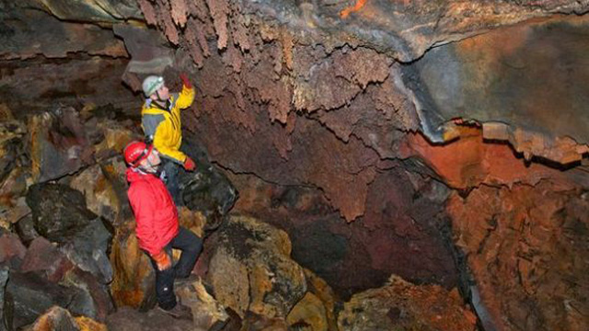
Descending into open space within Thrihnukagigur in Iceland. Note the red, oxidized zone along the vertical vent - this suggests a lot of hot gases escaping, altering the basalt wall of the vent.

Slide 9
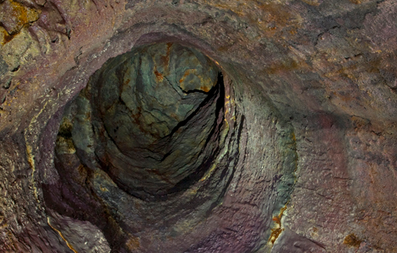
Lava tube seen within Thrihnukagigur volcano, Iceland.

Slide 10
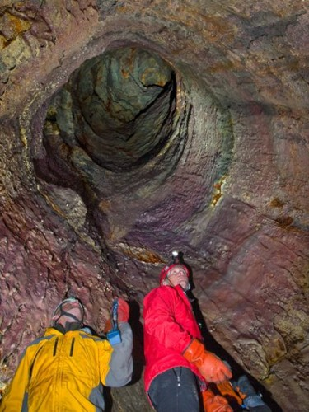

Slide 11
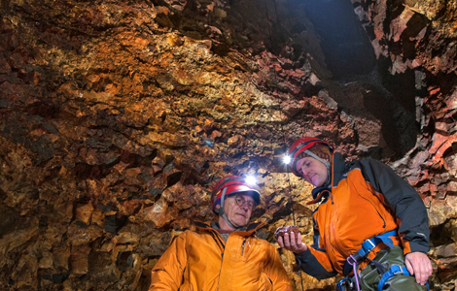

Slide 12
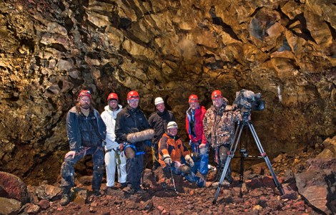
The film crew inside Thrihnukagigur volcano's magma chamber.

