Slide 1
Earthquake History
Major earthquakes throughout history in pictures. Statistics from The Geological Society of London.

Slide 2
One of the most devastating earthquakes in history occurred on 23 January 1556 in the Shaanxi province, China, killing more than 830,000 people (see 1556 Shaanxi earthquake). Most of the population in the area at the time lived in yaodongs, artificial caves in loess cliffs, many of which collapsed during the catastrophe with great loss of life. The 1976 Tangshan earthquake, with death toll estimated to be between 240,000 to 655,000, is believed to be the largest earthquake of the 20th century by death toll.

Slide 3
The largest earthquake that has been measured on a seismograph reached 9.5 magnitude, occurring on 22 May 1960. Its epicenter was near Cañete, Chile. The energy released was approximately twice that of the next most powerful earthquake, the Good Friday Earthquake, which was centered in Prince William Sound, Alaska. The ten largest recorded earthquakes have all been megathrust earthquakes; however, of these ten, only the 2004 Indian Ocean earthquake is simultaneously one of the deadliest earthquakes in history.

Slide 4
Earthquakes that caused the greatest loss of life, while powerful, were deadly because of their proximity to either heavily populated areas or the ocean, where earthquakes often create tsunamis that can devastate communities thousands of miles away. Regions most at risk for great loss of life include those where earthquakes are relatively rare but powerful, and poor regions with lax, unenforced, or nonexistent seismic building codes.

Slide 5
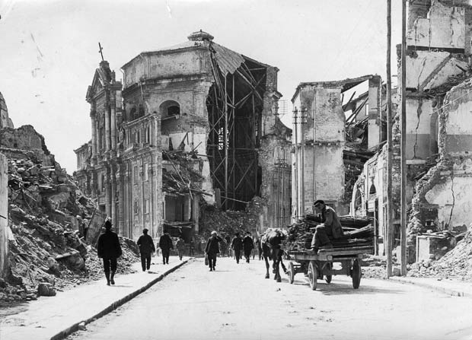
1908: Italy (Messina). Richter scale: 7.5, Deaths: 25,926, Cost: ($m) 116

Slide 6
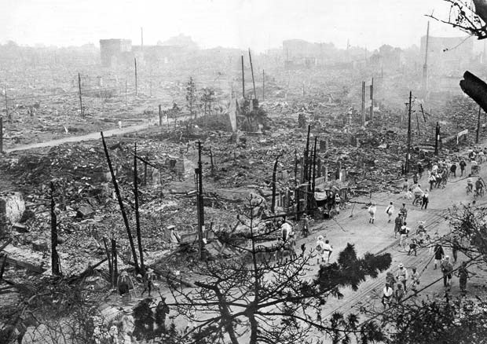
1923: Japan (Tokyo-Yokohama). Richter scale: 8.3, Deaths: 142,800, Cost ($m): 2,800

Slide 7
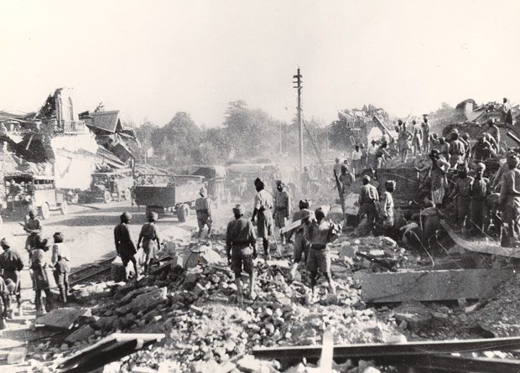
1936: Pakistan (Quetta). Richter scale: 7.5, Deaths: 35,000, Cost ($m): 25

Slide 8
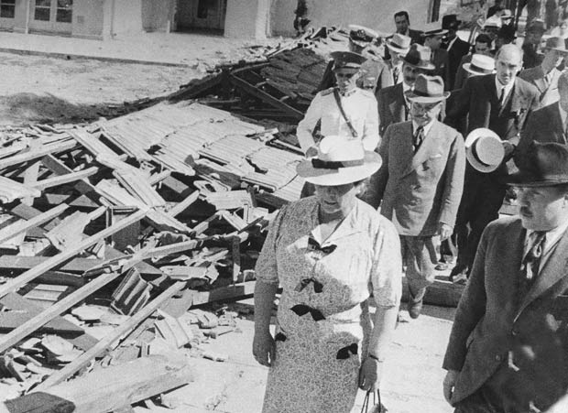
1939: Chile (Concepcion). Richter scale: 8.3, Deaths: 28,000, Cost ($m): 100

Slide 9
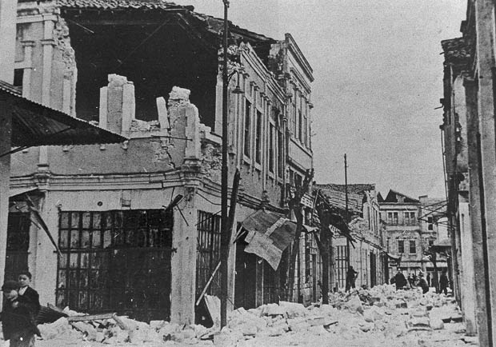
1939: Turkey (Erzincan). Richter scale: 8.0, Deaths: 36,740, Cost ($m): 20

Slide 10
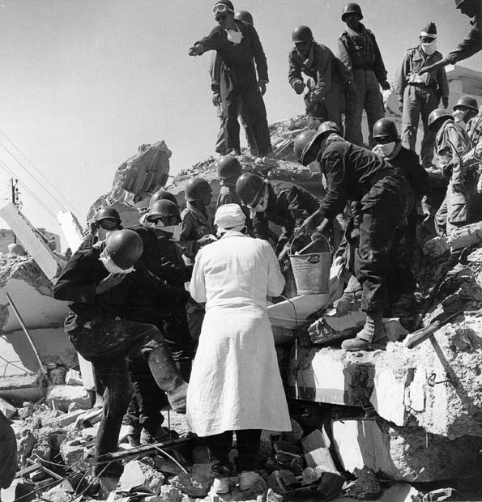
1960: Morocco (Agadir). Richter scale: 5.9, Deaths: 12,000, Cost ($m): 120

Slide 11
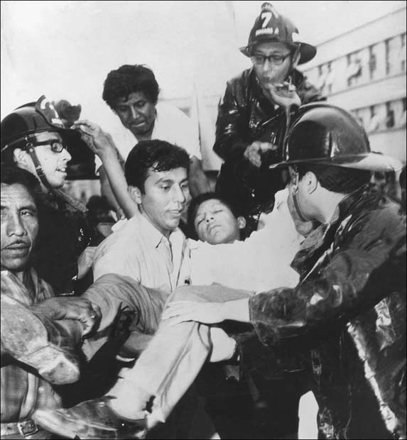
1970: Peru (Chimbote). Richter scale: 7.7, Deaths: 67,000, Cost ($m): 550

Slide 12
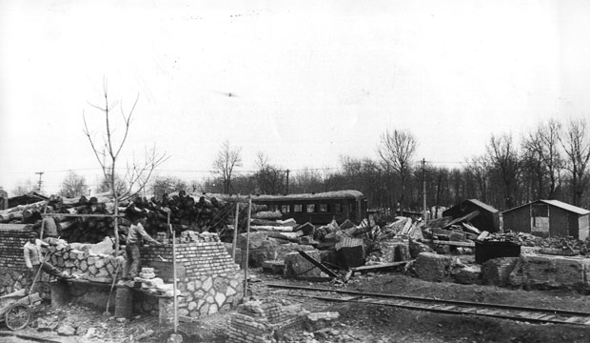
1976: China (Tangshan). Richter scale: 8.0, Deaths: 290,000, Cost ($m): 5,600

Slide 13
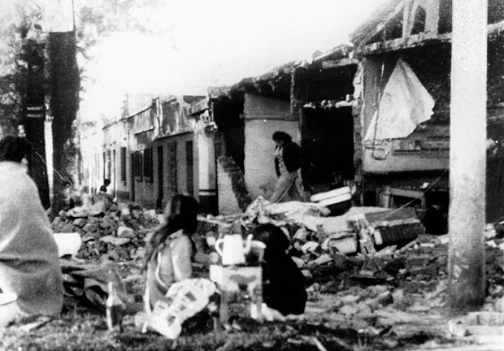
1976: Guatemala (Guatemala City). Richter scale: 7.5, Deaths: 22,084, Cost ($m): 1,100

Slide 14
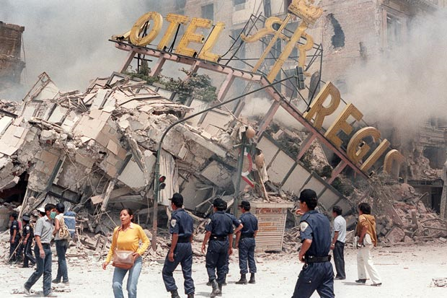
1985: Mexico (Mexico City). Richter scale: 8.1, Deaths: 10,000, Cost ($m): 4,000

Slide 15
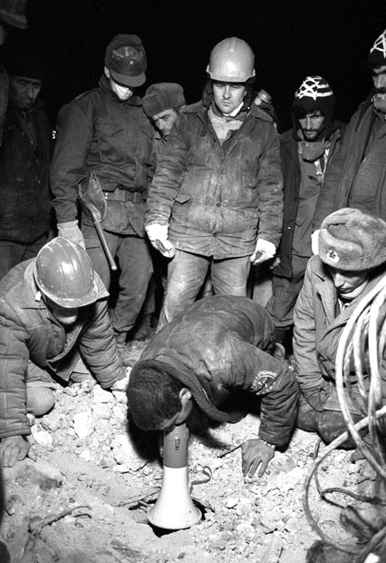
1988: Armenia (Spitak). Richter scale: 6.9, Deaths: 25,000 Cost ($m): 14,000

Slide 16
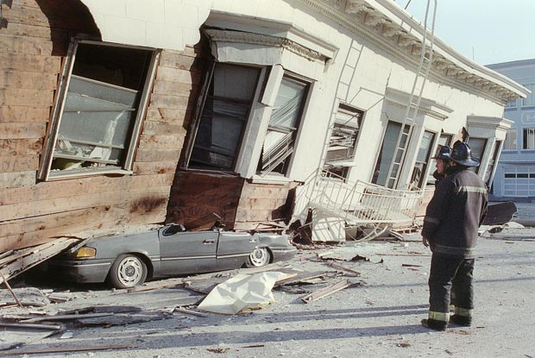
1989: USA (California, San Francisco). Richter Scale: 7.0, Deaths: 68, Cost ($m): 6,000

Slide 17
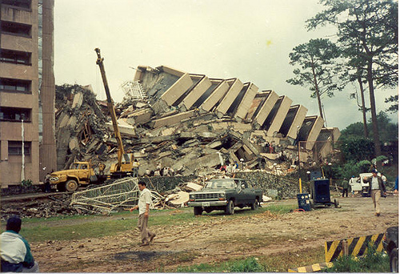
July 1990, Baguio City, Philippines. Deaths about 5000.

Slide 18
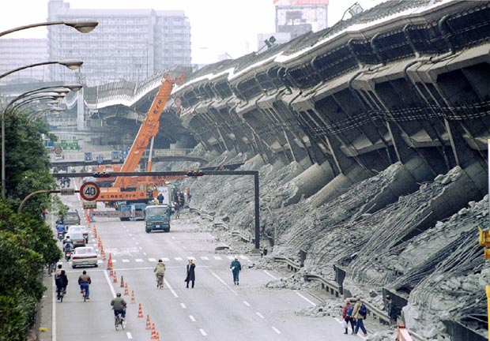
1995: Japan (Kobe). Richter scale: 7.2, Deaths: 6348, Cost ($m): 200,000

Slide 19
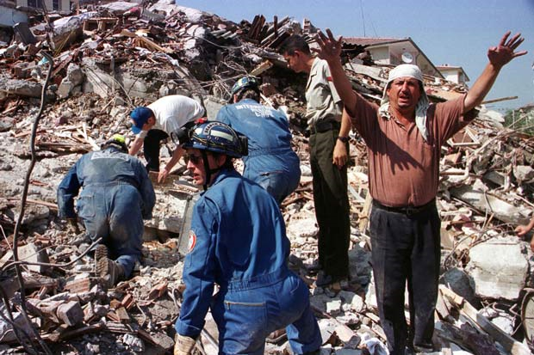
1999: Turkey (Kocaeli). Richter scale: 7.4, Deaths: 19,118, Cost ($m): 20,000

Slide 20
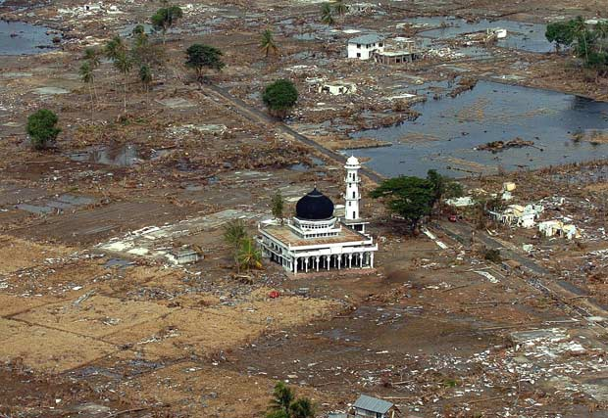
2004: Indian Ocean earthquake and tsunami. Richter scale: 9.2, Deaths: 230,000

Slide 21
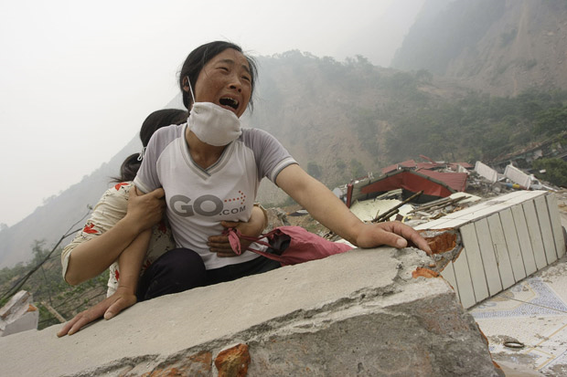
2008: Sichuan Province. Richter scale: 8.0, Deaths: 68,000, Cost ($m): 20,000

Slide 22
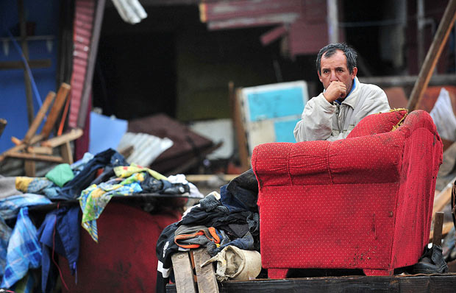
2010: Chile (Maule Region). Richter scale: 8.8, Deaths: 486

Slide 23
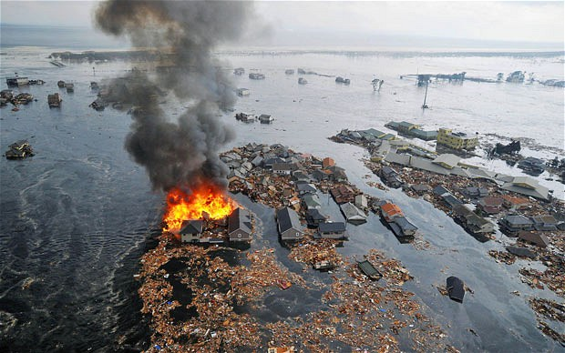
2011: Japan. Richter scale: 8.9. (deaths & cost undetermined at this time)

Slide 24
Significant earthquakes 2011 (by March 12)
* Magnitude 8.9 NEAR THE EAST COAST OF HONSHU, JAPAN March 11, 2011
* Magnitude 5.4 MYANMAR-CHINA BORDER REGION March 10, 2011
* Magnitude 6.5 NEW BRITAIN REGION, PAPUA NEW GUINEA March 09, 2011
* Magnitude 7.2 NEAR THE EAST COAST OF HONSHU, JAPAN March 09, 2011
* Magnitude 6.6 SOLOMON ISLANDS March 07, 2011
* Magnitude 6.5 SOUTH SANDWICH ISLANDS REGION March 06, 2011
* Magnitude 4.7 ARKANSAS February 28, 2011
* Magnitude 6.3 SOUTH ISLAND OF NEW ZEALAND February 21, 2011
* Magnitude 4.1 ARKANSAS February 18, 2011
* Magnitude 6.6 OFFSHORE MAULE, CHILE February 14, 2011
* Magnitude 6.8 OFFSHORE BIO-BIO, CHILE February 11, 2011
* Magnitude 6.5 CELEBES SEA February 10, 2011

Slide 25
* Magnitude 7.2 SOUTHWESTERN PAKISTAN January 18, 2011
* Magnitude 7.0 LOYALTY ISLANDS January 13, 2011
* Magnitude 6.6 VANUATU January 09, 2011
* Magnitude 4.1 NORTHERN CALIFORNIA January 08, 2011
* Magnitude 7.1 ARAUCANIA, CHILE January 02, 2011
* Magnitude 7.0 SANTIAGO DEL ESTERO, ARGENTINA January 01, 2011

Slide 26
Historical Earthquakes from Wikipedia
Date | Place | Mag. | Deaths
7/6/551 | Beirut, Lebanon | 7.5 | 30,000
9/12/1042 | Palmyra, Syria | 7.2 | 50,000
1268 | Anatolia | 7 approx. | 60,000
9/27/1290 | Chihli, China | 7.1 | 23,024
5/3/1481 | Rhodes, Greece | 7.1 | 30,000
1/23/1556 | Shaanxi, China | 8.2-8.3 | 830,000+
12/16/1575 | Valdivia, Chile | 8.5 | ?
11/25/1667 | Shamakhi, Azerbaijan | 6.9 | 80,000
10/28/1707 | Hoei, Japan | 8.6 | 5,000+
11/1/1755 | Lisbon, Portugal | 8.7 | 70,000
2/28/1780 | Iran | 7.4 | 200,000
2/7/1812 | New Madrid, MO | 8 | ?
June 1838 | San Francisco | 6.8 | ?
12/23/1854 | Honshu, Japan | 8.4 | thousands

Slide 27
Historical Earthquakes from Wikipedia
Date | Place | Mag. | Deaths
12/24/1854 | Honshu, Japan | 8.4
12/23/1855 | Wairarapa, New Zealand | 8 spprox | 4
2/16/1861 | Sumatra | 8.5 | 905
9/13/1868 | Arica, Chile | 9.0 | 25,000
5/10/1877 | Iquique, Chile | 8.8 | 2,541
12/31/1881 | Nicobar Islands | 7.9 | 0
10/27/1891 | Mino-Owari, Japan | 8 | 7,273
6/15/1896 | Off coast of Japan | 8.0-8.1 | 22,000+
9/4/1899 | Cape Yakataga, Alaska | 7.9 | ?
9/10/1899 | Yakutat Bay, Alaska | 8 | ?
10/9/1900 | Kodiak Is., Alaska | 7.7 | ?
4/18/1906 | San Francisco | 7.8 | 3,000
123/16/1920 | Ningxia–Gansu, China | 8.6 | 235,502
11/4/1952 | Kamchatka Peninsula | 9 | ?

